Slide 1
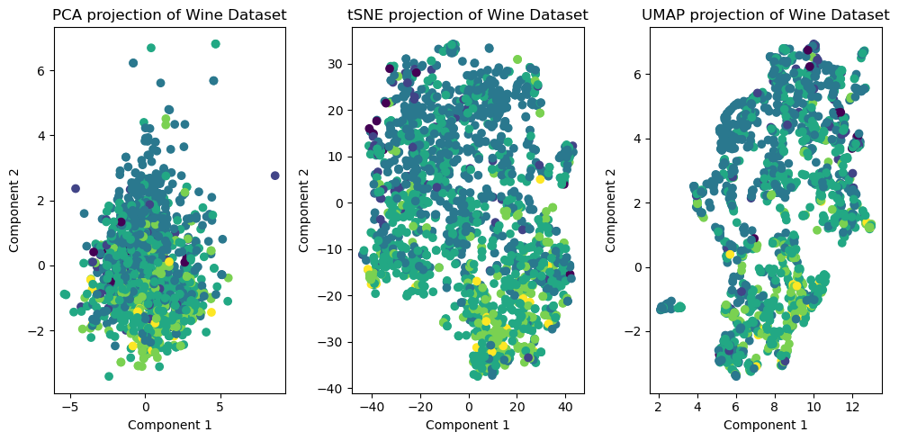
Homework - 5
Task 1
Task 2:
Null hypothesis: Alcohol content does not influence wine quality
Alternative hypothesis: Alcohol content influences wine quality
Test chosen: ANOVA
I chose ANOVA because we have a continuous values for alcohol content and discrete categorical labels for quality
Conclusion:
We can reject the null hypothesis since the p_value (1.209) > alpha (0.05). The alcohol content significantly influences the quality of the wine
RIFAH TASHFIA SHAMIM
IDM: ac83ekob
Student number: 23476978

