Slide 1

Indoor And Outdoor Real Time Information Collection in Disaster Scenario Project ID: (2019MP155)
Supervised by:
Mr. Analp Pathak
Assistant Professor
CSE Dept.
SRMIST Ghaziabad
Presented by: Mohit Sharma (RA1511003030073) Manik (RA1511003030077) Tejasvi Sharma (RA1511003030098) Tashi Munish (RA1511003030127) B.Tech(CSE-B)

Slide 2
INTRODUCTION
A disaster usually severely harms human health and property.
After a disaster, great amount of information of a disaster area is needed urgently.
The information not only indicates the severity of the disaster, but also is crucial for an efficient search and rescue process. In order
To quickly and accurately collect real time information in a disaster scenario, a mobile platform is developed for an outdoor scenario and a localization and navigation system for responders is introduced for an indoor scenario.

Slide 3
MOBILE PLATFORM
The mobile platform has been integrated to the DIORAMA system.
It is built with a 6-wheel robot chassis along with an Arduino microcontroller.
Controlled by a mounted Android smartphone, the mobile platform can receive commands from incident commanders and quickly respond to the commands.
While patrolling in a disaster area, a constant RFID signal is collected to improve the localization accuracy of victims.
Pictures and videos are also captured in order to enhance the situational awareness of rescuers.

Slide 4
Components of the DIORAMA
Components of the DIORAMA mobile platform includes
a robot chassis,
a microcontroller,
an Android phone running the DIORAMA robot monitor application
an active RFID reader.

Slide 5
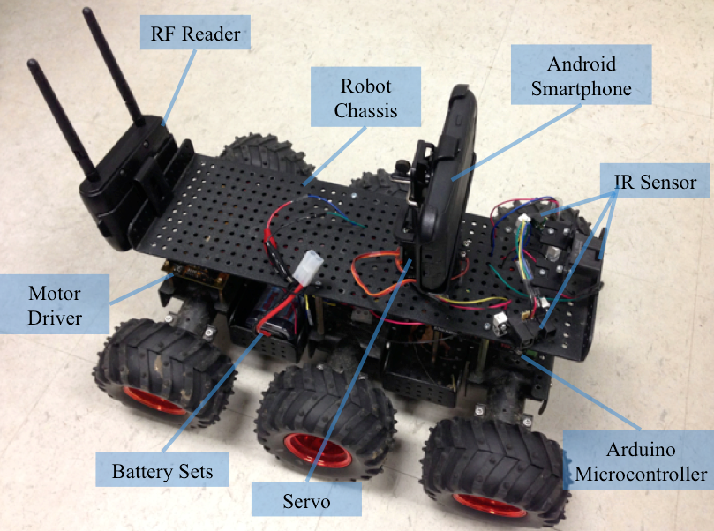
DIORAMA Mobile Platform

Slide 6
TECHNOLOGIES USED
DIORAMA
Machine Learning
AI

Slide 7
DIORAMA
Effectively handling a mass-casualty incident is one of the greatest challenges a community's emergency medical system can face.
In a disaster medicine triage, determining the number and location of victims, relative to the location of available resources is crucial for maximizing and hastening rescue efforts.
Currently there are many management systems, which implement a number of high-tech methods to help the rescue process.
One of them is the Dynamic Information Collection and Resource Tracking System for Disaster Management (DIORAMA) system, developed by 5G Mobile Evolution Laboratory in the University of Massachusetts Amherst .

Slide 8
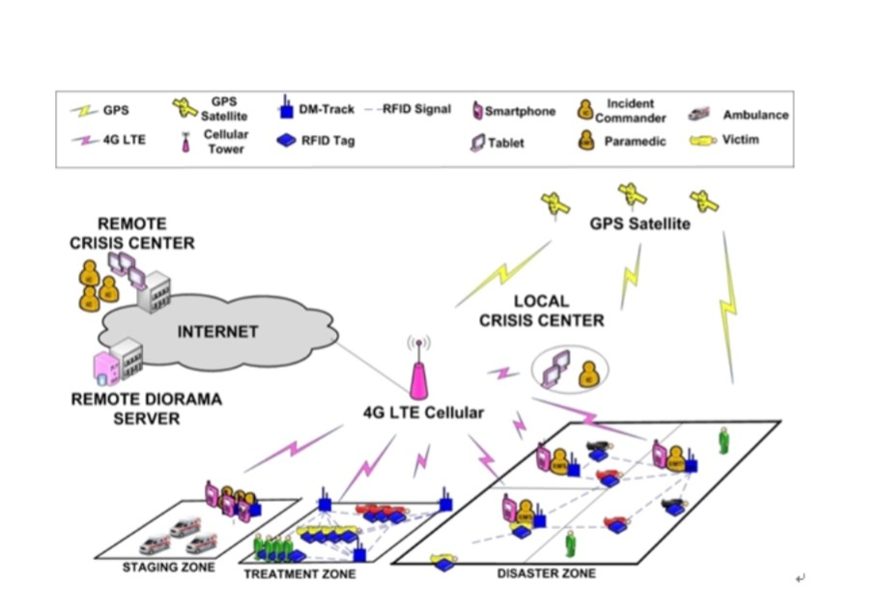
DIORAMA System Architecture

Slide 9
Mobile Platform for Outdoor Information Collection
A robot mobile platform could offer great help in the DIORAMA system.
As the DIORAMA system uses RSSI information to localize victims, a RF reader could be mounted on the robot platform to receive RF signals.
As a result, the localization information generated by the DIORAMA system is more accurate and more believable.
With the restriction of personnel resources, the actual location of one critical victim is not be covered by any responders.

Slide 10
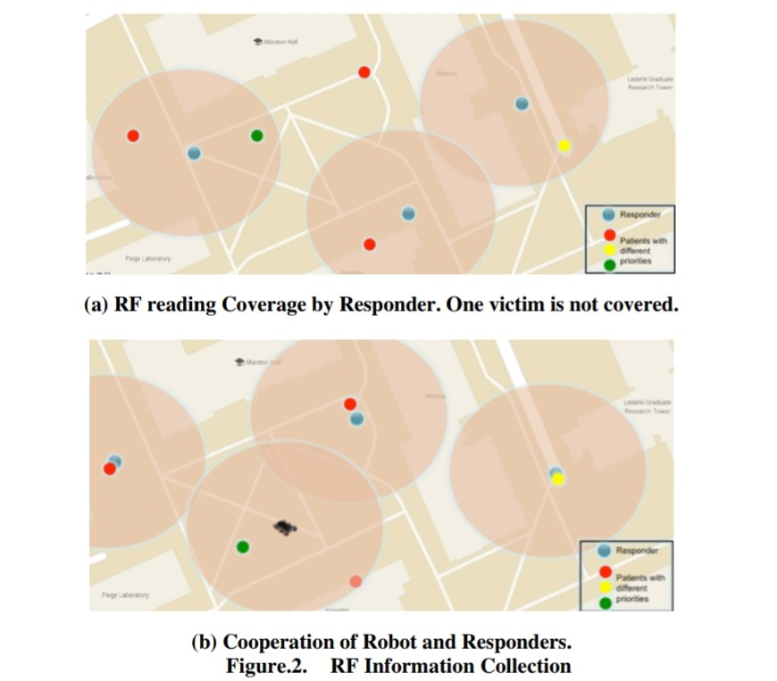

Slide 11
System Architecture
In order to realize the automatic outdoor real time information collection, the robot should have the following basic requirements:
• It can be controlled by human rescuer
• It can fulfill its task without a human rescuer
• It can move around in the disaster environment
• It can carry various sensors to collect data
. • It can communicate remotely with other device or human rescuers

Slide 12
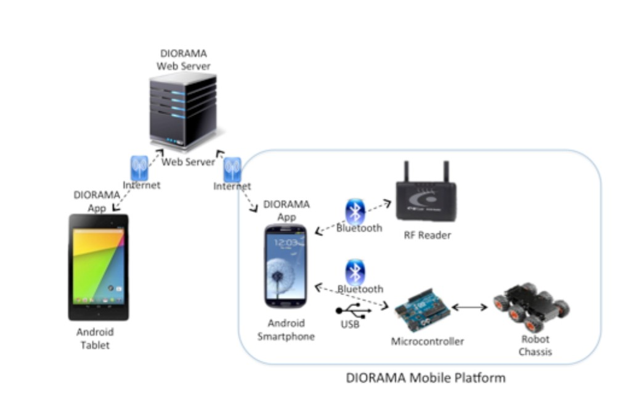
Architecture of Robot Integrated DIORAMA System

Slide 13
MACHINE LEARNING
Machine learning algorithms search for patterns and regularities in any given data and have found wide usage across various application domains.
They automatically learn from data by generalizing from examples.
These algorithms are typically implemented in two phases :-
In the first phase, called training phase, data is gathered and provided to the algorithm, so it can learn patterns and create a model to classify data or predict data properties.
In the second phase, called testing phase, new data is tested against the model that was built during the training phase, and the effectiveness of the model is revealed.
Such two-phase learning algorithms are called supervised learning algorithms There are also algorithms in which the testing phase is not used, and such algorithms are called unsupervised learning algorithms.

Slide 14
K-Nearest Neighbour
The K-Nearest Neighbour (KNN) algorithm is a simplistic non-parametric algorithm. Nonparametric methods assume that similar inputs have similar outputs.
It is a supervised algorithm but has a minimal training phase. Most of the effort in this algorithm is expended in the testing phase.
In our KNN implementation, the output value is calculated as the average of the value of its k nearest neighbours.
We make use of the Euclidean distance (D) measure between any two points a and b.

Slide 15
K-NN is often used in search applications where you are looking for “similar” items; that is, when our target is some form of “searching items similar to particular one”. We’d call it as the k-NN search.
We compute similarity by creating a vector demonstration of items, and then comparing the vectors using an suitable distance metric (like Euclidean distance, as example).
We have some prior data (also called training data), which classify coordinates into groups recognized by an characteristic.

Slide 16
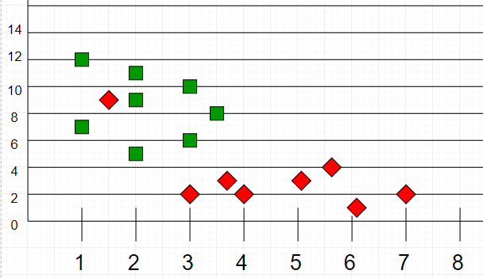
For example, consider the given table of data points having two characteristics:
Figure. Sample Data

Slide 17
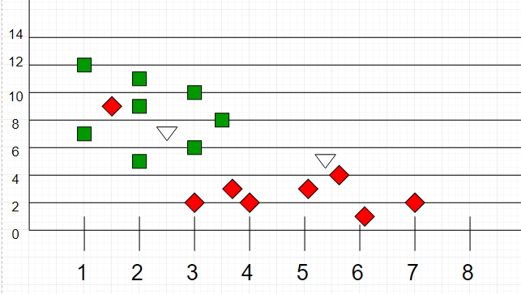
Now, we are given set of data points (called testing data), assign these points a group after analyzing the training set. Given that the unclassified points are marked as ‘White’.
Figure. Sample Data and Testing Data

Slide 18
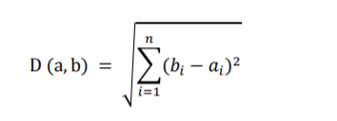
when we plot these points on a graph, we can locate some groups.
But, when we have an unclassified point, we can allocate it to a group by observing what group its nearest neighbors belong to.
That means, a point close to the group of points classified as ‘Red’ has a greater probability of being classified as ‘Red’.
Euclidean Distance

Slide 19
Algorithm
Let m be the total samples of training data. Let p be the point which is unknown.
1. Save the training data in an array of data points arr[]. That means
every element of the array represents a tuple(x, y).
2. for i=0 to m:
3. Compute Euclidean distance d(arr[i], p).
4. Construct a set S of K smallest distances obtained. Every distance
calculated corresponds to an already classified data point.
5. Now give the majority label among set S.

Slide 20
ARTIFICIAL INTELLIGENCE ( A* ALGORITHM )
A* is a search algorithm that is widely used in path finding and graph traversal.
A* achieves better performance by using heuristic.
Whenever we have to estimate the shortest path in real-life situations, like- in maps, games where there may be many obstacles we use this algorithm .
The cost function of A* is consisted of two parts:
• an heuristic estimate of the distance from the destination to the current
point
• the moving cost from the initial point to the current point.
It is a smart algorithm and it is different from other traditional algorithms and
unlike other traversal techniques, it uses its brain.

Slide 21

COST FUNCTION IN A*
As shown in above formula, the cost function of A* is consisted of two parts:
• an heuristic estimate of the distance from the destination to the current point
• the moving cost from the initial point to the current point.

Slide 22
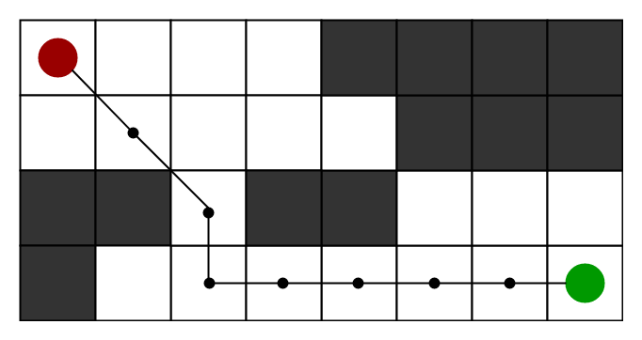
Figure. Source and Destination Points
In each step it will pick the node which is having the lowest value of cost function and will start processing that node.

Slide 23
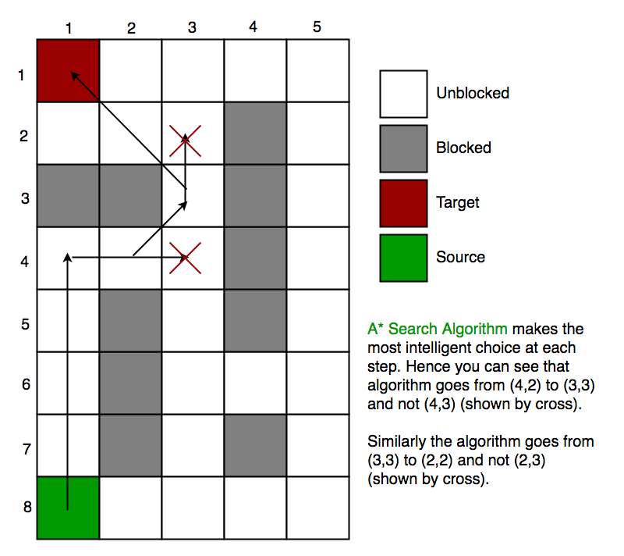
Figure. Path Generated By A * Algorithm

Slide 24
ALGORITHM
We create two lists – Open List and Closed List (just like Dijkstra Algorithm)
1. Initialize the open list
2. Initialize the closed list
put the starting node on the open
list (you can leave its f at zero)
3. while the open list has some elements
a) we will find node with lowest f from the open list, we term it as "q"
b)remove q from open list or pop q from open list
c) create q's successors and q will be their parent
d) for each successor
i) if successor itself is goal, stop searching
successor.g = distance between successor and q + distance between initial point and q
successor.h = distance from goal to successor
successor.f = successor.g + successor.h
ii) if there is a node whose position is same as successor position is present in OPEN list
and the f value of node is also lower than successor than skip the successor.
iii) if there is a node whose position is same as successor position is present in OPEN list and the f value of node is also l l
lower than successor than skip the successor otherwise, node should be added to open list.
end (for loop)
e) now q should be pushed to closed list
end (while loop)

Slide 25

CALCULATION OF HEURISTICS
A) Exact Heuristics –We will now find the exact value of h but we know that it is a time consuming process. Below are few methods to compute exact value of h.
1) Pre-calculate the distance between every pair of cells. This should be done before implementing the A* Search Algorithm.
B) Approximation Heuristics –There are three methods for approximation heuristics:
1) Manhattan Distance
2) Euclidean Distance-

Slide 26
Reference
https://www.elprocus.com/line-follower-robot-basics-controlling/
https://www.google.co.in/amp/s/www.electronicshub.org/arduino-line-follower-robot/%3famp
http://mnemstudio.org/path-finding-a-star.htm
https://www.ncbi.nlm.nih.gov/m/pubmed/25570543/

Slide 27


Slide 28

Any Questions?

