Slide 1

Workshop Name: Intro to Data Science w/ Python
Workshop Host:
Tashi T. Gurung
Notes:
Hello folks, Welcome to the workshop. I hope you guys are enjoying the Hackathon so far.
My name is Tashi.
And today, we’ll be looking at a short presentation… that will cover a high-level overview of, the field of data science.
And spend the remaining time on a
hands-on mini coding project…
I will share these slides with all participants …so don’t worry.

Slide 2

What is Data Science?
Artificial Intelligence (AI)
Machine Learning (ML)
Deep Learning (DL)
Notes:
So, what is Data Science? And what is… AI ML DL? Are they the same? Are they different?
It is generally agreed that AI is the wider term that includes Machine Learning.
And deep learning is just a sub field of Machine Learning.
So it’s AI > ML > DL
And where does DS fit in?
Data Science actually overlaps all of these fields, and includes more

Slide 3
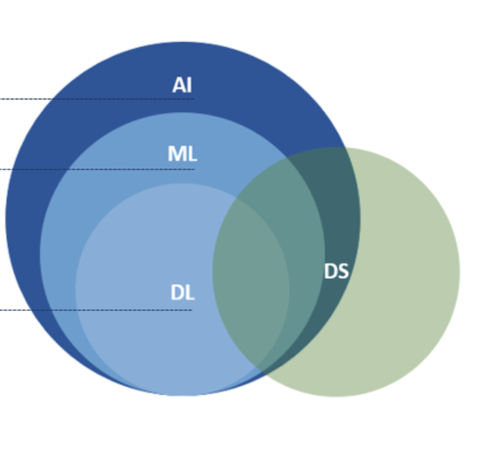
What is Data Science?
Artificial Intelligence (AI)
Machine Learning (ML)
Deep Learning (DL)
Notes:
So, what is Data Science? And what is… AI ML DL? Are they the same? Are they different?
It is generally agreed that AI is the wider term that includes Machine Learning.
And deep learning is just a sub field of Machine Learning.
So it’s AI > ML > DL
And where does DS fit in?
Data Science actually overlaps all of these fields, and includes more

Slide 4


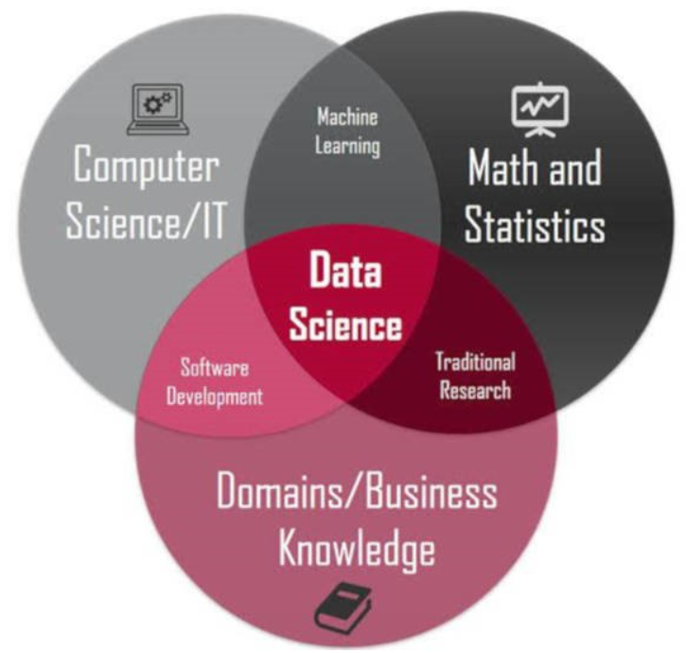

Intersection of
Computer Science
Statistics
Business
Notes:
Data Science is an interdisciplinary field:
Data Science makes use of
1st Computer Science Theory
2nd Concepts and tools from Statistics
And
3rd a little bit of Business Acumen and Domain Knowledge goes a long way
Next,
What are the different roles in data?

Slide 5
What are the different roles within the field of Data Science?
Data Analyst
Data Visualization Analyst
Business Analyst
Business Intelligence
Data Scientist
Statistician
Data Engineer
Data Architect
Database Administrator
Machine Learning Engineer
Notes:
These are some of the roles that can
arguably
be considered data science or at least related to…
But, the majority of roles can be classified into three categories:
Data Analysts, Data Scientists, and Data Engineer
MLE is something that is a mix of DS and DE, but more towards DE and ML
It is however essential to note that: These distinctions are not uniform across different companies and industries.
That is because
DS is a relatively a new and young field, and differences in these roles have not been clearly defined…

Slide 6
The Data Science Umbrella
Data Analyst
Data Scientist
Data Engineer
Notes:
Nonetheless, what are the differences between these roles? Or categories?

Slide 7
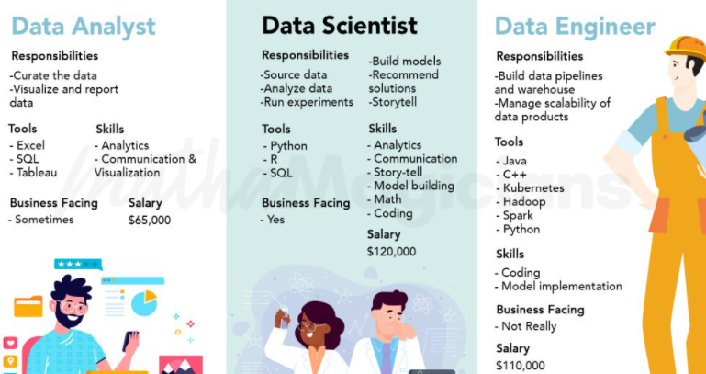
Notes:
Data Analysts usually do not code, and use tools like Excel, and Tableau.
They build dashboards, visualizations, and report on “what is”
Data Scientists code.
They use Python, or R, or both, and SQL among other programming languages.
They build models, some run experiments
Data Engineers are the most technical of the three. They lean heavily towards Software Engineering.
DE are responsible for building the infrastructure that DS and DA use for their work

Slide 8
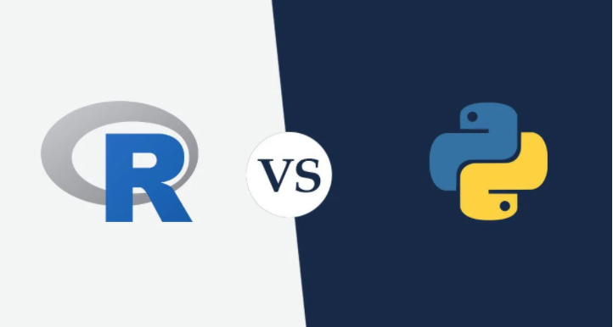
Python vs R
R is great for statistics
Used in research extensively, loved by academics
Great for time-series analysis
Python is a general-purpose language.
More widely used in the industry
Better for integration and deployment
Better for Deep Learning
Notes:
Alright, you decide you want to learn Data Science.
Should you learn R, Python, Stata, SAS, or something else?
Well, Python and R are the most popular
<read slide>
Although the differences between both of these languages are getting smaller and smaller day by day.

Slide 9

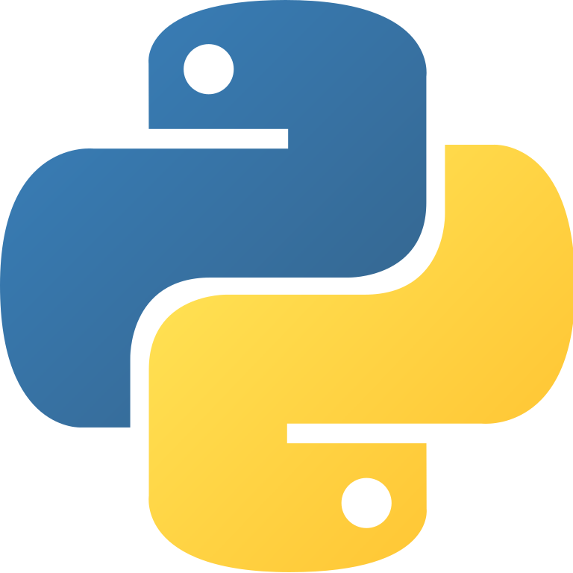

Data Science w/ Python
Notes:
For this workshop, we’ll stick to python

Slide 10



Jupyter Notebooks
Interactive web applications
Is composed of two types of cells:
Code Cells
Text Cells
Anaconda Navigator
Install in local machine
Google Colab
Run Online
Notes:
Code cells: where you can write executable code, and run them
Text cells: where you don’t have to worry about syntax and write what you want.
This is useful for organizing your code, documentation, or to provide additional information among other stuff
Jupyter Notebooks can be accessed using Anaconda Navigator, or Google Colab. These are the two most popular.
Although I’ve used something called Deepnote a long time ago.
For this workshop,
We’ll use google colab, because we don’t have to spend time on installing stuff, and dealing with issues…

Slide 11
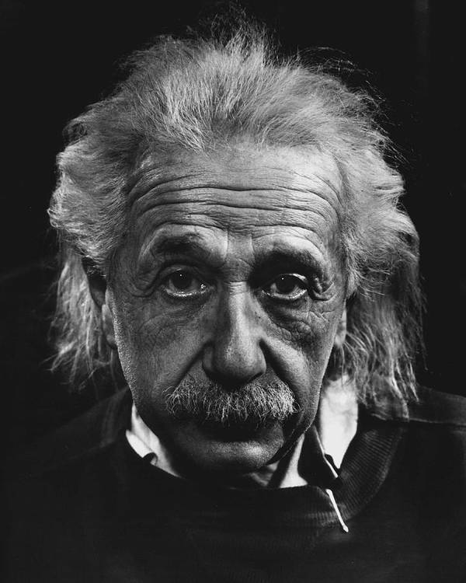
Questions?

Slide 12

CODING TIME !!!
Notes:
https://drive.google.com/drive/folders/1DDyq-an7WHTCUWt7gjnmGcjRH_OeqazO?usp=sharing
This should lead you to my google drive
You will see three files in there
One with all the answers to the tasks we’ll be doing today.
Second, we have a file called unguided. This is for participants who has some coding experience,
and has used python before.
It has minimal code, and you will have to code along with me
The third file, is called guided. This notebook has most of the code. And I recommend using this file, if you are new,
And don’t want to get lost and frustrated halfway through the workshop.

Slide 13
References
Images
AI vs ML vs DL: https://www.abrisconsult.com/artificial-intelligence-and-data-science/
Data Science Umbrella: https://mathamagicians.co/2020/04/06/differences-between-a-data-analyst-data-scientist-and-data-engineer/
Intersection of image: https://dzone.com/articles/why-you-should-learn-data-science-with-python-in-2

