Slide 1
Task 2: Individual Submission of Paper Unique within Course
Question Generation and Answering for exploring Digital Humanities collections
Team 7 Name: Md Iftekhar Islam Tashik
ID: 20301078
RA: Md Humaion Kabir Mehedi
ST: Abid Hossain

Slide 2
Introduction
Proposed methodology: Evaluate question generation and answering techniques with a focus on qualitative and semantic control
New approach: BART Transformer-based generative model enriched with semantic constraints for question generation
Evaluation: on multiple French corpora, including a digitized archive collection of a French Social Science journal
Aim: Enhance training material for Machine Reading Question Answering algorithms and establish explainable link s between documents

Slide 3
Experiment
Corpora Used in Experiments:
FQUAD: French Wikipedia articles with easy questions and answers.
CALOR-QUEST: Built on CALOR-FRAME with expert semantic annotations for evaluation.
ARCHIVAL: Challenging data from a French journal, serving as the target corpus.
Question Generation Experiments:
Approach: BART Transformer-based model trained on FQUAD with different semantic annotations (basicctx, Frame-ctx, SRL-ctx).
Purpose: Enhance question generation quality and incorporate qualitative and semantic control.
Evaluation: Performance assessed on CALOR-QUEST.

Slide 4
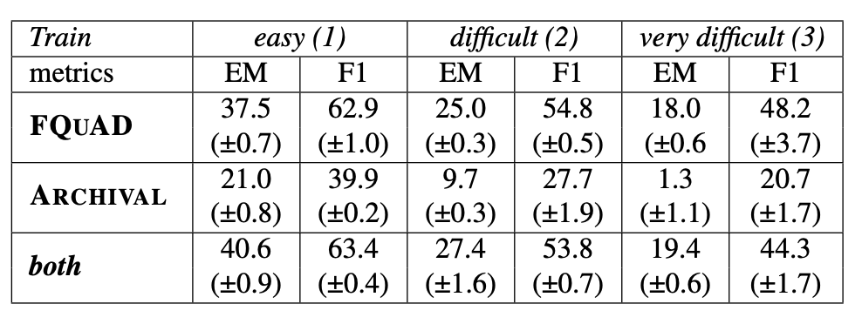
Results & Analysis
Results:
Semantic Annotations: Using semantic constraints enhances the quality of generated questions.
MRQA Performance: Models trained on automatically generated questions show no significant improvements on CALOR-QUEST and ARCHIVAL datasets.
FQUAD: Has better F1 score. Using both generates more consistent answer spans
Analysis and Distinctions:
Professional Readers vs. Crowdsourced Annotators: Highlighting the differences between questions generated by these two groups.
Self-Management Corpus: French journal collection spanning two decades, serving as archival material for the ARCHIVAL project.

Slide 5
Strengths &
Future Improvement Areas
Strengths:
Credible Findings: Well-executed experiments enhance the paper's credibility.
Valuable Insights: Offers valuable insights into machine reading and question generation for self-management tasks.
Educational Value: Contributes to exploring digitized archives for social science studies.
Areas for Improvement:
Quality of Candidate Questions: Limited quality of candidate questions
Detailed Discussion Needed: More detailed discussions on the evolution matrix, experimental results, and evaluation metrics.
System Comparison: Provide more insights on system strengths, weaknesses, and comparisons with state-of-the-art approaches.

Slide 6
Thank you for listening!

