Slide 1
Fruit Ninja using modern opengl (3.3)
Presented By:
Md. Shoriful Islam
Roll : 1807082

Slide 2
Outlines
Introduction
Keyboard Controls
Features
Dynamic Feature

Slide 3
Introduction
OpenGL 3.3 is used to simulate Fish Shooting game.
Basic objects that are created in this project are as below –
1. River
2. Shore
3. Fish
Scoreboard
Timeboard
6. Gun
7. Bullet
8. Time object
9. Tree

Slide 4
Key Controls(View)
Press W: Forward
Press S: Backward
Press A: Left
Press D: Right
Press I: Gun up
Press J: Gun left
Press K: Gun down
Press L: Gun right
Press O: Level 2
Press C: Pitch up
Press X: Pitch down
Press Y: Yaw left
Press U: Yaw right
Press Q: Roll left
Press E: Roll right
Press K: Down
Press P: Level 3
Press 0: Game Restart

Slide 5
Key Controls(Lighting)
Press 1: Direction Light
Press 2: Point Light
Press 3: Spot Light
Press 4: Ambient
Press 5: Diffuse
Press 6: Specular

Slide 6
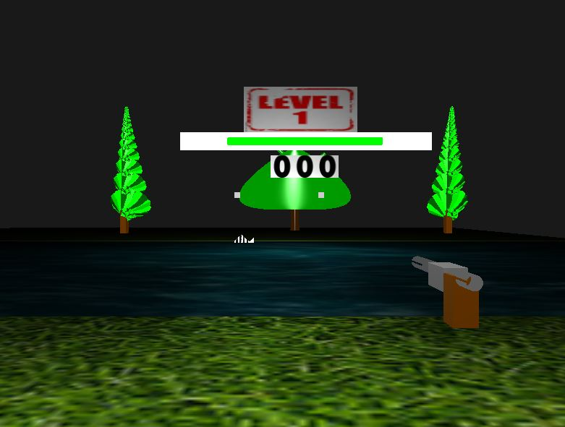
Features
Figure 1: Game Overview

Slide 7
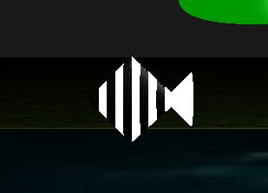
Features (Contd.)
Figure 2: Fish

Slide 8
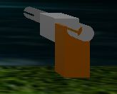
Features (Contd.)
Figure 3: Gun

Slide 9

Features (Contd.)
Figure 4: Scoreboard and timebar

Slide 10

Features (Contd.)
Figure 5: Levelblock

Slide 11
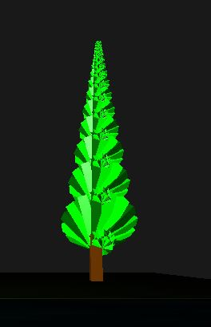
Features (Contd.)
Figure 6: Tree

Slide 12
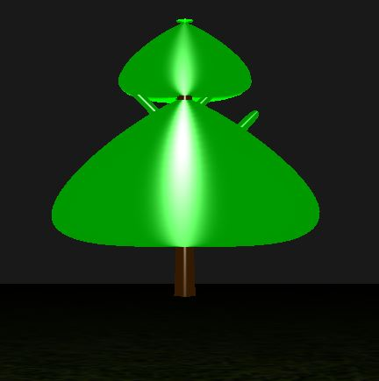
Features (Contd.)
Figure 7: Tree

Slide 13

Features (Contd.)
Figure 8: Watch

Slide 14
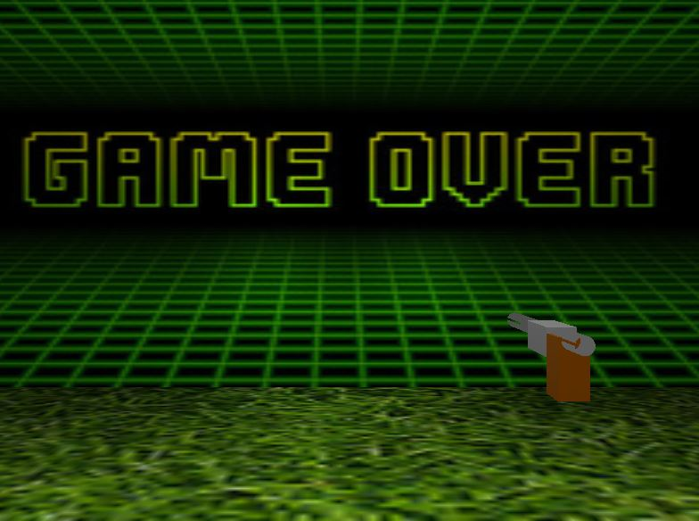
Features (Contd.)
Figure 9: Game Over

Slide 15
Dynamic Features
Fish
Bullet
Gun
Scoreboard
Timebar
Riverwater

Slide 16
References
https://learnopengl.com
https://en.wikipedia.org/wiki/Computer_graphics

Slide 17
Thank You

