Slide 1
In Defense of Classical Image Processing: Fast Depth Completion on the CPU J.Ku, A.Harakeh, L. Waslander
Presenter : Mohammad Sadegh Abadijou

Slide 2
Presentaition Headlines
Introduction
Newer Approaches
Paper Method
Results

Slide 3
INTRODUCTION
1
What is Depth Completion?

Slide 4
Introduction
Depth Perception
The procedure to Find Depth in 2D
Depth Estimation
Depth Completion
Converting Sparse DEPTH Dense map to Depth map
Depth Perception
Depth Estimation
Depth Completion

Slide 5
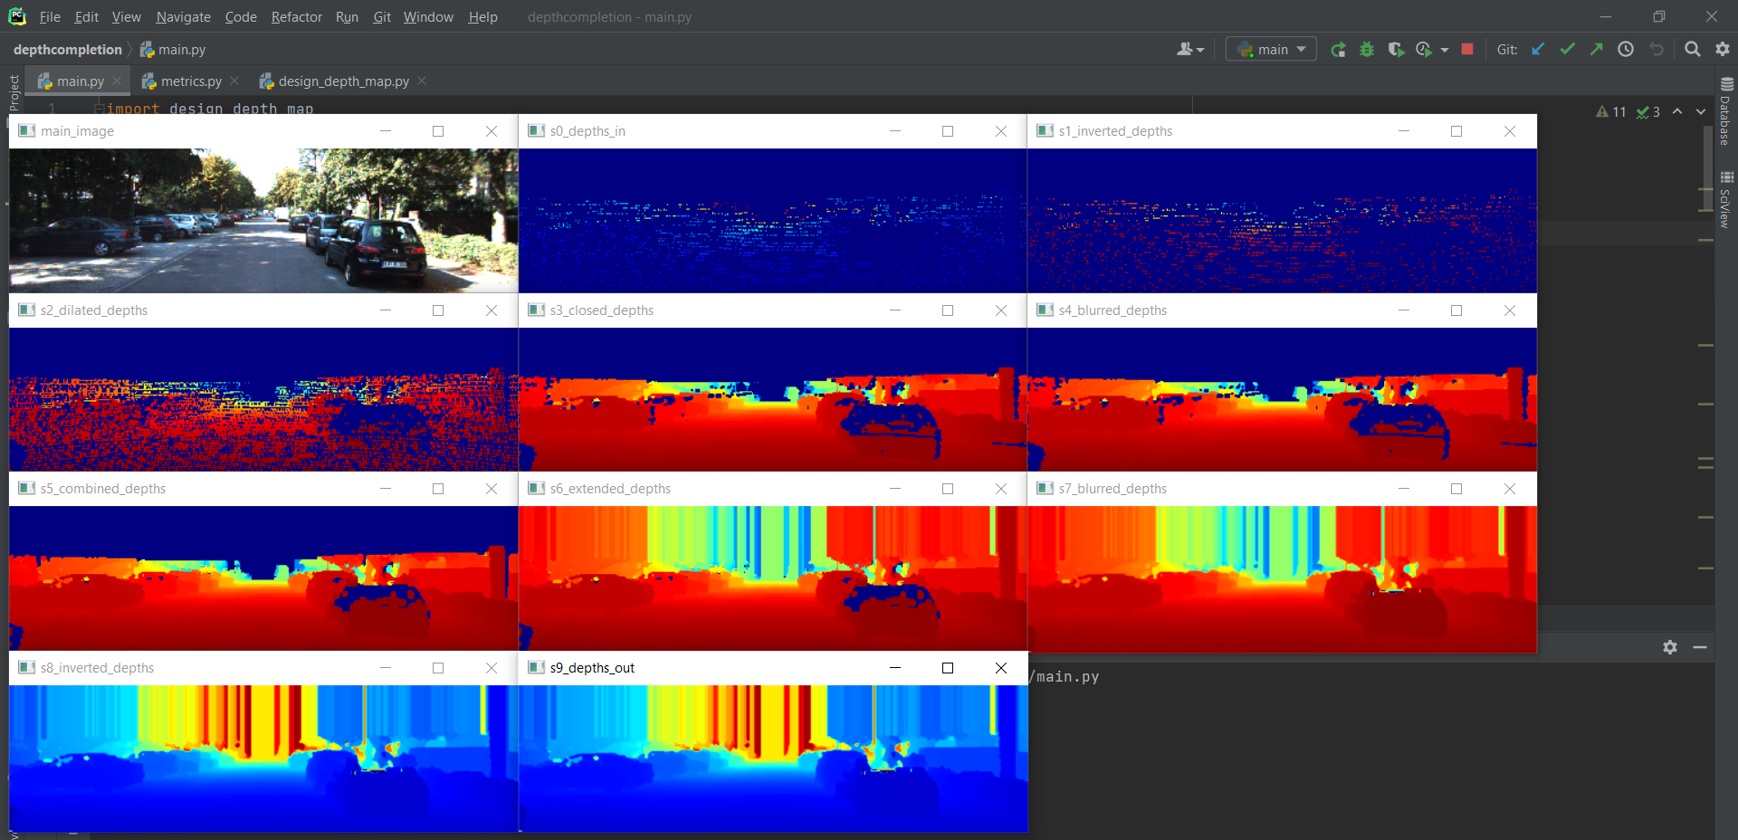
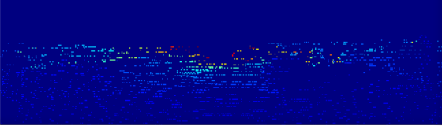
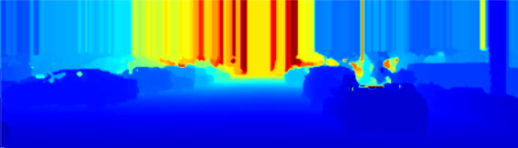
Introduction
Depth Perception
Depth Estimation
Depth Completion

Slide 6
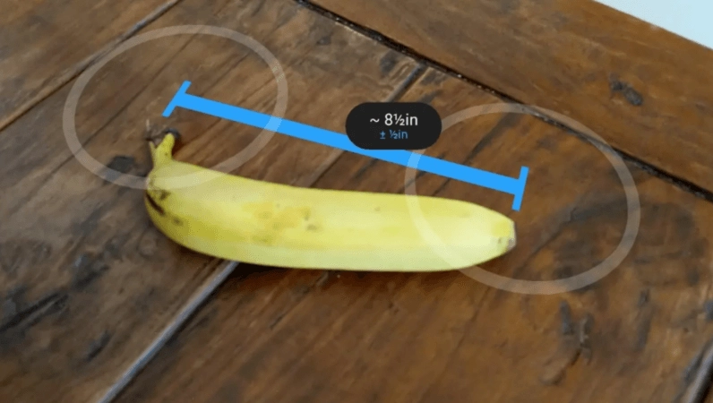
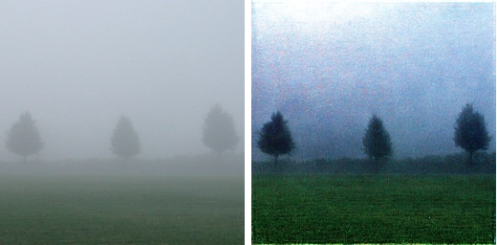
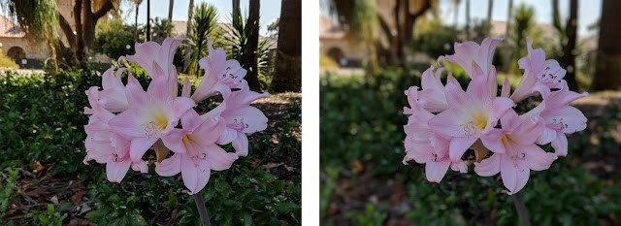
Application
Augmented reality
Robotics and object trajectory estimation
Haze and Fog removal
Portrait mode

Slide 7
NEWER APPROACHES
2
Faster but on GPU

Slide 8
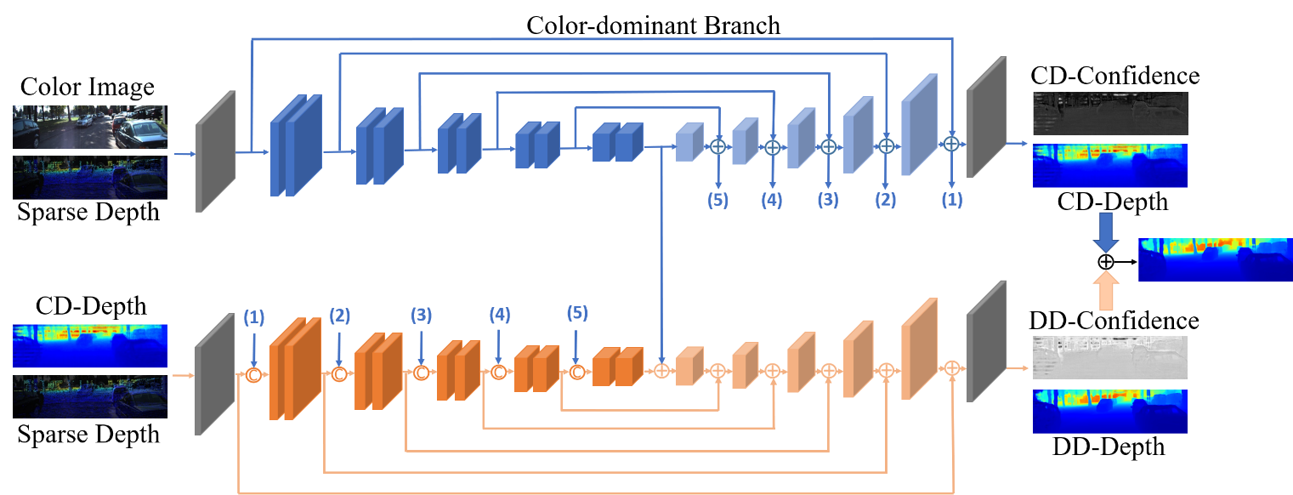
PENet-2020
More Accurate
Faster (GPU)
Supervised
Run Time | MAE | RMSE
0.04 | 210 | 730.08 | PENet[9]
0.011 | 302.6 | 1288.46 | Classic Method [1]

Slide 9
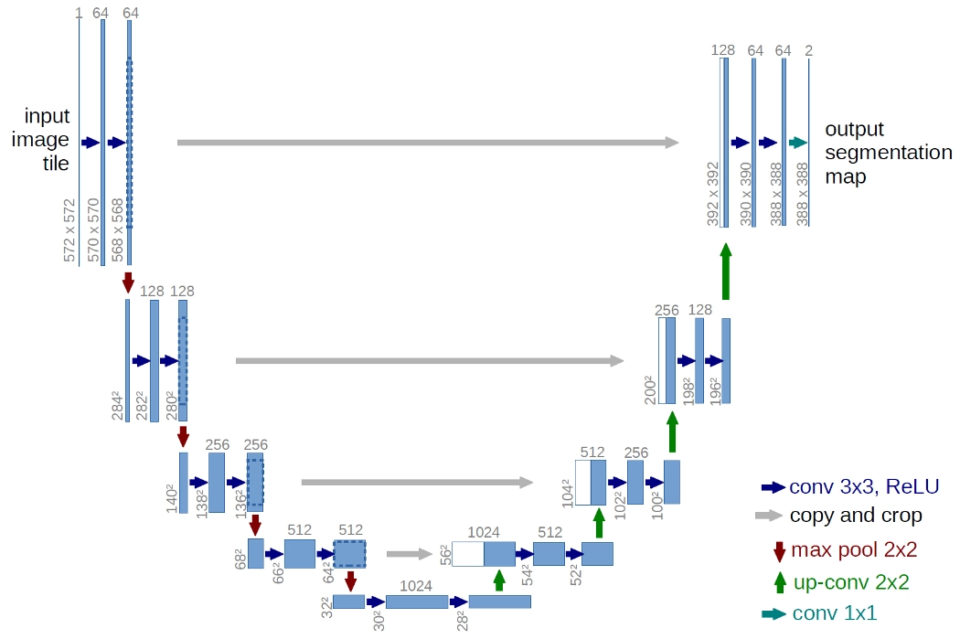
Monodepth-2019
More Accurate
Faster (GPU)
Unsupervised
Multi Loss

Slide 10
PAPER METHOD
3
Dive into Classical Image Processing.

Slide 11
8 STEPS TO REDEMPTION
The Authors have used morphology many times

Slide 13
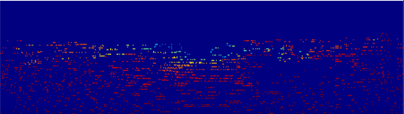
Step 1 – Depth Inverted
Input
How?
Result = 100 - Input
Result
Why?
Reduce the difference between Valid pixels and Empty pixels to prevent negative impact of dilation on edges.

Slide 14
Step 1 – Depth Inverted
Code

Slide 15
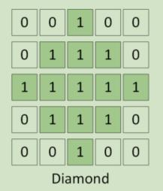
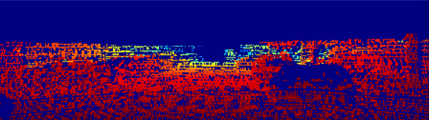
Step 2 – Dilating With Custom Kernel
Input
How?
Dilating with 3*3 ,5*5, 7*7 diamond filter
We can use cross filter here
Result
Why?
To Extend Efficient Pixels

Slide 16
Step 2 – Dilating With Custom Kernel
Code

Slide 17
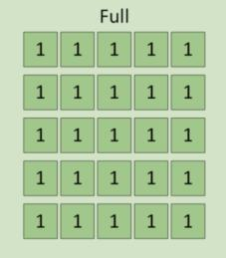
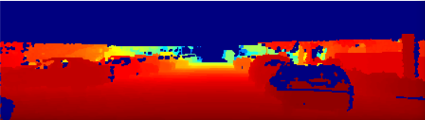
Step 3 – Small Hole Closure
Input
How?
1- Closing with 5*5 full filter
2- Using Median filter for denoising
7*7 and 3*3 decrease RMSE
Result
Why?
Fill small holes which is remaining from previous step

Slide 18
Step 3 – Small Hole Closure
Code

Slide 19
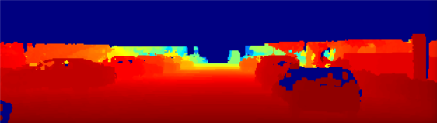
Step 4 – Medium Hole Fill
Input
How?
1- Dilating on unchanged pixel with 7*7 Full filter
Result
Why?
Fill Medium Holes

Slide 20
Step 4 – Small Hole Fill
Code

Slide 21
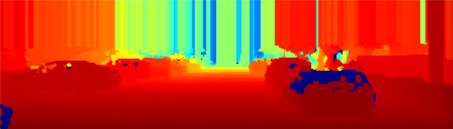
Step 5 – Extension to Top of Frame
Input
How?
the top value along each column is extrapolated to the top of the image, providing a denser depth map output.
Result
Why?
To account for tall objects such as trees, poles, and buildings To account for tall objects such as trees, poles, and buildings that extend above the top of LIDAR points

Slide 22
Step 5 – Extension to Top of Frame
Code

Slide 23
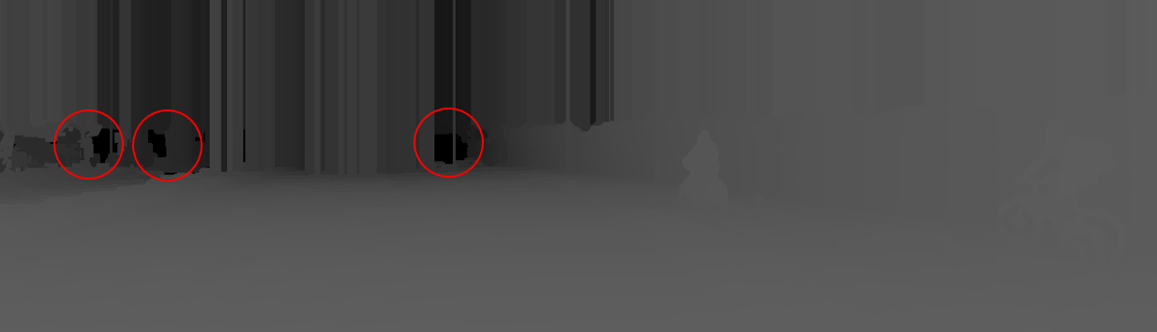

Step 6 – Large Hole Fill
How?
Why?

Slide 24
Step 6 – Large Hole Fill
Code

Slide 25
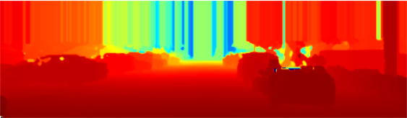
Step 7 – Median and Gaussian Blur
Input
How?
1- 5 × 5 kernel median blur
2- 5 × 5 kernel Gaussian blur
Result
Why?
To remove these outliers

Slide 26
Step 7 – Median and Gaussian Blur
Code

Slide 27
Step 8 – Depth Inversion
Input
How?
Result = 100 - Input
Result
Why?

Slide 28
Step 8 – Depth Inversion
Code

Slide 29
RESULT
4

Slide 30
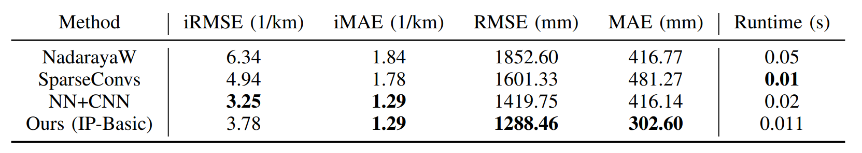
Result
MAE | RMSE | Dataset
302.6 | 1288.46 | KITTI Test Set | Paper Implementation
696.7 | 1651.34 | KITTI Validation Cropped | My Implementation

Slide 31

An Issue

