Slide 1

AN AES ENCRYPTION-DECRYPTION TOOL INTEGRATED WITH HUFFMAN COMPRESSION AND DECOMPRESSION
SPL-1 PROJECT
FILECRYPTOZIPPER:

Slide 2

Submitted By:
Name : Shahid-E-Kaiser
Md. Tashrif
Roll : 1448
Supervised By:
Toukir Ahammed
Lecturer, IIT
University of Dhaka

Slide 3

MOTIVATION
∎ Security
∎ Confidentiality
∎ Data Protection
∎ File Size Reduction
∎ Speed and Efficiency

Slide 4

FEATURES
∎ AES - 256 File Encryption
∎ AES - 256 File Decryption
∎ Huffman Compression
∎ Huffman Decompression
∎ User Interface

Slide 5
AES ENCRYPTION
∎ AES - 256 File Encryption
∎ AES - 256 File Decryption
∎ Huffman Compression
∎ Huffman Decompression
∎ User Interface
What is AES Encryption?
Why AES?

Slide 6
AES ENCRYPTION
Uses 256 bit key
14 rounds of operations
Substitute Bytes
Shift Row
Mix Column
Add Round key
∎ AES - 256 File Encryption
∎ AES - 256 File Decryption
∎ Huffman Compression
∎ Huffman Decompression
∎ User Interface

Slide 7
AES DECRYPTION
Uses same key
14 rounds of operations
Inverse Shift Row
Inverse Substitute Byte
Add Round Key
Inverse Mix Column
∎ AES - 256 File Encryption
∎ AES - 256 File Decryption
∎ Huffman Compression
∎ Huffman Decompression
∎ User Interface

Slide 8
HUFFMAN COMPRESSION
Variable-Length Code
Huffman Tree using the
frequencies of characters
Tree Traversal to assign
codes
∎ AES - 256 File Encryption
∎ AES - 256 File Decryption
∎ Huffman Compression
∎ Huffman Decompression
∎ User Interface

Slide 9
HUFFMAN DECOMPRESSION
Traverse from root of Tree
Read file bit by bit
Get character reaching
leaf node
∎ AES - 256 File Encryption
∎ AES - 256 File Decryption
∎ Huffman Compression
∎ Huffman Decompression
∎ User Interface

Slide 10
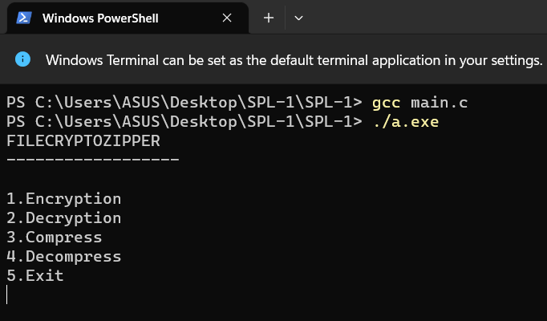
USER INTERFACE
User Selection :
∎ AES - 256 File Encryption
∎ AES - 256 File Decryption
∎ Huffman Compression
∎ Huffman Decompression
∎ User Interface

Slide 11
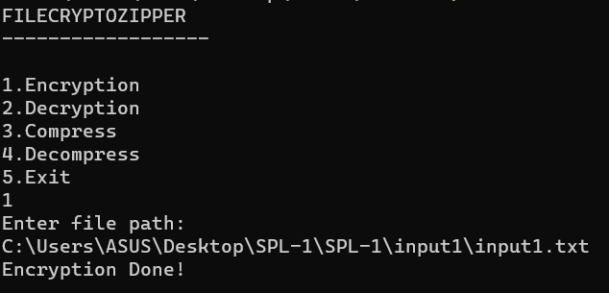
USER INTERFACE
Encryption :
∎ AES - 256 File Encryption
∎ AES - 256 File Decryption
∎ Huffman Compression
∎ Huffman Decompression
∎ User Interface

Slide 12
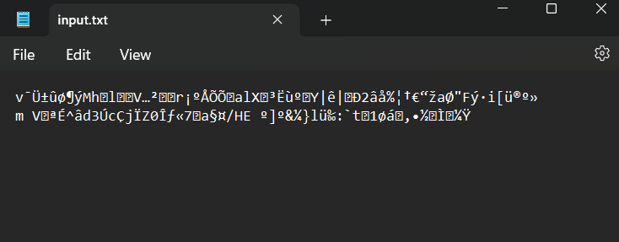
USER INTERFACE
Encryption :
∎ AES - 256 File Encryption
∎ AES - 256 File Decryption
∎ Huffman Compression
∎ Huffman Decompression
∎ User Interface

Slide 13
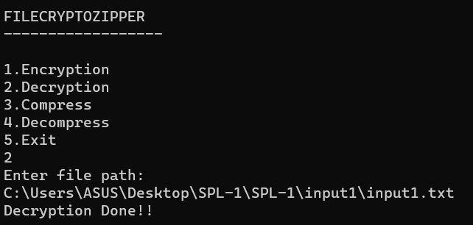
USER INTERFACE
Decryption :
∎ AES - 256 File Encryption
∎ AES - 256 File Decryption
∎ Huffman Compression
∎ Huffman Decompression
∎ User Interface

Slide 14
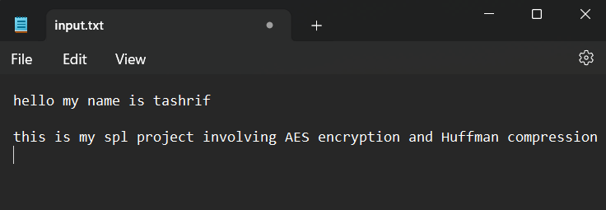
USER INTERFACE
Decryption :
∎ AES - 256 File Encryption
∎ AES - 256 File Decryption
∎ Huffman Compression
∎ Huffman Decompression
∎ User Interface

Slide 15
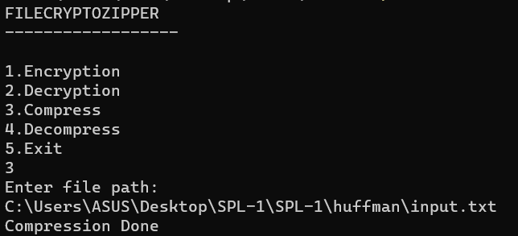
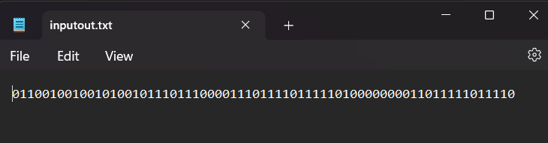
USER INTERFACE
Compression:
∎ AES - 256 File Encryption
∎ AES - 256 File Decryption
∎ Huffman Compression
∎ Huffman Decompression
∎ User Interface

Slide 16
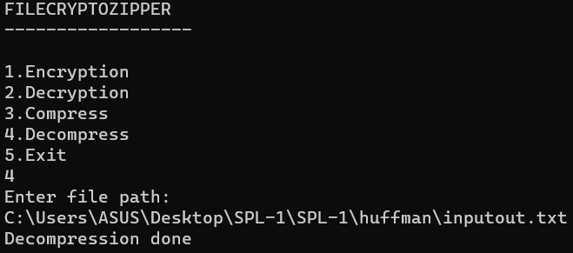
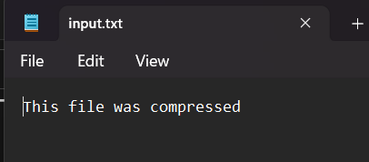
USER INTERFACE
Decompression:
∎ AES - 256 File Encryption
∎ AES - 256 File Decryption
∎ Huffman Compression
∎ Huffman Decompression
∎ User Interface

Slide 17
CHALLENGES
∎ Dividing the state arrays into blocks
of multiple state arrays
∎ Bit Manipulation
∎ Galois Field Arithmetic
∎ Integrating with the Huffman Algorithm

Slide 18
THANK YOU
Github Link:
https://github.com/Tashrif2001/SPL-1

