Slide 1

A File Manipulation Tool to Encrypt/Decrypt and Compress/Decompress with Algorithm Selection
SPL-1 PROJECT
FILECRYPTOZIPPER:

Slide 2

Submitted By:
Name : Shahid-E-Kaiser
Md. Tashrif
Roll : 1448
Supervised By:
Toukir Ahammed
Lecturer, IIT
University of Dhaka

Slide 3

Mid-Term Feedback
Implementing additional Algorithms:
BlowFish Encryption/Decryption
LZW Compression/Decompression
Comparison Report

Slide 4
FEATURES
∎ AES - 256 File Encryption/Decryption
∎ BlowFish Encryption/Decryption
∎ Huffman Compression/Decompression
∎ LZW Compression/Decompression
∎ Generating a detailed report

Slide 5
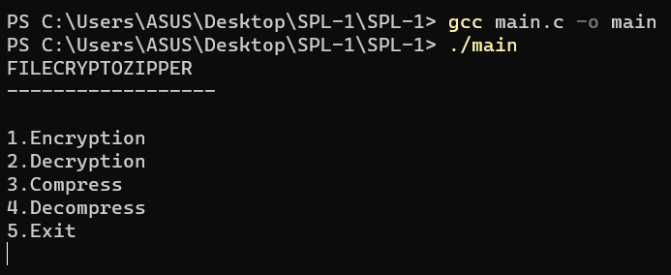
USER INTERFACE
User Selection :
∎ User Interface
∎ File Encryption
∎ File Decryption
∎ Compression
∎ Decompression
∎ Report

Slide 6
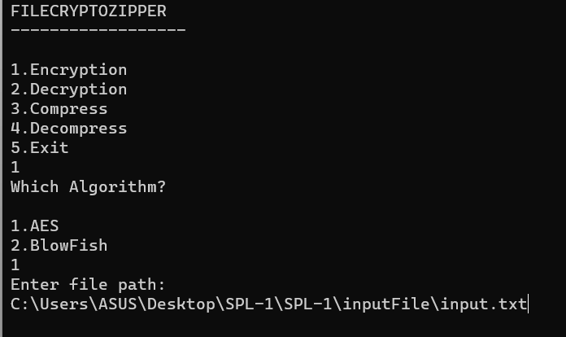
File Encryption
Encryption :
∎ User Interface
∎ File Encryption
∎ File Decryption
∎ Compression
∎ Decompression
∎ Report

Slide 7
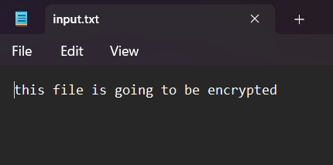
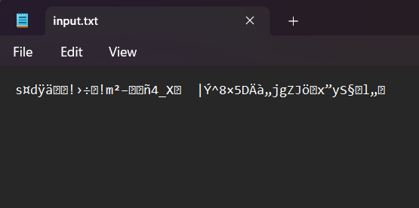
File Encryption
∎ User Interface
∎ File Encryption
∎ File Decryption
∎ Compression
∎ Decompression
∎ Report

Slide 8
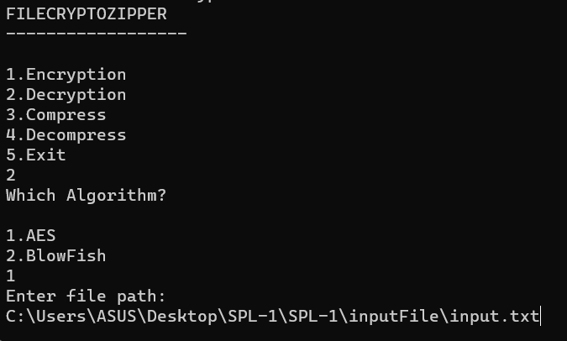
File Decryption
∎ User Interface
∎ File Encryption
∎ File Decryption
∎ Compression
∎ Decompression
∎ Report

Slide 9
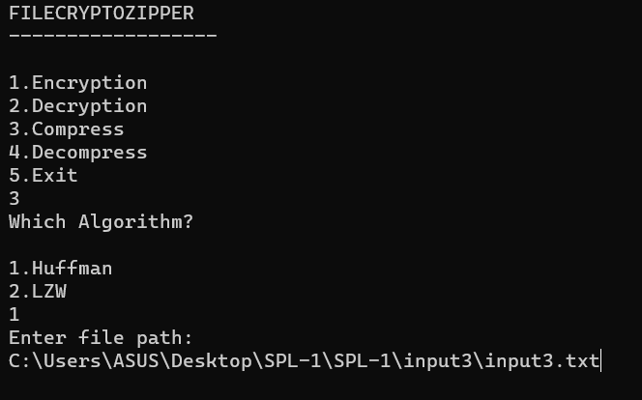
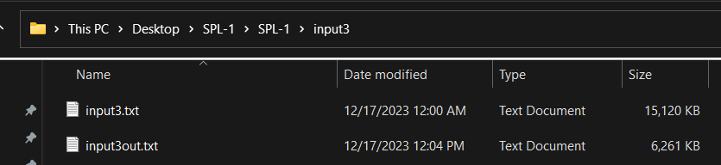
Compression
∎ User Interface
∎ File Encryption
∎ File Decryption
∎ Compression
∎ Decompression
∎ Report

Slide 10
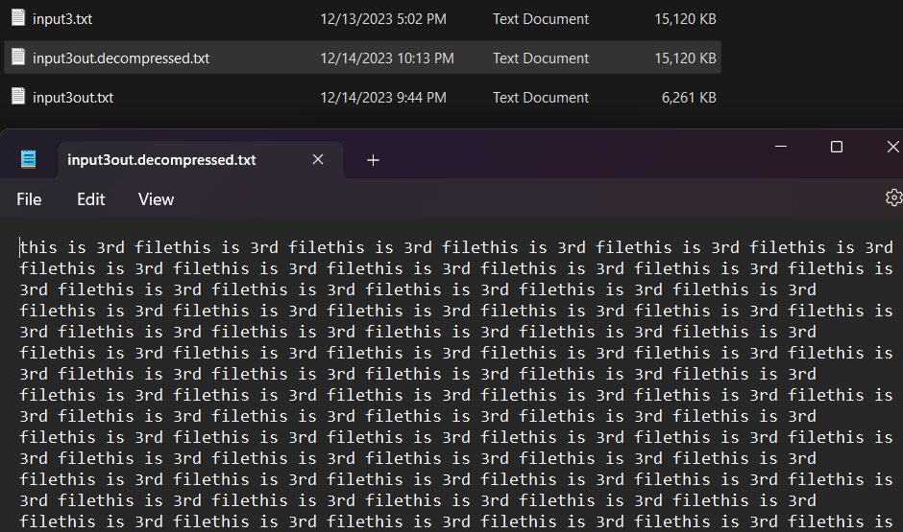
Decompression
∎ User Interface
∎ File Encryption
∎ File Decryption
∎ Compression
∎ Decompression
∎ Report

Slide 11
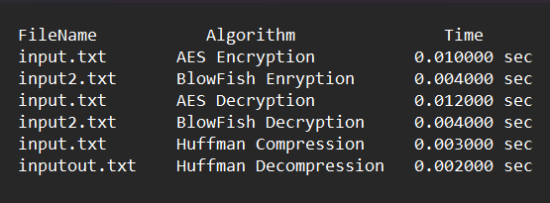
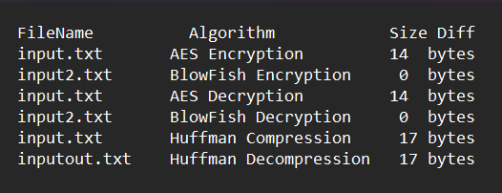
Report
∎ User Interface
∎ File Encryption
∎ File Decryption
∎ Compression
∎ Decompression
∎ Report

Slide 12

CHALLENGES
∎ Integrating Multiple Algorithms
∎ Bit Manipulation
∎ Galois Field Arithmetic
∎ File I/O Operations

Slide 13
THANK YOU
Github Link:
https://github.com/Tashrif2001/SPL-1

