Slide 1
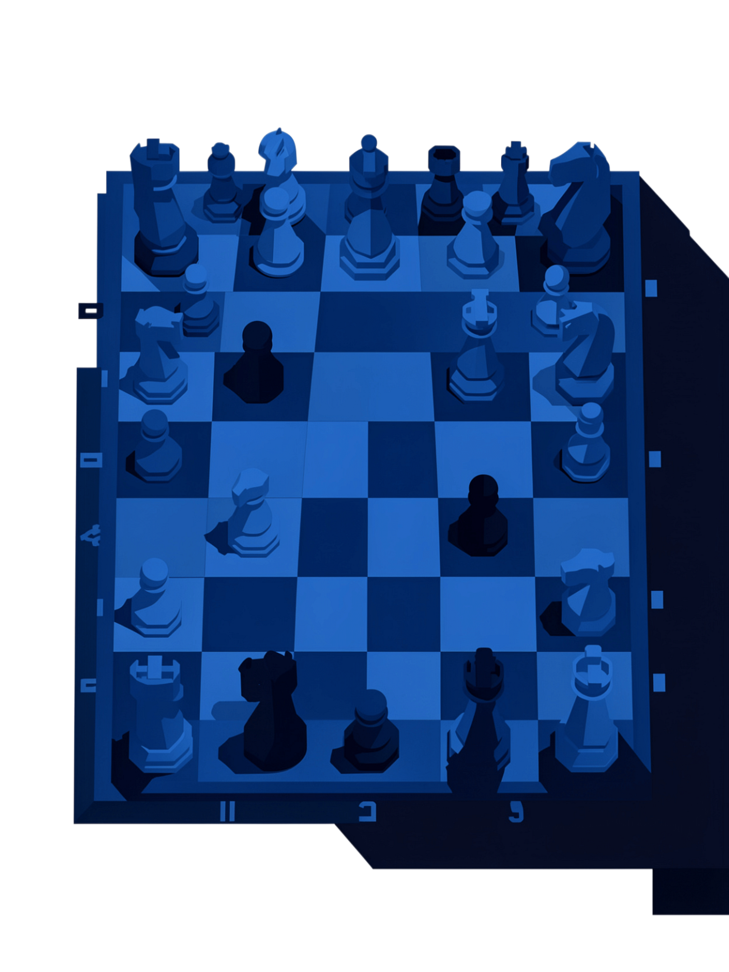

Chess Craft
A fully-featured chess application built in C++ from scratch with a custom AI opponent (Chess Bot) , local & online multiplayer via TCP sockets.
AHMED MUSTAQIM TASIN
1701
Supervised by: Dr. Md. Nurul Ahad Tawhid

Slide 2
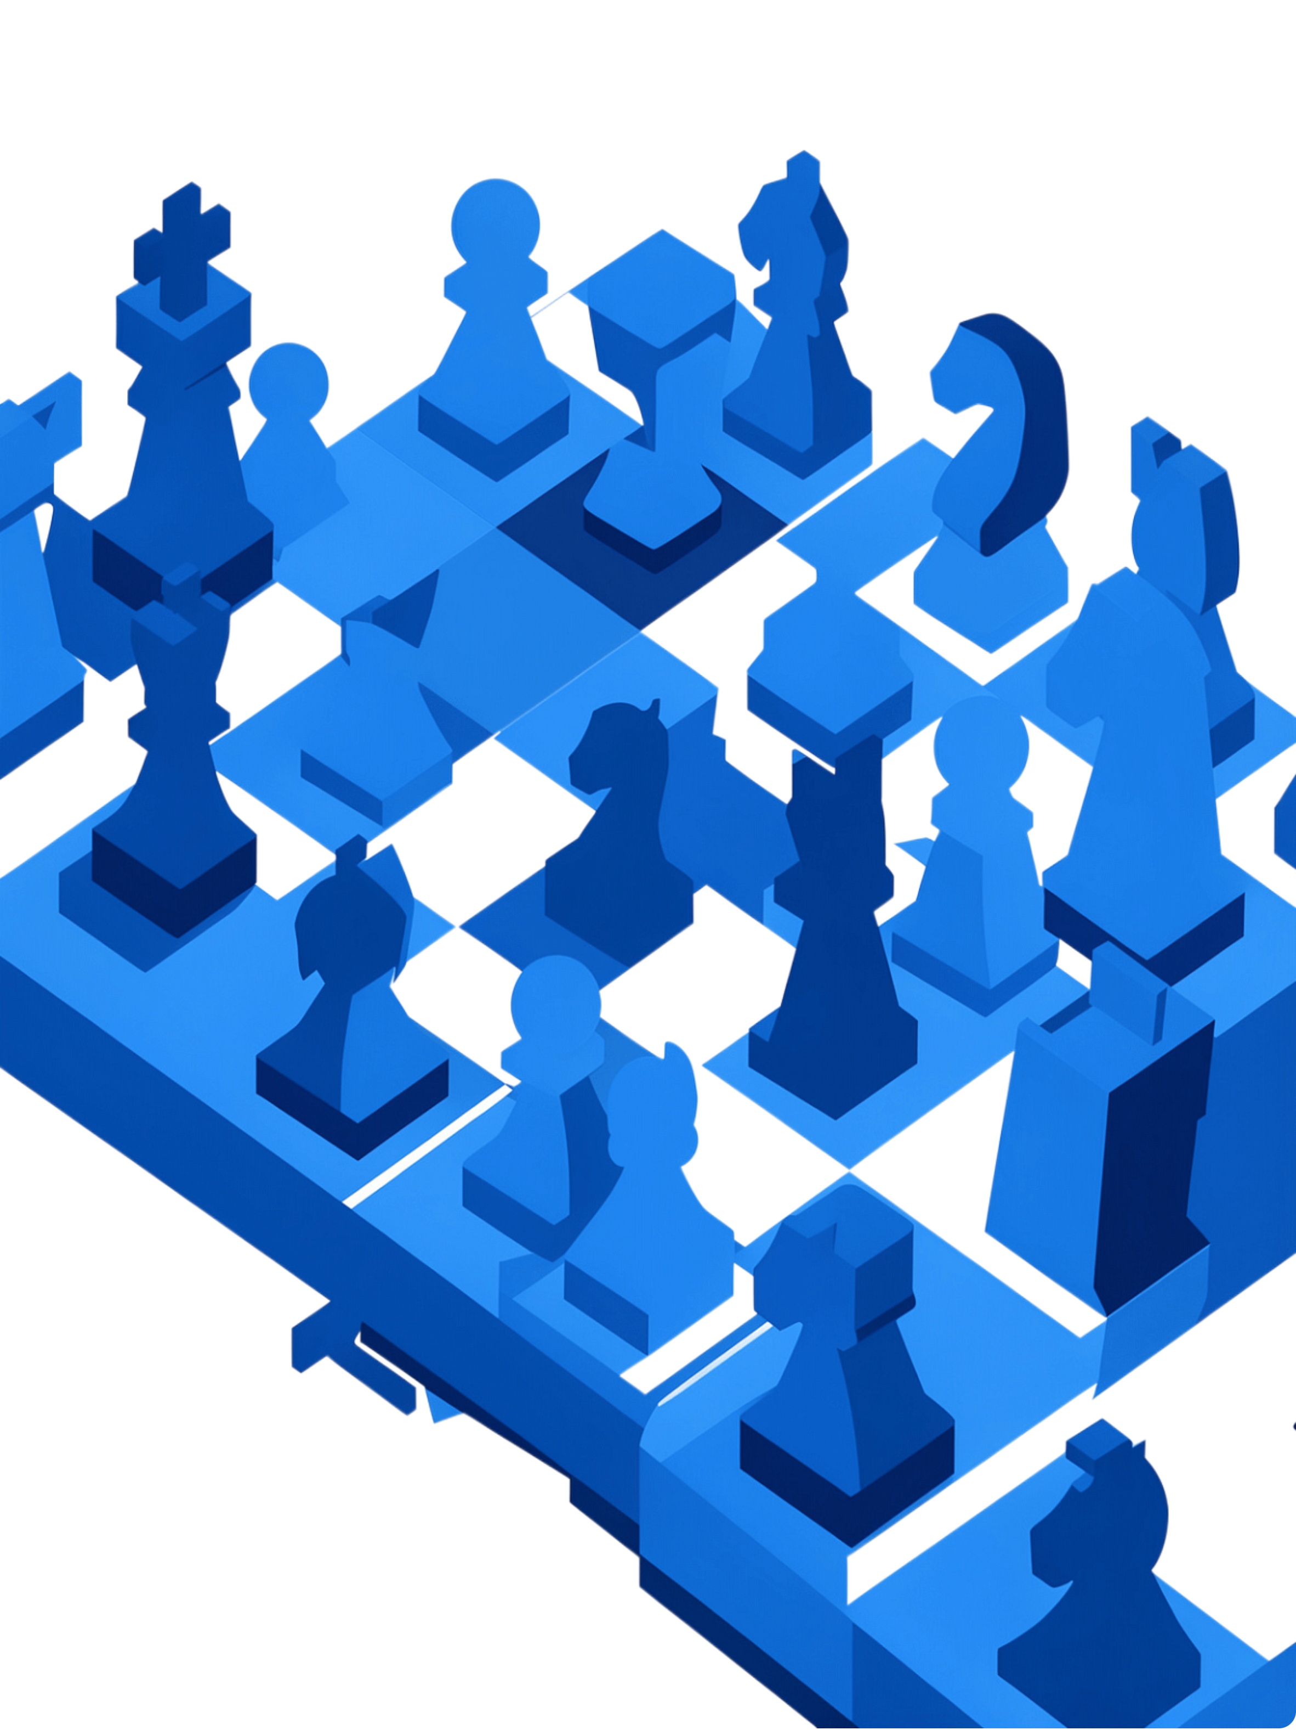
Why Chess?
It maps perfectly onto data structures and algorithms.
10¹²⁰
8×8
Possible Games
Board Grid
Shannon number - more than atoms in the observable universe
64 squares, each storing piece state, a natural 2D array
6
50+
Piece Types
Special Cases
Each with distinct movement rules, ideal for OOP and rule engines
En Passant, Promotion, Three Fold Draw, Castling, etc.

Slide 3
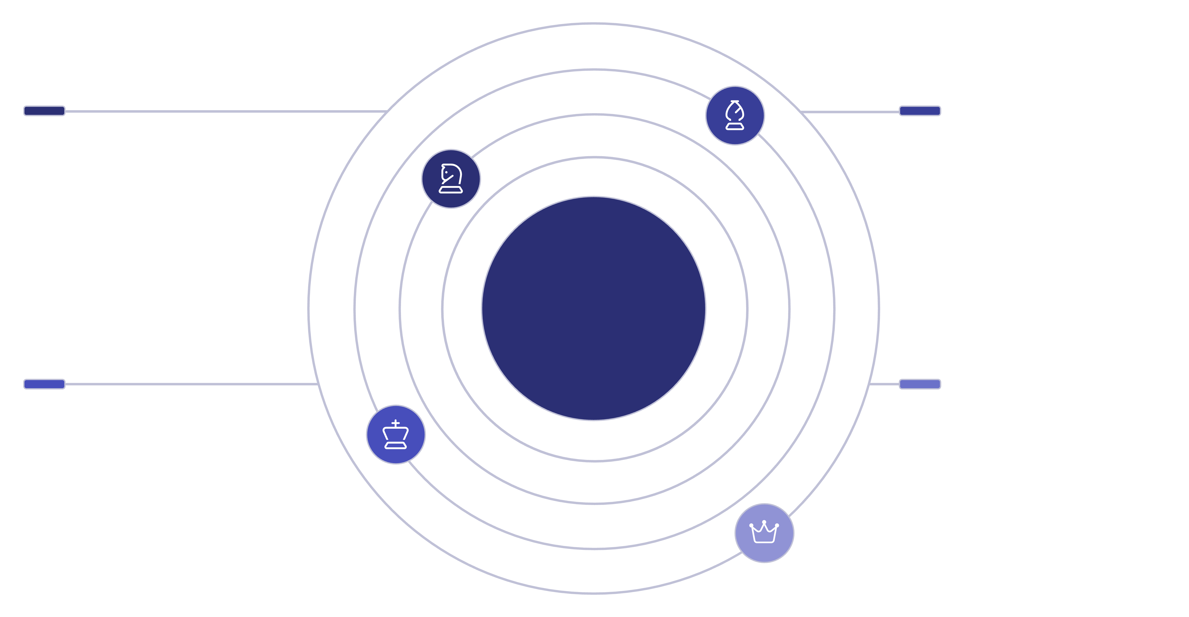
Boards & Pieces
Move & Game Logic
Structs the chessboard and
Validates legal move and checks for game state and special cases.
System Overview
Single Player
Multiplayer
AI or the Chess Engine uses MiniMax to predict and win.
Local & Onlineusing TCP sockets

Slide 4

How the Chess AI Thinks
Minimax Algorithm
The AI explores a game tree of possible future moves, assuming the opponent plays optimally. It selects the move that maximizes its advantage while minimizing the player's best response. Also, pruning for optimization.
Board Evaluation Function
Each board state is scored based on material balance, piece positioning, and control of key squares, giving the AI a sense of positional advantage.

Slide 5

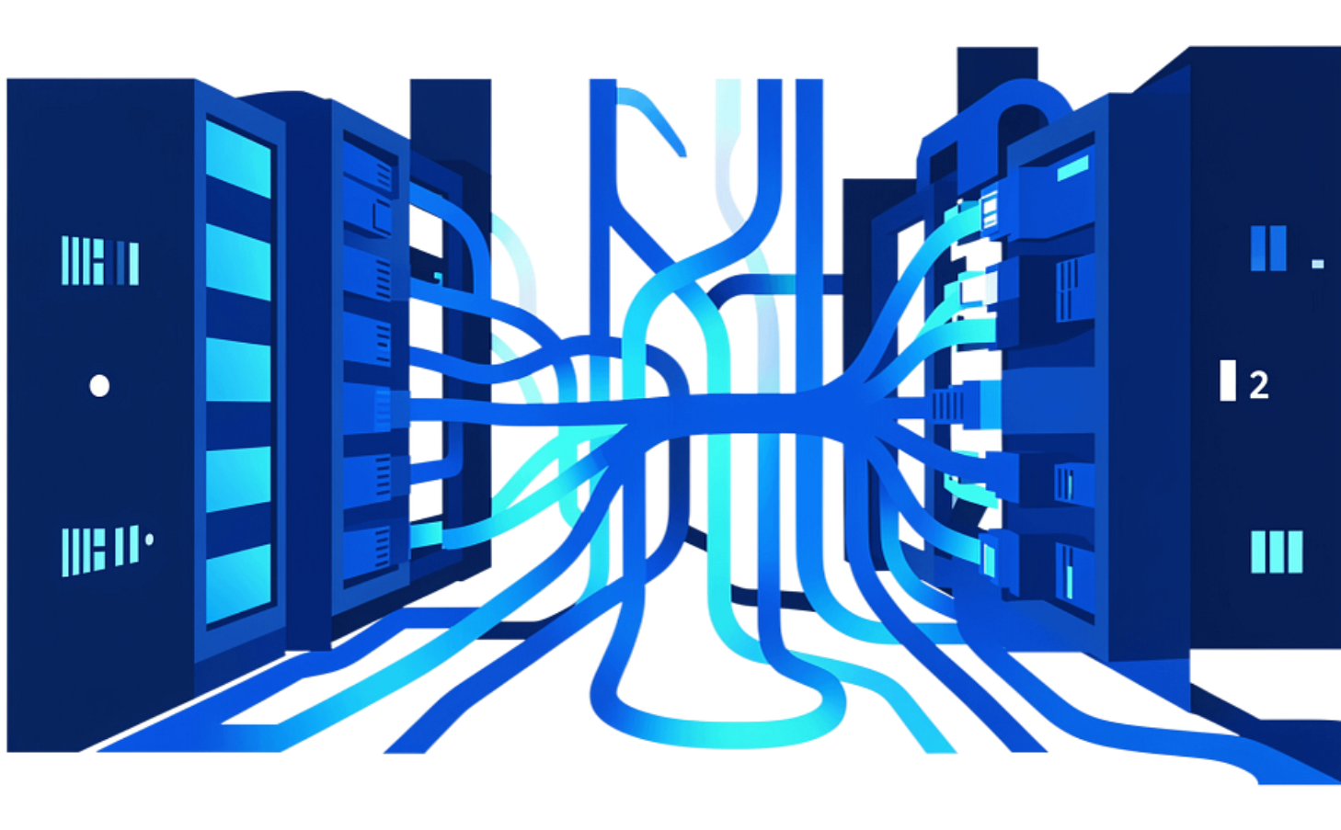
Multiplayer: Local and Online
Local Multiplayer
Online Multiplayer
Two players share the same machine. After each turn, the board flips so the next player sees the board from their perspective
Players connect over the internet via TCP sockets. Moves are serialized and transmitted between clients, keeping both game states fully synchronized in real time.

Slide 6
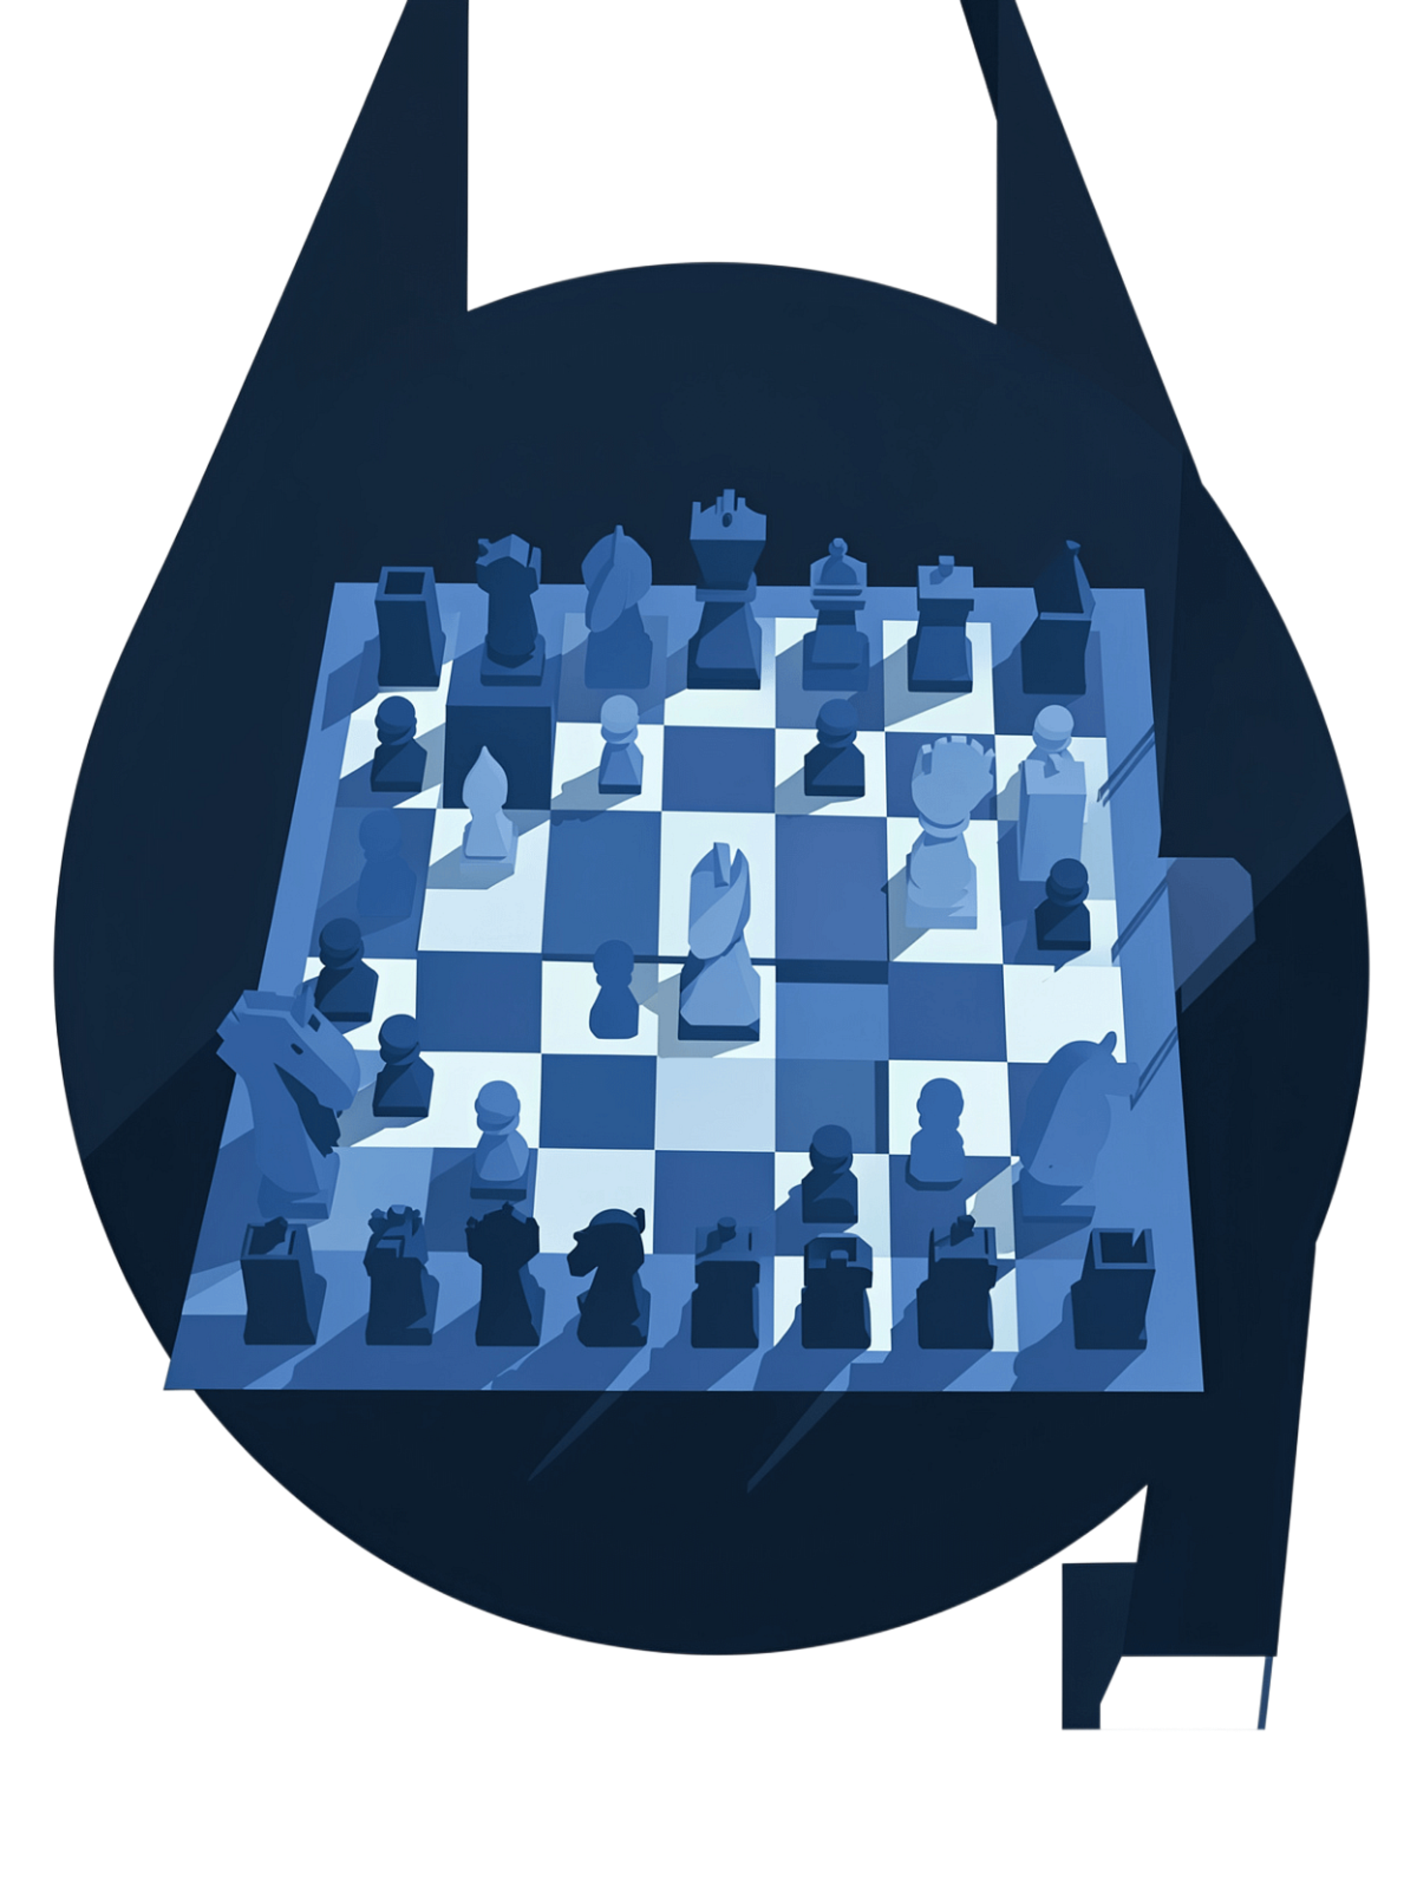
Thank You.
Language
C++
AI / Chess Engine Core
Minimax
Networking
TCP Sockets
Graphics
Raylib
AHMED MUSTAQTIM TASIN · 1701

