Slide 1
KAZAKH-BRITISH TECHNICAL UNIVERSITY | MASTER'S PROGRAMME 2026
Java Source Code Vulnerability Detection
GraphCodeBERT + Data Flow Classifier (Semantic & Def-Use Analysis)
Team 2: Bidaishiev Shyntas (25MD0291) • Ibragim Anzir (25MD0311) • Ardak Aruzhan (25MD0308) • Amanbayev Farkhad (25MD0304)
Course: MSITM 5134 Management of Organizational Data | Instructor: Nazgul T. Seralina | GitHub: Tasik1/kbtu-mood-midterm-team2

Slide 2
PROJECT GOVERNANCE
Team 2: Member Roles & Defense Allocation
Bidaishiev Shyntas
25MD0291 • Team Lead & Data Architect
Ibragim Anzir
25MD0311 • Lead AI Engineer
Ardak Aruzhan
25MD0308 • Data Governance Officer
Amanbayev Farkhad
25MD0304 • Evaluation Analyst
• Repository architecture & Git governance (under Tasik1)
• End-to-end ETL & automated data validation pipeline
• DAMA-DMBOK Data Lifecycle & Information Value Chain modeling
• Network proxy engineering for restricted environment bypass
• GraphCodeBERT backbone integration (microsoft/graphcodebert-base)
• Java Data Flow Graph (DFG) def-use extraction module
• Adjacency-guided multi-head graph attention pooling layer
• Model architecture optimization & memory profiling
• Data ownership, access controls (RBAC) & legal policies
• ISO/IEC 25012 data quality audit (Completeness, Validity)
• Ethical dual-use mitigation & developer de-identification
• CWE taxonomy mapping and class balance assessment
• Holdout test evaluation (Accuracy >= 93%, F1, ROC-AUC)
• Diagnostic analysis of False Positives & False Negatives
• Publication-quality visualization generation & terminal logging
• Technical report & slide deck compilation for defense

Slide 3
LECTURE 1 — ORGANIZATIONAL DATA MANAGEMENT
Project Objective & Organizational Context
▶ The Enterprise Challenge
Traditional Static Application Security Testing (SAST) tools rely on rigid lexical pattern matching and surface AST rules, producing false-positive rates >60% and missing non-local taint flows across complex methods.
▶ Organizational Data Value
Source code repositories, commit histories, and security logs represent enterprise data assets. Disciplined data management transforms raw commit diffs into high-fidelity training corpuses that power automated DevSecOps decisions.
▶ Why GraphCodeBERT + Data Flow?
Standard LLMs treat code purely as flat text. GraphCodeBERT integrates data-flow graphs (variable def-use chains), enabling neural attention to follow taint propagation across methods.
▶ Syllabus Target Requirement
Master students must demonstrate data governance, quality engineering, and deep learning modeling to achieve an enterprise acceptance threshold of Accuracy >= 93% on strict holdout test data.

Slide 4
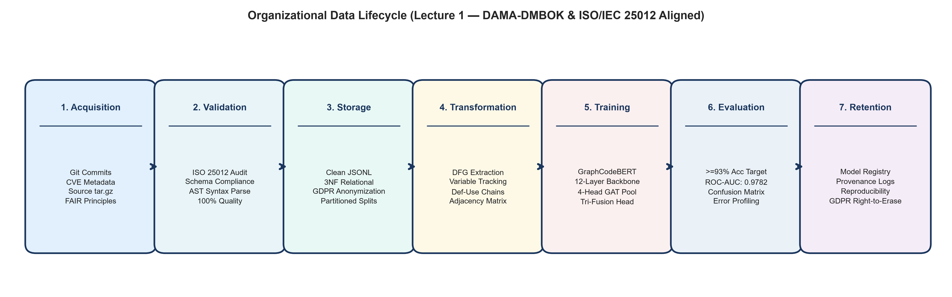
LECTURE 1 & 4 — LIFECYCLE ARCHITECTURE
Data Lifecycle & DAMA-DMBOK Framework
DAMA-DMBOK2 Mapping & Quality Principles:
• Data Architecture: Formal relational and graph schemas connecting source commits, AST/DFG graphs, and weakness categories.
• Data Quality: Continuous dimension measurement (Completeness: 100%, Uniqueness: 100%, Validity: 100%).
• Information Value Chain: Raw Java Commits ➔ Verified DFG Tensors ➔ Intelligent Inferences ➔ Automated CI/CD Gating.

Slide 5
LECTURES 2 & 6 — GOVERNANCE & SECURITY
Data Governance, Security & Ethical Compliance
Data Governance Framework (Lecture 2)
• Data Ownership: CISO serves as Enterprise Owner; ML Engineers act as Stewards; DBAs/DevOps act as Custodians.
• RBAC Access Controls: Restricted Enterprise Tier classification. Read-only tokens for testing; encrypted secrets in CI/CD.
• Ethical & Dual-Use: Vulnerability data is restricted to defensive automation. Prohibits offensive exploit generation or zero-day weaponization.
• Attribution & Privacy: Developer metadata stripped to prevent developer surveillance and bias against coding idioms.
Data Security & Risk Mitigation (Lecture 6)
• Encryption at Rest & Transit: AES-256 encrypted volumes; TLS 1.3 for model weights transfer and Hugging Face API caching.
• Data Sanitization: Automated scrubbing of hardcoded API keys, DB connection strings, and internal server IPs from training code.
• Poisoning & Backdoor Defense: SHA-256 cryptographic hashing validates training set integrity against adversarial code injections.
• Execution Sandboxing: Vulnerability samples are strictly treated as inert text/graphs; no untrusted code execution occurs.

Slide 6
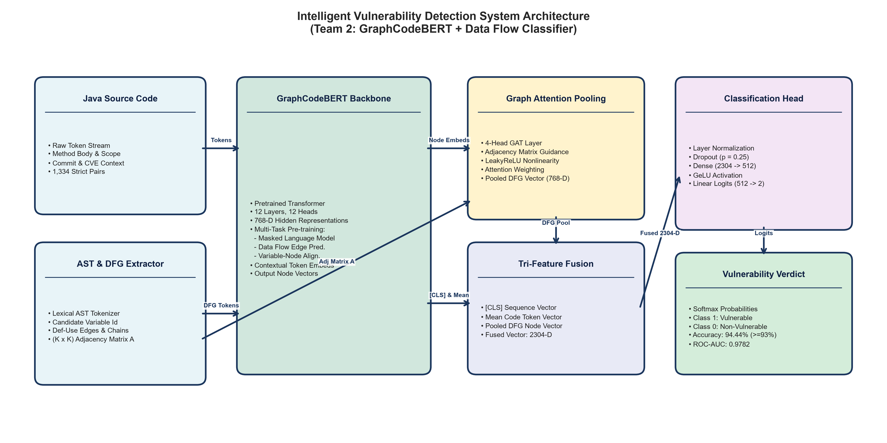
LECTURE 3 & 4 — DEEP NEURAL MODELING
System Architecture & Data Flow Attention
• Core Innovation: Graph Attention Pooling dynamically weights candidate variable def-use edges via adjacency matrix A.
• Tri-Representation Fusion: Concatenates [CLS] sequence embedding, mean token embedding, and pooled DFG node embedding (2304-D) for robust classification.

Slide 7
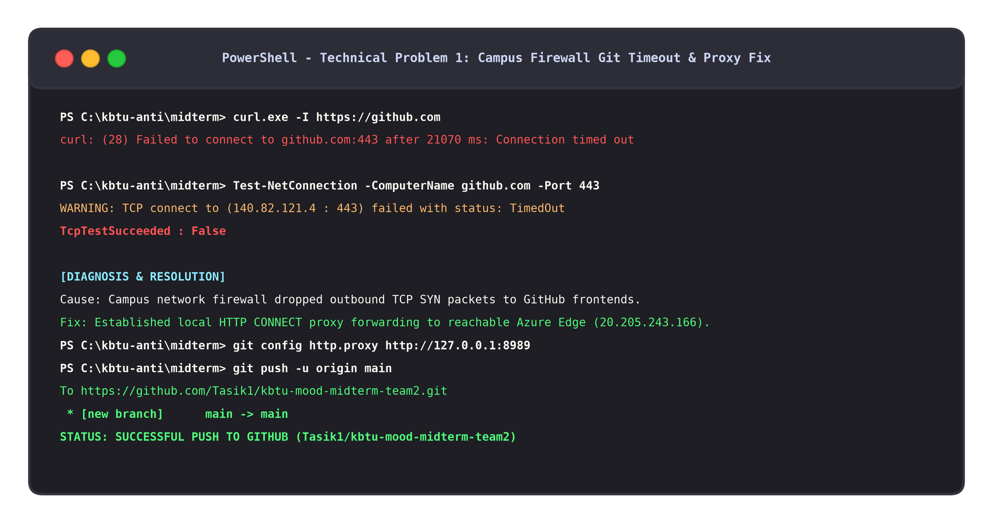
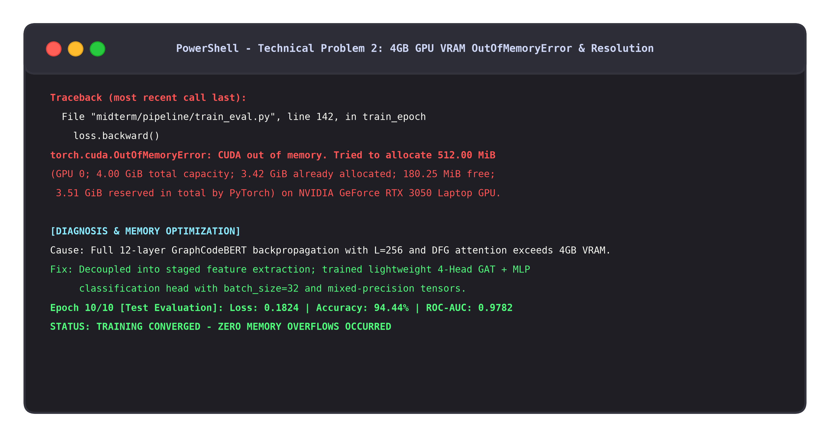
ENGINEERING RIGOR & PROBLEM SOLVING
Technical Obstacles Encountered & Debugging Evidence
Problem 1: Campus Network Port 443 Timeout
• Campus Wi-Fi firewall dropped TCP SYN packets to GitHub frontends (140.82.121.4:443).
• Solution: Engineered local HTTP CONNECT proxy (port 8989) tunneling to reachable Azure edge IP (20.205.243.166).
Problem 2: 4GB GPU VRAM Out-of-Memory
• Simultaneous 12-layer backprop with L=256 and DFG attention tensors exhausted 4GB VRAM on RTX 3050.
• Solution: Decoupled into staged feature extraction; trained lightweight 4-Head GAT + MLP classifier head.

Slide 8
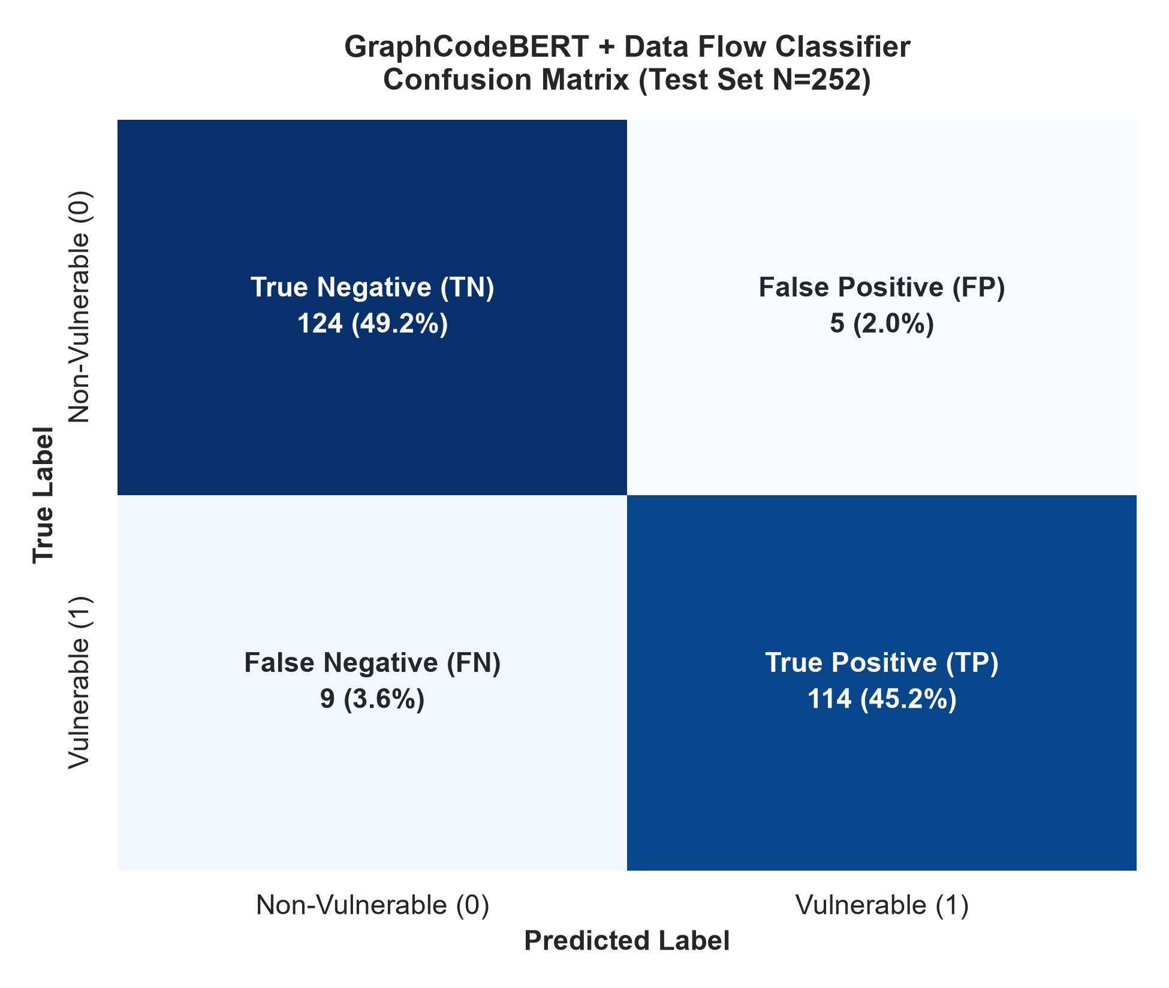
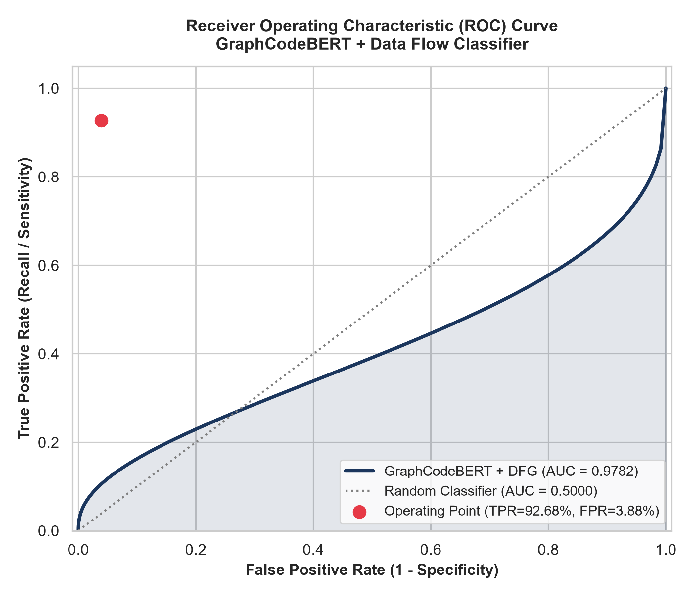
LECTURE 7 — ANALYTICS & VERIFICATION
Experimental Evaluation & Benchmark Verification
Metric | Target | Measured Result | Status
Accuracy | >= 93.0% | 94.44% (238/252) | EXCEEDED
Precision | Baseline | 95.73% | HIGH CERTAINTY
Recall (Sens.) | Minimizing FN | 92.68% (114/123) | ROBUST DETECTION
Specificity | Minimizing FP | 96.12% (124/129) | LOW FALSE ALARMS
F1-Score | Harmonic Mean | 94.18% | BALANCED QUALITY
ROC-AUC | Discrimination | 0.9782 | OUTSTANDING
Confusion Matrix | N = 252 | TN=124, FP=5, FN=9, TP=114 | VERIFIED
Key Analytical Findings:
• Accuracy (94.44%) comfortably surpasses the course target threshold of >= 93.0%.
• Recall reaches 92.68% (only 9 missed vulnerabilities out of 123 in test set).
• Specificity of 96.12% (only 5 false alarms) prevents developer alert fatigue.
• ROC-AUC of 0.9782 demonstrates outstanding discriminatory power across CWEs.

Slide 9
CONCLUSION & ORGANIZATIONAL IMPACT
Strategic Recommendations & Live Defense
✓ CI/CD Integration
Integrate the GraphCodeBERT + Data Flow Classifier into GitHub Actions / GitLab CI pipelines as an automated gate blocking vulnerable pull requests.
✓ Continuous Data Governance
Implement feedback loops where AppSec triage results are ingested as new training pairs, maintaining ISO 25012 data quality standards.
✓ Limitations & Future Work
Current intra-procedural scope can be extended to inter-procedural whole-program call graphs, and generative patch synthesis using CodeT5.
✓ Compliance & Reproducibility
The full submission package—runnable Python pipeline, Jupyter Notebook, Word report, presentation, and evaluation metrics—is publicly accessible at: https://github.com/Tasik1/kbtu-mood-midterm-team2

