Slide 1
(Unofficial) Veracode JavaSCRIPT Packager
A short demo of what it is and how to use it.

Slide 2
What is It?
A CLI tool
Attempts to automate away common struggles when uploading JavaScript (i.e., Node, Angular, Vue, React) applications to Veracode Static Analysis
Packages a JavaScript application and outputs a Zip archive

Slide 3
What does it do?
Feature I:
Check for common red flags
Feature II:
Create a zip that is upload-ready for the Veracode Platform…
… while omitting a lot of non-required files (such as images, style sheets, etc.)
Tool Output:
The tool ultimately outputs a Zip archive that can be uploaded to Veracode Static Analysis

Slide 4
Feature I – Red Flags Check
Identified Red Flags:
Check if a file for SCA exists (e.g. `package-lock.json`)
Check for .map files (indicate minified JS)
What does that mean?
Whenever a ”red flag” is encountered in the application-to-be-zipped, a warning or an error is printed into the console log

Slide 5
Feature II – Omit Non-Required Artifacts
Omitted files / directories:
`node_modules` – omits this folder because it usually only contains 3rd party dependencies
This folder causes a lot of upload issues...
It is usually not required for Veracode Static Analysis
Omit test files:
One should not upload test files (like unit- and integration tests) to Veracode Static Analysis, but only code that makes it into Production.
Specified via the `-tests <test>` flag
Omit images (e.g. `.jpg`)
Omit style sheets (e.g. `.css`)
…

Slide 6
How to use It?
Setup:
The code and some already compiled releases can be found here: https://github.com/fw10/veracode-javascript-packager
This GitHub repository also contains instructions on how to build the tool yourself
How to Run it:
The tool has a built-in help, which you can use like that: `./vc-node-packager --help`
The flags are documented here: https://github.com/fw10/veracode-javascript-packager#how-to-use-

Slide 7
Example – Sample-node-project
To showcase this tool, we use a self-created Node.js application (code: https://github.com/fw10/veracode-javascript-packager/tree/main/sample-projects/sample-node-project)
To show the power of this tool, we will show (parts of) the application structure before and after applying our tool

Slide 8
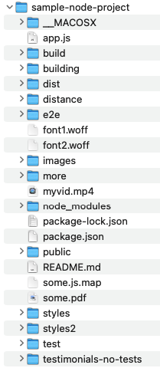
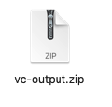
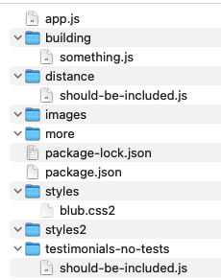
Before (with some folders collapsed):
After:

