Slide 1
(Unofficial) Veracode Node Packager
A short demo of what it is and how to use it.

Slide 2
What is It?
A CLI tool
Attempts to automate away common struggles when uploading Node.js applications to Veracode Static Analysis
Packages a Node.js application and outputs a Zip archive
May also work with JavaScript frontend frameworks (like Angular, React, etc.)
However, this has not been tested!

Slide 3
What does it do?
Feature I:
Check for common red flags
Feature II:
Create a zip that is upload-ready for the Veracode Platform…
… while omitting a lot of non-required files (such as images, style sheets, etc.)
Tool Output:
The tool ultimately outputs a Zip archive that can be uploaded to Veracode Static Analysis

Slide 4
Feature I – Red Flags Check
Identified Red Flags:
Check if `/dist` folder exists – indicates minified JavaScript (we don’t want that!)
Check if `/public` exists – may contain resources that are not part of the actual 1st party source code
Check if a `package-lock.json` exists (required for Veracode SCA, if NPM is used)
…
What does that mean?
Whenever a ”red flag” is encountered in the application-to-be-zipped, a warning or an error is printed into the console log

Slide 5
Feature II – Omit Non-Required Artifacts
Omitted files / directories:
`node_modules` – omits this folder because it usually only contains 3rd party dependencies
This folder causes a lot of upload issues...
It is usually not required for Veracode Static Analysis
Omit test files:
One should not upload test files (like unit- and integration tests) to Veracode Static Analysis, but only code that makes it into Production.
Specified via the `-tests <test>` flag
Omit images (e.g. `.jpg`)
Omit style sheets (e.g. `.css`)
…

Slide 6
How to use It?
Setup:
The code and some already compiled releases can be found here: https://github.com/fw10/veracode-node-packager
This GitHub repository also contains instructions on how to build the tool yourself
How to Run it:
The tool has a built-in help, which you can use like that: `./vc-node-packager --help`
The required flags are:
`-source`: The path of the Node.js app you want to package (default "sample-node-project")
`-target`: The path where you want the `vc-output.zip` to be stored to (default ".")
`-tests`: The path that contains your Node.js test files (relative to the source) (default "test")
Example Usage:
` ./vc-node-packager -source sample-node-project -target . -tests test`
This packages up a Node.js application in the folder `sample-node-project`, puts the `vc-output.zip` in the current directory, and ignores the `test` directory within `sample-node-project`

Slide 7
Example – Sample-node-project
To showcase this tool, we use a self-created Node.js application (code: https://github.com/fw10/veracode-node-packager/tree/main/sample-node-project)
To show the power of this tool, we will show (parts of) the application structure before and after applying our tool

Slide 8
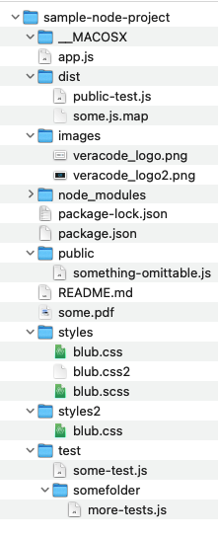
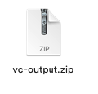
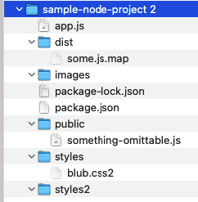
Before (with `node_modules` collapsed):
After:

Slide 9
Future Considerations
Maybe entirely omit `/public`
Maybe entirely omit `/dist`
Maybe omit all `.map` files
Add this tool to the NPM Registry

