Slide 1
E-Commerce Product Management System
Course: Computer programming ii
Group 7
lecturer: mr Drammeh

Slide 2
Project Overview
Objective
Develop a RESTful API That allows users to perform the CRUD operation.
Problem Solved
Manual product management
Poor inventory tracking
Lack of centralized storage
Technologies
Java, Spring Boot, Maven, JPA, Lombok, MySQL/H2, Postman, GitHub.

Slide 3







Technologies Used

Slide 4
System Architecture
Client (Postman)
Controller
Service
Database
Repository

Slide 5
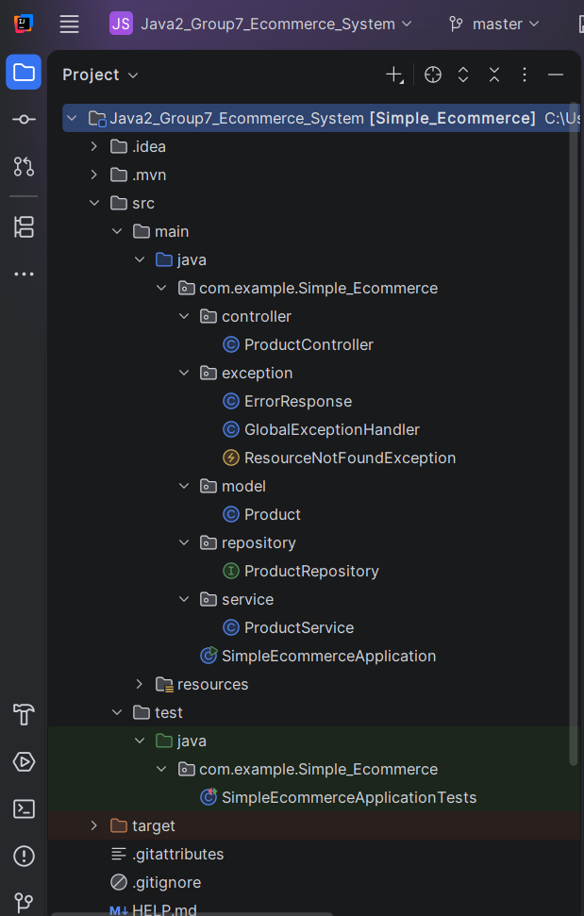
Project Structure

Slide 6
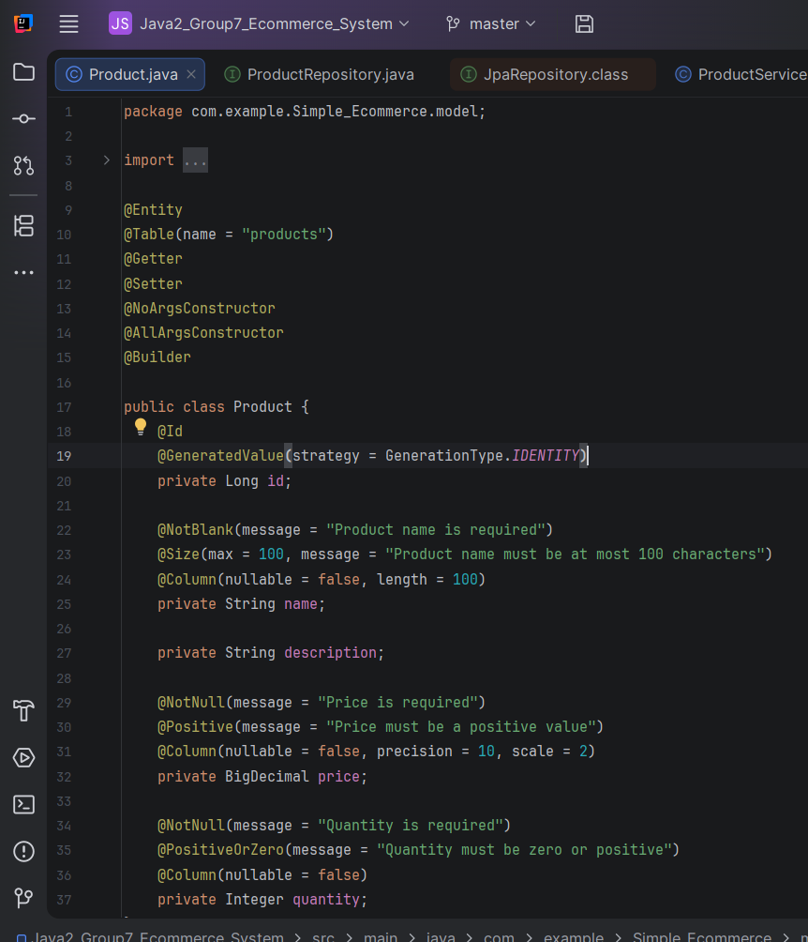
Product Entity
Fields
Id,
Name,
Description,
Price,
Quantity.
Validation annotations.
Lombok annotations.

Slide 7
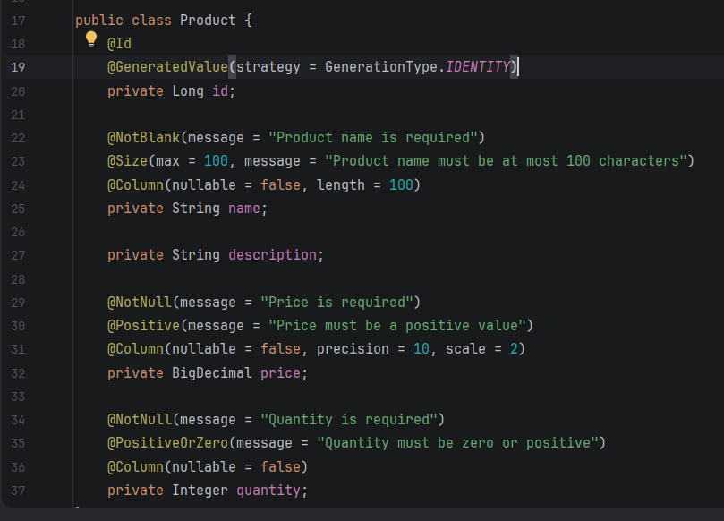
Product Fields
Field | Data Type | Validation
id | Long | Auto Generated
name | String | NotBlank
description | String | Optional
price | BigDecimal | Positive
quantity | Integer | PositiveOr Zero

Slide 8
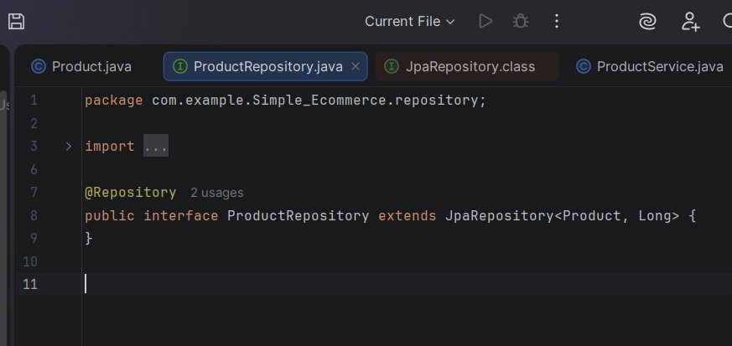
Repository Layer
ProductRepository extends JpaRepository.
Methods: save, findAll, findById, deleteById.

Slide 9
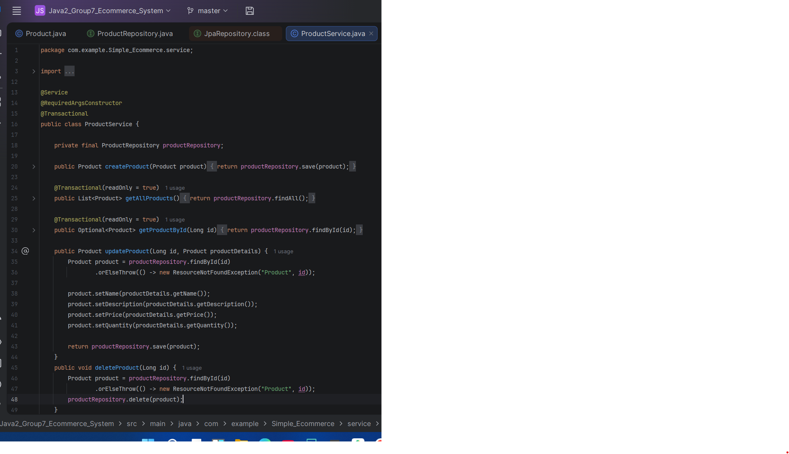
Service Layer
Business logic methods
createProduct
getAllProducts
getProductById
updateProduct
deleteProduct

Slide 10
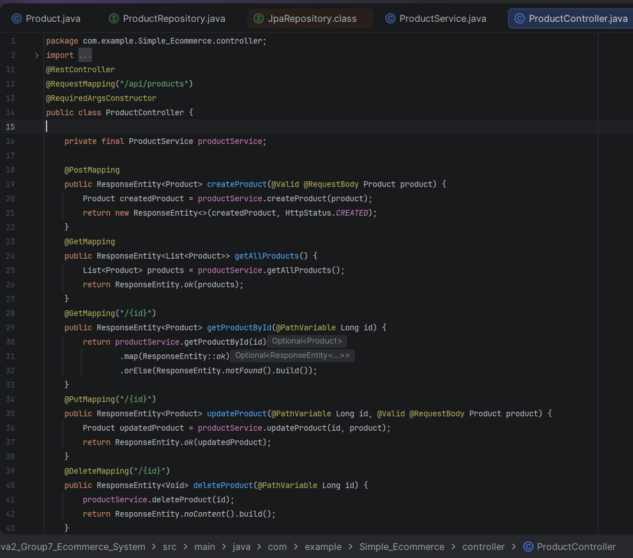
Controller Layer
@RestController
@RequestMapping
@PostMapping
@GetMapping
@PutMapping
@DeleteMapping

Slide 11
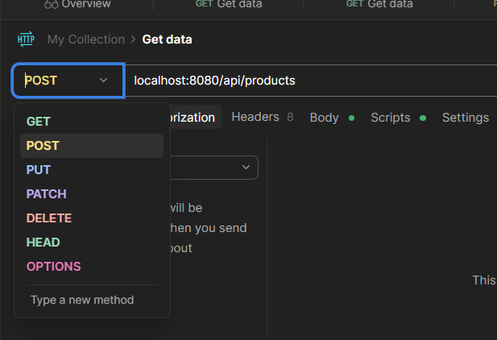
API Endpoints
Method | Endpoint
POST | /api/products
GET | /api/products
GET | /api/products/{id}
PUT | /api/products/{id}
DELETE | /api/products/{id}
Defult port URL http://localhost:8080/api/products http

Slide 12
HTTP Request Flow
Postman
Controller
Service
Response
Database
Repository

Slide 13
HTTP Status Codes
Codes
Meaning
200 OK
201 Created
204 No Content
404 Not Found
Request Successful
Resource Created
Successfully Deleted
Resource Missing

Slide 14
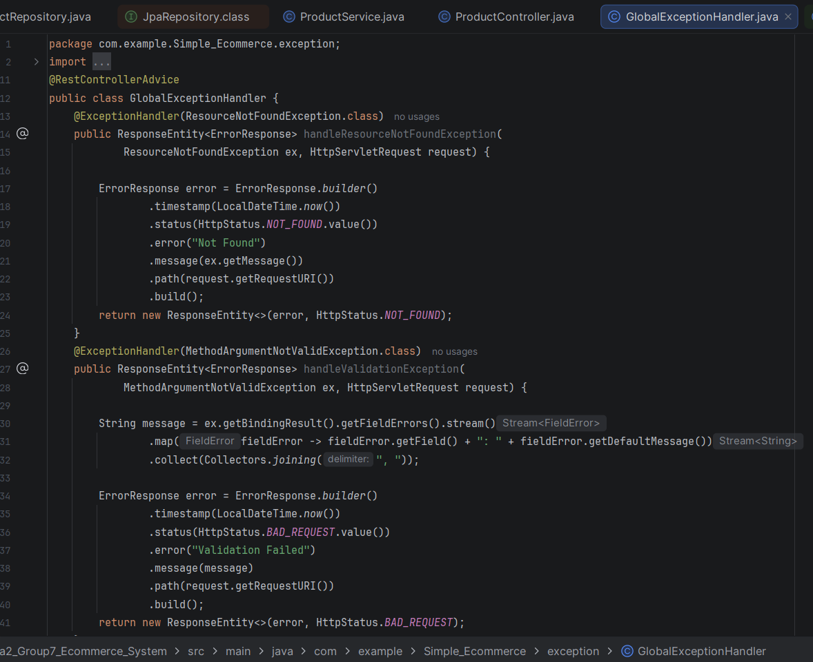
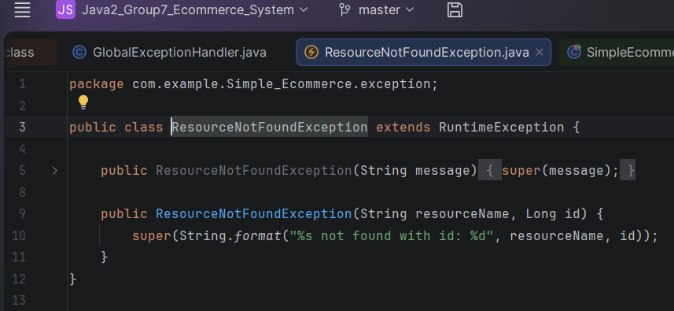
Exception Handling

Slide 15
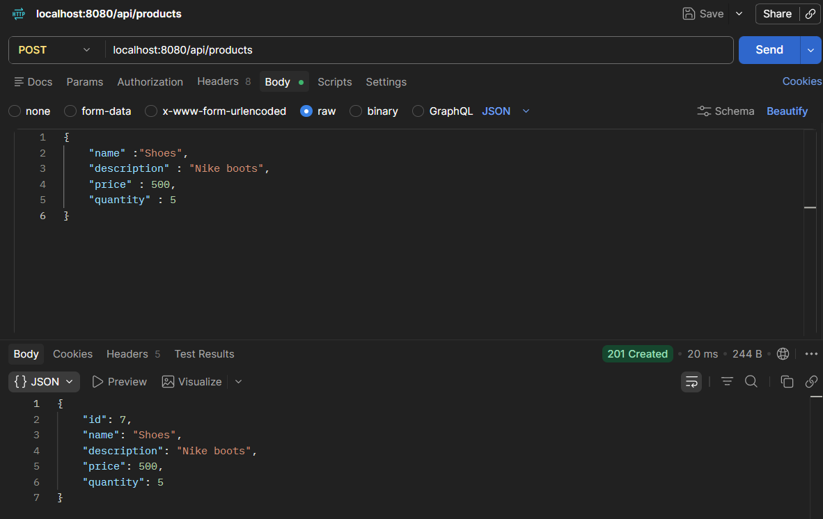
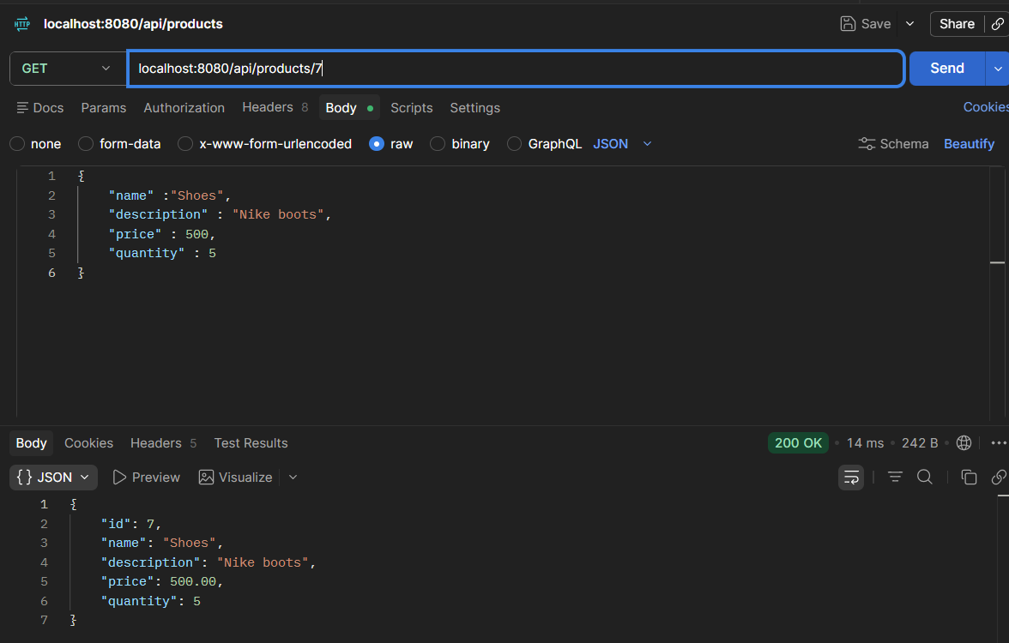
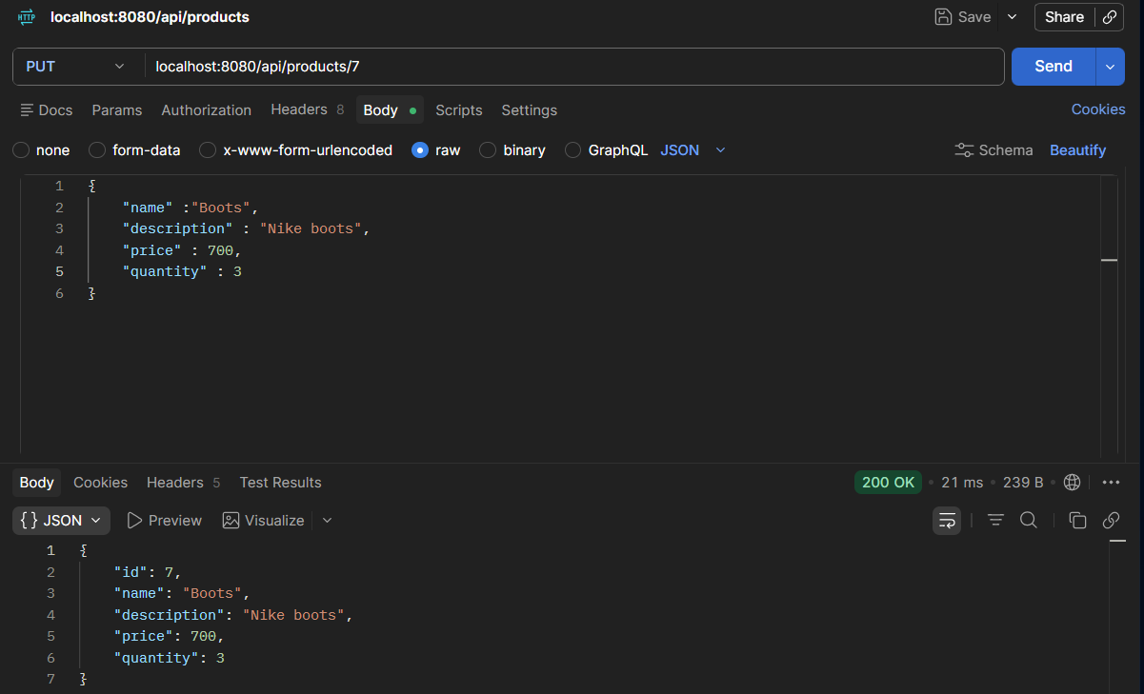
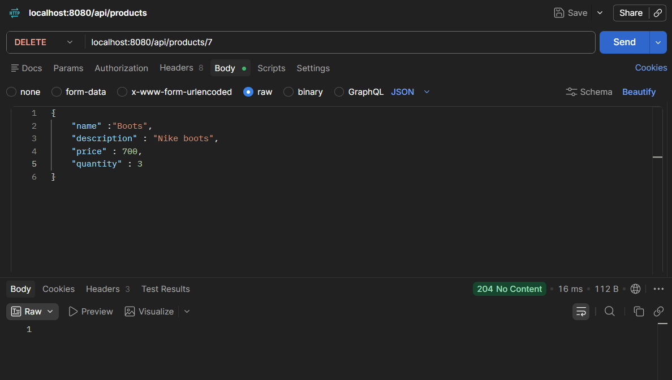
Application Workflow(Live Demo)
CRUD operations in Postman.

Slide 16
Challenges & Conclusion
Key Learning Points
Spring Boot architecture
REST APIs
JPA
CRUD Operations
GitHub
Future Improvements
User login
Authentication
Shopping Cart
Search and filter
Payment Integration
Order Management

Slide 17
Thank you

