Slide 1

Chart Audit Monthly Tracking Report
Data Month: October 2017

Slide 2


Slide 3
HCC: 1L New Patient Share
HCC
R2M
1L New Patient Share
Source: BMS Monthly Chart Audit, New patients, Weighted by Patient volume, Setting type and LOT size

Slide 4
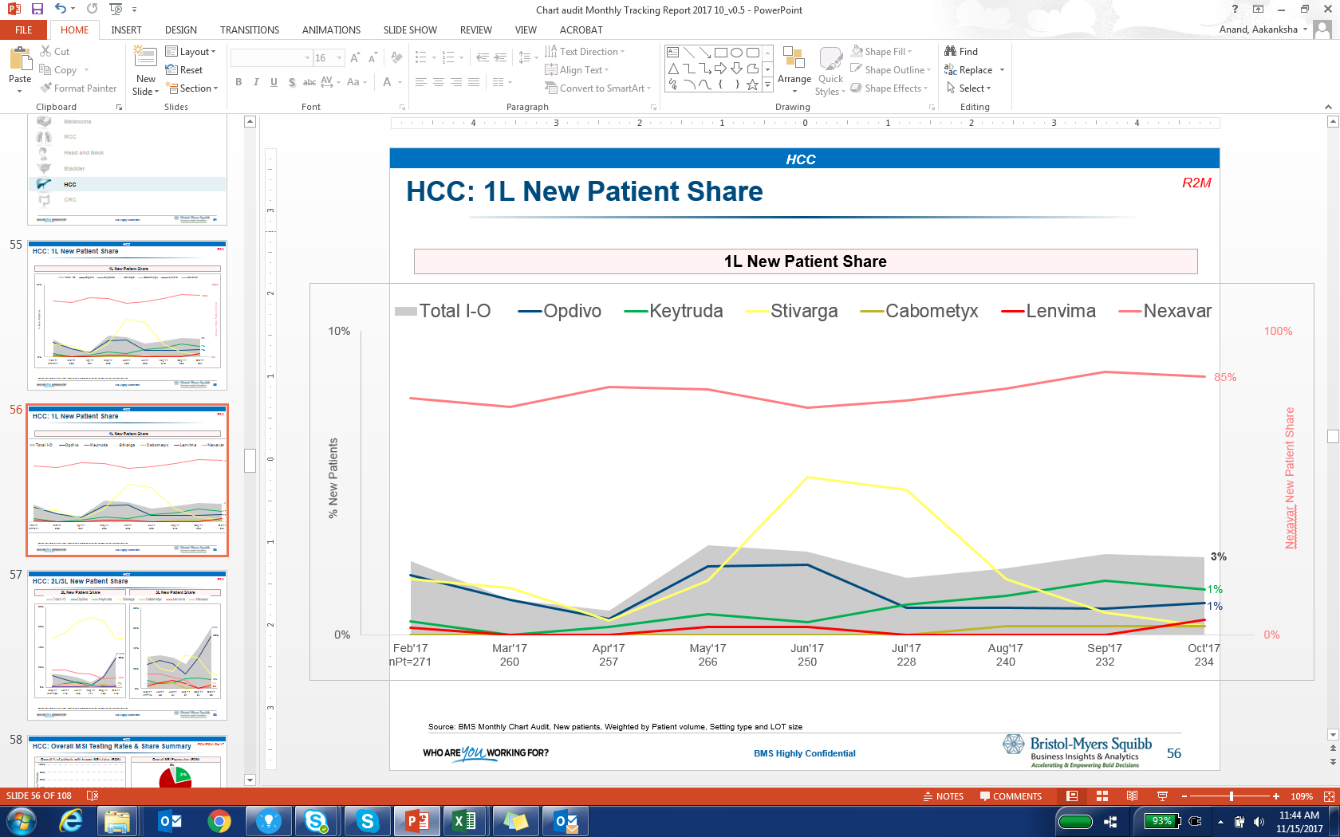
HCC: 2L/3L New Patient Share
HCC
R2M
2L New Patient Share
3L New Patient Share
Source: BMS Monthly Chart Audit, New patients, Weighted by Patient volume, Setting type and LOT size

Slide 5
HCC: Overall MSI Testing Rates & Share Summary
HCC
R2M/R3M- Oct’17
Overall % of patients with known MSI status (R2M)
Overall MSI Expression (R3M)
nPt=196
New Pt Share: MSI-High (R3M)
New Pt Share: MSI-Low/Stable (R3M)
New Pt Share : MSI Inc./UT (R3M)
*Low n- size
Source: BMS Monthly Chart Audit, New patients, Weighted by Patient volume, Setting type and LOT size

Slide 6
HCC: Overall PD-L1 Testing Rates & Share Summary
HCC
R2M/R3M- Oct’17
Overall % of patients with known PD-L1 status (R2M)
Overall PD-L1 Positivity (R2M)
nPt=120
New Pt Share: PD-L1 +ve (R3M)
New Pt Share: PD-L1 -ve (R3M)
New Pt Share : Inc./UT (R3M)
Source: BMS Monthly Chart Audit, New patients, Weighted by Patient volume, Setting type and LOT size

Slide 7
Appendix

Slide 8
HCC: 1L New Patient Share
HCC
Monthly
1L New Patient Share
Source: BMS Monthly Chart Audit, New patients, Weighted by Patient volume, Setting type and LOT size

Slide 9
HCC: 2L/3L New Patient Share
HCC
Monthly
2L New Patient Share
3L New Patient Share
Source: BMS Monthly Chart Audit, New patients, Weighted by Patient volume, Setting type and LOT size

