Slide 1
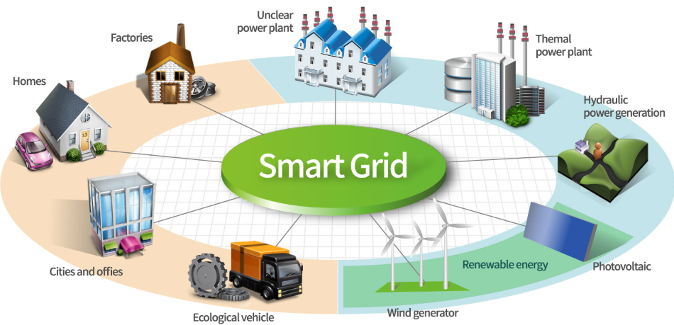
Smart grid in renewable energy system
Presented by:
Suchismita roy(1303124)
Anee pritam(1303128)
Oindrila mukherjee(1303129)
Debjit bhowmick(1303130)

Slide 2
What Is Smart Grid ?
Smart Grid :
“A Smart Grid is an electricity network that can intelligently integrate the actions of all users connected to it – generators, consumers and those that do both – in order to efficiently deliver sustainable, economic and secure electricity supplies.”
Includes:
Sensing
Embedded processing
Digital communications
Controllable (able to manipulated and optimised),
Automated (able to adapt and self-heal),
Fully integrated (fully interoperable with existing systems and with the capacity to incorporate a diverse set of energy sources).”

Slide 3
Difference Between Existing Grid And Smart Grid.
Existing Grid | Smart Grid
Electromechanical | Digital
One-way communication | Two-way communication
Centralized generation | Distributed generation
Few sensors | Sensors throughout
Manual monitoring | Self monitoring
Manual restoration | Self healing
Failures and blackouts | Adaptive and islanding
Limited control | Pervasive control
Few customer choices | Many customer choices

Slide 4
Renewable Energy Sources
Renewable energy sources are being developed in many countries
to reduce CO₂ emissions
provide sustainable electrical power.
The balance of particular technologies and their scale changes from country to country.
However, hydro, wind, biomass (solid biomass, bio liquids and biogas), tidal stream, and photovoltaic (PV) are common choices.
Generating electricity from renewable energy rather than fossil fuels offers significant public health benefits.
The air and water pollution emitted by coal and natural gas plants is linked to breathing problems, neurological damage, heart attacks, and cancer.

Slide 5
Integration Of Renewable Energy
GOAL: To advance system design, planning, and operation of the electric grid to:
Reduce carbon emissions through increased use of renewable energy
Increase asset use through integration of distributed systems and customer loads
Reduces peak load and thus lowers the cost of electricity.
Enhance reliability, security, and resiliency from microgrid applications in critical infrastructure protection and highly constrained areas of the electric grid.
Support reductions in oil use by enabling plug-in electric vehicle (PHEV) operations with the grid.

Slide 6
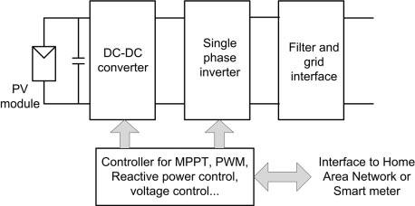
PV Power Generation

Slide 7
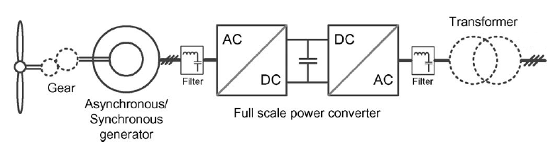
Wind Power Generation
Wind, hydro and tidal generation systems all involve converting the potential and/or kinetic energy in water or air into electrical energy.

Slide 8
Components of Smart Grid
1.Intelligent appliances
Used for reducing peak loads
2.Smart power meters
Features two-way communications between consumers and power providers to automate billing data collection
3.Smart substations
Monitors and controls the critical and non-critical operational data
4.Smart distribution
Used for self-healing, self-balancing and self-optimizing
5.Smart generation
Learns the unique behavior of power generation resources to optimize energy production
6.Universal access
Used for low-carbon electrical power generation

Slide 9
Smart Grid Technology
1. Integrated Communications
Includes data acquisition, protection, and control,
2. Sensing and Measurement technologies
Supports acquiring data to evaluate the health and integrity of the grid
Used to determine the electrical behaviour of the grid
3. Advanced Components
4. Advanced Control Methods
Are the devices and algorithms that will analyze, diagnose, and predict grid conditions
Converts complex power-system data into information that can be easily understood by grid operators.
5.Improved Interfaces and Decision Support

Slide 10
IMPLEMENTATION: AUTOMATIC POWER SWITCHING IN SMART GRID
Components Required
STEP DOWN TRANSFORMER 230/12 V
RECTIFIER AC-DC
VOLTAGE REGULATOR
MICRO-CONTROLLER
RELAY
16×2 LCD DISPLAY
BULB

Slide 11
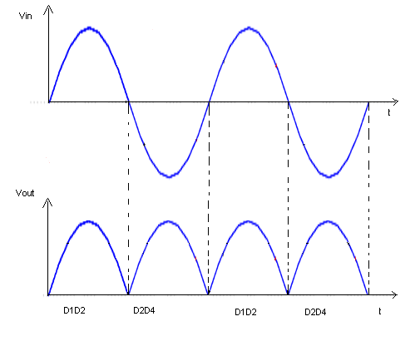
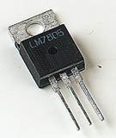
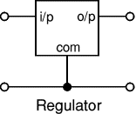
Full wave rectifier
Voltage regulator

Slide 12
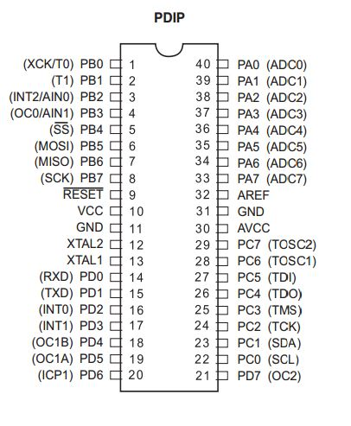
Atmega-16

Slide 13
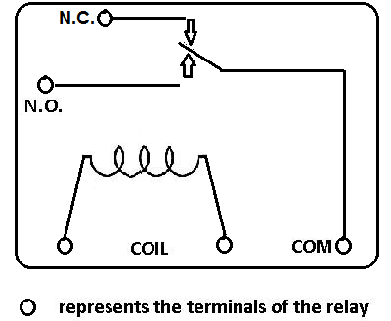
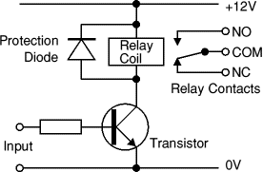
relay

Slide 14
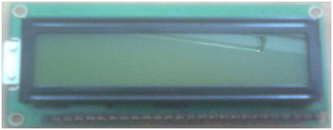
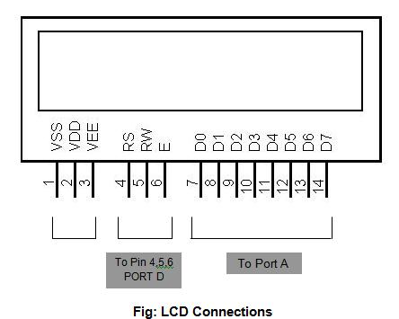
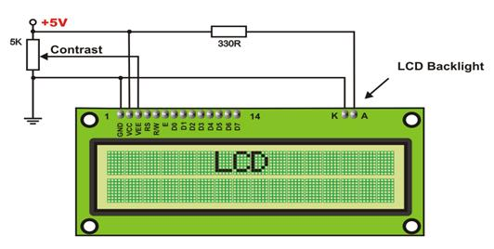
16x2 lcd

Slide 15
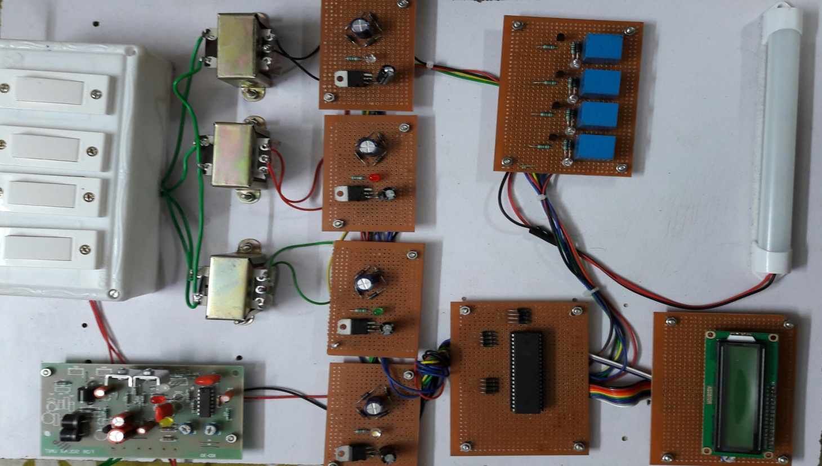
Automatic power switching model

Slide 16
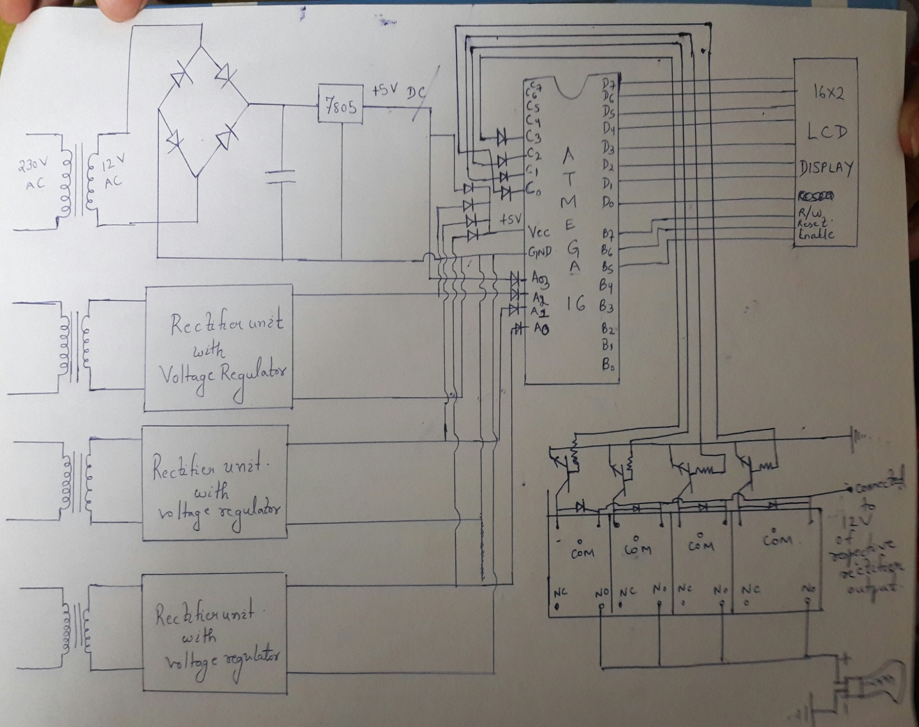
Circuit diagram

Slide 17
Challenges To Smart Grid
TECHNICAL CHALLENGES:
Managing variability and uncertainty during the continuous balancing of the system .
Balancing supply and demand during generation scarcity and surplus situations.
ECONOMIC, POLICY AND REGULATORY CHALLENGES:
Capital-intensive grid upgrades.
Uncertain RE project costs and cash flows.

Slide 18
Benefits Of Smart Grid
Future energy sustainability
Empowering grid in peak hours
Energy management
Independent systems
Upgrading Electrical market

Slide 19
FUTURE PROSPECTS
Many renewable energy systems have been installed over the years.
Countries are preferring smarter grids because of low carbon emission and automated control.
Countries like china, European Union, Japan, UK and USA have taken a lot of national initiatives for implementation of smart grid.
Many start-up companies have come up to modernize the present grid system of India.
India is planning $21.6 billion on smart grid infrastructure by 2025.
Power Grid Corporation of India has prepared report on overall distribution system improvement through smart grid technologies in Firozabad, Biduna, Shikohabad, Katra, Jammu-Gandhinagar, Baghat etc.
A lot of business opportunities could be facilitated by this.

Slide 20
CONCLUSION
Smart grid technology can control renewable resources to effect changes in the grid’s operating conditions and can provide additional benefits as distributed generation assets or when installed at the transmission level.
Distributed generation can support weak grids, adding grid voltage and improving power quality.
If harvested and taken care of control system,
“Renewable Resources will act as Smart Grid Assets.”

