Slide 1
Tic-Tac-Toe
Project Guide: Mrs.Bhavani
Tasleema-N130975
Reshma-N130954
Vennela-N130999
KrishnaTeja-N130252

Slide 2
Outline:
Introduction
Main Code
output

Slide 3
Introduction:
→Tic-Tac-Toe is a Paper and pencil game.
→Tic-Tac-Toe is a Game for two players which is simple to play.
→We’ve used JAVA to develop this game.
→Two different Tokens will be assigned for both players.
player1: X
player2: O
This game is designed in 3x3 matrix.
In this program there are two modes
Player Vs Player
Player Vs Computer

Slide 4
In this game the user can play against computer.
The computer makes a move based on the user’s move.
If three same symbols are matched horizontally , vertically or diagonally then the player wins.
If there is no possibility of winning for both players then the game is drawn.
We get the tokens(i.e., X or O) from the function and matches with the board.

Slide 5
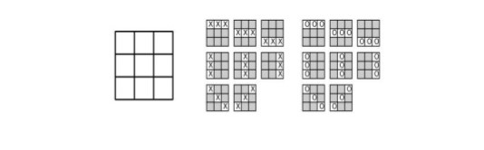
Winning Combinations in the game:

Slide 6
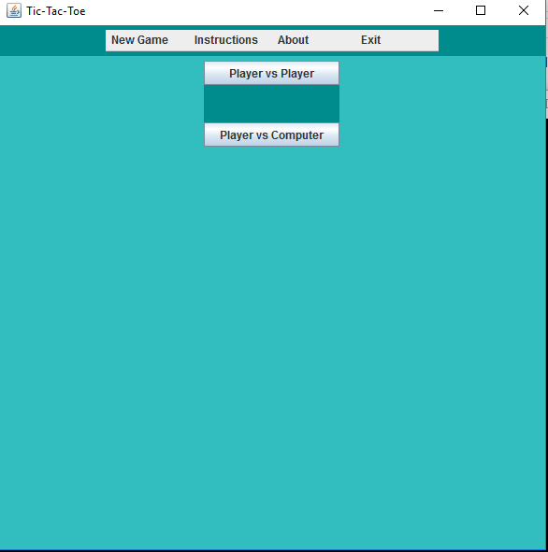

Slide 7
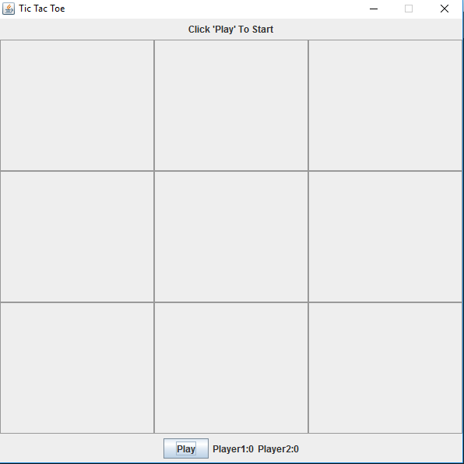

Slide 8
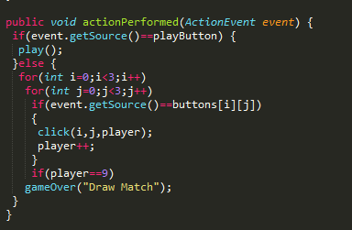
Player Vs Player
actionPerformed():
Here when the play button is clicked the game board will be activated.
When a move is placed on the board then the moves count will be incremented.
If moves count is incremented to 9 and no winning combination is found then the game will be draw.

Slide 9
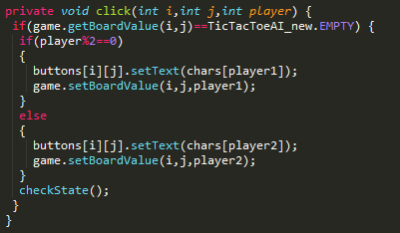
click():
In GUI we’re taking the input from the buttons but internally we’re maintaining a 3*3 matrix for the board.
Here we are displaying which player has taken the move and we are filling the clicked place with the token(X or O).

Slide 10
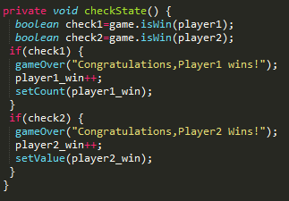
checkState():
In this function we will check whether player1 is win or player2 is win with the help of isWin() function.
We increment the count for every win of the player.

Slide 11
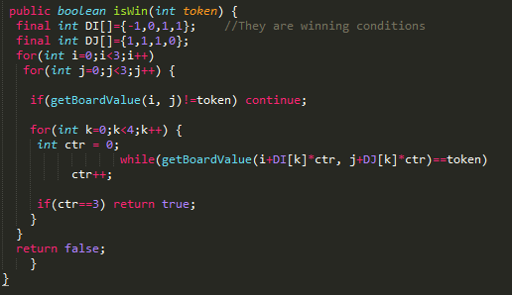
isWin():
In this we’ll check the winning combinations with the moves on the board.
It’ll also check whether the block is empty. If it is empty then we can place the token.

Slide 12
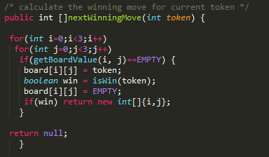
Player Vs Computer:-
nextWinningMove():
It checks whether the computer has any next winning move based on the player moves.

Slide 13
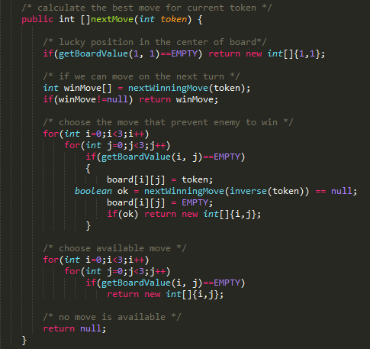
nextMove():
Here the computer checks whether the (1,1) position is free or not.
If (1,1) position is free then computer will fill that position with the related token.
Because the (1,1) position has the high possibilities to win.
If the (1,1) position is not free then the computer will select a move such that it has the priority to win.

Slide 14
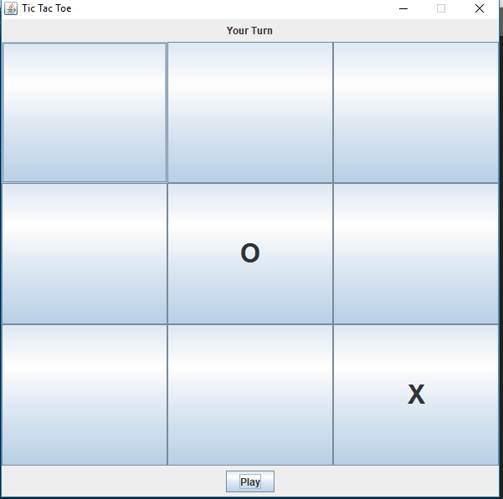

Slide 15
Conclusion
We made Tic-Tac-Toe game with the help of java language.
This game is very popular and entertaining.
Further we can develop this 3x3 game to nxn game.

Slide 16
References:
[1] Wikipedia
[2] Stack Overflow
[3] Object Oriented Programing (Black book) by Nageshwararao

Slide 17
Thank You

