Slide 1
3-1.
Answer the following questions:
(1) The following data fragment occurs in the middle of a data stream for which the byte-stuffing algorithm described in the text is used: A B ESC C ESC FLAG FLAG D. What is the output after stuffing?
(2) You receive the following data fragment: 0110 0111 1100 1111 0111 1101. You know that the protocol uses bit stuffing. Show the data after destuffing.
（1）After stuffing, we get A B ESC ESC C ESC ESC ESC FLAG ESC FLAG D.
（2）0110 0111 1101 1110 1111 11

Slide 2
3-2.
A 12-bit Hamming code whose hexadecimal value is 0xE4F arrives at a receiver. What was the original value in hexadecimal? Assume that not more than 1 bit is in error. (p.s.: number the bits from left to right starting at bit 1)
R1(1,3,5,7,9,11): 1+1+0+0+1+1=0
R2(2,3,6,7,10,11): 1+1+1+0+1+1=1
R4(4,5,6,7,12): 0+0+1+0+1=0
R8(8,9,10,11,12): 0+1+1+1+1=0
Syndrome: 0010,即第2位出错，应为1010 0100 1111 (0xA4F)，
初始传输的8bit数据为1010 1111 (0xAF)
1 | 2 | 3 | 4 | 5 | 6 | 7 | 8 | 9 | 10 | 11 | 12
1 | 1 | 1 | 0 | 0 | 1 | 0 | 0 | 1 | 1 | 1 | 1

Slide 3
3-3.
Suppose that a message 1001 1100 1010 0011 is transmitted using the Internet Checksum (4-bit word). What is the value of the checksum?
To obtain the checksum, we need to calculate the ones complement of the ones complement sum of the words.
The ones complement sum is same as sum modulo 2⁴ and adding any overflow of high order bits back into low-order bits:
0011 + 1010 = 1101
1101 + 1100 = 1001 + 1 = 1010
1010 + 1001 = 0011 + 1 = 0100.
So, the Internet checksum is the ones complement of 0100, namely 1011.

Slide 4
3-4.
A bit stream 10011101 is transmitted using the standard CRC method described in the text. The generator polynomial is x³ + 1. Show the actual bit string transmitted. Suppose that the third bit from the left is inverted during transmission. Show that this error is detected at the receiver’s end. Give an example of bit errors in the bit string transmitted that will not be detected by the receiver.
The frame is 10011101. The generator is 1001.
The message after appending three zeros is 10011101000.
The remainder on dividing 10011101000 by 1001 is 100.
So, the actual bit string transmitted is 10011101100.
The received bit stream with an error in the third bit from the left is 10111101100.
Dividing this by 1001 produces a remainder of 100, which is different from 0.
Thus, the receiver detects the error and can ask for a retransmission.
If the transmitted bit stream is converted to any multiple of 1001, the error will not be detected. A trivial example is if all ones in the bit stream are inverted to zeros.

Slide 5
3-5.
In the discussion of ARQ protocol in Section 3.3.3, a scenario was outlined that resulted in the receiver accepting two copies of the same frame due to a loss of acknowledgement frame. Is it possible that a receiver may accept multiple copies of the same frame when none of the frames (message or acknowledgement) are lost?
Yes, it is possible.
The reason is that an acknowledgement frame may arrive correctly, but after the sender’s timer has expired. This can happen if the receiver gets delayed in sending the acknowledgement frame, because its CPU is overloaded processing other jobs in the system.

Slide 6
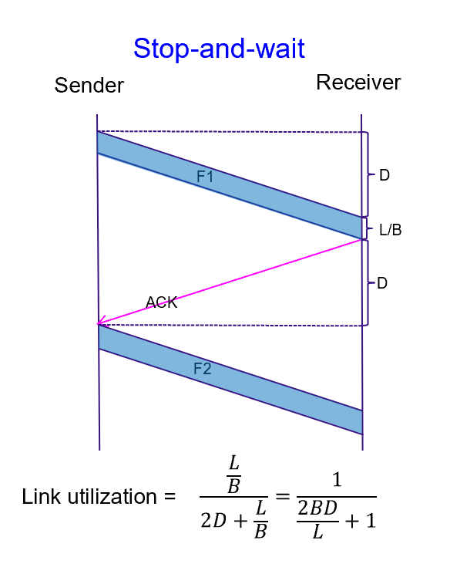
3-6.
A channel has a bit rate of 4 kbps and a propagation delay of 20 msec. For what range of frame sizes does stop-and-wait give an efficiency of at least 50%?
Efficiency will be 50% when the time required to transmit the frame equals the round-trip propagation delay.
At a transmission rate of 4 bits/msec, 160 bits takes 40 msec.
For frame sizes above 160 bits, stop-and-wait is reasonably efficient.

Slide 7
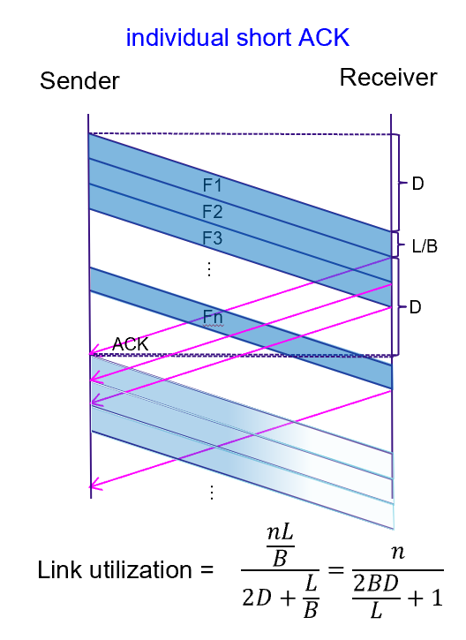
3-7.
A 3000-km-long T1 trunk is used to transmit 64-byte frames using protocol 5. If the propagation speed is 6 µsec / km, how many bits should the sequence numbers be?
To operate efficiently, the sequence space (actually, the sender’s window size) must be large enough to allow the transmitter to keep transmitting until the first acknowledgement has been received.
The propagation time is 18 ms.
At T1 speed, which is 1.536 Mbps (excluding the 1 header bit), a 64-byte frame takes 0.300 msec.(实际为0.333ms，此处为近似值）
The first frame fully arrives 18.3 msec after its transmission was started.
The acknowledgement takes another 18 msec to get back, plus a small (negligible) time for the acknowledgement to arrive fully.
In all, this time is 36.3 msec, so the transmitter needs to have enough window space to keep going for 36.3 msec.
A frame takes 0.3 ms, so it takes 121 frames to fill the pipe.
Seven-bit sequence numbers are needed.
另一种解法如下：
w = 2BDP/L+1，即2*1.536Mbps*18ms/64*8 +1=109
故需要7位序号
Notes:
如按照1.544Mbps计算也视为正确。

Slide 8
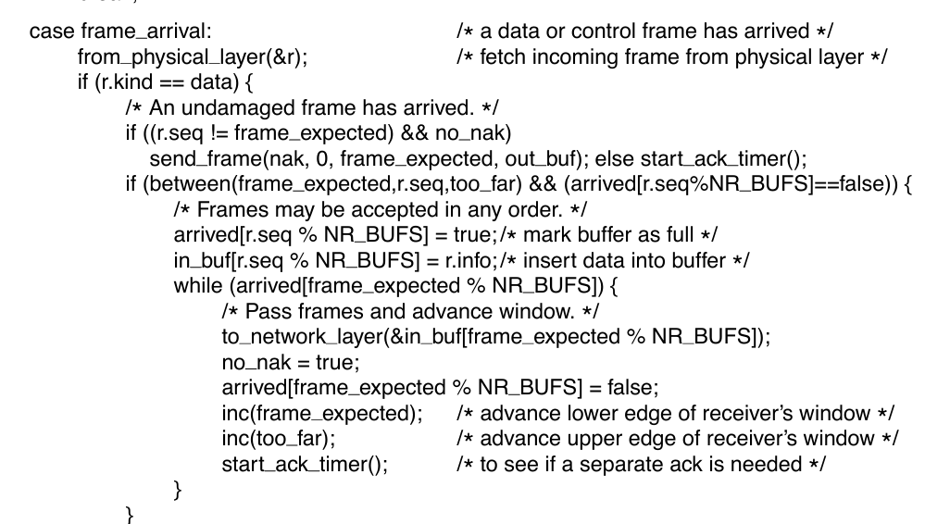
3-8.
In protocol 6, when a data frame arrives, a check is made to see if the sequence number differs from the one expected and no_nak is true. If both conditions hold, a NAK is sent. Otherwise, the auxiliary timer is started. Suppose that the else clause were omitted. Would this change affect the protocol’s correctness?
It would lead to deadlock because this is the only place that incoming acknowledgements are processed. Without this code, the sender would keep timing out and never make any progress.

Slide 9
3-9.
Frames of 1000 bits are sent over a 1-Mbps channel using a geostationary satellite whose propagation time from the earth is 270 msec. Acknowledgements are always piggybacked onto data frames. The headers are very short. Three-bit sequence numbers are used. What is the maximum achievable channel utilization for
(a) Stop-and-wait?
(b) Protocol 5?
(c) Protocol 6?
Let t = 0 denote the start of transmission. At t = 1 msec, the first frame has been fully transmitted. At t = 271 msec, the first frame has fully arrived. At t = 272 msec, the frame acknowledging the first one has been fully sent. At t = 542 msec, the acknowledgement-bearing frame has fully arrived. Thus, the cycle is 542 msec. A total of k frames are sent in 542 msec, for an efficiency of k/542. Hence, for
(a) k = 1, efficiency = 1/542 = 0.18%.
(b) k = 7, efficiency = 7/542 = 1.29%.
(c) k = 4, efficiency = 4/542 = 0.74%.

Slide 10
3-10.
Compute the fraction of the bandwidth that is wasted on overhead (headers and retransmissions) for protocol 6 on a heavily loaded 50-kbps satellite channel with data frames consisting of 40 header and 3960 data bits. Assume that the signal propagation time from the earth to the satellite is 270 msec. ACK frames never occur. NAK frames are 40 bits. The error rate for data frames is 1%, and the error rate for NAK frames is negligible. The sequence numbers are 8 bits.
With a 50-kbps channel, frames of 4000 bits and 8-bit sequence numbers, the pipe with a round-trip time of 540 msec is always full. The number of retransmissions per frame is about 0.01.
Each good frame wastes 40 header bits, plus 1% of 4000 bits (retransmission), plus a 40-bit NAK once every 100 frames. The total overhead is 80.4 bits per 3960 data bits, giving 80. 4/(3960 + 80. 4) = 1. 99%

