Slide 1
Homework-Ch6

Slide 2
6-1. In both parts of Fig. 6-6, there is a comment that the value of SERVER PORT must be the same in both client and server. Why is this so important?
If the client sends a packet to SERVER PORT and the server is not listening to that port, the packet will not be delivered to the server.

Slide 3
6-2. In the Internet File Server example (Figure 6-6), can the connect( ) system call on the client fail for any reason other than listen queue being full on the server? Assume that the network is perfect.
The connect( ) may fail if the server hasn’t yet executed its listen( ) call.

Slide 4
6-3. One criteria for deciding whether to have a server active all the time or have it start on demand using a process server is how frequently the service provided is used. Can you think of any other criteria for making this decision?
One other criteria is how the client is affected by extra delay involved in process server technique. The server for the requested service has to be loaded and probably has to be initialized before the client request can be serviced.

Slide 5
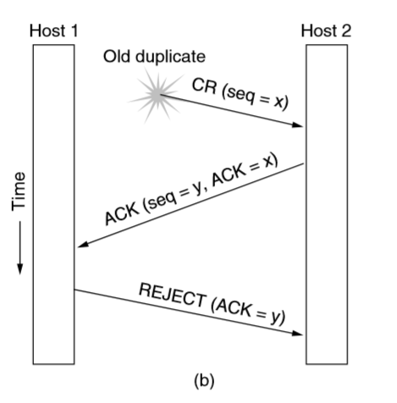
6-4. Why does the maximum packet lifetime, T, have to be large enough to ensure that not only the packet but also its acknowledgements have vanished?
Look at the second duplicate packet in Fig. 6-11(b).
When that packet arrives, it would be a disaster if acknowledgements to y were still ﬂoating around.

Slide 6
6-5. Discuss the advantages and disadvantages of credits versus sliding window protocols .
The sliding window is simpler, having only one set of parameters (the window edges) to manage. Furthermore, the problem of a window being increased and then decreased, with the segments arriving in the wrong order, does not occur.
However, the credit scheme is more ﬂexible, allowing a dynamic management of the buffering, separate from the acknowledgements.

Slide 7
6-6. Why does UDP exist? Would it not have been enough to just let user processes send raw IP packets?
No. IP packets contain IP addresses, which specify a destination machine. Once such a packet arrived, how would the network handler know which process to give it to?
UDP packets contain a destination port. This information is essential so they can be delivered to the correct process.

Slide 8
6-7. A process on host 1 has been assigned port p, and a process on host 2 has been assigned port q. Is it possible for there to be two or more TCP connections between these two ports at the same time?
No. A connection is identiﬁed only by its sockets. Thus, (1, p)–(2, q) is the only possible connection between those two ports.

Slide 9
6-8. Consider the effect of using slow start on a line with a 10-msec round-trip time and no congestion. The receive window is 24 KB and the maximum segment size is 2 KB. How long does it take before the first full window can be sent?
The ﬁrst bursts contain 2K, 4K, 8K, and 16K bytes, respectively. The next one is 24 KB and occurs after 40 msec.

Slide 10
6-9. Consider a connection that uses TCP Reno. The connection has an initial congestion window size of 1 KB, and an initial threshold of 64. Assume that additive increase uses a step-size of 1 KB. What is the size of the congestion window in transmission round 8, if the first transmission round is number 0?
Slow start reaches 64 KB in round 6. Additive increase is then used twice, increasing the window to 66 in round 8.

Slide 11
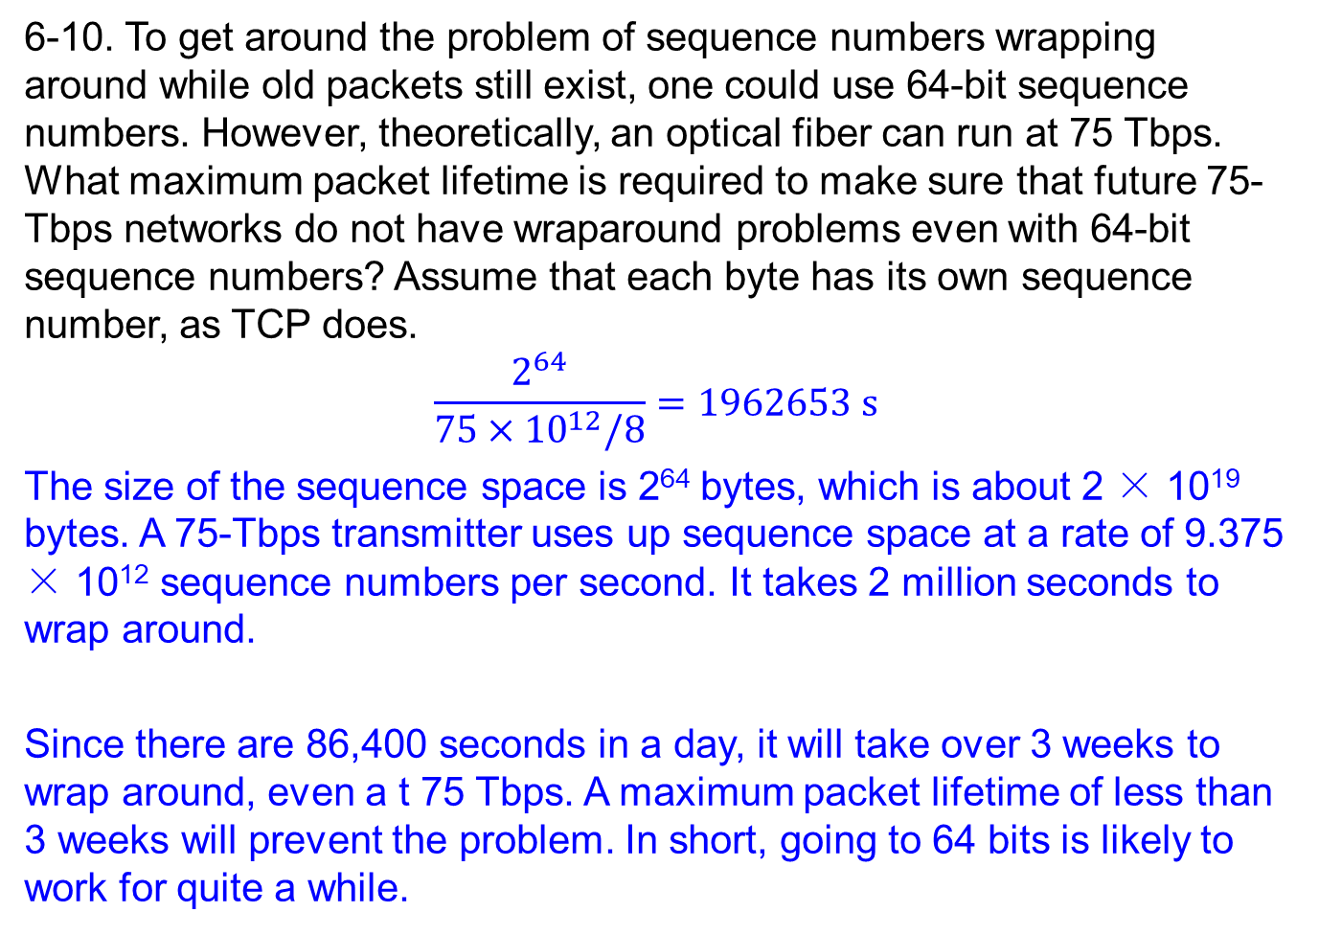
6-10. To get around the problem of sequence numbers wrapping around while old packets still exist, one could use 64-bit sequence numbers. However, theoretically, an optical fiber can run at 75 Tbps. What maximum packet lifetime is required to make sure that future 75-Tbps networks do not have wraparound problems even with 64-bit sequence numbers? Assume that each byte has its own sequence number, as TCP does.
$$\frac{2^{64}}{75×{10}^{12}/8}=1962653 s$$
The size of the sequence space is 2⁶⁴ bytes, which is about 2 × 10¹⁹ bytes. A 75-Tbps transmitter uses up sequence space at a rate of 9.375 × 10¹² sequence numbers per second. It takes 2 million seconds to wrap around.
Since there are 86,400 seconds in a day, it will take over 3 weeks to wrap around, even a t 75 Tbps. A maximum packet lifetime of less than 3 weeks will prevent the problem. In short, going to 64 bits is likely to work for quite a while.

Slide 12
End

