Slide 1
Lock-based Concurrency Control
SEI.ECNU

Slide 2
Concurrency Control
A database must provide a mechanism that will allow txns to access a database in a multi-programmed fashion while preserving the illusion that each of them is executing alone on a dedicated system.
serializable, recoverable and preferably cascadeless
A policy in which only one transaction can execute at a time generates serial schedules, but provides a poor degree of concurrency. Why?
Goal – to develop concurrency control protocols that will assure serializability.

Slide 3
Concurrency Control Schemes
Two-Phase Locking (2PL)
Assume txns will conflict so they must acquire locks on database objects before they are allowed to access them.
Timestamp Ordering (T/O)
Assume that conflicts are rare so txns do not need to first acquire locks on database objects and instead check for conflicts at commit time.

Slide 4
Lock-Based Protocols
A lock is a mechanism to control concurrent access to a data item
Data items can be locked in two modes :
1. exclusive (X) mode. Data item can be both read as well as
written. X-lock is requested using lock-X instruction.
2. shared (S) mode. Data item can only be read. S-lock is
requested using lock-S instruction.
Lock requests are made to concurrency-control manager.
Transaction can proceed only after request is granted.
Lock-Compatibility Matrix

Slide 5
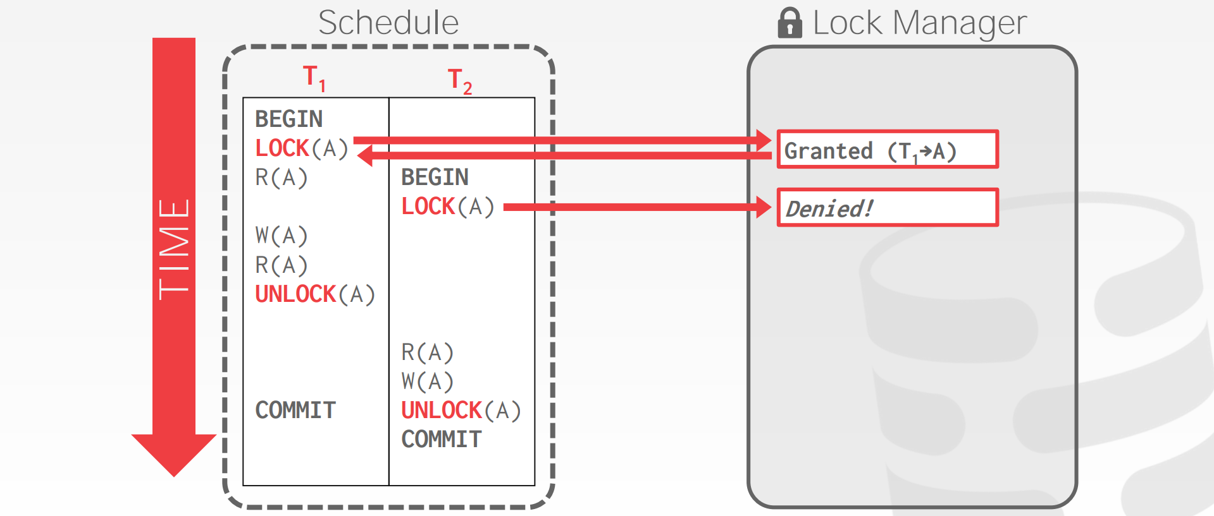
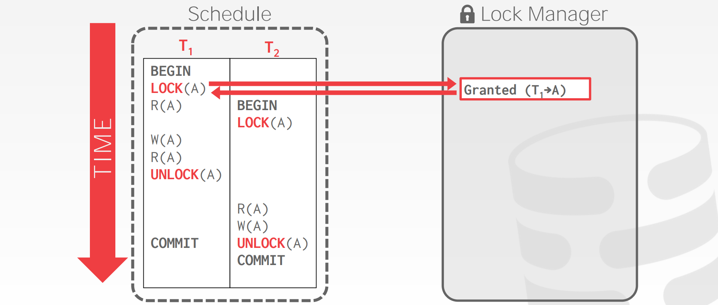
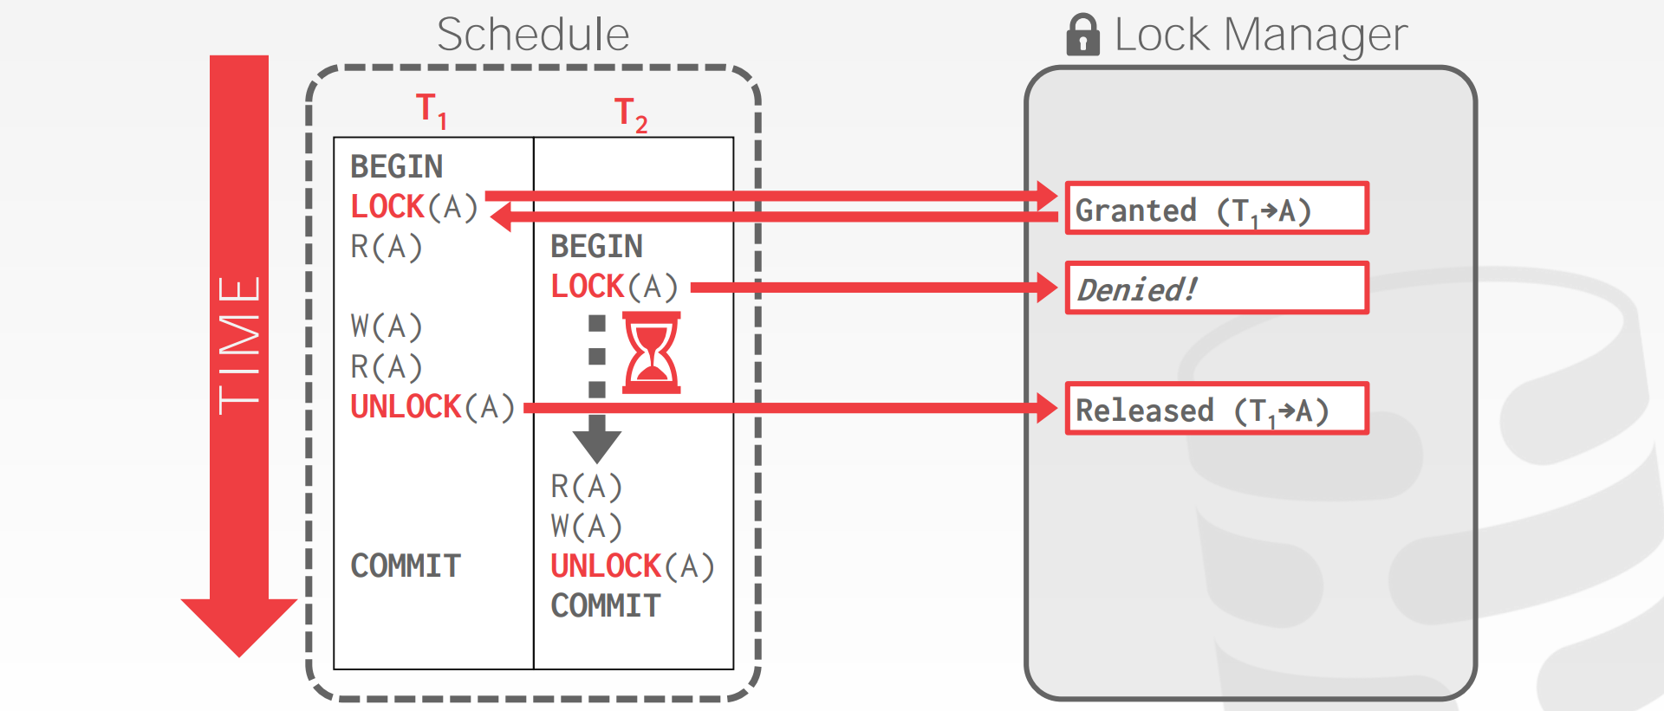
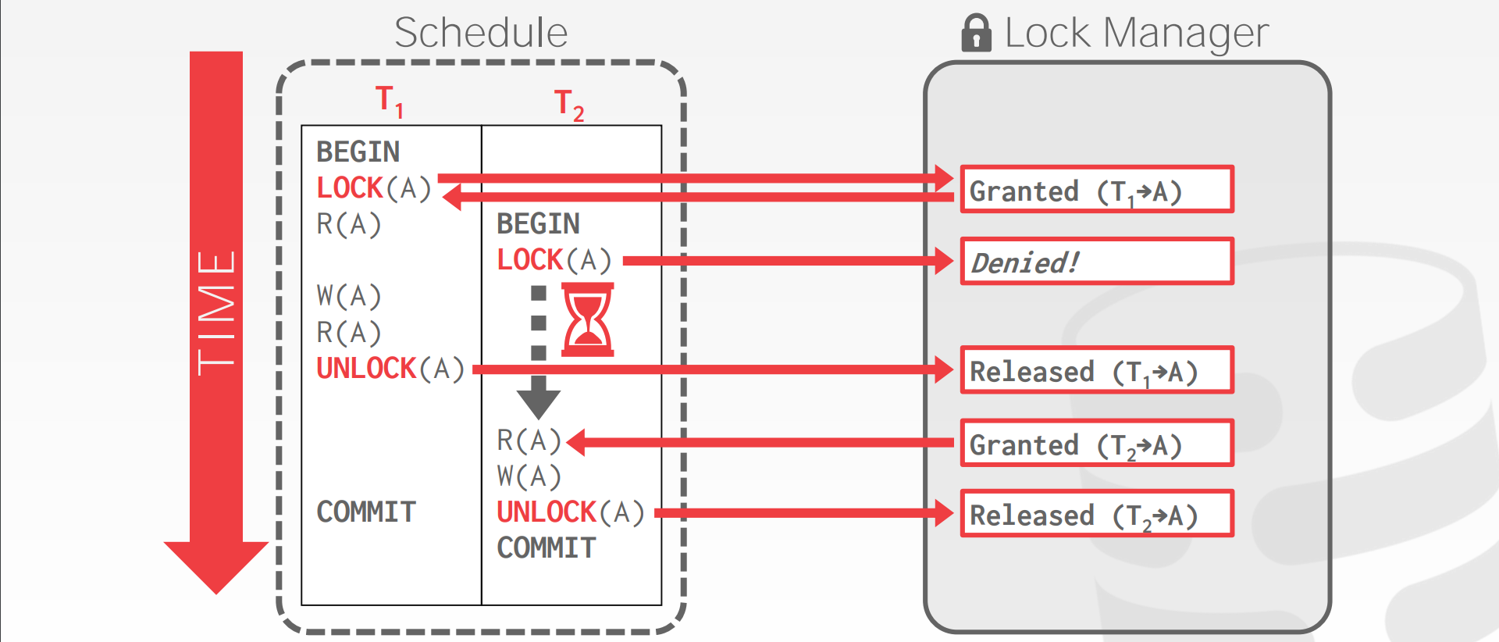
Executing with Locks

Slide 6
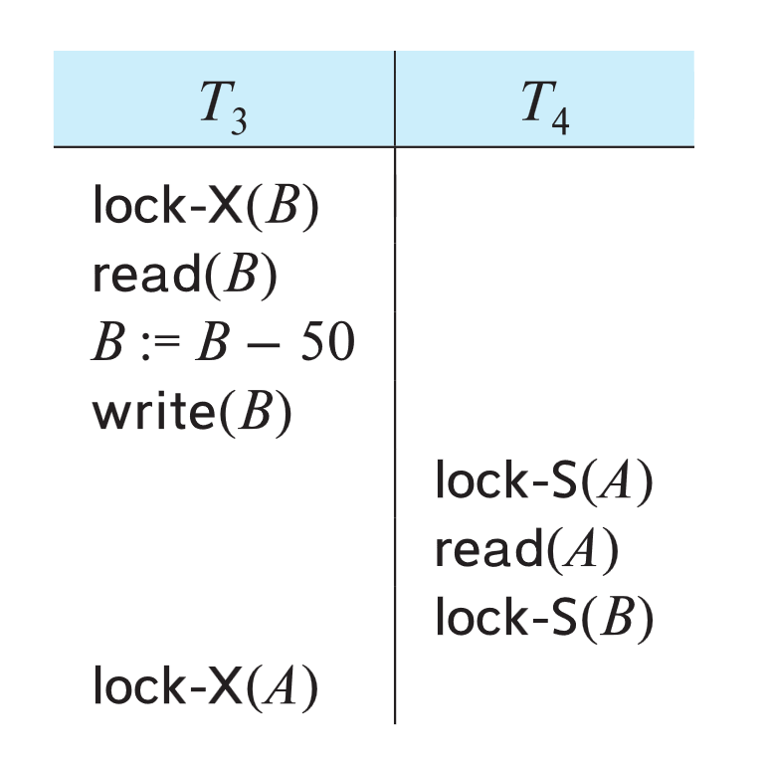
Deadlock
Neither T₃ nor T₄ can make progress
Executing lock-S(B) causes T₄ to wait for T₃ to release its lock on B
Executing lock-X(A) causes T₃ to wait for T₄ to release its lock on A.
Such a situation is called a deadlock
One of T₃ or T₄ must be rolled back and its locks released.
Starvation is also possible if concurrency control manager is badly designed

Slide 7
Two-Phase Locking
A protocol which ensures conflict-serializable schedules.
Phase 1: Growing Phase
Transaction may obtain locks
Transaction may not release locks
Phase 2: Shrinking Phase
Transaction may release locks
Transaction may not obtain locks
2PL is sufficient to guarantee conflict serializability.
It can be proved that the transactions can be serialized in the order of their lock points (i.e., the point where a transaction acquired its final lock).

Slide 8
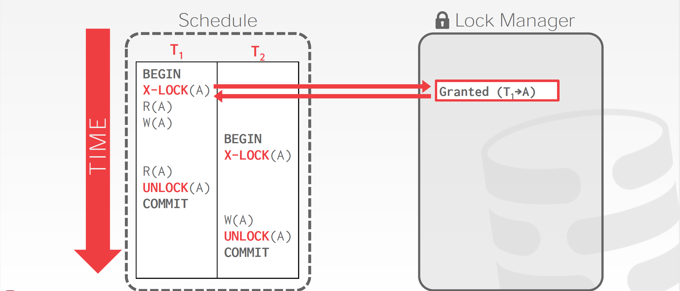
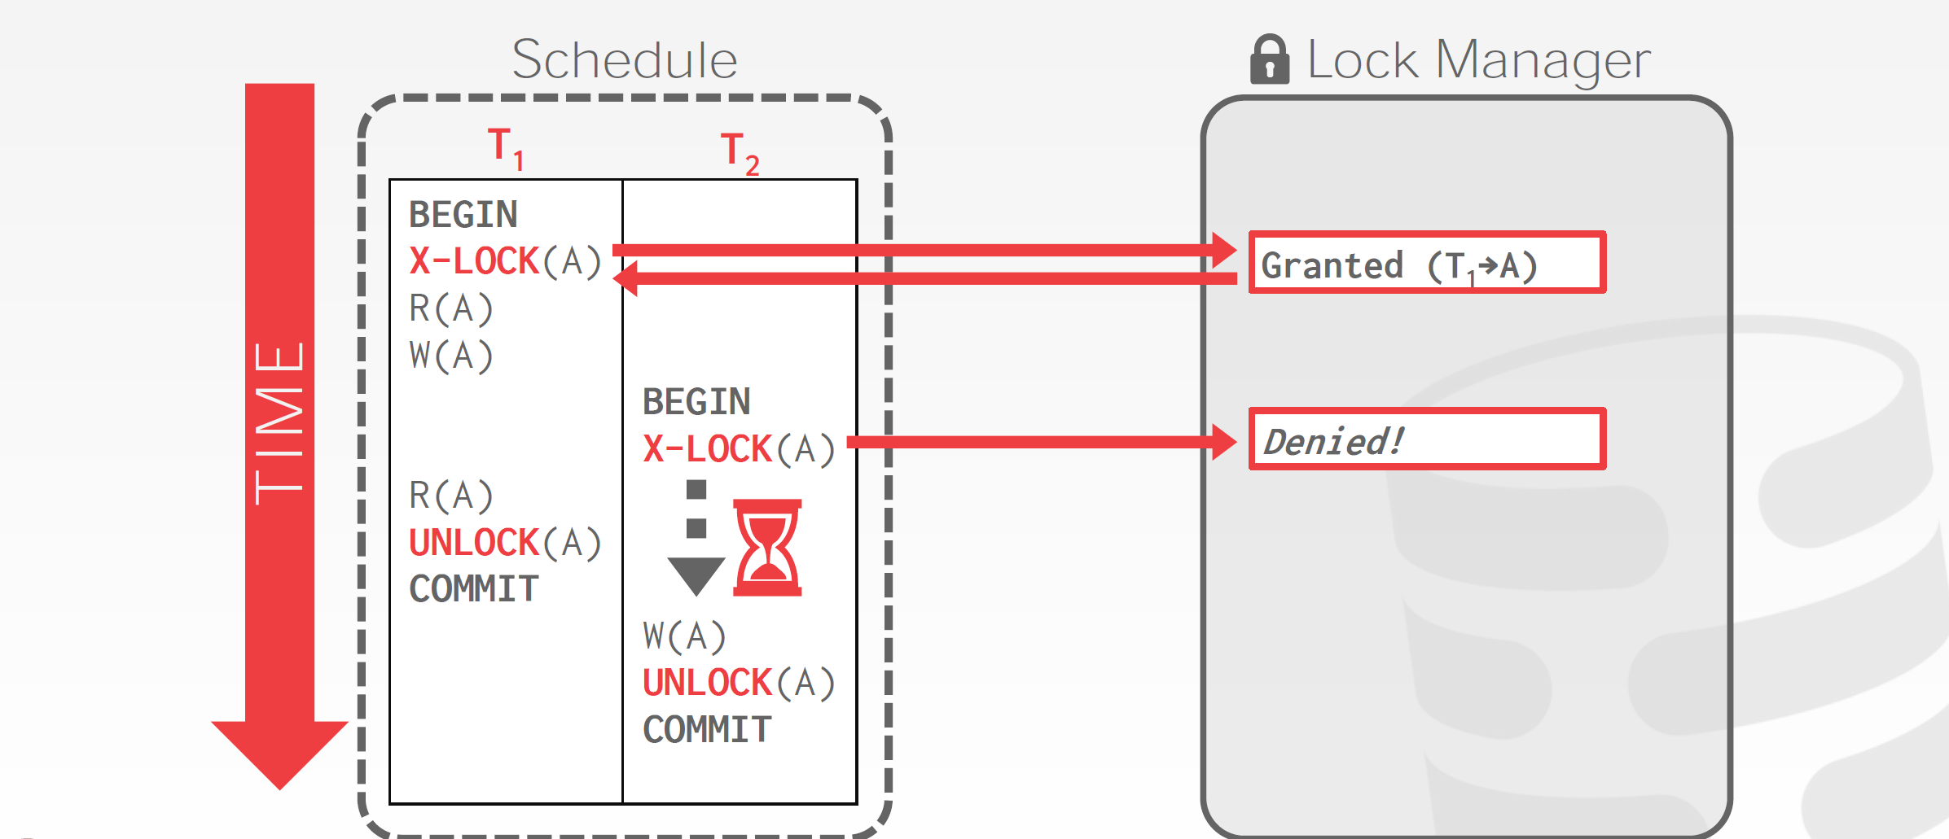
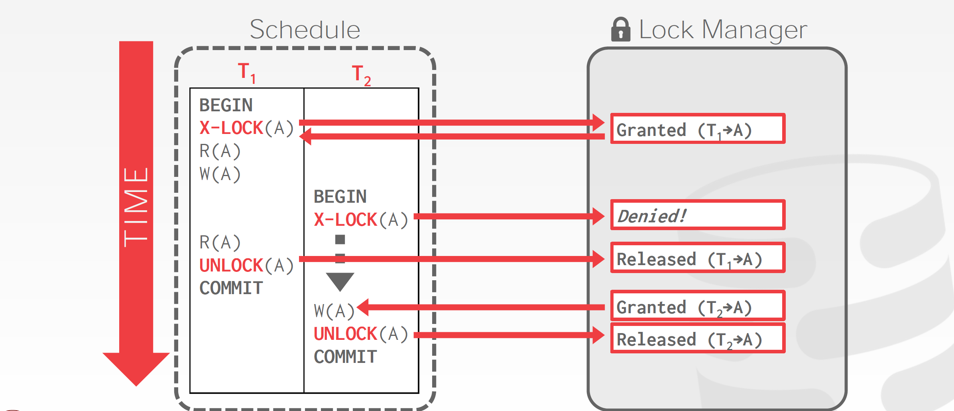
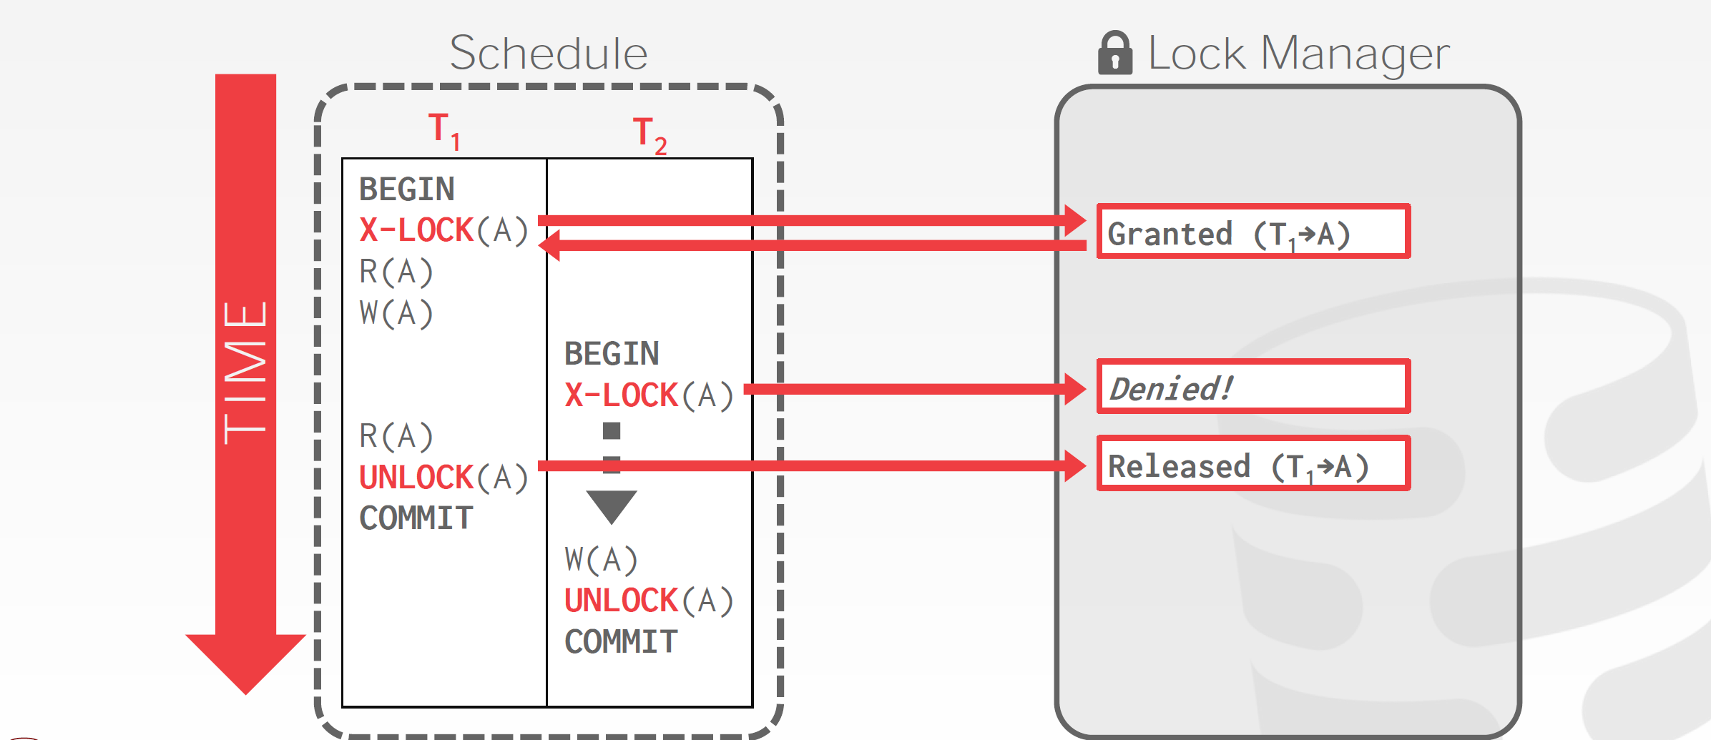
Executing with 2PL

Slide 9
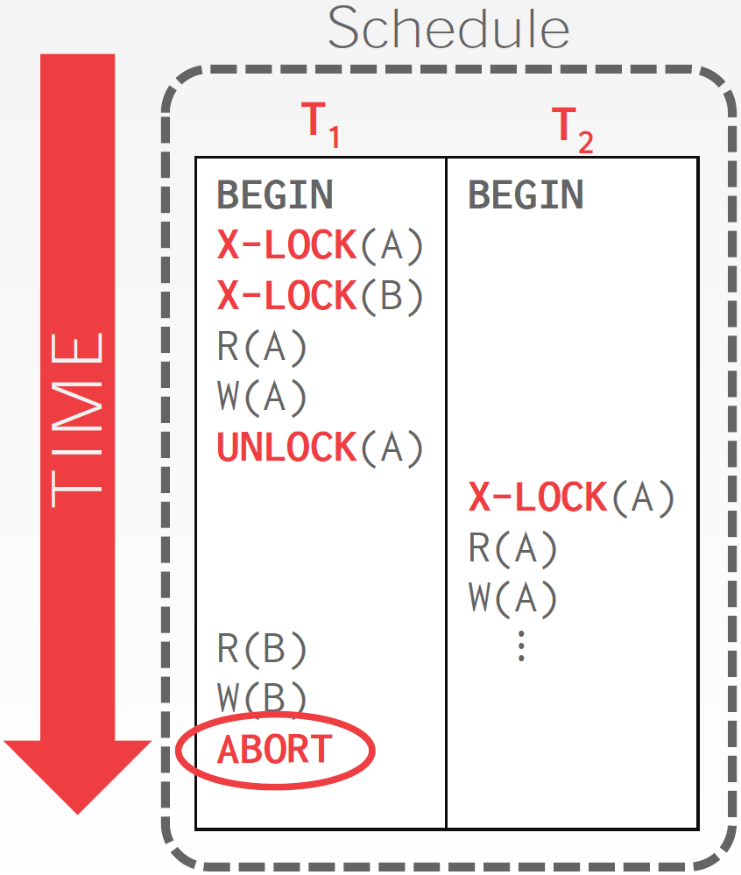
2PL – Cascading Aborts
This is a permissible schedule in 2PL, but the DBMS has to also abort T₂ when T₁ aborts.
Any information about T₁ cannot be "leaked" to the outside world.

Slide 10
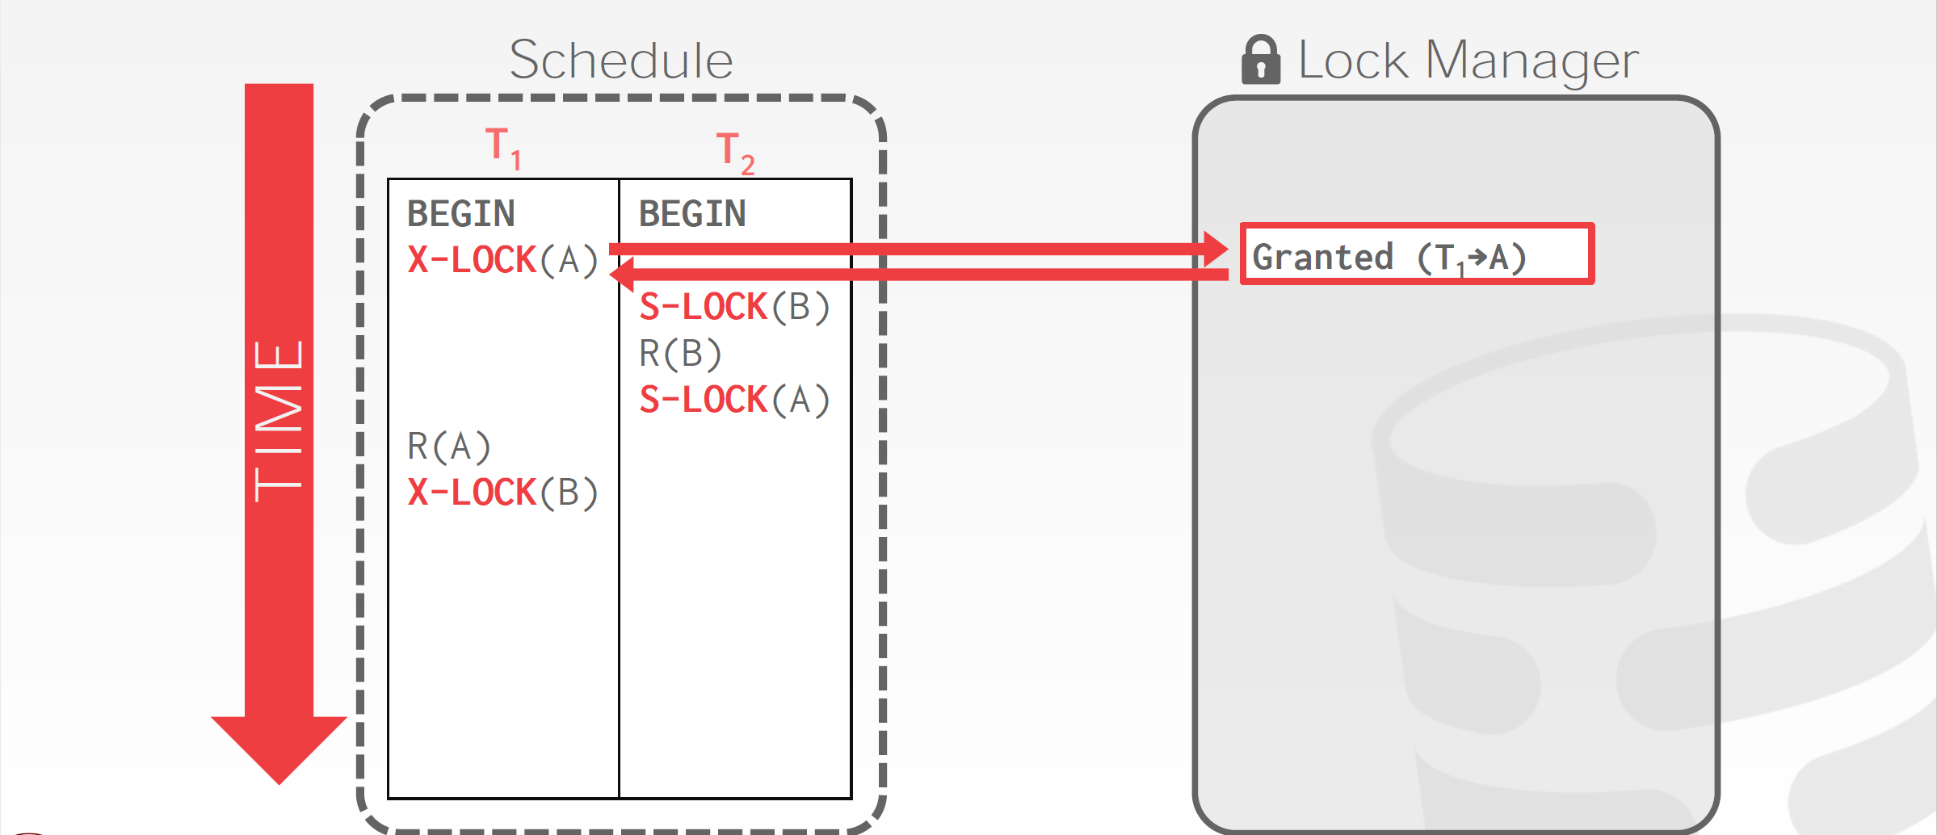
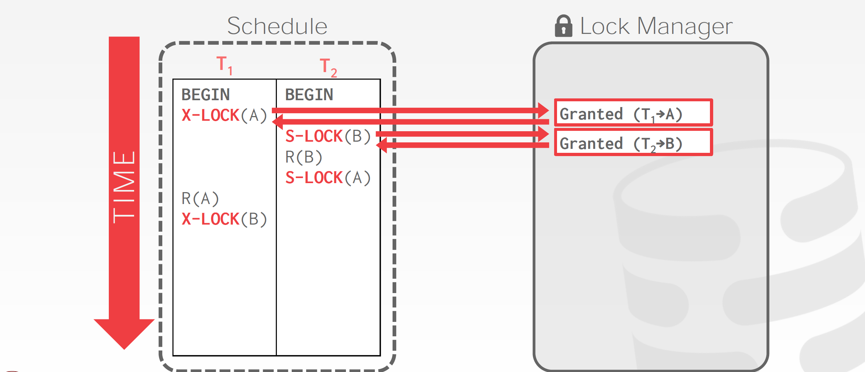
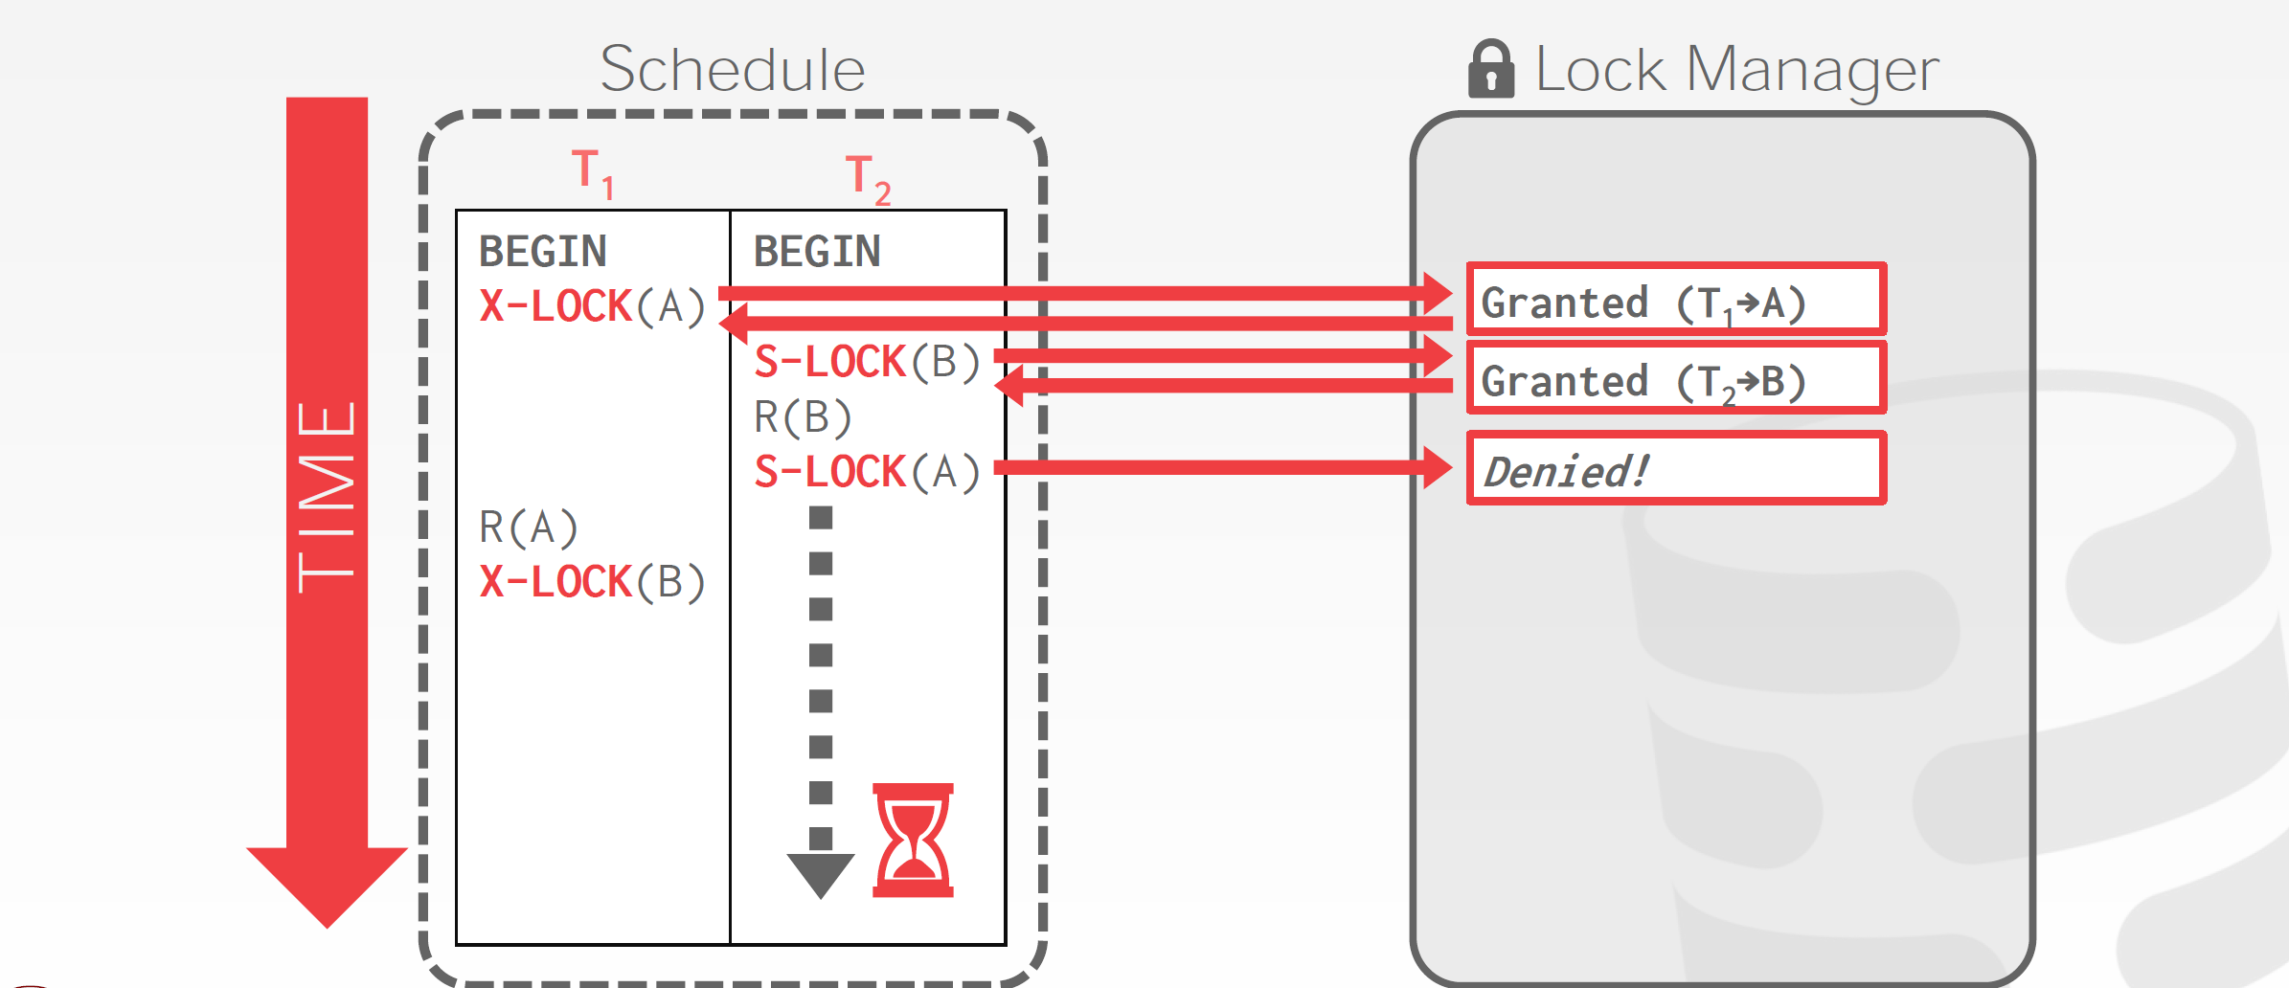
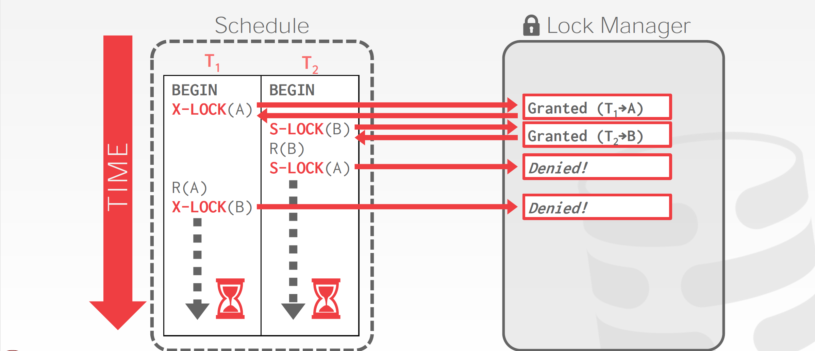
2PL – Deadlocks

Slide 11
Extensions to 2PL
2PL does not ensure freedom from cascading roll-back and deadlocks
Extensions to basic 2PL
Strict 2PL: a transaction must hold all its exclusive locks till it commits/aborts.
Ensures recoverability and avoids cascading roll-backs
Rigorous (Strong Strict) 2PL: a transaction must hold all locks till commit/abort.
Transactions can be serialized in the order in which they commit.
Most databases implement rigorous 2PL, but refer to it as 2PL

Slide 12
Lock Conversions
Two-phase locking protocol with lock conversions:
– Growing Phase:
can acquire a lock-S on item
can acquire a lock-X on item
can convert a lock-S to a lock-X (upgrade)
– Shrinking Phase:
can release a lock-S
can release a lock-X
can convert a lock-X to a lock-S (downgrade)
This protocol ensures serializability

Slide 13
Automatic Acquisition of Locks
A transaction T_{i} issues the standard read/write instruction, without explicit locking calls.
The operation read(D) is processed as:
if T_{i} has a lock on D
then read(D)
else begin
if necessary wait until no other transaction has a lock-X on D
grant T_{i} a lock-S on D;
read(D)
end

Slide 14
Automatic Acquisition of Locks
All locks are released after commit or abort
The operation write(D) is processed as:
if T_{i} has a lock-X on D
then write(D)
else begin
if necessary wait until no other trans. has any lock on D,
if T_{i} has a lock-S on D
then upgrade lock on D to lock-X
else grant T_{i} a lock-X on D
write(D)
end;

Slide 15
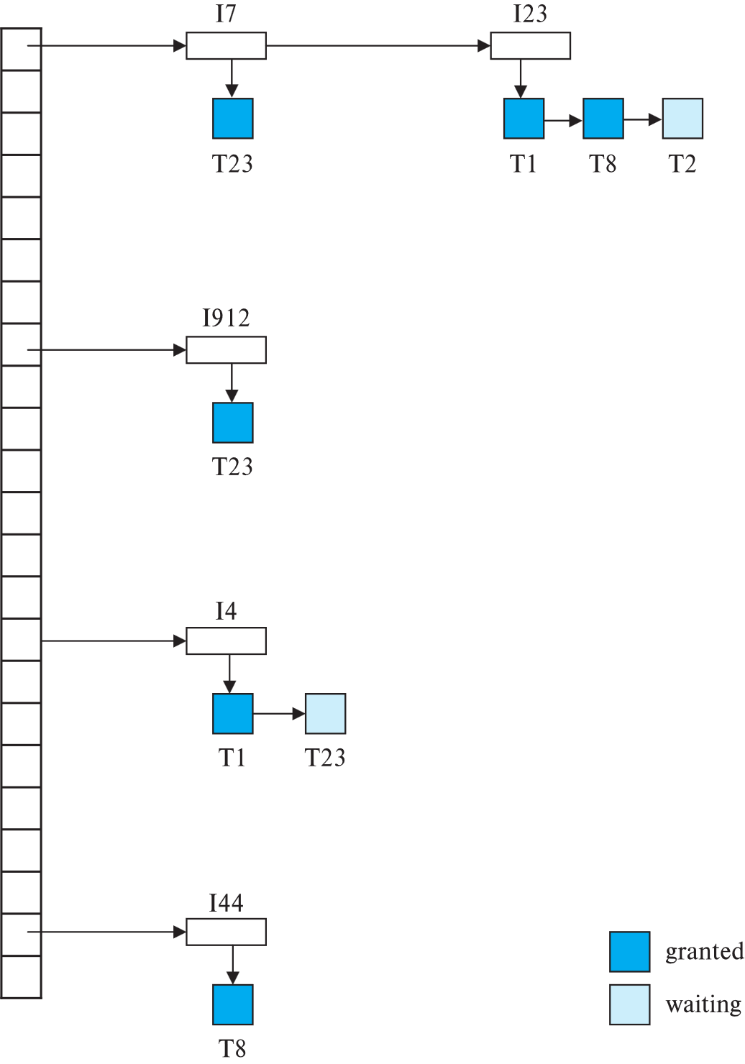
Lock Table
The lock manager maintains an in-memory data-structure called a lock table to record granted locks and pending requests
Txns can send lock and unlock requests to LM
The LM replies to a lock request by sending a lock grant messages (or a message asking the transaction to roll back, in case of a deadlock)
The LM may keep a list of locks held by each transaction

Slide 16
Graph-Based Protocols
An alternative to two-phase locking
Impose a partial ordering on the dataset
The tree-protocol is a simple kind of graph protocol
Ensures conflict serializability as well as freedom from deadlock
Unlocking may occur earlier
Does not guarantee recoverability or cascade freedom
Need to introduce commit dependencies
Have to lock data items that they do not access

Slide 17
Dealing with Deadlocks
Approach #1: Deadlock Detection
The DBMS creates a waits-for graph to keep track of what locks each txn is waiting to acquire:
Nodes are transactions
Edge from T_{i} to T_{j} if T_{i} is waiting for T_{j} to release a lock.
The system periodically checks for cycles in waits-for graph and then decides how to break it.
Approach #2: Deadlock Prevention
When a txn tries to acquire a lock that is held by another txn, the DBMS kills one of them to prevent a deadlock.

Slide 18
Deadlock Detection
Wait-for graph without a cycle
Wait-for graph with a cycle

Slide 19
Deadlock Prevention
wait-die scheme
Older transaction may wait for younger one to release data item.
Younger transactions never wait for older ones; they are rolled back instead.
A transaction may die several times before acquiring a lock
wound-wait scheme
Older transaction forces younger transaction rollback of instead of waiting
Younger transactions may wait for older ones.
Fewer rollbacks than wait-die scheme.
In both schemes, a rolled back transactions is restarted with its original timestamp.

Slide 20
Timeout-Based Schemes
A transaction waits for a lock only for a specified amount of time.
After that, the wait times out and the transaction is rolled back.
Ensures that deadlocks get resolved by timeout if they occur
Simple to implement
But may roll back transaction unnecessarily in absence of deadlock
Difficult to determine good value of the timeout interval.
Starvation is also possible

Slide 21
Deadlock Recovery
Some transaction will have to rolled back (victim) to break deadlock cycle.
Select that transaction as victim that will incur minimum cost
Rollback -- determine how far to roll back transaction
Total rollback: Abort the transaction and then restart it.
Partial rollback: Roll back victim transaction only as far as necessary to release locks that another transaction in cycle is waiting for
Starvation can happen (why?)
One solution: oldest transaction in the deadlock set is never chosen as victim

Slide 22
Multiple Granularity
Granularity of locking (level in tree where locking is done):
Fine granularity (lower in tree): high concurrency, high locking overhead
Coarse granularity (higher in tree): low locking overhead, low concurrency
database
area
file
record

Slide 23
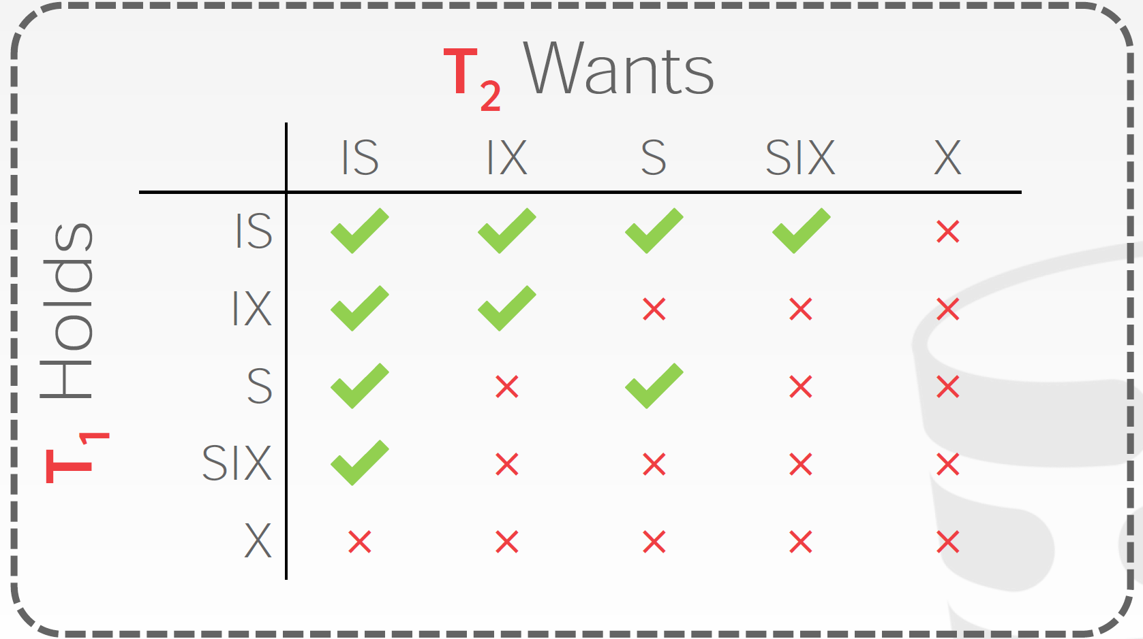
Lock Granularity
Allow data items to be of various sizes and define a hierarchy of data granularities, where the small granularities are nested within larger ones
Intention-Shared (IS): Indicates explicit locking at a lower level with shared locks.
Intention-Exclusive (IX): Indicates locking at lower level with exclusive or shared locks.
Shared+Intention-Exclusive (SIX): The subtree rooted by that node is locked explicitly in shared mode and explicit locking is being done at a lower level with exclusive-mode locks.

Slide 24
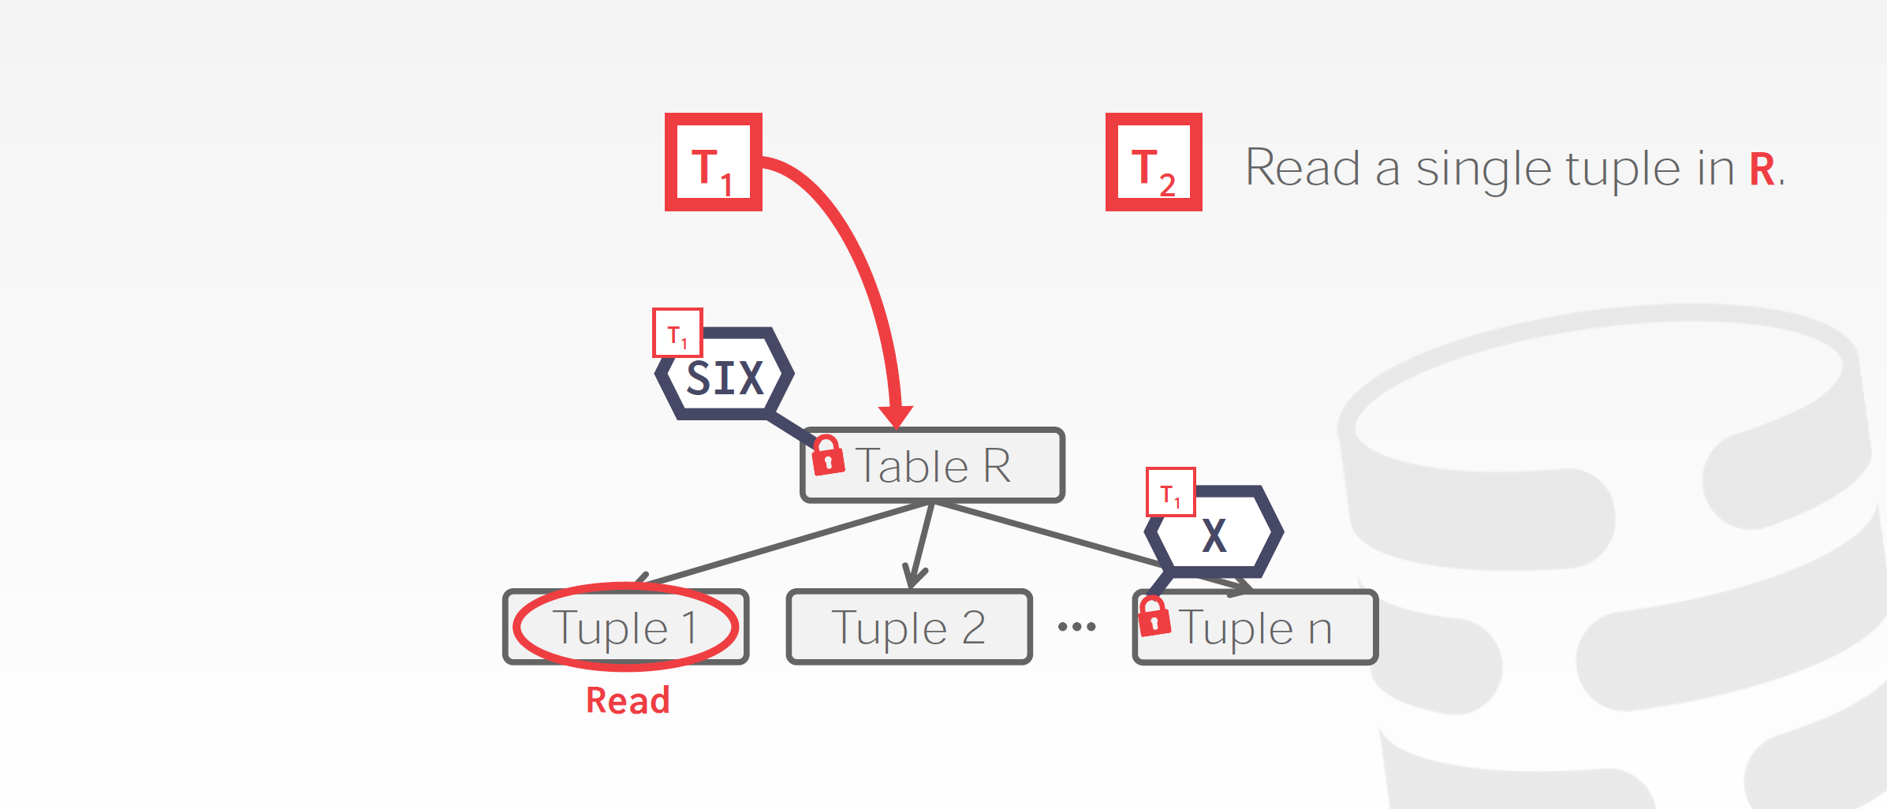
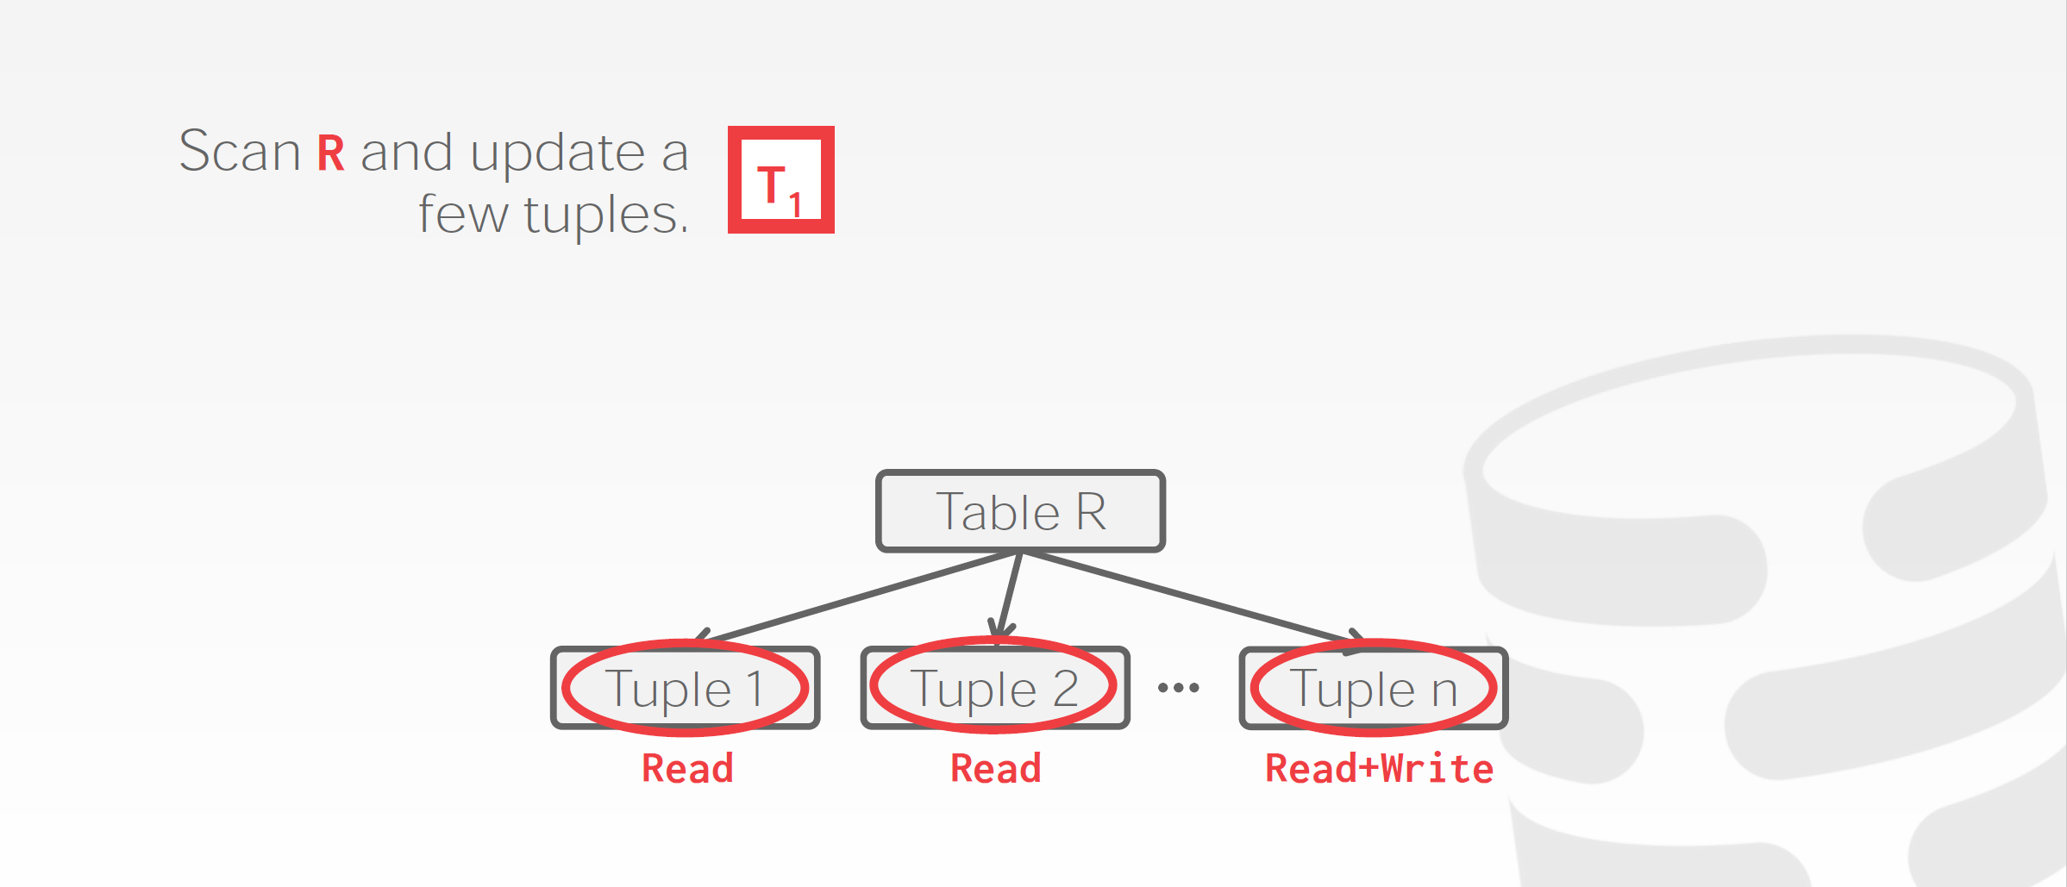
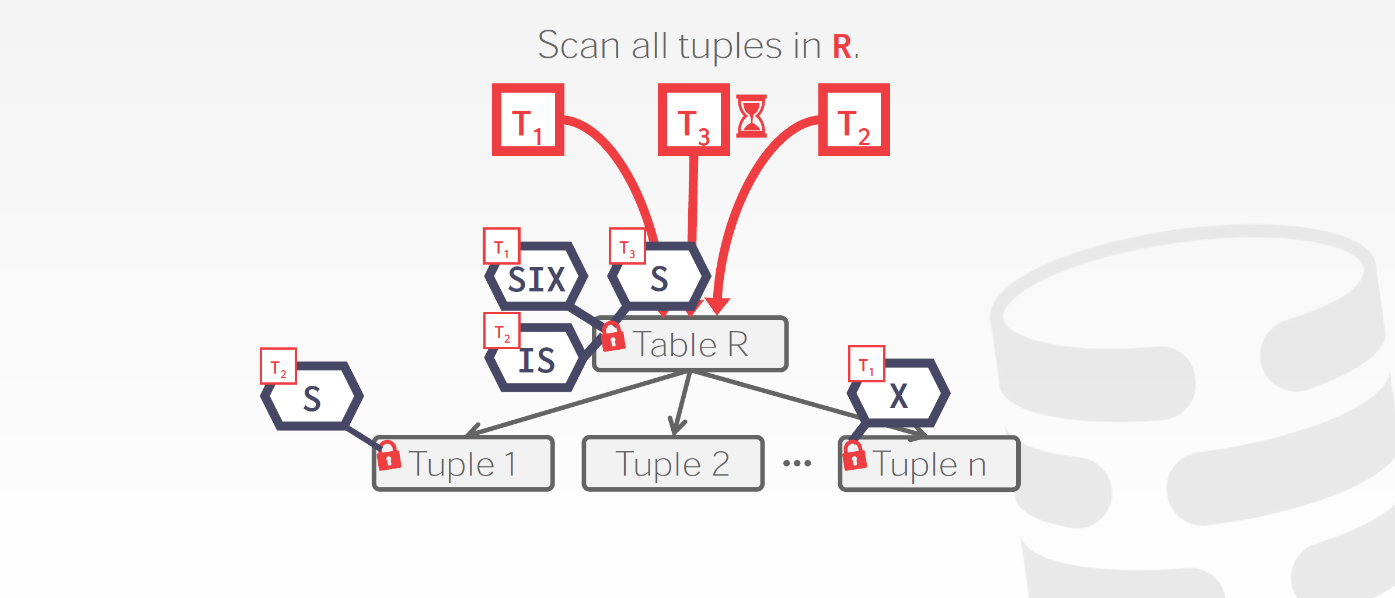
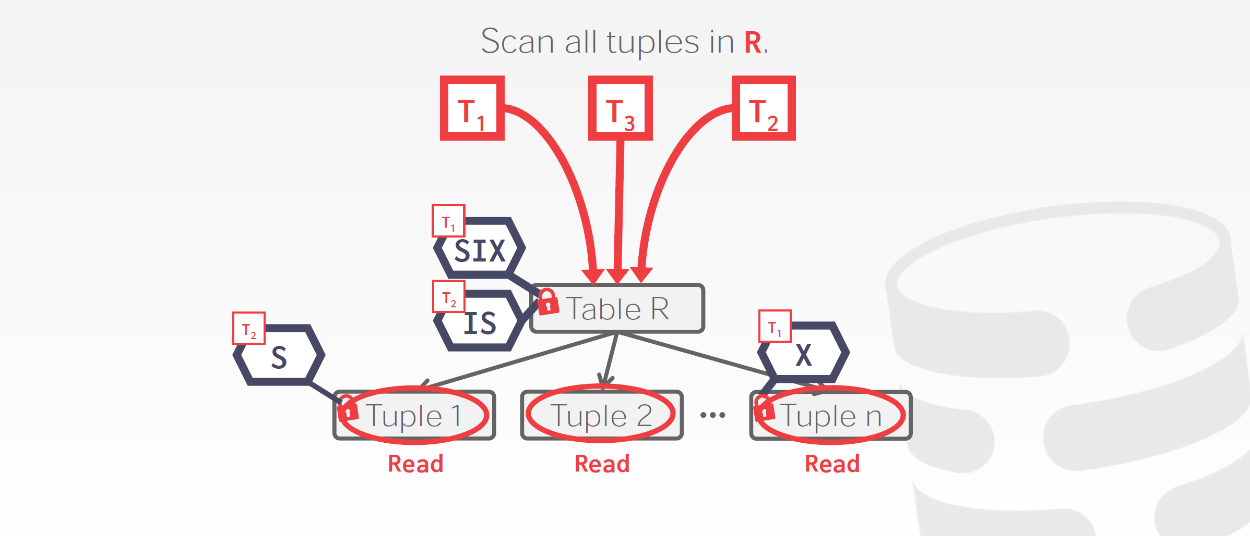
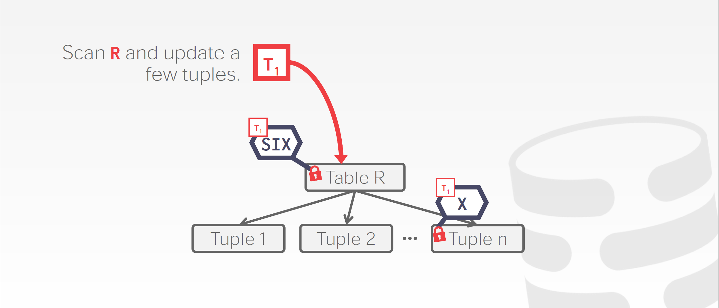
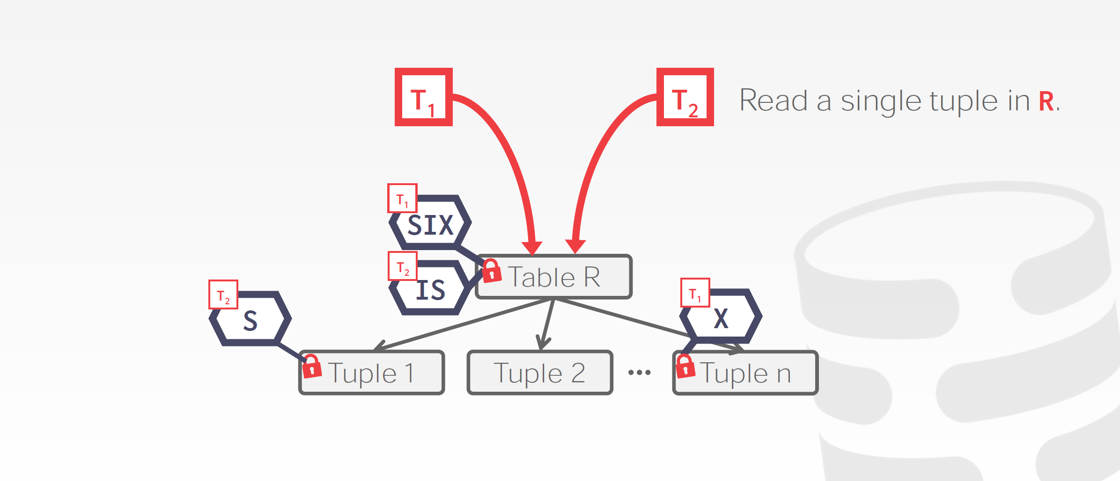
Example

Slide 25
Insert/Delete Operations
Locking rules for insert/delete operations
An X-mode lock must be obtained on an item before it is deleted
A transaction that inserts a new tuple into the database automatically given an X-mode lock on the tuple
Ensures that
reads/writes conflict with deletes
Inserted tuple is not accessible by other transactions until the transaction that inserts the tuple commits

Slide 26
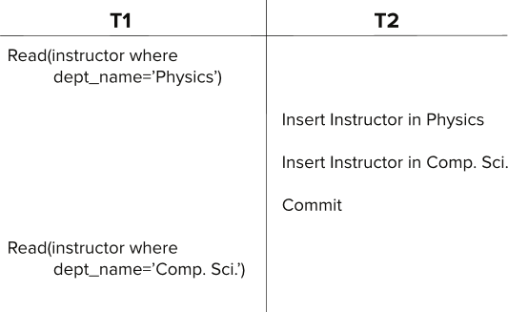
Predicate Reads

Slide 27
Handling Phantoms
There is a conflict at the database level
Predicate read or scanning the relation is reading information that indicates what tuples the relation contains
The transaction inserting/deleting/updating a tuple updates the same information.
The conflict should be detected, e.g. by locking the information.
One solution:
Associate a data item with the relation, to represent the information about what tuples the relation contains.
Transactions scanning the relation acquire a shared lock in the data item,
Transactions inserting or deleting a tuple acquire an exclusive lock on the data item. (Note: locks on the data item do not conflict with locks on individual tuples.)
Above protocol provides very low concurrency for insertions/deletions.

Slide 28
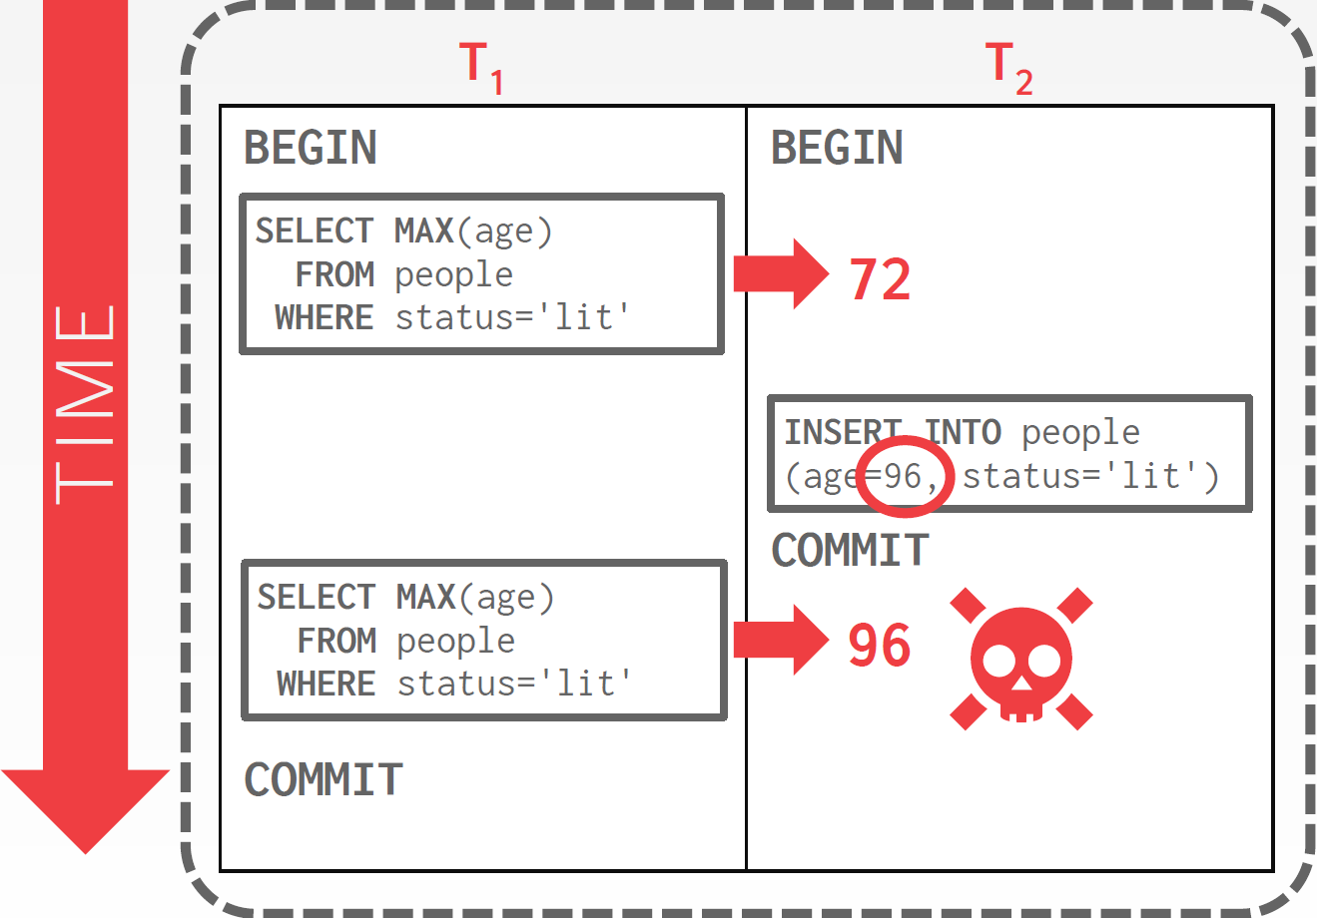
Predicate Locking
Conflict serializability on reads and writes of individual items guarantees serializability only if the set of objects is fixed.
Lock records that satisfy a logical predicate:
Example: status='lit'
In general, predicate locking has a lot of locking overhead.
Index locking is a special case of predicate locking that is potentially more efficient.

Slide 29
Index Locking
Every relation must have at least one index.
A transaction can access tuples only after finding them through one or more indices on the relation
A transaction T_{i} that performs a lookup must lock all the index leaf nodes that it accesses, in S-mode
Even if the leaf node does not contain any tuple satisfying the index lookup
A transaction T_{i} that inserts, updates or deletes a tuple t_{i} in a relation r
Must update all indices to r
Must obtain exclusive locks on all index leaf nodes affected by the insert/update/delete
The rules of the two-phase locking protocol must be observed

Slide 30
Next-Key Locking
Index-locking protocol can result in poor concurrency if there are many inserts
Next-key locking protocol: provides higher concurrency
Lock all values that satisfy index lookup
Also lock next key value in index
even for inserts/deletes
Consider B+-tree leaf nodes as below, with query predicate 7 ≤ X ≤ 16. Check what happens with next-key locking when inserting: (i) 15 and (ii) 7

Slide 31
Concurrency in Index Structures
Indices‘ job is to help in accessing data.
Index-structures are typically accessed very often.
2-phase locking of index nodes can lead to low concurrency.
Index concurrency protocols
Locks on internal nodes are released early, and not in a two-phase fashion.
It is acceptable to have non-serializable concurrent access to an index
The accuracy of the index is maintained.
In particular, the exact values read in an internal node of a B⁺-tree are irrelevant so long as we land up in the correct leaf node.

Slide 32
Crabbing Protocol
Instead of two-phase locking on the nodes of the B⁺-tree
First lock the root node in shared mode.
After locking all required children of a node in shared mode, release the lock on the node
During insertion/deletion, upgrade leaf node locks to exclusive mode.
When splitting or coalescing requires changes to a parent, lock the parent in exclusive mode.
Could cause excessive deadlocks
Can abort and restart search, without affecting transaction

