Slide 1
shawpno Grocery Shop

Slide 2

Introduction
In Bangladesh, shawpno grocery shop has revolutionised daily shopping. shawpno, the nation's largest retailer, is known for quality, convenience, and trust. This slide captures shawpno's essence and its impact on millions.
shawpno, operated by ACI Logistics Limited, opened as "Fresh and Near" in 2008 to connect farmers and consumers. shawpno has grown into a comprehensive retail hub, selling fresh produce, household essentials, apparel, electronics, and more.
shawpno is Bangladesh's largest retail chain, proving its dedication to quality, value, and service. shawpno influences the retail landscape of Bangladesh by touching over 35,000 households daily with 56 strategically placed outlets in Dhaka, Chittagong, Sylhet, and Comilla.
shawpno's impact goes beyond retail. shawpno changed daily life by adopting modern retail practises. It offers safe, convenient, and fun shopping instead of traditional channels. shawpno's nutrition and food safety campaigns demonstrate its commitment to customer health.

Slide 3
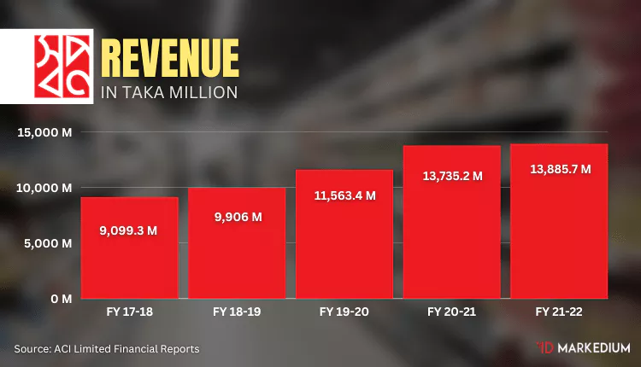
Financial Performance
shawpno grocery store's July–December 2022–23 sales grew 31% year-over-year. shawpno's impressive growth shows its ability to adapt to customer needs.
shawpno's revenue rose to Tk 840 crore from Tk 641 crore the year before. This increase shows shawpno's success in growing its customer base, offering a variety of products, and optimising sales.
While revenue has grown, shawpno's profit before tax was negative at Tk 66.90 crore. This compares to Tk 58 crore last year. The negative profit figure shows the challenges and investments made to grow sales so rapidly.

Slide 4


Product Analysis
Its wide product selection makes shawpno stand out. Customers can buy fresh fruits, vegetables, fish, and meat, as well as household goods. shawpno is a one-stop shop for apparel, home décor, and electronics in addition to daily needs. Grocery sells the most at Shawpno Outlets. Such as: Rice, Cooking oil, meat, fish, etc.
shawpno is proud of its quality and affordable in-house grocery private label brands. shawpno's in-house fashion label, Shwapno Life, shows its commitment to a holistic shopping experience. These in-house brands increase product variety and reflect the company's branding and quality.

Slide 5
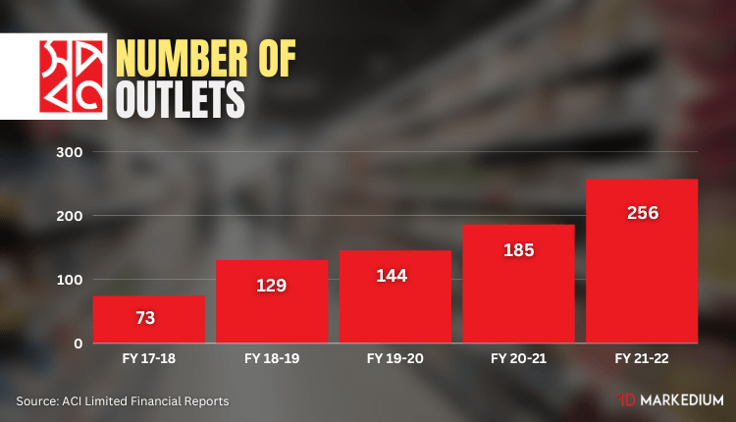
Outlet Analysis
shawpno grocery store's success comes from its diverse and strategic outlet formats. This section explores these outlets' unique qualities and their crucial role in shawpno's market leadership.
One size doesn't fit all in retail, says shawpno. To satisfy its diverse customers, it offers a variety of outlet formats. Small convenience stores to megamalls range in size from 1,500 to 27,000 square feet. shawpno ensures a great shopping experience regardless of location or customer preferences by tailoring its outlets to different market segments.
shawpno's dedication to quality, value, convenience, and service drives its market leadership. These pillars have created customer loyalty and helped shawpno reach 45% market share. shawpno is preferred by customers due to its high quality, reasonable prices, convenient shopping locations, and excellent service.
shawpno strives for excellence beyond its products. The company has invested in world-class retail architecture and shopping. shawpno prioritises safety, aesthetics, and enjoyment in the shopping experience as well as functional requirements. This focus on the shopping experience makes shawpno a retail leader.

Slide 6
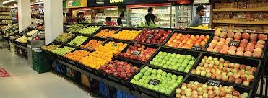
Operations
Modern retail has improved consumers' lives. shawpno outlets offer safe, convenient, and reliable shopping alternative to traditional markets. This change has improved convenience, quality, and safety.
shawpno sells and promotes health. The company runs nutrition and food safety campaigns. shawpno improves customer and community health by promoting healthy eating and safe food practises.
shawpno's parent company, ACI Logistics, has a nationwide sourcing network with growers to ensure product freshness and quality. Today, shawpno gets 65% of its fresh produce from the source. Direct procurement ensures product freshness and a fair and sustainable relationship with growers.
Membership in Global G.A.P., the leading private sector organisation dedicated to safe and sustainable agriculture worldwide, reinforces shawpno's commitment to product quality and grower well-being. This partnership improves shawpno's products and helps Bangladeshi growers.

Slide 7
Market Presence
With 45% market share shawpno's market presence shows its keen understanding of Bangladesh's diverse customer base and commitment to nurturing aspirations.
shawpno initially targeted price-sensitive customers because local affordability was important. shawpno gained a strong retail presence by making quality products more accessible.
shawpno's brand has changed over time. It now fosters aspirations rather than value. shawpno's transformation shows its dedication to meeting customers' immediate needs and inspiring and elevating their lifestyles.
shawpno is Bangladesh's most trusted retail brand due to its commitment to quality and customer satisfaction. The Bangladesh Brand Forum named shawpno Best Retail Brand in 2016. This recognition shows customer loyalty and trust in the brand.
shawpno's supply chain and quality standards are supported by thousands of suppliers and growers beyond its internal team.

Slide 8
Revenue Enhancement Strategies
shawpno grocery shop must develop revenue-sustaining and growth strategies to continue its success. Revenue-boosting strategies include marketing, pricing, customer experience, and operational efficiency. Ideas may include:
Marketing Campaigns
Pricing Strategies
Customer Experience
Operational Efficiency
Diversification
E-commerce Expansion

Slide 9

Conclusion
shawpno evolves and strives for excellence. With its growing customer base and strategic retail approach, shawpno could become Bangladesh's largest and most influential company.
shawpno is exploring e-commerce in addition to its physical presence. This forward-thinking approach matches customer shopping preferences and opens new growth and expansion opportunities.
shawpno grocery store leads the retail industry with quality, convenience, and innovation. Its mission goes beyond retail to improve millions of lives and Bangladesh's economy and society. shawpno's success and dedication to excellence are anticipated.

Slide 10
References
ACI (2023). Retail Chain (Shwapno). [online] www.https://www.aci-bd.com/our-businesses/retail-chain-shwapno.html. Available at: https://www.aci-bd.com/our-businesses/retail-chain-shwapno.html.Desk, C. (2022). Shwapno gets GLOBALGAP Certificate. [online] The Daily Star. Available at: https://www.thedailystar.net/business/organisation-news/press-releases/news/shwapno-gets-globalgap-certificate-2993091 [Accessed 8 Nov. 2023].Habib, A. (2023). Shwapno posts 31% sales growth. [online] The Daily Star. Available at: https://www.thedailystar.net/business/news/shwapno-posts-31-sales-growth-3236151.markedium.com (2023). How Shwapno Is Surviving Despite Incurring Massive Losses? | Markedium. [online] markedium.com. Available at: https://markedium.com/how-shwapno-is-surviving-despite-incurring-massive-losses/ [Accessed 8 Nov. 2023].
ACI (2022). FIN 1 July 2021 - 30 June 2022. [online] Available at: https://www.aci-bd.com/financials/fin-2021-2022/ [Accessed 8 Nov. 2023].

