Slide 1
NYC Parking Ticket Issuance Pattern Detection
Maria Mahbub (CS 690)
Tasmia Rahman (CS 594)

Slide 2
One slide - One concept

Slide 3
1 picture is better than 100 words

Slide 4
Motivation
Problem:
When are tickets most likely to be issued? Any seasonality?
What are the most common years and types of cars to be ticketed?
Relevancy:
Analyzing the pattern of ticket violation focusing the time of issuance and type of issued car can give us insight on the impacts of these features.
A prediction model can be useful to warn the drivers to avoid getting tickets issues
Overarching project goal:
An accurate prediction model
A clustering that can be evaluated for proper interpretation

Slide 5
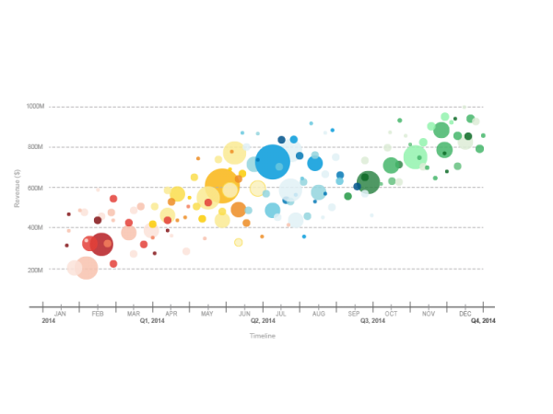
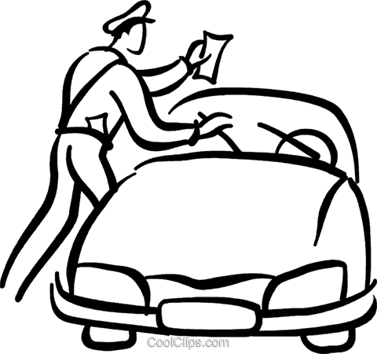



Contributions
Police Officer issues ticket for illegally parked cars
Data collected and provided by Department of Finance
Data with incomplete or missing attributes are cleaned
Analyze data features and perform algorithmic analysis
Communicate the findings using plots and interactive visualizations
Quantitative Data
Data Source
Data Preprocessing
Exploratory Data Analysis
Data Visualization

Slide 6
Background and Related Work
A work has been carried out on finding a pattern of parking ticket violations focusing on understanding the relationship between the locations and type of violations
Another paper analyzed the factors that affect truck parking violation frequency in urban areas
There is also a study on downtown parking model integrating traffic congestion and on-street parking
There is another study on cultural norms and legal enforcement in controlling corruption by analyzing the parking behavior of United Nations officials in Manhattan

Slide 7
Methodology
Two or three slides with the overview of the methodology you applied in your project
What tools do you use? Do you write a new tool?
What algorithms do you use? Do you write new algorithms?
How do you use the tools / algorithms? What is the solution workflow?

Slide 8
Methodology
MapReduce
Find the most common
violation location
violation time
Vehicle Make Company
Vehicle Body Type
Violation Code
Find a relation between
Violation Code and street
Violation Code and time
Violation Code and body type

Slide 9
Methodology
K-Means:
Identify how many groups there can be in terms of violation
Predictive Model
Using linear regression to predict violation type for certain attributes
All our tests will be run on JetStream

Slide 10
Results
Three or four slides with the results of your projects
Start from the environment you use to run your tests, i.e., on what system(s) do you run your test? What is the setting of the system?
Describe the test execution, e.g., how many times do you repeat the tests? What is the input data for each test?
List the metrics of success, e.g., what do you measure? Why? What is the metrics range? The higher the better? The lower the better?
Present relevant results in diagrams. For each diagram, list the main observations and takeaway for the reader

Slide 11
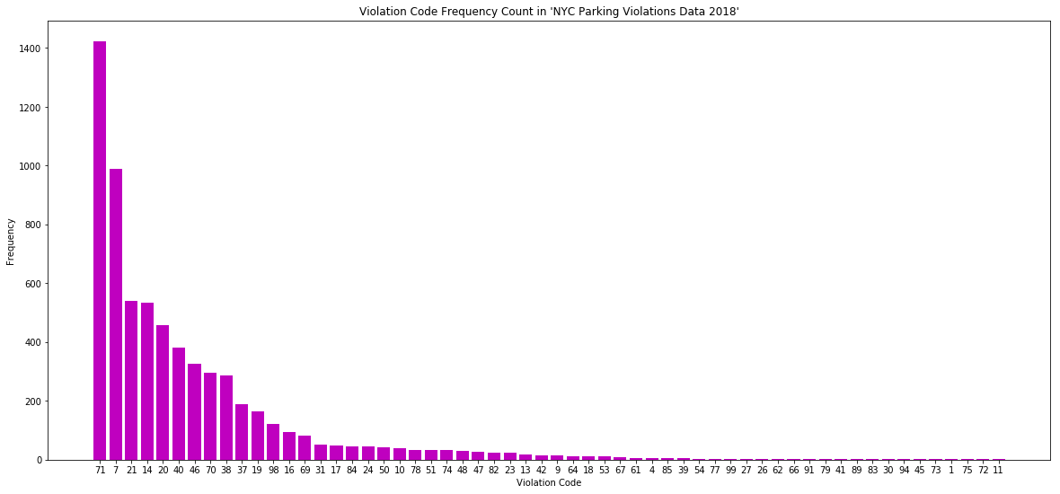
Results (for a subset of our data)
Frequency of violation code: 71, 7, 21, 14, 20 are top 5 most violated code

Slide 12
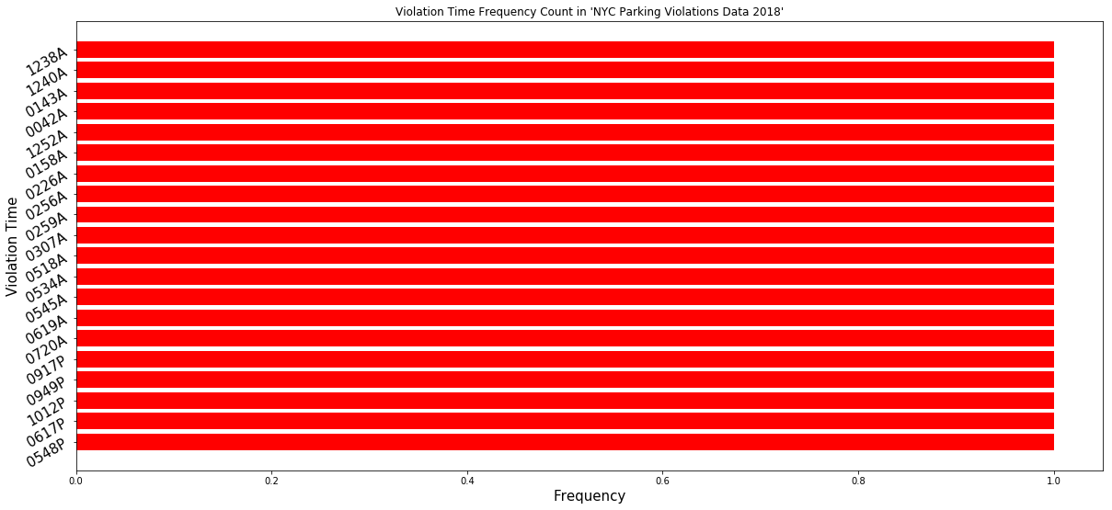
Results (for a subset of our data)
20 most common violation time: 1:33 p.m., 1:43 p.m., 11:46 a.m., 1:24 p.m., 1:18 p.m. are top 5 most common violation time, implying that either traffic police are more active or people are a little reckless at that time.

Slide 13
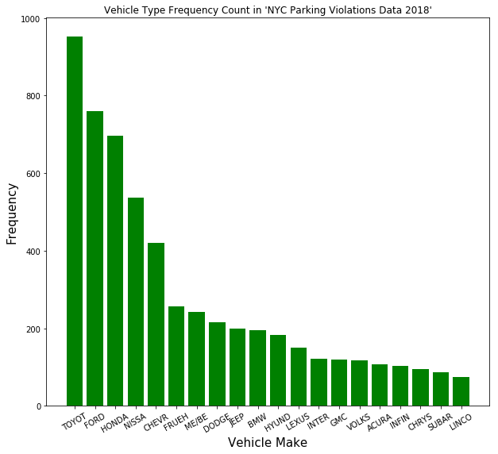
Results (for a subset of our data)
20 most common vehicle types responsible for violation: This result can be interpreted as the mostly used vehicle types by NYC residents or its visitors

Slide 14
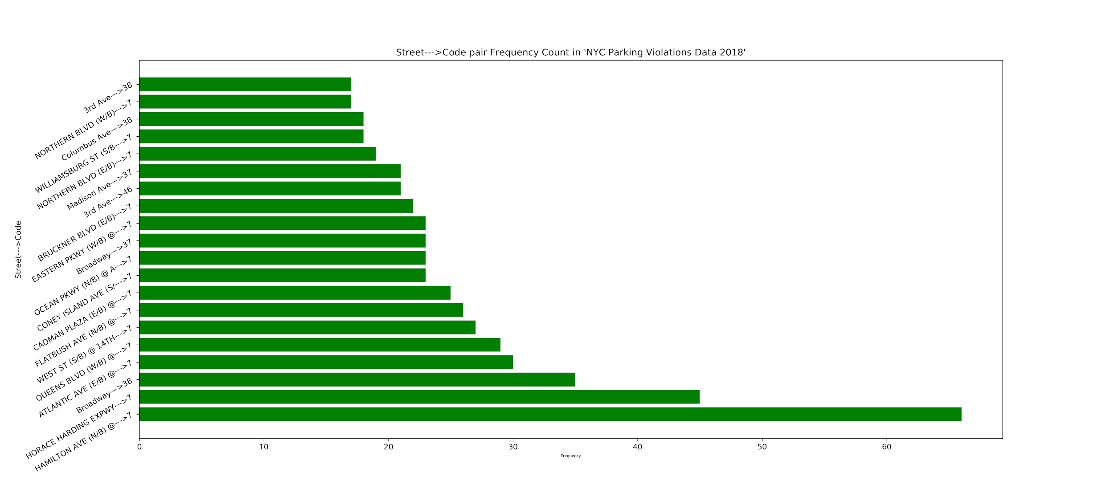
Results (for a subset of our data)
Relationship between issuance street and violation code:

Slide 15
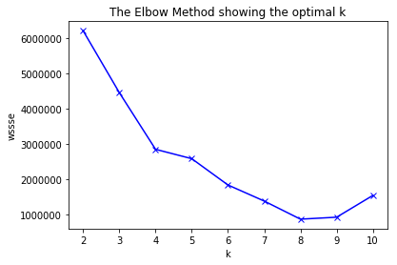
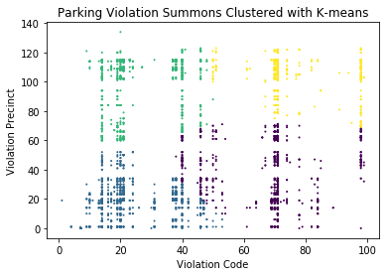
Results (for a subset of our data)
K-means: Choosing optimal K: Clustering with Violation code and Precinct:

Slide 16
Results (for a subset of our data)
Predictive Model

Slide 17
Lessons Learned and Future Work
This is a conclusion slide with lessons learned and future work; each item is one or two bullet points / sentences
Describe what is the project about and the key methodology you use
Describe one or two key numerical results and their significance
Describe the next step(s) of the project, i.e., what you would do if you have more time

Slide 18
Revision of your Slides
Go back to Slide 2 and review each one of your slides
Can you replace any text part with one or more figures?
Can you simplify / reduce any sentences?
Are there clear connections between consecutive slides?

Slide 19
NEVER end your presentation with a slide with “Thank you"

