Slide 1
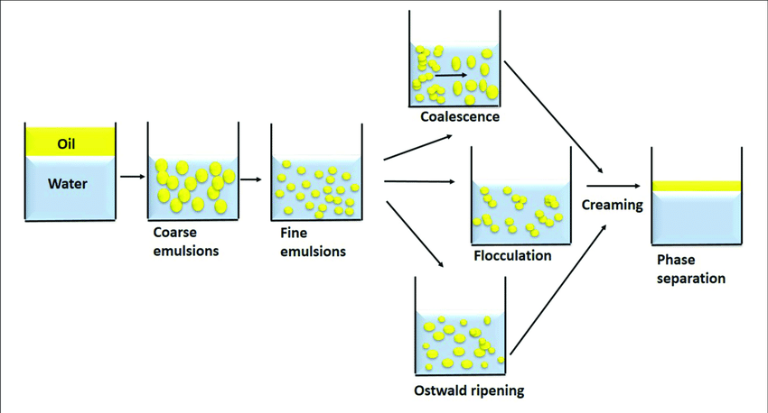
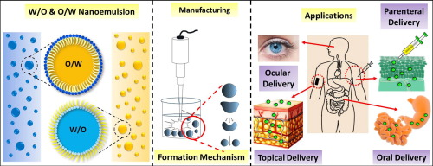
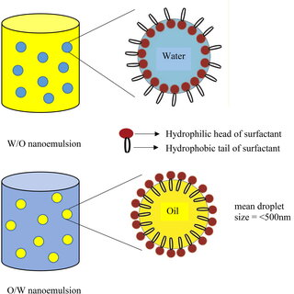
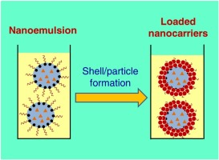
Nanoemulsion : A versatile drug delivery system
McClements, D. J. (2012). "Nanoemulsions: Formation, properties and applications." Current Opinion in Colloid & Interface Science, 17(5), 275-287.
1. Introduction
2. Problem Statement
Nanoemulsions are finely dispersed, thermodynamically stable mixtures of two immiscible liquids, typically oil and water, stabilized by surfactants.
Conventional drug delivery systems struggle with poor solubility, low bioavailability, and inefficient targeting of hydrophobic drugs. Nanoemulsions offer a promising solution to enhance drug absorption, stability, and targeted delivery with improved therapeutic outcomes.
)
3. Solution
Nanoemulsions enhance drug delivery by improving solubility, bioavailability, and stability of hydrophobic drugs. They enable targeted delivery, controlled release, and efficient absorption..
4. System Model & Proposed Scheme
The proposed system utilizes nanoemulsions to encapsulate hydrophobic drugs, enhancing solubility, bioavailability, and targeting. The model ensures controlled release, improved absorption, and efficient drug delivery at target sites.
5. Future Works
Future works include optimizing nanoemulsion formulations for enhanced stability, minimizing toxicity, scaling up production
Acknowledgement
We extend our gratitude to our mentors, research team, and funding bodies for their invaluable support, guidance, and resources in advancing nanoemulsion research and development.

