Slide 1
S0IL

Slide 2
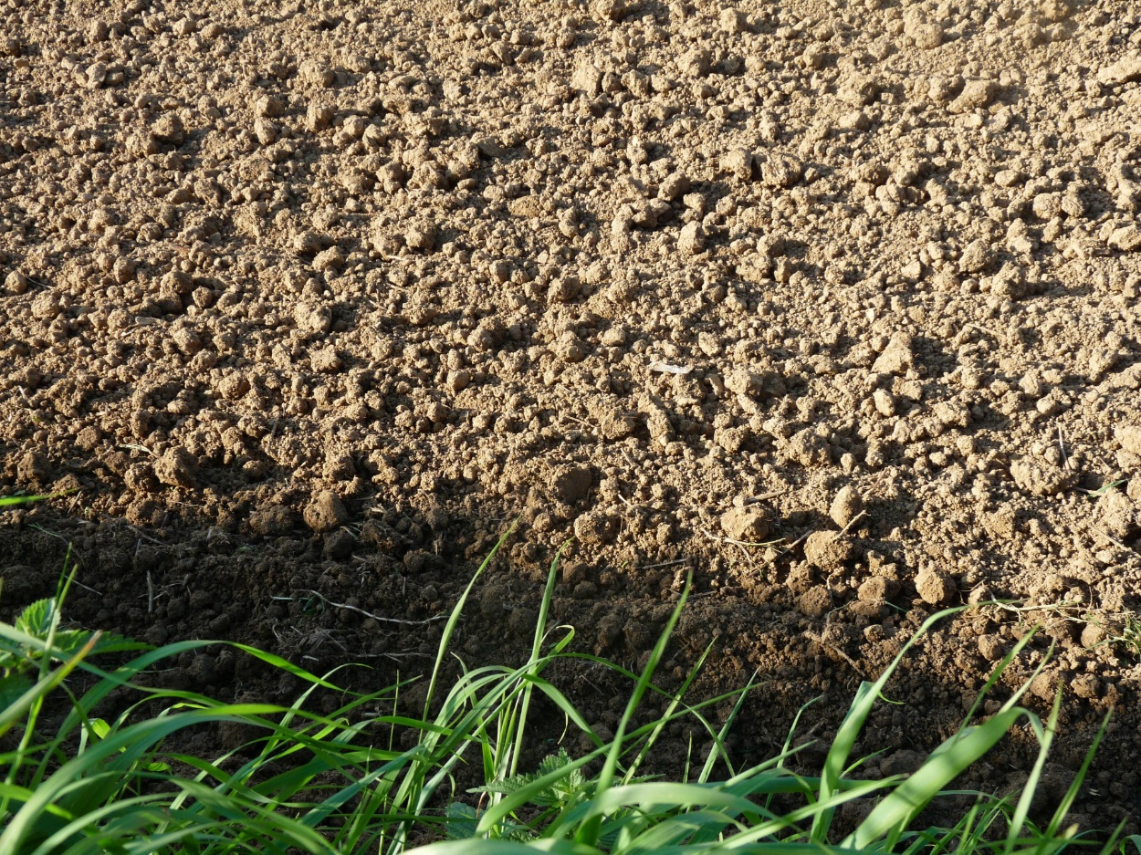
INTRODUCTION
The upper layer of earth in which plants grow, a black or dark brown material typically consisting of a mixture of organic remains, clay, and rock particles

Slide 3
Major Components of SOIL
Eroded rock
Solid
Air
Water
Living organisms

Slide 4
Importance of Soil
Provides nutrients
Recycles
Stores water
Soil is the basis of life on earth

Slide 5
property | sand | silt | clay
Fertility | Low | Moderate-high | High
Porosity | High | Moderate-low | Low
Permeability | High | Moderate-low | Low
Water holding capacity | low | Moderate-high | high

Slide 7
Flow chart of soil preparation
SOIL COLLECTION
DRYING
CRUSHING
SOIL CHARACTERIIZATION
BLOCKING

Slide 8
CONCLUTION
soil is essential for supporting life and agriculture. Maintaining its health through sustainable practices is crucial for food security and environmental balance. Protecting soil ensures a sustainable future for both nature and humanity.

Slide 9
WELCOME

