Slide 1
Fire Station Management System

Slide 2
Subsystems
Employee Management System
Resources and Equipment Management System
Fire Response System
Post Fire System

Slide 3
Actor
Worker
Station Officer
Public User
Workshop Inspector
Data Operator

Slide 4
Worker

Slide 5
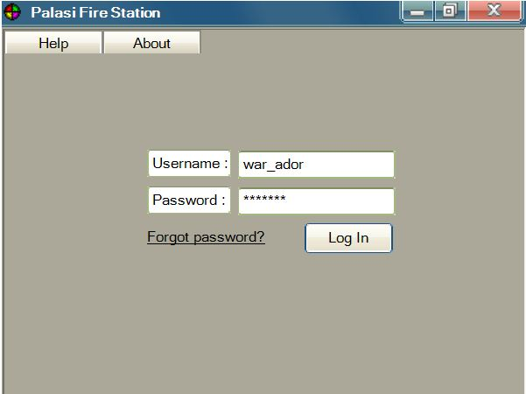
Login

Slide 6
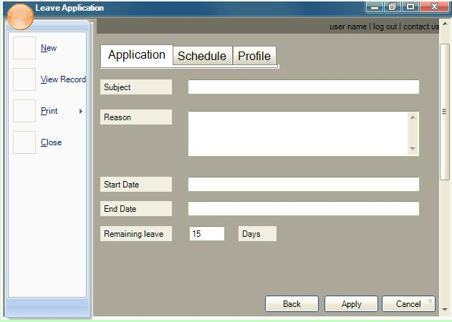
Application Form

Slide 7
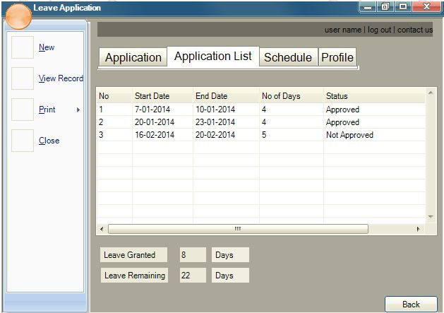
Show Application Record

Slide 8
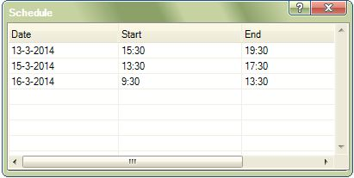
View Schedule

Slide 9
Station Officer

Slide 10
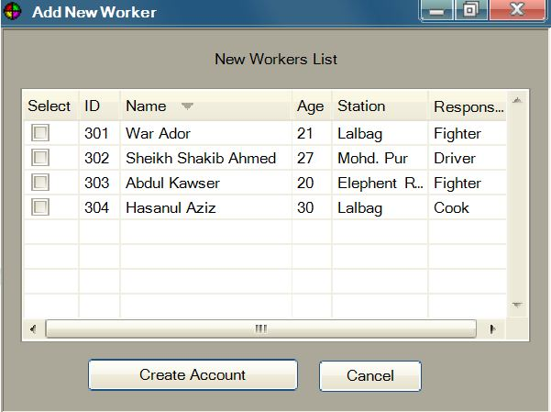
Add New Worker

Slide 11
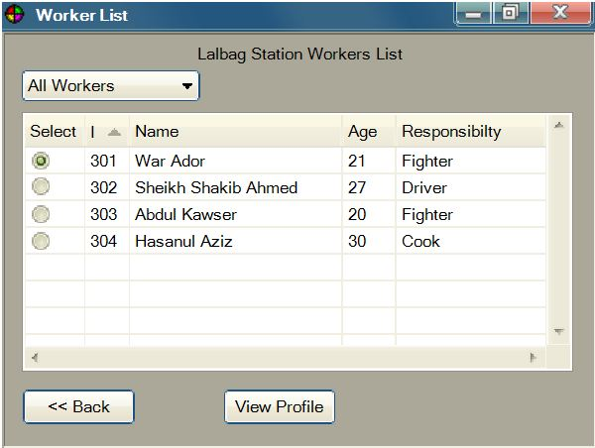
Show Worker List

Slide 12
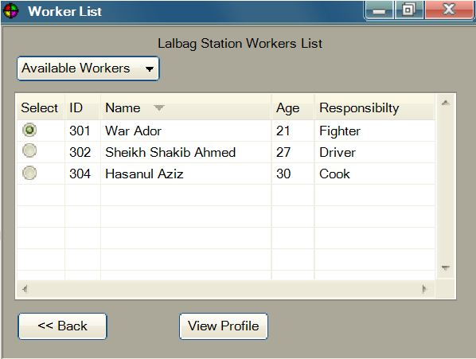
Show Available Worker List

Slide 13
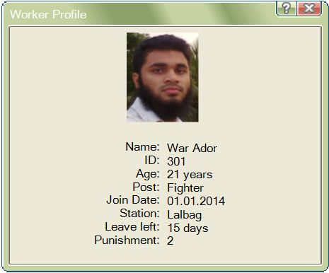
Worker Profile

Slide 14
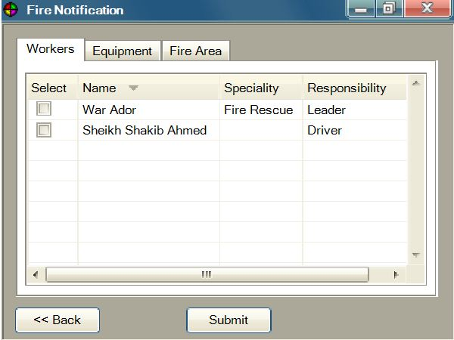
Available Workers

Slide 15
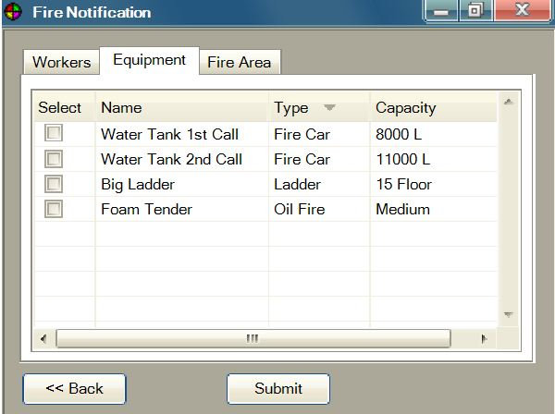
Available Equipment

Slide 16
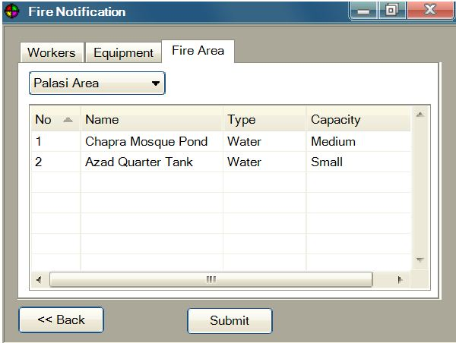
Fire Affected Area

Slide 17
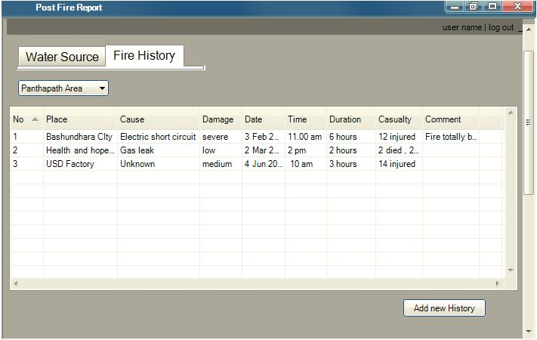
View Fire History

Slide 18
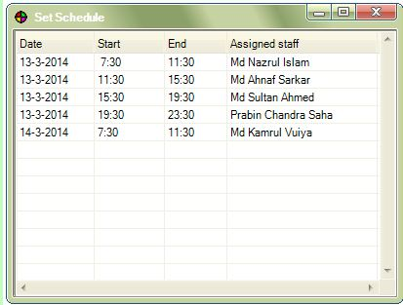
Set Schedule

Slide 19
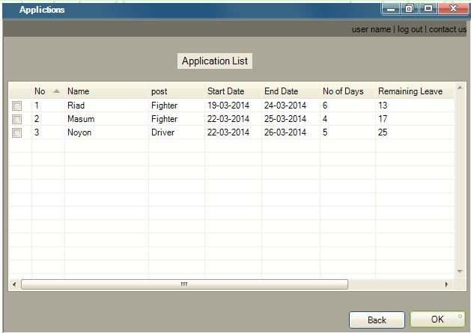
Show application list

Slide 20
Public User

Slide 21
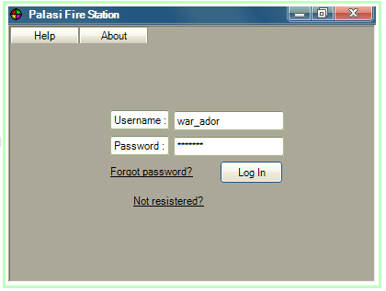
User Login

Slide 22
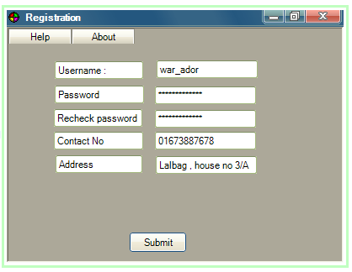
User Registration

Slide 23
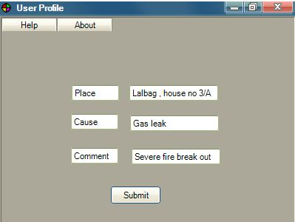
Fire Call

Slide 24
Workshop Inspector

Slide 25
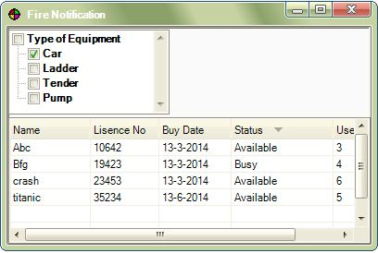
View Equipment

Slide 26
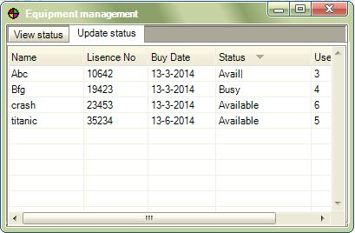
Update Equipment Status

Slide 27
Data Operator

Slide 28
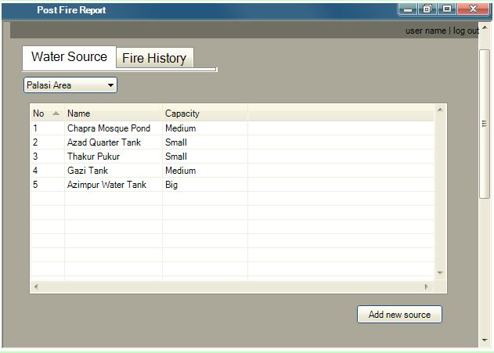
Update Water Source

Slide 29
Update Fire History

Slide 30
Questions
??

Slide 31
Thanking You
Sadia Atique, 1005013
Tasmin Chowdhury, 1005025
Mohammad Aman Ullah Aman, 1005026
Abdullah Al Fahim, 1005028
Hasanul Aziz, 1005030

