Slide 1


Slide 2
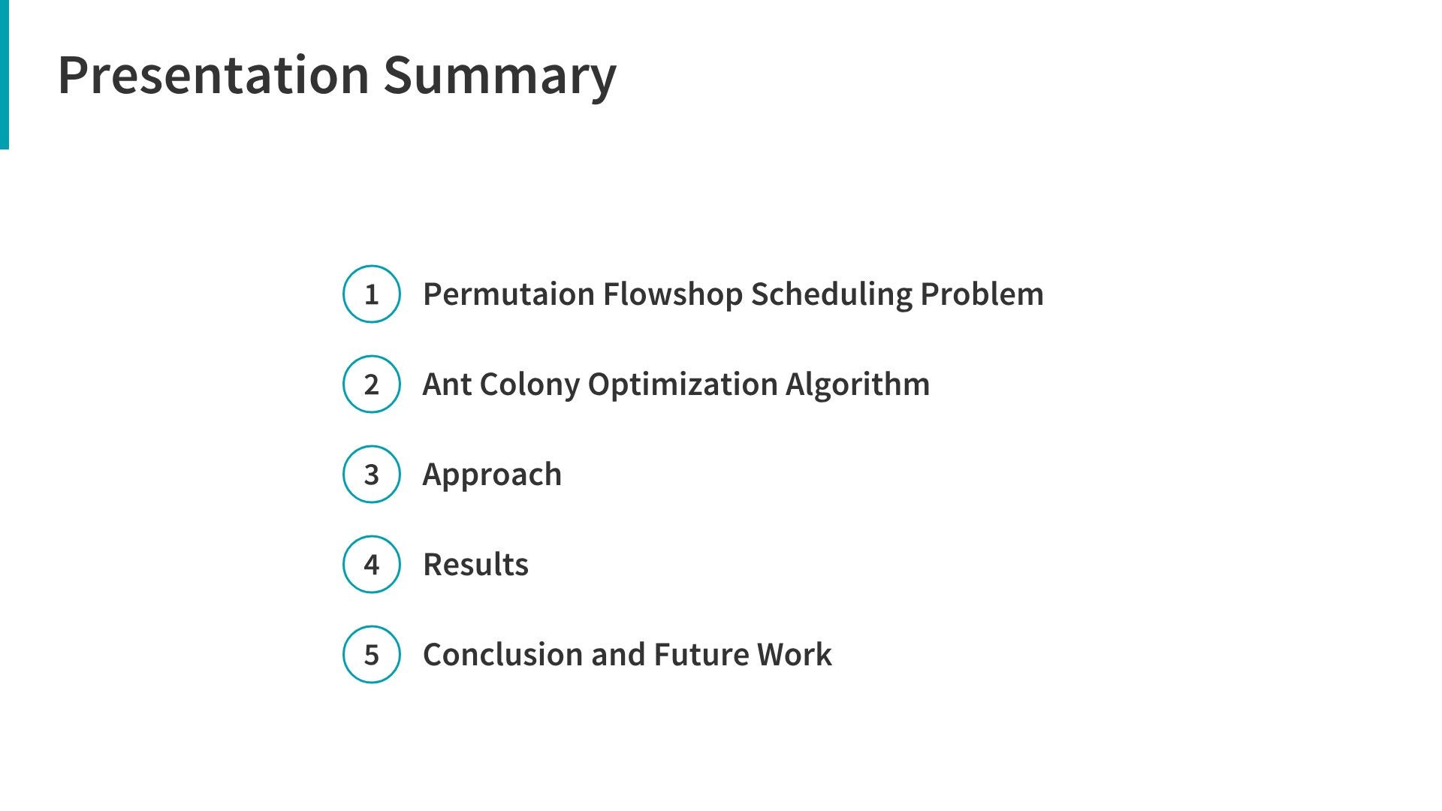
1

Slide 3
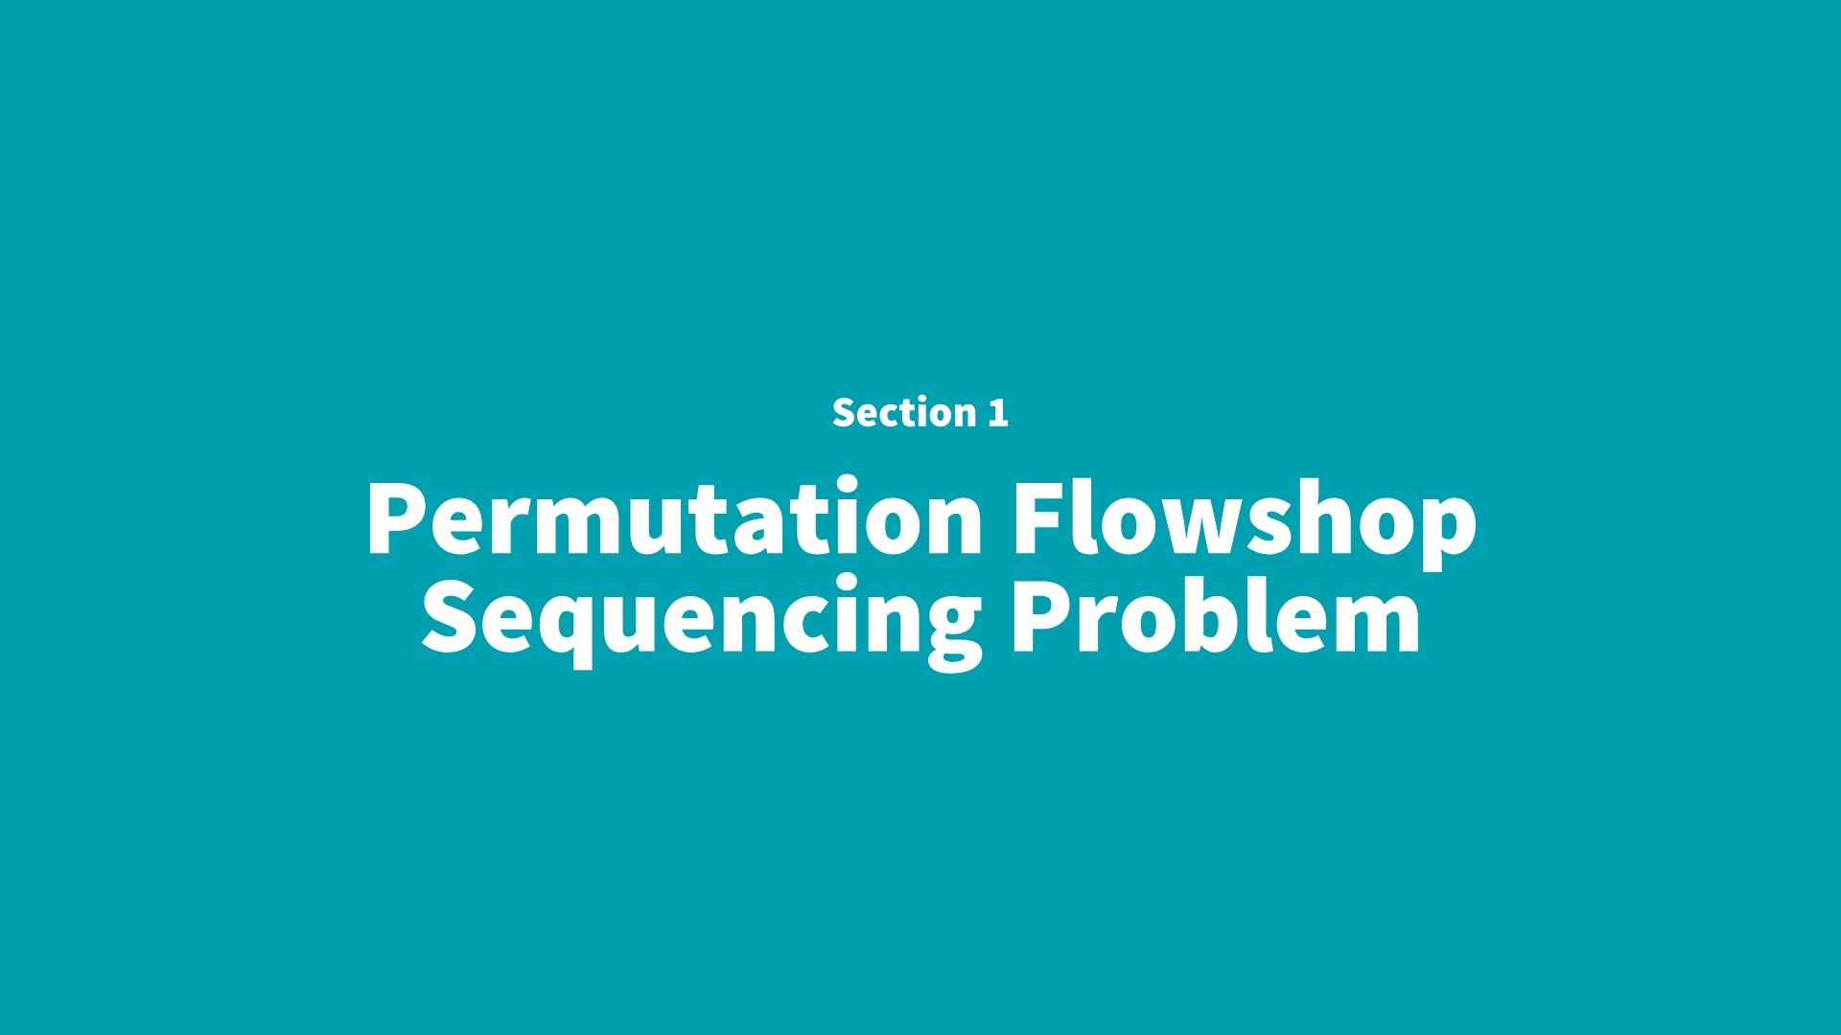

Slide 4
Definition
Permutation Flowshop Scheduling Problem is a special type of Flowshop
Scheduling Problem, in which jobs are processed in the same order on
each machine
2

Slide 5
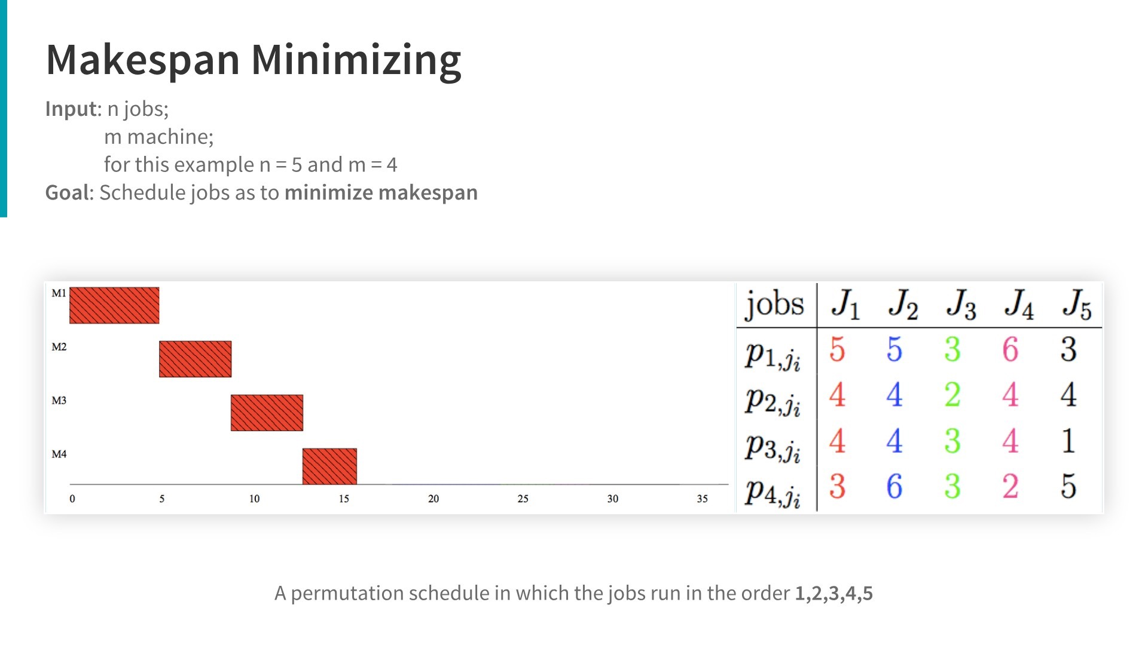
3

Slide 6
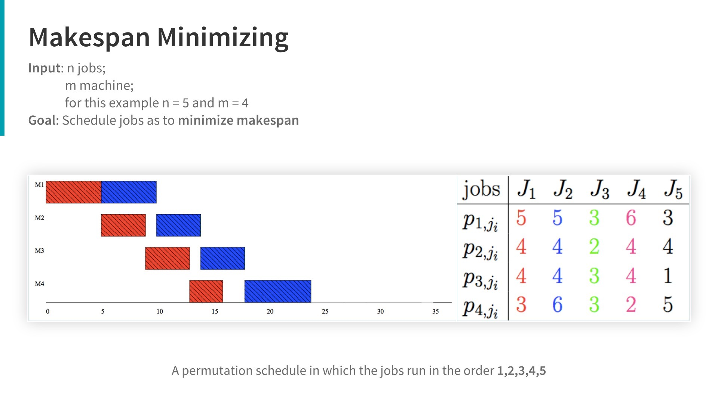

Slide 7
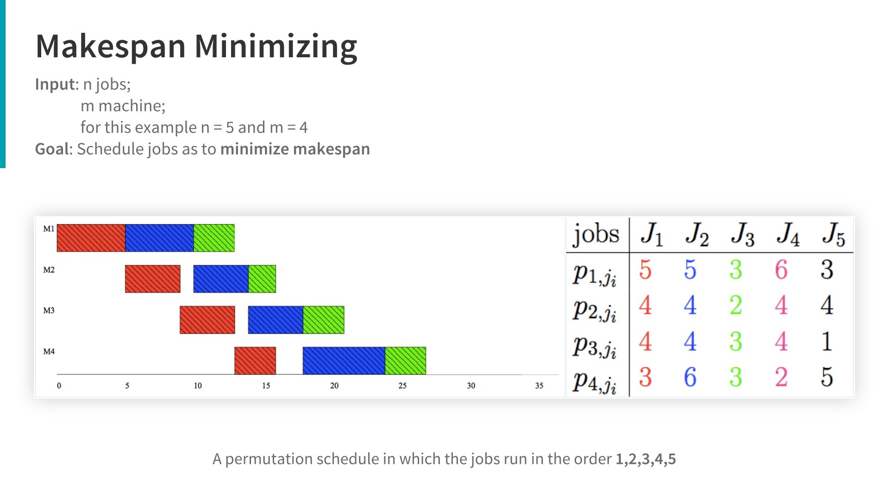

Slide 8
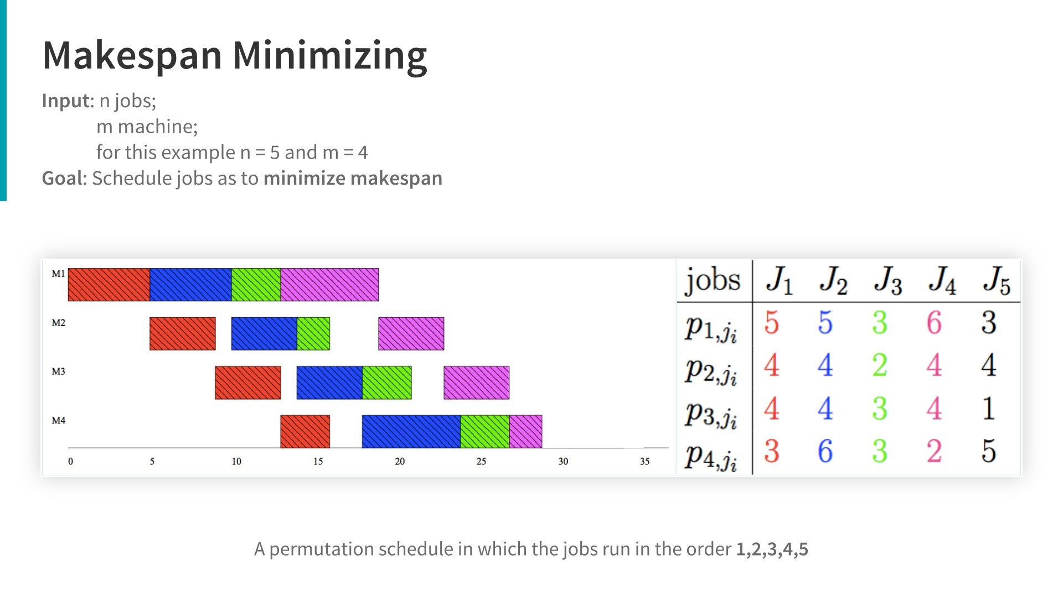

Slide 9
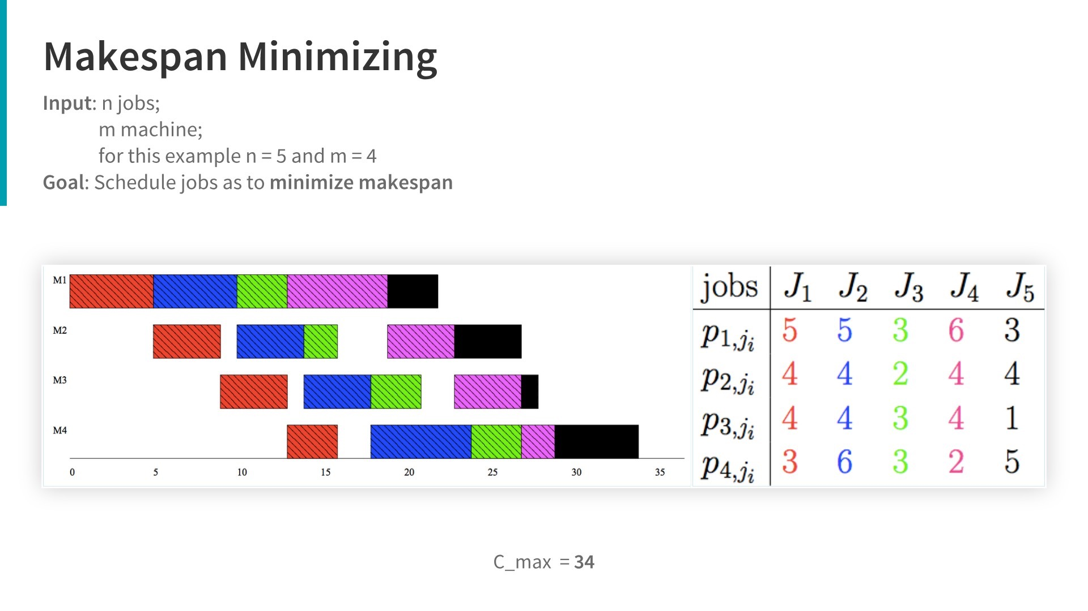
Makespan

Slide 10
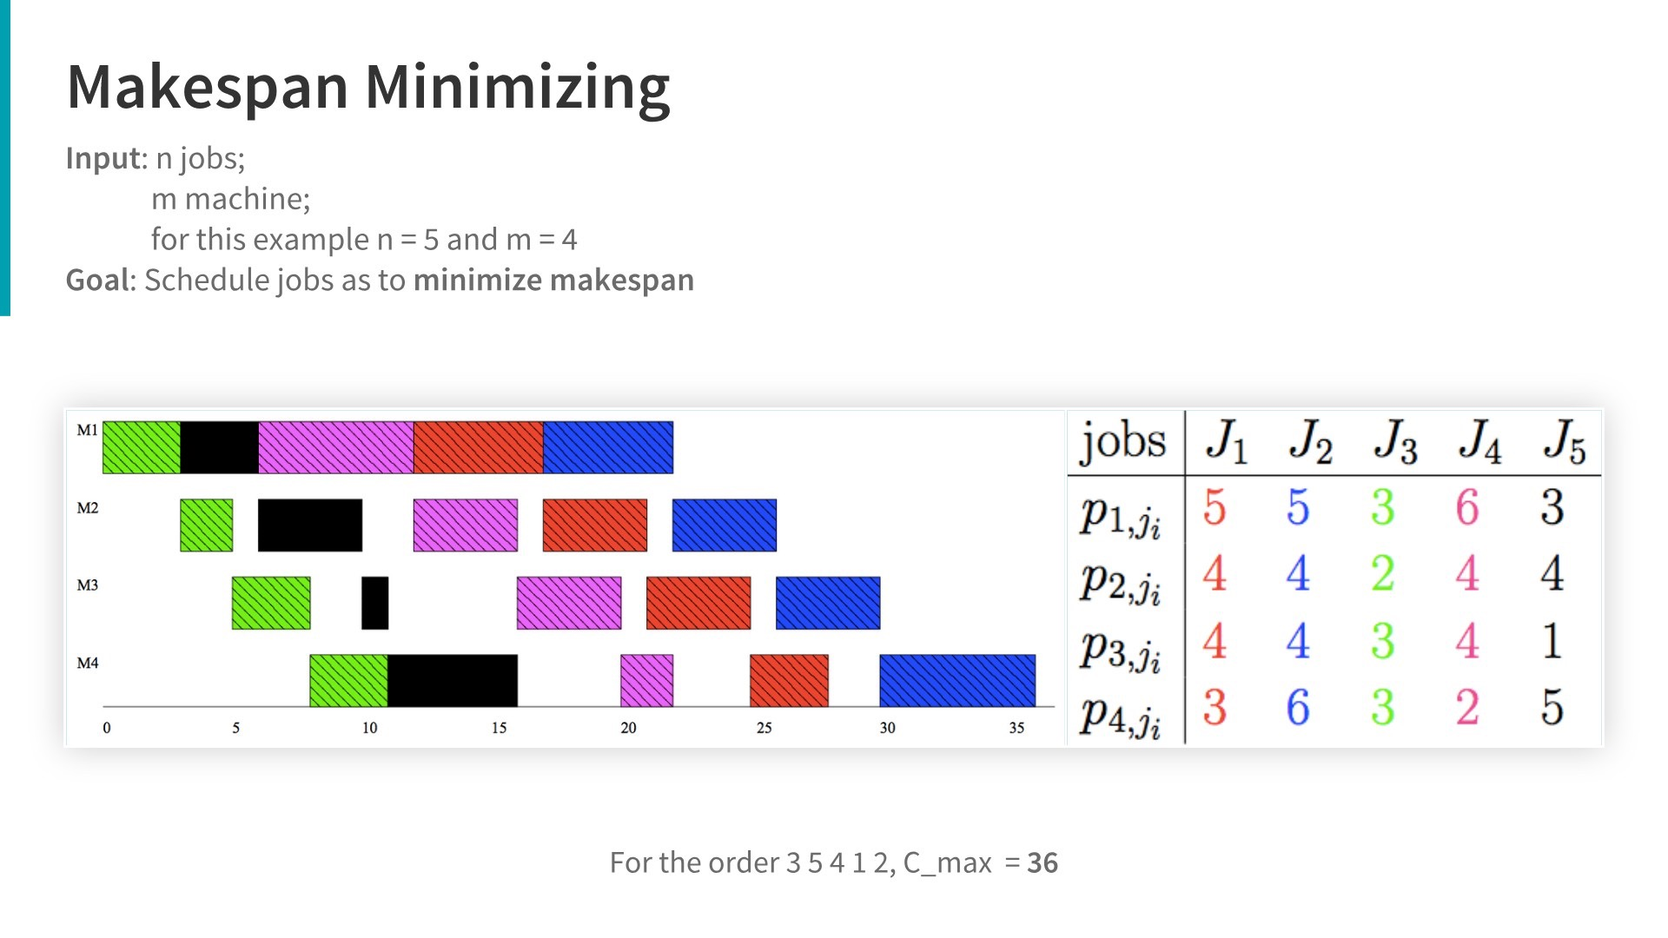
Makespan
5

Slide 11
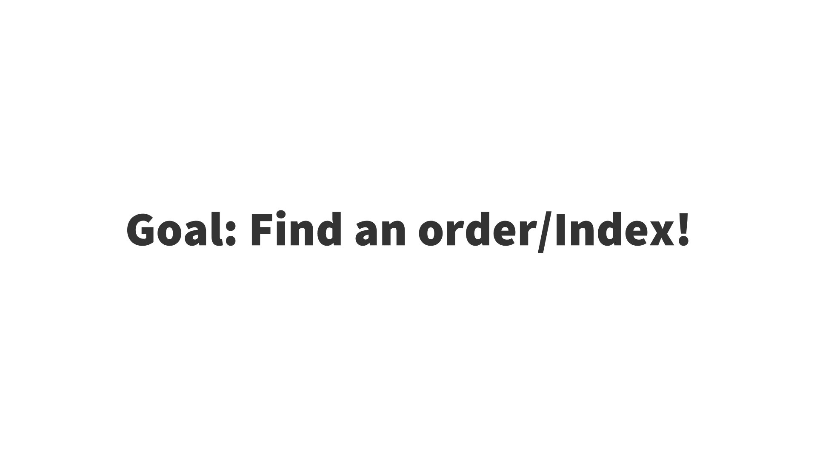

Slide 12
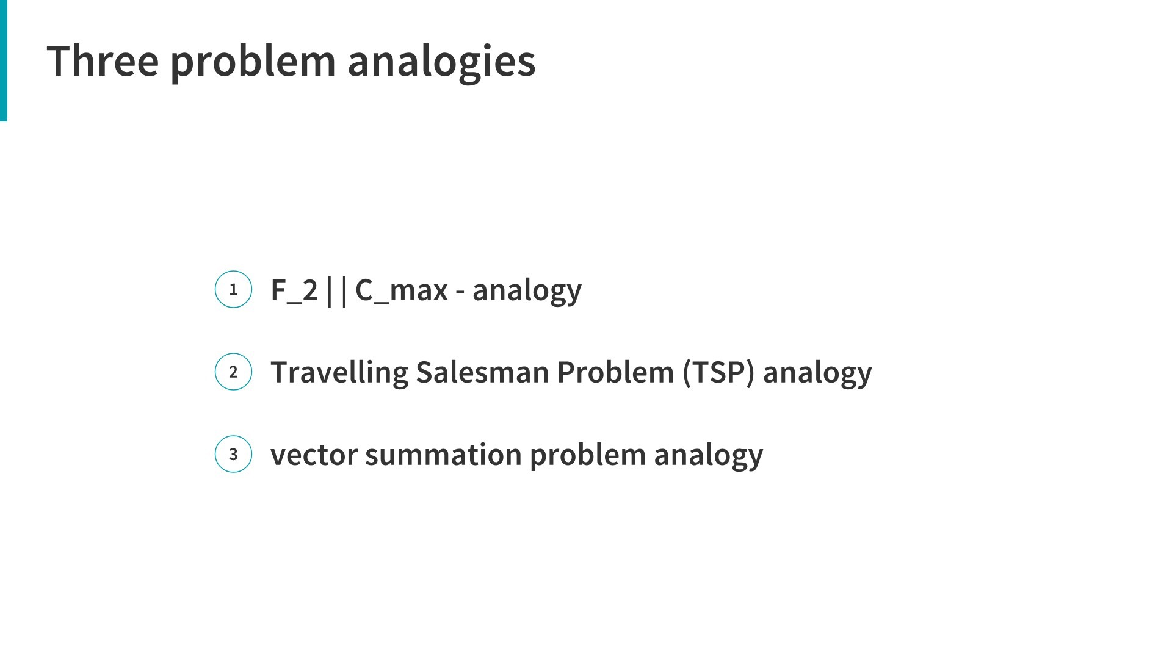
F2
6

Slide 13
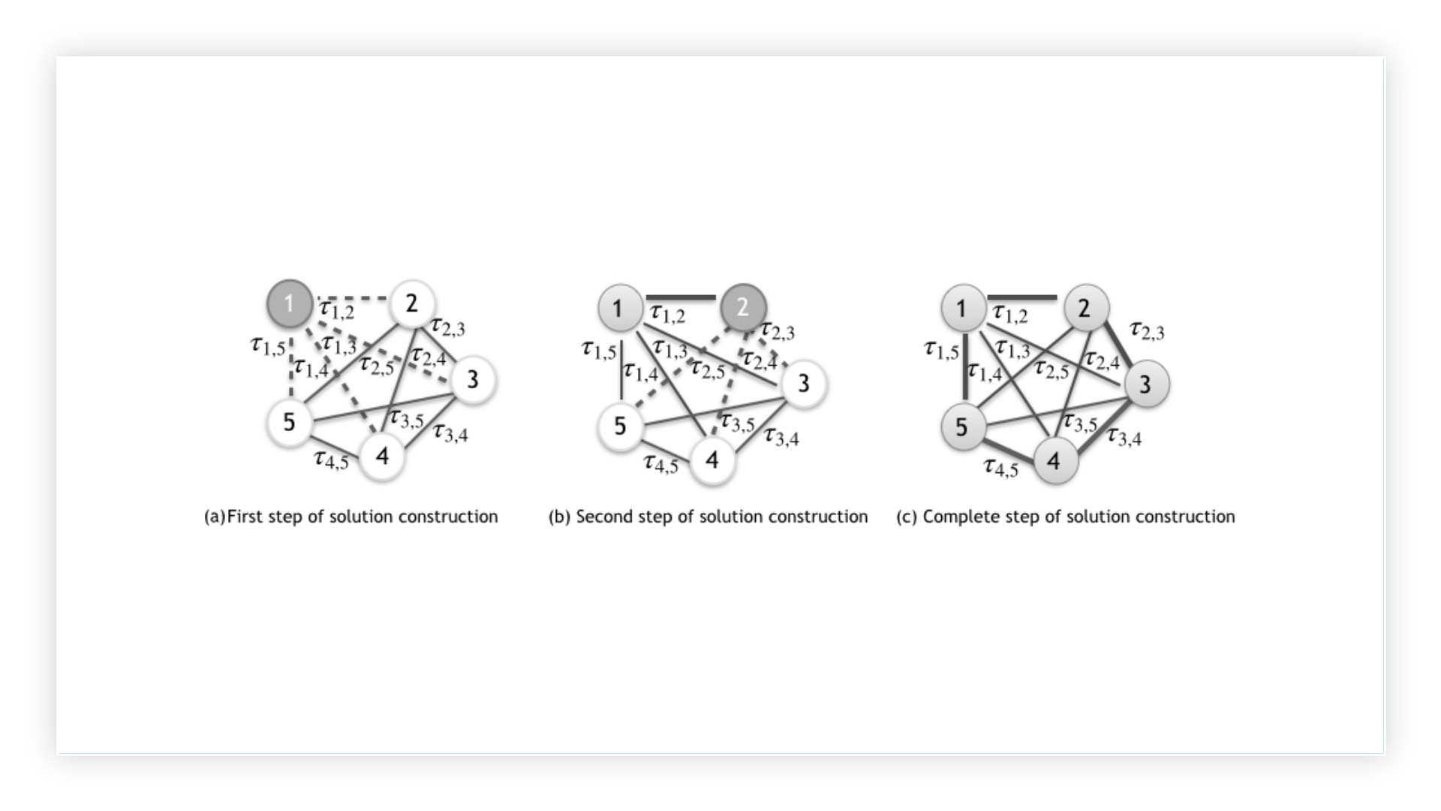
Traveling Salesman Problem(TSP)
7

Slide 14
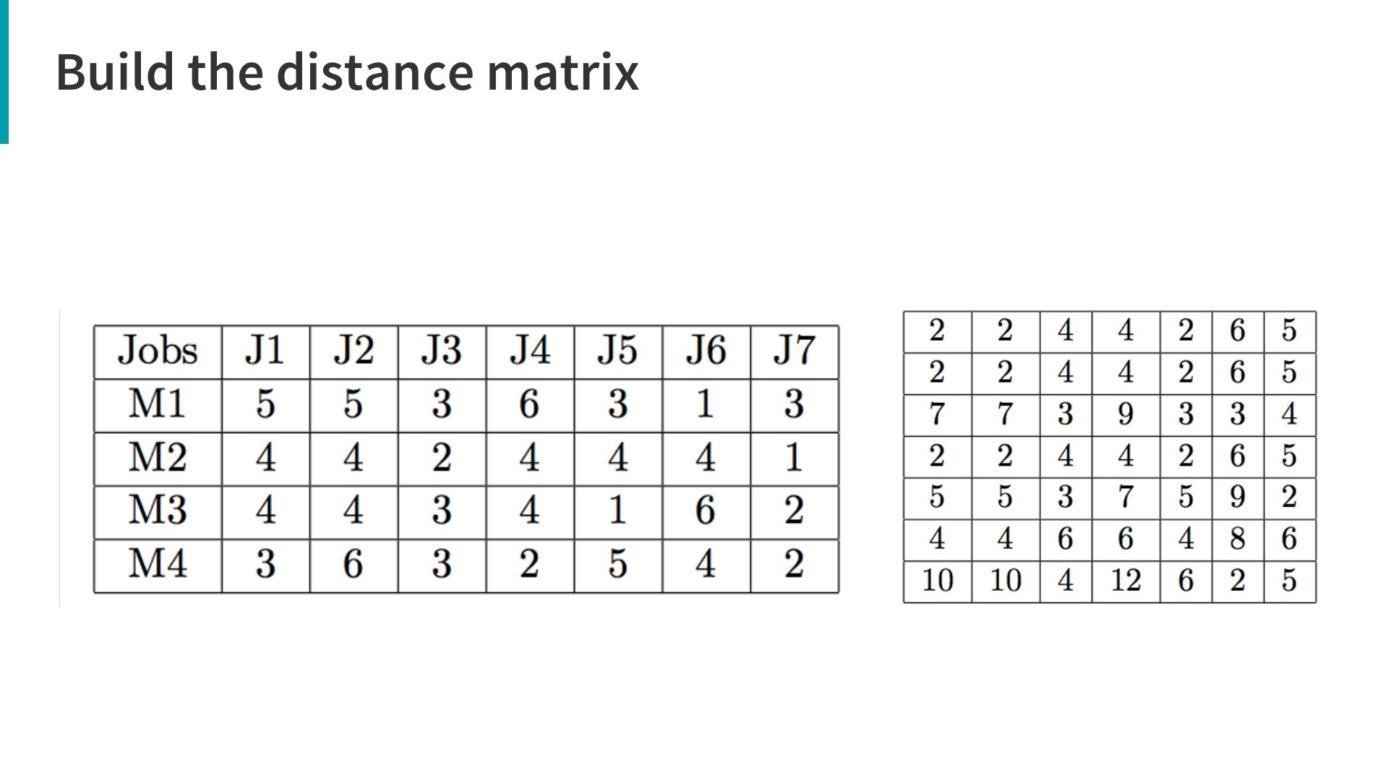
Processing time of jobs
7x7 Distance matrix
8

Slide 15
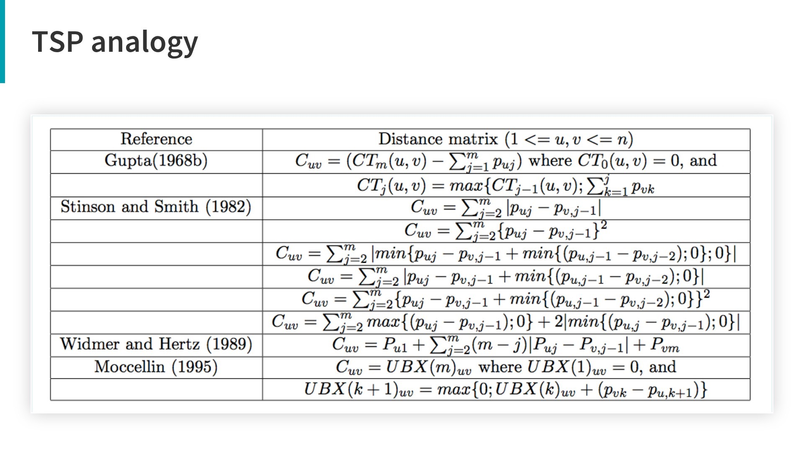
9

Slide 16
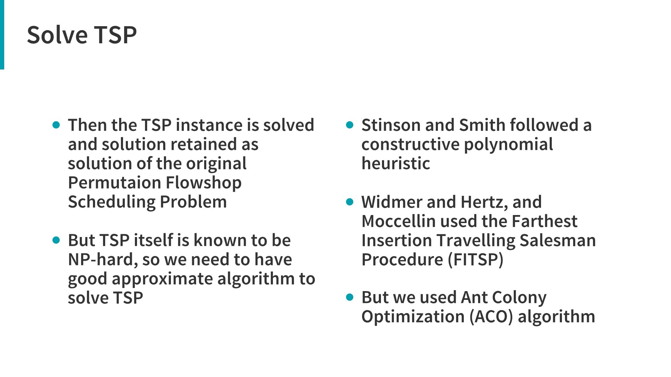
10

Slide 17
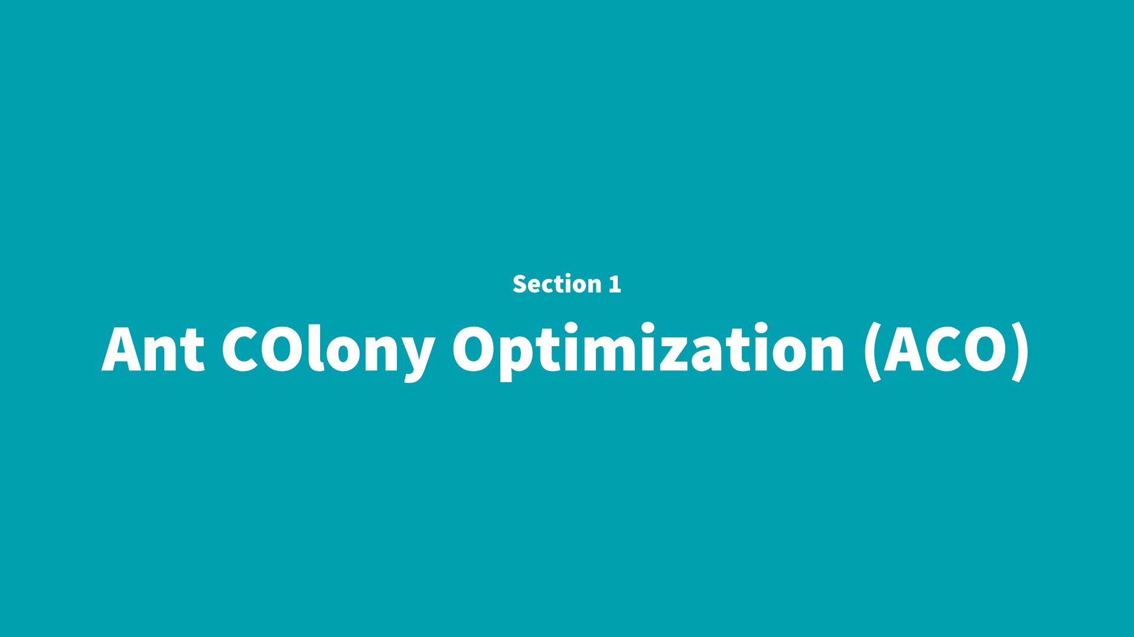
2

Slide 18
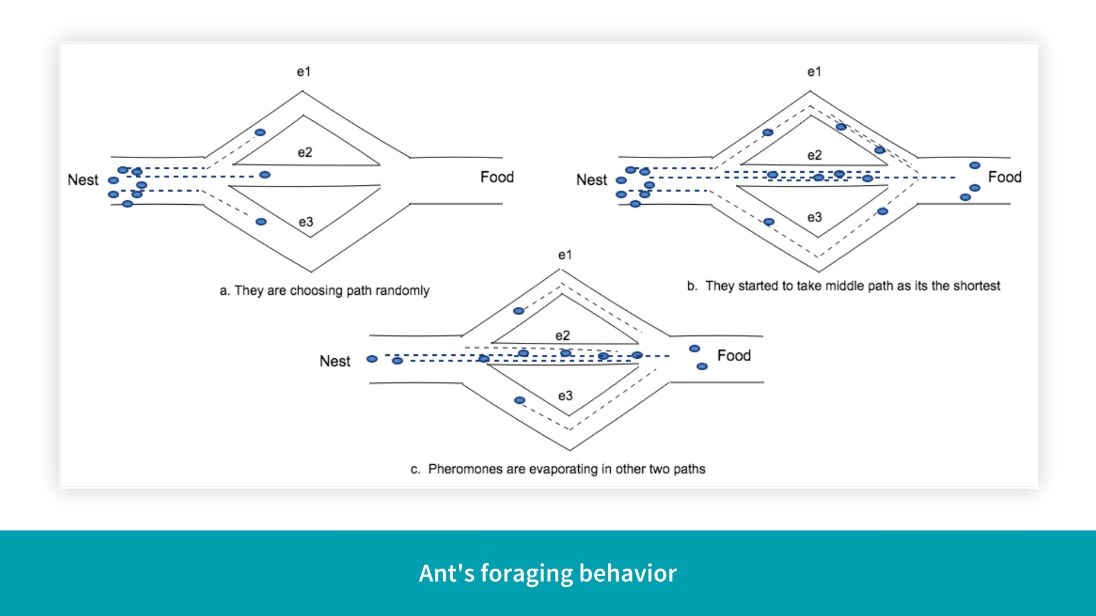
11

Slide 19
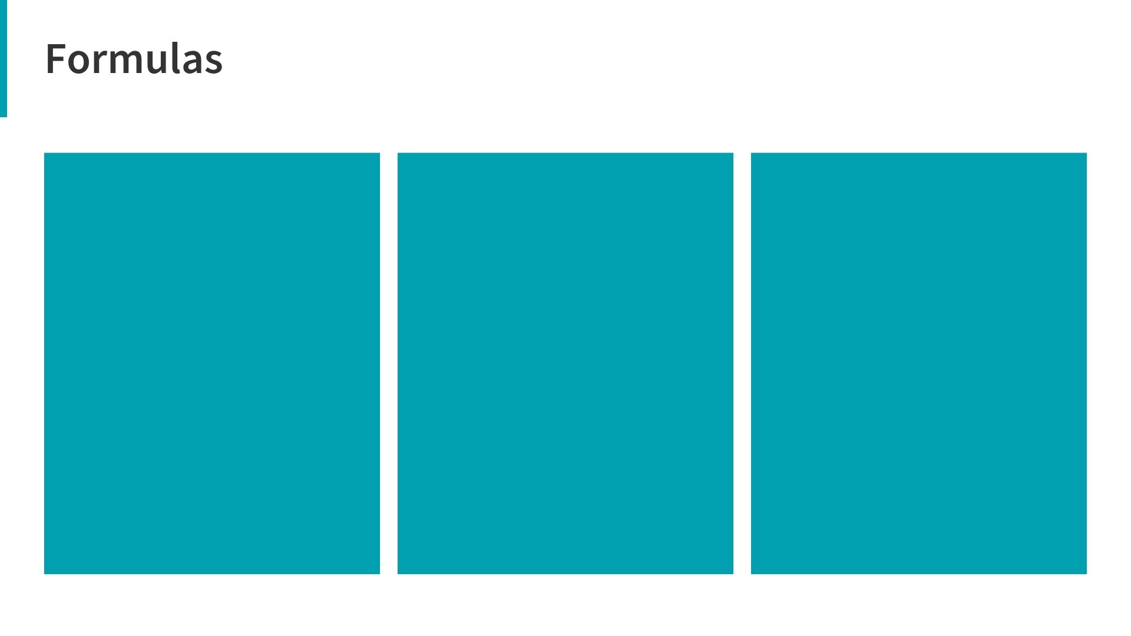
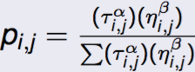
An ant will move from node i to node j with probability
where,
𝜏i,j is the amount of pheromone on edge i, j
α is a parameter to control the influence of 𝜏i,j
ηi,j is the visibility of edge i, j (typically 1/ di,j )
β is a parameter to control the influence of ηi,j
12

Slide 20
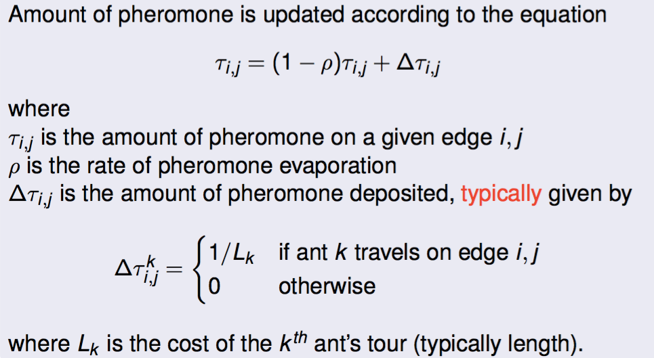
13

Slide 21
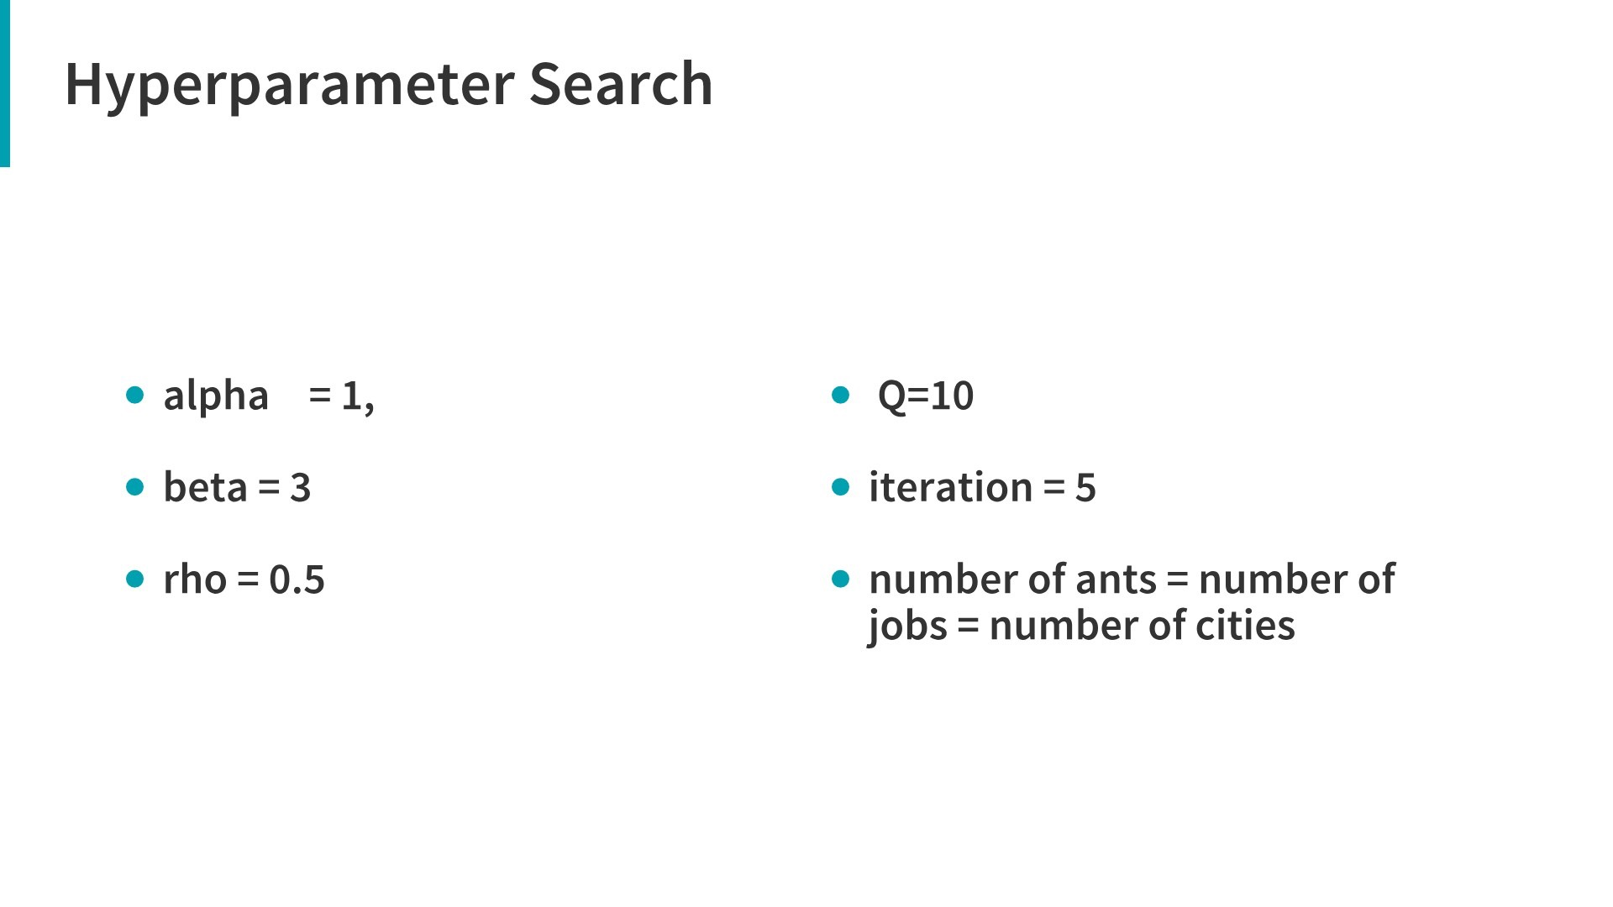
14

Slide 22
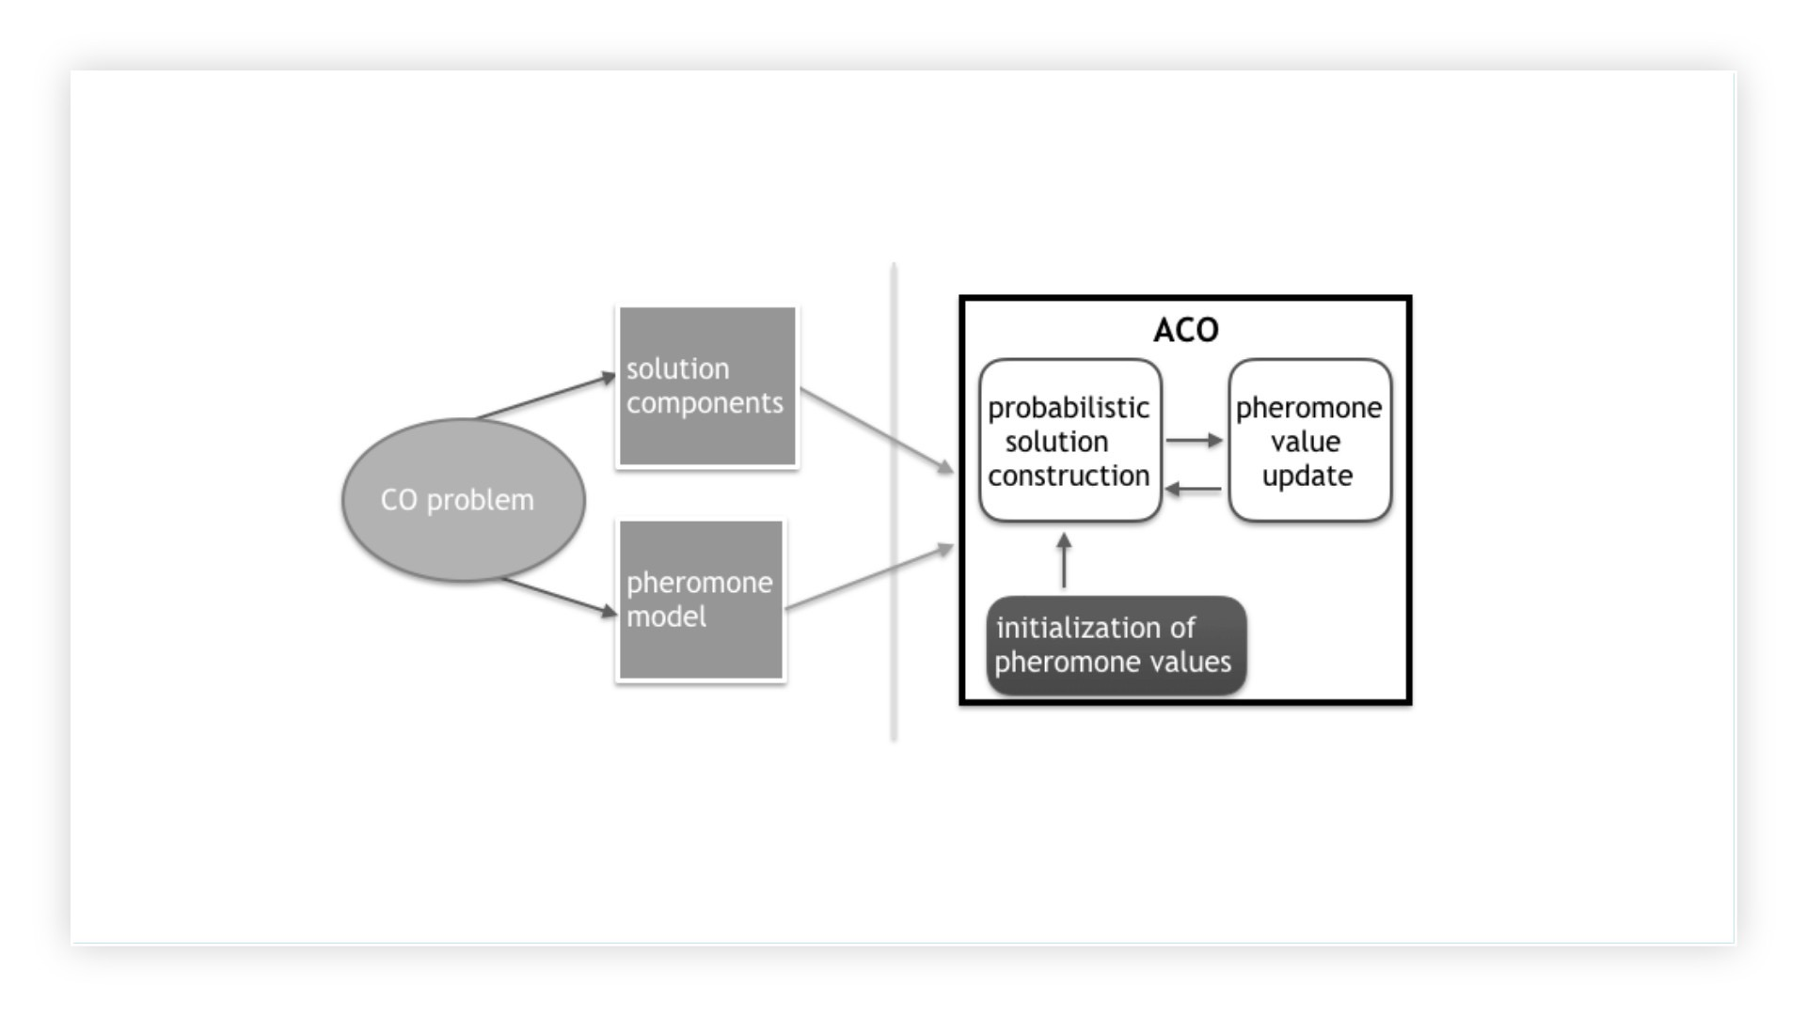
Basic workflow of ACO
15

Slide 23
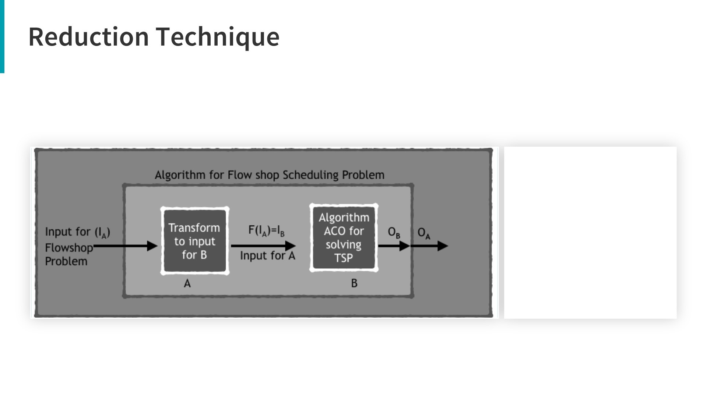
A = PFSP
B = TSP
IA = Input for PFSP
IB = Input for TSP
OA = Output for PFSP
OB = Output for TSP
F(IA) = Function that
transform IA to IB
B
16

Slide 24

3

Slide 25
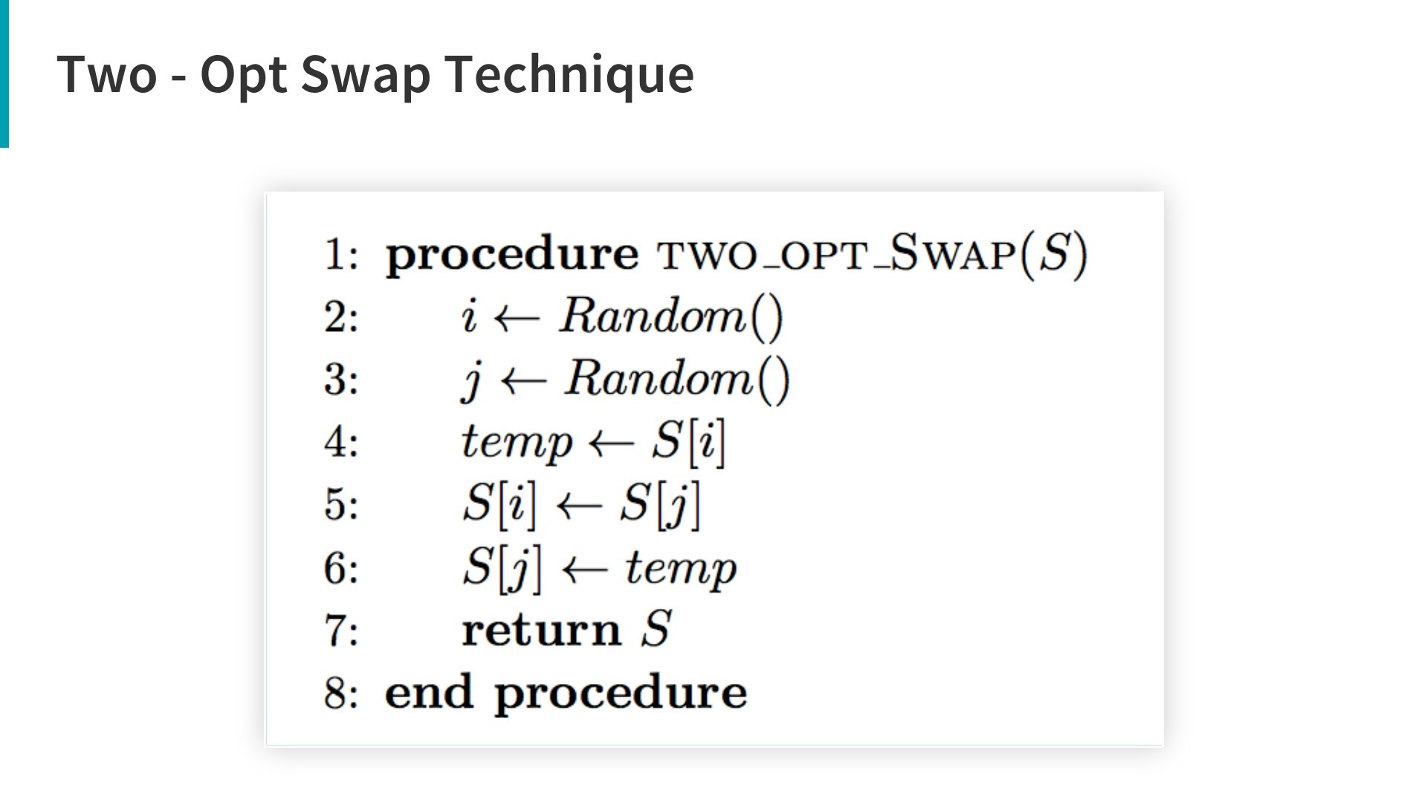
1 | 4 | 5 | 3 | 2
two indexes randomly chosen
1 | 3 | 5 | 4 | 2
we swapped them
17

Slide 26
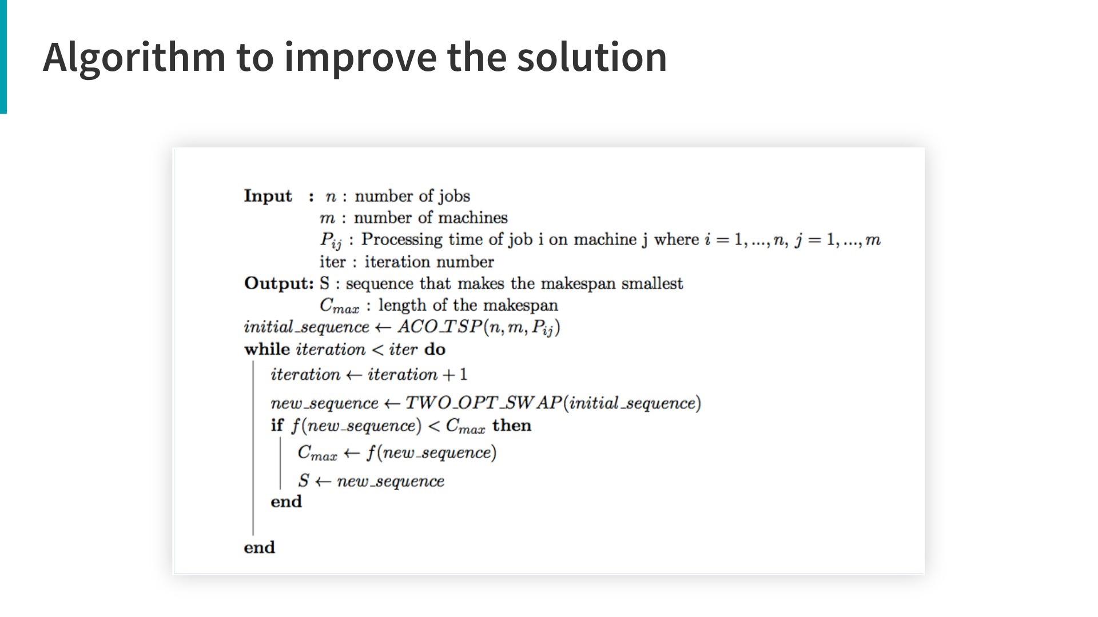
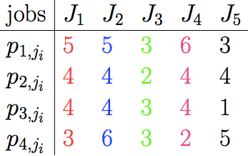

Slide 27
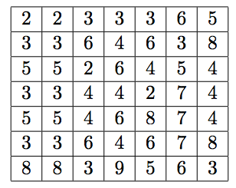

Slide 28
ACO-TSP

Slide 29
ACO-TSP
1 | 2 | 4 | 5 | 3
two-opt technique

Slide 30
ACO-TSP
1 | 2 | 4 | 5 | 3
two-opt technique
calculate New_Cmax
3 | 2 | 4 | 5 | 1

Slide 31
ACO-TSP
1 | 2 | 4 | 5 | 3
two-opt technique
calculate New_Cmax
3 | 2 | 4 | 5 | 1
Old_Cmax = 1000
iteration = 1
New_Cmax< Old_Cmax

Slide 32
ACO-TSP
1 | 2 | 4 | 5 | 3
two-opt technique
calculate New_Cmax
3 | 2 | 4 | 5 | 1
Old_Cmax = 1000
iteration = 1
New_Cmax< Old_Cmax
yes
update C_max

Slide 33
ACO-TSP
1 | 2 | 4 | 5 | 3
two-opt technique
calculate New_Cmax
3 | 2 | 4 | 5 | 1
Old_Cmax = 1000
iteration = 1
no
New_Cmax< Old_Cmax
iteration< max_iter
yes
update C_max

Slide 34
ACO-TSP
1 | 2 | 4 | 5 | 3
two-opt technique
3 | 2 | 4 | 5 | 1
calculate New_Cmax
Old_Cmax = 1000
iteration = 1
yes
no
New_Cmax< Old_Cmax
stop
iteration< max_iter
yes
update C_max

Slide 35
ACO-TSP
1 | 2 | 4 | 5 | 3
two-opt technique
2 | 1 | 4 | 5 | 3
calculate New_Cmax
Old_Cmax = 1000
iteration = 2
no
1 | 2 | 4 | 5 | 3
yes
no
New_Cmax< Old_Cmax
stop
iteration< max_iter
yes
update C_max

Slide 36
ACO-TSP
1 | 2 | 4 | 5 | 3
two-opt technique
4 | 1 | 2 | 5 | 3
calculate New_Cmax
Old_Cmax = 1000
iteration = 1
no
2 | 1 | 4 | 5 | 3
yes
no
New_Cmax< Old_Cmax
stop
iteration< max_iter
yes
update C_max
18

Slide 37

4

Slide 38
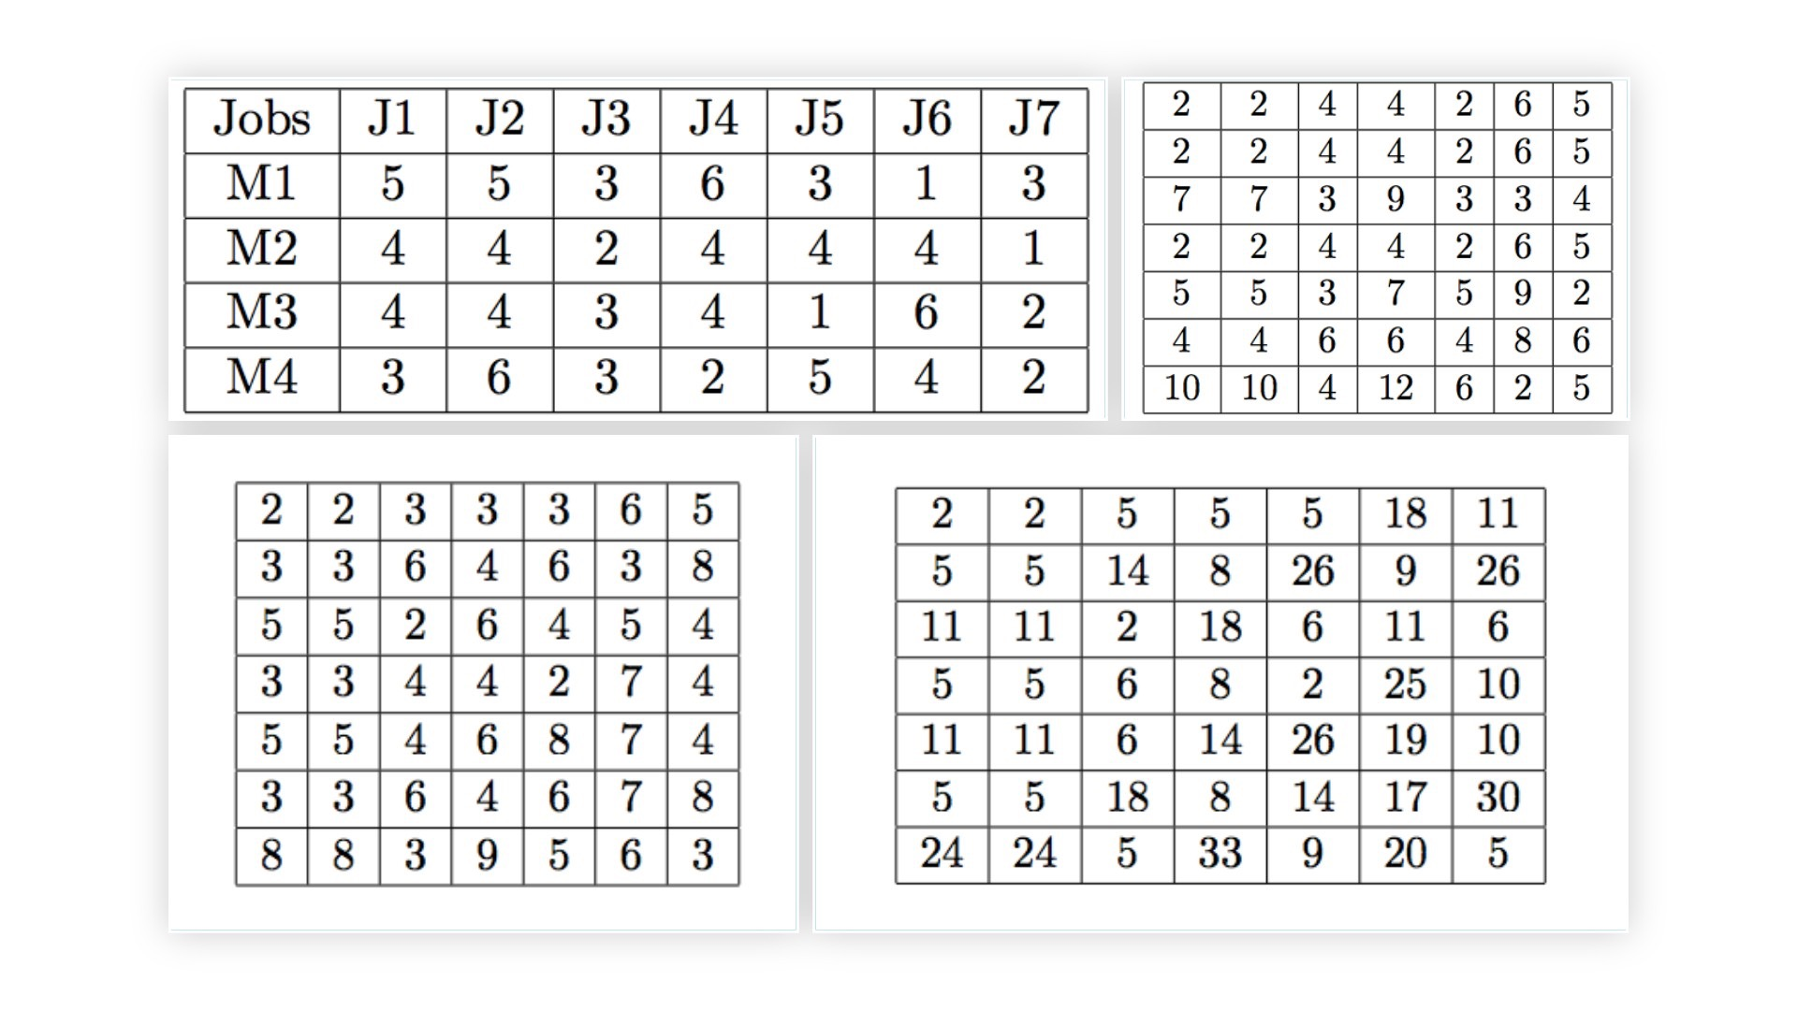
(a) Widmer and Hertz
(b) Stinson’s formula 1
(c) Stinson’s formula 2
19

Slide 39
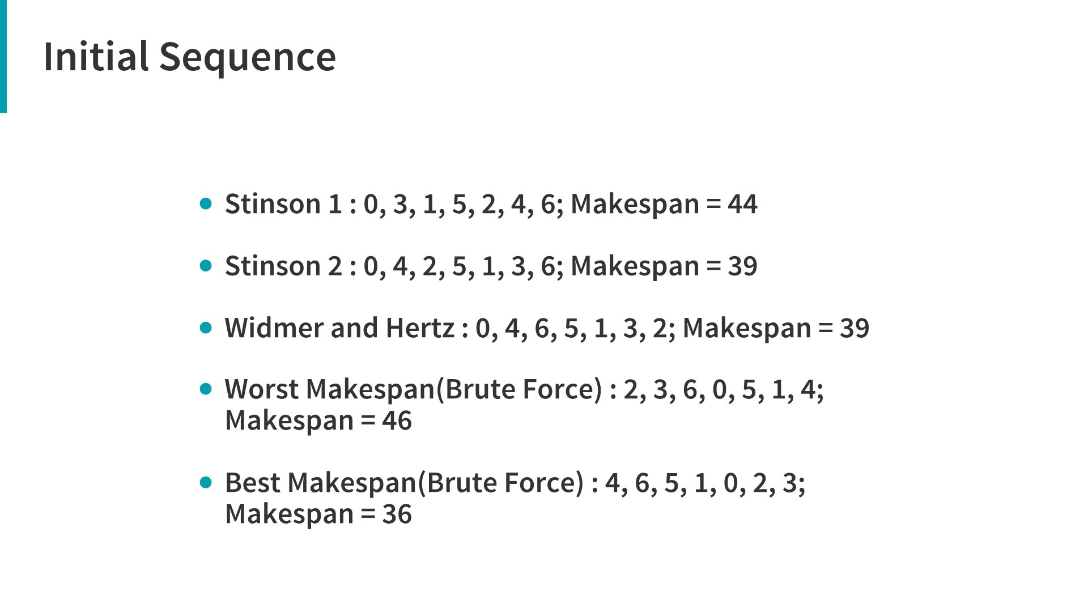
20

Slide 40
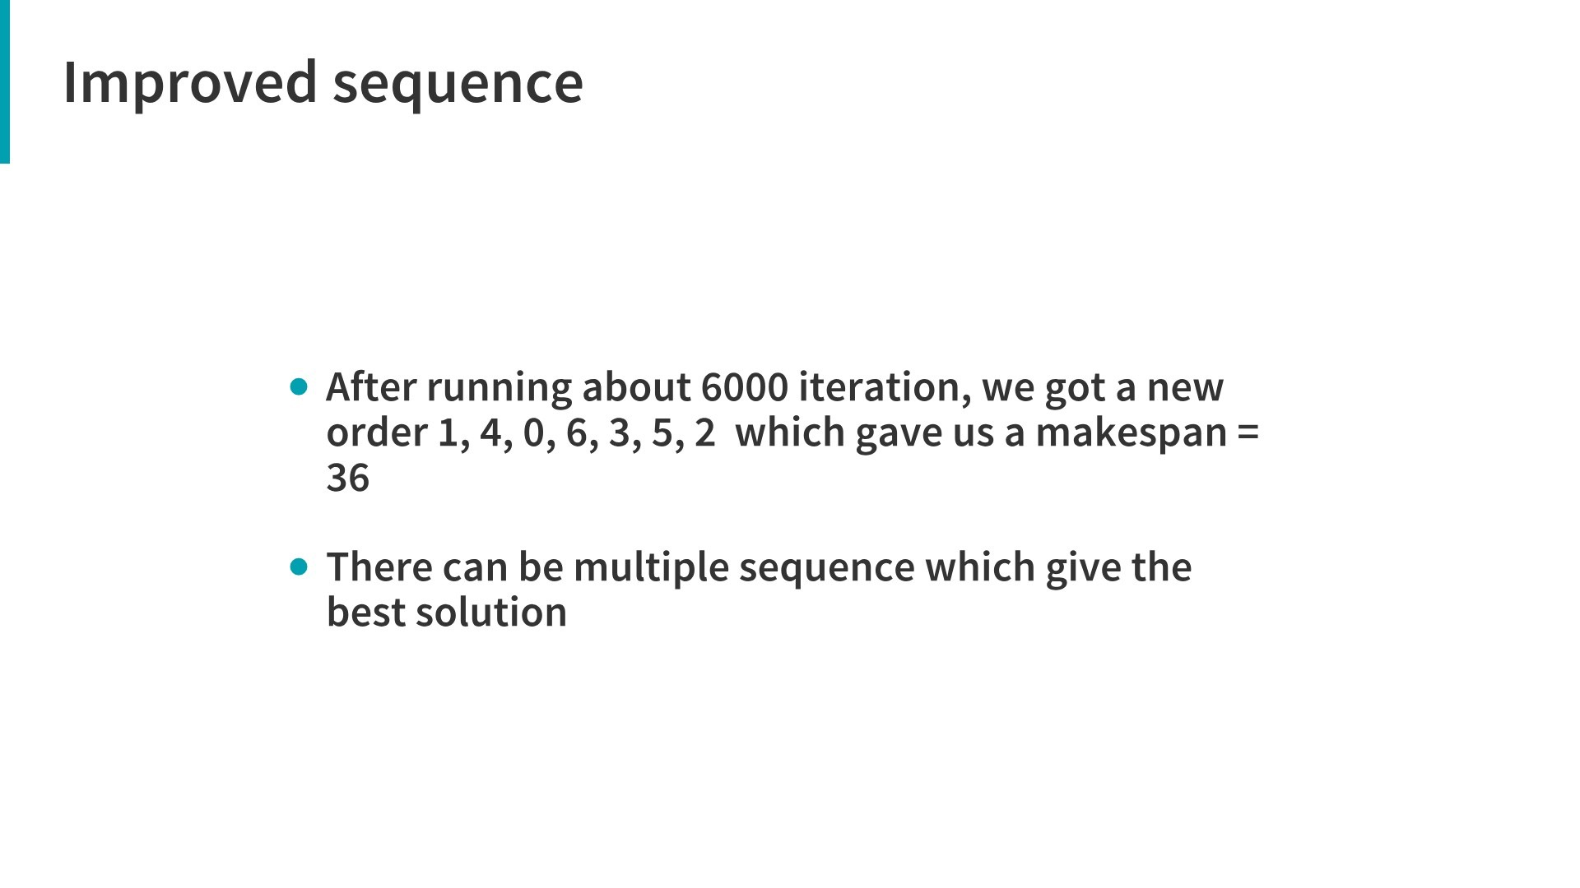
21

Slide 41
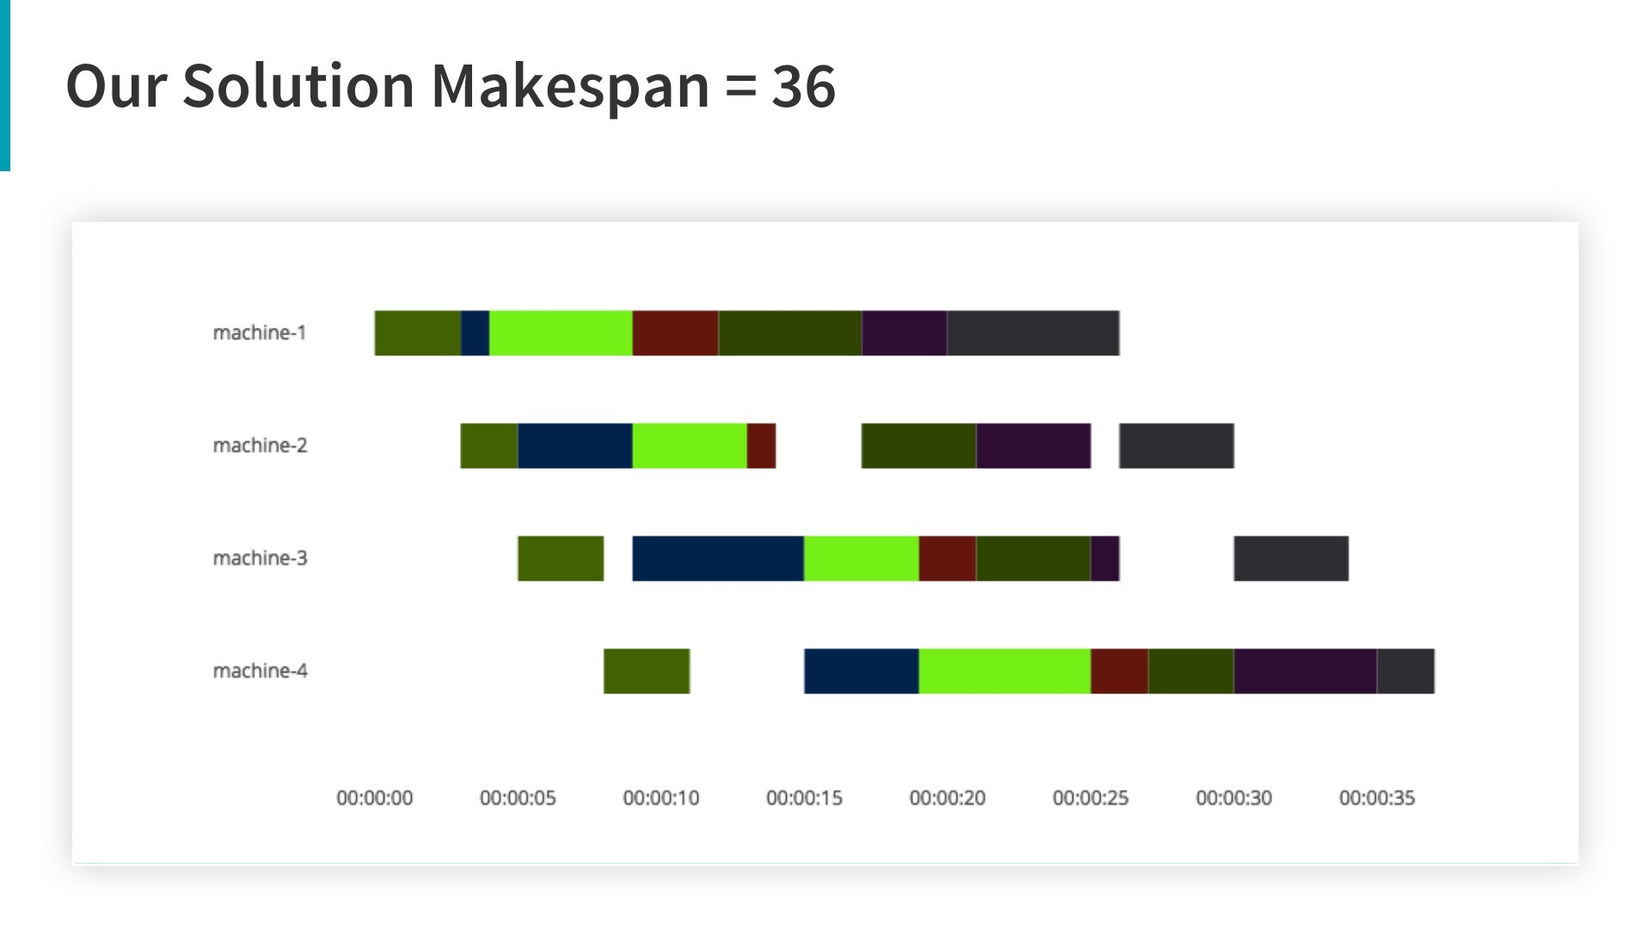
22

Slide 42
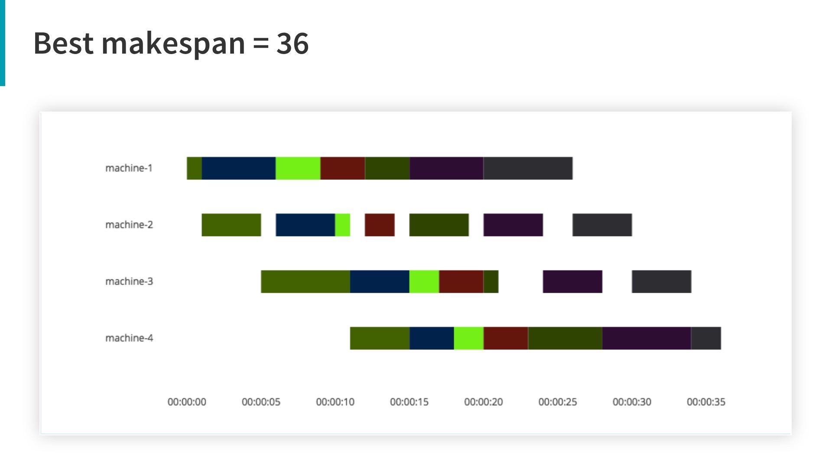
23

Slide 43
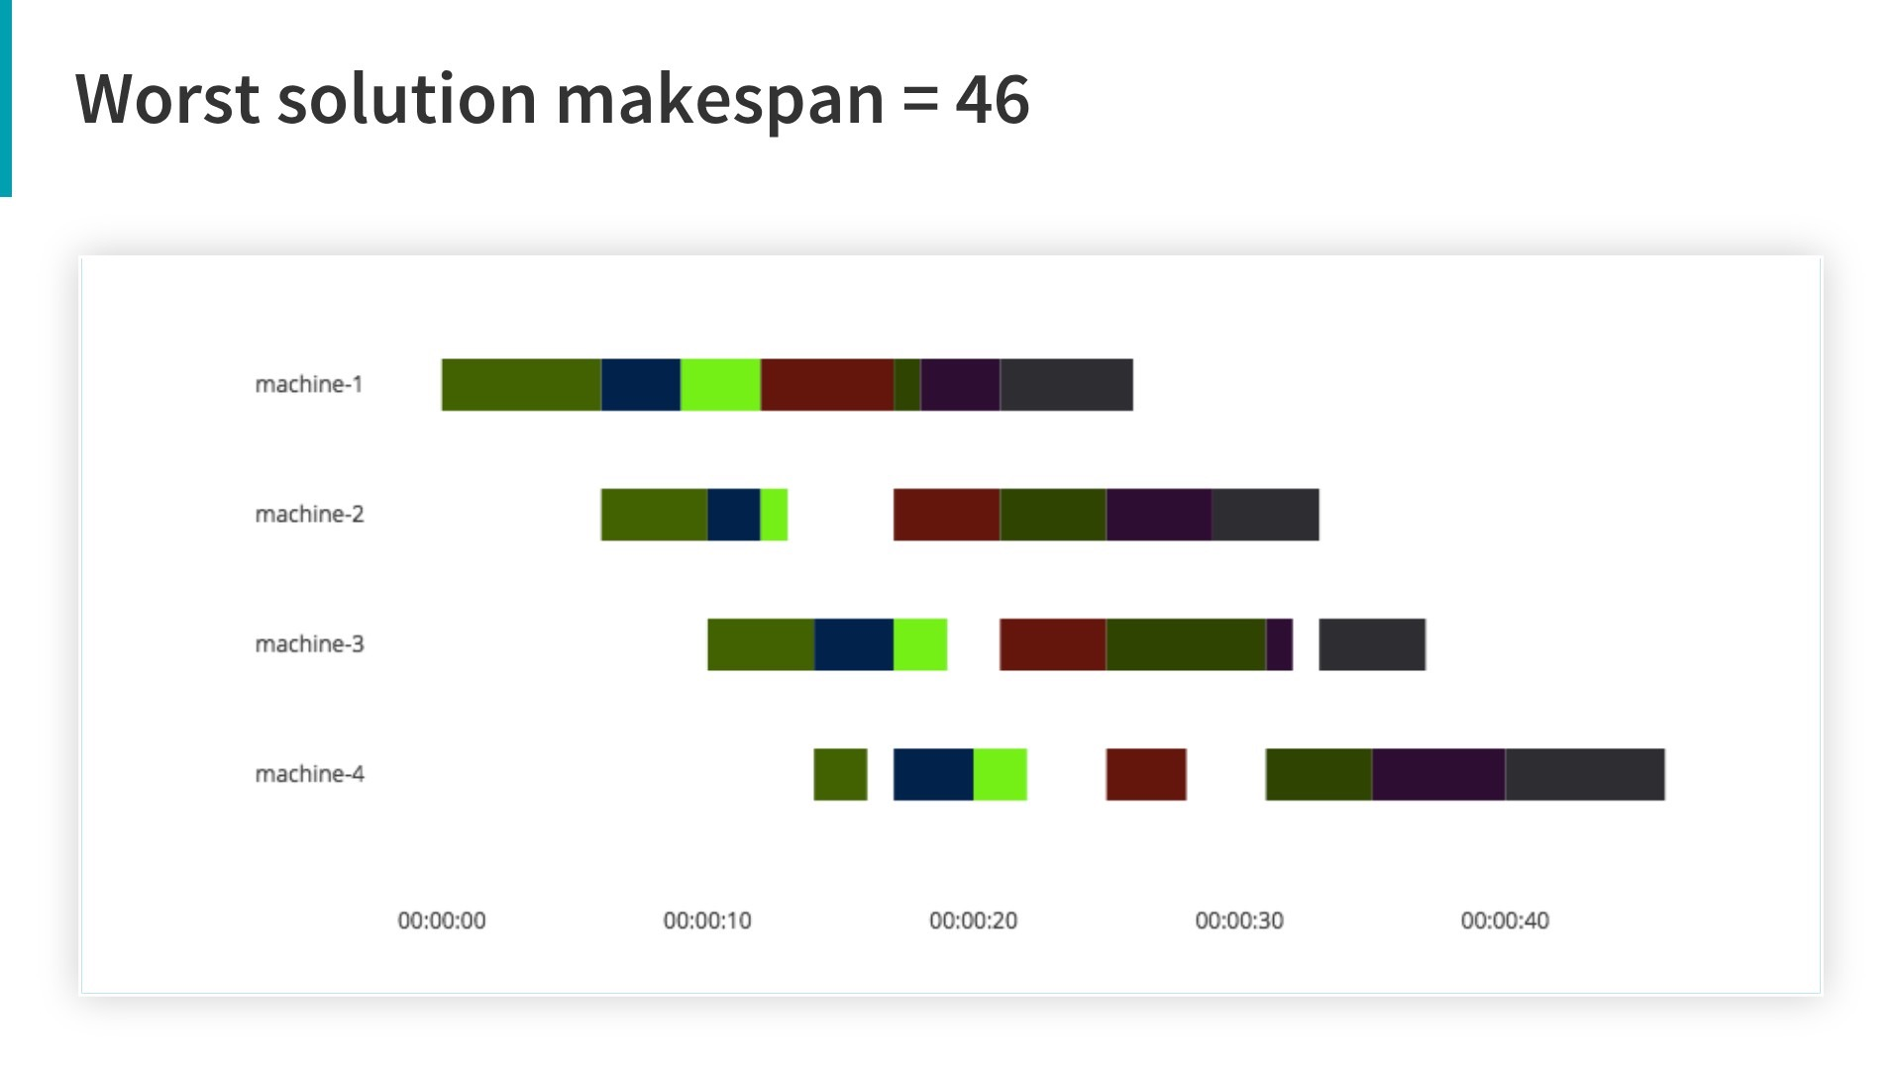
24

Slide 44
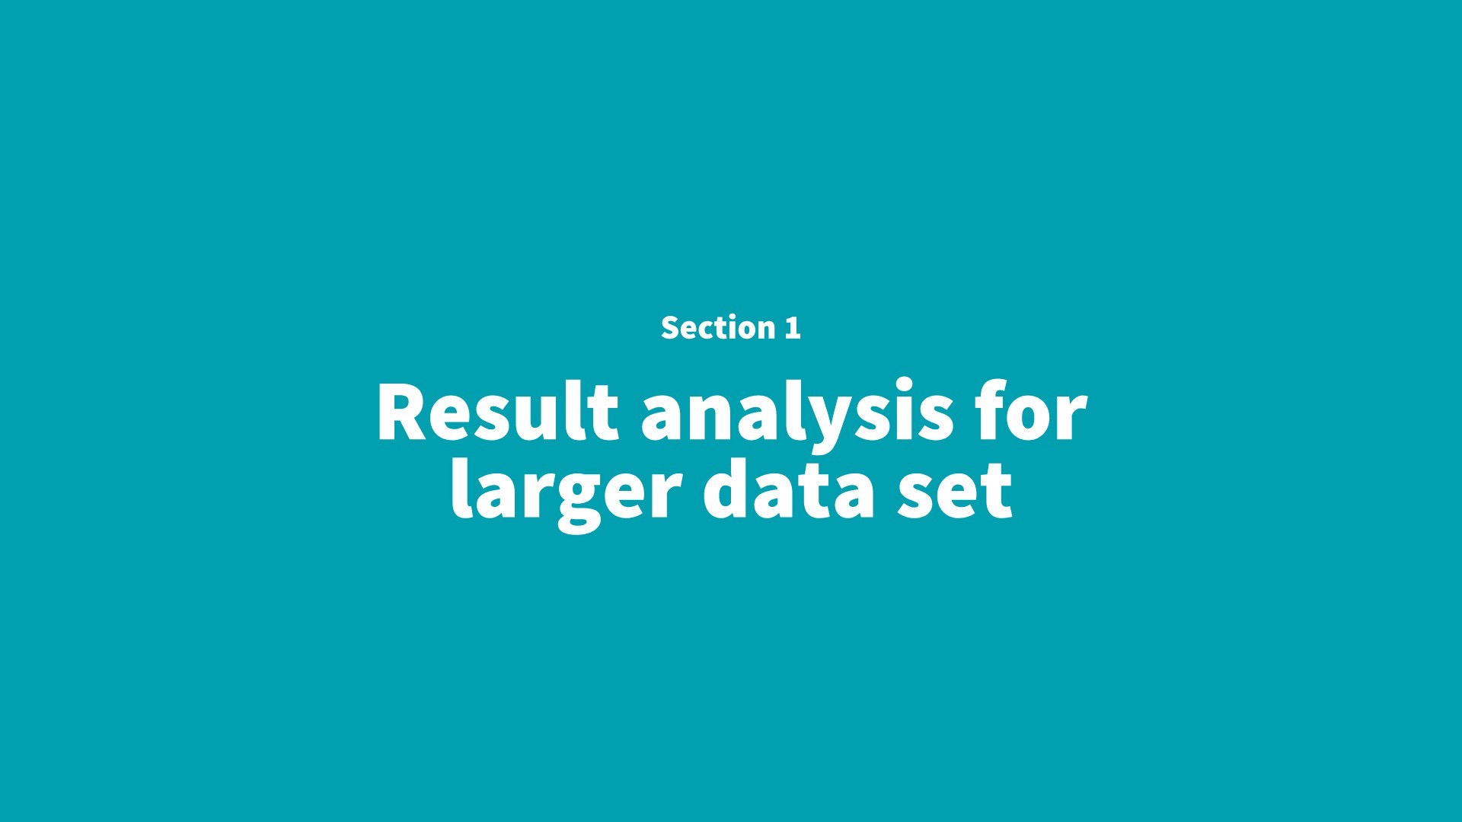
5

Slide 45
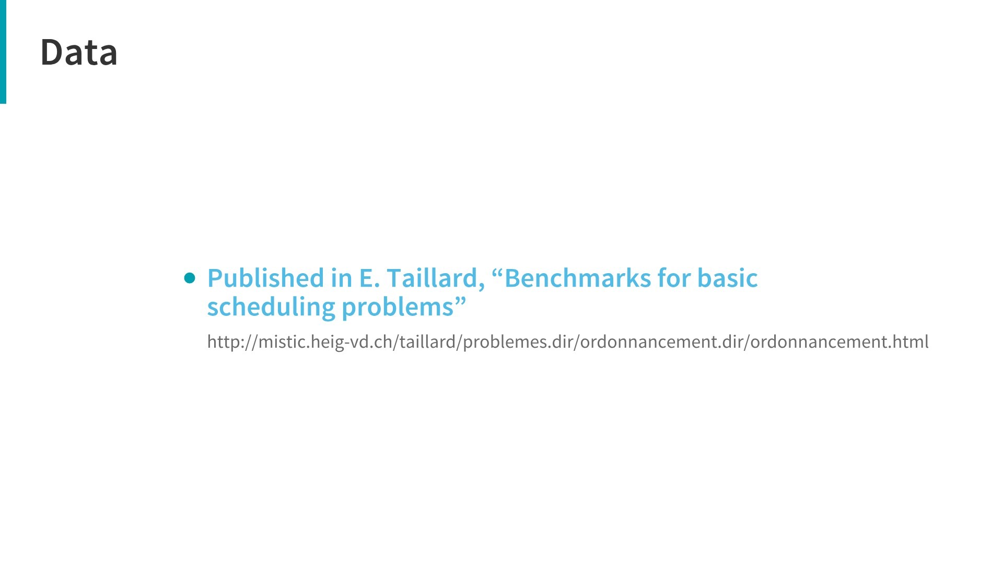
25

Slide 46
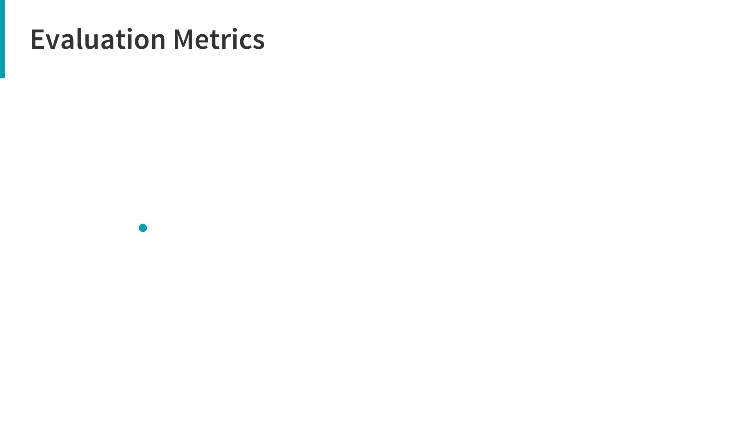
Deviation(%) = 100 ∗ (our_soln − opt) / opt
where,
our_soln = makespan we got from our algorithm
opt = makespan of the optimal solution
26

Slide 47
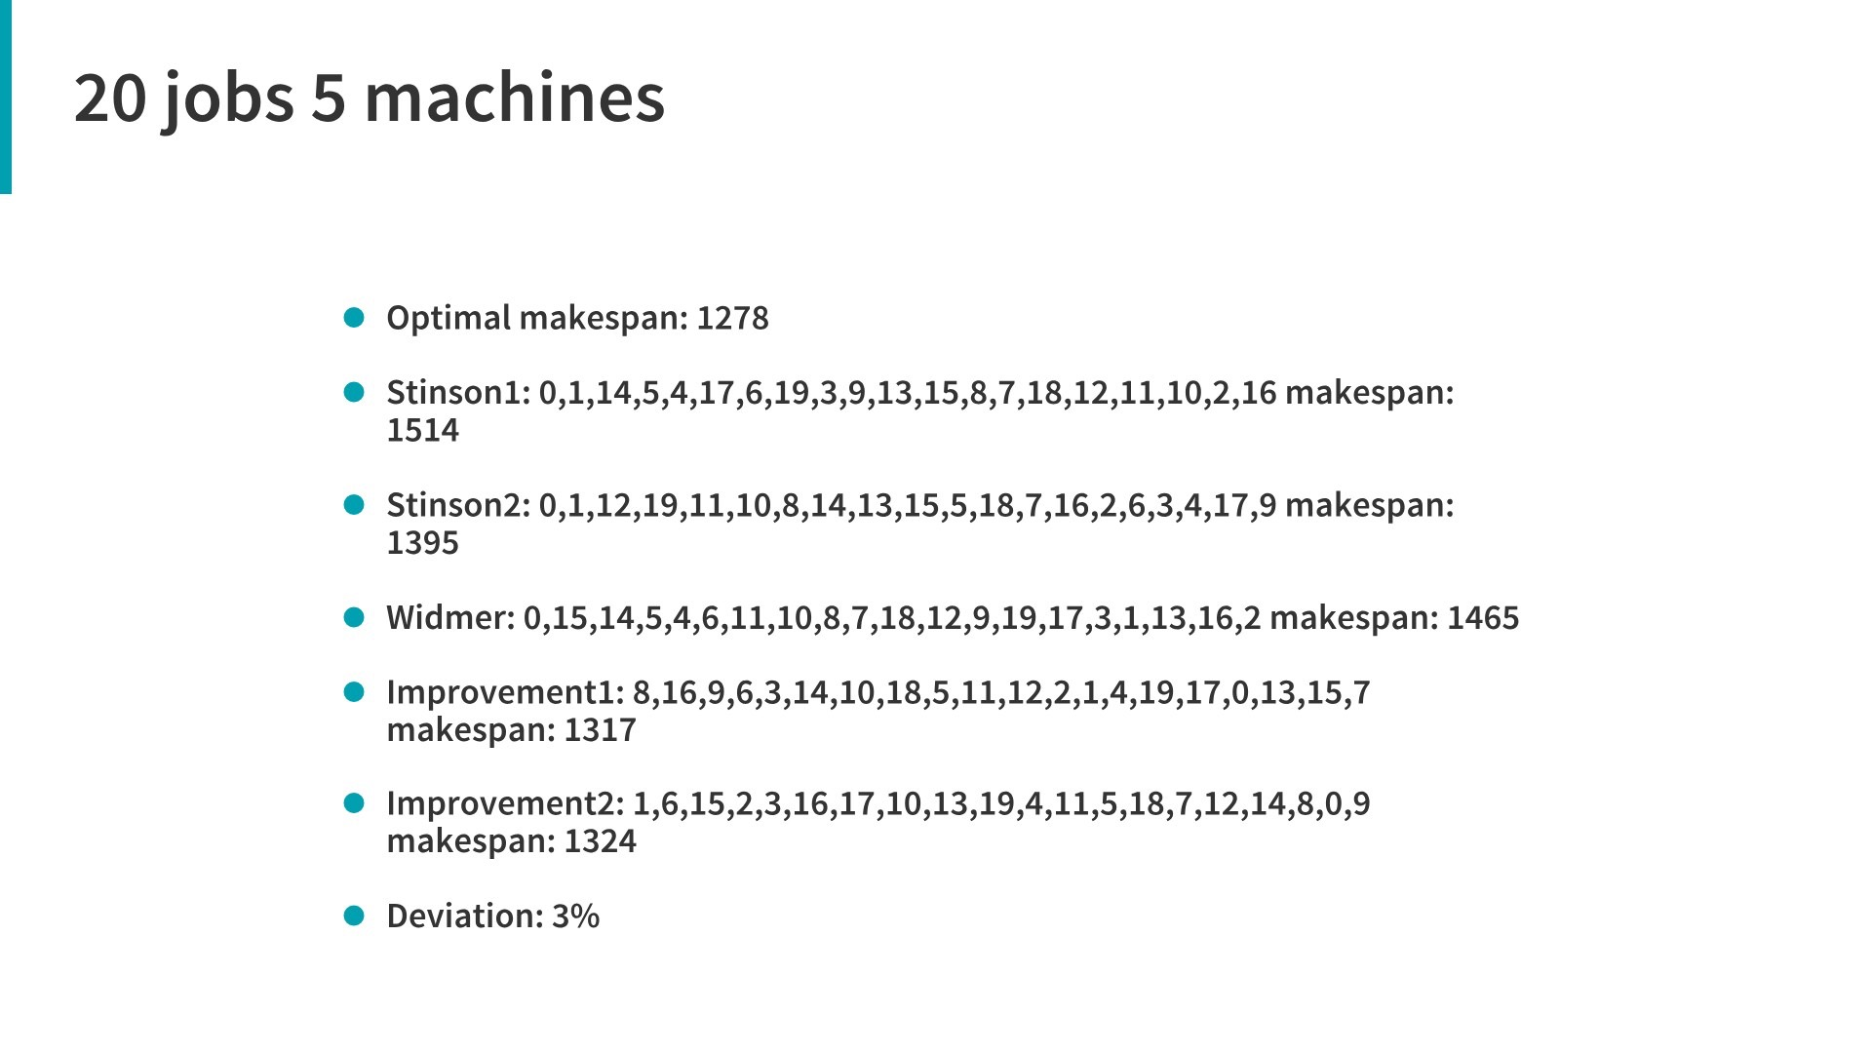
27

Slide 48
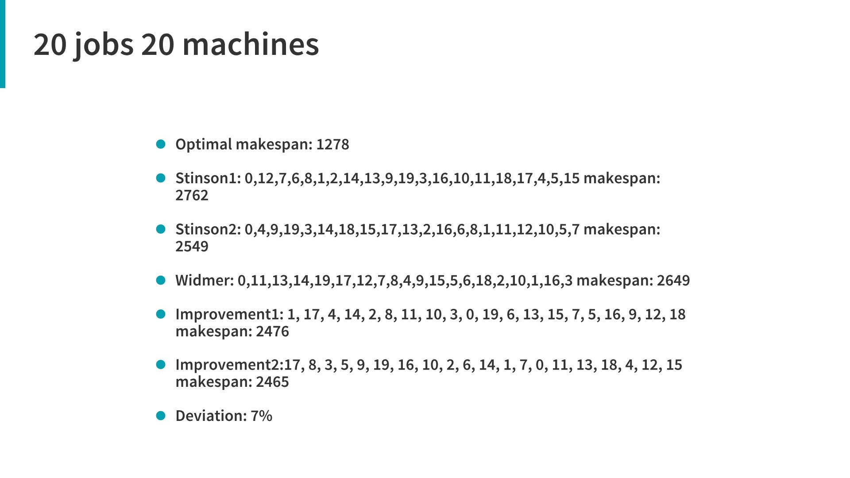
28

Slide 49
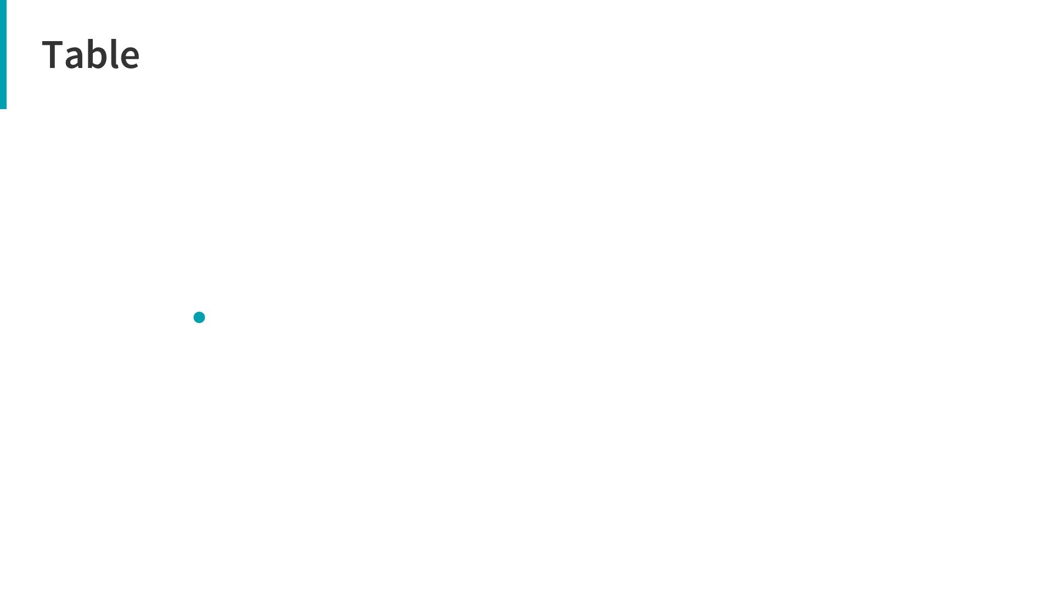
29
Id | m | n | optimal makespan | initial makespan (widmer) | initial makespan (Stinson1) | initial makespan (Stinson1) | improv1 | improv2 | deviation(%)
1 | 4 | 7 | 36 | 39 | 44 | 39 | 36 | 36 | 0
2 | 5 | 20 | 1278 | 1465 | 1514 | 1395 | 1317 | 1324 | 3
3 | 10 | 20 | 1582 | 1887 | 1907 | 2087 | 1760 | 1758 | 11
4 | 20 | 20 | 2297 | 2649 | 2762 | 2549 | 2476 | 2465 | 7
5 | 5 | 50 | 2724 | 3113 | 3162 | 2986 | 2855 | 2856 | 7
6 | 10 | 50 | 3025 | 3697 | 3657 | 3558 | 3452 | 3355 | 10
7 | 20 | 50 | 3875 | 4809 | 4672 | 4939 | 4481 | 4506 | 15
8 | 5 | 100 | 5493 | 5911 | 5855 | 5809 | 5657 | 5696 | 2.9
9 | 10 | 100 | 5770 | 6972 | 6830 | 6797 | 6444 | 6420 | 11
10 | 20 | 100 | 6286 | 7578 | 7827 | 7623 | 7350 | 7307 | 16
11 | 10 | 200 | 10868 | 11978 | 11933 | 11956 | 11605 | 11724 | 6.7

Slide 50
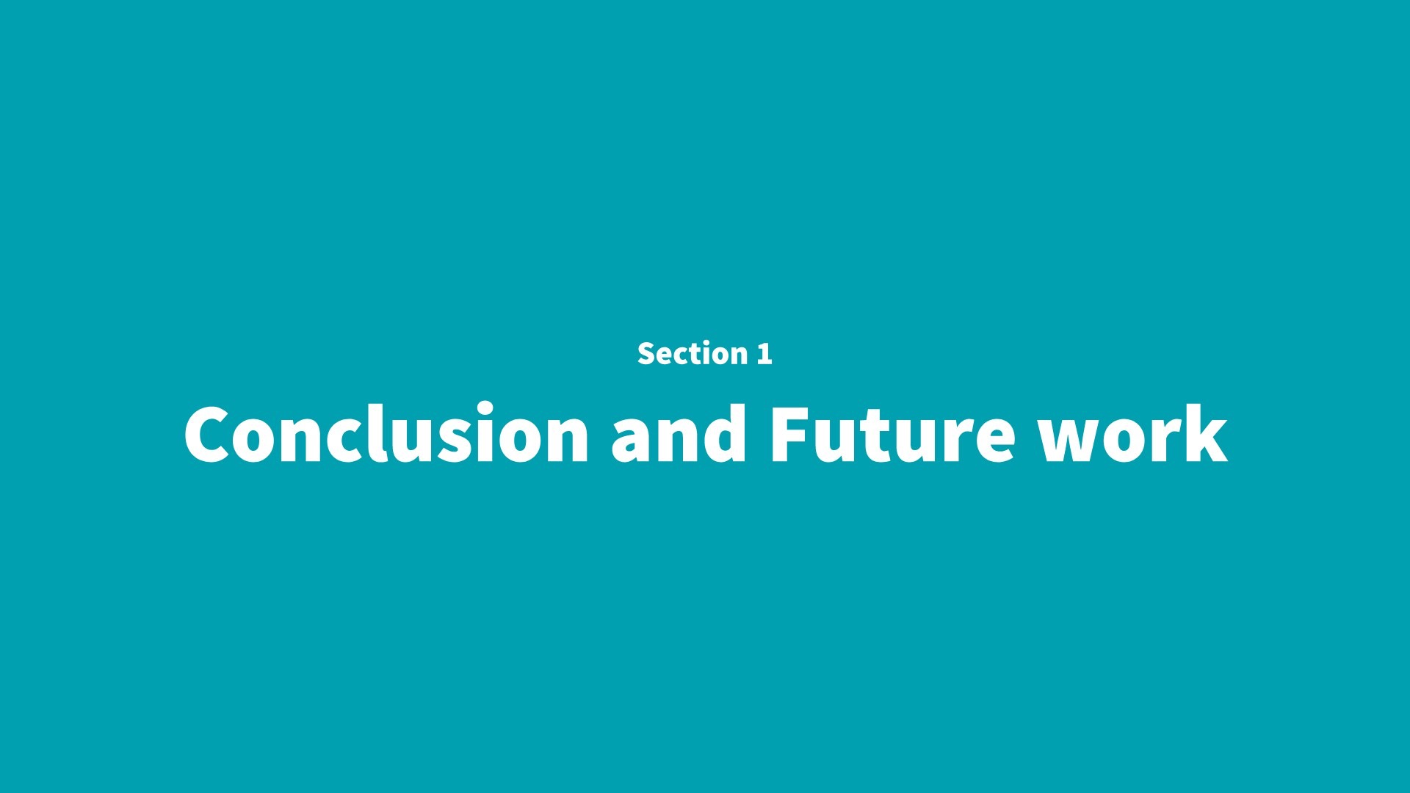
6

Slide 51
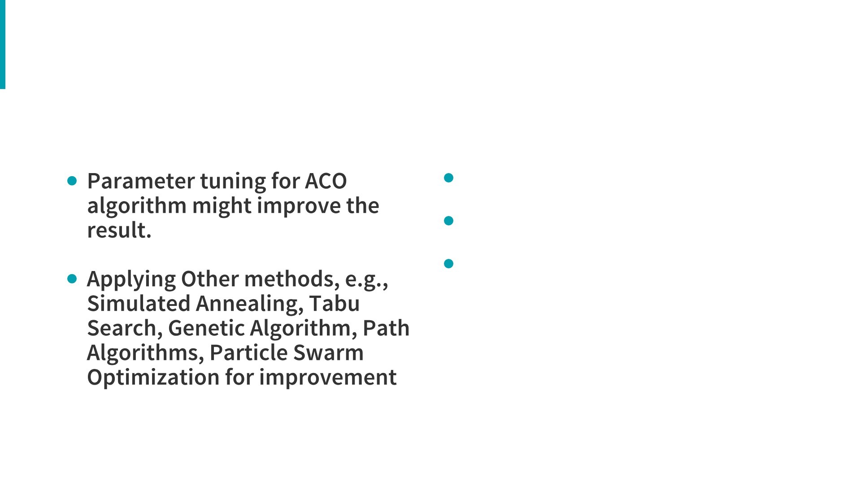
Conclusion an Contributions
Applying ACO to solve PFSP
with a complete new analogy.
This is a complete new study that
ever approached
30

Slide 52


