Slide 1
Backend specialization project - WEAPPER -
Tasneem A.Abdelaziz

Slide 2
Table of Content
01
02
03
04
Intro to the app
Technologies
What is this app?
Frameworks and packages.
Code Structure
Features
The file hierarchy of the project.
A brief overview to the endpoints.

Slide 3
01
Introduction
What is “WEAPPER”?

Slide 4
Introduction
A Backend Weather API Wrapper Service that acts as an intermediary between
the client application (like a weather app) and an external weather API (like VisualCrossing). It abstracts the communication with the third-party weather API, providing a more controlled, optimized, and customizable way to fetch weather data.
It uses Redis for caching to reduce API calls, improve performance, and minimize costs. The service handles errors and customizes the data presentation and optimizes performance by serving cached results for repeated queries.

Slide 5
02
Technologies
Frameworks and packages

Slide 6



Main technologies
Nodejs
Redis
MongoDB
A powerful JavaScript runtime that allows you to build scalable and efficient server-side applications with non-blocking I/O operations.
An in-memory data structure store used for caching, which helps improve performance by reducing the need for repeated API calls.
A NoSQL database that stores data in flexible, JSON-like documents, making it easy to handle and scale large amounts of unstructured data.

Slide 7
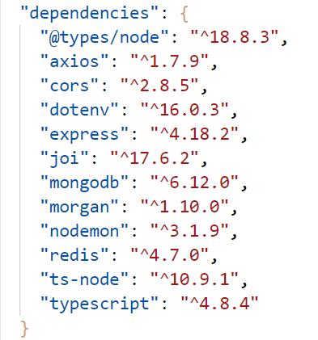
packages

Slide 8
03
Code Structure
The file hierarchy of the project.

Slide 9
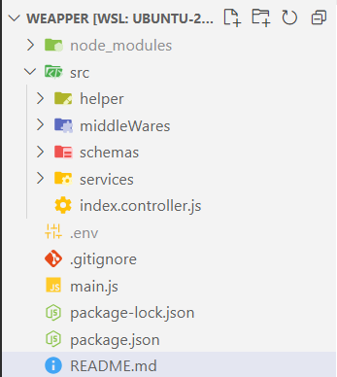
Code Structure

Slide 10
04
Features
A brief overview to the endpoints.

Slide 11
Thanks!
Do you have any questions?
tasneemabdeltawab205@gmail.com

