Slide 1


Movie Recommendation System Using Collaborative and Content-Based Filtering
EDS6346 - Data Mining for Engineers
GROUP_2
TEAM MEMBERS:
POOJITHA REDDY BOMMU - HARSHITHA KESANI - HARSHINI NIMMALA - | NUPOOR KUMBHAR - LIKHITHA REDDY KESARA - MONIKA NANJAPPA - | MUHAMMAD SAAD RAJA - SANJANA PONAGANTI - SUGUNA CHANDANA SIBBENA - TASNEEM SHABBIR ATTARWALA -

Slide 2
Agenda
Objective and Dataset Selection
Data preprocessing
EXPLORATORY DATA ANALYSIS
Methodology
Machine Learning Models
Functionality: Why Our Project Stands Out
TECHNOLOGY STACK
USER INTERFACE
Conclusion
Future scope

Slide 3
Objective and Dataset selection
Objective - To develop a personalized movie recommendation system that generates tailored movie suggestions by analyzing user preferences and their prior viewing history.
Dataset Used: MovieLens
Primary source for user-movie interaction data.
Includes comprehensive movie metadata and user ratings, ideal for implementing various recommendation techniques.
Contains:
20,000,263 ratings
465,564 tag applications
Across 27,278 movies

Slide 4
Data PREPROCESSING
Missing Data Imputation:
There are no Missing values. Hence, Missing data imputation techniques are not implemented.
Encoding Categorical Data:
One-Hot Encoding: Converted genres into binary columns.
Normalization: Scaled numerical features for uniformity and to enhance model performance.
Dropping Unnecessary Columns: Removed timestamp column as it is irrelevant for prediction.
Checking for Duplicates: Ensured dataset uniqueness to maintain data integrity.
Stratified Sampling: Sampled 20% of data stratified by rating and genres to ensure representativeness. Original Data: 20,000,263 entries; Sampled Data: 36,95,583 entries.
Balancing the Data:
Filtered users with ≥10 ratings and movies with ≥5 ratings to address imbalance.
Ensured sufficient representation across users and movies.

Slide 5
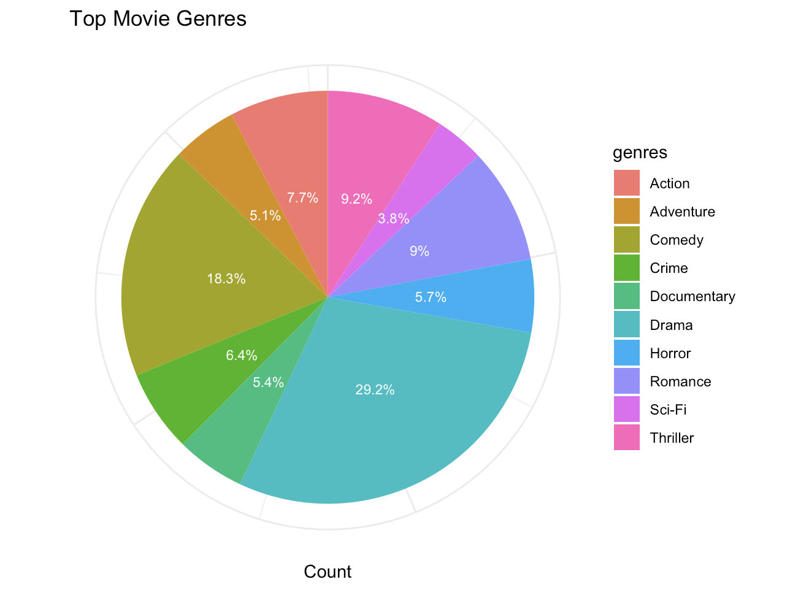
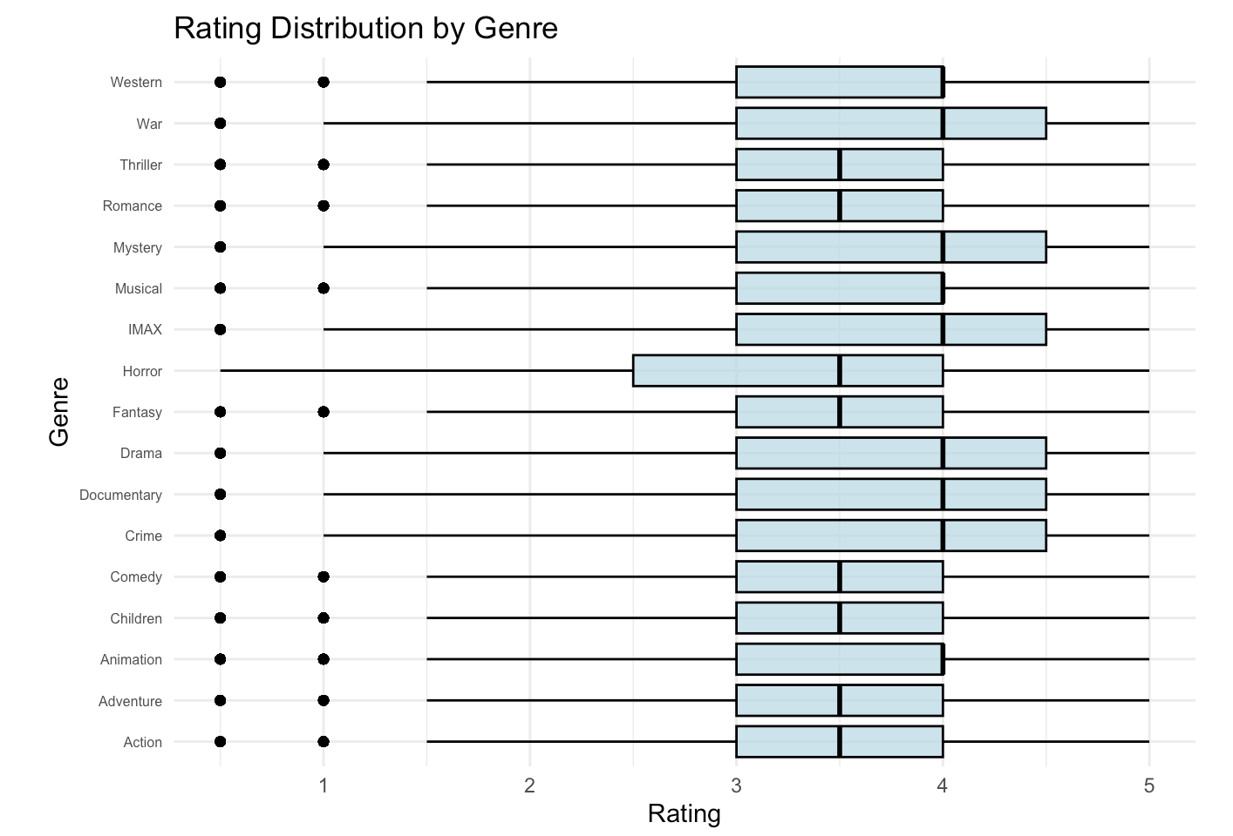
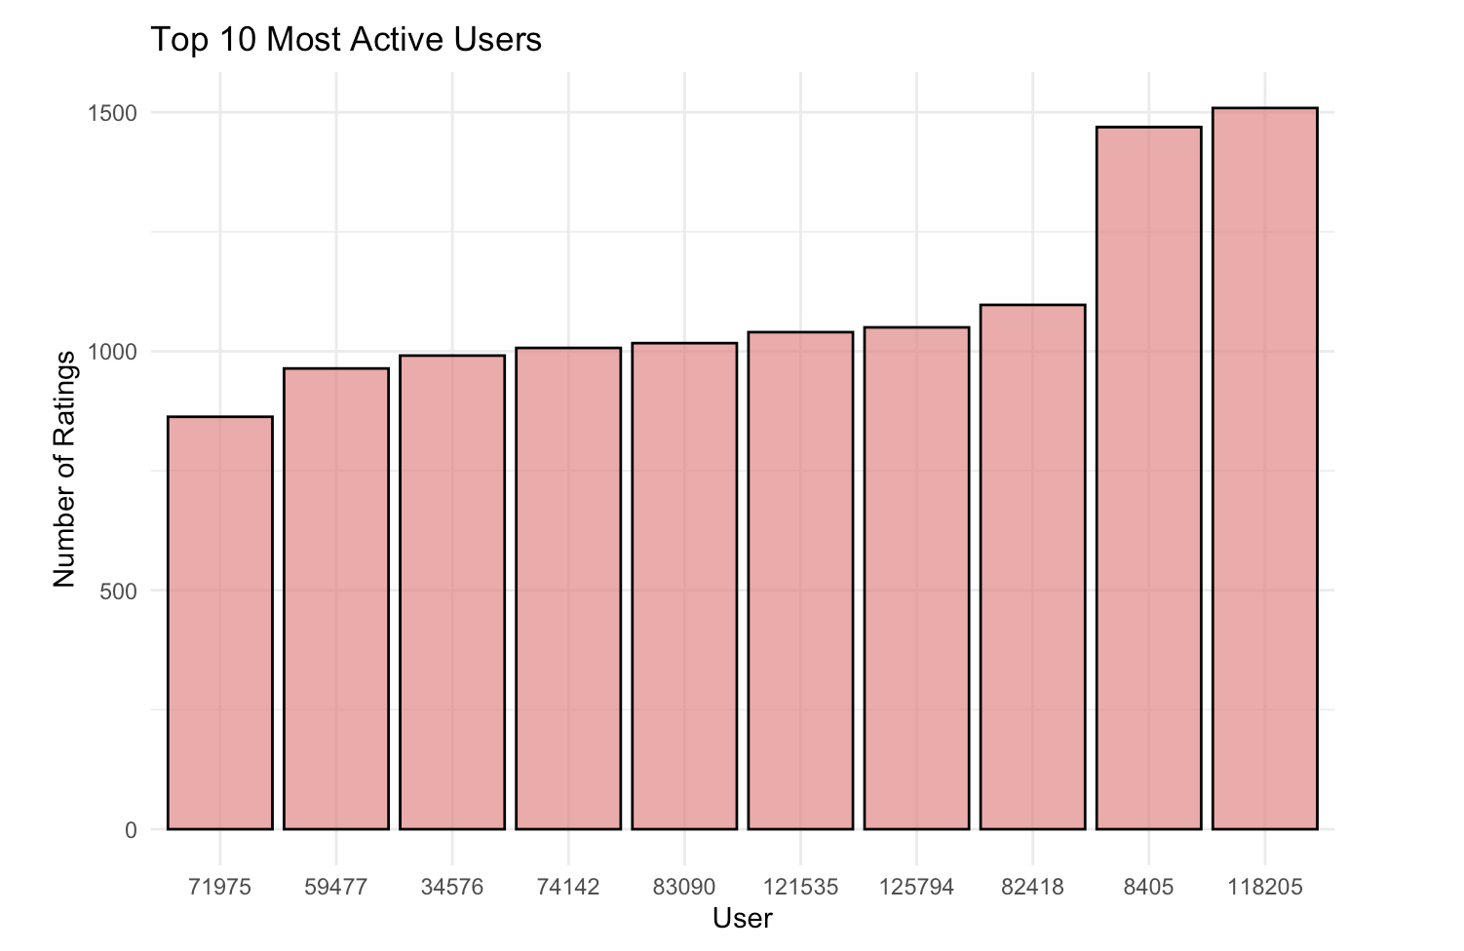
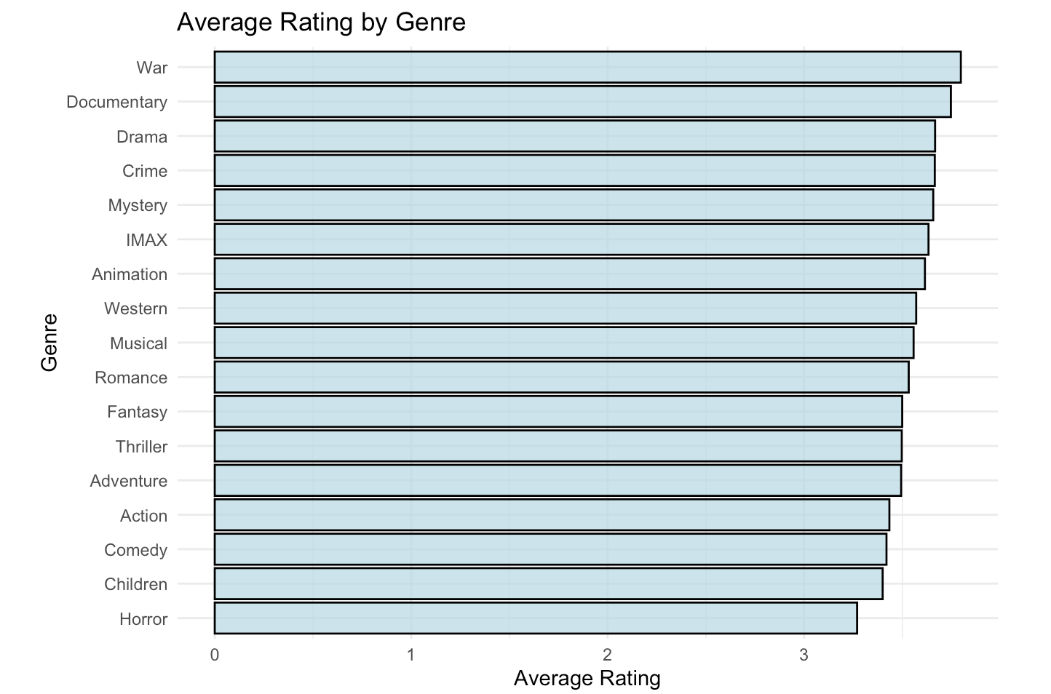
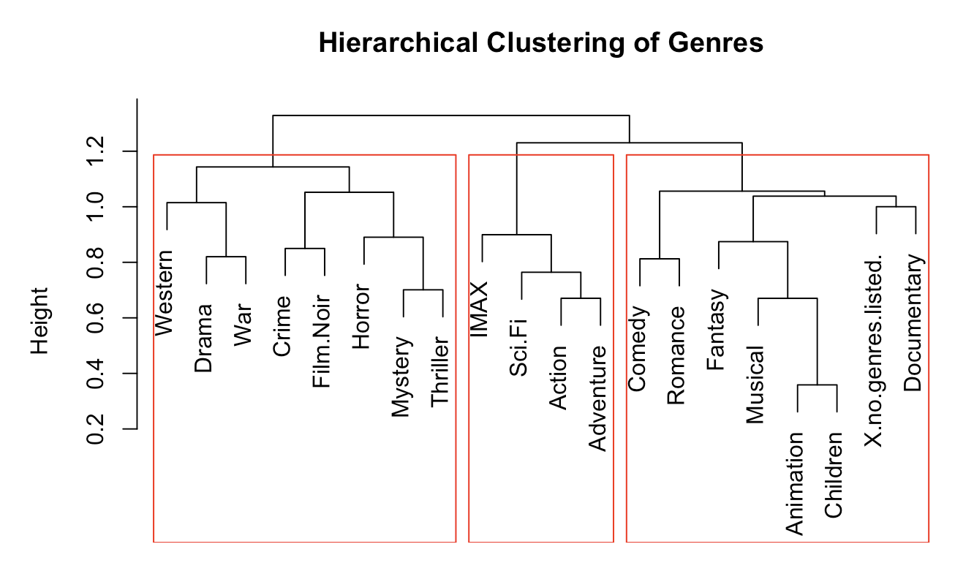
Exploratoty Data analysis

Slide 6
Machine Learning Models
1. Collaborative Filtering
2. Content-Based Filtering
Purpose: Recommends movies based on user behavior (e.g., ratings or watch history).
Types:
User-Based Collaborative Filtering:
Finds similar users (based on ratings/watch history) and recommends movies they liked.
Item-Based Collaborative Filtering:
Finds movies similar to the ones a user has watched and recommends them.
Machine Learning Method:
Uses similarity measures (e.g., cosine similarity, Pearson correlation).
Can be enhanced with matrix factorization techniques like SVD (Singular Value Decomposition).
Purpose: Recommends movies similar to the ones the user has watched or liked.
Steps:
Create a movie-feature vector (e.g., based on genres, cast, director, etc.).
Compute similarity (e.g., using cosine similarity or a distance metric) between movies.
Machine Learning Enhancement:
Use TF-IDF (Term Frequency-Inverse Document Frequency) for text features like movie descriptions.
Train a classification model (e.g., Logistic Regression, Naive Bayes) to predict user preferences.

Slide 7
Methodology
1. Similarity Calculation
Feature Matrix
Extracted genre columns to create a movie-feature matrix.
Distance Metric:
Used Euclidean distance to measure the similarity between movies:
Smaller distances indicate greater similarity.
Computed pairwise distances to form a genre similarity matrix.
2. Input Processing
Movie Selection
Accepted input movie names (from UI or batch file).
Normalized titles (converted to lowercase and trimmed).
Identify Input Movies:
Matched input titles to corresponding movieId from the dataset.
3. Generating Recommendations
Locate Input Movies
Found indices of input movies in the similarity matrix.
Average Similarity:
For each input movie, computed an average similarity score for all other movies.
Exclusion:
Excluded the input movies themselves from the recommendation list.
Ranking:
Sorted movies by similarity (ascending order for Euclidean distance).
Top Recommendations:
Selected top N movies with the highest similarity.

Slide 8
EVALUATION METRICS
Overlap Count
Summative Scores
Definition:
Counts the number of movies common between two lists (e.g., predicted vs. actual).
Implementation:
Uses the intersect() function in R to find common movies between:
Predicted vs. Actual Movies.
Predicted vs. Input Movies.
Significance:
Measures how well the recommendations align with actual or user-provided data.
Definition:
Sums up the overlap counts across all rows in the dataset.
Types:
Sum of Scores (Actual vs. Predicted):
Represents the overall alignment of the predicted recommendations with the ground truth.
Sum of Scores (Input vs. Predicted):
Measures the relevance of the recommendations to the original user input.

Slide 9
Functionality: Why Our Project Stands Out
Unlimited Movie Selection:
Users can select multiple movies from the dataset without any restrictions.
Customizable Recommendations:
Users specify how many recommendations they want, offering complete control over results.
Effortless Navigation:
Movies can be sorted for better visibility.
Options to display results on a single page or across multiple pages for user convenience.
High-Speed Performance:
Recommendations are generated within seconds for a seamless experience.
Backend Independence:
Backend processes are decoupled from the frontend, ensuring smooth performance.
Input data from a CSV file is processed in the background, delivering results without UI interruptions.
Enhanced Efficiency:
Utilizes parallel processing techniques, ensuring the frontend remains responsive even during intensive backend operations.

Slide 10
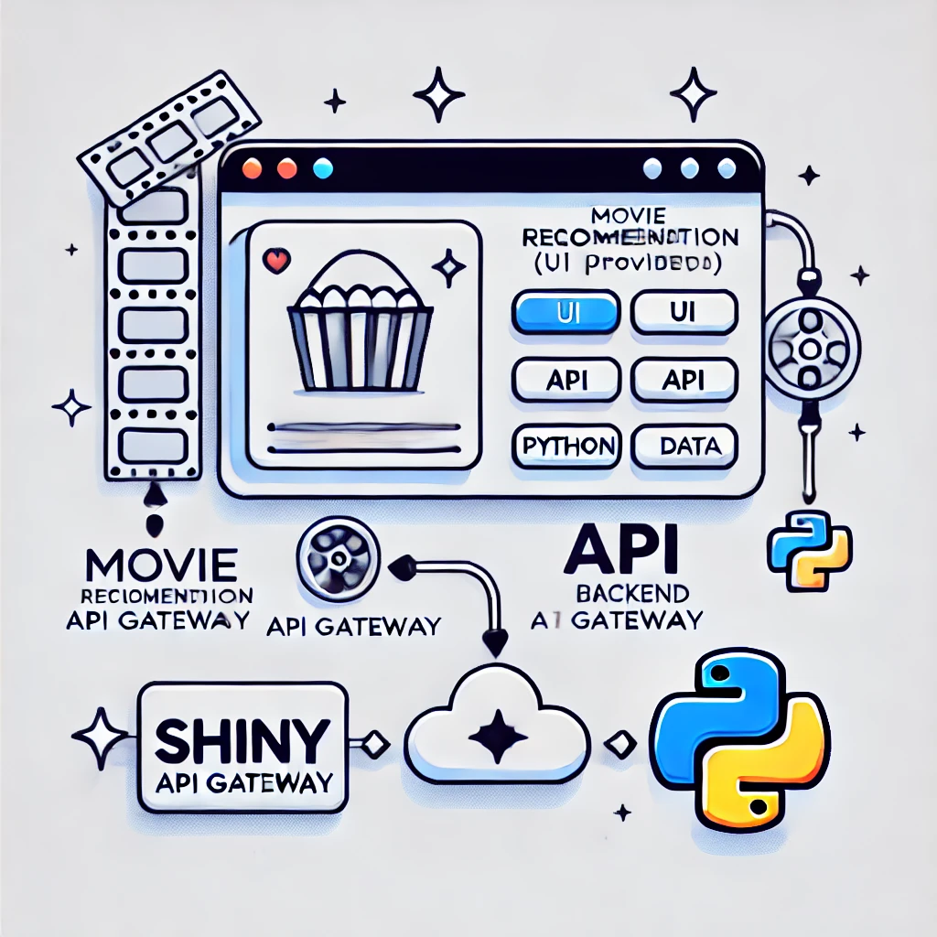
TECHNOLOGY STACK
API Gateway:
Utilized Shiny for seamless communication between the backend and user interface.
Supports real-time updates and efficient data handling.
User Interface (UI):
Developed using Python with integrated CSS for enhanced styling and responsiveness.
CSS Features:
Clean and modern design for easy navigation.
Ensures a consistent user experience across devices.
Provides intuitive access to personalized movie recommendations.
Model:
Built in Python to process user preferences and generate movie recommendations.

Slide 11
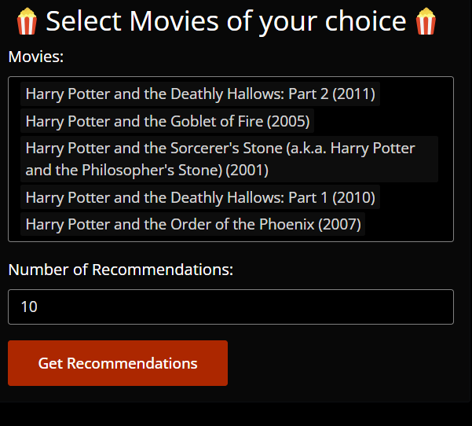
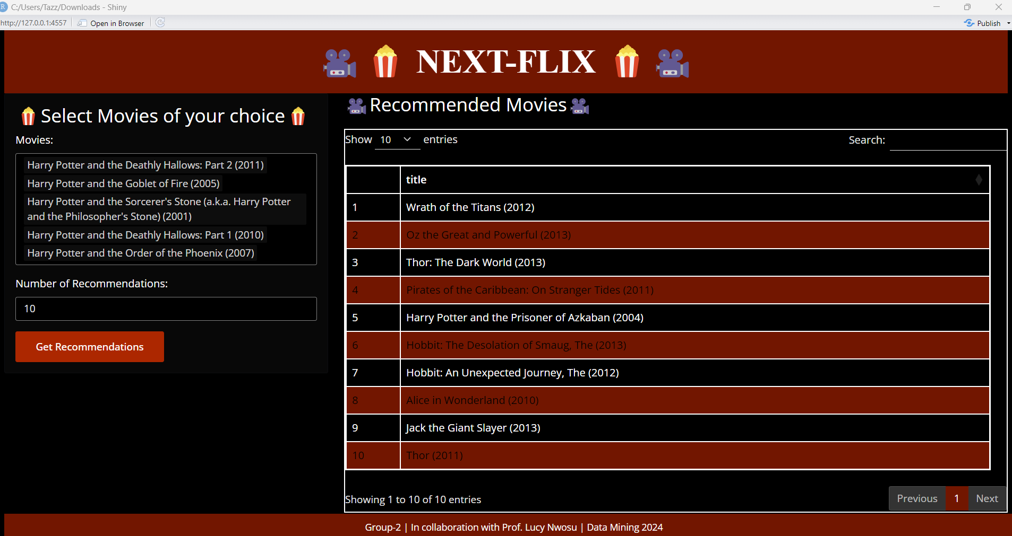
USER INTERFACE

Slide 12
Conclusion
The recommendation system successfully identifies movies similar to user preferences using genre-based similarity, providing accurate and relevant recommendations with a scalable and efficient design for both real-time and batch processing.
The evaluation framework demonstrates the system's effectiveness, aligning predicted recommendations with actual user preferences and ground truth data.

Slide 13
FUTURE SCOPE
Enhance the recommendation system by incorporating collaborative filtering and deep learning models to better capture user behavior and improve personalization.
Expand evaluation metrics to include diversity, novelty, and user feedback integration, enabling continuous improvement and a richer user experience.
Integrate real-time user interaction tracking and reinforcement learning techniques to dynamically adapt recommendations based on evolving user preferences and feedback.

Slide 14

THANK YOU

