Slide 1
Project Documentation
1.Overview :
This document outlines the approach taken to design and implement a relational database system, including the creation of tables, constraints, stored procedures, views, and necessary data manipulation tasks. The focus was on establishing a solid foundation for managing employee and project assignments within an organization.

Slide 2
2.Approach
1. Database Structure Design
Database: company database
Schema: employee
- Table: Employees
Departments
Projects
Assignments
- Constraint: PRIMARY KEY
FOREIGN KEY
UNIQUE
CHECK

Slide 3
Employees
Column | Data Type
Employee ID | INT IDENTITY(1,1),
FirstName | NVARCHAR(50) NOT NULL
Last Name | NVARCHAR(50) NOT NULL
Hire Date | DATE
Constraint:
- TABLE Employees
PRIMARY KEY (Employee ID);
- TABLE Departments
PRIMARY KEY (Department ID);
- TABLE Employees
FOREIGN KEY (Department ID) REFERENCES Departments(Department ID);
- TABLE Departments
UNIQUE (Department Name);
Departments
Column | Data Type
Department ID | INT IDENTITY(1,1)
Department Name | NVARCHAR(100) NOT NULL
Location | NVARCHAR(100)

Slide 4
Constraint:
- ALTER TABLE Projects - ALTER TABLE Assignments
PRIMARY KEY (Project ID); PRIMARY KEY (Assignment ID);
- ALTER TABLE Assignments
FOREIGN KEY (Employee ID)
EFERENCES Employees(Employee ID);
- ALTER TABLE Assignments
FOREIGN KEY (Project ID) REFERENCES Projects(Project ID);
- ALTER TABLE Projects
UNIQUE (Project Name);
- ALTER TABLE Assignments
CHECK (End Date >= StartDate);
- ALTER TABLE Projects
CHECK (End Date >= StartDate OR End Date IS NULL);
- ALTER TABLE Assignments
CHECK (Role != '');
Projects
Column | Data Type
Project ID | INT IDENTITY(1,1)
Project Name | NVARCHAR(100) NOT NULL
StartDate | DATE NOT NULL
End Date | DATE
Assignments
Column | Data Type
Assignment ID | INT IDENTITY(1,1)
Role | N varchar(100) NOT NULL
StartDate | DATE NOT NULL
End Date | DATE

Slide 5
2. Stored Procedures Implementation
Stored Procedures Created:
- Create Tables: Generates all required tables.
- Create Constraints And Relationships: Applies necessary constraints to ensure data integrity.
- Insert Data From Another Database: Populates tables from a specified source database.
- Perform Query Tasks: Executes specific queries to validate data and generate insights.
- Create Views: Establishes views to simplify data retrieval for reporting and analysis.
- Run All Setup Procedures: A master procedure that orchestrates the execution of all setup procedures in the correct order.

Slide 6
3. Use of Common Table Expressions (CTEs)
CTEs were utilized in the Employee Project Assignments view to enhance readability and maintainability. This modular approach allows for easier debugging and understanding of complex queries.
4. Execution of Procedures
A separate script was created to execute all stored procedures in the correct order to set up the database structure and populate it with initial data.

Slide 7
3.Challenge
We faced difficulty during creating the stored procedure Create Views because creating view inside stored procedure is not allowed in SQL Server. To overcome this, dynamic SQL is used within a stored procedure to create the view.

Slide 8
USE companydatabase;
GO
CREATE PROCEDURE CreateViews
AS
BEGIN
DECLARE @SQL NVARCHAR(MAX);
SET @SQL = N'
CREATE OR ALTER VIEW EmployeeProjectAssignments AS
SELECT
e.FirstName,
e.LastName,
d.DepartmentName,
p.ProjectName,
a.StartDate,
a.EndDate,
DATEDIFF(DAY, a.StartDate, a.EndDate) AS AssignmentDuration
FROM
Employees e
JOIN
Assignments a ON e.EmployeeID = a.EmployeeID
JOIN
Projects p ON a.ProjectID = p.ProjectID
JOIN
Departments d ON e.DepartmentID = d.DepartmentID;
';
EXEC sp_executesql @SQL;
END;
GO
This approach dynamically creates or alter Employee Project Assignments view.
The use of sp_executesql allows the dynamic SQL to be executed within the stored procedure.

Slide 9
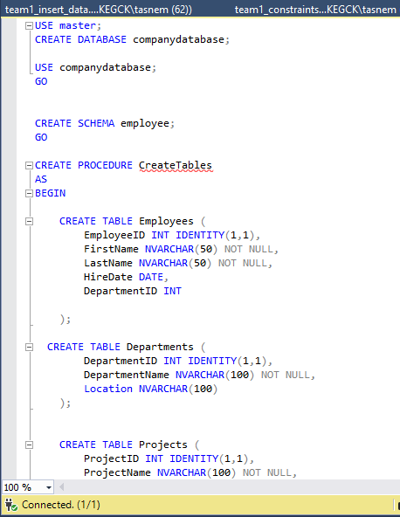
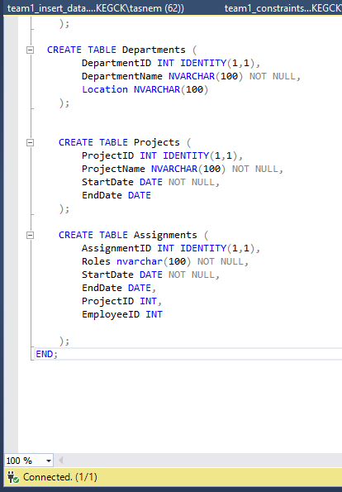
- Code

Slide 10
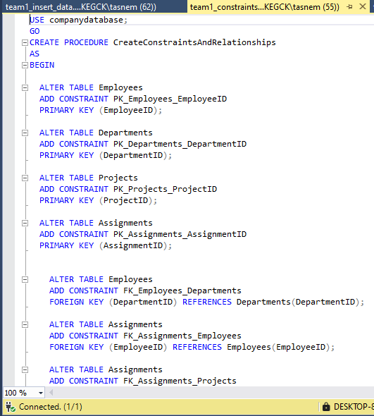
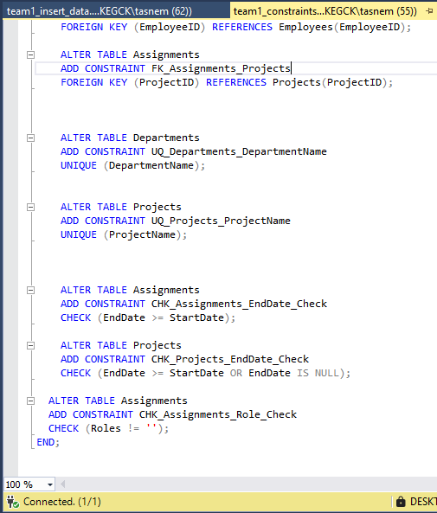

Slide 11
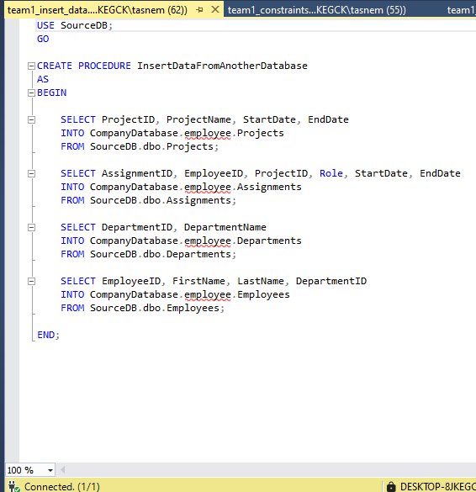

Slide 12
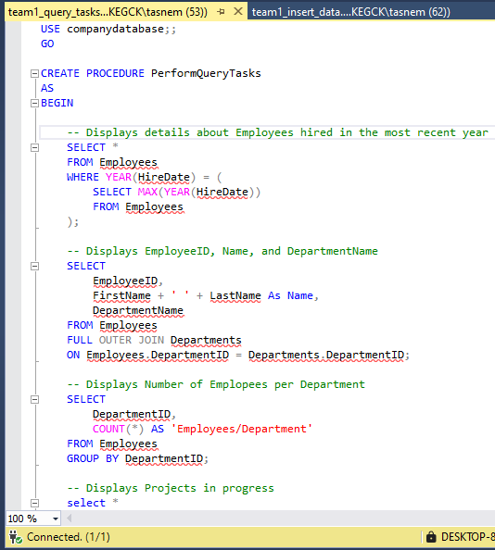
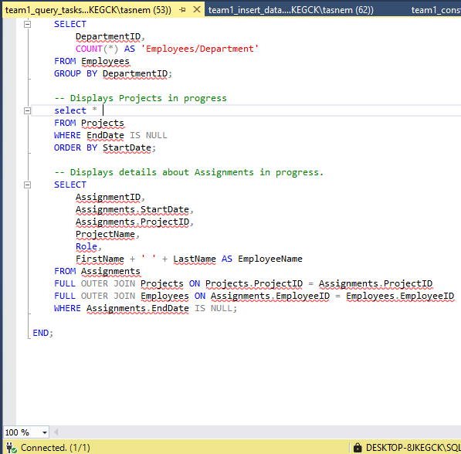

Slide 13
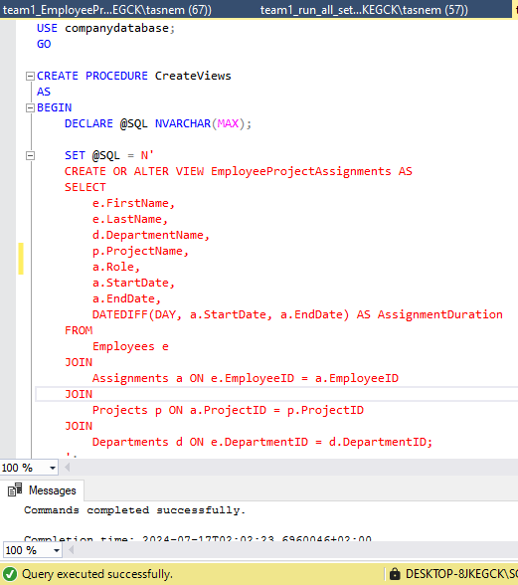
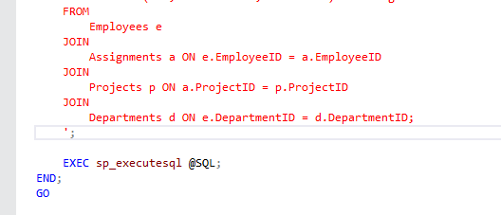

Slide 14
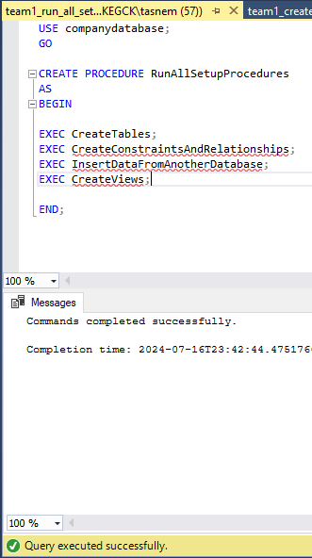
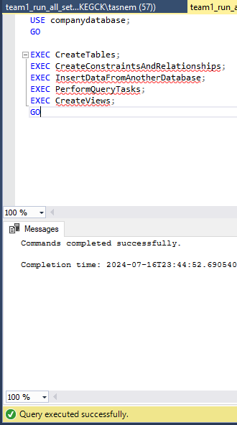

Slide 15
