Slide 1
Project Title
Multisensory Line-Following Robot for Surface Cleaning and Disinfection in Indoor Environments
Presented By
Group No: B8
ID: 202114041 – Mayesha Tasnim 202114081 – S. M. Nafis Ahmed
202114084 – Sadia Bintay Mostafiz
202114094 – Shohanur Rahman Shovo
Presented To
Dr. Md Akhtaruzzaman Dr. Nusrat Sharmin Fairooz Tasnia

Slide 2
Outline of Presentation
Introduction
Literature Review
Methodology
Result and Discussion
Limitations and Future Work
Conclusion
Reference

Slide 3
Introduction and Objectives
Surface-disinfecting robots are autonomous devices designed to sterilize or disinfect floors using UV-C light or chemical sprays. The objectives of our robot are given below:
To develop an indoor line-following mobile robot with obstacle avoidance for safe and efficient navigation.
To integrate safe UV sterilization and vacuum cleaning mechanisms to reduce the spread of infectious microbes.
To integrate an AI-based object detection surveillance system for enhanced monitoring and real-time alerts.
To set up a wireless charging system to charge the robot automatically.

Slide 4
Literature Review
Ref. | Paper Name | Contributions | Methodology | Experimental Result | Limitation
[1] | Exploring the Applicability of Robot-Assisted UV Disinfection in Radiology. | Evaluated germicidal effectiveness of a UVGI robot in hospital settings. | The germicidal effectiveness was examined at two hospital sites, with surfaces divided into eight 1 × 1 cm squares for sampling. | On the 2 surfaces, UVGI reduced microbial load by 84\% and 95\%. | No precautions were taken to protect against UV exposure while it is in proximity to human activity.
[2] | UVC-PURGE: A Novel Cost-Effective Disinfection Robot for Combating COVID-19 Pandemic. | Semi-autonomous UVC disinfection robot, focusing on cost-effectiveness and SARS-CoV-2 inactivation during covid. | Evaluated in a two-phase study: effectiveness in inactivating the SARS-CoV-2 virus and robot's usability through user feedback. | The above-average score of 81.91\% is based on user feedback. | No measures were taken to shield against UV exposure while it was near humans.

Slide 5
Literature Review
Ref. | Paper Name | Contributions | Methodology | Experimental Result | Limitation
[3] | Shuchi 1.0: Robotic System For Automatic Segregation of Waste & Floor Cleaning. | A domestic cleaning robot with waste segregation and floor cleaning, operating in both manual and automatic modes. | Operated through an Android application using wireless technology with an ultrasonic sensor and Arduino board to control the movement. | Based on wet and dry segregation, accuracy was 85%. | No integration of IoT or AI technologies.
[4] | RoboCoV Cleaner: An Indoor Autonomous UV-C Disinfection Robot with Advanced Dual-Safety Systems. | A UV-C disinfection robot with dual-redundant safety systems (PIR sensors and AI-based cameras) | Utilized UV-C light for pathogen elimination and included PIR sensors and a 360-degree AI-based object detection camera. | Dual-redundant safety systems prevented UV-C light exposure, achieved over 90% accuracy. | Autonomous operation is constrained by battery life, necessitating regular recharging or battery replacement.

Slide 6
Literature Review
Ref. | Paper Name | Contributions | Methodology | Experimental Result | Limitation
[5] | Design and Construction of an Obstacle Avoiding Robot Based on Arduino Platform and Programming Tools. | Created an obstacle-avoiding robot focusing on movement and obstacle avoidance | Based on electronic devices, wireless communication transmitters and sensors to operate the robot. | A robot prototype that solves the problem of obstacle avoidance. | Limits potential for additional applications like surface disinfecting or vacuum cleaning.
[6] | Autonomous vacuum cleaner. | An intelligent household cleaning robot for trash collection. | Designed with a four-wheeled TT DC motor, a detachable plastic bottle, and a coreless DC motor with high suction for cleaning. | Ensured reliable movement with high suction from the coreless DC motor. | Lack of intelligent decision-making and adaptation power.

Slide 7
Methodology(Components)
4 Wheel Robot Car Chassis
BO Motors and Wheels
Arduino Uno R3
Motor Shield L293D
HC-SR501 PIR Motion Sensor
Servo Motor
Ultrasonic Sensor HC-SR04
UV LED Short Shaft 180 DC Motor
IR Sensor
5V Relay Module
Wireless Charging Module
20A Battery Management System
MT3608 DC-DC Step-Up Converter Module
LM2596 STEP DOWN DC-DC Buck Converter
ESP-32 Cam Module
QC 3.0 2.0 USB Charging Module
Bluetooth Module
Vacuum Cleaner’s Fan

Slide 8
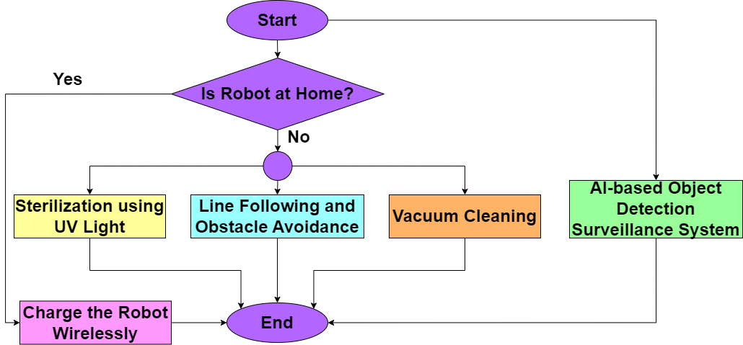
Methodology(Workflow Diagram)
The whole method is divided into four major parts:
Fig: Workflow Diagram of the Presented System

Slide 9
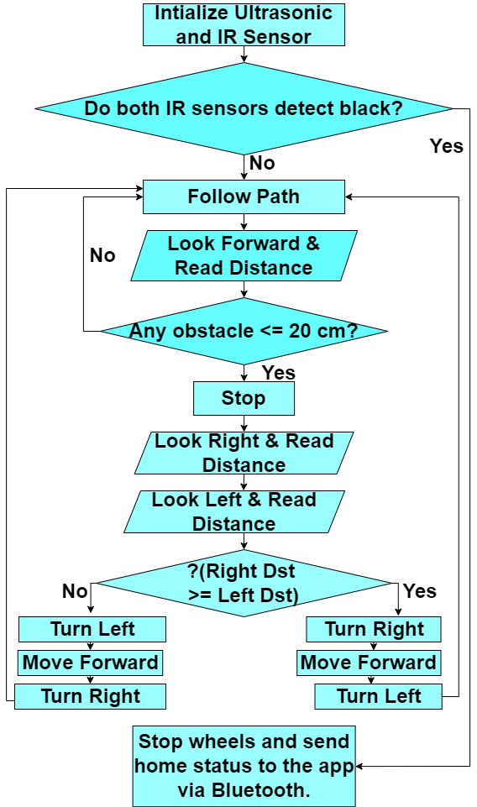
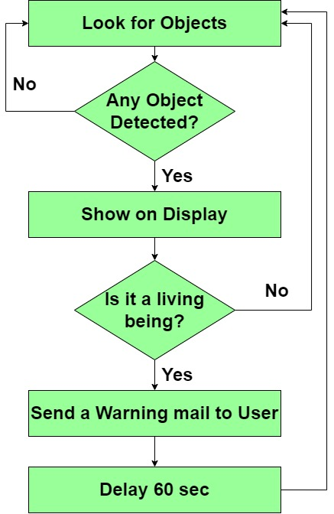
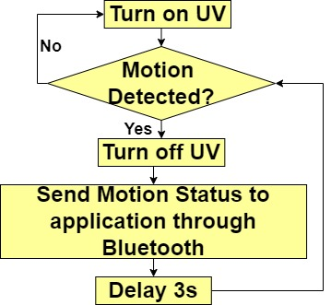
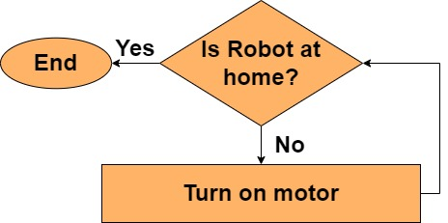
Methodology(Workflow Diagram)
Fig: Vacuum Cleaning
Fig: UV Sterilization
Fig: AI-based Object Detection
Fig: Line Following and Obstacle Avoidance

Slide 10
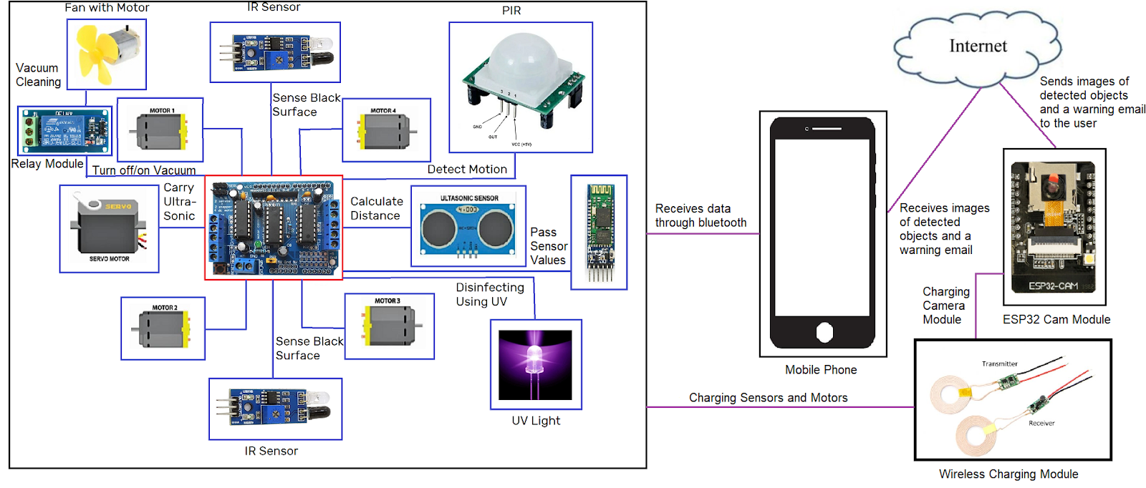
Methodology(System Architecture)
The robot employs multiple sensors and components including IR sensors, PIR sensor, ultrasonic sensor, servo motor, UV lights and vacuum cleaner. Data from the sensors is processed by a central microcontroller which communicates via Bluetooth with a mobile phone. The phone receives data and warnings about detected objects from ESP32 CAM module and forwards this information to the user. If the object is a living being then a warning is sent via email over the internet. Additionally, a wireless charging module powers the system’s sensors and motors. This design integrates smart cleaning, motion detection, UV disinfection, and real-time communication with the user.
Fig: System Architecture

Slide 11
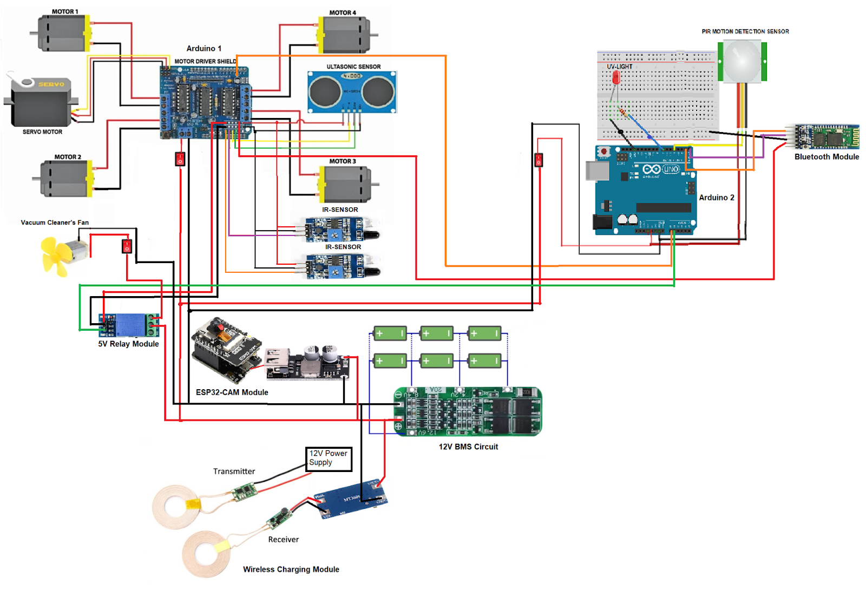
Methodology(Circuit Diagram)
The circuit diagram consists of an operational unit, a sterilization and processing unit, and a charging unit. In the operational unit, IR sensors, four BO motors, one ultrasonic sensor, and a servo motor have been connected to an Arduino UNO. In the sterilization and processing unit, PIR sensors, UV lights, and a Bluetooth module have been connected to another Arduino UNO. The microcontroller in the operational unit has been grounded with the microcontroller in the processing unit. Both the operational and processing units have been powered by the charging unit. The charging unit includes six lithium-ion batteries configured in a 3S2P arrangement (three in parallel, two in series) and these batteries have been connected to a BMS circuit.
Fig: Circuit Diagram

Slide 12
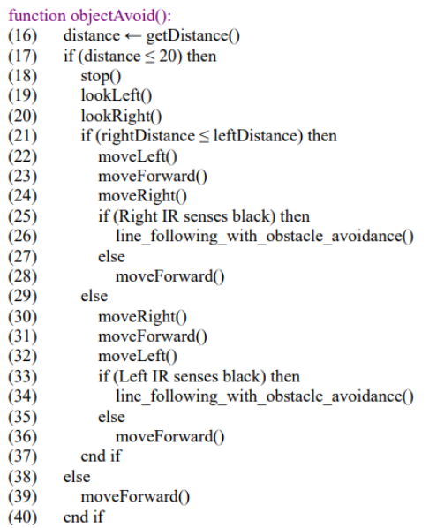
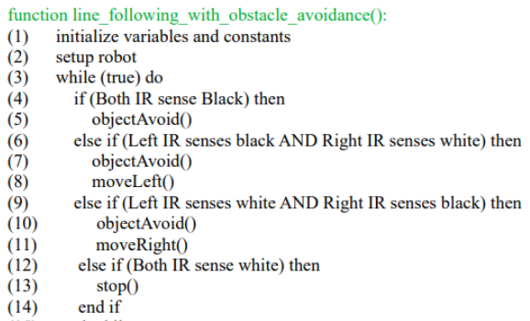
Methodology(Algorithm)
Line Following with Obstacle Avoidance

Slide 13
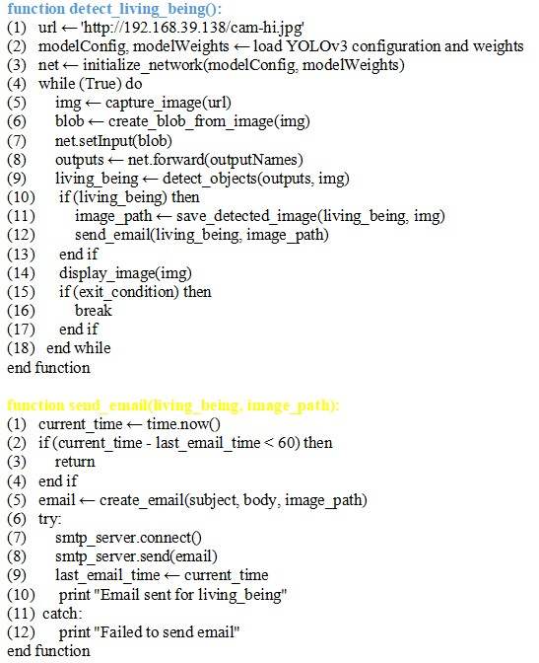
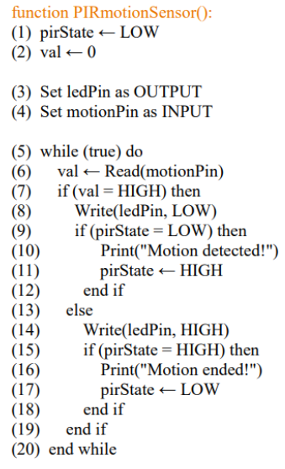
Methodology(Algorithm)
2)Surface Sterilization Using UV Light and Motion Sensing
3)AI-based Object Detection and Surveillance System:

Slide 14
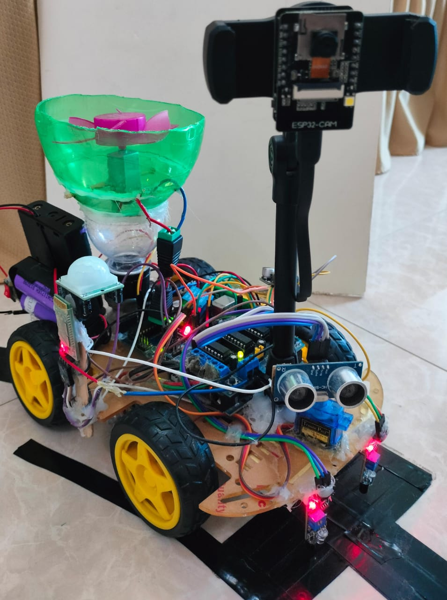
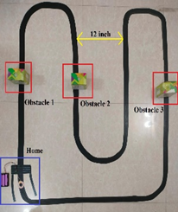
Environment Setup/ Implementation
The robot follows a black line path which is needed to be 3.5 cm thick for accurate tracking. The prototype of the robot is shown in the given Figure and the path followed by the robot is also presented in the Figure. The gap between the paths needs to be 12 inches or 30.48 cm.
Figure: Robot Prototype
Figure: Example Scenario of path with the robot

Slide 15
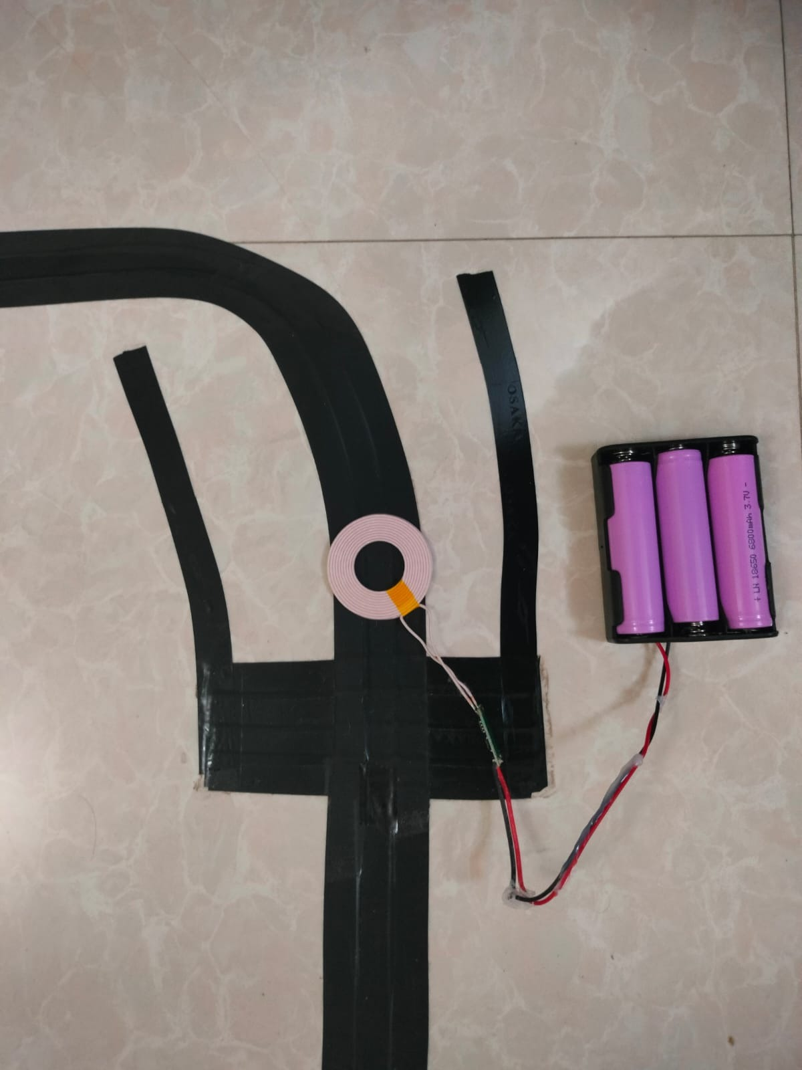
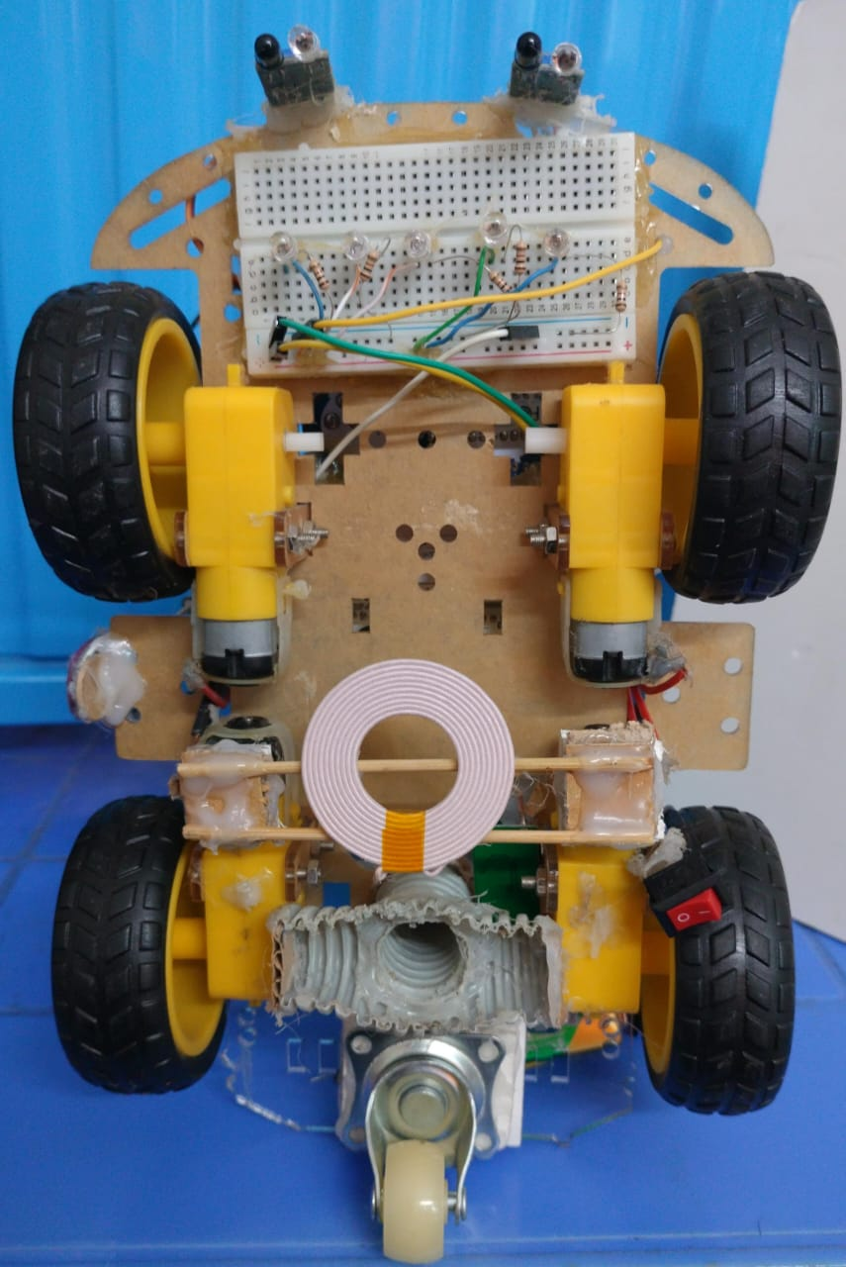
Environment Setup/ Implementation
When both IR sensors detect black line at the same time, the robot is back in the home position. It stops moving, turns off the UV lights and vacuum cleaner and starts charging using a wireless module. The charging station has a transmitter coil and a receiver coil underneath it shown in Figure.
Fig : Charging station at home (Transmitter coil)
(b) Receiver coil of charging module attached to the robot

Slide 16
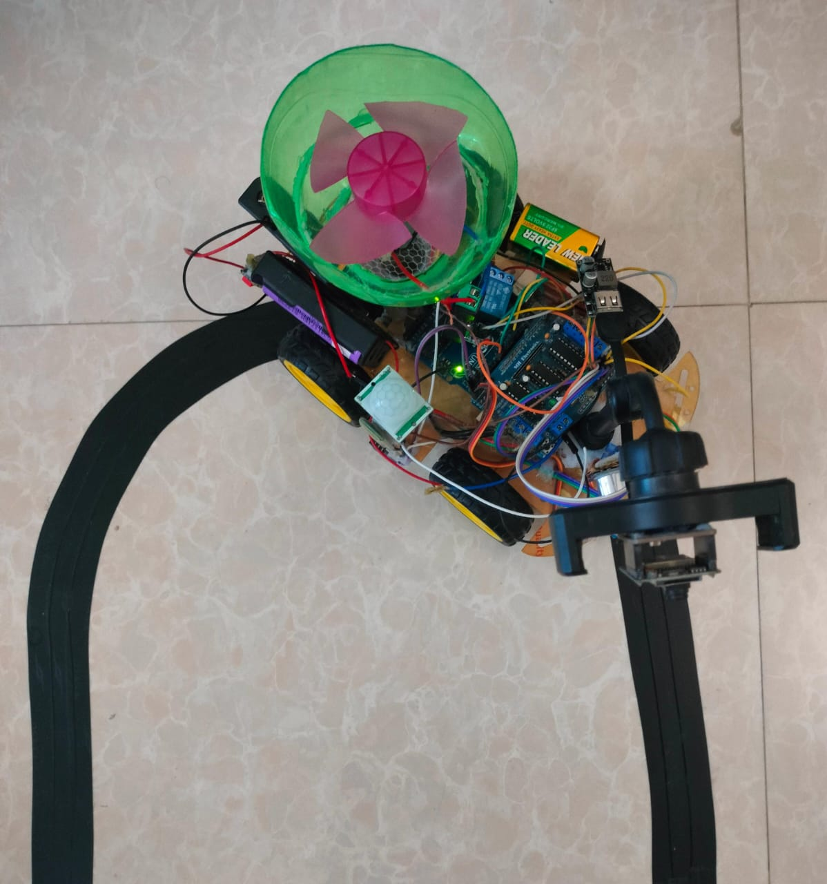
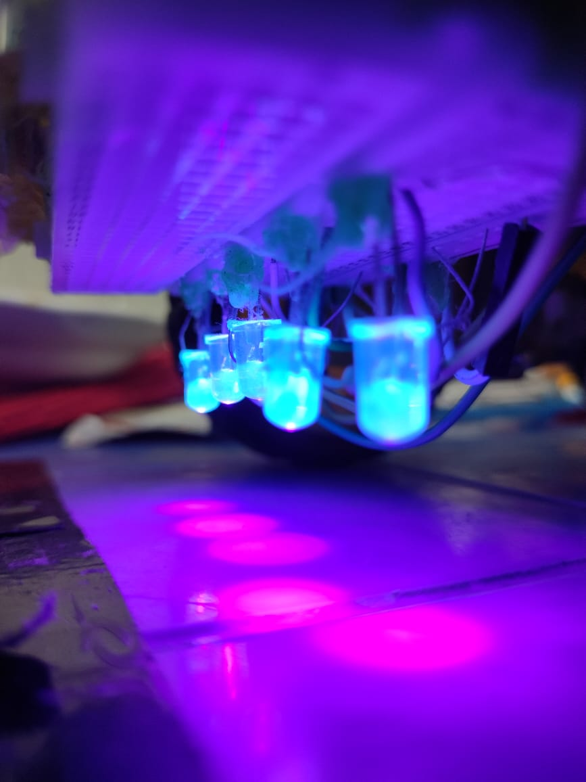
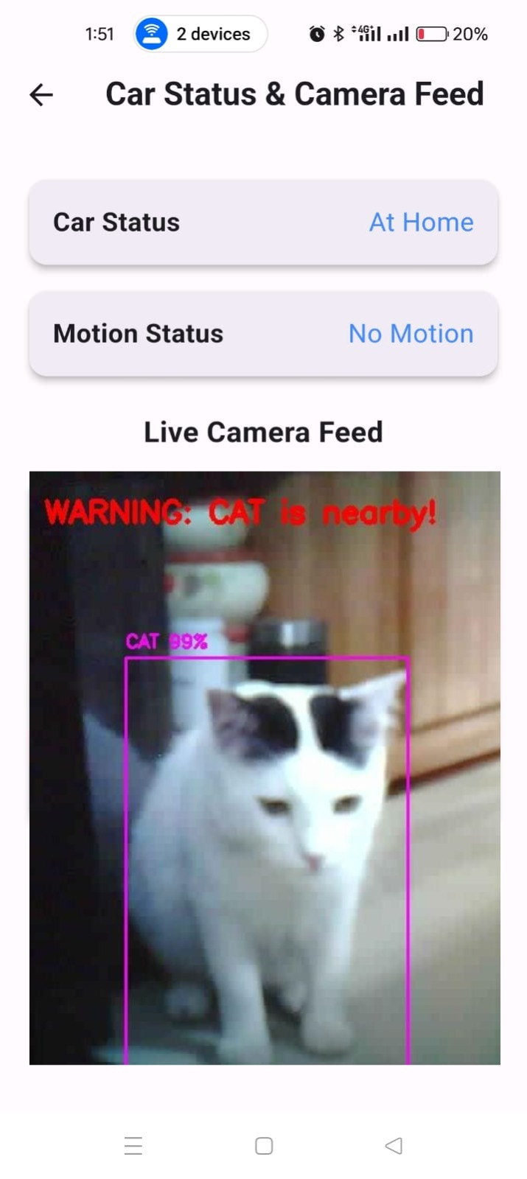
Environment Setup/ Implementation
A simple vacuum cleaner built into the robot is shown in Figure 11. The robot also uses UV light for sterilization, which turns on when the PIR sensor detects no movement. It has five UV lights connected in parallel, each with a wavelength of 100-400 nm and a brightness of 2500 MCD. The UV light setup is shown in Figure 12. A mobile application called ‘SanitiBot’ has also been developed using Flutter to show the robot’s real-time status and camera view. The robot’s status and camera view in the app are shown in Figure.
Fig: Vacuum Cleaning
Fig: Mobile App Interface
Fig : UV Light Set-Up

Slide 17
Environment Setup/ Implementation
When both IR sensors detect black line at the same time, the robot is back in the home position. It stops moving, turns off the UV lights and vacuum cleaner and starts charging using a wireless module. The charging station has a transmitter coil and a receiver coil underneath it shown in Figure.
Fig : Charging station at home (Transmitter coil)
(b) Receiver coil of charging module attached to the robot

Slide 18
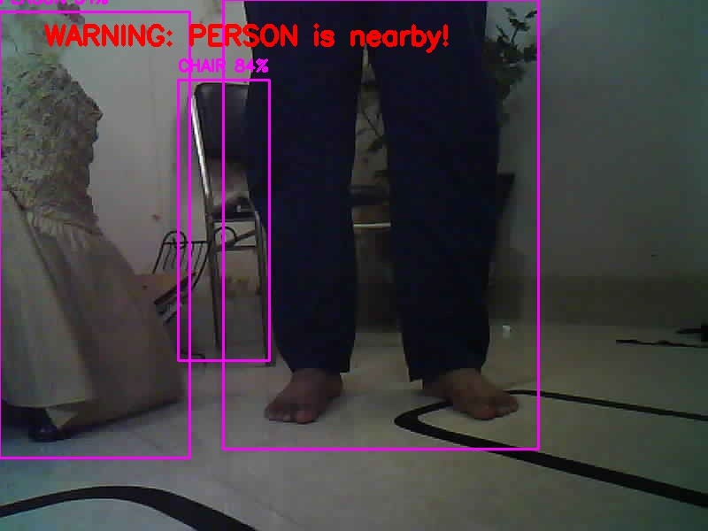
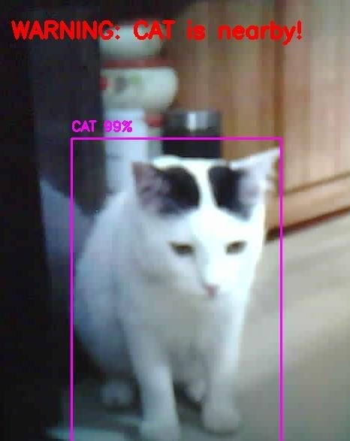
Result and Discussion
The robot equipped with YOLOv3 has been tested in our environment and showed satisfactory results. Each detection of a living being successfully triggered an email alert, demonstrating the robot’s reliability in real-time monitoring and alerting. It achieved 99% accuracy in detecting living beings and 98% accuracy for other objects.
Fig: Living Being Detection

Slide 19
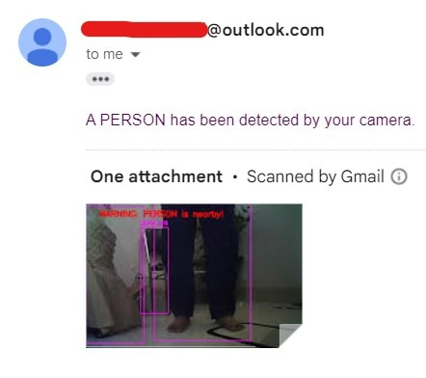
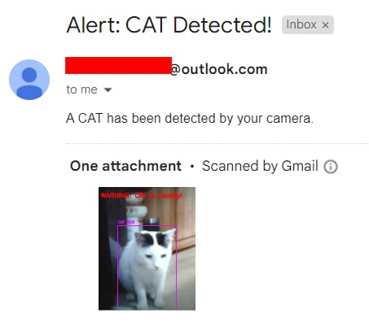
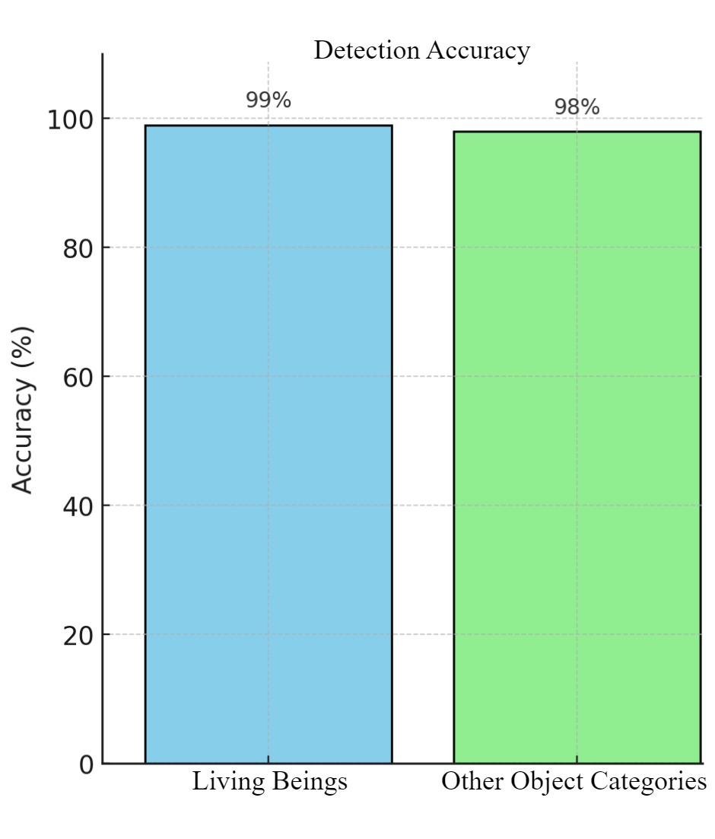
Result and Discussion
Fig: Warning email received after living being detection
Fig: Accuracy of detecting
living beings and objects

Slide 20
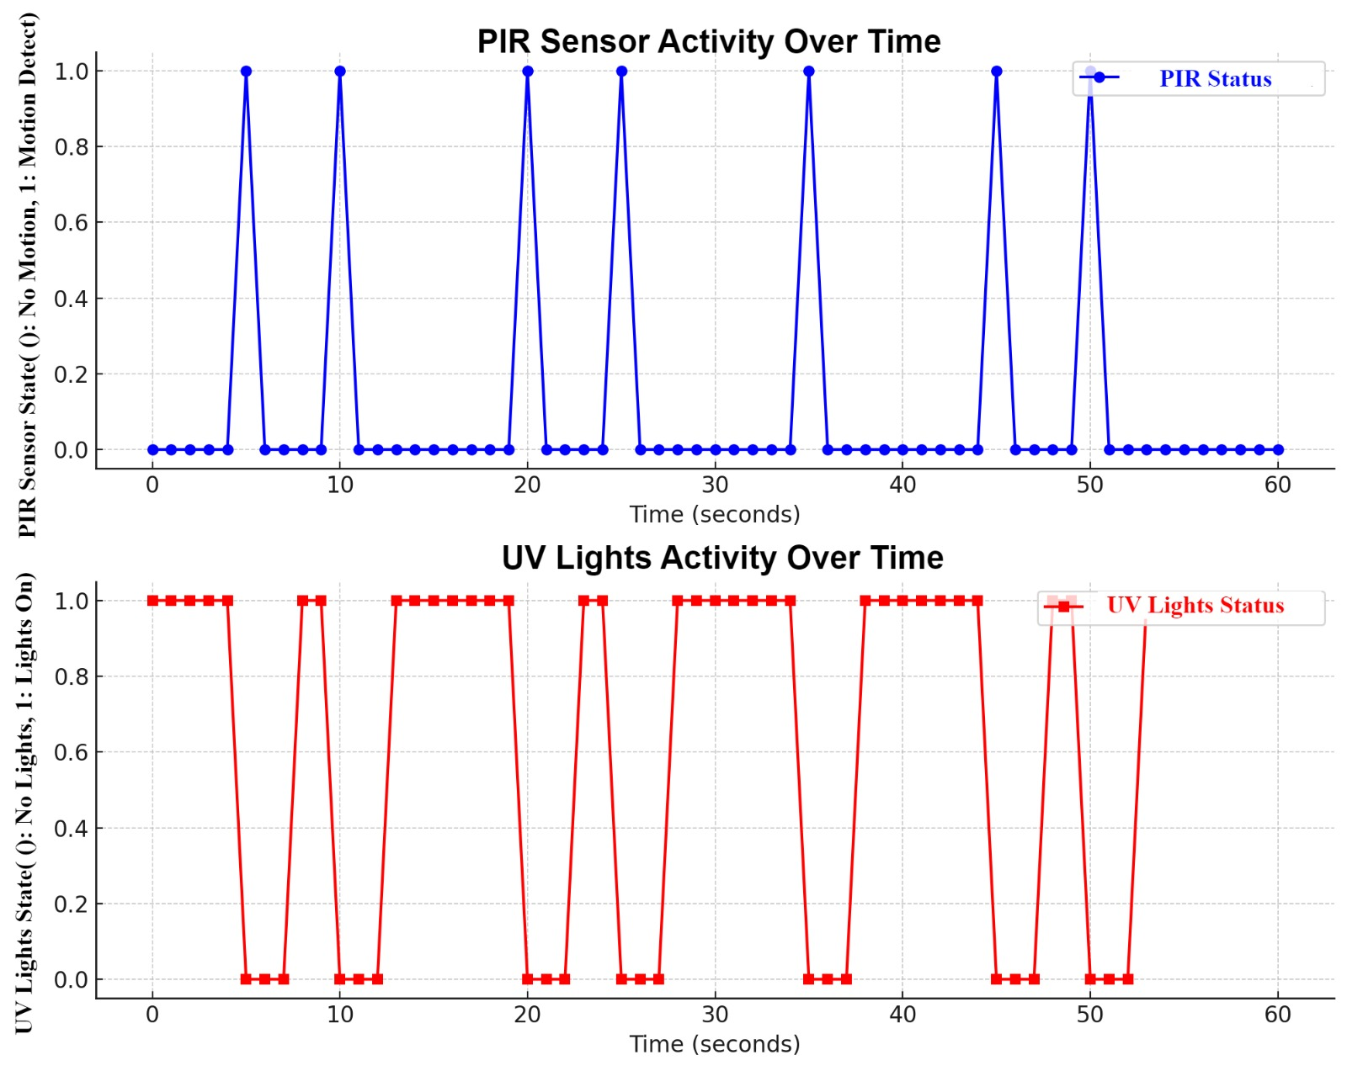
Result and Discussion
Experimental Result of Vacuum Cleaning: The dust collection percentage has been calculated by dividing the collected dust weight by the initial dust weight for each trial and then averaging the results. The overall data collection percentage was 97.68 %
Experimental Result of Obstacle Avoidance: In our designed environment, we have three obstacles. The robot is tested five times and the success rate is 86.67%.
Fig: Correlation Between PIR Motion Detection and UV Light Activation With 3-Second Delay Over Time

Slide 21
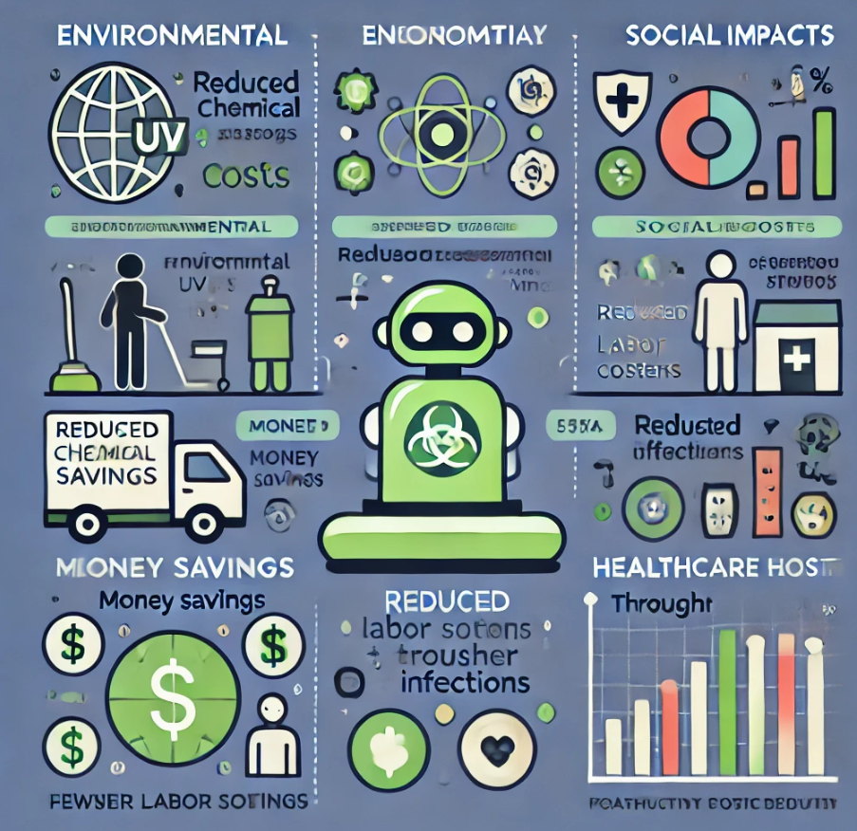
Impacts

Slide 22
Limitations and Future Works
Line-Following Limitations: The current robot relies on following lines, which may not always be present, limiting adaptability in various environments.
Real-Time Object Detection: Current camera latency affects real-time object detection efficiency.
Gyroscope and Wheel Encoder: Adding a gyroscope for accurate turns and a wheel encoder for precise distance measurement.
LiDAR Integration: Future models could include a LiDAR sensor to create a 2D map for optimized cleaning paths.
Round-Shaped Design: A round-shaped robot would improve surface coverage.
Enhanced Cleaning Mechanisms: Adding roller and side brushes to the vacuum cleaner to clean corners and edges more effectively.
AI Integration: Implement AI-driven algorithms to optimize object detection and decision-making.

Slide 23
Conclusion
The research introduces an autonomous line-following robot designed for cleaning and disinfection, combining UV sterilization, vacuum cleaning, and AI-powered object detection with integrated motion detection for user safety and wireless charging to enhance energy efficiency, the robot offers an effective, innovative solution.
Enhancing autonomy through AI, integrating IoT, expanding scalability, and incorporating multifunctionality are potential future advancements.

Slide 24
References
[1] C. McGinn, R. Scott, N. Donnelly, K. L. Roberts, M. Bogue, C. Kiernan, and M. Beckett, "Exploring the applicability of robot-assisted UV disinfection in radiology," Frontiers in Robotics and AI, vol. 7, p. 590306, 2021.
[2] Z. A. Majib, M. S. Tanjim, S. A. Siddique, S. Islam, M. S. Aadeeb, and M. N. Islam, "UVC-PURGE: A novel cost-effective disinfection robot for combating COVID-19 pandemic," IEEE Access, vol. 10, pp. 37613-37634, 2022.
[3]. Korti, B. S. Malapur, S. Gour, and R. M. Biradar, "Shuchi 1.0: Robotic system for automatic segregation of waste & floor cleaning," International Research Journal on Advanced Science Hub, vol. 4, no. 02, pp. 31-37, 2022.
[4] D. V. Bratu, M. A. Zolya, and S. A. Moraru, "RoboCoV Cleaner: An indoor autonomous UV-C disinfection robot with advanced dual-safety systems," Sensors, vol. 24, no. 3, p. 974, 2024.
[5] M. Molina, A. Vera, C. Molina, and P. Garzon, "Design and construction of an obstacle avoiding robot based on Arduino platform and programming tool," in 2018 9th IEEE Annual Ubiquitous Computing, Electronics & Mobile Communication Conference (UEMCON), pp. 788-791, IEEE, Nov. 2018.
[6] I. Ulrich, F. Mondada, and J. D. Nicoud, "Autonomous vacuum cleaner," Robotics and Autonomous Systems, vol. 19, no. 3-4, pp. 233-245, 1997.

Slide 25
Thank You !

