Slide 1
ReLocate
by: jenny, madeeha, Patrick, tasnim & umme salma

Slide 2
Motivation
Target demographic: Job-seekers, especially new immigrants
Uses quantitative measure of job characteristics in a region

Slide 3
I/O
Inputs:
Job Name
Province
Income
Outputs:
Top 5 cities with ranked in order of job potential
Income level for the cities
Cities with similar potential, but higher income

Slide 4
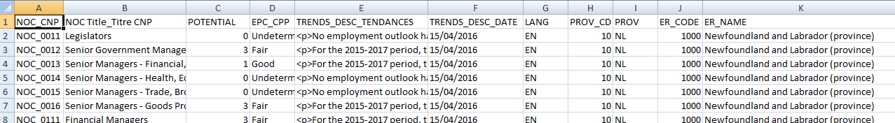
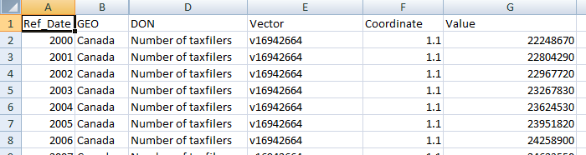
Data sets
Job Outlook data set
Income data set

Slide 5
Requirements
Input Job Name, Province, Income into a user-friendly GUI.
Text file output with top 5 cities ranked in order of outlook, with related income cities.
Display search results on the console screen.
Repeat search query by reloading GUI window.

Slide 6
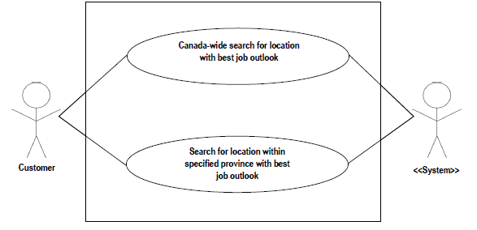

Slide 7
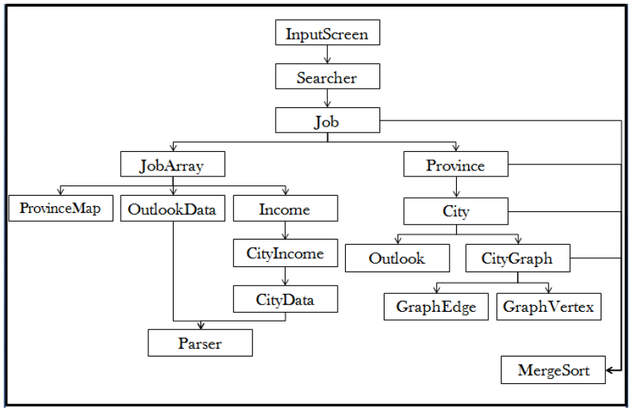
Data Structures

Slide 8
Sorting and Searching Algorithms
Sort: Merge Sort
Search: Linear

Slide 9
Graph Algorithm
Takes an array of cities
Constructs an undirected graph using these cities
Core of graph is linked “dummy” nodes for each outlook
Cities are clustered around these outlook nodes based on their outlook
Edges are weighted by city income

Slide 10
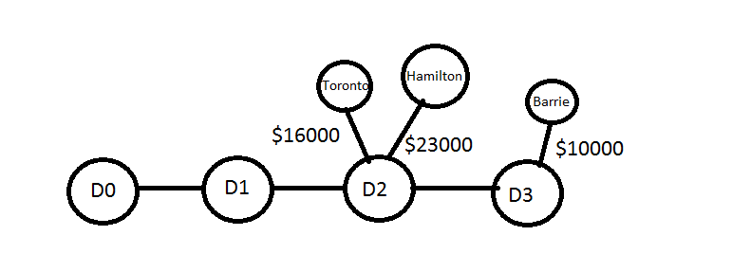
Graph Algorithm

Slide 11
Graph Algorithm
Search accepts a City object
Graph looks for the dummy vertex associated with the city’s outlook
Dummy node is found by following designated dummy edges
All edges leading out of this node are sorted by weight
Takes the top edges from this node, trace them back to the vertex, and return the City’s string representation

Slide 12
Graph Algorithm
Dummy nodes have a null reference for their city
Links to dummy nodes have a weight of -1
All dummy nodes are connected to at least one and at most two others
All cities have a single connection leading back to the dummy node

Slide 13
Testing
Unit testing
Integration testing

Slide 14
Scrum – Experiential Learning
4 sprints – in essence:
GUI development and data structure implementation
Sort and search implementation
Graph implementation
Integration and testing
Software development methodology:
Waterfall → Scrum
Version control:
Manual maintenance → GitLab repository

Slide 15
Improvements
Scalable
Better data: more information and outlook parameters
Online service
Database server to store processed data

Slide 16
Prototype Demonstration

