Slide 1
Computer Organziation and Architecture
Xiaofei Nan
Department of Computer Science and Artificial Intelligence
Zhengzhou University

Slide 2
Course Overview
Carnegie Mellon
2024 fall Semester
Time & Location:
Week 1- 2
Wed 14:00-15:40 South5 210
Fri 14:00-15:40 North2 305
Week 3-17
Tue 14:00-15:40 *
Wed 14:00-15:40 South5 210
Office: Room 3310, Computer Science Dept
Email: iexfnan@zzu.edu.cn

Slide 3
Overview
Carnegie Mellon
Grading
  Attendance
  Homework
  Final Exam
  Score = ?% Attendance + ?%Homework+ ?% Exam
Academic integrity
Reference books:
  Hennessy and Patterson, Computer Architecture: A Quantitative Approach (Fifth Edition),
  Bryant and O’Hallaron, Computer Systems: A Programmer’s Perspective, Third Edition
  But main focus on the slides in class

Slide 4

Homeworks
Carnegie Mellon
3-4 homeworks
DingTalk platform

Slide 5
Carnegie Mellon
Why take this course?
What do you want to learn?

Slide 6
The Big Picture
Carnegie Mellon

Slide 7
Course Theme:
(Systems) Knowledge is Power!
Carnegie Mellon
Systems Knowledge
  How hardware (processors, memories, disk drives, network infrastructure) plus software (operating systems, compilers, libraries, network protocols) combine to support the execution of application programs
  How you as a programmer can best use these resources
Useful outcomes from taking this course
  Become more effective programmers
    Able to find and eliminate bugs efficiently
    Able to understand and tune for program performance
  Prepare for later “systems” classes in CS & ECE
    Compilers, Operating Systems, Networks, Embedded Systems, Storage Systems, etc.

Slide 8
It’s Important to Understand How Things Work
Carnegie Mellon
Why do I need to know this stuff?
  Abstraction is good, but don’t forget reality
Most CS and CE courses emphasize abstraction
  Abstract data types
  Asymptotic analysis
These abstractions have limits
  Especially in the presence of bugs
  Need to understand details of underlying implementations
  Sometimes the abstract interfaces don’t provide the level of control or
performance you need

Slide 9
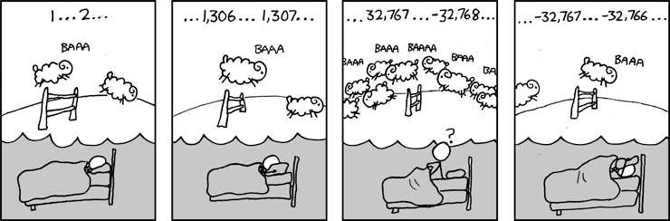
Great Reality #1:
Ints are not Integers, Floats are not Reals
Carnegie Mellon
Example 1: Is x² ≥ 0?
  Float’s: Yes!
Int’s:
  40000 * 40000 --> 1600000000
  50000 * 50000 --> ?
Example 2: Is (x + y) + z = x + (y + z)?
  Unsigned & Signed Int’s: Yes!
  Float’s:
    (1e20 + -1e20) + 3.14 --> 3.14
    1e20 + (-1e20 + 3.14) --> ??

Slide 10
Computer Arithmetic
Carnegie Mellon
Does not generate random values
  Arithmetic operations have important mathematical properties
Cannot assume all “usual” mathematical properties
  Due to finiteness of representations
  Integer operations satisfy “ring” properties
    Commutativity, associativity, distributivity
  Floating point operations satisfy “ordering” properties
    Monotonicity, values of signs
Observation
  Need to understand which abstractions apply in which contexts
  Important issues for compiler writers and serious application programmers

Slide 11
Great Reality #2:
You’ve Got to Know Assembly
Carnegie Mellon
Chances are, you’ll never write programs in assembly
  Compilers are much better & more patient than you are
But: Understanding assembly is key to machine-level execution model
  Behavior of programs in presence of bugs
    High-level language models break down
  Tuning program performance
    Understand optimizations done / not done by the compiler
    Understanding sources of program inefficiency
  Implementing system software
    Compiler has machine code as target
    Operating systems must manage process state
  Creating / fighting malware
    x86 assembly is the language of choice!

Slide 12
Great Reality #3: Memory Matters
Random Access Memory Is an Unphysical Abstraction
Carnegie Mellon
Memory is not unbounded
  It must be allocated and managed
  Many applications are memory dominated
Memory referencing bugs especially pernicious
  Effects are distant in both time and space
Memory performance is not uniform
  Cache and virtual memory effects can greatly affect program performance
  Adapting program to characteristics of memory system can lead to major speed improvements

Slide 13
Memory Referencing Bug Example
Carnegie Mellon
typedef struct { int a[2]; double d;
} struct_t;
double fun(int i) { volatile struct_t s; s.d = 3.14;
s.a[i] = 1073741824; /* Possibly out of bounds */ return s.d;
}
fun(0) | --> | 3.14
fun(1) | --> | 3.14
fun(2) | --> | 3.1399998664856
fun(3) | --> | 2.00000061035156
fun(4) | --> | 3.14
fun(6) | --> | Segmentation fault
Result is system specific

Slide 14
Memory Referencing Bug Example
Carnegie Mellon
typedef struct { | fun(0) | --> | 3.14
int a[2]; | fun(1) | --> | 3.14
double d; | fun(2) | --> | 3.1399998664856
} struct_t; | fun(3) | --> | 2.00000061035156
 | fun(4) | --> | 3.14
 | fun(6) | --> | Segmentation fault
Explanation:
Critical State
?
?
d7 ... d4
d3 ... d0
a[1]
a[0]
6
5
4
3
2
1
0
Location accessed by
fun(i)
struct_t

Slide 15
Memory Referencing Errors
Carnegie Mellon
C and C++ do not provide any memory protection
  Out of bounds array references
  Invalid pointer values
  Abuses of malloc/free
Can lead to nasty bugs
  Whether or not bug has any effect depends on system and compiler
  Action at a distance
    Corrupted object logically unrelated to one being accessed
    Effect of bug may be first observed long after it is generated
How can I deal with this?
  Program in Java, Ruby, Python, ML, …
  Understand what possible interactions may occur
  Use or develop tools to detect referencing errors (e.g. Valgrind)

Slide 16
Great Reality #4: There’s more to performance than asymptotic complexity
Carnegie Mellon
Constant factors matter too!
And even exact op count does not predict performance
  Easily see 10:1 performance range depending on how code written
  Must optimize at multiple levels: algorithm, data representations, procedures, and loops
Must understand system to optimize performance
  How programs compiled and executed
  How to measure program performance and identify bottlenecks
  How to improve performance without destroying code modularity and generality

Slide 17
Memory System Performance Example
Carnegie Mellon
void copyij(int src[2048][2048],
int dst[2048][2048])
{
int i,j;
for (i = 0; i < 2048; i++) for (j = 0; j < 2048; j++)
dst[i][j] = src[i][j];
}
void copyji(int src[2048][2048],
int dst[2048][2048])
{
int i,j;
for (j = 0; j < 2048; j++) for (i = 0; i < 2048; i++)
dst[i][j] = src[i][j];
}
4.3ms
81.8ms
2.0 GHz Intel Core i7 Haswell
Hierarchical memory organization
Performance depends on access patterns
  Including how step through multi-dimensional array

Slide 18
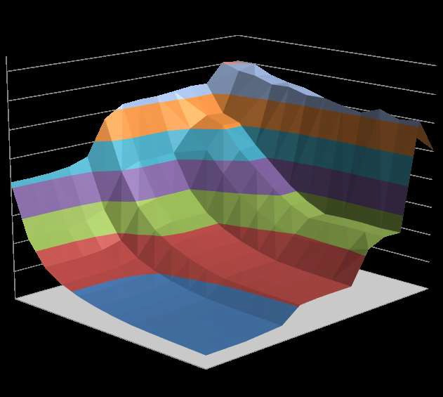
Why The Performance Differs
Carnegie Mellon
copyij
16000
14000
12000
10000
8000
6000
4000
Read throughput (MB/s)
2000
copyji

Slide 19
Great Reality #5:
Computers do more than execute programs
Carnegie Mellon
They need to get data in and out
  I/O system critical to program reliability and performance
They communicate with each other over networks
  Many system-level issues arise in presence of network
    Concurrent operations by autonomous processes
    Coping with unreliable media
    Cross platform compatibility
    Complex performance issues

Slide 20
Course Perspective
Carnegie Mellon
Most Systems Courses are Builder-Centric
  Computer Architecture
    Design pipelined processor in Verilog
  Operating Systems
    Implement sample portions of operating system
  Compilers
    Write compiler for simple language
  Networking
    Implement and simulate network protocols

Slide 21
Course Perspective (Cont.)
Carnegie Mellon
Our Course is Programmer-Centric
  By knowing more about the underlying system, you can be more effective as a programmer
  Enable you to
    Write programs that are more reliable and efficient
    Incorporate features that require hooks into OS
– E.g., concurrency, signal handlers
  Cover material in this course that you won’t see elsewhere
  Not just a course for dedicated hackers
    We bring out the hidden hacker in everyone!

Slide 22




Role within CS/ECE Curriculum
Carnegie Mellon
Introduction to Programming
Computer Organziation and Architecture
Foundation of Computer Systems Underlying principles for hardware, software, and networking
ECE Systems
Computer Security
Intro to Embedded Systems
Computer Networks
Computer Architecture
Wireless Networking
Cyberphysical Systems
CS Systems
Cloud Computing
Computer Security
Operating Systems
Compiler Design
Database Applications
Parallel Computing
Distributed Systems
Computer Networks
Database Systems

Slide 23
Welcome and Enjoy!
Carnegie Mellon

