Slide 1
Machine-Level Programming II: Control
Carnegie Mellon
Carnegie Mellon
Computer Organization and Architecture
6th Lecture
Instructor:
Xiaofei Nan
1

Slide 2
Today: Control Flow
Carnegie Mellon
⬛Review
⬛Unconditional branches
⬛Condition codes
⬛Conditional branches
⬛Structured ifs
⬛Loops
⬛Switch Statements
2

Slide 3
Review: Turning C into Object Code
Carnegie Mellon
Code in files p1.c p2.c
Compile with command: gcc –Og p1.c p2.c -o p
  Use basic optimizations (-Og) [New to recent versions of GCC]
  Put resulting binary in file p
text
C program (p1.c p2.c)
Compiler (gcc –Og -S)
text
Asm program (p1.s p2.s)
Assembler (gcc -c or as)
binary
Object program (p1.o p2.o)
Static libraries (.a)
Linker (gcc or ld)
binary
Executable program (p)
3

Slide 4
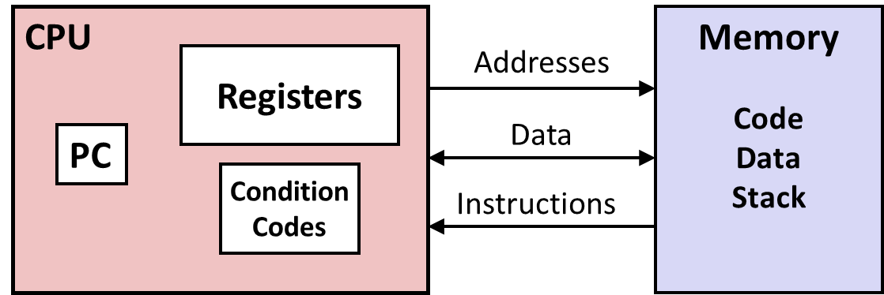
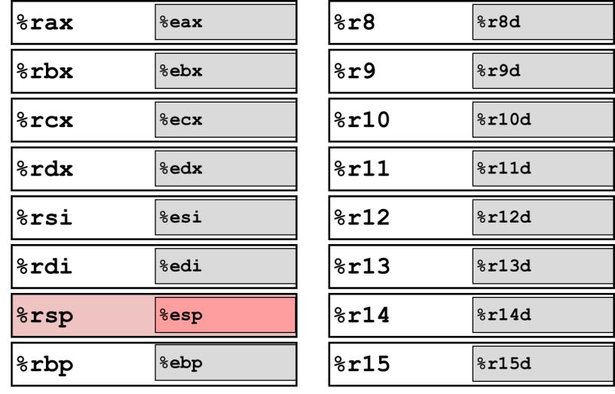
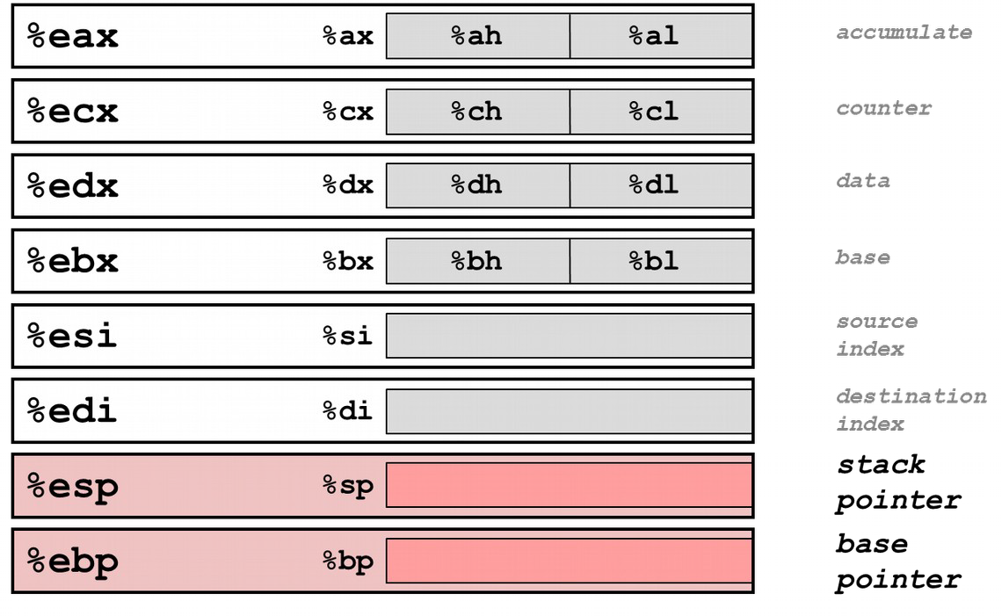
Review: x86-64 Architecture
Carnegie Mellon
Abstract view
X86-64 Integer Register File
4

Slide 5
Review: Address Modes
Carnegie Mellon
⬛Most General Form
D(Rb,Ri,S) Mem[Reg[Rb]+S*Reg[Ri]+ D]
D: Constant “displacement” 1, 2, or 4 bytes

0 if omitted
Rb: Base register: Any of 16 integer registers

to omit, use constant address form: D Mem[D]
Ri: Index register: Any, except for %rsp

0 if omitted
S: Scale: 1, 2, 4, or 8 (why these numbers?)

1 if omitted
5

Slide 6
Quiz
Given %rdx = 0x1000, %rcx = 0x0100, please compute the following expressions.
(1) 0x4(%rcx)
(2) (%rdx, %rcx, 4)
(3) 0x8(%rdx, %rcx, 2)

Slide 7
Quiz
Given %rdx = 0x1000, %rcx = 0x0100, please compute the following expressions.
(1) 0x4(%rcx)
(2) (%rdx, %rcx, 4)
0x8(%rdx, %rcx, 2)
ANS:(1)0x0104 (2) 0x1400 (3) 0x1208

Slide 8
Quiz
Given %rdi = x, %rsi = y, please compute the values of %rax respectively.
(1) leaq (%rdi, %rdi, 2), %rax
salq $2, %rax
(2) leaq 0x8(%rsi, %rdi,4), %rax
incq %rax

Slide 9
Quiz
Given %rdi = x, %rsi = y, please compute the values of %rax respectively.
(1) leaq (%rdi, %rdi, 2), %rax
salq $2, %rax
(2) leaq 0x8(%rsi, %rdi,4), %rax
incq %rax
ANS: (1) 12x (2) 4x+y+9

Slide 10
Today: Control Flow
Carnegie Mellon
⬛Review
⬛Unconditional branches
⬛Condition codes
⬛Conditional branches
⬛Structured ifs
⬛Loops
⬛Switch Statements
10

Slide 11
Carnegie Mellon
Control Flow
The order in which a set of program instructions are executed.
11

Slide 12
Linear Control Flow
Carnegie Mellon
C Declaration
int expr(int d, int s);
int expr(int d, int s);
Assembly Implementation
# expr(%edi, %esi) -> %eax expr:
What algebraic expression does this function compute?
(d + s) * s
How does the CPU find the next instruction to execute?
%rip
# expr(%edi, %esi) -> %eax
expr:
xorl %eax, %eax addl %edi, %eax addl %esi, %eax imull %esi, %eax ret
xorl | %eax, | %eax
addl | %edi, | %eax
addl | %esi, | %eax
imull | %esi, | %eax
ret
8

Slide 13
Unconditional Branches
Carnegie Mellon
C Declaration
int expr(int d, int s);
int expr(int d, int s);
Assembly Implementation
# expr(%edi, %esi) -> %eax expr:
# expr(%edi, %esi) -> %eax
expr:
xorl %eax, %eax jmp .Limul
.Ladd:
addl %edi, %eax jmp .Lret
.Limul:
addl %esi, %eax imull %esi, %eax jmp .Ladd
.Lret:
ret
xorl jmp
.Ladd:
addl jmp
.Limul:
addl
%eax, %eax
.Limul
What algebraic expression does this function compute?
%edi, %eax
.Lret
%esi, %eax
(d + s) * s d + (s * s)
imull %esi, %eax jmp .Ladd
.Lret:
ret
13

Slide 14
Today: Control Flow
Carnegie Mellon
⬛Review
⬛Unconditional branches
⬛Condition codes
⬛Conditional branches
⬛Structured ifs
⬛Loops
⬛Switch Statements

Slide 15
Processor State (x86-64, Partial)
Carnegie Mellon
⬛Information about
currently executing program
Temporary data ( %rax, … )
Location of runtime stack ( %rsp)
Location of current code control point
( %rip, … )
Status of recent tests ( CF, ZF, SF, OF )
Current stack top
Register
%rax
%rbx
%rcx
%rdx
%rsi
%rdi
%rsp
%rbp
%r8
%r9
%r10
%r11
%r12
%r13
%r14
%r15
%rip
Instruction pointer
CF
ZF
SF
OF
Condition codes

Slide 16
Condition Codes (Implicit Setting)
Carnegie Mellon
⬛Single-bit registers
ZF Zero Flag ▪SF Sign Flag (for signed)
CF Carry Flag (for unsigned) ▪OF Overflow Flag (for signed)
⬛Implicitly set (as side effect) of arithmetic operations
Example: addq Src,Dest ↔ t = a+b
ZF set if t == 0
SF set if t < 0(as signed)
CF set if carry out from most significant bit (unsigned overflow)
OF set if two’s-complement (signed) overflow
(a>0 && b>0 && t<0) || (a<0 && b<0 && t>=0)
⬛NOT set by leaqinstruction

Slide 17
Carnegie Mellon
ZF set when
000000000000…00000000000

Slide 18
SF set when
Carnegie Mellon
yxxxxxxxxxxxx...
+
yxxxxxxxxxxxx...
1xxxxxxxxxxxx...
For signed arithmetic, this reports when result is a negative number

Slide 19
CF set when
Carnegie Mellon
1xxxxxxxxxxxx...
+
1xxxxxxxxxxxx...
Carry
1
xxxxxxxxxxxxx...
1
–
0xxxxxxxxxxxx...
1xxxxxxxxxxxx...
Borrow
1xxxxxxxxxxxx...
For unsigned arithmetic, this reports overflow

Slide 20
OF set when
Carnegie Mellon
a b
yxxxxxxxxxxxx...
+
yxxxxxxxxxxxx...
zxxxxxxxxxxxx...
t
z = ~y
(a>0 && b>0 && t<0) || (a<0 && b<0 && t>=0)
For signed arithmetic, this reports overflow

Slide 21
Condition Codes (Explicit Setting: Test)
Carnegie Mellon
⬛Explicit Setting by Test instruction
testq Src2, Src1
  testq b,a like computing a&b without setting destination
Sets condition codes based on value of Src1 & Src2
Useful to have one of the operands be a mask
ZF set when a&b == 0
SF set when a&b < 0
Very often:
testq
%rax,%rax

Slide 22
Condition Codes (Explicit Setting: Compare)
Carnegie Mellon
⬛Explicit Setting by Compare Instruction
cmpq Src2, Src1
cmpq b,a like computing a-bwithout setting destination
ZF set if a == b
SF set if (a-b) < 0(as signed)
CF set if carry out from most significant bit (used for unsigned comparisons)
OF set if two’s-complement (signed) overflow
(a>0 && b<0 && (a-b)<0) || (a<0 && b>0 && (a-b)>0)

Slide 23
Today: Control Flow
Carnegie Mellon
⬛Review
⬛Unconditional branches
⬛Condition codes
⬛Conditional branches
⬛Structured ifs
⬛Loops
⬛Switch Statements

Slide 24
Jumping
Carnegie Mellon
⬛jX Instructions
Jump to different part of code depending on condition codes
jX | Condition | Description
jmp | 1 | Unconditional
je (jz) | ZF | Equal / Zero
jne(jnz) | ~ZF | Not Equal / Not Zero
js | SF | Negative
jns | ~SF | Nonnegative
jg | ~(SF^OF)&~ZF | Greater (Signed)
jge | ~(SF^OF) | Greater or Equal (Signed)
jl | (SF^OF) | Less (Signed)
jle | (SF^OF)|ZF | Less or Equal (Signed)
ja | ~CF&~ZF | Above (unsigned)
jb | CF | Below (unsigned)
20

Slide 25
Reading Condition Codes
Carnegie Mellon
⬛SetX Instructions
Set low-order byte of destination to 0 or 1 from current condition codes
Does not alter remaining 7 bytes!
SetX | Condition | Description
sete | ZF | Equal / Zero
setne | ~ZF | Not Equal / Not Zero
sets | SF | Negative
setns | ~SF | Nonnegative
setg | ~(SF^OF)&~ZF | Greater (Signed)
setge | ~(SF^OF) | Greater or Equal (Signed)
setl | (SF^OF) | Less (Signed)
setle | (SF^OF)|ZF | Less or Equal (Signed)
seta | ~CF&~ZF | Above (unsigned)
setb | CF | Below (unsigned)

Slide 26
x86-64 Integer Registers
Carnegie Mellon
%rax
%al
%r8
%r8b
%rbx
%bl
%r9
%r9b
%rcx
%cl
%r10
%r10b
%rdx
%dl
%r11
%r11b
%rsi
%sil
%r12
%r12b
%rdi
%dil
%r13
%r13b
%rsp
%spl
%r14
%r14b
%rbp | %bpl
%r15
%r15b
Can reference low-order byte

Slide 27
Reading Condition Codes (Cont.)
Carnegie Mellon
⬛SetX Instructions:
Set single byte based on combination of condition codes
⬛One of addressable byte registers
Does not alter remaining bytes
Typically use movzbl to finish job
  32-bit instructions also set upper 32 bits to 0
int gt (long x, long y)
{
return x > y;
}
Register | Use(s)
%rdi | Argument x
%rsi | Argument y
%rax | Return value
int gt (long x, long y)
{
return x > y;
}
cmpq
%rsi, %rdi
#
Compare x:y
# Set when >
# Zero rest of %rax
setg
%al
movzbl %al, %eax

Slide 28
Reading Condition Codes (Cont.)
Carnegie Mellon
◆SetX Instructions:
▪ Set single byte based on combination of condition codes
◆One of addressable byte registers
▪ Does not alter remaining bytes
▪ Typically use movzblto finish job
▪ 32-bit instructions also set upper 32 bits to 0
Register
int gt (long x, long y)
{ %rdi
return x > y; %rsi
} %rax
Beware weirdness movzbl (and others) movzbl %al, %eax 0x00000000 ^{0x000000 %al} Zapped to all 0’s
 | Use(s)
 | Argument x
 | Argument y
 | Return value
_{%rax%rax} 0x000000 _{%al}
%eax %al
int gt (long x, long y)
{
return x > y;
}
cmpq
%rsi, %rdi
#
Compare x:y
# Set when >
# Zero rest of %rax
setg
%al
movzbl %al, %eax

Slide 29
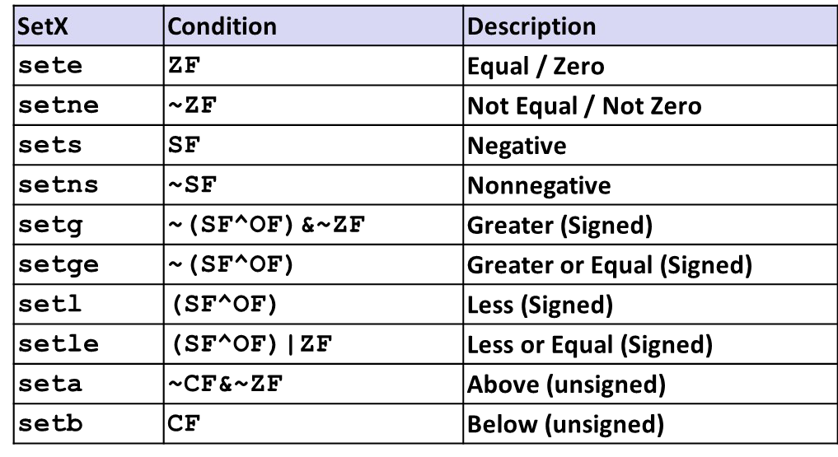
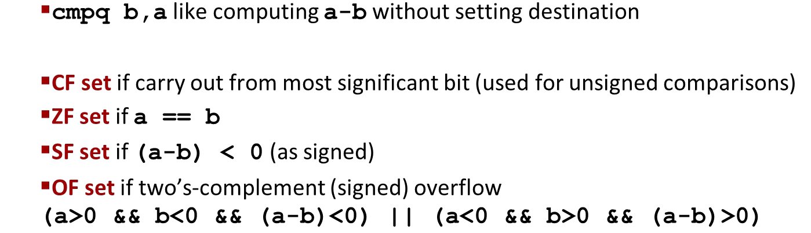
Exercise
Carnegie Mellon
%rax | SF | CF | OF | ZF
xor %rax, %rax
sub $1, %rax
cmp $2, %rax
setl %al movzbl %al, %eax
0x0000 0000 0000 0000 0 0 0 1
0xFFFF FFFF FFFF FFFF 1 1 0 0
0xFFFF FFFF FFFF FFFF 1 0 0 0
0xFFFF FFFF FFFF FF01 1 0 0 0
0x0000 0000 0000 0001 1 0 0 0

Slide 30
Exercise
Carnegie Mellon
%rax | SF | CF | OF | ZF
0x0000 0000 0000 0000 | 0 | 0 | 0 | 1
xor %rax, %rax
sub $1, %rax
cmp $2, %rax
setl %al movzbl %al, %eax
0x0000 0000 0000 0000 0 0 0 1
0xFFFF FFFF FFFF FFFF 1 1 0 0
0xFFFF FFFF FFFF FFFF 1 0 0 0
0xFFFF FFFF FFFF FF01 1 0 0 0
0x0000 0000 0000 0001 1 0 0 0

Slide 31
Exercise
Carnegie Mellon
%rax | SF | CF | OF | ZF
0x0000 0000 0000 0000 | 0 | 0 | 0 | 1
0xFFFF FFFF FFFF FFFF | 1 | 1 | 0 | 0
xor %rax, %rax
sub $1, %rax
cmp $2, %rax
setl %al movzbl %al, %eax
0x0000 0000 0000 0000 0 0 0 1
0xFFFF FFFF FFFF FFFF 1 1 0 0
0xFFFF FFFF FFFF FFFF 1 0 0 0
0xFFFF FFFF FFFF FF01 1 0 0 0
0x0000 0000 0000 0001 1 0 0 0

Slide 32
Exercise
Carnegie Mellon
%rax | SF | CF | OF | ZF
0x0000 0000 0000 0000 | 0 | 0 | 0 | 1
0xFFFF FFFF FFFF FFFF | 1 | 1 | 0 | 0
0xFFFF FFFF FFFF FFFF | 1 | 0 | 0 | 0
xor %rax, %rax
sub $1, %rax
cmp $2, %rax
setl %al movzbl %al, %eax
0x0000 0000 0000 0000 0 0 0 1
0xFFFF FFFF FFFF FFFF 1 1 0 0
0xFFFF FFFF FFFF FFFF 1 0 0 0
0xFFFF FFFF FFFF FF01 1 0 0 0
0x0000 0000 0000 0001 1 0 0 0

Slide 33
Exercise
Carnegie Mellon
%rax | SF | CF | OF | ZF
0x0000 0000 0000 0000 | 0 | 0 | 0 | 1
0xFFFF FFFF FFFF FFFF | 1 | 1 | 0 | 0
0xFFFF FFFF FFFF FFFF | 1 | 0 | 0 | 0
0xFFFF FFFF FFFF FF01 | 1 | 0 | 0 | 0
0x0000 0000 0000 0001 | 0 | 0 | 0 | 0
xor %rax, %rax
sub $1, %rax
cmp $2, %rax
setl %al movzbl %al, %eax

Slide 34
Today: Control Flow
Carnegie Mellon
⬛Review
⬛Unconditional branches
⬛Condition codes
⬛Conditional branches
⬛Structured ifs
⬛Loops
⬛Switch Statements

Slide 35
Conditional Branch Example (Old Style)
Carnegie Mellon
absdiff:
cmpq jle movq subq ret
.L4:
movq subq ret
long absdiff (long x, long y)
{
long result; if (x > y)
result = x-y; else
result = y-x; return result;
}
%rsi, %rdi
.L4
%rdi, %rax
%rsi, %rax
# x:y
long absdiff
(long x, long y)
{
long result; if (x > y)
result = x-y; else
result = y-x; return result;
}
# x <= y
%rsi, %rax
%rdi, %rax
Register | Use(s)
%rdi | Argument x
%rsi | Argument y
%rax | Return value

Slide 36
Conditional Branch Example (Old Style)
Carnegie Mellon
absdiff:
cmpq jle movq subq ret
.L4:
movq subq ret
long absdiff (long x, long y)
{
long result; if (x > y)
result = x-y; else
result = y-x; return result;
}
%rsi, %rdi
.L4
%rdi, %rax
%rsi, %rax
# x:y
long absdiff
(long x, long y)
{
long result; if (x > y)
result = x-y; else
result = y-x; return result;
}
# x <= y
%rsi, %rax
%rdi, %rax
Register | Use(s)
%rdi | Argument x
%rsi | Argument y
%rax | Return value

Slide 37
Expressing with Goto Code
Carnegie Mellon
C allows goto statement
  Closer to machine-level programming style
Jump to position designated by label
long absdiff_j
(long x, long y)
{
long result;
int ntest = x <= y; if (ntest) goto Else; result = x-y;
goto Done; Else:
result = y-x; Done:
return result;
}
long absdiff_j (long x, long y)
{
long result;
int ntest = x <= y; if (ntest) goto Else; result = x-y;
goto Done; Else:
result = y-x; Done:
return result;
}
long absdiff (long x, long y)
{
long result; if (x > y)
result = x-y; else
result = y-x; return result;
}

Slide 38
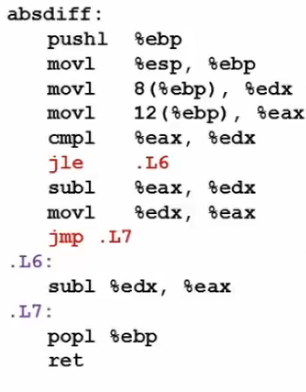
Expressing with Goto Code
Carnegie Mellon
C allows goto statement
  Closer to machine-level programming style
Jump to position designated by label
long absdiff_j
(long x, long y)
{
long result;
int ntest = x <= y; if (ntest) goto Else; result = x-y;
goto Done; Else:
result = y-x; Done:
return result;
}
long absdiff_j (long x, long y)
{
long result;
int ntest = x <= y; if (ntest) goto Else; result = x-y;
goto Done; Else:
result = y-x; Done:
return result;
}

Slide 39
General Conditional Expression Translation (Using Branches)
Carnegie Mellon
C Code
val = Test ? Then_Expr : Else_Expr;
val = Test ? Then_Expr : Else_Expr;
val = x>y ? x-y : y-x;
val = x>y ? x-y : y-x;
Goto Version
ntest = !Test;
if (ntest) goto Else; val = Then_Expr;
goto Done; Else:
val = Else_Expr; Done:
. . .
Create separate code regions for then & else expressions
Execute appropriate one
ntest = !Test;
if (ntest) goto Else; val = Then_Expr;
goto Done; Else:
val = Else_Expr; Done:
. . .

Slide 40
Today: Control Flow
Carnegie Mellon
⬛Review
⬛Unconditional branches
⬛Condition codes
⬛Conditional branches
⬛Structured ifs
⬛Loops
⬛Switch Statements

Slide 41
“Do-While” Loop Example
Carnegie Mellon
C Code Goto Version
long pcount_do (unsigned long x) { long result = 0; do {
result += x & 0x1; x >>= 1;
} while (x); return result;
}
long pcount_goto (unsigned long x) { long result = 0;
loop:
result += x & 0x1; x >>= 1;
if(x) goto loop; return result;
}
long pcount_do
(unsigned long x) { long result = 0; do {
result += x & 0x1; x >>= 1;
} while (x); return result;
}
long pcount_goto
(unsigned long x) { long result = 0;
loop:
result += x & 0x1; x >>= 1;
if(x) goto loop; return result;
}
⬛Count number of 1’s in argument x (“popcount”)
⬛Use conditional branch to either continue looping or to exit loop

Slide 42
“Do-While” Loop Compilation
Carnegie Mellon
Goto Version
long pcount_goto (unsigned long x) { long result = 0; loop:
result += x & 0x1; x >>= 1;
if(x) goto loop; return result;
}
long pcount_goto
(unsigned long x) { long result = 0; loop:
result += x & 0x1; x >>= 1;
if(x) goto loop; return result;
}
Register | Use(s)
%rdi | Argument x
%rax | result
movl
$0, %rax # loop:
%rdi, %rdx
$1, %rdx
%rdx, %rax
# result = 0
.L2:
movq andl addq shrq jne
# t = x & 0x1 # result += t
%rdi
.L2
# x >>= 1
# if (x) goto loop
rep; ret

Slide 43
General “Do-While” Translation
Carnegie Mellon
C Code Goto Version
do
Body
while (Test);
loop:
Body
if (Test) goto loop
do
Body
while (Test);
loop:
Body
if (Test) goto loop
⬛Body:
{
Statement₁; Statement₂;
… Statement_{n};
}

Slide 44
General “While” Translation #1
Carnegie Mellon
“Jump-to-middle” translation
Used with -Og
Goto Version
goto test; loop:
Body
test:
if (Test) goto loop;
done:
goto test;
loop:
Body
test:
if (Test) goto loop;
done:
While version
while (Test)
Body
while (Test)
Body

Slide 45
While Loop Example #1
Carnegie Mellon
C Code Jump to Middle
long pcount_while (unsigned long x) { long result = 0; while (x) {
result += x & 0x1; x >>= 1;
}
return result;
}
long pcount_goto_jtm (unsigned long x) { long result = 0; goto test;
loop:
result += x & 0x1; x >>= 1;
test:
if(x) goto loop; return result;
}
long pcount_while
(unsigned long x) { long result = 0; while (x) {
result += x & 0x1; x >>= 1;
}
return result;
}
Version
long pcount_goto_jtm
(unsigned long x) { long result = 0; goto test;
loop:
result += x & 0x1; x >>= 1;
test:
if(x) goto loop; return result;
}
⬛Compare to do-while version of function
⬛Initial goto starts loop at test

Slide 46
General “While” Translation #2
Carnegie Mellon
While version
“Do-while” conversion
Used with –O1
while (Test)
Body
while (Test)
Body
Goto Version
Do-While Version
if (!Test) goto done;
loop:
Body
if (Test) goto loop;
done:
if (!Test)
goto done; loop:
Body
if (Test) goto loop;
done:
if (!Test) goto done;
do
Body
while(Test); done:
if (!Test)
goto done; do
Body
while(Test); done:

Slide 47
While Loop Example #2
Carnegie Mellon
C Code Do-While Version
long pcount_while (unsigned long x) { long result = 0; while (x) {
result += x & 0x1; x >>= 1;
}
return result;
}
long pcount_goto_dw (unsigned long x) { long result = 0; if (!x) goto done;
loop:
result += x & 0x1; x >>= 1;
if(x) goto loop; done:
return result;
}
long pcount_while
(unsigned long x) { long result = 0; while (x) {
result += x & 0x1; x >>= 1;
}
return result;
}
long pcount_goto_dw
(unsigned long x) { long result = 0; if (!x) goto done;
loop:
result += x & 0x1; x >>= 1;
if(x) goto loop; done:
return result;
}
Compare to do-while version of function
Initial conditional guards entrance to loop

Slide 48
“For” Loop Form
Carnegie Mellon
Init
General Form
i = 0
i = 0
for (Init; Test; Update )
Body
Test
i < WSIZE
i < WSIZE
#define WSIZE 8*sizeof(int) long pcount_for
(unsigned long x)
{
size_t i;
long result = 0;
for (i = 0; i < WSIZE; i++)
{
unsigned bit =
(x >> i) & 0x1; result += bit;
}
return result;
Update
#define WSIZE 8*sizeof(int)
long pcount_for (unsigned long x)
{
size_t i;
long result = 0;
for (i = 0; i < WSIZE; i++)
{
unsigned bit =
(x >> i) & 0x1; result += bit;
}
return result;
}
i++
i++
Body
{
{
unsigned bit =
(x >> i) & 0x1; result += bit;
}
unsigned bit =
(x >> i) & 0x1; result += bit;
}
t and O’Hallaron, Computer Systems: A Programmer’s Perspective, Third Edition
38

Slide 49
“For” Loop → While Loop
Carnegie Mellon
For Version
for (Init; Test; Update )
Body
While Version
Init;
while (Test ) {
Body Update;
}

Slide 50
For-While Conversion
Carnegie Mellon
long pcount_for_while (unsigned long x)
{
size_t i;
long result = 0; i = 0;
while (i < WSIZE)
{
unsigned bit =
(x >> i) & 0x1; result += bit; i++;
}
return result;
}
long pcount_for_while
(unsigned long x)
{
size_t i;
long result = 0; i = 0;
while (i < WSIZE)
{
unsigned bit =
(x >> i) & 0x1; result += bit; i++;
}
return result;
}
Init
i = 0
i = 0
Test
i < WSIZE
i < WSIZE
Update
i++
i++
Body
{
unsigned bit =
(x >> i) & 0x1; result += bit;
}
{
unsigned bit =
(x >> i) & 0x1; result += bit;
}

Slide 51
“For” Loop Do-While Conversion
Carnegie Mellon
Goto Version
C Code
long pcount_for_goto_dw (unsigned long x) { size_t i;
long result = 0; i = 0;
if (!(i < WSIZE))
goto done; loop:
{
unsigned bit =
(x >> i) & 0x1; result += bit;
} i++;
if (i < WSIZE)
goto loop; done:
return result;
}
long pcount_for_goto_dw
(unsigned long x) { size_t i;
long result = 0; i = 0;
if (!(i < WSIZE))
goto done; loop:
{
unsigned bit =
(x >> i) & 0x1; result += bit;
} i++;
if (i < WSIZE)
goto loop; done:
return result;
}
long pcount_for (unsigned long x)
{
size_t i;
long result = 0;
for (i = 0; i < WSIZE; i++)
{
unsigned bit =
(x >> i) & 0x1; result += bit;
}
return result;
}
long pcount_for
(unsigned long x)
{
size_t i;
long result = 0;
for (i = 0; i < WSIZE; i++)
{
unsigned bit =
(x >> i) & 0x1; result += bit;
}
return result;
}
Init
!Test
Body
Update
Test
Initial test can be optimized away
41

Slide 52
Today: Control Flow
Carnegie Mellon
⬛Review
⬛Unconditional branches
⬛Condition codes
⬛Conditional branches
⬛Structured ifs
⬛Loops
⬛Switch Statements

Slide 53
Switch Statement Example
Carnegie Mellon
long switch_eg
(long x, long y, long z)
{
long w = 1; switch(x) { case 1:
w = y*z; break;
case 2:
w = y/z;
/* Fall Through */ case 3:
w += z; break;
case 5:
case 6:
w -= z; break;
default:
w = 2;
}
return w;
}
long switch_eg
(long x, long y, long z)
{
long w = 1; switch(x) { case 1:
w = y*z; break;
case 2:
w = y/z;
/* Fall Through */ case 3:
w += z; break;
case 5:
case 6:
w -= z; break;
default:
w = 2;
}
return w;
}
Multiple case labels
  Here: 5 & 6
Fall through cases
  Here: 2
Missing cases
  Here: 4

Slide 54

填空题
4分
Given the following switch statement,
int switch_ex(int x, int y, int z)
{
int w = 0;
switch(x)
{
case 1:
w = y++;
break;
case 2:
w = z++;
case 3:
w +=y;
break;
case 5:
case 6:
w = w - z;
break;
default:
w = 3;
}
return w;
}
Please compute the return values of switch_ex() function.
When x = 1, y = 1, z =1, w = [填空1] ;
When x = 2, y = 3, z=1, w = [填空2] ;
When x = 5, y = 1, z =2, w = [填空3] ;
When x =8, y=2, z = 1, w = [填空4] .
正常使用填空题需3.0以上版本雨课堂
submit

Slide 55
Jump Table Structure
Carnegie Mellon
Switch Form
Jump Table
Jump Targets
switch(x) { case val_0:
Block 0
case val_1:
Block 1
• • • case val_n-1:
Block n–1
}
Targ0
Targ1
Targ2
• • •
Targn-1
Targ0:
Code Block 0
switch(x) { case val_0:
Block 0
case val_1:
Block 1
• • • case val_n-1:
Block n–1
}
jtab:
Targ1:
Code Block 1
Targ2:
Code Block 2
•
•
•
Translation (Extended C)
goto *JTab[x];
goto *JTab[x];
Targn-1:
Code Block
n–1

Slide 56
Switch Statement Example
Carnegie Mellon
long switch_eg(long x, long y, long z)
{
long w = 1; switch(x) {
. . .
}
return w;
}
long switch_eg(long x, long y, long z)
{
long w = 1; switch(x) {
. . .
}
return w;
}
Setup:
switch_eg:
movq cmpq ja jmp
Register | Use(s)
%rdi | Argument x
%rsi | Argument y
%rdx | Argument z
%rax | Return value
%rdx, %rcx
$6, %rdi
.L8
# x:6
*.L4(,%rdi,8)
What range of values takes default?
Note that w not initialized here

Slide 57
Switch Statement Example
Carnegie Mellon
long switch_eg(long x, long y, long z)
{
long w = 1; switch(x) {
. . .
}
return w;
}
long switch_eg(long x, long y, long z)
{
long w = 1; switch(x) {
. . .
}
return w;
}
Jump table
.section .rodata
.align 8
.L4:
.quad .L8 # x = 0
.quad .L3 # x = 1
.quad .L5 # x = 2
.quad .L9 # x = 3
.quad .L8 # x = 4
.quad .L7 # x = 5
.quad .L7 # x = 6
.section .rodata
.align 8
.L4:
.quad .L8 # x = 0
.quad .L3 # x = 1
.quad .L5 # x = 2
.quad .L9 # x = 3
.quad .L8 # x = 4
.quad .L7 # x = 5
.quad .L7 # x = 6
Setup:
switch_eg:
movq cmpq ja jmp
%rdx, %rcx
$6, %rdi
.L8
# x:6
# Use default
Indirect jump
*.L4(,%rdi,8) # goto *JTab[x]

Slide 58
Assembly Setup Explanation
Carnegie Mellon
Table Structure
  Each target requires 8 bytes
  Base address at .L4
Jump table
 | .section .rodata .align 8
 | .L4:
 |  | .quad |  | .L8 | # | x | = | 0
 |  | .quad |  | .L3 | # | x | = | 1
 |  | .quad |  | .L5 | # | x | = | 2
 |  | .quad |  | .L9 | # | x | = | 3
 |  | .quad |  | .L8 | # | x | = | 4
 |  | .quad |  | .L7 | # | x | = | 5
 |  | .quad |  | .L7 | # | x | = | 6
.section .rodata
.align 8
.L4:
.quad .L8 # x = 0
.quad .L3 # x = 1
.quad .L5 # x = 2
.quad .L9 # x = 3
.quad .L8 # x = 4
.quad .L7 # x = 5
.quad .L7 # x = 6
Jumping
  Direct: jmp .L8
  Jump target is denoted by label .L8
  Indirect: jmp *.L4(,%rdi,8)
  Start of jump table: .L4
  Must scale by factor of 8 (addresses are 8 bytes)
  Fetch target from effective Address .L4 + x*8
    Only for 0 ≤ x≤ 6

Slide 59
Jump Table
Carnegie Mellon
Jump table
switch(x) { case 1:
w = y*z; break;
case 2:
w = y/z;
switch(x) {
case 1: // .L3 w = y*z; break;
case 2: // .L5 w = y/z;
/* Fall Through */ case 3: // .L9
w += z; break;
case 5:
case 6: // .L7 w -= z;
break; default: // .L8
w = 2;
}
 | .section .rodata .align 8
 | .L4:
 |  | .quad |  | .L8 | # | x | = | 0
 |  | .quad |  | .L3 | # | x | = | 1
 |  | .quad |  | .L5 | # | x | = | 2
 |  | .quad |  | .L9 | # | x | = | 3
 |  | .quad |  | .L8 | # | x | = | 4
 |  | .quad |  | .L7 | # | x | = | 5
 |  | .quad |  | .L7 | # | x | = | 6
// .L3
.section .rodata
.align 8
.L4:
.quad .L8 # x = 0
.quad .L3 # x = 1
.quad .L5 # x = 2
.quad .L9 # x = 3
.quad .L8 # x = 4
.quad .L7 # x = 5
.quad .L7 # x = 6
// .L5
/* Fall Through */
case 3:
w += z; break;
case 5:
case 6:
w -= z; break;
default:
w = 2;
}
// .L9
// .L7
// .L8

Slide 60
Code Blocks (x == 1)
Carnegie Mellon
switch(x) {
case 1: // .L3
w = y*z; break;
. . .
}
.L3:
movq imulq ret
switch(x) {
case 1: // .L3
w = y*z; break;
. . .
}
.L3:
movq %rsi, %rax # y imulq %rdx, %rax # y*z ret
%rsi, %rax # y
%rdx, %rax # y*z
Register | Use(s)
%rdi | Argument x
%rsi | Argument y
%rdx | Argument z
%rax | Return value

Slide 61
Handling Fall-Through
Carnegie Mellon
long w = 1;
. . .
switch(x) {
. . .
case 2:
w = y/z;
/* Fall Through */ case 3:
w += z; break;
. . .
}
long w = 1;
. . .
switch(x) {
. . .
case 2:
w = y/z;
/* Fall Through */ case 3:
w += z; break;
. . .
}
case 2:
w = y/z; goto merge;
case 2:
w = y/z; goto merge;
case 3:
case 3:
w = 1;
w = 1;
merge:
w += z;
merge:
w += z;
61

Slide 62
Code Blocks (x == 2, x == 3)
Carnegie Mellon
.L5:
# Case 2
long w = 1;
. . .
switch(x) {
. . .
case 2:
w = y/z;
/* Fall Through */ case 3:
w += z; break;
. . .
}
.L5: # Case 2
movq %rsi, %rax cqto
idivq %rcx # y/z
jmp .L6 # goto merge
.L9: # Case 3
movl $1, %eax # w = 1
.L6: # merge:
addq %rcx, %rax # w += z ret
long w = 1;
. . .
switch(x) {
. . .
case 2:
w = y/z;
/* Fall Through */ case 3:
w += z; break;
. . .
}
movq cqto
idivq %rcx
jmp .L6
%rsi, %rax
# y/z
# goto merge
.L9:
# Case 3
movl
$1, %eax #
w = 1
.L6:
# merge:
%rcx, %rax # w += z
addq ret
Register
Use(s)
%rdi
Argument x
%rsi
Argument y
%rdx
Argument z
%rax
Return value
62

Slide 63
Code Blocks (x == 5, x == 6, default)
Carnegie Mellon
switch(x) {
. . .
case 5:
case 6:
.L7: # Case 5,6
switch(x) {
. . .
case 5: // .L7 case 6: // .L7 w -= z;
break; default: // .L8
w = 2;
}
.L7: # Case 5,6
movl $1, %eax # w = 1 subq %rdx, %rax # w -= z ret
.L8: # Default:
movl $2, %eax # 2 ret
movl $1, %eax # w = 1 subq %rdx, %rax # w -= z ret
// .L7
// .L7
w -= z; break;
default: // .L8 w = 2;
.L8:
# Default: # 2
movl $2, %eax ret
}
Register | Use(s)
%rdi | Argument x
%rsi | Argument y
%rdx | Argument z
%rax | Return value
63

Slide 64
Finding Jump Table in Binary
Carnegie Mellon
00000000004005e0 <switch_eg>:
00000000004005e0 <switch_eg>:
4005e0: 48 89 d1 mov %rdx,%rcx
4005e3: 48 83 ff 06 cmp $0x6,%rdi
4005e7: 77 2b ja 400614 <switch_eg+0x34>
4005e9: ff 24 fd f0 07 40 00 jmpq *0x4007f0(,%rdi,8)
4005f0: 48 89 f0 mov %rsi,%rax
4005f3: 48 0f af c2 imul %rdx,%rax
4005f7: c3 retq
4005f8: 48 89 f0 mov %rsi,%rax
4005fb: 48 99 cqto
4005fd: 48 f7 f9 idiv %rcx
400600: eb 05 jmp 400607 <switch_eg+0x27>
400602: b8 01 00 00 00 mov $0x1,%eax
400607: 48 01 c8 add %rcx,%rax
40060a: c3 retq
40060b: b8 01 00 00 00 mov $0x1,%eax
400610: 48 29 d0 sub %rdx,%rax
400613: c3 retq
400614: b8 02 00 00 00 mov $0x2,%eax
400619: c3 retq
4005e0: | 48 | 89 | d1 |  |  |  |  | mov | %rdx,%rcx
4005e3: | 48 | 83 | ff | 06 |  |  |  | cmp | $0x6,%rdi
4005e7: | 77 | 2b |  |  |  |  |  | ja | 400614 <switch_eg+0x34>
4005e9: | ff | 24 | fd | f0 | 07 | 40 | 00 | jmpq | *0x4007f0(,%rdi,8)
4005f0: | 48 | 89 | f0 |  |  |  |  | mov | %rsi,%rax
4005f3: | 48 | 0f | af | c2 |  |  |  | imul | %rdx,%rax
4005f7: | c3 |  |  |  |  |  |  | retq
4005f8: | 48 | 89 | f0 |  |  |  |  | mov | %rsi,%rax
4005fb: | 48 | 99 |  |  |  |  |  | cqto
4005fd: | 48 | f7 | f9 |  |  |  |  | idiv | %rcx
400600: | eb | 05 |  |  |  |  |  | jmp | 400607 <switch_eg+0x27>
400602: | b8 | 01 | 00 | 00 | 00 |  |  | mov | $0x1,%eax
400607: | 48 | 01 | c8 |  |  |  |  | add | %rcx,%rax
40060a: | c3 |  |  |  |  |  |  | retq
40060b: | b8 | 01 | 00 | 00 | 00 |  |  | mov | $0x1,%eax
400610: | 48 | 29 | d0 |  |  |  |  | sub | %rdx,%rax
400613: | c3 |  |  |  |  |  |  | retq
400614: | b8 | 02 | 00 | 00 | 00 |  |  | mov | $0x2,%eax
400619: | c3 |  |  |  |  |  |  | retq
64

Slide 65
Finding Jump Table in Binary (cont.)
Carnegie Mellon
00000000004005e0 <switch_eg>:
. . .
4005e9: ff 24 fd f0 07 40 00
. . .
00000000004005e0 <switch_eg>:
. . .
4005e9: ff 24 fd f0 07 40 00 jmpq *0x4007f0(,%rdi,8)
. . .
jmpq
*0x4007f0(,%rdi,8)
% gdb switch
(gdb) x /8xg 0x4007f0
% gdb switch
(gdb) x /8xg 0x4007f0
0x4007f0: 0x0000000000400614 0x00000000004005f0
0x400800: 0x00000000004005f8 0x0000000000400602
0x400810: 0x0000000000400614 0x000000000040060b
0x400820: 0x000000000040060b 0x2c646c25203d2078
(gdb)
0x4007f0:
0x0000000000400614
0x00000000004005f8
0x0000000000400614
0x000000000040060b
0x00000000004005f0
0x0000000000400602
0x000000000040060b
0x2c646c25203d2078
0x400800:
0x400810:
0x400820:
(gdb)
65

Slide 66
Finding Jump Table in Binary (cont.)
Carnegie Mellon
% gdb switch
(gdb) x /8xg 0x4007f0
% gdb switch
(gdb) x /8xg 0x4007f0
0x4007f0: 0x0000000000400614 0x00000000004005f0
0x400800: 0x00000000004005f8 0x0000000000400602
0x400810: 0x0000000000400614 0x000000000040060b
0x400820: 0x000000000040060b 0x2c646c25203d2078
0x4007f0:
0x0000000000400614
0x00000000004005f8
0x0000000000400614
0x000000000040060b
0x00000000004005f0
0x0000000000400602
0x000000000040060b
0x2c646c25203d2078
0x400800:
0x400810:
0x400820:
. . .
4005f0: | 48 | 89 | f0 |  |  | mov | %rsi,%rax
4005f3: | 48 | 0f | af | c2 |  | imul | %rdx,%rax
4005f7: | c3 |  |  |  |  | retq
4005f8: | 48 | 89 | f0 |  |  | mov | %rsi,%rax
4005fb: | 48 | 99 |  |  |  | cqto
4005fd: | 48 | f7 | f9 |  |  | idiv | %rcx
400600: | eb | 05 |  |  |  | jmp | 400607 <switch_eg+0x27>
400602: | b8 | 01 | 00 | 00 | 00 | mov | $0x1,%eax
400607: | 48 | 01 | c8 |  |  | add | %rcx,%rax
40060a: | c3 |  |  |  |  | retq
40060b: | b8 | 01 | 00 | 00 | 00 | mov | $0x1,%eax
400610: | 48 | 29 | d0 |  |  | sub | %rdx,%rax
400613: | c3 |  |  |  |  | retq
400614: | b8 | 02 | 00 | 00 | 00 | mov | $0x2,%eax
400619: | c3 |  |  |  |  | retq
. . .
4005f0: 48 89 f0 mov %rsi,%rax
4005f3: 48 0f af c2 imul %rdx,%rax
4005f7: c3 retq
4005f8: 48 89 f0 mov %rsi,%rax
4005fb: 48 99 cqto
4005fd: 48 f7 f9 idiv %rcx
400600: eb 05 jmp 400607 <switch_eg+0x27>
400602: b8 01 00 00 00 mov $0x1,%eax
400607: 48 01 c8 add %rcx,%rax
40060a: c3 retq
40060b: b8 01 00 00 00 mov $0x1,%eax
400610: 48 29 d0 sub %rdx,%rax
400613: c3 retq
400614: b8 02 00 00 00 mov $0x2,%eax
400619: c3 retq
66

Slide 67
Summarizing
Carnegie Mellon
C Control
  if-then-else
  do-while
  while, for
  switch
Assembler Control
  Conditional jump
  Conditional move
  Indirect jump (via jump tables)
  Compiler generates code sequence to implement more complex control
Standard Techniques
  Loops converted to do-while or jump-to-middle form
  Large switch statements use jump tables
  Sparse switch statements may use decision trees (if-elseif-elseif-else)
67

Slide 68
Summary
Carnegie Mellon
⬛Today: Control Flow
Branches & condition codes
If statements
Loops
Switch statements
⬛Next Time: Functions!
Stack
Call / return
Procedure call discipline
68

Slide 69
Appendix
Carnegie Mellon
69

Slide 70
Using Conditional Moves
Carnegie Mellon
⬛Conditional Move Instructions
Instruction supports: if (Test) Dest ← Src
Supported in post-1995 x86 processors
GCC tries to use them
  But, only when known to be safe
⬛Why?
C Code
val = Test
? Then_Expr
: Else_Expr;
val = Test
? Then_Expr
: Else_Expr;
Branches are very disruptive to instruction flow through pipelines
Conditional moves do not require control transfer
Goto Version
result = Then_Expr;
eval = Else_Expr; nt = !Test;
if (nt) result = eval; return result;
result = Then_Expr;
eval = Else_Expr; nt = !Test;
if (nt) result = eval; return result;
70

Slide 71
Conditional Move Example
Carnegie Mellon
long absdiff (long x, long y)
{
long result; if (x > y)
result = x-y; else
result = y-x; return result;
}
long absdiff
(long x, long y)
{
long result; if (x > y)
result = x-y; else
result = y-x; return result;
}
Register | Use(s)
%rdi | Argument x
%rsi | Argument y
%rax | Return value
absdiff:
movq | %rdi, | %rax | # | x
subq | %rsi, | %rax | # | result | = x-y
movq | %rsi, | %rdx
subq | %rdi, | %rdx | # | eval = | y-x
cmpq | %rsi, | %rdi | # | x:y
cmovle | %rdx, | %rax | # | if <=, | result = eval
ret

Slide 72
Bad Cases for Conditional Move
Carnegie Mellon
Expensive Computations
val = Test(x) ? Hard1(x) : Hard2(x);
val = Test(x) ? Hard1(x) : Hard2(x);
⬛Both values get computed
⬛Only makes sense when computations are very simple
Risky Computations
Bad Performance
val = p ? *p : 0;
val = p ? *p : 0;
⬛Both values get computed
⬛May have undesirable effects
Computations with side effects
Unsafe
val = x > 0 ? x*=7 : x+=3;
val = x > 0 ? x*=7 : x+=3;
⬛Both values get computed
Must be side-effect
Illegal
61

