Slide 1
Functions
f( ) =
A
B

Slide 2
This Lecture
We will define a function formally, and then
in the next lecture we will use this concept in counting.
We will also study the pigeonhole principle and its applications.
Examples and definitions (injection, surjection, bijection)
Pigeonhole principle and applications

Slide 3
Functions
Informally, a function f “maps” the element of an input set A
to the elements of an output set B.
More formally, we write
to represent that f is a function from set A to set B, which
associates an element with an element
The domain (input) of f is A.
The codomain (output) of f is B.
Definition: For every input there is exactly one output.

Slide 4
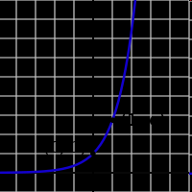

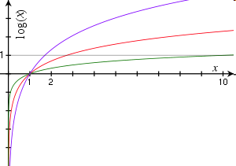

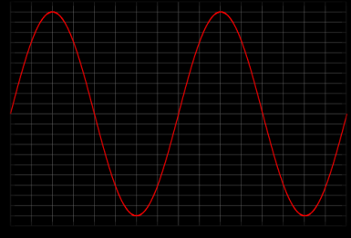


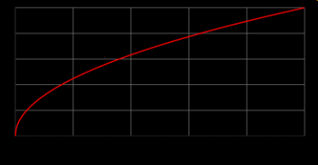
Functions
domain = R
codomain = R⁺-{0}
domain = R⁺-{0}
codomain = R
domain = R
codomain = [0,1]
domain = R⁺
codomain = R⁺

Slide 5
Functions
f(S) = |S|
domain = the set of all sets
codomain = non-negative integers
domain = the set of all strings
codomain = non-negative integers
f(string) = length(string)
not a function,
since one input could have
more than one output
f(student-name) = student-ID
f(x) = is-prime(x)
domain = positive integers
codomain = {T,F}

Slide 6
Injections (One-to-One)
is an injection iff no two inputs have the same output.
f( ) =
≤ 1 arrow in
A
B
|A| ≤ |B|

Slide 7
Surjections (Onto)
is a surjection iff every output is possible.
f( ) =
1 arrow in
A
B
|A| ≥ |B|

Slide 8
Bijections
is a bijection iff it is surjection and injection.
exactly one arrow in
f( ) =
A
B
|A| = |B|

Slide 9
In-Class Exercises
Function | Domain | Codomain | Injective? | Surjective? | Bijective?
f(x)=sin(x) | Real | [0,1]
f(x)=2^{x} | Real | Positive real
f(x)=x² | Real | Non-negative real
Reverse string | Bit strings of length n | Bit strings of length n
No
Yes
No
Yes
Yes
Yes
No
Yes
No
Yes
Yes
Yes
Whether a function is injective, surjective, bijective
depends on its domain and the codomain.

Slide 10
Inverse Sets
A
B
Given an element y in B, the inverse set of y := f⁻¹(y) = {x in A | f(x) = y}.
In words, this is the set of inputs that are mapped to y.
More generally, for a subset Y of B,
the inverse set of Y := f⁻¹(Y) = {x in A | f(x) in Y}.

Slide 11
Inverse Function
Informally, an inverse function f⁻¹ is to “undo” the operation of function f.
exactly one arrow in
f( ) =
A
B
There is an inverse function f⁻¹ for f if and only if f is a bijection.

Slide 12
Composition of Functions
Two functions f:X->Y’, g:Y->Z so that Y’ is a subset of Y,
then the composition of f and g is the function g。f: X->Z, where
g。f(x) = g(f(x)).
f
Y’
g
X
Z
Y

Slide 13
In-Class Exercises
Function f | Function g | g。f injective? | g。f surjective? | g。f bijective?
f:X->Y f surjective | g:Y->Z g injective
f:X->Y f surjective | g:Y->Z g surjective
f:X->Y f injective | g:Y->Z g surjective
f:X->Y f bijective | g:Y->Z g bijective
f:X->Y | f⁻¹:Y->X
No
No
No
No
Yes
No
No
No
No
Yes
Yes
Yes
Yes
Yes
Yes

Slide 14
This Lecture
Examples and definitions (injection, surjection, bijection)
Pigeonhole principle and applications

Slide 15
Pigeonhole Principle
If more pigeons
than pigeonholes,

Slide 16
Pigeonhole Principle
then some hole must have at least two pigeons!
Pigeonhole principle
A function from a larger set to a smaller set cannot be injective.
(There must be at least two elements in the domain that have
the same image in the codomain.)

Slide 17
Example 1
Question: Let A = {1,2,3,4,5,6,7,8}
If five integers are selected from A,
must a pair of integers have a sum of 9?
Consider the pairs {1,8}, {2,7}, {3,6}, {4,5}.
The sum of each pair is equal to 9.
If we choose 5 numbers from this set,
then by the pigeonhole principle,
both elements of some pair will be chosen,
and their sum is equal to 9.

Slide 18
Example 2
Question: In a party of n people, is it always true that there are
two people shaking hands with the same number of people?
Everyone can shake hand with 0 to n-1 people, and there are n people,
and so it does not seem that it must be the case, but think about it carefully:
Case 1: if there is a person who does not shake hand with others,
then any person can shake hands with at most n-2 people,
and so everyone shakes hand with 0 to n-2 people, and so
the answer is “yes” by the pigeonhole principle.
Case 2: if everyone shakes hand with at least one person, then
any person shakes hand with 1 to n-1 people, and so
the answer is “yes” by the pigeonhole principle.

Slide 19
Birthday Paradox
In a group of 366 people, there must be two people having the same birthday.
Suppose n <= 365, what is the probability that in a random set of n people,
some pair of them will have the same birthday?
We can think of it as picking n random numbers from 1 to 365 without repetition.
There are 365^{n} ways of picking n numbers from 1 to 365.
There are 365·364·363·…·(365-n+1) ways of
picking n numbers from 1 to 365 without repetition.
So the probability that no pairs have the same birthday is
equal to 365·364·363·…·(365-n+1) / 365^{n}
This is smaller than 50% for 23 people, smaller than 1% for 57 people.

Slide 20
Generalized Pigeonhole Principle
Generalized Pigeonhole Principle
If n pigeons and h holes,
then some hole has at least
pigeons.
♠ ♥ ♣ ♦
Cannot have < 3 cards in every hole.

Slide 21
Subset Sum
Two different subsets of the 90 25-digit numbers shown above have the same sum.

Slide 22
Subset Sum
Let A be the set of the 90 numbers, each with at most 25 digits.
So the total sum of the 90 numbers is at most 90x10²⁵.
Let 2^{A} be the set of all subsets of the 90 numbers.
(pigeons)
Let B be the set of integers from 0 to 90x10²⁵.
(pigeonholes)
Let f:2^{A}->B be a function mapping each subset of A into its sum.
If we could show that |2^{A}| > |B|, then by the pigeonhole principle,
the function f must map two elements in 2^{A} into the same element in B.
This means that there are two subsets with the same sum.

Slide 23

Subset Sum
90 numbers, each with at most 25 digits.
So the total sum of the 90 numbers is at most 90x10²⁵
Let 2^{A} be the set of all subsets of the 90 numbers.
(pigeons)
Let B be the set of integers from 0 to 90x10²⁵.
(pigeonholes)
So, |2^{A}| > |B|.
By the pigeonhole principle, there are two different subsets with the same sum.

Slide 24
Club vs Strangers
Let’s agree that given any two people, either they have met or not.
If every people in a group has met, then we’ll call the group a club.
If every people in a group has not met, then we’ll call a group of strangers.
Theorem: Every collection of 6 people includes a club of 3 people,
or a group of 3 strangers.
Let x be one of the six people.
By the (generalized) pigeonhole principle, we have the following claim.
Claim: Among the remaining 5 people, either 3 of them have met x,
or 3 of them have not met x.

Slide 25
Club vs Strangers
Theorem: Every collection of 6 people includes a club of 3 people,
or a group of 3 strangers.
Claim: Among the remaining 5 people, either 3 of them have met x,
or 3 of them have not met x.
Case 1: “3 people have met x”
Case 1.1: No pair among those people met each other.
Then there is a group of 3 strangers.
OK!
Case 1.2: Some pair among those people have met each other.
Then that pair, together with x, form a club of 3 people.
OK!

Slide 26
Club vs Strangers
Theorem: Every collection of 6 people includes a club of 3 people,
or a group of 3 strangers.
Claim: Among the remaining 5 people, either 3 of them have met x,
or 3 of them have not met x.
Case 2: “3 people have not met x”
Case 2.1: Every pair among those people met each other.
Then there is a club of 3 people.
OK!
Case 2.2: Some pair among those people have not met each other.
Then that pair, together with x, form a group of 3 strangers.
OK!

Slide 27
Club vs Strangers
Theorem: Every collection of 6 people includes a club of 3 people,
or a group of 3 strangers.
Theorem: For every k, if there are enough people,
then either there exists a club of k people,
or a group of k strangers.
A large enough structure cannot be totally disorder.

Slide 28
Cardinality
Functions are useful to compare the sizes of two different sets.
Question: Do all infinite sets have the same cardinality?
Two sets A and B have the same cardinality if and only if
there is a bijection between A and B.
A set, S, is countable if there exists an injective mapping from S to the set of positive integers.

Slide 29
Integers vs Positive Integers
Is the set of integers countable?
Define an injection from the set of all integers to the positive integers.
1 2 3 4 5 6 7 8 . . .
0 1 −1 2 −2 3 −3 4 . . .
n/2, if n is even;
−(n − 1)/2, if n is odd.
f(n) =
So, the set of integers is countable.

Slide 30
Rational Numbers vs Positive Integers
Question: Is the set of rational numbers countable?
We want to show that the set rational numbers is countable, by defining an injective mapping to the set of positive integers.
The mapping is defined by visiting the rational numbers in a specific order such that all numbers appear.

Slide 31
Rational Numbers vs Positive Integers
(0, 0), (0, 1), (0,−1), (0, 2), (0,−2), (0, 3), (0,−3), . . .
(1, 0), (1, 1), (1,−1), (1, 2), (1,−2), (1, 3), (1,−3), . . .
(−1, 0),(−1, 1),(−1,−1),(−1, 2),(−1,−2),(−1, 3), (−1,−3), . . .
(2, 0), (2, 1), (2,−1), (2, 2), (2,−2), (2, 3), (2,−3), . . .
(−2, 0),(−2, 1),(−2,−1),(−2, 2),(−2,−2), (−2, 3),(−2,−3), . . .
If we first visit all numbers in first row/column then we will never reach the second row/column.
The trick is to visit the rational numbers diagonal by diagonal.
Each diagonal is finite, so eventually every pair will be visited.
Therefore, there is an injective mapping from the rationals to the set of positive integers,and so the set of rational numbers is countable.

Slide 32
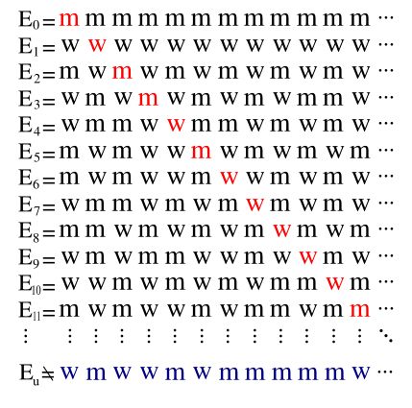
Real Numbers vs Positive Integers (Opitional)
Question: Is the set of real numbers countable?
Theorem: No injective mapping from real numbers to positive integers.
The string map to the first natural number
The string map to the fifth natural number
It can not be in any row i because its i-th bit is different, and so this string is not mapped!
The opposite of the diagonal

Slide 33
Diagonalization Argument
Similarly, power sets can be shown to be uncountable.
This argument is called Cantor’s diagonal argument.
http://en.wikipedia.org/wiki/Cantor's_diagonal_argument
This has been used in many places; for example the Russell’s paradox.

Slide 34
Cardinality and Computability
The set of all computer programs in a given computer language is countable.
The set of all functions is uncountable.
There must exist a non-computable function!

Slide 35
Quick Summary
Make sure you understand basic definitions of functions.
These will be used in the next lecture for counting.
The pigeonhole principle is very simple,
but there are many clever uses of it to prove non-trivial results.

