Slide 1
The Memory Hierarchy
Carnegie Mellon
Computer Organization and Architecture
11th Lecture
Instructor:
Xiaofei Nan

Slide 2
Today
Carnegie Mellon
Storage technologies and trends
Locality of reference
Caching in the memory hierarchy

Slide 3
Random-Access Memory (RAM)
Carnegie Mellon
Key features
  RAM is traditionally packaged as a chip.
  Basic storage unit is normally a cell (one bit per cell).
  Multiple RAM chips form a memory.
RAM comes in two varieties:
  SRAM (Static RAM)
  DRAM (Dynamic RAM)

Slide 4
SRAM vs DRAM Summary
Carnegie Mellon
Trans. Access Needs Needs per bit time refresh? EDC? Cost Applications
SRAM DRAM | 4 or 6 1 | 1X 10X | No Yes | Maybe Yes | 100x 1X | Cache memories Main memories, frame buffers

Slide 5
Enhanced DRAMs
Carnegie Mellon
Basic DRAM cell has not changed since its invention in 1966.
  Commercialized by Intel in 1970.
DRAM cores with better interface logic and faster I/O :
  Synchronous DRAM (SDRAM)
    Uses a conventional clock signal instead of asynchronous control
    Allows reuse of the row addresses (e.g., RAS, CAS, CAS, CAS)
  Double data-rate synchronous DRAM (DDR SDRAM)
    Double edge clocking sends two bits per cycle per pin
    Different types distinguished by size of small prefetch buffer:
– DDR (2 bits), DDR2 (4 bits), DDR3 (8 bits)
    By 2010, standard for most server and desktop systems
    Intel Core i7 supports DDR3 and DDR4 SDRAM

Slide 6
Nonvolatile Memories
Carnegie Mellon
DRAM and SRAM are volatile memories
  Lose information if powered off.
Nonvolatile memories retain value even if powered off
  Read-only memory (ROM): programmed during production
  Programmable ROM (PROM): can be programmed once
  Eraseable PROM (EPROM): can be bulk erased (UV, X-Ray)
  Electrically eraseable PROM (EEPROM): electronic erase capability
  Flash memory: EEPROMs. with partial (block-level) erase capability
    Wears out after about 100,000 erasings
Uses for Nonvolatile Memories
  Firmware programs stored in a ROM (BIOS, controllers for disks, network cards, graphics accelerators, security subsystems,…)
  Solid state disks (replace rotating disks in thumb drives, smart
phones, mp3 players, tablets, laptops,…)
  Disk caches

Slide 7
Traditional Bus Structure Connecting CPU and Memory
Carnegie Mellon
A bus is a collection of parallel wires that carry address, data, and control signals.
Buses are typically shared by multiple devices.
CPU chip
Register file
ALU
System bus
Memory bus
Main memory
Bus interface
I/O bridge

Slide 8
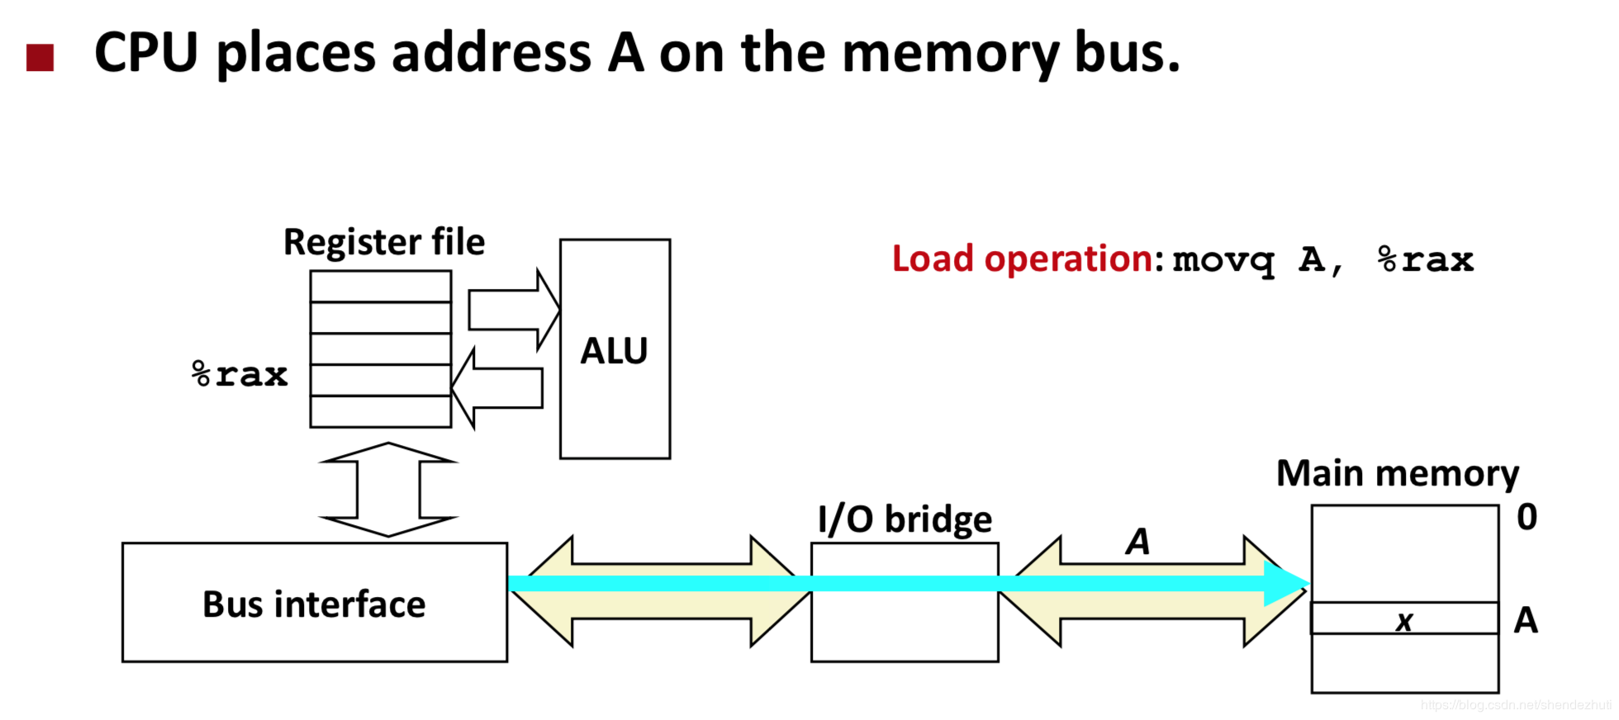
Memory Read Transaction

Slide 9
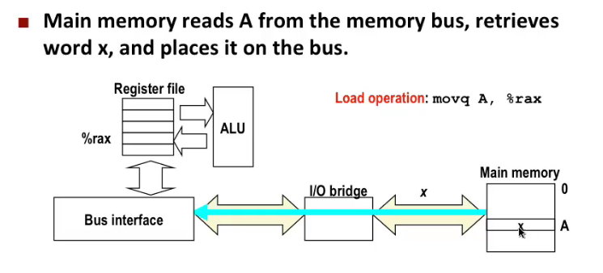
Memory Read Transaction

Slide 10
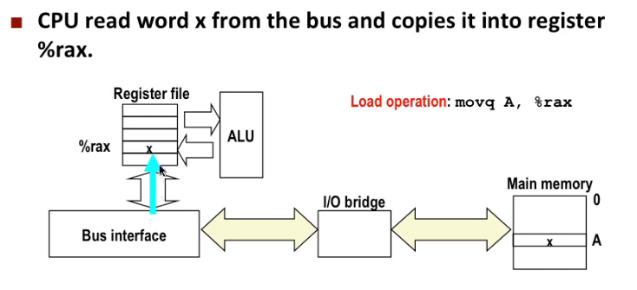
Memory Read Transaction

Slide 11
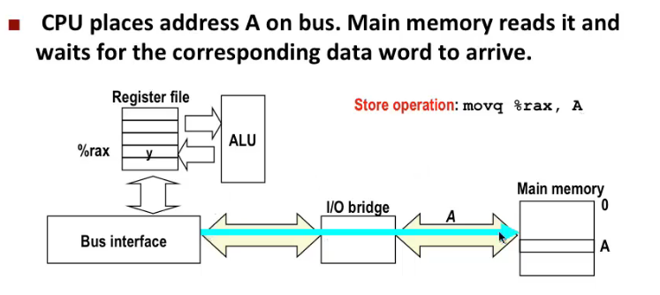
Memory Write Transaction

Slide 12
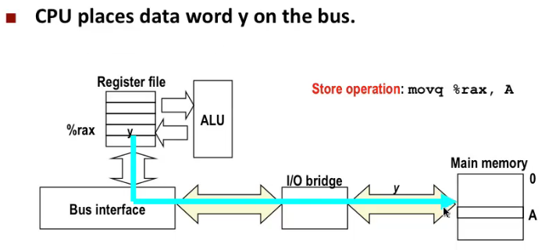
Memory Write Transaction

Slide 13
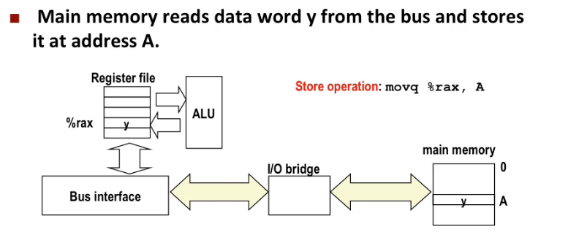
Memory Write Transaction

Slide 14
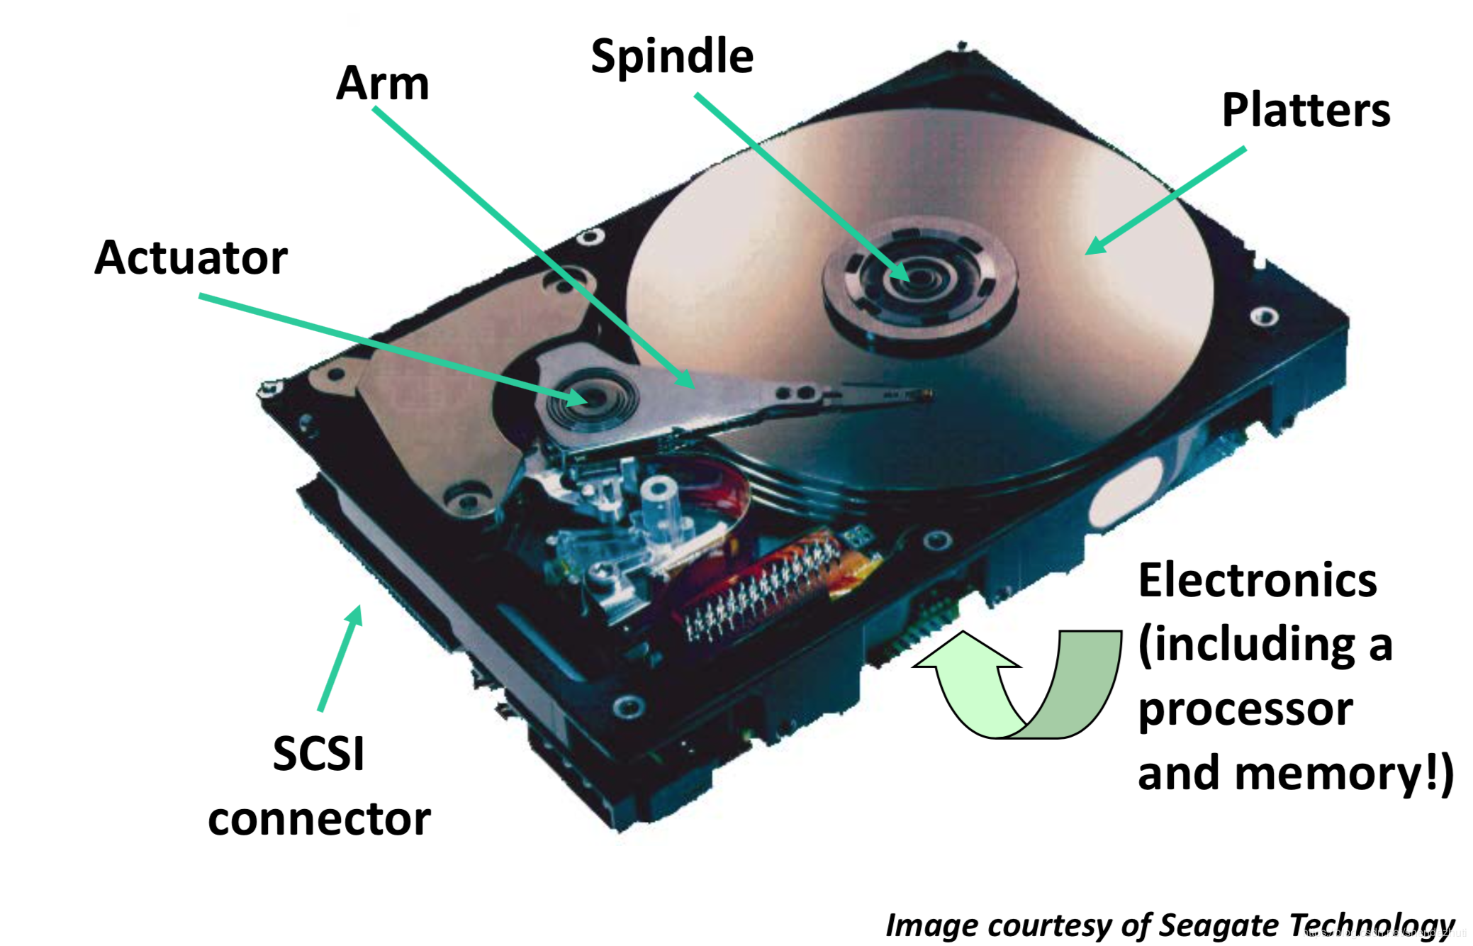
What’s Inside A Disk Drive?

Slide 15
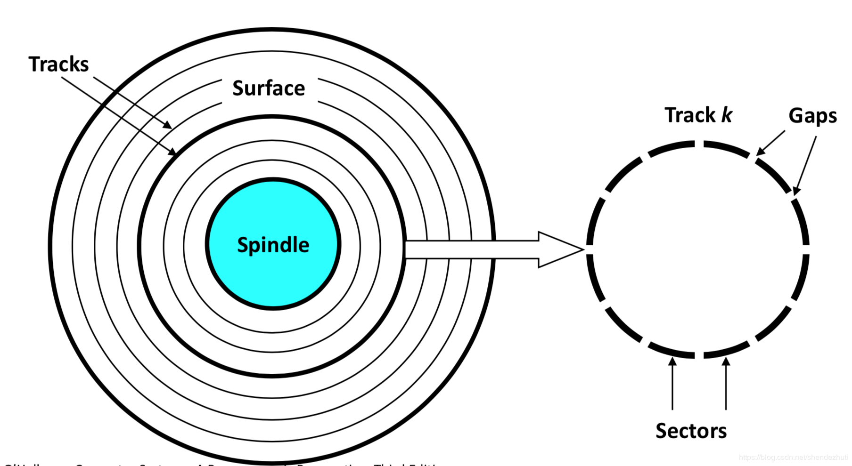
Disk Geometry
Disks consist of platters, each with two surfaces.
Each surface consists of concentric rings called tracks.
Each track consists of sectors separated by gaps.

Slide 16
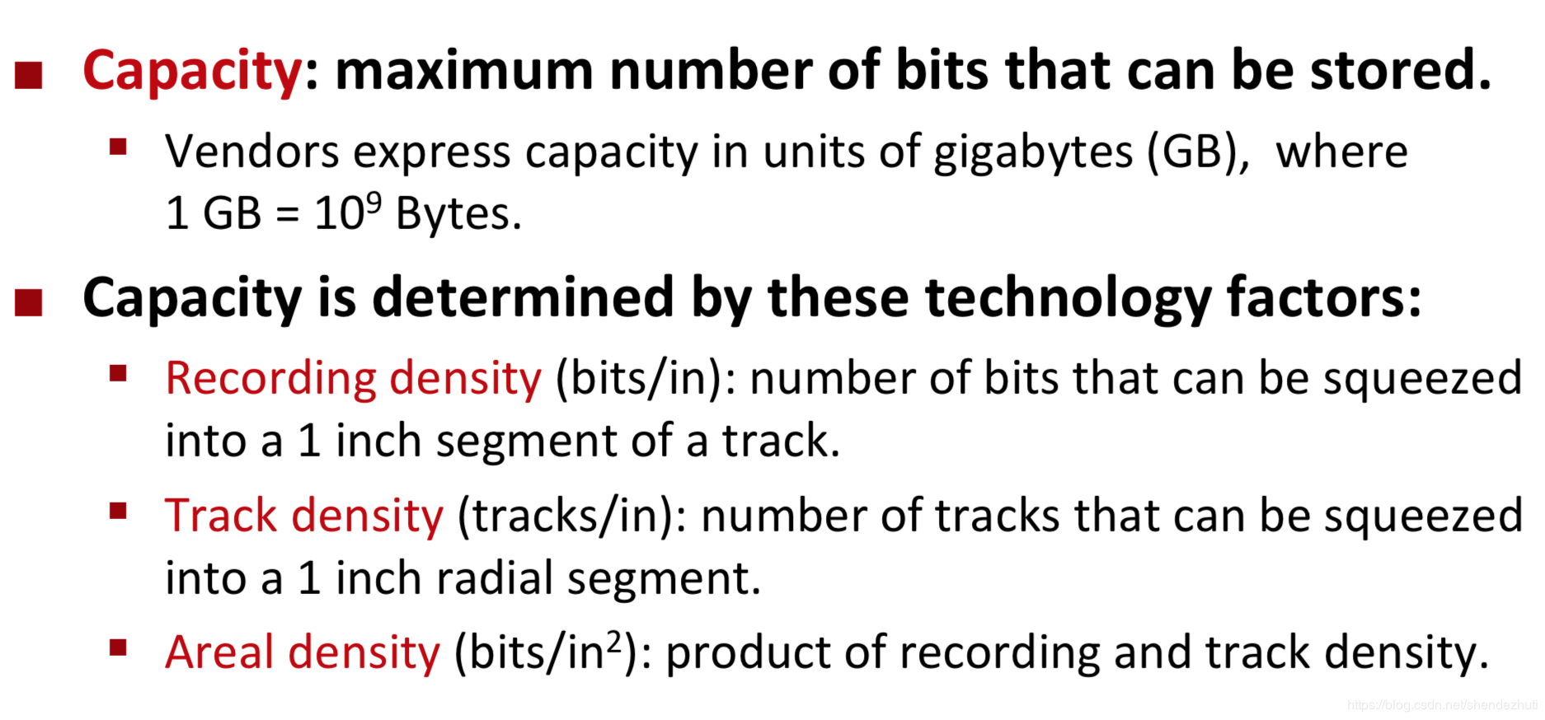
Disk Capacity

Slide 17
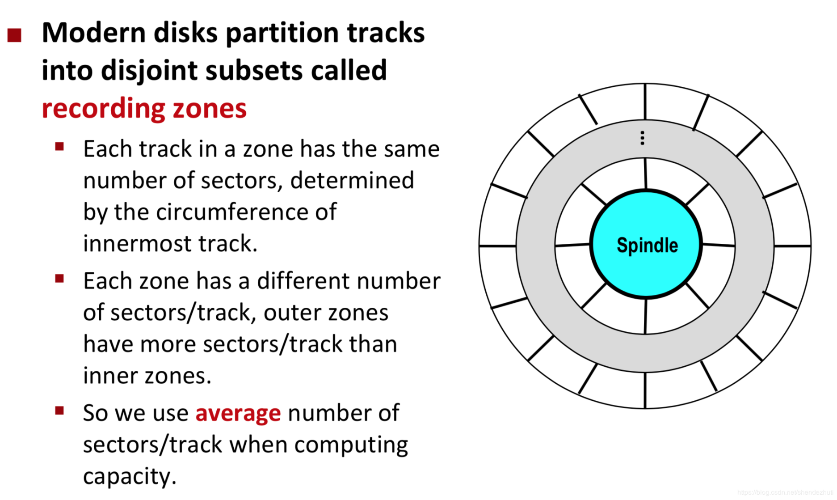
Recording zones

Slide 18
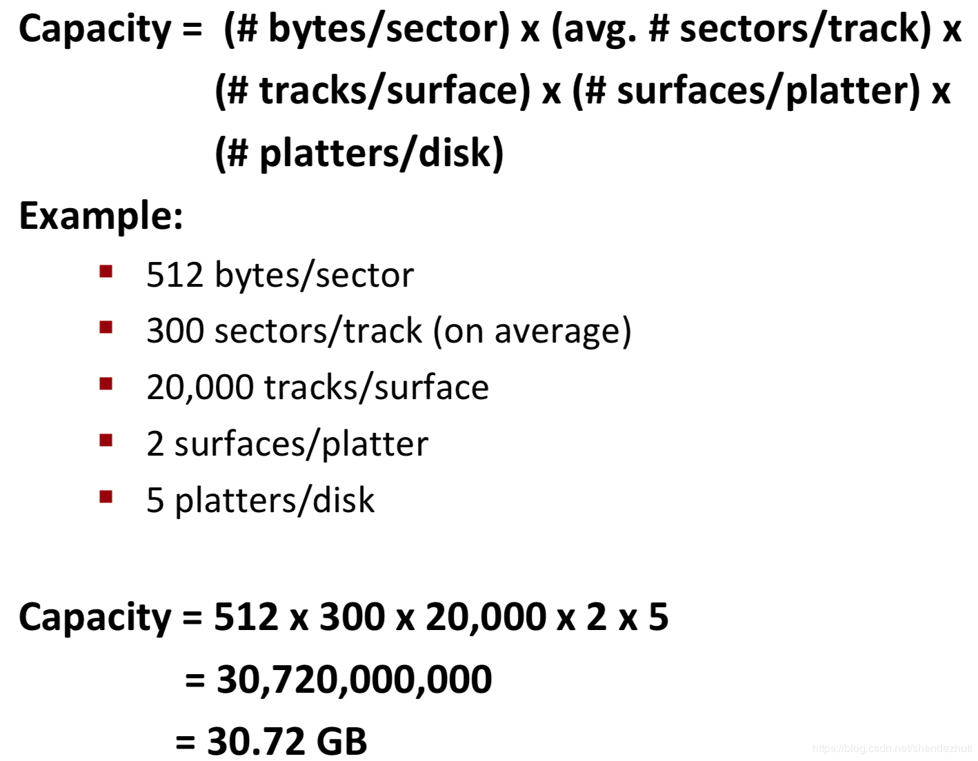
Computing Disk Capacity

Slide 19
Solid State Disks (SSDs)
Carnegie Mellon
I/O bus
Requests to read and
Solid State Disk (SSD)
write logical disk blocks
Flash memory
Flash
translation layer
Block 0 Block B-1
… …
Page 0 Page 1
Page P-1
…
Page 0 Page 1
Page P-1
Pages: 512KB to 4KB, Blocks: 32 to 128 pages
Data read/written in units of pages.
Page can be written only after its block has been erased
A block wears out after about 100,000 repeated writes.

Slide 20
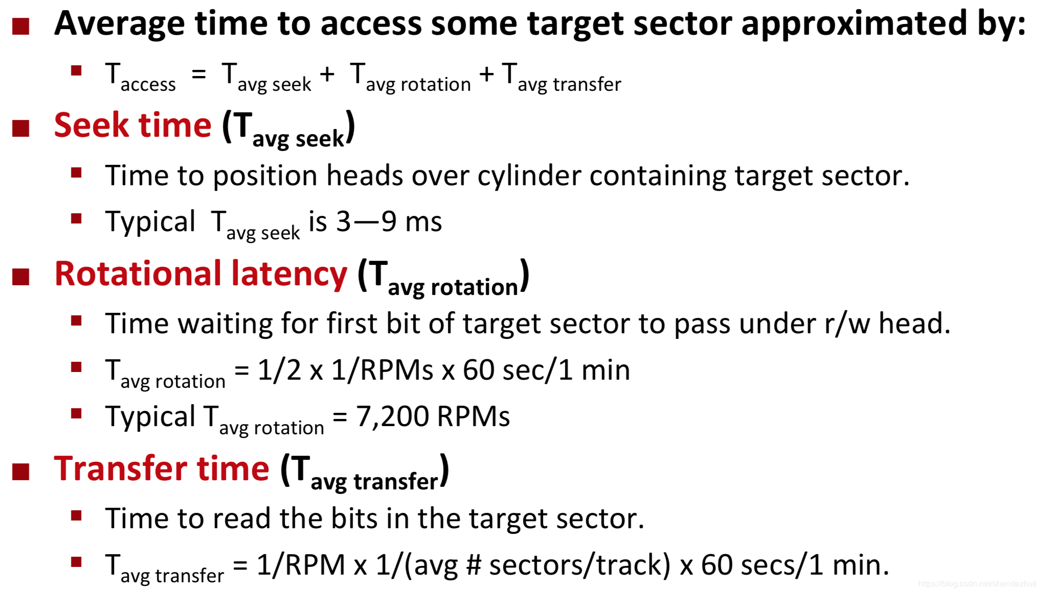
Disk Access Time

Slide 21
SSD Performance Characteristics
Carnegie Mellon
Sequential read tput Random read tput Avg seq read time
550 MB/s
365 MB/s
50 us
Sequential write tput Random write tput Avg seq write time
470 MB/s
303 MB/s
60 us
Sequential access faster than random access
  Common theme in the memory hierarchy
Random writes are somewhat slower
  Erasing a block takes a long time (~1 ms)
  Modifying a block page requires all other pages to be copied to
new block
  In earlier SSDs, the read/write gap was much larger.
Source: Intel SSD 730 product specification.

Slide 22
SSD Tradeoffs vs Rotating Disks
Carnegie Mellon
Advantages
  No moving parts → faster, less power, more rugged
Disadvantages
  Have the potential to wear out
    Mitigated by “wear leveling logic” in flash translation layer
    E.g. Intel SSD 730 guarantees 128 petabyte (128 x 10¹⁵ bytes) of
writes before they wear out
  In 2015, about 30 times more expensive per byte
Applications
  MP3 players, smart phones, laptops
  Beginning to appear in desktops and servers

Slide 23

The CPU-Memory Gap
The gap between DRAM, disk, and CPU speeds.
Carnegie Mellon

Slide 24
Carnegie Mellon
Locality to the Rescue!
The key to bridging this CPU-Memory gap is a fundamental property of computer programs known as locality

Slide 25
Today
Carnegie Mellon
Storage technologies and trends
Locality of reference
Caching in the memory hierarchy

Slide 26
Locality
Carnegie Mellon
Principle of Locality: Programs tend to use data and instructions with addresses near or equal to those they have used recently
Temporal locality:
  Recently referenced items are likely
to be referenced again in the near future
Spatial locality:
  Items with nearby addresses tend
to be referenced close together in time

Slide 27
Memory Hierarchies
Carnegie Mellon
Some fundamental and enduring properties of hardware and software:
  Fast storage technologies cost more per byte, have less capacity,
and require more power (heat!).
  The gap between CPU and main memory speed is widening.
  Well-written programs tend to exhibit good locality.
These fundamental properties complement each other beautifully.
They suggest an approach for organizing memory and
storage systems known as a memory hierarchy.

Slide 28

Example Memory Hierarchy
Carnegie Mellon
L0:
Regs
CPU registers hold words retrieved from the L1 cache.
Smaller,
L1 cache (SRAM)
faster, and costlier (per byte) storage devices
L1:
L1 cache holds cache lines retrieved from the L2 cache.
L2:
L2 cache
(SRAM)
L2 cache holds cache lines
retrieved from L3 cache
L3:
L3 cache
(SRAM)
L3 cache holds cache lines
retrieved from main memory.
Larger, slower, and cheaper (per byte)
L4:
Main memory (DRAM)
Main memory holds disk blocks retrieved from local disks.
storage devices
L5:
Local secondary storage (local disks)
Local disks hold files retrieved from disks on remote servers
L6:
Remote secondary storage (e.g., Web servers)

Slide 29
Today
Carnegie Mellon
Storage technologies and trends
Locality of reference
Caching in the memory hierarchy

Slide 30
Caches
Carnegie Mellon
Cache: A smaller, faster storage device that acts as a staging
area for a subset of the data in a larger, slower device.
Fundamental idea of a memory hierarchy:
  For each k, the faster, smaller device at level k serves as a cache for the
larger, slower device at level k+1.
Why do memory hierarchies work?
  Because of locality, programs tend to access the data at level k more often than they access the data at level k+1.
  Thus, the storage at level k+1 can be slower, and thus larger and
cheaper per bit.
Big Idea: The memory hierarchy creates a large pool of storage that costs as much as the cheap storage near the bottom, but that serves data to programs at the rate of the fast storage near the top.

Slide 31
General Cache Concepts
Carnegie Mellon
Smaller, faster, more expensive memory caches a subset of the blocks
Cache
4
9
10
3
8
14
Data is copied in block-sized transfer units
10
4
Larger, slower, cheaper memory
viewed as partitioned into “blocks”
Memory
0
1
2
3
4
5
6
7
4
8
9
10
11
10
12
13
14
15

Slide 32
General Cache Concepts: Hit
Carnegie Mellon
Request: 14
Data in block b is needed
Block b is in cache:
Hit!
Cache
8
9
14
3
14
Memory
0
1
2
3
4
5
6
7
8
9
10
11
12
13
14
15

Slide 33
General Cache Concepts: Miss
Carnegie Mellon
Request: 12
Data in block b is needed
Block b is not in cache:
Miss!
Cache
8
12
14
3
9
Block b is fetched from memory
12
Request: 12
0
4
8
1
5
9
2
6
10
3
7
11
Block b is stored in cache
Placement policy:
determines where b goes
Replacement policy: determines which block gets evicted (victim)
Memory
12
13
14
15
12

Slide 34
General Caching Concepts: Types of Cache Misses
Carnegie Mellon
Cold (compulsory) miss
  Cold misses occur because the cache is empty.
Conflict miss
  Most caches limit blocks at level k+1 to a small subset (sometimes a singleton) of the block positions at level k.
    E.g. Block i at level k+1 must be placed in block (i mod 4) at level k.
  Conflict misses occur when the level k cache is large enough, but multiple
data objects all map to the same level k block.
    E.g. Referencing blocks 0, 8, 0, 8, 0, 8, ... would miss every time.
Capacity miss
  Occurs when the set of active cache blocks (working set) is larger than
the cache.

Slide 35
Examples of Caching in the Mem. Hierarchy
Carnegie Mellon
Cache Type | What is Cached? | Where is it Cached? | Latency (cycles) | Managed By
Registers | 4-8 bytes words | CPU core | 0 | Compiler
TLB | Address translations | On-Chip TLB | 0 | Hardware MMU
L1 cache | 64-byte blocks | On-Chip L1 | 4 | Hardware
L2 cache | 64-byte blocks | On-Chip L2 | 10 | Hardware
Virtual Memory | 4-KB pages | Main memory | 100 | Hardware + OS
Buffer cache | Parts of files | Main memory | 100 | OS
Disk cache | Disk sectors | Disk controller | 100,000 | Disk firmware
Network buffer cache | Parts of files | Local disk | 10,000,000 | NFS client
Browser cache | Web pages | Local disk | 10,000,000 | Web browser
Web cache | Web pages | Remote server disks | 1,000,000,000 | Web proxy server
Notes:
MMU: Memory management Unit
TLB: translation lookaside buffer

Slide 36
Summary
Carnegie Mellon
The speed gap between CPU, memory and mass storage continues to widen.
Well-written programs exhibit a property called locality.
Memory hierarchies based on caching close the gap by exploiting locality.

