Slide 1
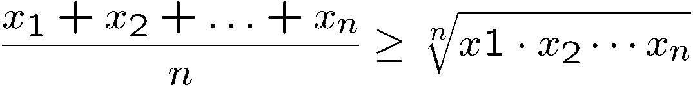

Introduction to Discrete Mathematics
A
B
C
a = qb+r gcd(a,b) = gcd(b,r)

Slide 2
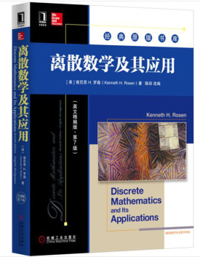
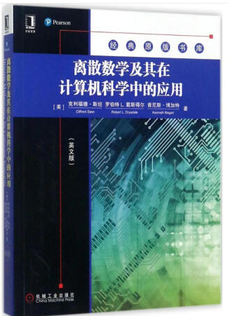
Basic Information
Instructor: Dr. Yibo Guo, Associate Professor
Lectures: Monday 7th-8th classes, Wednesday 7th-8th classes
Textbooks:
Discrete Mathematics and its Applications, 7th ed
Author: Kenneth H. Rosen
Publisher: McGraw Hill
https://item.jd.com/12125408.html
Discrete Mathematics for Computer Scientists
Author: Clifford Seth Stein
Publisher: Pearson
https://item.jd.com/12203473.html

Slide 3
Course Requirements
Attendence: 10-20%
Project: 0-30%
Final exam: 50-80%

Slide 4
Checker
x=0
Start with any configuration with all men on or below the x-axis.

Slide 5
Checker
x=0
Move: jump through your adjacent neighbour,
but then your neighbour will disappear.

Slide 6
Checker
x=0
Move: jump through your adjacent neighbour,
but then your neighbour will disappear.

Slide 7
Checker
x=0
Goal: Find an initial configuration with least number of men to jump up to level k.

Slide 8
K=1
x=0
2 men.

Slide 9
K=2
x=0

Slide 10
K=2
x=0
Now we have reduced to the k=1 configuration, but one level higher.
4 men.

Slide 11
K=3
x=0
This is the configuration for k=2, so jump two level higher.

Slide 12
K=3
x=0
8 men.

Slide 13
K=4
x=0

Slide 14
K=4
x=0

Slide 15
K=4
x=0

Slide 16
K=4
x=0

Slide 17
K=4
x=0
Now we have reduced to the k=3 configuration, but one level higher
20 men!

Slide 18
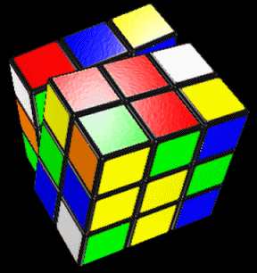
Example 1
How to play Rubik Cube?
Google: Rubik cube in 26 steps
http://www.cse.cuhk.edu.hk/~chi/csc2110-2008/notes/Rubik-Cube.ppt

Slide 19
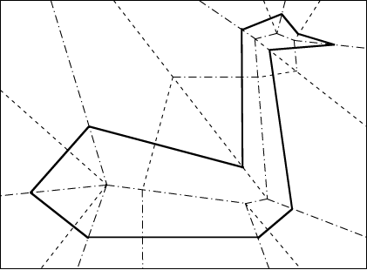
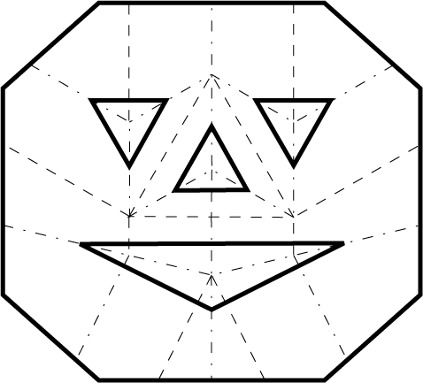
Example 2
The mathematics of paper folding
https://en.wikipedia.org/wiki/Fold-and-cut_theorem
http://erikdemaine.org/foldcut/
Notes:
Segmentation and Coverage

Slide 20
Why Mathematics?
Design efficient computer systems.
How did Google manage to build a fast search engine?
What is the foundation of internet security?
algorithms, data structures, database,
parallel computing, distributed systems,
cryptography, computer networks…
Logic, number theory, counting, graph theory…

Slide 21
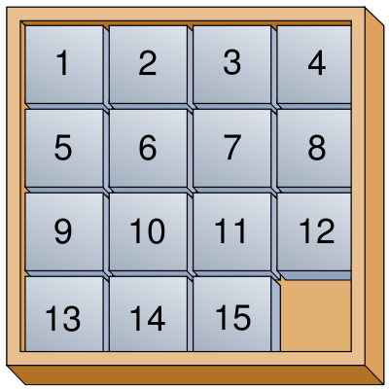

Topic 1: Logic and Proofs
How do computers think?
Logic: propositional logic, first order logic
Proof: induction, contradiction
Artificial intelligence, database, circuit, algorithms

Slide 22
Topic 2: Number Theory
Number sequence
(Extended) Euclidean algorithm
Prime number, modular arithmetic, Chinese remainder theorem
Cryptography, RSA protocol
Cryptography, coding theory, data structures

Slide 23
Topic 3: Counting
Sets and Functions
Combinations, Permutations, Binomial theorem
Counting by mapping, pigeonhole principle
Recursions
A
B
C
Probability, algorithms, data structures

Slide 24
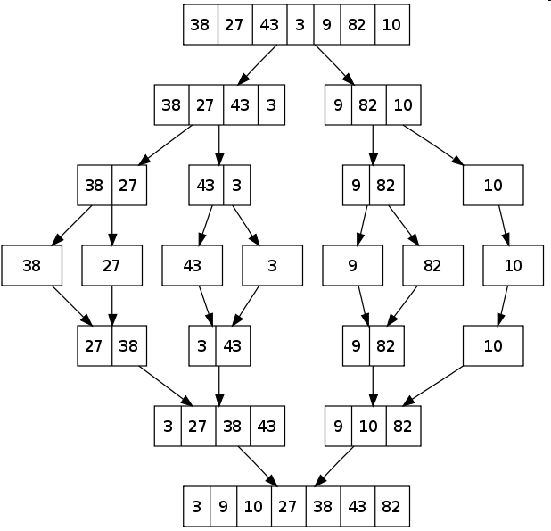
Topic 3: Counting
How many steps are needed to sort n numbers?
Algorithm 1 (Bubble Sort):
Every iteration moves the i-th smallest number to the i-th position
Algorithm 2 (Merge Sort):
Which algorithm runs faster?

Slide 25
Topic 4: Graph Theory
Graphs, Relations
Degree sequence, Eulerian graphs, isomorphism
Trees
Matching
Coloring
Computer networks, circuit design, data structures

Slide 26
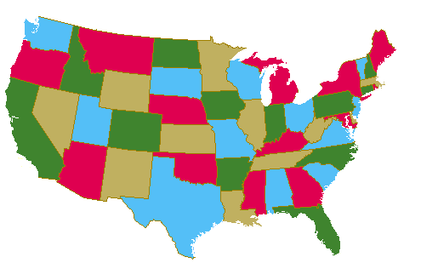
Topic 4: Graph Theory
How to color a map?
How to send data efficiently?

Slide 27
Objectives of This Course
To learn basic mathematical concepts, e.g. sets, functions, graphs
To be familiar with formal mathematical reasoning, e.g. logic, proofs
To improve problem solving skills
To see the connections between discrete mathematics and computer science

Slide 28
Pythagorean theorem
c
b
a
Familiar?
Obvious?

Slide 29

Good Proof
b
c
b-a
a
b-a
We will show that these five pieces can be rearranged into:
(i) a c×c square, and then
(ii) an a×a & a b×b square
And then we can conclude that

Slide 30
Good Proof
The five pieces can be rearranged into:
(i) a c×c square
c
b-a
c
c
a
b
c

Slide 31
Good Proof
How to rearrange them into an axa square and a bxb square?
b
c
b-a
a
b-a

Slide 32
Good Proof
a
b
a
b-a
a
b
74 proofs in http://www.cut-the-knot.org/pythagoras/index.shtml

Slide 33
Mathematical Proof
To prove mathematical theorems, we need a more rigorous system.
The standard procedure for proving mathematical theorems is invented by
Euclid in 300BC. First he started with five axioms (the truth of these
statements are taken for granted). Then he uses logic to deduce the truth
of other statements.
It is possible to draw a straight line from any point to any other point.
It is possible to produce a finite straight line continuously in a straight line.
It is possible to describe a circle with any center and any radius.
It is true that all right angles are equal to one another.
("Parallel postulate") It is true that, if a straight line falling on two straight lines make the interior angles on the same side less than two right angles,
the two straight lines, if produced indefinitely, intersect on that side on which are the angles less than the two right angles.
Euclid’s proof of Pythagorean’s theorem
http://en.wikipedia.org/wiki/Pythagorean_theorem

Slide 34
Statement (Proposition)
A Statement is a sentence that is either True or False
Examples:
2 + 2 = 4
True
3 x 3 = 8
False
787009911 is a prime
Non-examples:
x+y>0
x²+y²=z²
They are true for some values of x and y
but are false for some other values of x and y.

Slide 35


Logic Operators
~p is true if p is false
P
Q
P Q
P
Q
P Q
T
T
T
T
T
T
T
F
F
T
F
T
F
T
F
F
T
T
F
F
F
F
F
F

Slide 36



Compound Statement
p = “it is hot”
q = “it is sunny”
It is hot and sunny
It is not hot but sunny
It is neither hot nor sunny

Slide 37

Exclusive-Or

coffee “or” tea
exclusive-or
How to construct a compound statement for exclusive-or?
Idea 1: Look at the true rows
Idea 1: Look at the true rows
Idea 1: Look at the true rows
p | q | p  q
T | T | F
T | F | T
F | T | T
F | F | F
Want the formula to be true
exactly when the input belongs
to a “true” row.
The input is the second row exactly if this sub-formula is satisfied
And the formula is true exactly when the input is the second row or the third row.

Slide 38
Exclusive-Or

coffee “or” tea
exclusive-or
How to construct a compound statement for exclusive-or?
p | q | p  q
T | T | F
T | F | T
F | T | T
F | F | F
Idea 2: Look at the false rows
Want the formula to be true
exactly when the input does
not belong to a “false” row.
The input is the first row exactly if this sub-formula is satisfied
And the formula is true exactly when the input is not in the 1st row and the 4th row.

Slide 39



Logical Equivalence
Idea 3: Guess and check
p | q
T | T | F | T | F | F
T | F | T | T | T | T
F | T | T | T | T | T
F | F | F | F | T | F
Logical equivalence: Two statements have the same truth table
As you see, there are many different ways to write the same logical formula.
One can always use a truth table to check whether two statements are equivalent.

Slide 40
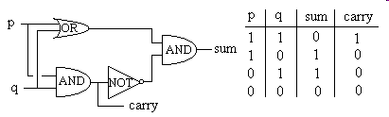
Writing Logical Formula for a Truth Table
Digital logic:
Given a digital circuit, we can construct the truth table.
Now, suppose we are given only the truth table (i.e. the specification),
how can we construct a circuit (i.e. formula) that has the same function?

Slide 41













Writing Logical Formula for a Truth Table
Use idea 1 or idea 2.
Idea 1: Look at the true rows
and take the “or”.
p | q | r | output
T | T | T | F
T | T | F | T
T | F | T | T
T | F | F | F
F | T | T | T
F | T | F | T
F | F | T | T
F | F | F | F
The formula is true exactly when the input is one of the true rows.

Slide 42



Writing Logical Formula for a Truth Table
Idea 2: Look at the false rows,
negate and take the “and”.
p | q | r | output
T | T | T | F
T | T | F | T
T | F | T | T
T | F | F | F
F | T | T | T
F | T | F | T
F | F | T | T
F | F | F | F
The formula is true exactly when the input is not one of the false row.

Slide 43
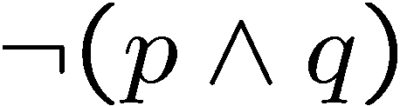
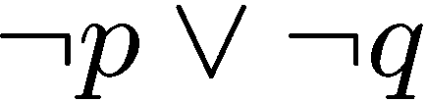


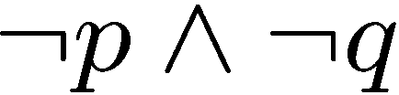
DeMorgan’s Laws
Logical equivalence: Two statements have the same truth table
De Morgan’s Law
Statement: Tom is in the football team and the basketball team.
Negation: Tom is not in the football team or not in the basketball team.
De Morgan’s Law
Statement: The number 783477841 is divisible by 7 or 11.
Negation: The number 783477841 is not divisible by 7 and not divisible by 11.

Slide 44



DeMorgan’s Laws
Logical equivalence: Two statements have the same truth table
De Morgan’s Law
T | T | F | F
T | F | T | T
F | T | T | T
F | F | T | T
De Morgan’s Law

Slide 45
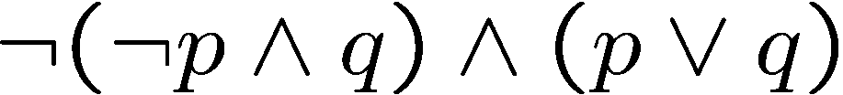
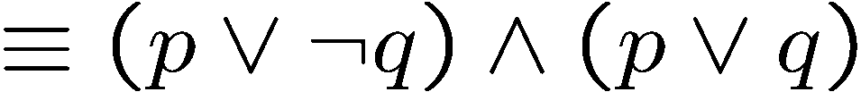
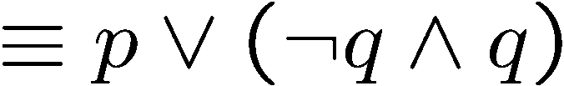


Simplifying Statement
DeMorgan
Distributive
See textbook for more identities.

Slide 46


Tautology, Contradiction
A tautology is a statement that is always true.
A contradiction is a statement that is always false.
(negation of a tautology)
In general it is “difficult” to tell whether a statement is a contradiction.
It is one of the most important problems in CS – the satisfiability problem.

Slide 47
Quick Summary
Key points to know.
Write a logical formula from a truth table.
Check logical equivalence of two logical formulas.
DeMorgan’s rule and other simple logical rules (e.g. distributive).
Use simple logical rules to simplify a logical formula.

