Slide 1
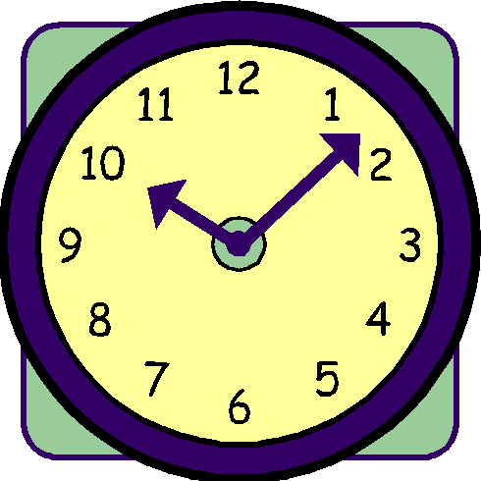
Modular Arithmetic

Slide 2
This Lecture
Modular arithmetic is an arithmetic about remainders.
It is very useful in coding theory and cryptography.
In this lecture we will focus on additions and multiplications,
while in the next lecture we will talk about “divisions”.
This lecture is short. We will talk about:
Basic rule of modular addition and modular multiplication
Applications: Fast exponentiation and fast division test

Slide 3
Modular Arithmetic
Def: a  b (mod n) iff n|(a - b) iff a mod n = b mod n.
Be careful, a mod n means “the remainder when a is divided by n”.
a  b (mod n) means “a and b have the same remainder when divided by n”.
e.g. 12  2 (mod 10)
107  207 (mod 10)
7  3 (mod 2)
7  -1 (mod 2)
13  -1 (mod 7)
-15  10 (mod 5)
12 mod 10 = 2
207 mod 10 = 7
7 mod 2 = 1
-1 mod 2 = 1
-1 mod 7 = 6
-15 mod 5 = 0
Fact: a  a mod n (mod n)
as a and a mod n have the same remainder mod n
Fact: if a  b (mod n), then a = b + nx for some integer x.
Notes:
In modular arithmetic, the modulo operation finds the remainder when one integer is divided by another. In the case of -1 mod 7, we want to find the remainder when -1 is divided by 7.
When you divide -1 by 7, the quotient is 0 and the remainder is -1. However, in modular arithmetic, we typically want to express the remainder as a non-negative integer between 0 and the modulus minus 1. To achieve this, we add the modulus (7 in this case) to the negative remainder until we get a non-negative result.
So, adding 7 to -1 gives us 6. Therefore, -1 mod 7 is 6. This is because -1 is equivalent to 6 modulo 7, meaning that -1 and 6 leave the same remainder when divided by 7.

Slide 4
Modular Addition
Lemma: If a  c (mod n), and b  d (mod n) then
a+b  c+d (mod n).
When you try to understand a statement like this,
first think about the familiar cases, e.g. n=10 or n=2.
When n=2, it says that if a and c have the same parity,
and b and d have the same parity,
then a+b and c+d have the same parity.
When n=10, it says that if a and c have the same last digit,
and b and d have the same last digit,
then a+b and c+d have the same last digit.
And the lemma says that the same principle applied for all n.

Slide 5
Modular Addition
Lemma: If a  c (mod n), and b  d (mod n) then
a+b  c+d (mod n).
Example 1 13  1 (mod 3), 25  1 (mod 3)
=> 12 + 25 (mod 3)  1 + 1 (mod 3)  2 (mod 3)
Example 2 87  2 (mod 17), 222  1 (mod 17)
=> 87 + 222 (mod 17)  2 + 1 (mod 17)  3 (mod 17)
Example 3 101  2 (mod 11), 141  -2 (mod 11)
=> 101 + 141 (mod 11)  0 (mod 11)
In particular, when computing a+b mod n, we can first replace
a by a mod n and b by b mod n, so that the computation is faster.

Slide 6
Modular Addition
Lemma: If a  c (mod n), and b  d (mod n) then
a+b  c+d (mod n).
Proof
a  c (mod n) => a = c + nx for some integer x
b  d (mod n) => b = d + ny for some integer y
To show a+b  c+d (mod n), it is equivalent to showing that n | (a+b-c-d).
Consider a+b-c-d.
a+b-c-d = (c+nx) + (d+ny) – c –d = nx + ny.
It is clear that n | nx + ny.
Therefore, n | a+b-c-d.
We conclude that a+b  c+d (mod n).

Slide 7
Modular Multiplication
Lemma: If a  c (mod n), and b  d (mod n) then
ab  cd (mod n).
Example 1 9876  6 (mod 10), 17642  2 (mod 10)
=> 9876 * 17642 (mod 10)  6 * 2 (mod 10)  2 (mod 10)
Example 2 10987  1 (mod 2), 28663  1 (mod 2)
=> 10987 * 28663 (mod 2)  1 (mod 2)
Example 3 1000  -1 (mod 7), 1000000  1 (mod 7)
=> 1000 * 1000000 (mod 7)  -1 * 1 (mod 7)  -1 (mod 7)
In particular, when computing ab mod n, we can first replace
a by a mod n and b by b mod n, so that the computation is faster.

Slide 8
Modular Multiplication
Lemma: If a  c (mod n), and b  d (mod n) then
ab  cd (mod n).
Proof
a  c (mod n) => a = c + nx for some integer x
b  d (mod n) => b = d + ny for some integer y
To show ab  cd (mod n), it is equivalent to showing that n | (ab-cd).
Consider ab-cd.
ab-cd = (c+nx) (d+ny) – cd
= cd + dnx + cny + n²xy – cd = n(dx + cy + nxy).
It is clear that n | n(dx + cy + nxy). Therefore, n | ab-cd.
We conclude that ab  cd (mod n).

Slide 9
This Lecture
Basic rule of modular addition and modular multiplication
Applications: Fast exponentiation and fast division test

Slide 10
Fast Exponentiation
20736 * 20736 mod 713
= 59 * 59 mod 713
= 3481 mod 713
= 629 mod 713
144⁴ mod 713
= 144 * 144 * 144 * 144 mod 713
= 20736 * 144 * 144 mod 713
= 59 * 144 * 144 mod 713
= 8496 * 144 mod 713
= 653 * 144 mod 713
= 94032 mod 713
= 629 mod 713
shortcut
Because 20736  59 (mod 713)
Because 653  8496 (mod 713)

Slide 11
Repeated Squaring
144² mod 713 = 59
144⁴ mod 713
= 144^{2 ·}144² mod 713
= 59·59 mod 713
= 629
144⁸ mod 713
= 144⁴·144⁴ mod 713
= 629·629 mod 713
= 639
144¹⁶ mod 713
= 144⁸·144⁸ mod 713
= 639·639 mod 713
= 485
144³² mod 713
= 144¹⁶·144¹⁶ mod 713
= 485·485 mod 713
= 648
Note that 50 = 32 + 16 + 2
144⁵⁰ mod 713
= 144³² 144¹⁶ 144² mod 713
= 648·485·59 mod 713
= 242

Slide 12
Fast Division Test
Using the basic rules for modular addition and modular multiplication,
we can derive some quick test to see if a big number is divisible by a small number.
Suppose we are given the decimal representation of a big number N.
To test if N is divisible by a small number n, of course we can do a division to check.
But can we do faster?
If n = 2, we just need to check whether the last digit of N is even or not.
If n = 10, we just need to check whether the last digit of N is 0 or not.
If n = 5, we just need to check whether the last digit of N is either 5 or 0 or not.
What about when n=3? When n=7? When n=11?

Slide 13
Fast Division Test
A number written in decimal divisible by 9 if and only if
the sum of its digits is a multiple of 9?
Example 1. 9333234513171 is divisible by 9.
9+3+3+3+2+3+4+5+1+3+1+7+1 = 45 is divisible by 9.
Example 2. 128573649683 is not divisible by 9.
1+2+8+5+7+3+6+4+9+6+8+3 = 62 is not divisible by 9.

Slide 14
Fast Division Test
Claim. A number written in decimal is divisible by 9 if and only if
the sum of its digits is a multiple of 9.
Hint: 10  1 (mod 9).
Let the decimal representation of N be d_{k}d_{k-1}d_{k-2}…d₁d_{0.}
This means that N = d_{k}10^{k} + d_{k-1}10^{k-1} + … + d₁10 + d₀
Note that d_{i}10^{i} mod 9
= (d_{i}) (10^{i} mod 9) mod 9
= (d_{i}) (10 mod 9) (10 mod 9) … (10 mod 9) mod 9
= (d_{i}) (1 mod 9) (1 mod 9) … (1 mod 9) mod 9
= d_{i} mod 9
Rule of modular multiplication
i terms

Slide 15
Fast Division Test
Claim. A number written in decimal is divisible by 9 if and only if
the sum of its digits is a multiple of 9.
Hint: 10  1 (mod 9).
Let the decimal representation of n be d_{k}d_{k-1}d_{k-2}…d₁d_{0.}
This means that N = d_{k}10^{k} + d_{k-1}10^{k-1} + … + d₁10 + d₀
Note that d_{i}10^{i} mod 9 = d_{i} mod 9.
Hence N mod 9 = (d_{k}10^{k} + d_{k-1}10^{k-1} + … + d₁10 + d₀) mod 9
= (d_{k}10^{k} mod 9 + d_{k-1}10^{k-1} mod 9 + … + d₁10 mod 9 + d₀ mod 9) mod 9
= (d_{k} mod 9 + d_{k-1} mod 9 + … + d₁ mod 9 + d₀ mod 9) mod 9
= (d_{k} + d_{k-1} + … + d₁ + d₀) mod 9
Rule of modular addition
By previous slide

Slide 16
Fast Division Test
The same procedure works to test whether N is divisible by n=3.
What about n=11?
Hint: 10  -1 (mod 11).
Let the decimal representation of N be d₉₂d₉₁d₉₀…d₁d₀
Then N is divisible by 11 if and only if
d₉₂-d₉₁+d₉₀…-d₁+d₀ is divisible by 11.
What about n=7?
Hint: 1000  -1 (mod 7).

Slide 17
Quick Summary
Need to know how to apply the basic rules effectively.
Understand the principle of fast division tests.
Repeated squaring will be useful later.

Slide 18
Multiplication Inverse
The multiplicative inverse of a number a is another number a’ such that:
a · a’  1 (mod n)
For real numbers, every nonzero number has a multiplicative inverse.
For integers, only 1 has a multiplicative inverse.
An interesting property of modular arithmetic is that
there are multiplicative inverse for integers.
For example, 2 * 5 = 1 mod 3, so 5 is a multiplicative inverse
for 2 under modulo 3 (and vice versa).
Does every number has a multiplicative inverse in modular arithmetic?

Slide 19
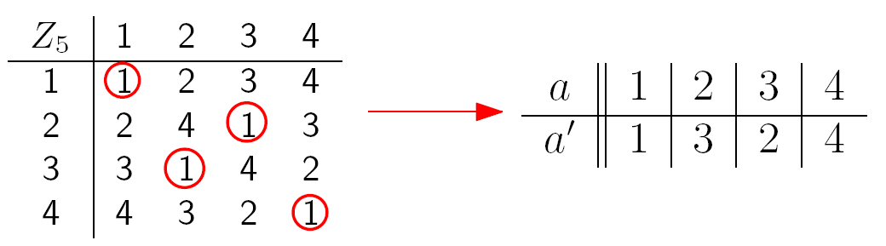
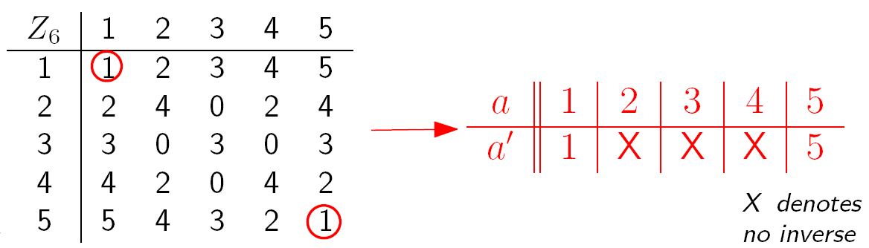
Multiplication Inverse
Does every number has a multiplicative inverse in modular arithmetic?

Slide 20
Multiplication Inverse
What is the pattern?

Slide 21
Case Study
Why 2 does not have a multiplicative inverse under modulo 6?
Suppose it has a multiplicative inverse y.
2y  1 (mod 6)
=> 2y = 1 + 6x for some integer x
=> y = ½ + 3x
This is a contradiction since both x and y are integers.

Slide 22
Necessary Condition
Claim. An integer k does not have an multiplicative inverse under modulo n,
if k and n have a common factor >= 2 (gcd(k,n) >= 2).
Proof.
Suppose, by contradiction, that there is an inverse k’ for k such that
k’k = 1 (mod n)
Then k’k = 1 + xn for some integer x.
Since both k and n have a common factor, say c>=2,
then k=ck₁ and n=cn₁ for some integers k₁ and n₁.
So k’ck₁ = 1 + xcn₁.
Then k’k₁ = 1/c + xn₁
This is a contradiction since the LHS is an integer but the RHS is not.
This claim says that for k to have a multiplicative inverse modulo n,
then a necessary condition is that k and n do not have a common factor >= 2.

Slide 23
Sufficient Condition
What about if gcd(k,n)=1?
Would k always have an multiplicative inverse under modulo n?
For example,
gcd(3,7) = 1
3·5  1 (mod 7)
gcd(4,11) = 1
4·3  1 (mod 11)
gcd(8,9) = 1
8·8  1 (mod 9)
It seems that there is always an inverse in such a case, but why?
gcd(8,9) = 1
8s + 9t = 1 for some integers s and t
8s = 1 – 9t
gcd(8,9) = spc(8,9)
8s  1 (mod 9)

Slide 24
Sufficient Condition
Theorem. If gcd(k,n)=1, then have k’ such that
k·k’  1 (mod n).
gcd(k,n)=spc(k,n)
Proof: Since gcd(k,n)=1, there exist s and t so that sk + tn = 1.
So tn = 1 - sk
This means n | 1 – sk.
This means that 1 – sk  0 (mod n).
This means that 1  sk (mod n).
So k’ = s is an multiplicative inverse for k.
The multiplicative inverse can be computed by the extended Euclidean algorithm.
Corollary: k has a multiplicative inverse mod n if and only if gcd(k,n)=1

Slide 25
This Lecture
Multiplicative inverse
Cancellation in modular arithmetic
Application: check digit scheme
Fermat’s little theorem

Slide 26
Cancellation
Note that  (mod n) is very similar to =.
If a  b (mod n), then a+c  b+c (mod n).
If a  b (mod n), then ac  bc (mod n)
However, if ac  bc (mod n),
it is not necessarily true that a  b (mod n).
For example, 4·2  1·2 (mod 6), but 4  1 (mod 6)
3·4  1·4 (mod 8), but 3  1 (mod 8)
4·3  1·3 (mod 9), but 4  1 (mod 9)
There is no general cancellation in modular arithmetic.
Observation: In all the above examples c and n have a common factor.

Slide 27
Cancellation
Why a·k  b·k (mod n) when a ≠ b?
Without loss of generality, assume 0 < a < n and 0 < b < n.
Because if a·k  b·k (mod n), then also (a mod n)·k  (b mod n)·k (mod n).
smaller than n.
This means that ak = bk + nx.
This means that (a-b)k = nx, which means a-b=(nx)/k.
Since 0 < a < n and 0 < b < n, it implies that –n < a-b < n.
Therefore, nx/k must be < n.
For this to happen, n and k must have a common divisor >= 2!
Okay, so, can we say something when gcd(n,k)=1?

Slide 28
Cancellation
Claim: Assume gcd(k,n) = 1. If i·k  j·k (mod n), then i  j (mod n).
For example, multiplicative inverse always exists if n is a prime!
Proof.
Since gcd(k,n) = 1, there exists k’ such that kk’  1 (mod n).
i·k  j·k (mod n).
=> i·k·k’  j·k·k’ (mod n).
=> i  j (mod n)
Remarks (Optional): This makes arithmetic modulo prime a field,
a structure that “behaves like” real numbers.
Arithmetic modulo prime is very useful in coding theory.

Slide 29
This Lecture
Multiplicative inverse
Cancellation in modular arithmetic
Application: check digit scheme
  US Postal Money Order
  Airline Ticket
  ISBN
Fermat’s little theorem

Slide 30
Check Digit Scheme
In many identification numbers, there is a check digit appended at the end.
The purpose of this check digit is to detect errors (e.g. transmission error).
For example, consider an ID card number M123456(X).
You want to have the check digit X to detect typos. Typical typos are:
single digit 123456 123356
transposition 123456 124356
We want to design check digit scheme (a formula to compute X)
so that these two types of errors can always be detected.
It turns out that some simple modular arithmetic can do the trick.

Slide 31

US Postal Money Order
The last digit is the check digit, and it is computed by the following formula:
a₁₁ = (a₁ + a₂ + a₃ + … + a₈ + a₉ + a₁₀) mod 9
In the above example,
1 = (1 + 6 + 4 + 2 + 0 + 6 + 9 + 0 + 3 + 6) mod 9
You can use this formula to generate the check digit.

Slide 32
US Postal Money Order
a₁₁ = a₁ + a₂ + a₃ + … + a₈ + a₉ + a₁₀ (mod 9)
Can it be used to detect single digit error?
Correct number 27914009534 27914009534
Incorrect number 27914009834 27014009534
In the first case, (2 + 7 + 9 + 1 + 4 + 0 + 0 + 9 + 8 + 3) mod 9 = 43 mod 9 = 7
and the error is detected.
But in the second case, (2+7+0+1+4+0+0+9+8+3) mod 9 = 31 mod 9 = 4
and the error is not detected.

Slide 33
US Postal Money Order
a₁₁ = a₁ + a₂ + a₃ + … + a₈ + a₉ + a₁₀ (mod 9)
Can it be used to detect single digit error?
Correct number a₁a₂a₃…a₁₀a₁₁
Incorrect number b₁a₂a₃…a₁₀a₁₁
To be able to detect the error, we want
a₁ + a₂ + a₃ + … + a₈ + a₉ + a₁₀ (mod 9) ≠ b₁ + a₂ + a₃ + … + a₈ + a₉ + a₁₀ (mod 9)
This happens if and only if a₁ (mod 9) ≠ b₁ (mod 9)
So it cannot detect the error exactly when a₁ (mod 9) = b₁ (mod 9)

Slide 34
US Postal Money Order
a₁₁ = a₁ + a₂ + a₃ + … + a₈ + a₉ + a₁₀ (mod 9)
Can it be used to detect transposition error?
Correct number a₁a₂a₃…a₁₀a₁₁
Incorrect number a₂a₁a₃…a₁₀a₁₁
To be able to detect the error, we want
a₁ + a₂ + a₃ + … + a₈ + a₉ + a₁₀ (mod 9) ≠ a₂ + a₁ + a₃ + … + a₈ + a₉ + a₁₀ (mod 9)
This will never happen because the two sums are always the same.

Slide 35
US Postal Money Order
The last digit is the check digit, and it is computed by the following formula:
a₁₁ = a₁ + a₂ + a₃ + … + a₈ + a₉ + a₁₀ (mod 9)
Can it be used to detect single digit error?
Except when a_{i} (mod 9) = b_{i} (mod 9)
Can it be used to detect transposition error?
Never, except possibly the error is not the check digit

Slide 36
This Lecture
Multiplicative inverse
Cancellation in modular arithmetic
Application: check digit scheme
  US Postal Money Order
  Airline Ticket
  ISBN
Fermat’s little theorem

Slide 37
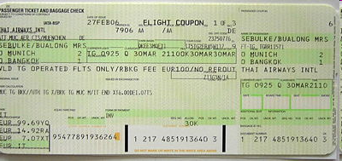
Airline Ticket Identification Number
The last digit is the check digit, and it is computed by the following formula:
a₁₅ = a₁a₂a₃…a₁₃a₁₄ (mod 7)
For example, consider the ticket number 0-001-1300696719-4
The check digit is 4, since
00011300696719 = 11300696719 = 1614385245 · 7 + 4

Slide 38
Airline Ticket Identification Number
a₁₅ = a₁a₂a₃…a₁₃a₁₄ (mod 7)
Can it be used to detect single digit error?
Correct number a₁a₂…a_{i}…a₁₃a₁₄
Incorrect number a₁a₂…b_{i}…a₁₃a₁₄
The error is not detected if and only if
a₁a₂…a_{i}…a₁₃a₁₄  a₁a₂…b_{i}…a₁₃a₁₄ (mod 7)
if and only if a₁a₂…a_{i}…a₁₃a₁₄ - a₁a₂…b_{i}…a₁₃a₁₄  0 (mod 7)
if and only if a_{i}10^{14-i} - b_{i}10^{14-i}  0 (mod 7)
if and only if a_{i} - b_{i}  0 (mod 7) since 7 does not divide 10
if and only if a_{i}  b_{i} (mod 7)

Slide 39
Airline Ticket Identification Number
a₁₅ = a₁a₂a₃…a₁₃a₁₄ (mod 7)
Can it be used to detect transposition error?
Correct number a₁a₂…cd…a₁₃a₁₄
Incorrect number a₁a₂…dc…a₁₃a₁₄
The error is not detected if and only if
a₁a₂…cd…a₁₃a₁₄  a₁a₂…dc…a₁₃a₁₄ (mod 7)
if and only if a₁a₂…cd…a₁₃a₁₄ - a₁a₂…dc…a₁₃a₁₄  0 (mod 7)
if and only if (c10^{j+1} + d10^{j}) – (d10^{j+1} + c10^{j})  0 (mod 7)
if and only if c10^{j}(10-1) - d10^{j}(10-1)  0 (mod 7)
if and only if 9·10^{j}(c-d)  0 (mod 7)
if and only if c  d (mod 7) since 7 does not divide 9 and 7 does not divide 10

Slide 40
Airline Ticket Identification Number
The last digit is the check digit, and it is computed by the following formula:
a₁₅ = a₁a₂a₃…a₁₃a₁₄ (mod 7)
Can it be used to detect single digit error?
Except when a_{i} (mod 7) = b_{i} (mod 7)
Can it be used to detect transposition error?
Except when c (mod 7) = d (mod 7)

Slide 41
This Lecture
Multiplicative inverse
Cancellation in modular arithmetic
Application: check digit scheme
  US Postal Money Order
  Airline Ticket
  ISBN
Fermat’s little theorem

Slide 42
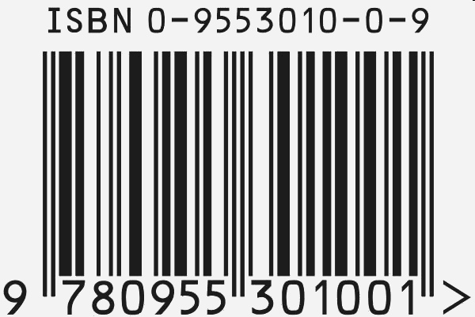
International Standard Book Number
The last digit is the check digit, and it satisfies the following equation:
10a₁ + 9a₂ + 8a₃ + 7a₄ + 6a₅ + 5a₆ + 4a₇ + 3a₈ + 2a₉ + a₁₀  0 (mod 11)
Note: When the check digit is 10, it assigns a₁₀ the special symbol X.

Slide 43
International Standard Book Number
10a₁ + 9a₂ + 8a₃ + 7a₄ + 6a₅ + 5a₆ + 4a₇ + 3a₈ + 2a₉ + a₁₀  0 (mod 11)
Can it be used to detect single digit error?
Correct number a₁a₂…a_{i}…a₉a₁₀
Incorrect number a₁a₂…b_{i}…a₉a₁₀
The error is not detected if and only if
10a₁ + 9·10₂…+(11-i)a_{i}…+2·a₉+a₁₀  10a₁ + 9·10₂…+(11-i)b_{i}…+a₁₀ (mod 11)
if and only if (11-i)a_{i}  (11-i)b_{i} (mod 11)
if and only if a_{i}  b_{i} (mod 11) since gcd(11-i,11)=1 and so we can cancel
(Another way to see it is to multiply the multiplicative inverse of (11-i) on both sides.)
This happens only when a_{i} = b_{i}, in which case there is no error!

Slide 44
International Standard Book Number
10a₁ + 9a₂ + 8a₃ + 7a₄ + 6a₅ + 5a₆ + 4a₇ + 3a₈ + 2a₉ + a₁₀  0 (mod 11)
Can it be used to detect transposition error?
Correct number a₁a₂…cd…a₉a₁₀
Incorrect number a₁a₂…dc…a₉a₁₀
The error is not detected if and only if
10a₁+…+ (11-i-1)c + (11-i)d +…+a₁₀  10a₁+…+ (11-i-1)d + (11-i)c +…+a₁₀ (mod 11)
if and only if (11-i-1)(c-d) + (11-i)(d-c)  0 (mod 11)
if and only if c-d  0 (mod 11)
This happens only when c = d, in which case there is no error!

Slide 45
International Standard Book Number
The last digit is the check digit, and it satisfies the following equation:
10a₁ + 9a₂ + 8a₃ + 7a₄ + 6a₅ + 5a₆ + 4a₇ + 3a₈ + 2a₉ + a₁₀  0 (mod 11)
Note: When the check digit is 10, it assigns a₁₀ the special symbol X.
Can it be used to detect single digit error?
Yes, always.
Can it be used to detect transposition error?
Yes, always.

Slide 46
This Lecture
Multiplicative inverse
Cancellation in modular arithmetic
Application: check digit scheme
Fermat’s little theorem

Slide 47
Fermat’s Little Theorem
Claim 1: Assume gcd(k,n) = 1. If i·k  j·k (mod n), then i  j (mod n).
Claim 2: Assume gcd(k,n) = 1. If i  j (mod n), then i·k  j·k (mod n) .
In particular, when p is a prime & k not a multiple of p, then gcd(k,p)=1.
If i  j (mod p), then i·k  j·k (mod p)
Therefore,
k mod p, 2k mod p, …, (p-1)k mod p
are all different numbers.
For example, when p=7 and k=3,
3 mod 7 = 3, 2·3 mod 7 = 6, 3·3 mod 7 = 2, 4·3 mod 7 = 5, 5·3 mod 7 = 1, 6·3 mod 7 = 4
Notice that in the above example every number from 1 to 6 appears exactly once.

Slide 48
Fermat’s Little Theorem
In particular, when p is a prime & k not a multiple of p, then gcd(k,p)=1.
If i  j (mod p), then i·k  j·k (mod p)
Therefore,
k mod p, 2k mod p, …, (p-1)k mod p
are all different numbers.
Each of ik mod p cannot be equal to 0, because p is a prime number
Let c_{i} = ik mod p.
So 1 <= c₁ <= p-1, 1 <= c₂ <= p-1, …, 1< = c_{p-1} <= p-1
By the above we know that c₁,c₂,…,c_{p-2},c_{p-1} are all different.
So for each i from 1 to p-1, there is exactly one c_{j} such that c_{j} = i.
Therefore, we have
(k mod p)·(2k mod p)·…·((p-1)k mod p) = c₁·c₂·…·c_{p-2}·c_{p-1} = 1·2·3…·(p-2)·(p-1)

Slide 49
Fermat’s Little Theorem
Theorem: If p is prime & k not a multiple of p
1  k^{p-1} (mod p)
For example, when p=5, k=4, we have k^{p-1} mod p = 4⁴ mod 5 = 1
“Proof”
By the previous slide or direct calculation
4·3·2·1  [(4 mod 5) (2·4 mod 5) (3·4 mod 5) (4·4 mod 5)] (mod 5)
 [4 · (2·4) · (3·4) · (4·4)] (mod 5)
 [4⁴ · (1·2·3·4)] (mod 5)
Since gcd(1·2·3·4, 5)=1, we can cancel 1·2·3·4 on both sides.
This implies
1  4⁴ (mod 5)

Slide 50
Fermat’s Little Theorem
Theorem: If p is prime & k not a multiple of p
1  k^{p-1} (mod p)
Proof.
1·2···(p-1)  (k mod p · 2k mod p·…·(p-1)k mod p) mod p
 (k·2k ··· (p-1)k) mod p
 (k^{p-1})·1·2 ··· (p-1) (mod p)
So, by cancelling 1·2 ··· (p-1) on both sides applying Claim 1
(we can cancel them because gcd(1·2 ··· (p-1), p)=1), we have
1  k^{p-1} (mod p)
By 2 slides before
By the multiplication rule

Slide 51
Wilson’s Theorem
Theorem: p is a prime if and only if
(p-1)!  -1 (mod p)
First we consider the easy direction.
If p is not a prime, assume p >= 5, (for p=4, 3!  2 (mod 4) )
Then p=qr for some 2 <= q < p and 2 <= r < p.
If q ≠ r, then both q and r appear in (p-1)!,
and so (p-1)!  0 (mod p).
If q = r, then p = q² > 2q (since we assume p > 5 and thus q > 2).
then both q and 2q are in (p-1)!,
and so again (p-1)!  0 (mod p).

Slide 52
Wilson’s Theorem
Theorem: p is a prime if and only if
(p-1)!  -1 (mod p)
To prove the more interesting direction, first we need a lemma.
Lemma. If p is a prime number,
x²  1 (mod p) if and only if x  1 (mod p) or x  -1 (mod p)
Proof. x²  1 (mod p)
iff p | x² - 1
iff p | (x – 1)(x + 1)
iff p | (x – 1) or p | (x+1)
iff x  1 (mod p) or x  -1 (mod p)
Lemma: p prime and p|a·b iff p|a or p|b.

Slide 53
Wilson’s Theorem
Theorem: p is a prime if and only if
(p-1)!  -1 (mod p)
Let’s get the proof idea by considering a concrete example.
10!
 1·2·3·4·5·6·7·8·9·10 mod 11
 1·10·(2·6)·(3·4)·(5·9)·(7·8) mod 11
 1·-1·(1)·(1)·(1)·(1) mod 11
 -1 mod 11
Besides 1 and 10, the remaining numbers are paired up into multiplicative inverse!

Slide 54
Wilson’s Theorem
Theorem: p is a prime if and only if
(p-1)!  -1 (mod p)
Proof.
Since p is a prime, every number from 1 to p-1 has a multiplicative inverse.
By the Lemma, every number 2 <= k <= p-2 has an inverse k’ with k≠k’.
Since p is odd, the numbers from 2 to p-2 can be grouped into pairs
(a₁,b₁),(a₂,b₂),…,(a_{(p-3)/2},b_{(p-3)/2}) so that a_{i}b_{i}  1 (mod p)
Therefore, (p-1)!  1·(p-1)·2·3·····(p-3)·(p-2) (mod p)
 1·(p-1)·(a₁b₁)·(a₂b₂)·····(a_{(p-3)/2}b_{(p-3)/2}) (mod p)
 1·(-1)·(1)·(1)·····(1) (mod p)
 -1 (mod p)

Slide 55
Quick Summary
One key point is that multiplicative inverse of k modulo n exists
if and only if gcd(k,n) = 1
And the inverse can be computed by extended Euclidean’s algorithm.
Then, using the existence of multiplicative inverse,
we see that when ik  jk mod n, then we can cancel k if gcd(k,n)=1.
We can apply these simple modular arithmetic to study whether
different check digit schemes work.
Finally, we use the cancellation rule to derive Fermat’s little theorem,
which will be very useful in the next lecture.

