Slide 1
Bits, Bytes, and Integers – Part 2
Carnegie Mellon
Computer Organization and Architecture
3rd Lecture
Instructors:
Xiaofei Nan

Slide 2
Today: Bits, Bytes, and Integers
Carnegie Mellon
Representing information as bits
Integers
  Representation: unsigned and signed
  Bit-level manipulations
  Conversion, casting
  Expanding, truncating
  Addition, negation, multiplication, shifting
  Summary
Representations in memory, pointers, strings

Slide 3
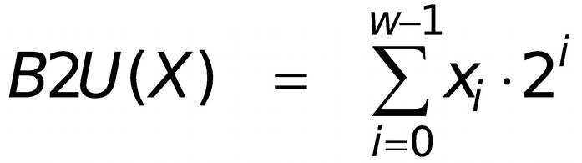
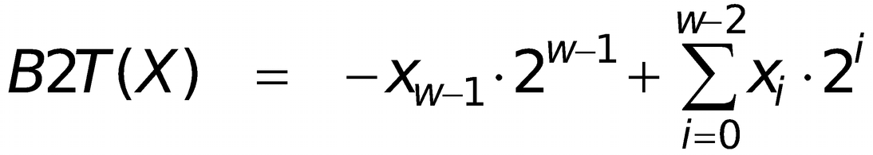
Encoding Integers
Carnegie Mellon
Unsigned
Two’s Complement
Sign Bit
Two’s Complement Examples (w = 5)
-16 | 8 | 4 | 2 | 1
0 | 1 | 0 | 1 | 0
10 =
8+2 = 10
-16 | 8 | 4 | 2 | 1
1 | 0 | 1 | 1 | 0
-10 =
-16+4+2 = -10
6

Slide 4
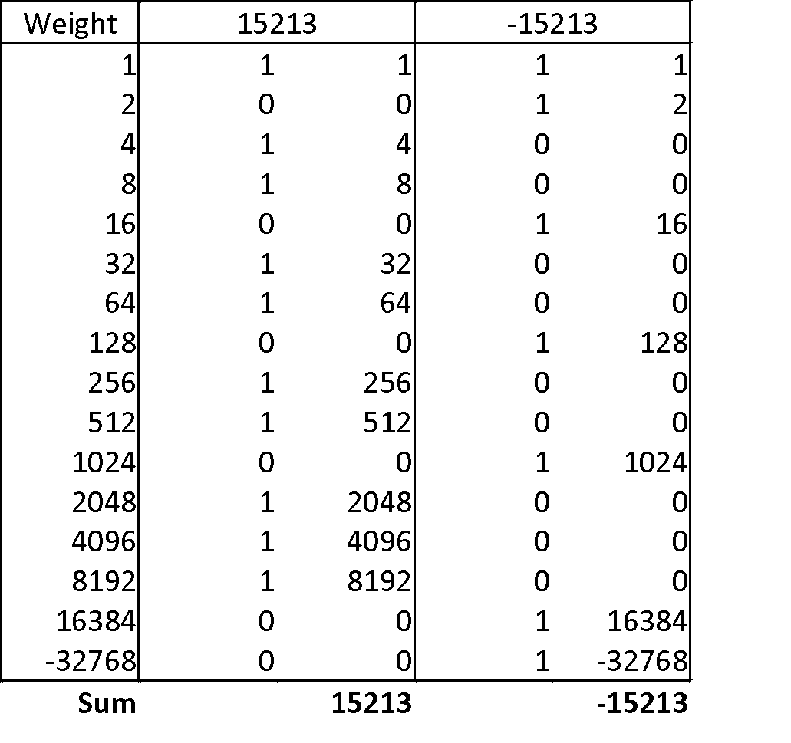
Two-complement Encoding Example (Cont.)
Carnegie Mellon
x =
y =
15213: 00111011 01101101
-15213: 11000100 10010011
7

Slide 5
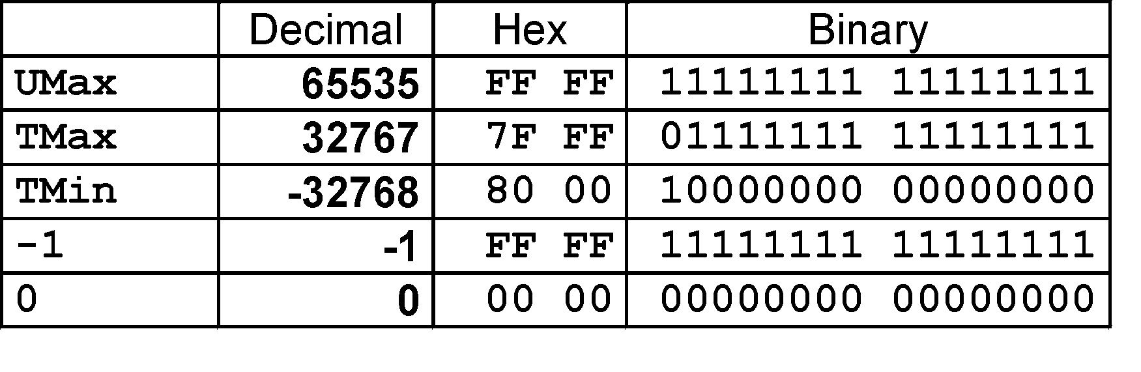
Numeric Ranges
Carnegie Mellon
⬛Unsigned Values
UMin = 0
000…0
UMax = 2^{w} – 1
111…1
⬛Two’s Complement Values
TMin
100…0
TMax =
011…1
Minus 1
111…1
_{–2}w–1
=
₂w–1 _{– 1}
Values for W = 16
8

Slide 6

填空题
4分
Unsigned integer conversions:
The unsigned binary representation of 11 is [填空1] .
The decimal value of unsigned binary number 1001₂ is [填空2] .
Signed integer conversions (8-bit representation):
The signed (two-complement) binary representation of -128 is [填空3] .
The decimal value of signed binary 11000000₂ is [填空4] .
正常使用填空题需3.0以上版本雨课堂
submit

Slide 7
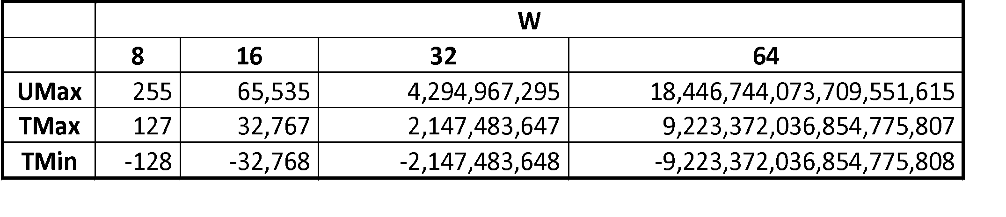
Values for Different Word Sizes
Carnegie Mellon
⬛ Observations
C Programming
  #include <limits.h>
  Declares constants, e.g.,
    ULONG_MAX
    LONG_MAX
    LONG_MIN
  Values platform specific
|TMin | = TMax + 1
  Asymmetric range
UMax = 2 * TMax + 1
9

Slide 8
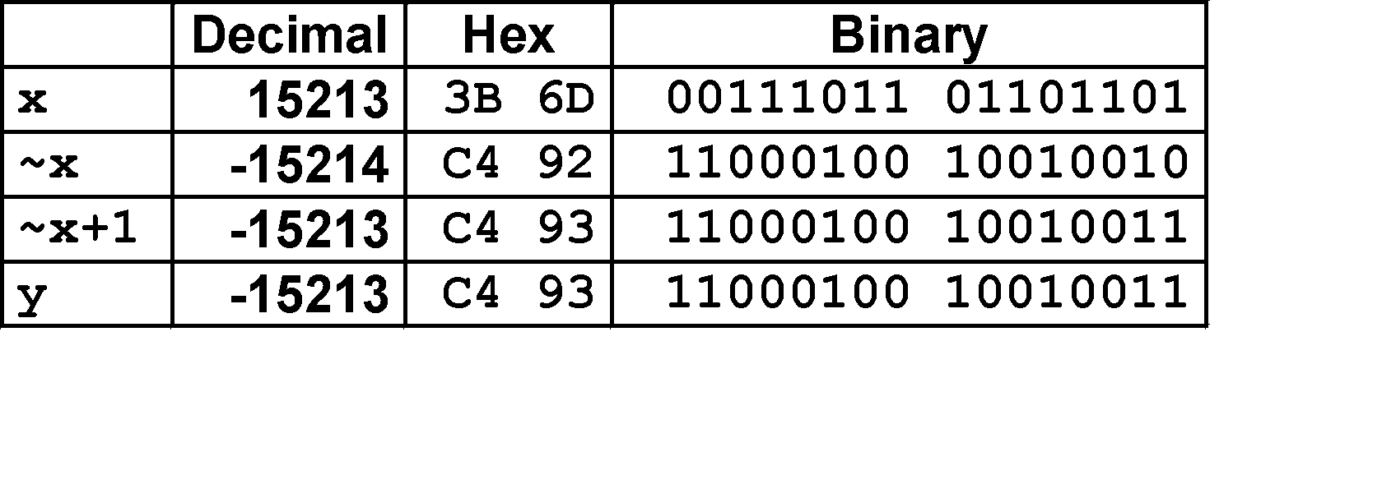
Negation: Complement & Increment
Carnegie Mellon
⬛ Negate through complement and increase
~x + 1 == -x
⬛ Why this works
Observation: ~x + x == 1111…111 == -1
 | x | 1 0 0 1 1 1 0 1
+ | ~x | 0 1 1 0 0 0 1 0
 | -1 | 1 1 1 1 1 1 1 1

Slide 9
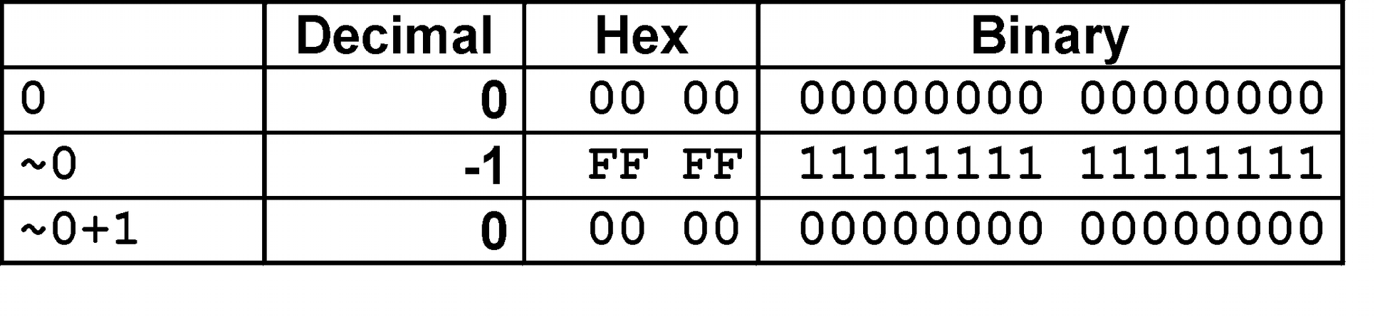
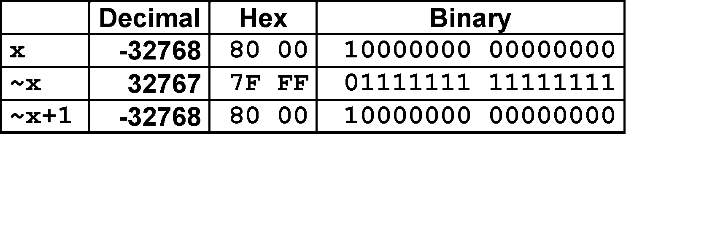
Complement & Increment Examples
Carnegie Mellon
x = 0
x = TMin
Canonical counter example

Slide 10
Today: Bits, Bytes, and Integers
Carnegie Mellon
Representing information as bits
Integers
  Representation: unsigned and signed
  Bit-level manipulations
  Conversion, casting
  Expanding, truncating
  Addition, negation, multiplication, shifting
  Summary
Representations in memory, pointers, strings

Slide 11
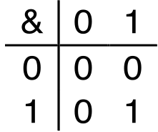
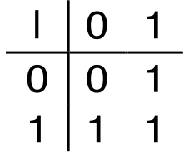
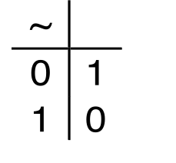
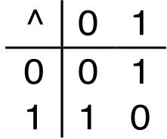
Boolean Algebra
Carnegie Mellon
Developed by George Boole in 19th Century
  Algebraic representation of logic
    Encode “True” as 1 and “False” as 0
And
A&B = 1 when both A=1 and B=1
Or
A|B = 1 when either A=1 or B=1
Not
~A = 1 when A=0
Exclusive-Or (Xor)
A^B = 1 when either A=1 or B=1, but not both

Slide 12
General Boolean Algebras
Carnegie Mellon
Operate on Bit Vectors
  Operations applied bitwise
01101001 & 01010101
01000001
01101001
| 01010101
01111101
01101001
^ 01010101
00111100
~ 01010101 10101010
All of the Properties of Boolean Algebra Apply

Slide 13
Example: Representing & Manipulating Sets
Carnegie Mellon
Representation
  Width w bit vector represents subsets of {0, …, w-1}
  a_{j} = 1 if j ∈ A
    76543210 { 0, 3, 5, 6 }
    01101001
76543210
01010101
Operations
  & Intersection
{ 0, 2, 4, 6 }
01000001 { 0, 6 }
01111101 { 0, 2, 3, 4, 5, 6 }
{ 2, 3, 4, 5 }
{ 1, 3, 5, 7 }
| Union
^ Symmetric difference 00111100
~ Complement 10101010

Slide 14
Bit-Level Operations in C
Carnegie Mellon
Decimal
Operations &, |, ~, ^ Available in C
  Apply to any “integral” data type
    long, int, short, char, unsigned
  View arguments as bit vectors
  Arguments applied bit-wise
Examples (char data type)
  ~0x41 →
  ~0x00 →
  0x69 & 0x55 →
  0x69 | 0x55 →
Hex
Binary
0 | 0 | 0000
1 | 1 | 0001
2 | 2 | 0010
3 | 3 | 0011
4 | 4 | 0100
5 | 5 | 0101
6 | 6 | 0110
7 | 7 | 0111
8 | 8 | 1000
9 | 9 | 1001
A | 10 | 1010
B | 11 | 1011
C | 12 | 1100
D | 13 | 1101
E | 14 | 1110
F | 15 | 1111

Slide 15
Bit-Level Operations in C
Carnegie Mellon
Decimal
Operations &, |, ~, ^ Available in C
  Apply to any “integral” data type
    long, int, short, char, unsigned
  View arguments as bit vectors
  Arguments applied bit-wise
Examples (char data type)
  ~0x41 → 0xBE
    ~0100 0001₂ → 1011 1110₂
  ~0x00 → 0xFF
    ~0000 0000₂ → 1111 1111₂
  0x69 & 0x55 → 0x41
    0110 1001₂ & 0101 0101₂ → 0100 0001₂
  0x69 | 0x55 → 0x7D
    0110 1001₂ | 0101 0101₂ → 0111 1101₂
Hex
Binary
0 | 0 | 0000
1 | 1 | 0001
2 | 2 | 0010
3 | 3 | 0011
4 | 4 | 0100
5 | 5 | 0101
6 | 6 | 0110
7 | 7 | 0111
8 | 8 | 1000
9 | 9 | 1001
A | 10 | 1010
B | 11 | 1011
C | 12 | 1100
D | 13 | 1101
E | 14 | 1110
F | 15 | 1111

Slide 16
Contrast: Logic Operations in C
Carnegie Mellon
Contrast to Bit-Level Operators
  Logic Operations: &&, ||, !
    View 0 as “False”
    Anything nonzero as “True”
    Always return 0 or 1
    Early termination
_{Examples}
Watch out for && vs. & (and || vs. |) common programmer mistake!
!0x41 → 0x00
!0x00 → 0x01
!!0x41→ 0x01
0x69 && 0x55 → 0x01
0x69 || 0x55 → 0x01
p && *p (avoids null pointer access)

Slide 17
Today: Bits, Bytes, and Integers
Carnegie Mellon
Representing information as bits
Integers
  Representation: unsigned and signed
  Bit-level manipulations
  Conversion, casting
  Expanding, truncating
  Addition, negation, multiplication, shifting
  Summary
Representations in memory, pointers, strings

Slide 18
Mapping Between Signed & Unsigned
Carnegie Mellon
Two’s Complement
x
Unsigned
ux
T2U
T2B
X
B2U
Maintain Same Bit Pattern
Unsigned
U2T
Two’s Complement
x
ux
U2B
B2T
X
Maintain Same Bit Pattern
⬛ Mappings between unsigned and two’s complement numbers: Keep bit representations and reinterpret

Slide 19
Mapping Signed ↔ Unsigned
Carnegie Mellon
Bits
0000
0001
0010
0011
0100
0101
0110
0111
1000
1001
1010
1011
1100
1101
1110
1111
Signed
0
1
2
3
4
5
6
7
-8
-7
-6
-5
-4
-3
-2
-1
Unsigned
0
1
2
3
4
5
6
7
8
9
10
11
12
13
14
15
T2U
U2T

Slide 20
Mapping Signed ↔ Unsigned
Carnegie Mellon
Bits
0000
0001
0010
0011
0100
0101
0110
0111
1000
1001
1010
1011
1100
1101
1110
1111
Signed
0
1
2
3
4
5
6
7
-8
-7
-6
-5
-4
-3
-2
-1
Unsigned
0
1
2
3
4
5
6
7
8
9
10
11
12
13
14
15
=
±16

Slide 21
Relation between Signed & Unsigned
Carnegie Mellon
Two’s Complement
x
Unsigned
ux
T2U
T2B
X
B2U
Maintain Same Bit Pattern
w–1
0
ux x
+ | + | + | • • • | + | + | +
- | + | + | • • • | + | + | +
Large negative weight
becomes
Large positive weight

Slide 22
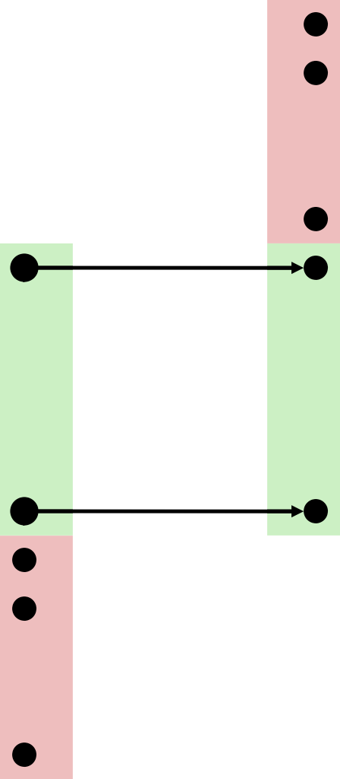
Conversion Visualized
Carnegie Mellon
⬛ 2’s Comp. → Unsigned
Ordering Inversion
Negative → Big Positive
UMax UMax – 1
TMax + 1
TMax
Unsigned Range
TMax
2’s Complement
Range
0
–1
–2
0
TMin

Slide 23
Signed vs. Unsigned in C
Carnegie Mellon
Constants
  By default are considered to be signed integers
  Unsigned if have “U” as suffix
0U, 4294967259U
Casting
  Explicit casting between signed & unsigned same as U2T and T2U
int tx, ty; unsigned ux, uy; tx = (int) ux;
uy = (unsigned) ty;
  Implicit conversion occurs via assignments and procedure calls!
tx = ux; uy = ty;
int fun(unsigned u); uy = fun(tx);

Slide 24
Conversion Surprises
Carnegie Mellon
Expression Evaluation
  If there is a mix of unsigned and signed in single expression,
signed values implicitly converted to unsigned
  Including comparison operations <, >, ==, <=, >=
Examples for W = 32:
TMIN = -2,147,483,648 ,
Relation
==
<
>
TMAX = 2,147,483,647
Evaluation
unsigned signed
unsigned
Constant₁ Constant₂
0 0U
-1 0
-1 0U
2147483647 | -2147483647-1 | > | signed
2147483647U | -2147483647-1 | < | unsigned
-1 | -2 | > | signed
(unsigned) -1 | -2 | > | unsigned
2147483647 | 2147483648U | < | unsigned
2147483647 | (int) 2147483648U | > | signed

Slide 25
单选题
答案解析
1分
答案解析
1. What is the comparison result between -1 and 1U?
-1 in signed binary is 11…1₂. After conversion to unsigned format, it becomes the largest value.
A
<
B
>
C
=
submit
可为此题添加文本、图片、公式等解析，且需将内容全部放在本区域内。正常使用需3.0以上版本

Slide 26
单选题
答案解析
1分
答案解析
1. What is the comparison result between -1 and 1U?
-1 in signed binary is 11…1₂. After conversion to unsigned format, it becomes the largest value.
A
<
B
>
C
=
submit
可为此题添加文本、图片、公式等解析，且需将内容全部放在本区域内。正常使用需3.0以上版本

Slide 27
单选题
1分
2. What is the comparison result between (unsigned)-2 and -1?
A
<
B
>
C
=
提交

Slide 28
单选题
1分
2. What is the comparison result between (unsigned)-2 and -1?
A
<
B
>
C
=
提交

Slide 29
Today: Bits, Bytes, and Integers
Carnegie Mellon
Representing information as bits
Integers
  Representation: unsigned and signed
  Bit-level manipulations
  Conversion, casting
  Expanding, truncating
  Addition, negation, multiplication, shifting
  Summary
Representations in memory, pointers, strings
29

Slide 30

Sign Extension
Carnegie Mellon
⬛ Task:
Given w-bit signed integer x
Convert it to w+k-bit integer with same value
⬛ Rule:
Make k copies of sign bit:
X ′ = x_{w–1} ,…, x_{w–1} , x_{w–1} , x_{w–2} ,…, x₀
k copies of MSB
w
X
 |  |  | • • •
• • •
X
′
• • • |  |  |  |  |  | • • •
k
w
erspe
30

Slide 31
Sign Extension: Simple Example
Carnegie Mellon
Positive number
Negative number
-16
8
4
2
1
-16
8
4
2
1
10 =
0
1
0
1
0
-10 =
1
0
1
1
0
-32
1
6
8
4
2
1
-32
1
6
8
4
2
1
10 =
0 0
1
0
1
0
-10 =
1 1
0
1
1
0

Slide 32
Larger Sign Extension Example
Carnegie Mellon
short int | int x ix | = = | 15213; (int) x;
short | int y | = | -15213;
int | iy | = | (int) y;
 | Decimal | Hex | Binary
x | 15213 | 3B 6D | 00111011 01101101
ix | 15213 | 00 00 3B 6D | 00000000 00000000 00111011 01101101
y | -15213 | C4 93 | 11000100 10010011
iy | -15213 | FF FF C4 93 | 11111111 11111111 11000100 10010011
⬛ Converting from smaller to larger integer data type
⬛ C automatically performs sign extension

Slide 33

Truncation
Carnegie Mellon
⬛ Task:
Given k+w-bit signed or unsigned integer X
Convert it to w-bit integer X’ with same value for “small enough” X
⬛ Rule:
Drop top k bits:
X ′ = x_{w–1} , x_{w–2} ,…, x₀
k
w
X
• • • |  |  |  |  |  |  |  |  | • • •
• • •
X′
w
 |  |  | • • •
33

Slide 34
Truncation: Simple Example
Carnegie Mellon
No sign change
Sign change
-16 | 8 | 4 | 2 | 1
0 | 0 | 0 | 1 | 0
-16 | 8 | 4 | 2 | 1
0 | 1 | 0 | 1 | 0
2 =
10 =
 | -8 | 4 | 2 | 1
 | 0 | 0 | 1 | 0
 | -8 | 4 | 2 | 1
 | 1 | 0 | 1 | 0
2 =
-6 =
2 mod 16 = 2
10 mod 16 = 10U mod 16 = 10U = -6
-16 | 8 | 4 | 2 | 1
1 | 1 | 0 | 1 | 0
-16 | 8 | 4 | 2 | 1
1 | 0 | 1 | 1 | 0
-6 =
-10 =
 | -8 | 4 | 2 | 1
 | 1 | 0 | 1 | 0
 | -8 | 4 | 2 | 1
 | 0 | 1 | 1 | 0
-6 =
6 =
-6 mod 16 = 26U mod 16 = 10U = -6
-10 mod 16 = 22U mod 16 = 6U = 6

Slide 35
Summary:
Expanding, Truncating: Basic Rules
Carnegie Mellon
Expanding (e.g., short int to int)
  Unsigned: zeros added
  Signed: sign extension
  Both yield expected result
Truncating (e.g., unsigned to unsigned short)
  Unsigned/signed: bits are truncated
  Result reinterpreted
  Unsigned: mod operation
  Signed: similar to mod
  For small numbers yields expected behavior

Slide 36
Today: Bits, Bytes, and Integers
Carnegie Mellon
Representing information as bits
Integers
  Representation: unsigned and signed
  Bit-level manipulations
  Conversion, casting
  Expanding, truncating
  Addition, negation, multiplication, shifting
  Summary
Representations in memory, pointers, strings

Slide 37
Shift Operations
Carnegie Mellon
Left Shift: x << y
  Shift bit-vector x left y positions
– Throw away extra bits on left
    Fill with 0’s on right
Right Shift: x >> y
  Shift bit-vector x right y positions
    Throw away extra bits on right
  Logical shift
    Fill with 0’s on left
  Arithmetic shift
    Replicate most significant bit on left
Undefined Behavior
  Shift amount < 0 or ≥ word size
Argument x | 01100010
<< 3 | 00010000
Log. >> 2 | 00011000
Arith. >> 2 | 00011000
Argument x | 10100010
<< 3 | 00010000
Log. >> 2 | 00101000
Arith. >> 2 | 11101000

Slide 38
填空题
3分
The result of 01100101 << 2 is [填空1].
The result of 01100101 >> 2 (logical shift) is [填空2] .
The result of 11100101 >>2 (arithmetic shift) is [填空3] .
正常使用填空题需3.0以上版本雨课堂
Submit

Slide 39
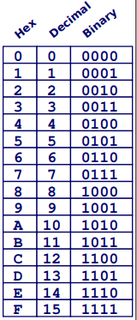
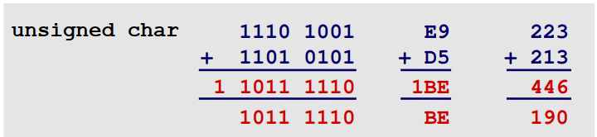
Unsigned Addition
Carnegie Mellon
u
+v
Operands: w bits
 |  |  | • • •
 |  |  | • • •
True Sum: w+1 bits
u+v
 |  |  |  | • • •
Discard Carry: w bits
UAdd_{w}(u,v)
 |  |  | • • •
⬛ Standard Addition Function
Ignores carry output
⬛ Implements Modular Arithmetic
s = UAdd (u , v) =
u + v mod 2^{w}
w

Slide 40
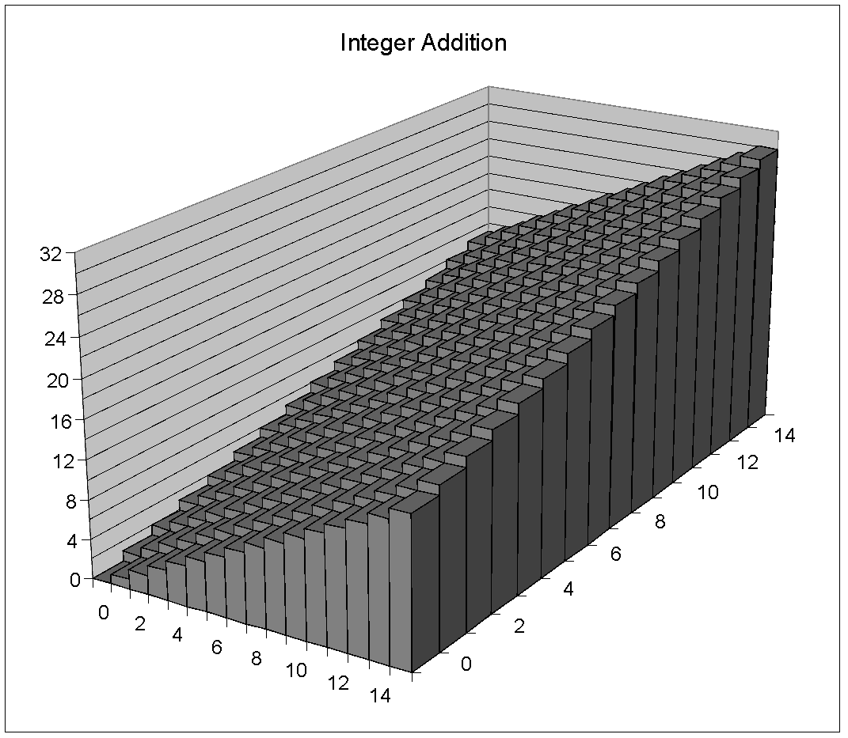
Visualizing (Mathematical) Integer Addition
Carnegie Mellon
⬛Integer Addition
4-bit integers u, v
Compute true sum Add₄(u , v)
Values increase linearly with u and v
Forms planar surface
Add₄(u , v)
v
u

Slide 41
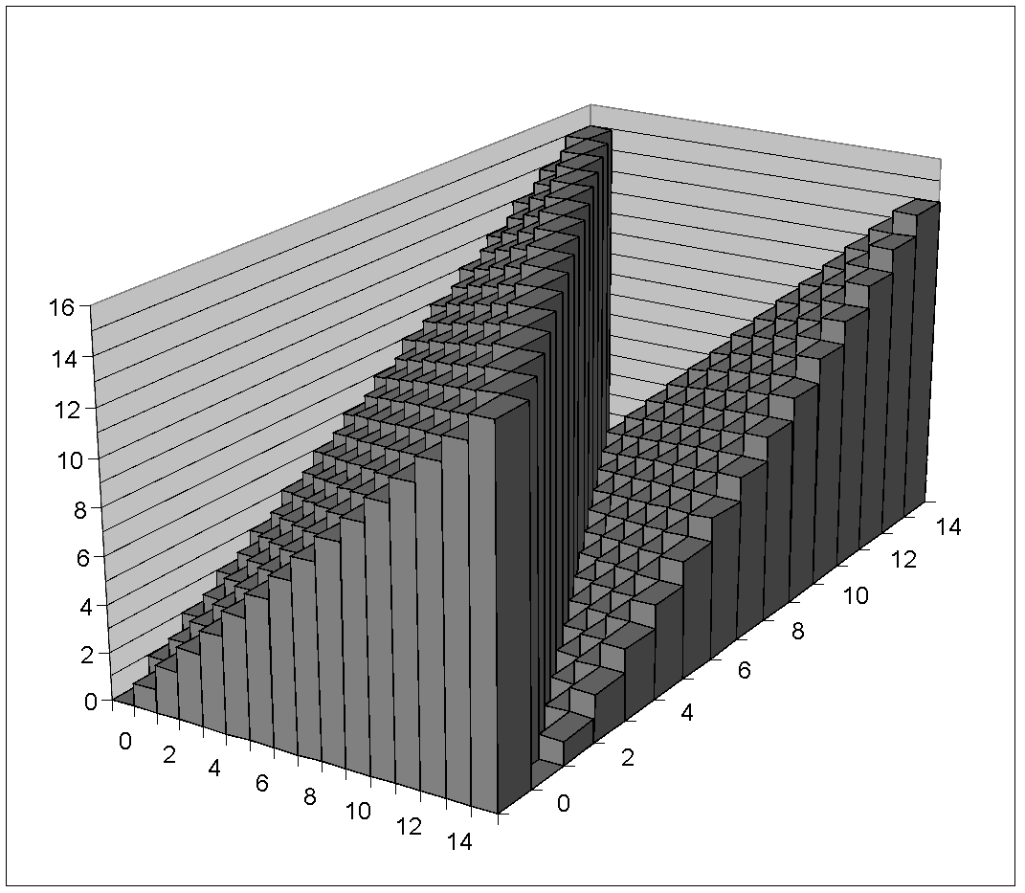
Visualizing Unsigned Addition
Carnegie Mellon
Wraps Around
  If true sum ≥ 2^{w}
  At most once
Overflow
UAdd₄(u , v)
True Sum
₂w+1
Overflow
₂w
v
0
Modular Sum
u

Slide 42
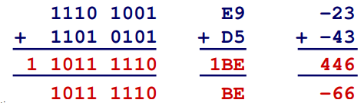
Two’s Complement Addition
Carnegie Mellon
u
+ v
 |  |  | • • •
Operands: w bits
 |  |  | • • •
True Sum: w+1 bits
u+v
 |  |  |  | • • •
Discard Carry: w bits
TAdd_{w}(u,v)
 |  |  | • • •
TAdd and UAdd have Identical Bit-Level Behavior
  Signed vs. unsigned addition in C:
int | s, t, | u, v;
s = | (int) | ((unsigned) | u + (unsigned) | v);
t = | u + v
Will give
s == t
51

Slide 43
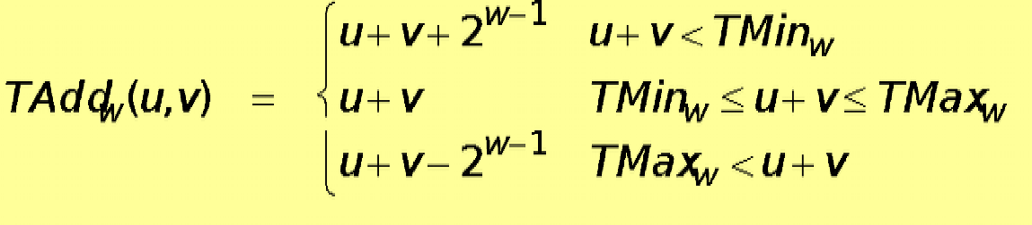
Characterizing TAdd
Carnegie Mellon
⬛ Functionality
True sum requires w+1 bits
Drop off MSB
Treat remaining bits as 2’s comp. integer
Positive Overflow
TAdd(u , v)
> 0
v
< 0
< 0 _{u} > 0
Negative Overflow
(NegOver)
(PosOver)
₂w
₂w

Slide 44
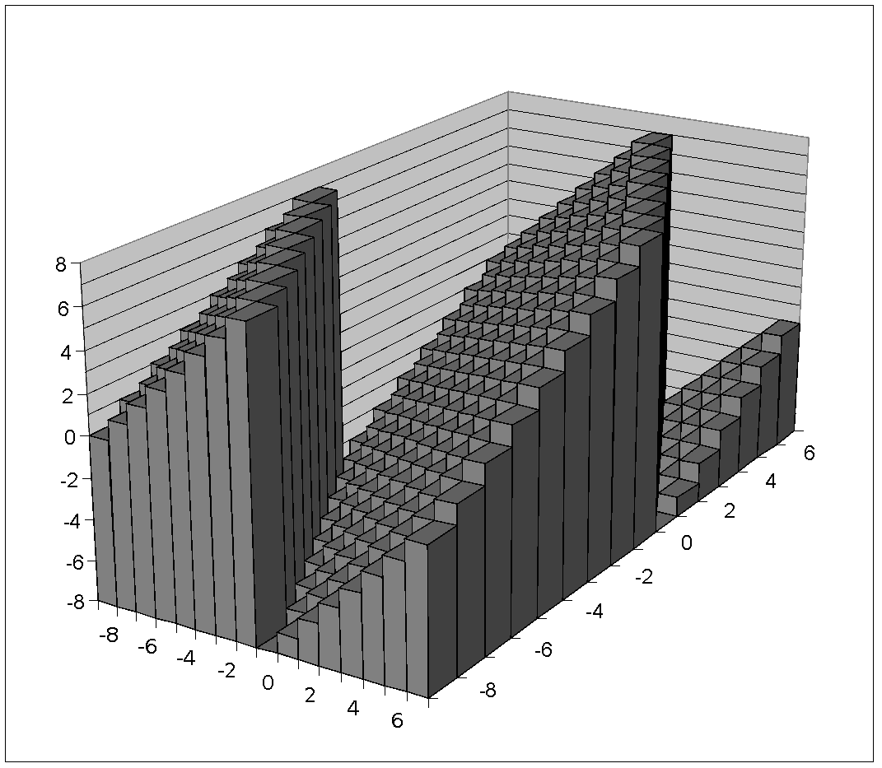
Visualizing 2’s Complement Addition
Carnegie Mellon
NegOver
Values
4-bit two’s comp.
Range from -8 to +7
Wraps Around
  If sum ≥ 2^{w–1}
    Becomes negative
    At most once
  If sum < –2^{w–1}
    Becomes positive
    At most once
TAdd₄(u , v)
v
PosOver
u

Slide 45
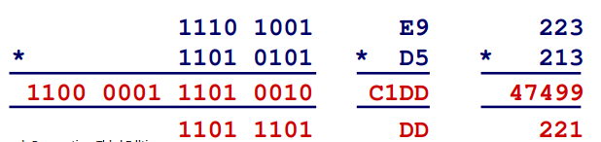
Unsigned Multiplication in C
Carnegie Mellon
u
* v
 |  |  | • • •
Operands: w bits
 |  |  | • • •
True Product: 2*w bits
u
·
 |  |  | • • • |  |  |  |  |  |  | • • •
v
UMult_{w}(u,v)
Discard w bits: w bits
⬛ Standard Multiplication Function
Ignores high order w bits
⬛ Implements Modular Arithmetic
UMult_{w}(u , v) = u · v mod 2^{w}
 |  |  | • • •
221
55

Slide 46
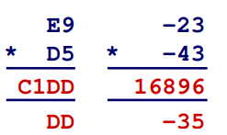
Signed Multiplication in C
Carnegie Mellon
u
* v
 |  |  | • • •
Operands: w bits
 |  |  | • • •
True Product: 2*w bits
u
·
 |  |  | • • • |  |  |  |  |  |  | • • •
v
TMult_{w}(u,v)
Discard w bits: w bits
Standard Multiplication Function
  Ignores high order w bits
  Lower bits are the same
 |  |  | • • •
1110 1001
* 1101 0101
110 0001 1 01 0010
1101 1101
-35
56

Slide 47
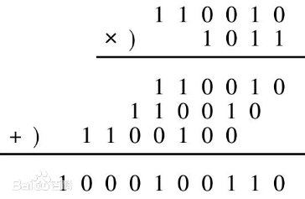
Power-of-2 Multiply with Shift
Carnegie Mellon
Operation
u << k gives u *
₂k
Both signed and unsigned
k
u
* 2
 |  |  | • • •
Operands: w bits
k
0 | ••• | 0 | 1 | 0 | ••• | 0 | 0
True Product: w+k bits
u*2^{k}
· |  |  | • • • |  |  |  | 0 | ••• | 0 | 0
Example
110010 << 1 = 1100100
gives u * 2¹
110010 << 3 = 110010000
gives u * 2³

Slide 48
Power-of-2 Multiply with Shift
Carnegie Mellon
Operation
u << k gives u *
₂k
Both signed and unsigned
k
u
* 2
 |  |  | • • •
Operands: w bits
k
0 | ••• | 0 | 1 | 0 | ••• | 0 | 0
True Product: w+k bits
u*2^{k}
· |  |  | • • • |  |  |  | 0 | ••• | 0 | 0
Discard k bits: w bits
Examples
  u << 3 == u * 8
k
UMult (u,2 )
••• |  |  |  | 0 | ••• | 0 | 0
w
TMult_{w}(u,2^{k})
(u << 5) – (u << 3) == u * 24
Most machines shift and add faster than multiply
  Compiler generates this code automatically

Slide 49


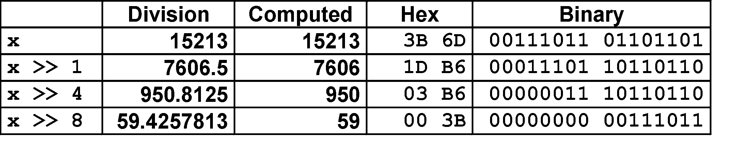
Unsigned Power-of-2 Divide with Shift
Carnegie Mellon
⬛ Quotient of Unsigned by Power of 2
u >> k gives ⎣ u / 2^{k} ⎦
Uses logical shift
k
u Binary Point
2^{k}
••• |  |  | •••
Operands:
0 | ••• | 0 | 1 | 0 | ••• | 0 | 0
Division: Result:
_{u / 2}k
0 | ••• | 0 | 0
••• . •••
•••
0
⎣ u/2^{k}⎦
0 | ••• | 0 | 0
0

Slide 50


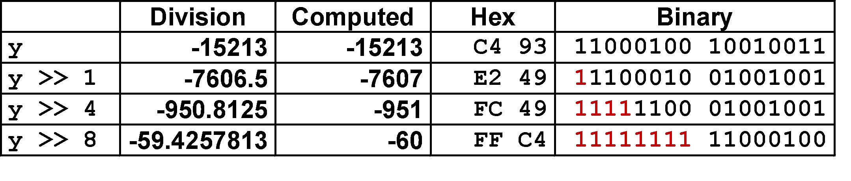
Signed Power-of-2 Divide with Shift
Carnegie Mellon
⬛ Quotient of Signed by Power of 2
x >> k gives ⎣ x / 2^{k} ⎦
Uses arithmetic shift
Rounds wrong direction when x < 0
k
x
2^{k}
••• |  |  | •••
Binary Point
Operands:
0 | ••• | 0 | 1 | 0 | ••• | 0 | 0
Division:
x/2^{k}
0
•••
•••
.
•••
Result:
RoundDown(x/2^{k})
0
•••
•••

Slide 51
Arithmetic: Basic Rules
Carnegie Mellon
Addition:
  Unsigned/signed: Normal addition followed by truncate, same operation on bit level
  Unsigned: addition mod 2^{w}
    Mathematical addition + possible subtraction of 2^{w}
  Signed: modified addition mod 2^{w} (result in proper range)
    Mathematical addition + possible addition or subtraction of 2^{w}
Multiplication:
  Unsigned/signed: Normal multiplication followed by truncate, same operation on bit level
  Unsigned: multiplication mod 2^{w}
  Signed: modified multiplication mod 2^{w} (result in proper range)

Slide 52
Multiplication
Carnegie Mellon
⬛ Goal: Computing Product of w-bit numbers x, y
Either signed or unsigned
⬛ But, exact results can be bigger than w bits
Unsigned: up to 2w bits
  Result range: 0 ≤ x * y ≤ (2^{w} – 1) ² = 2^{2w} – 2^{w+1} + 1
Two’s complement min (negative): Up to 2w-1 bits
  Result range: x * y ≥ (–2^{w–1})*(2^{w–1}–1) = –2^{2w–2} + 2^{w–1}
Two’s complement max (positive): Up to 2w bits, but only for (TMin_{w})²
Result range: x * y ≤ (–2^{w–1}) ²
₌ ₂2w–2
⬛ So, maintaining exact results…
would need to keep expanding word size with each product computed
is done in software, if needed
  e.g., by “arbitrary precision” arithmetic packages

Slide 53
Today: Bits, Bytes, and Integers
Carnegie Mellon
Representing information as bits
Integers
  Representation: unsigned and signed
  Bit-level manipulations
  Conversion, casting
  Expanding, truncating
  Addition, negation, multiplication, shifting
  Summary
Representations in memory, pointers, strings

Slide 54
Summary
Casting Signed ↔ Unsigned: Basic Rules
Carnegie Mellon
Bit pattern is maintained
But reinterpreted
Can have unexpected effects: adding or subtracting 2^{w}
Expression containing signed and unsigned int
  int is cast to unsigned!!

Slide 55
Why Should I Use Unsigned?
Carnegie Mellon
⬛ Don’t use without understanding implications
Easy to make mistakes
unsigned i;
for (i = cnt-2; i >= 0; i--)
a[i] += a[i+1];
Can be very subtle
#define DELTA sizeof(int) int i;
for (i = CNT; i-DELTA >= 0; i-= DELTA)
. . .

Slide 56
Counting Down with Unsigned
Carnegie Mellon
⬛ Proper way to use unsigned as loop index
unsigned i;
for (i = cnt-2; i < cnt; i--)
a[i] += a[i+1];
⬛ See Robert Seacord, Secure Coding in C and C++
C Standard guarantees that unsigned addition will behave like modular arithmetic
  0 – 1 → UMax
⬛ Even better
size_t i;
for (i = cnt-2; i < cnt; i--)
a[i] += a[i+1];
Data type size_t defined as unsigned value with length = word size
Code will work even if cnt = UMax
What if cnt is signed and < 0?

Slide 57
Why Should I Use Unsigned? (cont.)
Carnegie Mellon
⬛ Do Use When Performing Modular Arithmetic
Multiprecision arithmetic
⬛ Do Use When Using Bits to Represent Sets
Logical right shift, no sign extension
⬛ Do Use In System Programming
Bit masks, device commands,…

Slide 58
Today: Bits, Bytes, and Integers
Carnegie Mellon
Representing information as bits
Bit-level manipulations
Integers
  Representation: unsigned and signed
  Conversion, casting
  Expanding, truncating
  Addition, negation, multiplication, shifting
  Summary
Representations in memory, pointers, strings

Slide 59
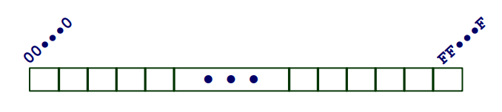
Byte-Addressable Memory
Carnegie Mellon
Programs refer to data by address
  For now, imagine memory as a large array of bytes
  An address is like an index into that array
  A pointer variable stores an address
⬛Note: system provides private address spaces to each “process”
A process is a running instance of a program
So, a program can clobber its own data, but not that of others

Slide 60
Machine Words
Carnegie Mellon
Any given computer has a “Word Size”
  Nominal size of integer-valued data
    and of addresses
  Until recently, most machines used 32 bits (4 bytes) as word size
    Limits addresses to 4GB (2³² bytes)
Increasingly, machines have 64-bit word size
  Potentially, could have 18 EB (exabytes) of addressable memory
  That’s 18.4 X 10¹⁸
Machines still support multiple data formats
  Fractions or multiples of word size
  Always integral number of bytes

Slide 61
Example Data Representations
Carnegie Mellon
C Data Type | Typical 32-bit | Typical 64-bit | x86-64
char | 1 | 1 | 1
short | 2 | 2 | 2
int | 4 | 4 | 4
long | 4 | 8 | 8
float | 4 | 4 | 4
double | 8 | 8 | 8
pointer | 4 | 8 | 8

Slide 62
Word-Oriented Memory Organization
Carnegie Mellon
32-bit Words
64-bit Words
Addresses Specify Byte Locations
  Address of first byte in word
  Addresses of successive words differ by 4 (32-bit) or 8 (64-bit)
Bytes | Addr.
 | 0000
 | 0001
 | 0002
 | 0003
 | 0004
 | 0005
 | 0006
 | 0007
 | 0008
 | 0009
 | 0010
 | 0011
 | 0012
 | 0013
 | 0014
 | 0015
Add r 0000 ??
Add r 0004 ??
Add r 0008 ??
Add r 0012 ??
Add r 0000
??
=
=
=
Add r 0008
??
=
=
=

Slide 63
Byte Ordering
Carnegie Mellon
So, how are the bytes within a multi-byte word ordered in memory?
Conventions
  Big Endian: Sun, PPC Mac, Internet
    Least significant byte has highest address
  Little Endian: x86, ARM processors running Android, iOS, and Windows
    Least significant byte has lowest address

Slide 64
Byte Ordering Example
Carnegie Mellon
Example
  Variable x has 4-byte value of 0x01234567
  Address given by &x is 0x100
Big Endian
0x100 0x101 0x102
0x103
 |  | 01 | 23 | 45 | 67
Little Endian
0x100 0x101 0x102
0x103
 |  | 67 | 45 | 23 | 01

Slide 65
Representing Integers
Carnegie Mellon
Decimal: 15213
Binary: 0011 1011 0110 1101
Decimal: 15213
Binary: 0011 1011 0110 1101
Hex: 3 B 6 D
Hex: 3 B 6 D
long int C = 15213;
IA32 x86-64 Sun
int A = 15213;
IA32, x86-64 Sun
Increasing addresses
6D
3B
00
00
00
00
3B
6D
6D
3B
00
00
6D
3B
00
00
00
00
00
00
00
00
3B
6D
int B = -15213;
IA32, x86-64 Sun
93
C4
FF
FF
FF
FF
C4
93
Two’s complement representation

Slide 66
填空题
8分
Given a 4-byte value of 0x76543210 and its location starting from address 0x100, please denote the contents in each address.
Big Endian:
Address: 0x100 0x101 0x102 0x103
Content: [填空1] [填空2] [填空3] [填空4]
(2) Little Endian
Address: 0x100 0x101 0x102 0x103
Content: [填空5] [填空6] [填空7] [填空8]
正常使用填空题需3.0以上版本雨课堂
Submit

Slide 67
Examining Data Representations
Carnegie Mellon
Code to Print Byte Representation of Data
  Casting pointer to unsigned char * allows use as a byte array
typedef unsigned char *pointer;
void show_bytes(pointer start, size_t len){ size_t i;
for (i = 0; i < len; i++) printf(”%p\t0x%.2x\n", start+i, start[i]);
printf("\n");
}
typedef unsigned char *pointer;
void show_bytes(pointer start, size_t len){ size_t i;
for (i = 0; i < len; i++) printf(”%p\t0x%.2x\n", start+i, start[i]);
printf("\n");
}
Printf directives:
%p: Print pointer
%x: Print Hexadecimal
Non-portable C code!

Slide 68
show_bytesExecution Example
Carnegie Mellon
int a = 15213; // 0x3b6d
printf("int a = 15213;\n"); show_bytes((pointer) &a, sizeof(a));
int a = 15213; // 0x3b6d
printf("int a = 15213;\n"); show_bytes((pointer) &a, sizeof(a));
Result (Linux x86-64):
int a = 15213;
0x7fffb7f71dbc 6d
0x7fffb7f71dbd 3b 0x7fffb7f71dbe 00
0x7fffb7f71dbf 00
int a = 15213;
0x7fffb7f71dbc 6d 0x7fffb7f71dbd 3b 0x7fffb7f71dbe 00
0x7fffb7f71dbf 00

Slide 69
Representing Pointers
Carnegie Mellon
int B = -15213;
int *P = &B;
int B = -15213;
int *P = &B;
Sun
IA32
x86-64
EF
FF
FB
2C
AC
28
F5
FF
3C
1B
FE
82
FD
7F
00
00
Different compilers & machines assign different locations to objects Even get different results each time run program

Slide 70
Representing Strings
Carnegie Mellon
char S[6] = "18213";
char S[6] = "18213";
Strings in C
Represented by array of characters
Each character encoded in ASCII format
  Standard 7-bit encoding of character set
  Character “0” has code 0x30
– Digit i has code 0x30+i
String should be NUL-terminated
  Final character = 0
IA32
Sun
31
38
32
31
33
00
31
38
32
31
33
00
Compatibility
  Byte ordering not an issue

Slide 71
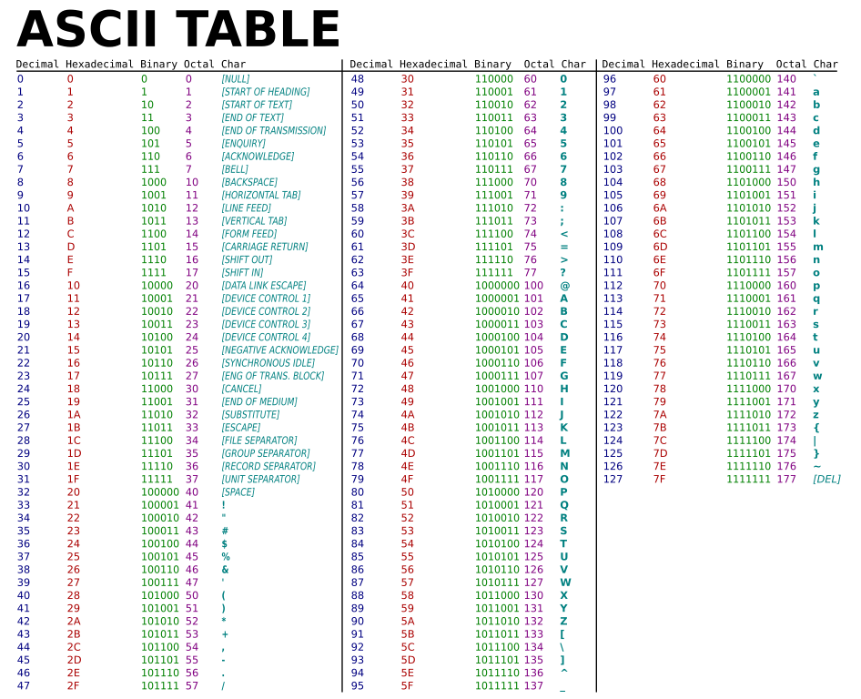

Slide 72
Reading Byte-Reversed Listings
Carnegie Mellon
Disassembly
  Text representation of binary machine code
  Generated by program that reads the machine code
Example Fragment
Address Instruction Code Assembly Rendition
8048365: 5b
pop %ebx
add $0x12ab,%ebx cmpl $0x0,0x28(%ebx)
8048366: 81 c3 ab 12 00 00
804836c: 83 bb 28 00 00 00 00
Deciphering Numbers
  Value: 0x12ab
Pad to 32 bits:
Split into bytes:
0x000012ab 00 00 12 ab
Reverse: ab 12 00 00

Slide 73
Summary
Carnegie Mellon
Representing information as bits
Integers
  Representation: unsigned and signed
  Bit-level manipulations
  Conversion, casting
  Expanding, truncating
  Addition, negation, multiplication, shifting
  Summary
Representations in memory, pointers, strings

Slide 74


Integer C Puzzles
Carnegie Mellon
x < 0 ⇒
ux >= 0
x & 7 == 7 ⇒
ux > -1
((x*2) < 0)
(x<<30) < 0
x > y ⇒ -x < -y x * x >= 0
x > 0 && y > 0 ⇒
Initialization
x + y > 0
x | >= | 0 | ⇒ | -x <= | 0
x | <= | 0 | ⇒ | -x >= | 0
int x = foo();
int y = bar(); unsigned ux = x; unsigned uy = y;
(x|-x)>>31 == -1
ux >> 3 == ux/8 x >> 3 == x/8 x & (x-1) != 0

Slide 75
Appendix
Carnegie Mellon

Slide 76
Correct Power-of-2 Divide
Carnegie Mellon
⬛ Quotient of Negative Number by Power of 2
Want ⎡ x / 2^{k} ⎤ (Round Toward 0)
Compute as ⎣ (x+2^{k}-1)/ 2^{k} ⎦
  In C: (x + (1<<k)-1) >> k
  Biases dividend toward 0
Case 1: No rounding
Dividend:
k
u
+2^{k}
1 |  | ••• |  | 0 | ••• | 0 | 0
0 | ••• | 0 | 0 | 1 | ••• | 1 | 1
–1
₂k
1 |  | ••• |  | 1 | ••• | 1 | 1
Binary Point
Divisor:
/
0 | ••• | 0 | 1 | 0 | ••• | 0 | 0
⎡ u/2^{k}⎤
1 | ••• | 1 | 1 | 1 |  | •••
.
1 | ••• | 1 | 1
0
Biasing has no effect

Slide 77


Correct Power-of-2 Divide (Cont.)
Carnegie Mellon
Case 2: Rounding
k
Dividend:
x
+2^{k}
1 |  | ••• |  |  | •••
0 | ••• | 0 | 0 | 1 | ••• | 1 | 1
–1
1 |  | ••• |  |  | •••
Incremented by 1
Binary Point
Divisor:
/
₂k
0 | ••• | 0 | 1 | 0 | ••• | 0 | 0
⎡ x/2^{k}⎤
1 | ••• | 1 | 1 | 1 |  | •••
.
•••
0
Incremented by 1
Biasing adds 1 to final result

