Slide 1
Machine-Level Programming IV: Data
Carnegie Mellon
Computer Organization and Architecture
8th Lecture
Instructors:
Xiaofei Nan
1

Slide 2
Today
Carnegie Mellon
Activity: r integer and
r array ONLY
Arrays
Structures
  Nested arrays and structures
Nested arrays
  Multi-dimensional
  Multi-level
Endianness
2

Slide 3
Array Allocation
Carnegie Mellon
⬛ Basic Principle
T A[L];
Array of data type T and length L
Contiguously allocated region of L * sizeof(T) bytes in memory
char string[12];
x
x + 12
int val[5];
x
x + 4
x + 8
x + 12
x + 16
x + 20
double a[3];
x
x + 8
x + 16
x + 24
char *p[3];
x
x + 8
x + 16
x + 24
3

Slide 4
Array Access
Carnegie Mellon
⬛Basic Principle
T A[L];
Array of data type T and length L
Identifier A can be used as a pointer to array element 0: Type T *
int val[5];
1
5
2
1
3
x x + 4 x + 8 x + 12
x + 16 x + 20
⬛Reference Type
val int *
*val int
val + 4 int *
*(val + 4) int val[4] int &val[4]
val + i val[5]
Value
x 1
x + 16
3
3
x + 16
x + 4 * i // &val[i]
???
int *
int * int
4

Slide 5
quiz
double abc[3] = {4.5, 9.234, -12}
double abc[3];
4.5
9.234
-12
x x + 8 x + 16 x + 24
⬛Reference Type
abc
*val
val + 1
*(val + 1)
val[2]
&val[2]
Value

Slide 6
Array Example
Carnegie Mellon
#define ZLEN 5 typedef int zip_dig[ZLEN];
zip_dig | cmu | = | { | 1, | 5, | 2, | 1, | 3 | };
zip_dig | mit | = | { | 0, | 2, | 1, | 3, | 9 | };
zip_dig | ucb | = | { | 9, | 4, | 7, | 2, | 0 | };
zip_dig cmu;
1
5
2
1
3
16 20
24
28
32 36
zip_dig mit;
0
2
1
3
9
36
40
44
48
52 56
zip_dig ucb;
9
4
7
2
0
56
60 64 68 72 76
Declaration “zip_dig cmu” equivalent to “int cmu[5]”
Example arrays were allocated in successive 20 byte blocks
  Not guaranteed to happen in general

Slide 7
Array Accessing Example
Carnegie Mellon
zip_dig cmu;
1
5
2
1
3
16
20
24
28
32 36
int get_digit
(zip_dig z, int digit)
{
return z[digit];
}
Register %rdi contains starting address of array
Register %rsi contains array index
Desired digit at
%rdi + 4*%rsi
Use memory reference
(%rdi,%rsi,4)
x86-64
# %rdi = z
# %rsi = digit
movl (%rdi,%rsi,4), %eax
# z[digit]

Slide 8
Array Accessing Example
Carnegie Mellon
int val[5];
1
5
2
1
3
16
20
24
28
32 36
int getNth
(int *z, size_t digit)
{
return z[digit];
}
Register %rdi contains starting address of array
Register %rsi contains array index
Desired digit at
%rdi + 4*%rsi
Use memory reference
(%rdi,%rsi,4)
x86-64
# %rdi = z
# %rsi = digit
movl (%rdi,%rsi,4), %eax
# z[digit]
8

Slide 9
Array Loop Example
Carnegie Mellon
# %rdi = z
movl jmp
.L4:
addl addq
.L3:
cmpq jbe
rep; ret
$0, %eax
.L3
# i = 0
# goto middle # loop:
# z[i]++
# i++
# middle # i:4
# if <=, goto loop
$1, (%rdi,%rax,4)
$1, %rax
$4, %rax
.L4

Slide 10
Array Loop Example
Carnegie Mellon
void zincr(zip_dig z) { size_t i;
for (i = 0; i < ZLEN; i++) z[i]++;
}
# %rdi = z
movl jmp
.L4:
addl addq
.L3:
cmpq jbe
rep; ret
$0, %eax
.L3
# i = 0
# goto middle # loop:
# z[i]++
# i++
# middle # i:4
# if <=, goto loop
$1, (%rdi,%rax,4)
$1, %rax
$4, %rax
.L4

Slide 11
Understanding Pointers & Arrays #1
Carnegie Mellon
Decl | A1, A2 |  |  | *A1,*A2
 | Cmp | Bad | Size | Cmp | Bad | Size
int A1[3];
int *A2;
Cmp: Compiles (Y/N)
Bad: Possible bad pointer reference (Y/N)
Size: Value returned by sizeof
11

Slide 12
Understanding Pointers & Arrays #1
Carnegie Mellon
Decl | A1,A2 |  |  | *A1, *A2
 | Cmp | Bad | Size | Cmp | Bad | Size
int A1[3]; | Y | N | 12 | Y | N | 4
int *A2; | Y | N | 8 | Y | Y | 4
A1
Allocated pointer Unallocated pointer
Allocated int Unallocated int
A2
Cmp: Compiles (Y/N)
Bad: Possible bad pointer reference (Y/N)
Size: Value returned by sizeof
12

Slide 13
Today
Carnegie Mellon
Arrays
Structures
  Nested arrays and structures
Nested arrays
  Multi-dimensional
  Multi-level
Endianness
Activity: r struct and
r nested ONLY
13

Slide 14
Structure Representation
Carnegie Mellon
r
struct rec {
int a[4]; size_t i;
struct rec *next;
};
a | i | next
0
16
24
32
⬛ Structure represented as block of memory
Big enough to hold all of the fields
⬛ Fields ordered according to declaration
Even if another ordering could yield a more compact representation
⬛ Compiler determines overall size + positions of fields
Machine-level program has no understanding of the structures in the source code

Slide 15
Generating Pointer to Structure Member
Carnegie Mellon
r r+4*idx
struct rec {
int a[4]; size_t i;
struct rec *next;
};
a | i | next
0
16
24
32
⬛ Generating Pointer to Array Element
Offset of each structure member determined at compile time
Compute as r + 4*idx
int *get_ap
(struct rec *r, size_t idx)
{
return &r->a[idx];
}
# r in %rdi, idx in %rsi leaq (%rdi,%rsi,4), %rax ret

Slide 16
Following Linked List
Carnegie Mellon
struct rec {
int a[4]; int i;
struct rec *next;
};
C Code
r
void set_val
(struct rec *r, int val)
{
while (r) {
int i = r->i; r->a[i] = val; r = r->next;
}
}
a
i
next
0 16
Element i
24
32
Register | Value
%rdi | r
%rsi | val
.L11: # loop: movslq 16(%rdi), %rax # i = M[r+16]
movl | %esi, (%rdi,%rax,4) | # | M[r+4*i] = val
movq | 24(%rdi), %rdi | # | r = M[r+24]
testq | %rdi, %rdi | # | Test r
jne | .L11 | # | if !=0 goto loop

Slide 17
Alignment Principles
Carnegie Mellon
Aligned Data
  Primitive data type requires K bytes
  Address must be multiple of K
  Required on some machines; advised on x86-64
Motivation for Aligning Data
  Memory accessed by (aligned) chunks of 4 or 8 bytes (system dependent)
    Inefficient to load or store datum that spans quad word boundaries
    Virtual memory trickier when datum spans 2 pages
Compiler
  Inserts gaps in structure to ensure correct alignment of fields

Slide 18
Specific Cases of Alignment (x86-64)
Carnegie Mellon
1 byte: char, …
  no restrictions on address
2 bytes: short, …
  lowest 1 bit of address must be 0₂
4 bytes: int, float, …
  lowest 2 bits of address must be 00₂
8 bytes: double, long, char *, …
  lowest 3 bits of address must be 000₂

Slide 19
Structures & Alignment
Carnegie Mellon
Unaligned Data
struct S1 { char c; int i[2]; double v;
} *p;
struct S1 {
char c; int i[2]; double v;
} *p;
c | i[0] | i[1] | v
p p+1
p+5
p+9
p+17
Aligned Data
  Address must be multiple of K
  Here K = 8, due to double element
c | 3 bytes | i[0] | i[1] | 4 bytes | v
p+0
p+4
p+8
p+16
p+24
Multiple of 4
Multiple of 8
Multiple of 8
Multiple of 8

Slide 20
Meeting Overall Alignment Requirement
Carnegie Mellon
For largest alignment requirement K
Overall structure must be multiple of K
struct S2 { double v; int i[2]; char c;
} *p;
struct S2 {
double v; int i[2]; char c;
} *p;
 | v |  |  | i[0] |  | i[1] |  | c | 7 bytes
p+0 |  |  | p+8 |  |  |  | p+16 |  |  | p+24
Multiple of K=8

Slide 21
Arrays of Structures
Carnegie Mellon
struct S2 { double v; int i[2]; char c;
} a[10];
Overall structure length multiple of K
Satisfy alignment requirement for every element
struct S2 {
double v; int i[2]; char c;
} a[10];
 | a[0] |  |  | a[1] |  |  | a[2] |  |  | • • •
a+0 |  |  | a+24 |  |  | a+48 |  |  | a+72
 | v |  |  | i[0] |  | i[1] |  | c | 7 bytes
a+24 |  |  | a+32 |  |  |  | a+40 |  |  | a+48

Slide 22
Accessing Array Elements
Carnegie Mellon
struct S3 { short i; float v; short j;
} a[10];
struct S3 {
short i; float v; short j;
} a[10];
Compute array offset 12*idx
  sizeof(S3), including alignment spacers
Element j is at offset 8 within structure
Assembler gives offset a+8
  Resolved during linking
 | a[0] |  |  |  |  | • • • |  |  |  | a[idx] |  |  |  | • |  |  | •
a+0 |  |  |  |  | a+12 |  |  |  | a+12*idx
 |  |  |  |  | i | 2 bytes |  | v |  |  | j | 2 bytes
 |  |  |  | a+12*idx |  |  |  |  |  | a+12*idx+8
short get_j(int idx)
# %rdi = idx
leaq (%rdi,%rdi,2),%rax # 3*idx movzwl a+8(,%rax,4),%eax
short get_j(int idx)
{
return a[idx].j;
}
# %rdi = idx
leaq (%rdi,%rdi,2),%rax # 3*idx movzwl a+8(,%rax,4),%eax
{
return a[idx].j;
}

Slide 23
Saving Space
Carnegie Mellon
Put large data types first
struct S4 { char c; int i; char d;
} *p;
struct S5 { int i; char c; char d;
} *p;
struct S4 {
char c; int i; char d;
} *p;
struct S5 {
int i; char c; char d;
} *p;
Effect (K=4)
c | 3 bytes | i | d | 3 bytes
i | c | d | 2 bytes

Slide 24
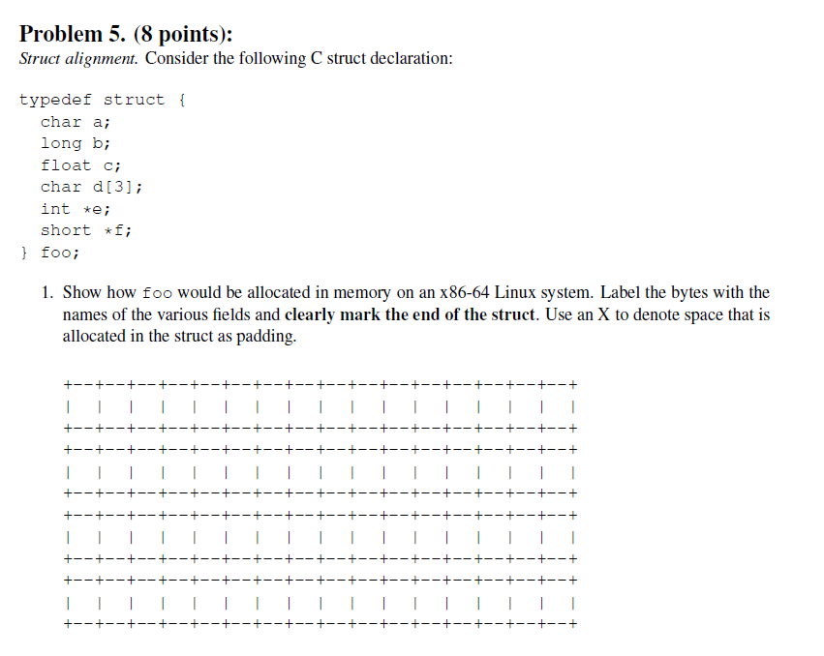
Example Struct Exam Question
Carnegie Mellon

Slide 25
Example Struct Exam Question
Carnegie Mellon
a | X | X | X | X | X | X | X b b b b b b b b
c | c | c | c | d | d | d | X e e e e e e e e
f | f | f | f | f | f | f | f

Slide 26
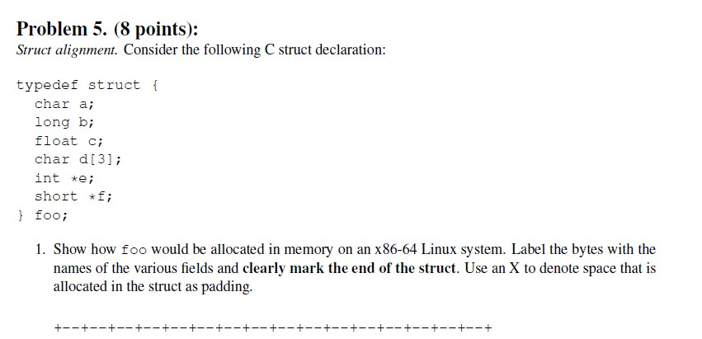
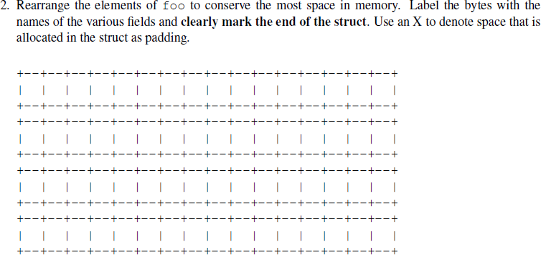
Example Struct Exam Question (Cont’d)
Carnegie Mellon

Slide 27
Example Struct Exam Question (Cont’d)
Carnegie Mellon
b b b b b b b b e e e e e e e e
f f f f f f f f c c c c d d d a

Slide 28
Today
Carnegie Mellon
Arrays
Structures
  Nested arrays and structures
Nested arrays
  Multi-dimensional
  Multi-level
Endianness

Slide 29
Multidimensional (Nested) Arrays
Carnegie Mellon
Declaration
T A[R][C];
2D array of data type T
R rows, C columns
Type T element requires K bytes
Array Size
  R * C * K bytes
Arrangement
  Row-Major Ordering
A[0][0] •
•
•
•
A[R-1][0] •
• • A[0][C-1]
•
•
•
• • A[R-1][C-1]
int A[R][C];
A |  |  | A | A |  |  | A |  |  | A |  |  | A
[0] | • • | • | [0] | [1] | • • | • | [1] | • • | • | [R-1] | • • | • | [R-1]
[0] |  |  | [C-1] | [0] |  |  | [C-1] |  |  | [0] |  |  | [C-1]
4*R*C
Bytes

Slide 30
Nested Array Example
Carnegie Mellon
int pgh[4][5] = {{1, 5, 2, 0, 6},
{1, | 5, | 2, | 1, | 3 | },
{1, | 5, | 2, | 1, | 7 | },
{1, | 5, | 2, | 2, | 1 | }};
1 | 5 | 2 | 0 | 6 | 1 | 5 | 2 | 1 | 3 | 1 | 5 | 2 | 1 | 7 | 1 | 5 | 2 | 2 | 1
int pgh[4][5];
76 96 116 136
“Row-Major” ordering of all elements in memory
  Variable pgh: array of 4 elements, allocated contiguously
  Each element is an array of 5 int’s, allocated contiguously
156

Slide 31
Nested Array Row Access
Carnegie Mellon
Row Vectors
  A[i] is array of C elements
  Each element of type T requires K bytes
  Starting address A + i * (C * K)
int A[R][C];
A[0]
A[i]
A[R-1]
A |  | A
[0] | • • • | [0]
[0] |  | [C-1]
A [i] [0] | • • • | A [i] [C-1]
A [R-1] [0] | • • • | A [R-1] [C-1]
• • •
• • •
A
A+(i*C*4)
A+((R-1)*C*4)

Slide 32
Nested Array Row Access Code
Carnegie Mellon
1 | 5 | 2 | 0 | 6 | 1 | 5 | 2 | 1 | 3 | 1 | 5 | 2 | 1 | 7 | 1 | 5 | 2 | 2 | 1
pgh
pgh[2]
int *get_pgh_zip(size_t index)
{
return pgh[index];
}
# %rdi = index
leaq (%rdi,%rdi,4),%rax # 5 * index
leaq pgh(,%rax,4),%rax # pgh + (20 * index)
Row Vector
  pgh[index] is array of 5 int’s
  Starting address pgh+20*index
Machine Code
  Computes and returns address
  Compute as pgh + 4*(index+4*index)

Slide 33
Nested Array Element Access
Carnegie Mellon
Array Elements
  A[i][j] is element of type T, which requires K bytes
  Address A + i * (C * K) + j * K
= A + (i * C + j) * K
int A[R][C];
A[0]
A[i]
A[R- 1]
A [0] [0] | • • • | A [0] [C- 1]
• • • | A [i] [j] | • • •
A [R- 1] [0] | • • • | A [R- 1] [C-
• • •
• • •
1]
A
A+(i*C*4)
A+((R-1)*C*4)
A+(i*C*4)+(j*4)

Slide 34
Nested Array Element Access Code
Carnegie Mellon
1 | 5 | 2 | 0 | 6 | 1 | 5 | 2 | 1 | 3 | 1 | 5 | 2 | 1 | 7 | 1 | 5 | 2 | 2 | 1
pgh
pgh[1][1]
int get_pgh_digit(size_t index, size_t dig)
{
return pgh[index][dig];
}
leaq addl | (%rdi,%rdi,4), %rax # 5*index %rax, %rsi # 5*index+dig
movl | pgh(,%rsi,4), %eax # M[pgh + | 4*(5*index+dig)]
Array Elements
  pgh[index][dig] is int
  Address: pgh + 20*index + 4*dig
= pgh + 4*(5*index + dig)

Slide 35
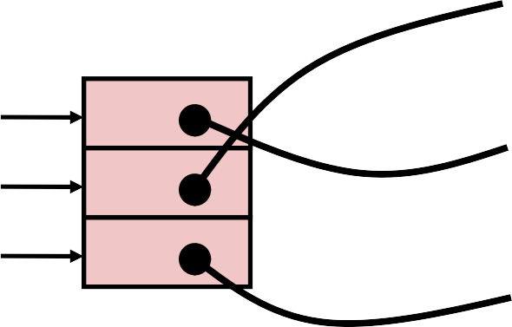
Multi-Level Array Example
Carnegie Mellon
int | cmu[5] | = | { | 1, | 5, | 2, | 1, | 3 | };
int | mit[5] | = | { | 0, | 2, | 1, | 3, | 9 | };
int | ucb[5] | = | { | 9, | 4, | 7, | 2, | 0 | };
Variable univ denotes array of 3 elements
Each element is a pointer
  8 bytes
Each pointer points to array of int’s
int *univ[3] = {mit, cmu, ucb};
cmu
1
5
2
1
3
 | univ
160 | 36 | mit
168 | 16
16
20
24
28
32 36
0
2
1
3
9
ucb
36 40
44
48
52 56
176
56
9
4
7
2
0
56 60
64
68
72 76

Slide 36
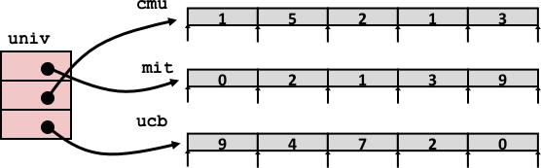
Element Access in Multi-Level Array
Carnegie Mellon
int get_univ_digit
(size_t index, size_t digit)
{
return univ[index][digit];
}
salq addq movl ret
$2, %rsi # 4*digit
univ(,%rdi,8), %rsi # p = univ[index] + 4*digit (%rsi), %eax # return *p
Computation
  Element access Mem[Mem[univ+8*index]+4*digit]
  Must do two memory reads
    First get pointer to row array
    Then access element within array

Slide 37
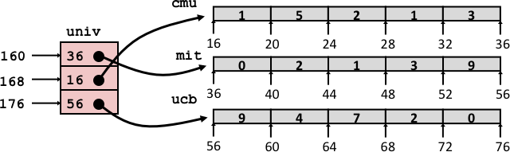
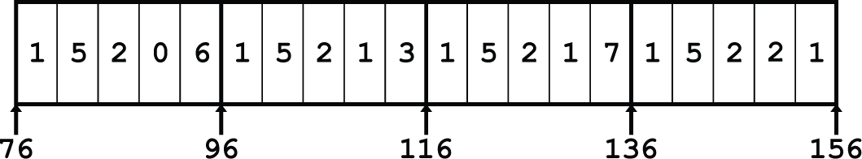
Array Element Accesses
Carnegie Mellon
Nested array Multi-level array
int get_pgh_digit
(size_t index, size_t digit)
{
return pgh[index][digit];
}
int get_univ_digit
(size_t index, size_t digit)
{
return univ[index][digit];
}
Accesses looks similar in C, but address computations very different:
Mem[pgh+20*index+4*digit] Mem[Mem[univ+8*index]+4*digit]

Slide 38
N X N Matrix Code
Carnegie Mellon
#define N 16
typedef int fix_matrix[N][N];
/* Get element A[i][j] */ int fix_ele(fix_matrix A,
size_t i, size_t j)
{
return A[i][j];
}
⬛ Fixed dimensions
Know value of N at compile time
⬛ Variable dimensions, explicit indexing
Traditional way to implement dynamic arrays
#define IDX(n, i, j) ((i)*(n)+(j))
/* Get element A[i][j] */
int vec_ele(size_t n, int *A,
size_t i, size_t j)
{
return A[IDX(n,i,j)];
}
⬛ Variable dimensions, implicit indexing
Now supported by gcc
/* Get element a[i][j] */
int var_ele(size_t n, int A[n][n],
size_t i, size_t j) { return A[i][j];
}

Slide 39
16 X 16 Matrix Access
Carnegie Mellon
Array Elements
  int A[16][16];
  Address A + i * (C * K) +
  C = 16, K = 4
j * K
/* Get element A[i][j] */
int fix_ele(fix_matrix A, size_t i, size_t j) { return A[i][j];
}
# A in %rdi, i in %rsi, j in %rdx
salq addq movl ret
$6, %rsi
%rsi, %rdi (%rdi,%rdx,4), %eax
# 64*i
# A + 64*i
# M[A + 64*i + 4*j]

Slide 40
n X n Matrix Access
Carnegie Mellon
Array Elements
  size_t n;
  int A[n][n];
  Address A + i * (C * K) +
  C = n, K = 4
  Must perform integer multiplication
j * K
/* Get element A[i][j] */
int var_ele(size_t n, int A[n][n], size_t i, size_t j)
{
return A[i][j];
}
# n in %rdi, A in %rsi, i in %rdx, j in %rcx
imulq leaq movl ret
%rdx, %rdi (%rsi,%rdi,4), %rax (%rax,%rcx,4), %eax
# n*i
# A + 4*n*i
# A + 4*n*i + 4*j

Slide 41
Example: Array Access
Carnegie Mellon
#include <stdio.h> #define ZLEN 5
#define PCOUNT 4
typedef int zip_dig[ZLEN];
int main(int argc, char** argv) { zip_dig pgh[PCOUNT] =
{{1, 5, 2, 0, 6},
{1, | 5, | 2, | 1, | 3 | },
{1, | 5, | 2, | 1, | 7 | }, | linux> ./array
{1, | 5, | 2, | 2, | 1 | }}; | result: 9
int *linear_zip = (int *) pgh; int *zip2 = (int *) pgh[2]; int result =
pgh[0][0] + linear_zip[7] +
*(linear_zip + 8) + zip2[1];
printf("result: %d\n", result); return 0;
}

Slide 42
Example: Array Access
Carnegie Mellon
#include <stdio.h> #define ZLEN 5
#define PCOUNT 4
typedef int zip_dig[ZLEN];
int main(int argc, char** argv) { zip_dig pgh[PCOUNT] =
{{1, 5, 2, 0, 6},
{1, | 5, | 2, | 1, | 3 | },
{1, | 5, | 2, | 1, | 7 | }, | linux> ./array
{1, | 5, | 2, | 2, | 1 | }}; | result: 9
int *linear_zip = (int *) pgh; int *zip2 = (int *) pgh[2]; int result =
pgh[0][0] + linear_zip[7] +
*(linear_zip + 8) + zip2[1];
printf("result: %d\n", result); return 0;
}

Slide 43
Understanding Pointers & Arrays #2
Carnegie Mellon
Decl | An |  |  | *An |  |  | **An
 | Cmp | Bad | Size | Cmp | Bad | Size | Cmp | Bad | Size
int A1[15];
int A2[3][5];
int (*A3)[5];
int *A4[3];
int (*A5[3]);
Cmp: Compiles (Y/N)
Bad: Possible bad pointer reference (Y/N)
Size: Value returned by sizeof

Slide 44
Understanding Pointers & Arrays #2
Carnegie Mellon
Decl | An |  |  | *An |  |  | **An
 | Cmp | Bad | Size | Cmp | Bad | Size | Cmp | Bad | Size
int A1[15]; | Y | N | 60 | Y | N | 4 | N | - | -
int A2[3][5]; | Y | N | 60 | Y | N | 20 | Y | N | 4
int (*A3)[5]; | Y | N | 8 | Y | Y | 20 | Y | Y | 4
int *A4[3]; | Y | N | 24 | Y | N | 8 | Y | Y | 4
int (*A5[3]); | Y | N | 24 | Y | N | 8 | Y | Y | 4
A3 A4/A5
A1
Allocated pointer Unallocated pointer
Allocated int Unallocated int

Slide 45
Understanding Pointers & Arrays #3
Carnegie Mellon
Decl | An |  |  | *An |  |  | **An
 | Cmp | Bad | Size | Cmp | Bad | Size | Cmp | Bad | Size
int A1[3][5]
int *A2[3][5]
int (*A3)[3][5]
int *(A4[3][5])
int (*A5[3])[5]
Decl | ***An
 | Cmp | Bad | Size
int A1[3][5]
int *A2[3][5]
int (*A3)[3][5]
int *(A4[3][5])
int (*A5[3])[5]
⬛ Cmp: Compiles (Y/N)
⬛ Bad: Possible bad pointer reference (Y/N)
⬛ Size: Value returned by
sizeof

Slide 46
Carnegie Mellon
Allocated pointer Allocated pointer to unallocated int
Unallocated pointer
Allocated int Unallocated int
A1 A2/A4
Declaration
int | A1[3][5]
int | *A2[3][5]
int | (*A3)[3][5]
int | *(A4[3][5])
int | (*A5[3])[5]
A3
A5

Slide 47
Understanding Pointers & Arrays #3
Carnegie Mellon
Decl | An |  |  | *An |  |  | **An
 | Cmp | Bad | Size | Cmp | Bad | Size | Cmp | Bad | Size
int A1[3][5] | Y | N | 60 | Y | N | 20 | Y | N | 4
int *A2[3][5] | Y | N | 120 | Y | N | 40 | Y | N | 8
int (*A3)[3][5] | Y | N | 8 | Y | Y | 60 | Y | Y | 20
int *(A4[3][5]) | Y | N | 120 | Y | N | 40 | Y | N | 8
int (*A5[3])[5] | Y | N | 24 | Y | N | 8 | Y | Y | 20
Decl | ***An
 | Cmp | Bad | Size
int A1[3][5] | N | - | -
int *A2[3][5] | Y | Y | 4
int (*A3)[3][5] | Y | Y | 4
int *(A4[3][5]) | Y | Y | 4
int (*A5[3])[5] | Y | Y | 4
⬛ Cmp: Compiles (Y/N)
⬛ Bad: Possible bad pointer reference (Y/N)
⬛ Size: Value returned by
sizeof

Slide 48
Quiz
Given the following statements, please fill the table below.
int A1[3] ={1,2,3};
int A2[3] = {4,5,6}
int *A3 = A1+1;
int A4[2][3] = {{7,8,9},{10,11,12}};
Assuming A1 locates at address 100 in Memory, A2 at 200, A3 at 300, A4 at 400.
Reference | A1[2] | *(A2+1) | *A3 | A4[2][1]
Type
Value

Slide 49
Quiz
Given the following statements, please fill the table below.
int A1[3] ={1,2,3};
int A2[3] = {4,5,6}
int *A3 = A1+1;
int A4[2][3] = {{7,8,9},{10,11,12}};
Assuming A1 locates at address 100 in Memory, A2 at 200, A3 at 300, A4 at 400.
Reference | A1[2] | *(A2+1) | A3 | A4[1][2]
Type | Int | int | int * | int
Value | 3 | 5 | 104 | 12

Slide 51
Today
Carnegie Mellon
Arrays
Structures
  Nested arrays and structures
Nested arrays
  Multi-dimensional
  Multi-level
Endianness

Slide 52
Byte-Addressable Memory
Carnegie Mellon
0 • •0
F • •F
 |  |  |  |  | • • •
Programs refer to data by address
  For now, imagine memory as a large array of bytes
  An address is like an index into that array
  A pointer variable stores an address

Slide 53
Example Data Representations
Carnegie Mellon
C Data Type | Typical 32-bit | Typical 64-bit | x86-64
char | 1 | 1 | 1
short | 2 | 2 | 2
int | 4 | 4 | 4
long | 4 | 8 | 8
float | 4 | 4 | 4
double | 8 | 8 | 8
pointer | 4 | 8 | 8

Slide 54
Word-Oriented Memory Organization
Carnegie Mellon
32-bit Words
64-bit Words
Addresses Specify Byte Locations
  Address of first byte in word
  Addresses of successive words differ by 4 (32-bit) or 8 (64-bit)
Bytes | Addr.
 | 0000
 | 0001
 | 0002
 | 0003
 | 0004
 | 0005
 | 0006
 | 0007
 | 0008
 | 0009
 | 0010
 | 0011
 | 0012
 | 0013
 | 0014
 | 0015
Addr 0000
Addr 0004
Addr 0008
Addr 0012
Addr
0000
Addr
0008
33

Slide 55
Byte Ordering
Carnegie Mellon
So, how are the bytes within a multi-byte word ordered in memory?
Conventions
  Big Endian: Sun, PPC Mac, Internet
    Least significant byte has highest address
  Little Endian: x86, ARM processors running Android, iOS, and Windows
    Least significant byte has lowest address

Slide 56
Byte Ordering Example
Carnegie Mellon
Example
  Variable x has 4-byte value of 0x01234567
  Address given by &x is 0x100
Big Endian
0x100 0x101 0x102
0x103
 |  | 01 | 23 | 45 | 67
Little Endian
0x100 0x101 0x102
0x103
 |  | 67 | 45 | 23 | 01

Slide 57
Examining Data Representations
Carnegie Mellon
Code to Print Byte Representation of Data
  Casting pointer to unsigned char * allows use as a byte array
typedef unsigned char *pointer;
void show_bytes(pointer start, size_t len){ size_t i;
for (i = 0; i < len; i++) printf(”%p\t0x%.2x\n", start+i, start[i]);
printf("\n");
}
typedef unsigned char *pointer;
void show_bytes(pointer start, size_t len){ size_t i;
for (i = 0; i < len; i++) printf(”%p\t0x%.2x\n", start+i, start[i]);
printf("\n");
}
Printf directives:
%p: Print pointer
%x: Print Hexadecimal

Slide 58
show_bytesExecution Example
Carnegie Mellon
int a = 15213; // 0x3b6d
printf("int a = 15213;\n"); show_bytes((pointer) &a, sizeof(a));
int a = 15213; // 0x3b6d
printf("int a = 15213;\n"); show_bytes((pointer) &a, sizeof(a));
Result (Linux x86-64):
int a = 15213;
0x7fffb7f71dbc 6d
0x7fffb7f71dbd 3b 0x7fffb7f71dbe 00
0x7fffb7f71dbf 00
int a = 15213;
0x7fffb7f71dbc 6d 0x7fffb7f71dbd 3b 0x7fffb7f71dbe 00
0x7fffb7f71dbf 00

Slide 59
Representing Pointers
Carnegie Mellon
int B = -15213;
int *P = &B;
int B = -15213;
int *P = &B;
Sun
IA32
x86-64
EF
FF
FB
2C
AC
28
F5
FF
3C
1B
FE
82
FD
7F
00
00
Different compilers & machines assign different locations to objects Even get different results each time run program

Slide 60
Representing Strings
Carnegie Mellon
char S[6] = "18213";
char S[6] = "18213";
Strings in C
Represented by array of characters
Each character encoded in ASCII format
  Standard 7-bit encoding of character set
  Character “0” has code 0x30
– Digit i has code 0x30+i
String should be NUL-terminated
  Final character = 0
IA32
Sun
31
38
32
31
33
00
31
38
32
31
33
00
Compatibility
  Byte ordering not an issue

Slide 61

填空题
8分
There are two conventions of Byte Ordering, Big Endian and Little Endian. Given a 4-byte value of 0x76543210 and its location starting from address 0x100, please denote the contents in each address.
Big Endian
Address 0x100 0x101 0x102 0x103
Content [填空1] [填空2] [填空3] [填空4]
2. Little Endian
Address 0x100 0x101 0x102 0x103
Content [填空5] [填空6] [填空7] [填空8]
正常使用填空题需3.0以上版本雨课堂
作答

Slide 62
Reading Byte-Reversed Listings
Carnegie Mellon
Disassembly
  Text representation of binary machine code
  Generated by program that reads the machine code
Example Fragment
Address Instruction Code Assembly Rendition
8048365: 5b
pop %ebx
add $0x12ab,%ebx cmpl $0x0,0x28(%ebx)
8048366: 81 c3 ab 12 00 00
804836c: 83 bb 28 00 00 00 00
Deciphering Numbers
  Value: 0x12ab
Pad to 32 bits:
Split into bytes:
0x000012ab 00 00 12 ab
Reverse: ab 12 00 00

Slide 63
Summary
Carnegie Mellon
Arrays
  Elements packed into contiguous region of memory
  Use index arithmetic to locate individual elements
Structures
  Elements packed into single region of memory
  Access using offsets determined by compiler
  Possible require internal and external padding to ensure alignment
Combinations
  Can nest structure and array code arbitrarily
Endianness
  Byte-addressable mem. introduces ordering within multibyte types
Floating Point (see appendix!)
  Data held and operated on in XMM registers

Slide 64
Appendix
Carnegie Mellon

Slide 65
Floating Point Background
Carnegie Mellon
History
  x87 FP
    Legacy, very ugly
  SSE FP
    Supported by Shark machines
    Special case use of vector instructions
  AVX FP
    Newest version
    Similar to SSE
    Documented in book

Slide 66
Programming with SSE3
Carnegie Mellon
XMM Registers
16 total, each 16 bytes
16 single-byte integers
8 16-bit integers
4 32-bit integers
4 single-precision floats
2 double-precision floats
1 single-precision float
1 double-precision float

Slide 67
Scalar & SIMD Operations
Carnegie Mellon
Scalar Operations: Single Precision
addss
x
x%m_{x}m_{m}1_{m} 0
 |  |  |  |  |  |  |  |  |  |  |  |  | % | mm | 0,%
+
%xmm 1
SIMD Operations: Single Precision
+ +
addps
x
x%m_{x}m_{m}1_{m} 0
 |  |  |  |  |  |  |  |  |  |  |  |  | % | mm | 0,%
+
+
%xmm 1
Scalar Operations: Double Precision
addsd
x
x%m_{x}m_{m}1_{m} 0
 |  |  |  |  |  |  |  |  |  |  |  |  | % | mm | 0,%
+
%xmm 1
Bryant and O’Hallaron, Computer Systems: A Programmer’s Perspective, Third Edition
65

Slide 68
FP Basics
Carnegie Mellon
Arguments passed in %xmm0, %xmm1, ...
Result returned in %xmm0
All XMM registers caller-saved
float fadd(float x, float y)
{
return x + y;
}
double dadd(double x, double y)
{
return x + y;
}
# x in %xmm0, y in %xmm1 addss %xmm1, %xmm0 ret
# x in %xmm0, y in %xmm1 addsd %xmm1, %xmm0 ret

Slide 69
FP Memory Referencing
Carnegie Mellon
Integer (and pointer) arguments passed in regular registers
FP values passed in XMM registers
Different mov instructions to move between XMM registers, and between memory and XMM registers
double dincr(double *p, double v)
{
double x = *p;
*p = x + v; return x;
}
# p in %rdi, v in %xmm0
movapd movsd addsd movsd ret
%xmm0, %xmm1 (%rdi), %xmm0
%xmm0, %xmm1
%xmm1, (%rdi)
# Copy v # x = *p
# t = x + v # *p = t

Slide 70
Other Aspects of FP Code
Carnegie Mellon
Lots of instructions
  Different operations, different formats, ...
Floating-point comparisons
  Instructions ucomiss and ucomisd
  Set condition codes CF, ZF, and PF
Using constant values
  Set XMM0 register to 0 with instruction xorpd %xmm0, %xmm0
  Others loaded from memory

