Slide 1
Floating Point
Carnegie Mellon
Computer Organization and Architecture
4th Lecture
Instructors:
Xiaofei Nan

Slide 2
Today: Floating Point
Carnegie Mellon
Background: Fractional binary numbers
IEEE floating point standard: Definition
Example and properties
Rounding, addition, multiplication
Floating point in C
Summary

Slide 3
Fractional binary numbers
Carnegie Mellon
What is 1011.101₂?

Slide 4

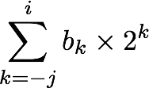
Fractional Binary Numbers
Carnegie Mellon
₂i ₂i-1
4
2
1
• • •
b_{i} | ^{b}i-1 | ••• | b₂ | b₁ | b₀ | ^{b}-1 | ^{b}-2 | ^{b}-3 | ••• | ^{b}-j
1/2 1/4 1/8
• • •
Representation
₂-j
Bits to right of “binary point” represent fractional powers of 2
Represents rational number:

Slide 5
Fractional Binary Numbers: Examples
Carnegie Mellon
Value
5 3/4
2 7/8
1 7/16
Representation
101.11₂
10.111₂
= 4 + 1 + 1/2 + 1/4
= 2 + 1/2 + 1/4 + 1/8
1.0111₂ = 1 + 1/4 + 1/8 + 1/16
Observations
  Divide by 2 by shifting right (unsigned)
  Multiply by 2 by shifting left
  Numbers of form 0.111111… are just below 1.0
2
    1/2 + 1/4 + 1/8 + … + 1/2^{i} + … ➙ 1.0
    Use notation 1.0 – ε

Slide 6
Representable Numbers
Carnegie Mellon
Limitation #1
  Can only exactly represent numbers of the form x/2^{k}
  Other rational numbers have repeating bit representations
Value
  1/3
  1/5
Representation
0.0101010101[01]…₂
0.001100110011[0011]…₂
1/10 0.0001100110011[0011]…₂
Limitation #2
  Just one setting of binary point within the w bits
    Limited range of numbers (very small values? very large?)

Slide 7
Today: Floating Point
Carnegie Mellon
Background: Fractional binary numbers
IEEE floating point standard: Definition
Example and properties
Rounding, addition, multiplication
Floating point in C
Summary

Slide 8
IEEE Floating Point
Carnegie Mellon
IEEE Standard 754
  Established in 1985 as uniform standard for floating point arithmetic
    Before that, many idiosyncratic formats
  Supported by all major CPUs
  Some CPUs don’t implement IEEE 754 in full e.g., early GPUs, Cell BE processor
Driven by numerical concerns
  Nice standards for rounding, overflow, underflow
  Hard to make fast in hardware
    Numerical analysts predominated over hardware designers in defining standard

Slide 9
Floating Point Representation
Carnegie Mellon
Example:
Numerical Form:
(–1)^{s} M 2E
15213 = (-1)⁰ x 1.1101101101101 x 2¹³
10 2
Sign bit s determines whether number is negative or positive
Significand M normally a fractional value in range [1.0,2.0).
Exponent E weights value by power of two
Encoding
  MSB s is sign bit s
  exp field encodes E (but is not equal to E)
  frac field encodes M (but is not equal to M)
s | exp | frac

Slide 10
Precision options
Carnegie Mellon
Single precision: 32 bits
≈ 7 decimal digits, 10^{±38}
s | exp | frac
1 8-bits
Double precision: 64 bits
≈ 16 decimal digits, 10^{±308}
23-bits
s | exp | frac
1 11-bits 52-bits
Other formats: half precision, quad precision

Slide 11
Three “kinds” of floating point numbers
Carnegie Mellon
s | exp | frac
1
e-bits
f-bits
00…00 |  | exp ≠ 0 and exp ≠ 11…11 |  | 11…11
denorm |  | normalized |  | special

Slide 12
“Normalized” Values
Carnegie Mellon
v = (–1)^{s} M 2E
When: exp ≠ 000…0 and exp ≠ 111…1
Exponent coded as a biased value: Exp = E + Bias
  Exp: unsigned value of exp field
  Bias = 2^{k-1} - 1, where k is number of exponent bits
    Single precision: 127 (Exp: 1…254, E: -126…127)
    Double precision: 1023 (Exp: 1…2046, E: -1022…1023)
Significand coded with implied leading 1: M = 1.xxx…x
  xxx…x: bits of frac field
  Minimum when frac=000…0 (M = 1.0)
  Maximum when frac=111…1 (M = 2.0 – ε)
  Get extra leading bit for “free”
2

Slide 13
Normalized Encoding Example
Carnegie Mellon
v = (–1)^{s} M 2E
Exp = E + Bias
Value: float F = 15213.0;
15213 = 11101101101101
10 2
= (-1)⁰ x 1.1101101101101 x 2¹³
2
Significand
M =
frac =
1.1101101101101₂
11011011011010000000000₂
Exponent
E | = | 13
Bias Exp | = = | 127 140 = | 10001100₂
Result:
0 10001100 11011011011010000000000
s exp frac

Slide 14
Denormalized Values
Carnegie Mellon
v = (–1)^{s} M 2E
E = 1 – Bias
Condition: exp = 000…0
Exponent value: E = 1 – Bias (instead of E = 0 – Bias)
Significand coded with implied leading 0: M = 0.xxx…x
  xxx…x: bits of frac
Cases
2
exp = 000…0, frac = 000…0
  Represents zero value
  Note distinct values: +0 and –0 (why?)
exp = 000…0, frac ≠ 000…0
  Numbers closest to 0.0
  Equispaced

Slide 15
Special Values
Carnegie Mellon
Condition: exp = 111…1
Case: exp = 111…1, frac = 000…0
  Represents value ∞ (infinity)
  Operation that overflows
  Both positive and negative
  E.g., 1.0/0.0 = −1.0/−0.0 = +∞, 1.0/−0.0 = −∞
Case: exp = 111…1, frac ≠ 000…0
  Not-a-Number (NaN)
  Represents case when no numeric value can be determined
  E.g., sqrt(–1), ∞ − ∞, ∞ × 0

Slide 16
IEEE floating numbers
Carnegie Mellon
s | exp | frac
v = (–1)^{s} M 2E
E = exp – Bias; exp = E + Bias. (Normalized)
  Bias = 2^{k-1} - 1, where k is number of exp bits.
Normalized: exp ≠ 000…0 and exp ≠ 111…1
M=1.xxx
Denormalized: exp = 000…0
M=0.xxx, E = 1 – Bias
(1) exp = 000…0, frac = 000…0 , v = 0 (+0 or -0);
(2) exp = 000…0, frac ≠ 000…0, v closes to 0.
Special: exp = 111…1
(1) exp = 111…1, frac = 000…0, v= ∞ (+∞, -∞);
(2) exp = 111…1, frac ≠ 000…0, v = NaN

Slide 17
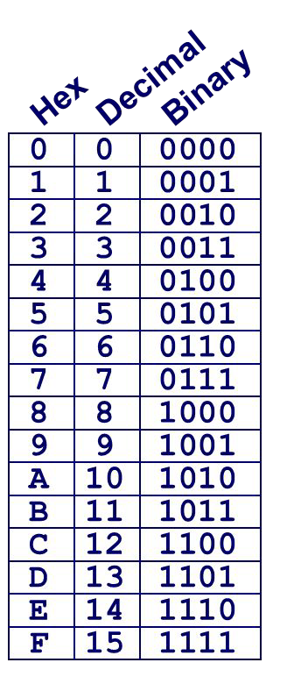
C float Decoding Example
Carnegie Mellon
v = (–1)^{s} M 2E
E = Exp – Bias
float: 0xC0A00000
Bias = 2^{k-1} – 1 = 127
binary:
1 8-bits
-> Exp =
23-bits
E = S = M =
(decimal)
v = (–1)^{s} M 2E =

Slide 18
C float Decoding Example
Carnegie Mellon
v = (–1)^{s} M 2E
E = Exp – Bias
float: 0xC0A00000
binary: 1100 0000 1010 0000 0000 0000 0000 0000
1 | 1000 | 0001 | 010 | 0000 | 0000 | 0000 | 0000 | 0000
1 8-bits
-> Exp =
23-bits
E = S =
M = 1.
(decimal)
v = (–1)^{s} M 2E =

Slide 19
C float Decoding Example
Carnegie Mellon
v = (–1)^{s} M 2E
E = Exp – Bias
float: 0xC0A00000
Bias = 2^{k-1} – 1 = 127
binary: 1100 0000 1010 0000 0000 0000 0000 0000
1 8-bits 23-bits
E = 129 -> Exp –Bias = 129 – 127 = 2 (decimal)
S = 1 -> negative number
M = 1.010 0000 0000 0000 0000 0000
= 1 + 1/4 = 1.25
1 | 1000 | 0001 | 010 | 0000 | 0000 | 0000 | 0000 | 0000
v = (–1)^{s} M 2E = (-1)¹ * 1.25 * 2² = -5

Slide 20
Visualization: Floating Point Encodings
Carnegie Mellon
−∞
+∞
−Normalized
−Denorm
+Denorm
+Normalized
NaN
NaN
−0 +0

Slide 21
Today: Floating Point
Carnegie Mellon
Background: Fractional binary numbers
IEEE floating point standard: Definition
Example and properties
Rounding, addition, multiplication
Floating point in C
Summary

Slide 22
Tiny Floating Point Example
Carnegie Mellon
s | exp | frac
1 4-bits 3-bits
8-bit Floating Point Representation
  the sign bit is in the most significant bit
  the next four bits are the exponent, with a bias of 7
  the last three bits are the frac
Same general form as IEEE Format
  normalized, denormalized, special
  representation of 0, NaN, infinity

Slide 23
Tiny Floating Point Examples
Carnegie Mellon
s | exp | frac
1 4-bits 3-bits
v = (–1)^{s} M 2E
E = exp – Bias; exp = E + Bias. (Normalized)
  Bias = 2^{k-1} - 1, where k is number of exp bits. When k=4, Bias = 7.
1. Normalized:
exp ≠ 0000 and exp ≠ 1111 , M=1.xxx
2. Denormalized:
exp = 0000 = 0, M=0.xxx, E = 1 – Bias
3. Special Values:
(1) exp = 111…1, frac = 000…0, v= ∞ (+∞, -∞);
(2) exp = 111…1, frac ≠ 000…0, v = NaN

Slide 24
Carnegie Mellon
Dynamic Range (Positive Only) s exp frac E Value |  |  |  |  |  |  | v = (–1)^{s} M 2E n: E = Exp – Bias d: E = 1 – Bias
0 | 0000 | 000 | -6 | 0
0 | 0000 | 001 | -6 | 1/8*1/64 | = | 1/512 | closest to zero
Denormalized ⁰ 0 | 0000 0000 | 010 110 | -6 -6 | 2/8*1/64 6/8*1/64 | = = | 2/512 (-1)⁰(0+1/4)*2⁻⁶ 6/512
0 | 0000 | 111 | -6 | 7/8*1/64 | = | 7/512 | largest denorm
0 | 0001 | 000 | -6 | 8/8*1/64 | = | 8/512 | smallest norm
0 … 0 | 0001 0110 | 001 110 | -6 -1 | 9/8*1/64 = 9/512 ₍₋₁₎0_{(1+1/8)*2}-6 14/8*1/2 = 14/16
0 | 0110 | 111 | -1 | ^{15/8*1/2 = 15/16} closest to 1 below
Normalized ⁰ | 0111 | 000 | 0 | 8/8*1 = 1
numbers 0 | 0111 | 001 | 0 | 9/8*1 = 9/8 closest to 1 above
0 … 0 | 0111 1110 | 010 110 | 0 7 | 10/8*1 = 10/8 14/8*128 = 224
0 | 1110 | 111 | 7 | 15/8*128 = 240 largest norm
0 | 1111 1111 | 000 001 |  | inf NaN
numbers
…

Slide 25
Quiz
s(1) | exp(4) | frac(3)
Given tiny floating point format above, Which category does 00000001 belong?
A. Normalized B. Denormalized C. Special
2. Given tiny floating point format above, which category does
00001001 belong?
A. Normalized B. Denormalized C. Special
3. Given tiny floating point format above, which category does
01111001 belong?
A. Normalized B. Denormalized C. Special

Slide 26
Quiz
s(1) | exp(4) | frac(3)
Given tiny floating point format above, Which category does 00000001 belong?
A. Normalized B. Denormalized C. Special
2. Given tiny floating point format above, which category does
00001001 belong?
A. Normalized B. Denormalized C. Special
3. Given tiny floating point format above, which category does
01111001 belong?
A. Normalized B. Denormalized C. Special

Slide 27
Quiz
s(1) | exp(4) | frac(3)
4. Given tiny floating point format above, what is the decimal value of 00000100?

Slide 28
Quiz
s(1) | exp(4) | frac(3)
4. Given tiny floating point format above, what is the decimal value of 00000100?
Answer:
Denormalized: exp = 000…0
M=0.xxx, E = 1 – Bias , v = (–1)^{s} M 2E
Bias = 2^{k-1} - 1, where k is number of exp bits. When k=4, Bias = 7
s = 0, exp = 0000, frac = 100
E = 1-Bias = 1-7 = -6
M = 0.100 (Binary) = 1/2 = 2⁻¹
v = (–1)^{s} M 2E= (-1)⁰ *2⁻¹ * 2⁻⁶ = 2⁻⁷= 1/128

Slide 29
Quiz
s(1) | exp(4) | frac(3)
5. Given tiny floating point format above, what is the decimal value of 00111010?

Slide 30
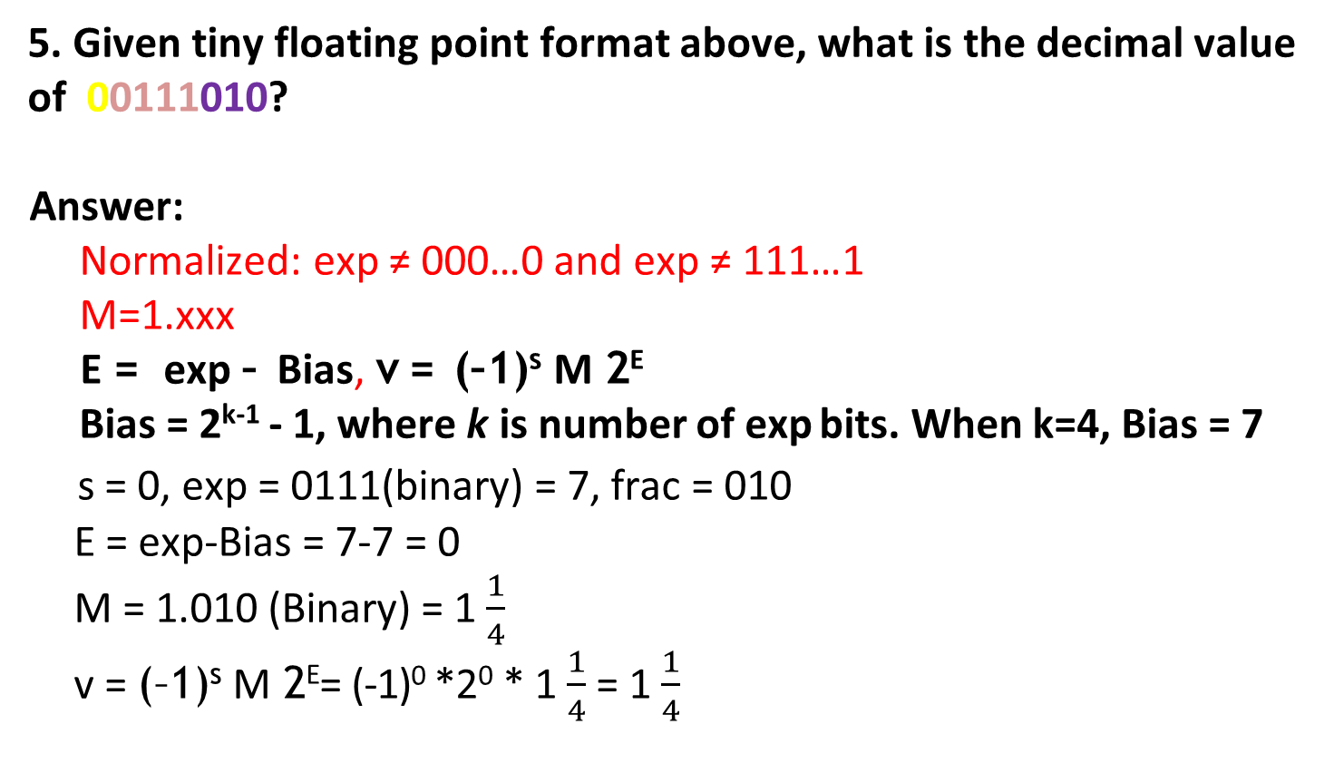
Quiz
s(1) | exp(4) | frac(3)
5. Given tiny floating point format above, what is the decimal value of 00111010?
Answer:
Normalized: exp ≠ 000…0 and exp ≠ 111…1
M=1.xxx
E = exp – Bias, v = (–1)^{s} M 2E
Bias = 2^{k-1} - 1, where k is number of exp bits. When k=4, Bias = 7
s = 0, exp = 0111(binary) = 7, frac = 010
E = exp-Bias = 7-7 = 0
M = 1.010 (Binary) = 1 $\frac{1}{4}$
v = (–1)^{s} M 2E= (-1)⁰ *2⁰ * 1 $\frac{1}{4}$ = 1 $\frac{1}{4}$

Slide 31
Quiz
s(1) | exp(4) | frac(3)
6. Given tiny floating point format above, what is the decimal value of 11000100?

Slide 32

Quiz
s(1) | exp(4) | frac(3)
6. Given tiny floating point format above, what is the decimal value of 11000100?
Answer:
Normalized: exp ≠ 000…0 and exp ≠ 111…1
M=1.xxx
E = exp – Bias, v = (–1)^{s} M 2E
Bias = 2^{k-1} - 1, where k is number of exp bits. When k=4, Bias = 7
s = 1, exp = 1000(binary) = 8, frac = 100
E = exp-Bias = 8-7 = 1
M = 1.100 (Binary) = 1 $\frac{1}{2}$
v = (–1)^{s} M 2E= (-1)¹ *2¹ * 1 $\frac{1}{2}$ = -3

Slide 33
Quiz
s(1) | exp(4) | frac(3)
7. Given tiny floating point format above, what is the decimal value of 01111100?

Slide 34
Quiz
s(1) | exp(4) | frac(3)
7. Given tiny floating point format above, what is the decimal value of 01111100?
Answer:
Special: exp = 111…1
(1) exp = 111…1, frac = 000…0, v= ∞ (+∞, -∞);
(2) exp = 111…1, frac ≠ 000…0, v = NaN
NaN

Slide 35
Quiz
s(1) | exp(4) | frac(3)
8. Given tiny floating point format above, what is the binary representation of 2.75?

Slide 36
Quiz
v = (–1)^{s} M 2E
E = Exp – Bias
s(1) | exp(4) | frac(3)
8. Given tiny floating point format above, what is the binary representation of 2.75?
Answer:
v = (–1)^{s} M 2E
2.75 = 10. 11 = (–1)⁰ *1.011 * 2¹
s = 0, M = 1.011, E = 1, Bias = 7
exp = E + bias = 1 + 7 = 8 = 1000(Binary)
frac = 011
Final : 01000011

Slide 37
Quiz
s(1) | exp(4) | frac(3)
9. Given tiny floating point format above, what is the binary representation of -12?

Slide 38
Quiz
v = (–1)^{s} M 2E
E = Exp – Bias
s(1) | exp(4) | frac(3)
9. Given tiny floating point format above, what is the binary representation of -12?
Answer:
v = (–1)^{s} M 2E
-12 = (-1)*1100 = (–1)¹ *1.100 * 2³
s = 1, M = 1.100, E = 3, Bias = 7
exp = E + bias = 3 + 7 = 10 = 1010(Binary)
frac = 100
Final : 11010100

Slide 39
Quiz
s(1) | exp(4) | frac(3)
9. Given tiny floating point format above, what is the largest positive Denormalized number (in decimal)?

Slide 40
Quiz
v = (–1)^{s} M 2E
E = Exp – Bias
s(1) | exp(4) | frac(3)
9. Given tiny floating point format above, what is the largest positive Denormalized number (in decimal)?
Answer:
Denormalized: exp = 000…0
00000111
s = 0, exp = 0000, frac = 1111
M=0.xxx, E = 1 – Bias , v = (–1)^{s} M 2E
E = 1-Bias = 1-7 = -6
M = 0.111 (Binary) = 7/8
v = (–1)^{s} M 2E= (-1)⁰ *7/8 * 2⁻⁶ = 7/512

Slide 41
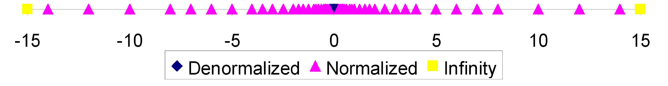
Distribution of Values
Carnegie Mellon
6-bit IEEE-like format
  e = 3 exponent bits
  f = 2 fraction bits
  Bias is 2³⁻¹-1 = 3
s | exp | frac
1
3-bits
2-bits
Notice how the distribution gets denser toward zero.
8 values

Slide 42
Carnegie Mellon
Dynamic Range (Positive Only) s exp frac E Value |  |  |  |  |  |  | v = (–1)^{s} M 2E n: E = Exp – Bias d: E = 1 – Bias
0 | 0000 | 000 | -6 | 0
0 | 0000 | 001 | -6 | 1/8*1/64 | = | 1/512 | closest to zero
Denormalized ⁰ 0 | 0000 0000 | 010 110 | -6 -6 | 2/8*1/64 6/8*1/64 | = = | 2/512 (-1)⁰(0+1/4)*2⁻⁶ 6/512
0 | 0000 | 111 | -6 | 7/8*1/64 | = | 7/512 | largest denorm
0 | 0001 | 000 | -6 | 8/8*1/64 | = | 8/512 | smallest norm
0 … 0 | 0001 0110 | 001 110 | -6 -1 | 9/8*1/64 = 9/512 ₍₋₁₎0_{(1+1/8)*2}-6 14/8*1/2 = 14/16
0 | 0110 | 111 | -1 | ^{15/8*1/2 = 15/16} closest to 1 below
Normalized ⁰ | 0111 | 000 | 0 | 8/8*1 = 1
numbers 0 | 0111 | 001 | 0 | 9/8*1 = 9/8 closest to 1 above
0 … 0 | 0111 1110 | 010 110 | 0 7 | 10/8*1 = 10/8 14/8*128 = 224
0 | 1110 | 111 | 7 | 15/8*128 = 240 largest norm
0 | 1111 1111 | 000 001 |  | inf NaN
numbers
…

Slide 43
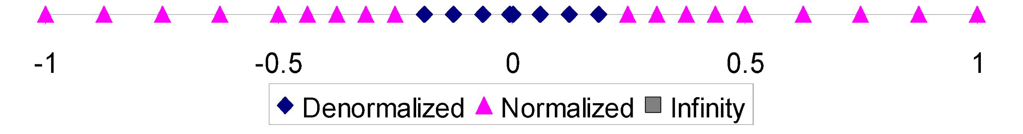
Distribution of Values (close-up view)
Carnegie Mellon
6-bit IEEE-like format
  e = 3 exponent bits
  f = 2 fraction bits
  Bias is 3
s | exp | frac
1
3-bits
2-bits

Slide 44
Special Properties of the IEEE Encoding
Carnegie Mellon
FP Zero Same as Integer Zero
  All bits = 0
Can (Almost) Use Unsigned Integer Comparison
  Must first compare sign bits
  Must consider −0 = 0
  NaNs problematic
    Will be greater than any other values
    What should comparison yield? The answer is complicated.
  Otherwise OK
    Denorm vs. normalized
    Normalized vs. infinity

Slide 45
Today: Floating Point
Carnegie Mellon
Background: Fractional binary numbers
IEEE floating point standard: Definition
Example and properties
Rounding, addition, multiplication
Floating point in C
Summary

Slide 46
Floating Point Operations: Basic Idea
Carnegie Mellon
⬛ | x | +_{f} | y | = | Round(x | + | y)
⬛ | x | ×_{f} | y | = | Round(x | × | y)
Basic idea
  First compute exact result
  Make it fit into desired precision
    Possibly overflow if exponent too large
    Possibly round to fit into frac

Slide 47
Rounding
Carnegie Mellon
Rounding Modes
1.40 1.60
  Towards zero
1.50 2.50 –1.50
1
1 | 1 | 2 | –1
1 | 1 | 1 | 2 –2
2 | 2 | 3 | –1
Round down (−∞)
Round up (+∞) 2
Nearest Even (default)
1 2 2 2 –2

Slide 48
Closer Look at Round-To-Even
Carnegie Mellon
Default Rounding Mode
  Hard to get any other kind without dropping into assembly
  C99 has support for rounding mode management
  All others are statistically biased
    Sum of set of positive numbers will consistently be over- or under- estimated
Applying to Other Decimal Places / Bit Positions
  When exactly halfway between two possible values
    Round so that least significant digit is even
  E.g., round to nearest hundredth
7.8949999 | 7.89(Less than half way)
7.8950001 | 7.90(Greater than half way)
7.8950000 | 7.90(Half way—round up)
7.8850000 | 7.88(Half way—round down)

Slide 49
Rounding Binary Numbers
Carnegie Mellon
Binary Fractional Numbers
  “Even” when least significant bit is 0
  “Half way” when bits to right of rounding position = 100…2
Examples
  Round to nearest 1/4 (2 bits right of binary point)
  Value Binary Rounded Action Rounded Value
2 3/32 | 10.00011₂ | 10.00₂ | (<1/2—down) 2
2 3/16 | 10.00110₂ | 10.01₂ | (>1/2—up) 2 1/4
2 7/8 10.11100₂ | 11.00₂ | ( 1/2—up) 3
2 5/8 10.10100₂ | 10.10₂ | ( 1/2—down) 2 1/2

Slide 50
FP Multiplication
Carnegie Mellon
(–1)^{s1} M1 2^{E1} x (–1)^{s2} M2 2^{E2}
Exact Result: (–1)^{s} M 2E
  Sign s: s1 ^ s2
M1 x M2 E1 + E2
Significand M:
Exponent E:
Fixing
If M ≥ 2, shift M right, increment E
If E out of range, overflow
Round M to fit frac precision
Implementation
  Biggest chore is multiplying significands
4 bit mantissa: 1.010*2² | x 1.110*2³ | = 10.0011*2⁵
= | 1.00011*2⁶ | = 1.001*2⁶

Slide 51


Floating Point Addition
Carnegie Mellon
(–1)^{s1} M1 2^{E1} + (-1)^{s2} M2 2^{E2}
  Assume E1 > E2
Get binary points lined up
Exact Result: (–1)^{s} M 2E
  Sign s, significand M:
    Result of signed align & add
E1–E2
(–1)^{s1} M1
+
Exponent E: E1
Fixing
  If M ≥ 2, shift M right, increment E
(–1)^{s2} M2
(–1)^{s} M
if M < 1, shift M left k positions, decrement E by k
Overflow if E out of range
Round M to fit frac precision
1.010*2² + 1.110*2³ = (0.1010 + 1.1100)*2³
= 10.0110 * 2³ = 1.00110 * 2⁴ = 1.010 * 2⁴

Slide 52
Mathematical Properties of FP Add
Carnegie Mellon
Compare to those of Abelian Group
  Closed under addition?
    But may generate infinity or NaN
  Commutative?
  Associative?
    Overflow and inexactness of rounding
Yes
Yes
No
(3.14+1e10)-1e10 = 0, 3.14+(1e10-1e10) = 3.14
Yes
0 is additive identity?
Every element has additive inverse?
  Yes, except for infinities & NaNs
Monotonicity
  a ≥ b ⇒ a+c ≥ b+c?
Almost
Almost
▪ Except for infinities & NaNs
Bryant and O’Hallaron, Computer Systems: A Programmer’s Perspective, Third Edition

Slide 53
Mathematical Properties of FP Mult
Carnegie Mellon
Compare to Commutative Ring
  Closed under multiplication?
    But may generate infinity or NaN
  Multiplication Commutative?
  Multiplication is Associative?
    Possibility of overflow, inexactness of rounding
Yes
Yes
No
Ex: (1e20*1e20)*1e-20= inf, 1e20*(1e20*1e-20)= 1e20
1 is multiplicative identity?
Multiplication distributes over addition?
  Possibility of overflow, inexactness of rounding
Yes
No
1e20*(1e20-1e20)= 0.0, 1e20*1e20 – 1e20*1e20
= NaN
Monotonicity
  a ≥ b & c ≥ 0 ⇒ a * c ≥ b *c?
  Except for infinities & NaNs
Almost
34

Slide 54
Today: Floating Point
Carnegie Mellon
Background: Fractional binary numbers
IEEE floating point standard: Definition
Example and properties
Rounding, addition, multiplication
Floating point in C
Summary

Slide 55
Floating Point in C
Carnegie Mellon
C Guarantees Two Levels
  float single precision
  double double precision
Conversions/Casting
  Casting between int, float, and double changes bit representation
  double/float → int
    Truncates fractional part
    Like rounding toward zero
    Not defined when out of range or NaN: Generally sets to TMin
  int → double
    Exact conversion, as long as int has ≤ 53 bit word size
  int → float
    Will round according to rounding mode

Slide 56


Floating Point Puzzles
Carnegie Mellon
For each of the following C expressions, either:
  Argue that it is true for all argument values
  Explain why not true
x x f d | == == == == | (int)(float) x (int)(double) x (float)(double) (double)(float) |  |  | f d
f | == | -(-f);
2/3 |  | == 2/3.0
d | < | 0.0 | ⇒ | ((d*2) < |  | 0.0)
d | > | f | ⇒ | -f > -d
d | * | d >= | 0.0
(d+f)-d == f
int x = …;
float f = …; double d = …;
Assume neither
d nor f is NaN

Slide 57
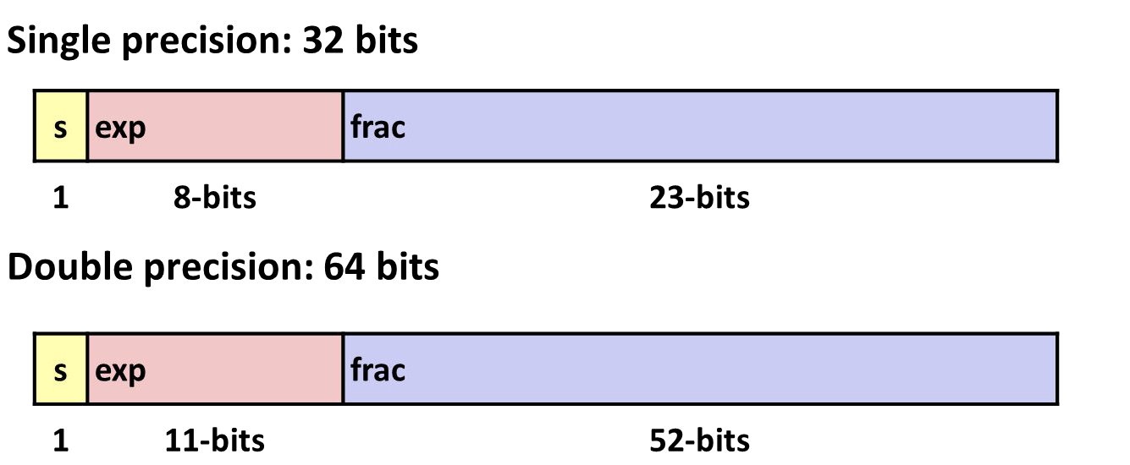
Summary
Carnegie Mellon
IEEE Floating Point has clear mathematical properties
Represents numbers of form M x 2E
One can reason about operations independent of implementation
  As if computed with perfect precision and then rounded
Not the same as real arithmetic
  Violates associativity/distributivity
  Makes life difficult for compilers & serious numerical applications programmers

Slide 58
Additional Slides
Carnegie Mellon

Slide 59
Creating Floating Point Number
Carnegie Mellon
Steps
  Normalize to have leading 1
  Round to fit within fraction
s | exp | frac
1 4-bits
3-bits
Postnormalize to deal with effects of rounding
Case Study
  Convert 8-bit unsigned numbers to tiny floating point format Example Numbers
128 | 10000000
15 | 00001101
33 | 00010001
35 | 00010011
138 | 10001010
63 | 00111111

Slide 60
Normalize
Carnegie Mellon
s | exp | frac
1 4-bits
3-bits
Requirement
Set binary point so that numbers of form 1.xxxxx
Adjust all to have leading one
  Decrement exponent as shift left ValueBinary Fraction Exponent
128 | 10000000 | 1.00000007
15 | 00001101 | 1.10100003
17 | 00010001 | 1.00010004
19 | 00010011 | 1.00110004
138 | 10001010 | 1.00010107
63 | 00111111 | 1.11111005

Slide 61
Rounding
Carnegie Mellon
1.BBGRXXX
Guard bit: LSB of result
Sticky bit: OR of remaining bits
Round bit: 1st bit
removed
Round up conditions
  Round = 1, Sticky = 1 ➙ > 0.5
  Guard = 1, Round = 1, Sticky = 0 ➙ Round to even ValueFraction GRS Incr? Rounded
128 | 1.0000000 | 000 N | 1.000
15 | 1.1010000 | 100 N | 1.101
17 | 1.0001000 | 010 N | 1.000
19 | 1.0011000 | 110 Y | 1.010
138 | 1.0001010 | 011 Y | 1.001
63 | 1.1111100 | 111 Y | 10.000

Slide 62
Postnormalize
Carnegie Mellon
Issue
  Rounding may have caused overflow
  Handle by shifting right once & incrementing exponent ValueRounded Exp Adjusted Result
128 | 1.0007 | 128
15 | 1.1013 | 15
17 | 1.0004 | 16
19 | 1.0104 | 20
138 | 1.0017 | 134
63 | 10.0005 | 1.000/6 | 64

Slide 63
Interesting Numbers
Carnegie Mellon
{single,double}
Description exp frac Numeric Value
Zero 00…00 00…00 0.0
Smallest Pos. Denorm. 00…00 00…01 2^{– {23,52}} x 2^{– {126,1022}}
  Single ≈ 1.4 x 10^{–45}
  Double ≈ 4.9 x 10^{–324}
Largest Denormalized 00…00 11…11 (1.0 – ε) x 2^{– {126,1022}}
  Single ≈ 1.18 x 10^{–38}
  Double ≈ 2.2 x 10^{–308}
Smallest Pos. Normalized 00…01 00…00 1.0 x 2^{– {126,1022}}
  Just larger than largest denormalized
One 01…11 00…00 1.0
Largest Normalized
  Single ≈ 3.4 x 10³⁸
  Double ≈ 1.8 x 10³⁰⁸
11…10 11…11 (2.0 – ε) x 2^{{127,1023}}

