Slide 1
Number Sequences
?
overhang

Slide 2
This Lecture
We will study some simple number sequences and their properties.
The topics include:
Representation of a sequence
Sum of a sequence
  Arithmetic sequence
  Geometric sequence
    Applications
  Harmonic sequence
Product of a sequence
  Factorial

Slide 3
Number Sequences
In general a number sequence is just a sequence of numbers
a₁, a₂, a₃, …, a_{n} (it is an infinite sequence if n goes to infinity).
We will study sequences that have interesting patterns.
e.g. a_{i} = i
1, 2, 3, 4, 5, …
a_{i} = i²
1, 4, 9, 16, 25, …
a_{i} = 2^{i}
2, 4, 8, 16, 32, …
a_{i} = (-1)^{i}
-1, 1, -1, 1, -1, …
a_{i} = i/(i+1)
1/2, 2/3, 3/4, 4/5, 5/6, …

Slide 4
Finding General Pattern
Given a number sequence, can you find a general formula for its terms?
a₁, a₂, a₃, …, a_{n}, …
General formula
1/4, 2/9, 3/16, 4/25, 5/36, …
1/3, 2/9, 3/27, 4/81, 5/243,…
0, 1, -2, 3, -4, 5, …
1, -1/4, 1/9, -1/16, 1/25, …
a_{i} = i/(i+1)²
a_{i} = i/3^{i}
a_{i} = (i-1)·(-1)^{i}
a_{i} = (-1)^{i+1} / i²

Slide 5
Recursive Definition
We can also define a sequence by writing the relations between its terms.
e.g.
1 when i=1
a_{i} =
1, 3, 5, 7, 9, …, 2n+1, …
a_{i-1}+2 when i>1
1 when i=1
1, 2, 4, 8, 16, …, 2^{n}, …
a_{i} =
2a_{i-1} when i>1
1 when i=1 or i=2
Fibonacci sequence
a_{i} =
a_{i-1}+a_{i-2} when i>2
1, 1, 2, 3, 5, 8, 13, 21, …, ??, …
Will compute its general formula in a later lecture.

Slide 6
Proving a Property of a Sequence
What is the n-th term of this sequence?
3 when i=1
a_{i} =
(a_{i-1})² when i>1
Step 1: Computing the first few terms, 3, 9, 81, 6561, …
n
Step 2: Guess the general pattern, 3, 3², 3⁴, 3⁸, …, 3² ? ,…
Step 3: Verify it.
Check a₁=3
i-1
i
In general, assume a_{i}=3² , show that a_{i+1}=3²
i-1
i
a_{i+1} = (a_{i})² = (3² )² =3²
(We can be more formal after we learned proof by induction.)

Slide 7
This Lecture
Representation of a sequence
Sum of a sequence
  Arithmetic sequence
  Geometric sequence
    Applications
  Harmonic sequence
  (Optional) The integral method
Product of a sequence
  Factorial

Slide 8
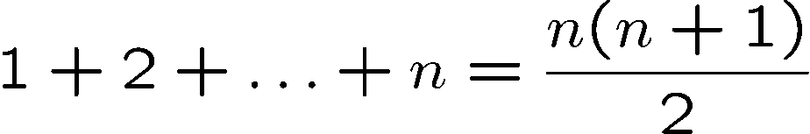
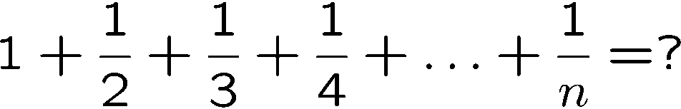
Sum of Sequences
We have seen how to prove these equalities by induction,
but how do we come up with the right hand side?

Slide 9
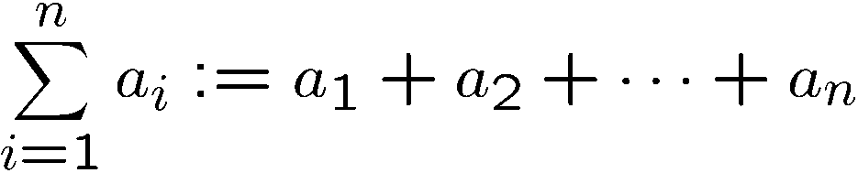
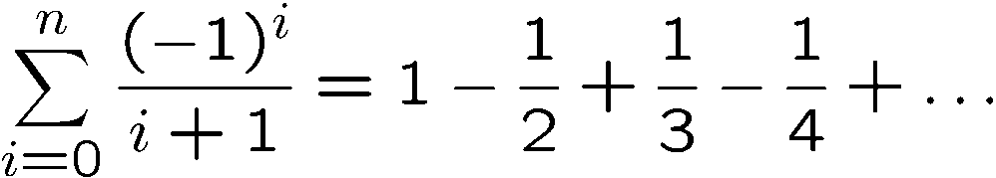
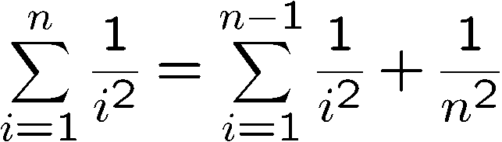
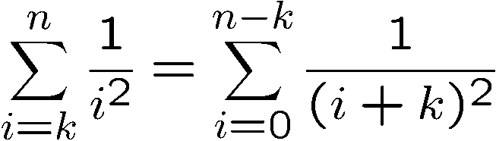
Summation
(adding or subtracting from a sequence)
(change of variable)

Slide 10
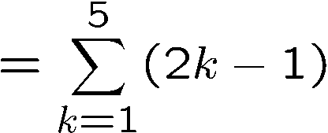
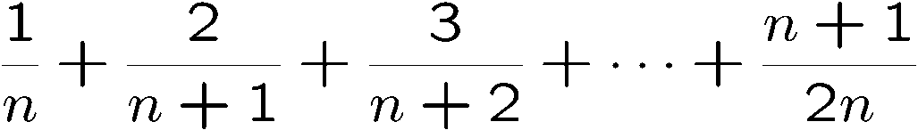
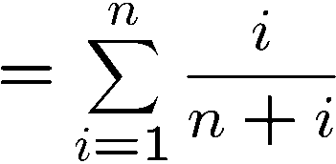
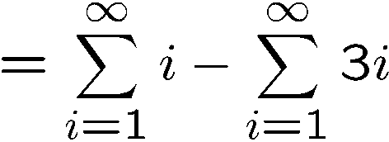
Summation
Write the sum using the summation notation.

Slide 11
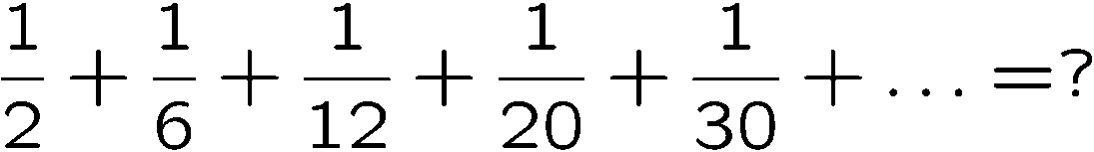

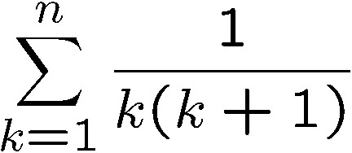
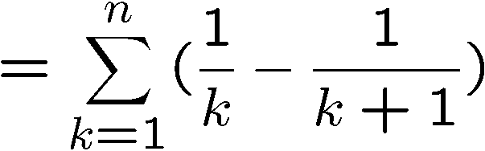
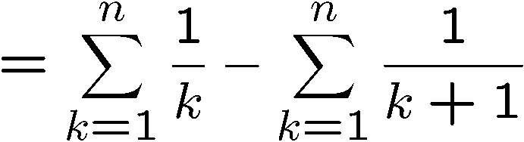
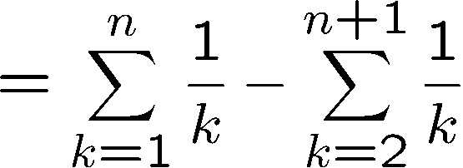
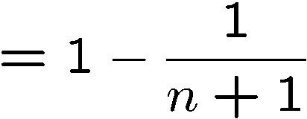
A Telescoping Sum
When do we have such closed form formulas?

Slide 12
Sum for Children
89 + 102 + 115 + 128 + 141 +
154 + ··· +
193 + ··· +
232 + ··· +
323 + ··· +
414 + ··· + 453 + 466
Nine-year old Gauss saw
30 numbers, each 13 greater than the previous one.
1st + 30th = 89 + 466 = 555
2nd + 29th =
(1st+13) + (30th−13) = 555
3rd + 28th =
(2nd+13) + (29th−13) = 555
So the sum is equal to 15x555 = 8325.

Slide 13
Arithmetic Sequence
A number sequence is called an arithmetic sequence if a_{i+1} = a_{i}+d for all i.
e.g. 1,2,3,4,5,… 5,3,1,-1,-3,-5,-7,…
What is the formula for the n-th term?
a_{i+1} = a₁ + i·d
(can be proved by induction)
What is the formula for the sum S=1+2+3+4+5+…+n?
Write the sum S = 1 + 2 + 3 + … + (n-2) + (n-1) + n
Write the sum S = n + (n-1) + (n-2) + … + 3 + 2 + 1
Adding terms following the arrows, the sum of each pair is n+1.
We have n pairs, and therefore 2S = n(n+1), and thus S = n(n+1)/2.

Slide 14
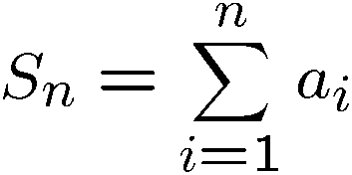

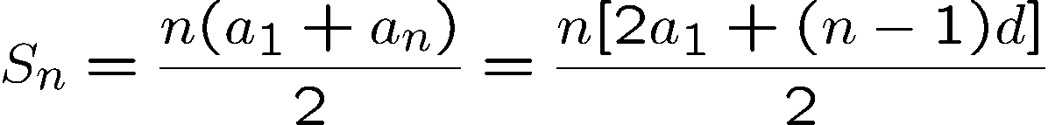
Arithmetic Sequence
A number sequence is called an arithmetic sequence if a_{i+1} = a_{i}+d for all i.
What is a simple expression of the sum?
Adding the equations together gives:
Rearranging and remembering that a_{n} = a₁ + (n − 1)d, we get:

Slide 15
This Lecture
Representation of a sequence
Sum of a sequence
  Arithmetic sequence
  Geometric sequence
    Applications
  Harmonic sequence
  (Optional) The integral method
Product of a sequence
  Factorial

Slide 16
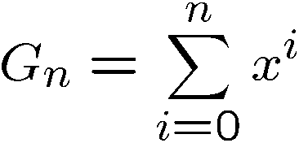
Geometric Series
What is the closed form expression of G_{n}?
G_{n}−xG_{n}=
1
− x^{n+1}

Slide 17
Infinite Geometric Series
Consider infinite sum (series)
for |x| < 1

Slide 18




Some Examples

Slide 19
This Lecture
Representation of a sequence
Sum of a sequence
  Arithmetic sequence
  Geometric sequence
    Applications
  Harmonic sequence
  (Optional) The integral method
Product of a sequence
  Factorial

Slide 20
The Value of an Annuity
Would you prefer a million dollars today
or $50,000 a year for the rest of your life?
An annuity is a financial instrument that pays out
a fixed amount of money at the beginning of
every year for some specified number of years.
Examples: lottery payouts, student loans, home mortgages.
A key question is: what is an annuity worth?
In order to answer such questions, we need to know
what a dollar paid out in the future is worth today.

Slide 21
The Future Value of Money
My bank will pay me 3% interest. define bankrate
b ::= 1.03
-- bank increases my $ by this factor in 1 year.
So if I have $X today,
One year later I will have $bX
Therefore, to have $1 after one year,
It is enough to have
b⋅X ≥ 1.
X ≥ $1/1.03 ≈ $0.9709

Slide 22
The Future Value of Money
$1 in 1 year is worth $0.9709 now.
$1/b last year is worth $1 today,
So $n paid in 2 years is worth
$n/b paid in 1 year, and is worth
$n/b² today.
$n paid k years from now
is only worth $n/b^{k} today

Slide 23
Annuities
$n paid k years from now
is only worth $n/b^{k} today
Someone pays you $100/year for 10 years.
Let r ::= 1/bankrate = 1/1.03
In terms of current value, this is worth:
100r + 100r² + 100r³ +  + 100r¹⁰
= 100r(1+ r +  + r⁹)
= 100r(1−r¹⁰)/(1−r) = $853.02

Slide 24
Annuities
I pay you $100/year for 10 years,
if you will pay me $853.02.
QUICKIE: If bankrates unexpectedly
increase in the next few years,
  You come out ahead
  The deal stays fair
  I come out ahead

Slide 25
Annuities
Would you prefer a million dollars today
or $50,000 a year for the rest of your life?
Let r = 1/bankrate
In terms of current value, this is worth:
50000 + 50000r + 50000r² + 
= 50000r(1+ r +  )/(1−r)
If bankrate = 3%, then the sum is $1716666
If bankrate = 8%, then the sum is $675000

Slide 26
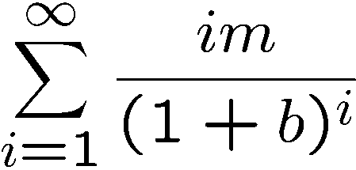
Annuities
Suppose there is an annuity that pays im dollars at the end of each year i forever.
For example, if m = $50, 000, then the payouts are $50, 000 and then $100, 000 and then $150, 000 and so on…
What is a simple closed form expression of the following sum?

Slide 27
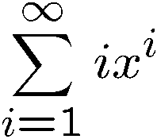

Manipulating Sums
What is a simple closed form expression of ?
(see an inductive proof in tutorial 2)

Slide 28


Manipulating Sums
for x < 1
For example, if m = $50, 000, then the payouts are $50, 000 and then $100, 000 and then $150, 000 and so on…
For example, if p=0.08, then V=8437500.
Still not infinite! Exponential decrease beats additive increase.

Slide 29
Loan
Suppose you were about to enter college today and a college loan officer offered you the following deal:
$25,000 at the start of each year for four years to pay for your college tuition and an option of choosing one of the following repayment plans:
Plan A: Wait four years, then repay $20,000 at the
start of each year for the next ten years.
Plan B: Wait five years, then repay $30,000 at the
start of each year for the next five years.
Assume interest rate 7%
Let r = 1/1.07.

Slide 30



Plan A
Plan A: Wait four years, then repay $20,000 at the
start of each year for the next ten years.
Current value for plan A

Slide 31
Plan B
Plan B: Wait five years, then repay $30,000 at the
start of each year for the next five years.
Current value for plan B

Slide 32
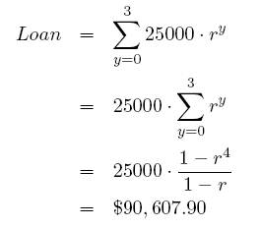
Profit
$25,000 at the start of each year for four years
to pay for your college tuition.
Loan office profit = $3233.

Slide 33
This Lecture
Representation of a sequence
Sum of a sequence
  Arithmetic sequence
  Geometric sequence
    Applications
  Harmonic sequence
  (Optional) The integral method
Product of a sequence
  Factorial

Slide 34
Book Stacking
How far out?
?
overhang

Slide 35
One Book
book center
of mass

Slide 36
One Book
book center
of mass

Slide 37
One Book
book center
of mass
1
2

Slide 38
More Books
1
How far can we reach?
2
To infinity??
n

Slide 39
More Books
1
2
n
center
of mass

Slide 40
More Books
need
center of mass
over table
1
2
n

Slide 41
More Books
1
2
center of mass
of the whole stack
n

Slide 42
Overhang
1
2
center of mass
of all n+1 books
at table edge
center of mass of top n books at edge of book n+1
n
n+1
center of mass
of the new book
∆overhang

Slide 43
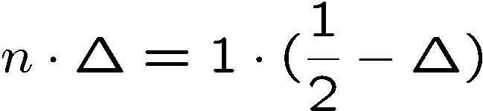
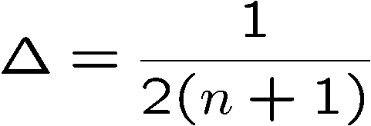
Overhang
n
1
}
1/2
center of n-stack at x = 0.
center of n+1st book is at x = 1/2,
so center of n+1-stack is at

Slide 44
Overhang
1
2
center of mass
of all n+1 books
center of mass of top n books
n
n+1
1/2(n+1)

Slide 45
Overhang
B_{n} ::= overhang of n books
B₁ = 1/2
B_{n+1} = B_{n} +
B_{n} =
n^{th} Harmonic number
B_{n} = H_{n}/2

Slide 46

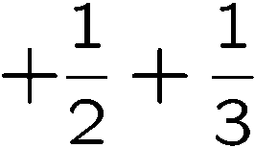
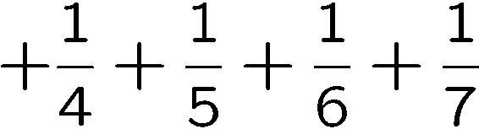
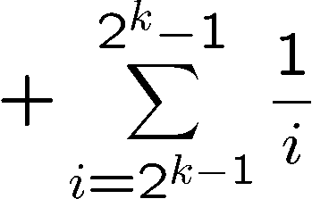
Harmonic Number
How large is
?
1 number
2 numbers, each <= 1/2 and > 1/4
Row sum is <= 1 and >= 1/2
4 numbers, each <= 1/4 and > 1/8
Row sum is <= 1 and >= 1/2
…
2^{k} numbers, each <= 1/2^{k} and > 1/2^{k+1}
Row sum is <= 1 and >= 1/2
…
The sum of each row is <=1 and >= 1/2.

Slide 47
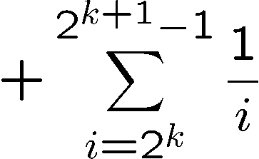
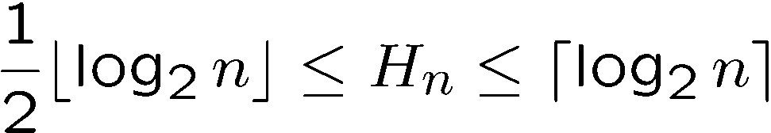
Harmonic Number
How large is
?
k rows have 2^{k}-1 numbers.
If n is between 2^{k}-1 and 2^{k+1}-1,
there are >= k rows and <= k+1 rows,
and so the sum is at least k/2
and is at most (k+1).
…
…
The sum of each row is <=1 and >= 1/2.

Slide 48
Harmonic Number
1
Estimate H_{n}:
1
x+1
1
2
1
3
1
1
2
1
3
0 1 2 3 4 5 6 7 8

Slide 49
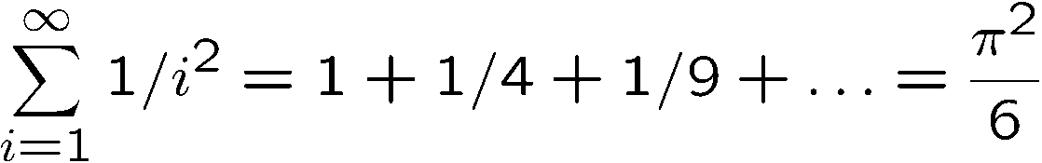
Integral Method (OPTIONAL)
Now H_{n} → ∞ as n → ∞, so
Harmonic series can go to infinity!
Amazing equality
http://www.answers.com/topic/basel-problem
Proofs from the book, M. Aigner, G.M. Ziegler, Springer

Slide 50

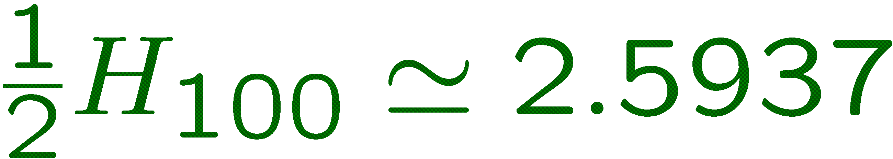
Optimal Overhang?
(slides by Uri Zwick)
Towers
Shield
Spine

Slide 51
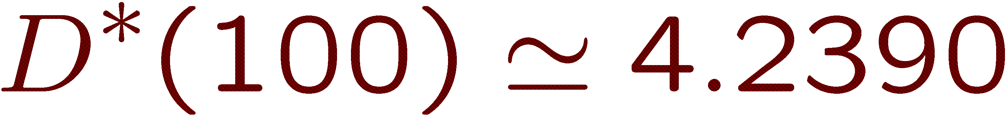
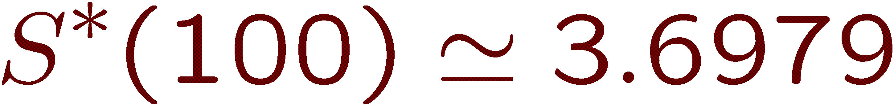
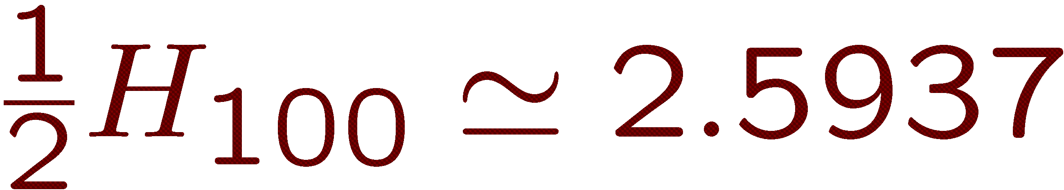
Optimal Overhang?
(slides by Uri Zwick)
Weight = 100
Blocks = 49
Overhang = 4.2390

Slide 52
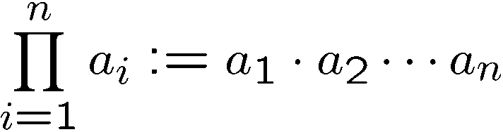
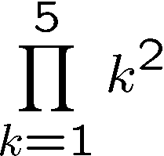
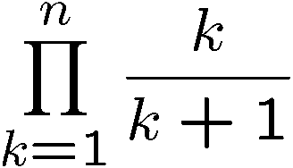
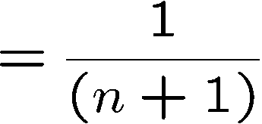
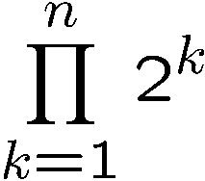

Product

Slide 53
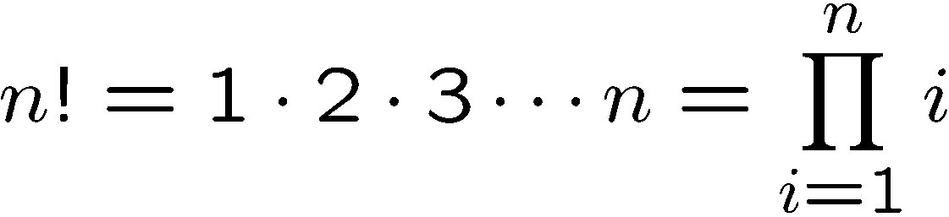
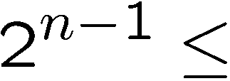

Factorial
Factorial defines a product:
How to estimate n!?
Too rough…

Slide 54
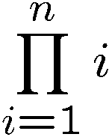
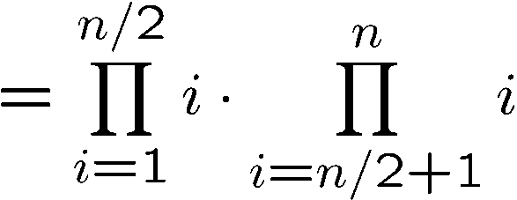
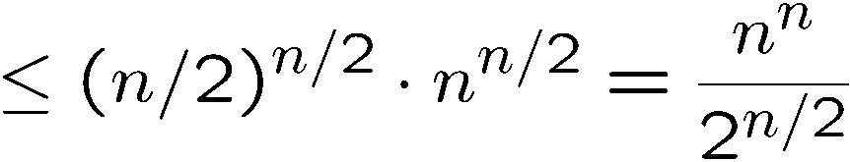

Factorial
Factorial defines a product:
How to estimate n!?
Still very rough, but at least show that it is much larger than C^{n}

Slide 55
Factorial
Factorial defines a product:
How to estimate n!?
Turn product into a sum taking logs:
ln(n!) = ln(1·2·3 ··· (n – 1)·n)
= ln 1 + ln 2 + ··· + ln(n – 1) + ln(n)

Slide 56
Integral Method (OPTIONAL)
ln n
ln (x)
ln (x+1)
ln 5
ln 4
ln 3
ln
n-1
ln n
ln 5
ln 2
ln 4
…
ln 3
ln 2
1
2
3
4
5
n–2
n–1
n

Slide 57
Analysis (OPTIONAL)
n
n
n
⇩ ln(x) dx  ∑ ln(i)   ln (x+1)dx
1
i=1
0
Reminder:
n ln(n/e)  ∑ ln(i)  (n+1) ln((n+1)/e)
so guess:

Slide 58
Stirling’s Formula
exponentiating:
Stirling’s formula:

Slide 59
More Integral Method
What is a simple closed form expressions of ?
Idea: use integral method.
So we guess that
Make a hypothesis

Slide 60

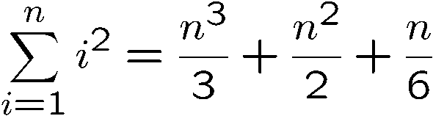
Sum of Squares
Make a hypothesis
Plug in a few value of n to determine a,b,c,d.
Solve this linear equations gives a=1/3, b=1/2, c=1/6, d=0.
Go back and check by induction if

Slide 61
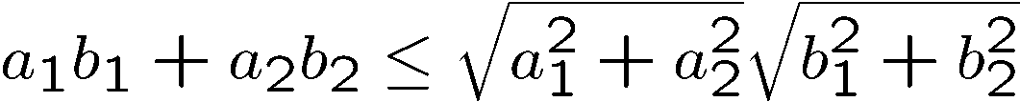



Cauchy-Schwarz
(Cauchy-Schwarz inequality) For any a1,…,an, and any b1,…bn
Proof by induction (on n):
When n=1, LHS <= RHS.
When n=2, want to show
Consider

Slide 62

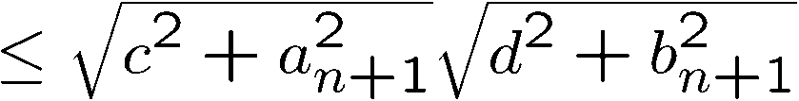
Cauchy-Schwarz
(Cauchy-Schwarz inequality) For any a1,…,an, and any b1,…bn
Induction step: assume true for <=n, prove n+1.
induction
by P(2)

Slide 63
Cauchy-Schwarz
(Cauchy-Schwarz inequality) For any a1,…,an, and any b1,…bn
Exercise: prove
Answer: Let b_{i} = 1 for all i, and plug into Cauchy-Schwarz
This has a very nice application in graph theory that hopefully we’ll see.

Slide 64

Geometric Interpretation
(Cauchy-Schwarz inequality) For any a1,…,an, and any b1,…bn
The left hand side computes the inner
product of the two vectors
If we rescale the two vectors to be of
length 1, then the left hand side is <= 1
The right hand side is always 1.
a
b

Slide 65
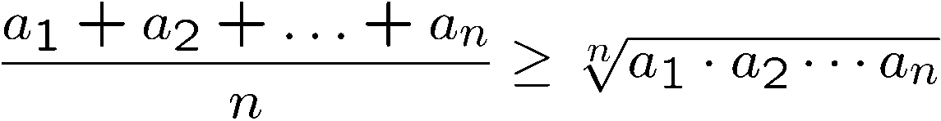
Arithmetic Mean – Geometric Mean Inequality
(AM-GM inequality) For any a1,…,an,
Interesting induction (on n):
Prove P(2)
Prove P(n) -> P(2n)
Prove P(n) -> P(n-1)

Slide 66
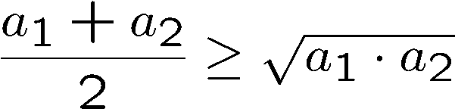
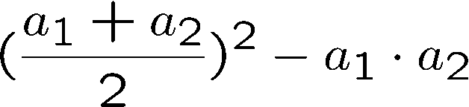


Arithmetic Mean – Geometric Mean Inequality
(AM-GM inequality) For any sequence of non-negative numbers a1,…,an,
Interesting induction (on n):
Prove P(2)
Want to show
Consider

Slide 67





Arithmetic Mean – Geometric Mean Inequality
(AM-GM inequality) For any sequence of non-negative numbers a1,…,an,
Interesting induction (on n):
Prove P(n) -> P(2n)
induction
by P(2)

Slide 68



Arithmetic Mean – Geometric Mean Inequality
(AM-GM inequality) For any sequence of non-negative numbers a1,…,an,
Interesting induction (on n):
Prove P(n) -> P(n-1)
Let
the average of the first n-1 numbers.

Slide 69



Arithmetic Mean – Geometric Mean Inequality
(AM-GM inequality) For any sequence of non-negative numbers a1,…,an,
Interesting induction (on n):
Prove P(n) -> P(n-1)
Let

Slide 70

Geometric Interpretation
(AM-GM inequality) For any sequence of non-negative numbers a1,…,an,
Think of a1, a2, …, an are the side lengths of a high-dimensional rectangle.
Then the right hand side is the volume of this rectangle.
The left hand side is the volume of the square with the same total side length.
The inequality says that the volume of the square is always not smaller.
e.g.

Slide 71

Arithmetic Mean – Geometric Mean Inequality
(AM-GM inequality) For any sequence of non-negative numbers a1,…,an,
Exercise: What is an upper bound on
?
Set a₁=n and a₂=…=a_{n}=1, then the upper bound is 2 – 1/n.
Set a₁=a₂=√n and a₃=…=a_{n}=1, then the upper bound is 1 + 2/√n – 2/n.
…
Set a₁=…=a_{logn}=2 and a_{i}=1 otherwise, then the upper bound is 1 + log(n)/n

