Slide 1
Operating Systems
Week 5 Lecture/Discussion 5
Junaid Abdul Wahid cture 0 - Introduction

Slide 2
Previous
  Scheduling Algorithms (FCFS- SJF)

Slide 3
Today Discussion
  Continue Scheduling Algorithms

Slide 4
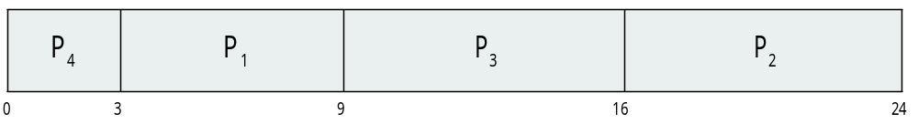
Example of SJF
Process Burst Time
P₁ 6
P₂ 8
P₃ 7
P₄ 3
SJF scheduling chart
Average waiting time = (3 + 16 + 9 + 0) / 4 = 7

Slide 5
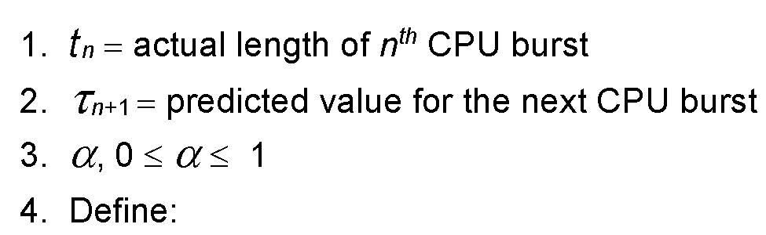

Determining Length of Next CPU Burst
Can only estimate the length – should be similar to the previous one
  Then pick process with shortest predicted next CPU burst
Can be done by using the length of previous CPU bursts, using exponential averaging
Commonly, α set to ½

Slide 6
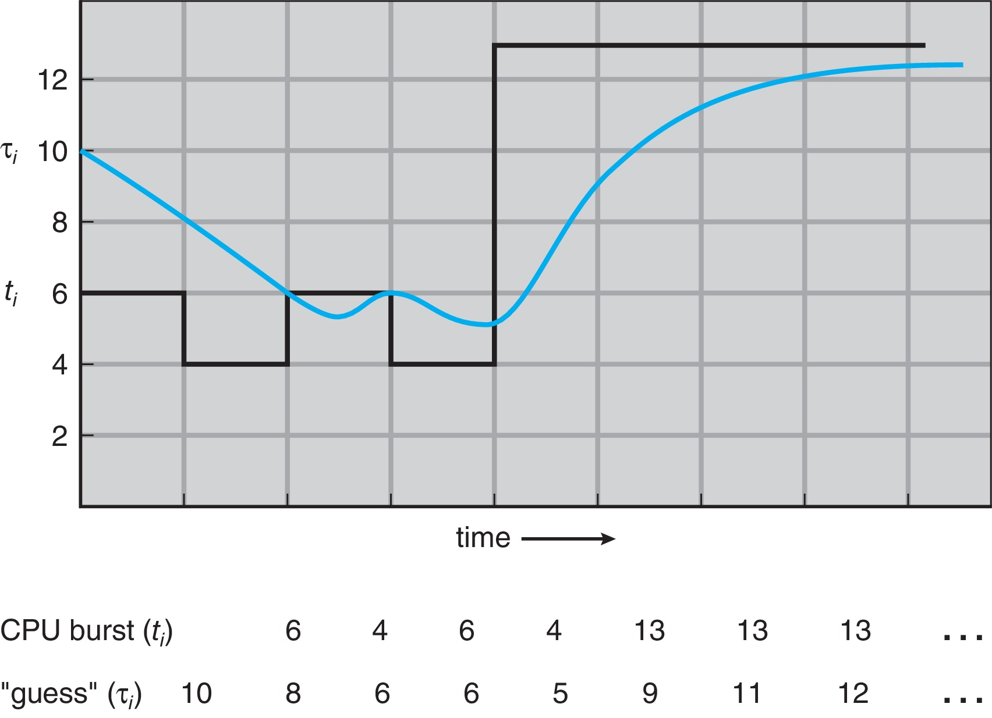
Prediction of the Length of the Next CPU Burst

Slide 7
Examples of Exponential Averaging
α =0
  τ_{n+1} = τ_{n}
  Recent history does not count
α =1
  τ_{n+1} = α t_{n}
  Only the actual last CPU burst counts
If we expand the formula, we get:
    τ_{n+1} = α t_{n}+(1 - α)α t_{n} ₋₁ + …
    +(1 - α )^{j} α t_{n} _{-j} + …
    +(1 - α )^{n +1} τ₀
Since both α and (1 - α) are less than or equal to 1, each successor predecessor term has less weight than its predecessor

Slide 8
Shortest Remaining Time First Scheduling
Preemptive version of SJN
Whenever a new process arrives in the ready queue, the decision on which process to schedule next is redone using the SJN algorithm.
Is SRT more “optimal” than SJN in terms of the minimum average waiting time for a given set of processes?

Slide 9

Example of Shortest-remaining-time-first
Now we add the concepts of varying arrival times and preemption to the analysis
Process i Arrival TimeT Burst Time
P₁ 0 8
P₂ 1 4
P₃ 2 9
P₄ 3 5
Preemptive SJF Gantt Chart
Average waiting time = [(10-1)+(1-1)+(17-2)+(5-3)]/4 = 26/4 = 6.5

