Slide 1
Operating Systems
Lecture 0 - Introduction

Slide 2
Welcome！
▶ Welcome to the course of Operating system
▶ In this lecture we will:
▶ Discuss some key administrative issues.
▶ Describe what we’re going to do in this course
and overview of Operating Systems

Slide 3
Teaching Staff
▶ Dr. Junaid Abdul Wahid (PhD in Software Engineering)
▶ Email: junaid_wahid@zzu.edu.cn
▶ Research Directions: Data Science, AI, NLP, Multimodal
▶ If you have any questions regarding this course and cannot find the answer everywhere
▶ Use the discussion group (will tell later)
▶ For personal issues, please send me an email with [PP] in subject line.

Slide 4
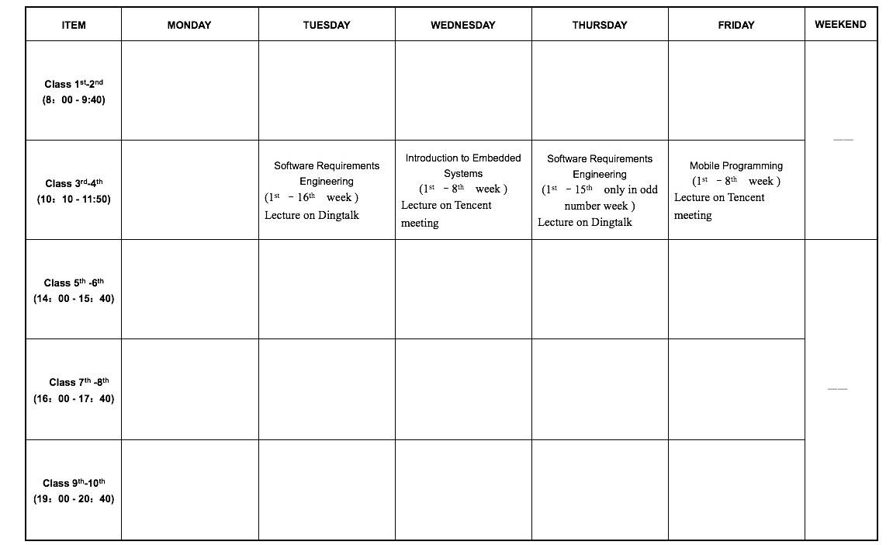
Schedule
Lecture
▶ Lectures are held every Tuesday and Thursday.
▶ Discussion session will be scheduled on Thursday.
Lecture/ Discussion

Slide 5
Academic Honesty
▶ Plagiarism
▶ Using another person’s ideas, designs, words or works without
appropriate acknowledgment.
▶ Collusion
▶ Another person assisting in the production of an assessment submission without the express requirement, or consent, or knowledge of the assessor.
Do not submit any work or part there of which is not yours.
Do not submit any work for which you have received unfair assistance.

Slide 6
Academic Honesty
▶ Assignment work helps to develop your understanding and ability to apply techniques.
▶ The best way to avoid the need to plagiarize is to start
preparing your assignments early. Don’t let your work get
on top of you.
DOs and DON’Ts
DO your own work.
DON’T copy others’ work.
DON’T let others to copy your work.
DO feel free to discuss problems with your friends.
DO seek help from lecturer when stuck.
DO start your assignments early.

Slide 7
Late submission policy
▶ You should hand your coursework in on time.
▶ If you hand in your work late, your mark will be capped based on how many days late it is:
▶ 1 day late- mark capped at 75%
▶ 2 day late- mark capped at 50%
▶ 3 day late- mark capped at 25%
▶ More than 3 days late- no marks available
▶ Hand in early!

Slide 8
Important!
▶ Email is a formal communication method. Please check the contents before sending your emails out. Do NOT flood the other's mailbox.
▶ Please check the requirements for assignments carefully. Especially
for the file type and submission time.
▶ Do NOT directly copy and paste the contents that you find anywhere else. For all diagrams and figures from other resources, please put careful references.
▶ If you want to apply for assignment extension, please send me emails with supporting document and state clearly how long do you need. Do NOT apply for extension on the last day.

Slide 9
IF YOU DON’T DO THE WORK YOU WON’T
HAVE THE KNOWLEDGE AND YOU WON’T PASS THE COURSE

Slide 10
About This Course
Basic information about the course
Course Category: Compulsory courses for discipline and professional courses
Credits: 64 hours in total, 4 credits
Course content
It mainly teaches the basic principles of operating systems, i.e., chapters 1 to 13 of the textbook
Methodology for assessing grades
70% final exam score and 30% usual grade
Usual grades include: homework, experiments, classes, and attendance

Slide 11
Textbook & References
Abraham Silberschatz．Applied Operating System Concepts．Higher Education Press, 2001,5

Slide 12
Lecture Format
Help you understand important OS concepts
Lectures do not cover everything
  Not all questions in homework or exams are from lectures
Students responsibility
  Attend lectures
  Read textbooks
  Homework, Experiments, Exam

Slide 13
Course Outline 1-8 (Overview and Process Management)
▶ Week 1: Introduction to Operating System (OS)
▶ Week 2: Design and Construction of OS
▶ Week 3: Features of OS
▶ Week 4: Process Scheduling and Interprocess Communication
▶ Week 5: Process Synchronization
▶ Week 6: Deadlock Handling
▶ Week 7-8: Discussion of Threads

Slide 14
Course Outline(9-15) (Storage Management , Protection and Security)
▶ Week 9: Memory Management of OS
▶ Week 10: Virtual Memory
▶ Week 11: File Systems
▶ Week 12: I/O Systems
▶ Week 13: Mass Storage Structure
▶ Week 14: Protection
▶ Week 15: Security
▶ Week 16: Overall Course Discussion and Q/A

Slide 15
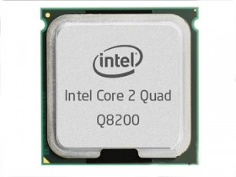
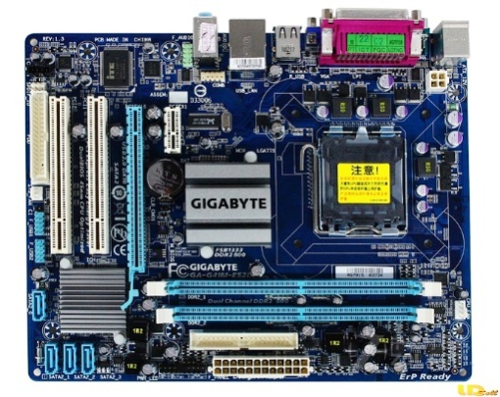
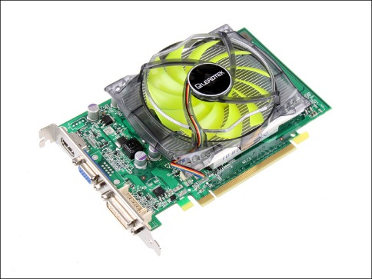
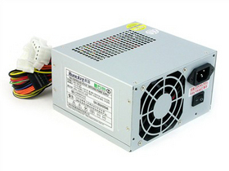
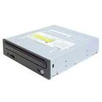
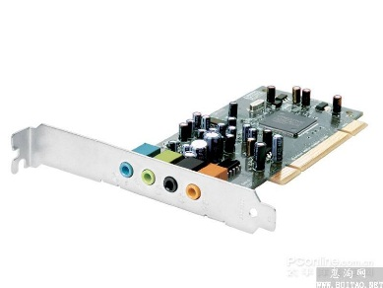
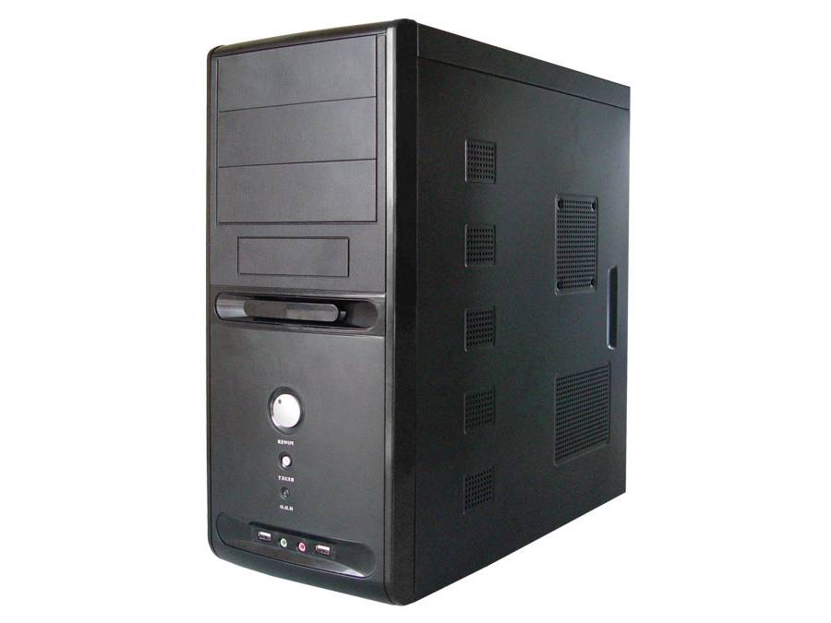
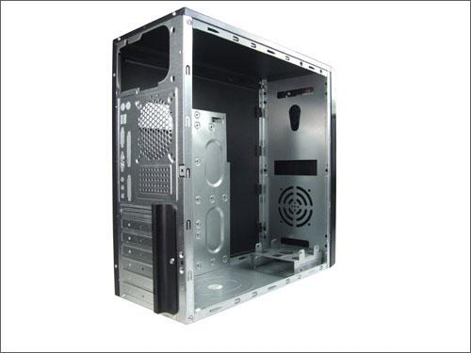
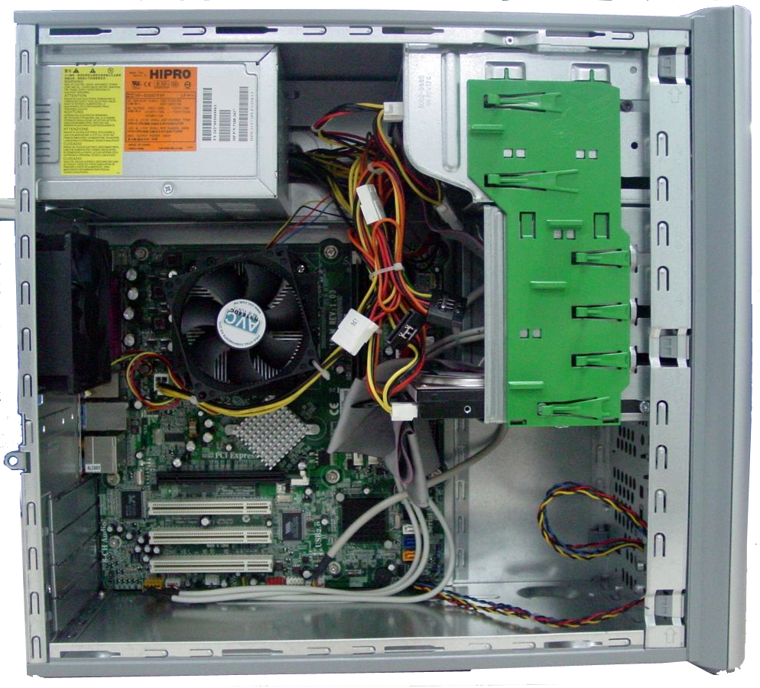
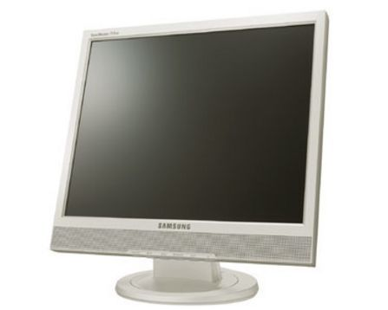
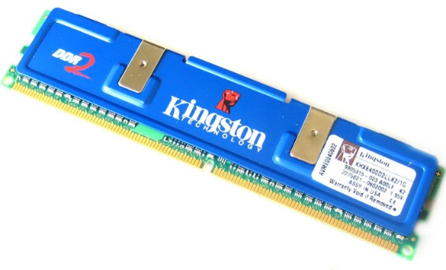
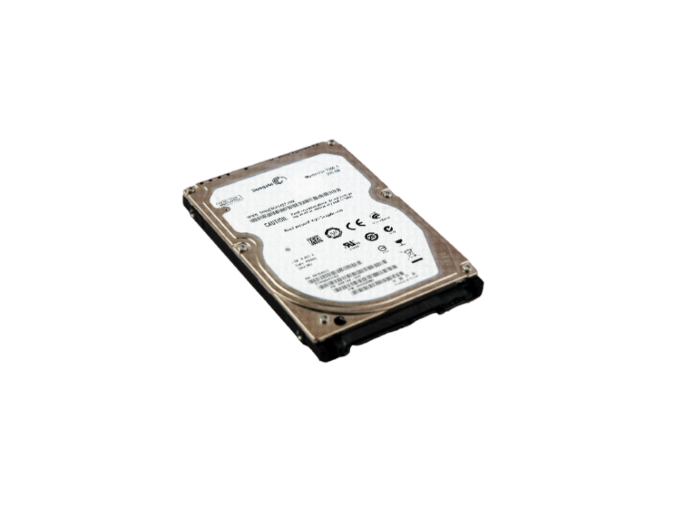
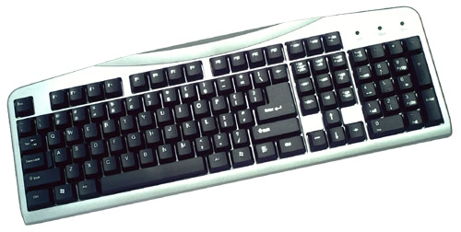

After the hardware is assembled, connect the monitor, keyboard, mouse, plug in the power supply, and now, can this computer be used normally? Why?
CPU
Video card
power
motherboard
CD-ROM
Hardware systems alone will not work
The software system must also be installed 。
Sound
card
memory
display
case
Rigid disk
keyboard
mouse
Notes:
讲课之前，我们先聊聊计算机。
我们见过计算机吧？谁能说说计算机长什么样子？也就是计算机的主要组成？显示器、键盘、鼠标和一台主机箱。
主机箱里都有什么呢？CPU、主板、内存、硬盘、光驱、声卡、显卡和电源。
硬件组装好以后，再连接上显示器、键盘、鼠标，插上电源，现在，这台计算机可以正常使用用了吗？为什么？
只有硬件系统是不行的，还必须安装上软件系统

Slide 16
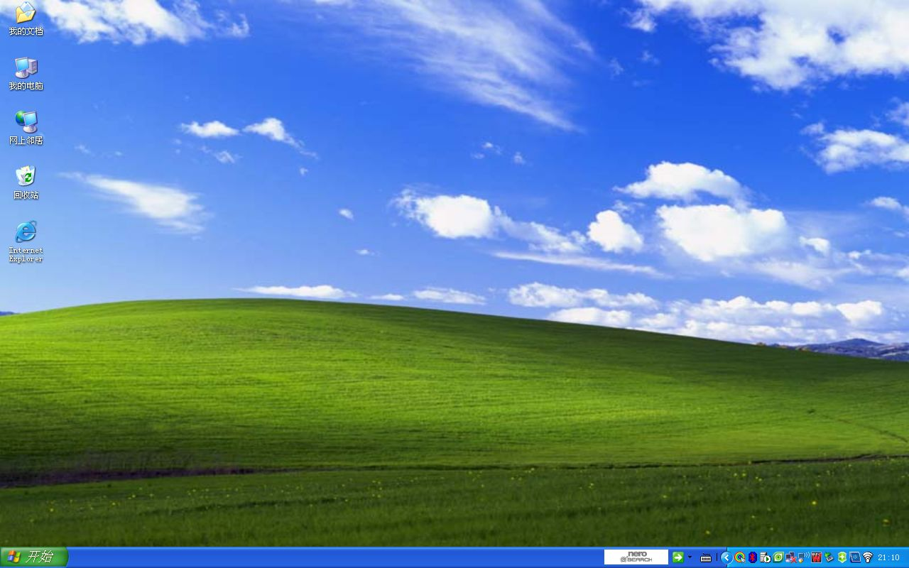
Q1: Is the operating system application software or system software?
system software
Windows XP

Slide 17
TOPIC：how does the operating system make a program run?

Slide 18
Chapter 1: Introduction
What is an Operating System?
History of Operating Systems
The Operating System Zoo
Notes:
An operating system mediates among application programs, utilities, and users, on the one hand, and the computer system hardware on the other.
To appreciate the functionality of the operating system and the design issues involved, one must have some appreciation for computer organization and architecture.
This chapter provides a brief survey of the basic elements of a computer system including
the processor,
memory, and
Input/Output (I/O)

Slide 19
What is an Operating System?
There are a lot of definitions.
Do you know?

Slide 20
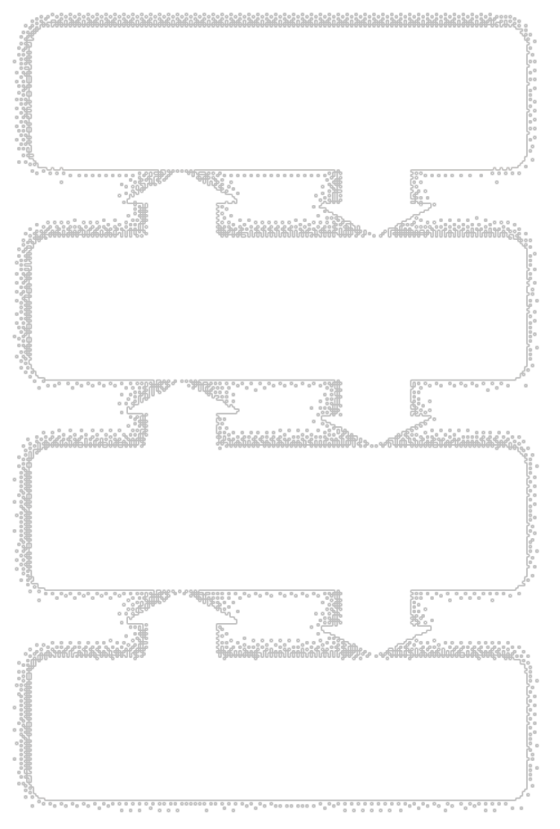
Definition from Wikipedia
An operating system (OS) is an interface between hardware and applications; it is responsible for the management and coordination of activities and the sharing of the limited resources of the computer.
Notes:
操作系统的定义有很多，ppt上是维基百科对操作系统的定义。
So,An operating system (OS) exploits the hardware resources of one or more processors to provide a set of services to system users.
The OS also manages secondary memory and I/O (input/output) devices on behalf of its users.
Accordingly, it is important to have some understanding of the underlying computer system hardware before we begin our examination of operating systems.
Many areas introduced in this chapter are covered in more depth later.

Slide 21
Computer System Components
1. Hardware – provides basic computing resources (CPU, memory, I/O devices).
2. Operating system – controls and coordinates the use of the hardware among the various application programs for the various users.
3. Application programs– define the ways in which the system resources are used to solve the computing problems of the users (compilers, database systems, video games, business programs).
4. Users (people, machines, other computers)
Notes:
At a top level, a computer consists of processor, memory, and I/O components, with one or more modules of each type.
These components are interconnected in some fashion to achieve the main function of the computer, which is to execute programs.
在一个计算机系统中，通常都含有多种硬件和软件资源。归纳起来可将这些资源分为四类：处理机、存储器、I/O设备以及文件(数据和程序)。相应地，OS的主要功能也正是对这四类资源进行有效的管理。处理机管理是用于分配和控制处理机；存储器管理主要负责内存的分配与回收；I/O设备管理是负责I/O设备的分配(回收)与操纵；文件管理是用于实现对文件的存取、共享和保护。可见，OS的确是计算机系统资源的管理者。

Slide 22
What is an Operating System?
a program that acts as an intermediary between a user of a computer and the computer hardware.
Operating system purpose:
  Provide an environment in which a user can execute programs.
Operating system goals:
  Make the computer system convenient to use(Convenience).
  Use the computer hardware in an efficient manner(Efficiency).
Notes:
OS作为用户与计算机硬件系统之间接口的含义是：OS处于用户与计算机硬件系统之间，用户通过OS来使用计算机系统。或者说，用户在OS帮助下能够方便、快捷、可靠地操纵计算机硬件和运行自己的程序。

Slide 23
Definitions of an Operating System
Resource allocator – manages and allocates resources.
Control program– controls the execution of user programs and operations of I/O devices . Kernel – the one program running at all times (all else being application programs).

Slide 24
Our Traditional Definition
A set of programs that control and manage computer hardware and software, and organize computer's workflow so as to make the computer system convenient for users to use reasonably and efficiently.
Notes:
Traditional Definition

Slide 25
Operating System Goals
Manage system resources to make them utilized and shared effectively.
Organize computer’s workflow reasonably in order to improve system performance (response time /throughput).
Provide user interfaces to simplify user operations.
(Convenience、Efficiency、Scalability、Open)
Notes:
An OS is a program that controls the execution of application programs and acts as an interface between applications and the computer hardware.
It can be thought of as having three objectives:
Convenience:
An OS makes a computer more convenient to use.
Efficiency:
An OS allows the computer system resources to be used in an efficient manner.
Ability to evolve:
An OS should be constructed in such a way as to permit the effective development, testing, and introduction of new system functions without interfering with service.

Slide 26
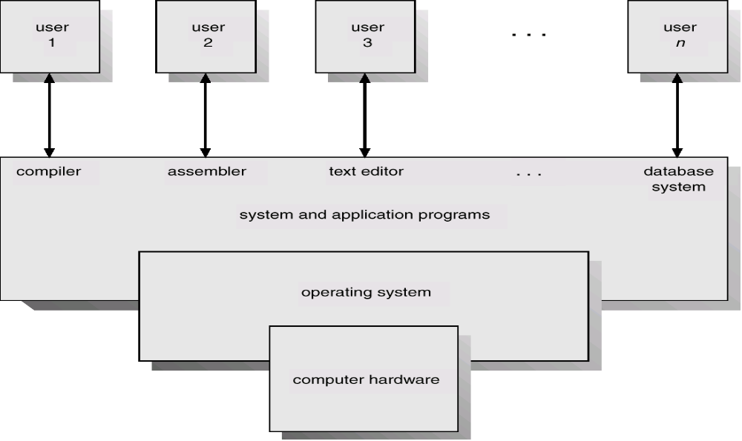
Abstract View of System Components
Virtual machine Bare metal becomes a more powerful machine with each additional layer of software, and this "new more powerful machine" is often referred to as a "virtual machine"
Virtual machine： After each additional layer of software, a bare machine becomes a more powerful machine.
This "new and more powerful machine" is usually called a "virtual machine"
Notes:
对于一台完全无软件的计算机系统(即裸机)，由于它向用户提供的仅是硬件接口(物理接口)，因此，用户必须对物理接口的实现细节有充分的了解，这就致使该物理机器难于广泛使用。为了方便用户使用I/O设备，人们在裸机上覆盖上一层I/O设备管理软件，如图1-2所示，由它来实现对I/O设备操作的细节，并向上将I/O设备抽象为一组数据结构以及一组I/O操作命令，如read和write命令，这样用户即可利用这些数据结构及操作命令来进行数据输入或输出，而无需关心I/O是如何具体实现的。
Virtual machine 裸机在每增加一层软件后，就成为一个功能更强的机器，通常将这个“新的功能更强的机器”称为“虚拟机”
The hardware and software used in providing applications to a user can be viewed in a layered or hierarchical fashion, as depicted here.
The user of those applications, the end user, generally is not concerned with the details of computer hardware.
The end user views a computer system in terms of a set of applications.
An application can be expressed in a programming language and is developed by an application programmer.
If one were to develop an application program as a set of machine instructions that is completely responsible for controlling the computer hardware, one would be faced with an overwhelmingly complex undertaking.
The most important collection of system programs comprises the OS.
The OS masks the details of the hardware from the programmer and provides the programmer with a convenient interface for using the system.
It acts as mediator, making it easier for the programmer and for application programs to access and use those facilities and services.

Slide 27
Summary
  OS is system software, residing between computer hardware and the other software or users in the system
  OS provides the interfaces for the users and application programs to use computer software and hardware resources conveniently
  it also efficiently manages and controls hardware resources, such as CPU, memory, and I/O devices, to maximize the utilization of these resources.

Slide 28
Summary
OS as user-machine interaction:
  for persons, GUI, MMI, Touch, and other(e.g. audio, video) man-machine interfaces
  for system programs or applications, system calls (API) provided by OS

Slide 29
Commonly acknowledged classifications of OS
  PC/Desktop OS :
  Windows, Linux，Mac OS X
  Server OS :
  Unix, Linux, Windows NT
  Mainframe OS :
  Unix, Linux——open source！！
  Embedded OS :
  Vxworks, (Palm OS), (Symbian),
  (WinCE)/Windows Mobile/Phone/RT, Android, iOS,
  embedded Linux (e.g. μcLinux)

