Slide 1
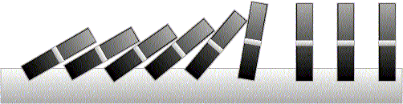
Induction

Slide 2
This Lecture
Last time we have discussed different proof techniques.
This time we will focus on probably the most important one
– mathematical induction.
This lecture’s plan is to go through the following:
The idea of mathematical induction
Basic induction proofs (e.g. equality, inequality, property,etc)
An interesting example
A paradox

Slide 3


Odd Powers Are Odd
Fact: If m is odd and n is odd, then nm is odd.
Proposition: for an odd number m, m^{k} is odd for all non-negative integer k.
Let P(i) be the proposition that m^{i} is odd.
Idea of induction.
P(1) is true by definition.
P(2) is true by P(1) and the fact.
P(3) is true by P(2) and the fact.
P(i+1) is true by P(i) and the fact.
So P(i) is true for all i.

Slide 4
Divisibility by a Prime
Theorem. Any integer n > 1 is divisible by a prime number.
Let n be an integer.
If n is a prime number, then we are done.
Otherwise, n = ab, both are smaller than n.
If a or b is a prime number, then we are done.
Otherwise, a = cd, both are smaller than a.
If c or d is a prime number, then we are done.
Otherwise, repeat this argument, since the numbers are
getting smaller and smaller, this will eventually stop and
we have found a prime factor of n.
Idea of induction.

Slide 5
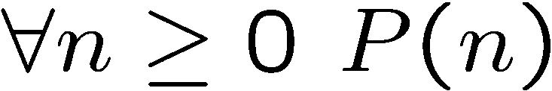
Idea of Induction
Objective: Prove
This is to prove
The idea of induction is to first prove P(0) unconditionally,
then use P(0) to prove P(1)
then use P(1) to prove P(2)
and repeat this to infinity…

Slide 6
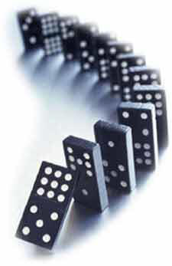
The Induction Rule
0 and (from n to n +1),
proves 0, 1, 2, 3,….
P (0), P (n)P (n+1)
∀m∈N. P (m)
Much easier to prove with P(n) as an assumption.
Very easy to prove
For any n>=0
Like domino effect…

Slide 7
This Lecture
The idea of mathematical induction
Basic induction proofs (e.g. equality, inequality, property,etc)
An interesting example
A paradox

Slide 8
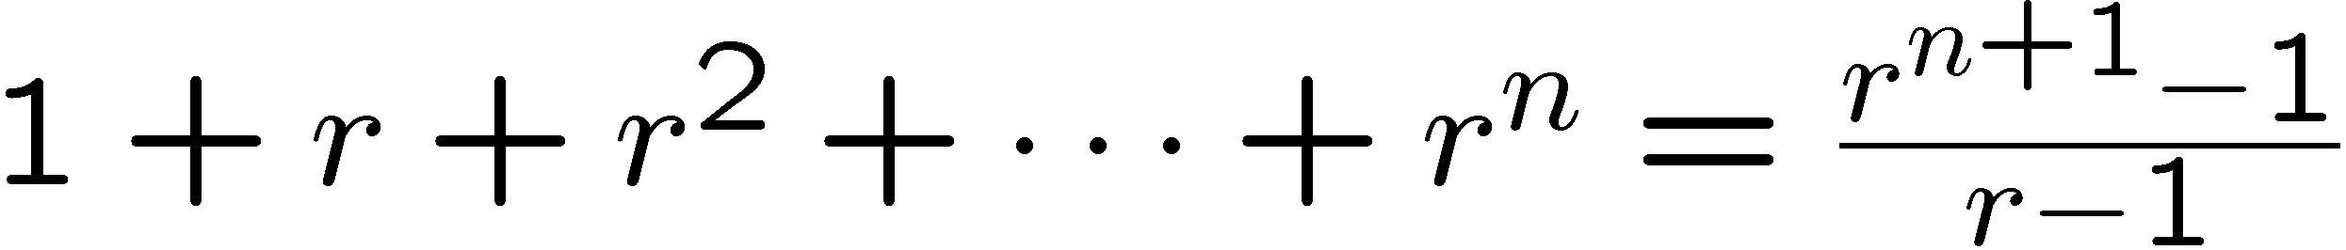
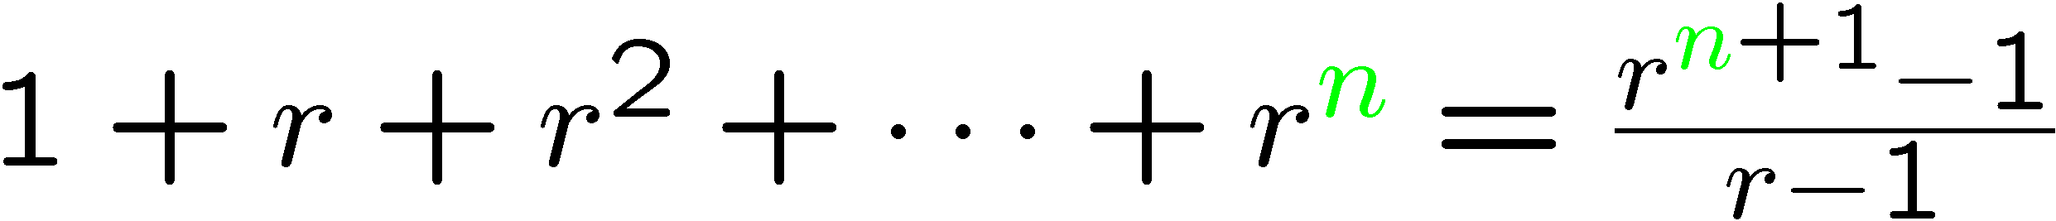
Proof by Induction
Let’s prove:
Statements in green form a template for inductive proofs.
Proof: (by induction on n)
The induction hypothesis, P(n), is:

Slide 9
Proof by Induction
Induction Step: Assume P(n) for some n ≥ 0 and prove P(n + 1):
Have P (n) by assumption:
So let r be any number  1, then from P (n) we have
How do we proceed?

Slide 10
Proof by Induction
adding r ^{n+1} to both sides,
But since r  1 was arbitrary, we conclude (by UG), that
which is P (n+1). This completes the induction proof.

Slide 11
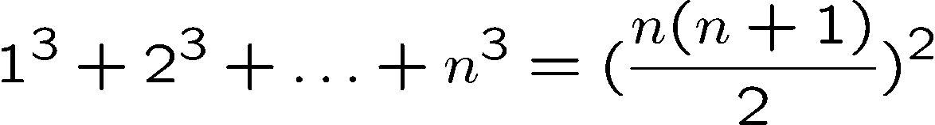

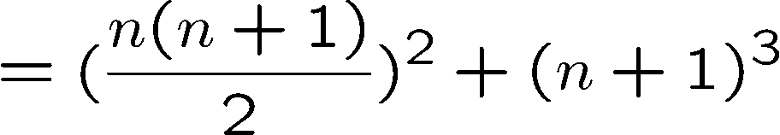

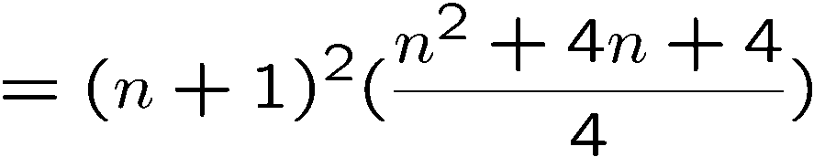
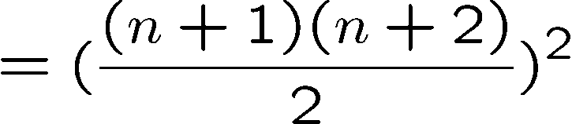
Proving an Equality
Let P(n) be the induction hypothesis that the statement is true for n.
Base case: P(1) is true
Induction step: assume P(n) is true, prove P(n+1) is true.
by induction

Slide 12






Proving a Property
Base Case (n = 1):
Induction Step: Assume P(i) for some i ≥ 1 and prove P(i + 1):
Assume
is divisible by 3, prove
Is divisible by 3.
Divisible by 3
Divisible by 3 by induction

Slide 13





Proving a Property
Base Case (n = 2):
Induction Step: Assume P(i) for some i ≥ 2 and prove P(i + 1):
Assume
is divisible by 6
Prove
is divisible by 6.
Divisible by 6
by induction
Divisible by 2
by case analysis

Slide 14









Proving an Inequality
Base Case (n = 3):
Induction Step: Assume P(i) for some i ≥ 3 and prove P(i + 1):
Assume
, prove
by induction
since i >= 3

Slide 15
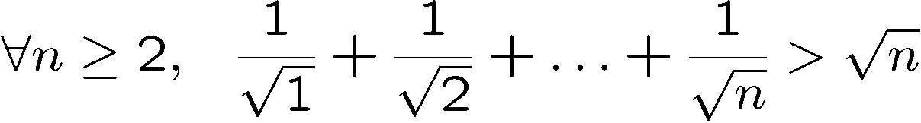
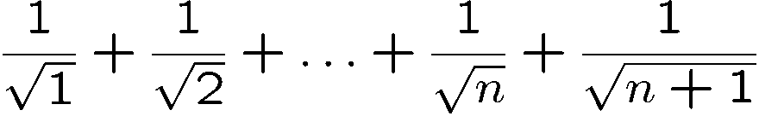
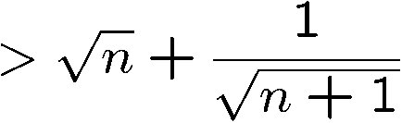
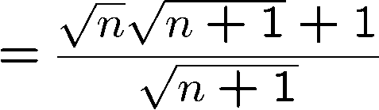
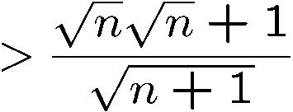
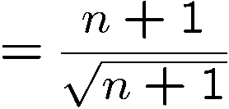

Proving an Inequality
Base Case (n = 2): is true
Induction Step: Assume P(i) for some i ≥ 2 and prove P(i + 1):
by induction

Slide 16
This Lecture
The idea of mathematical induction
Basic induction proofs (e.g. equality, inequality, property,etc)
An interesting example
A paradox

Slide 17
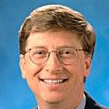
Puzzle
Goal: tile the squares, except one in the middle for Bill.

Slide 18

Puzzle
There are only L-shaped tiles covering three squares:
For example, for 8 x 8 puzzle might tile for Bill this way:

Slide 19

Puzzle
Theorem: For any 2^{n} x 2^{n} puzzle, there is a tiling with Bill in the middle.
Did you remember that we proved
is divisble by 3?
Proof: (by induction on n)
P(n) ::= can tile 2^{n} x 2^{n} with Bill in middle.
Base case: (n=0)
(no tiles needed)

Slide 20
Puzzle
Induction step: assume can tile 2^{n} x 2^{n},
prove can handle 2^{n+1} x 2^{n+1}.
Now what??
2
n
+
1

Slide 21
Puzzle
The new idea:
A stronger property
Prove that we can always find a tiling with Bill anywhere.
Theorem B: For any 2^{n} x 2^{n} puzzle, there is a tiling with Bill anywhere.
Clearly Theorem B implies Theorem.
Theorem: For any 2^{n} x 2^{n} puzzle, there is a tiling with Bill in the middle.

Slide 22
Puzzle
Theorem B: For any 2^{n} x 2^{n} puzzle, there is a tiling with Bill anywhere.
Proof: (by induction on n)
P(n) ::= can tile 2^{n} x 2^{n} with Bill anywhere.
Base case: (n=0)
(no tiles needed)

Slide 23
Puzzle
Induction step:
Assume we can get Bill anywhere in 2^{n} x 2^{n}.
Prove we can get Bill anywhere in 2^{n+1} x 2^{n+1}.

Slide 24
Puzzle
Induction step:
Assume we can get Bill anywhere in 2^{n} x 2^{n}.
Prove we can get Bill anywhere in 2^{n+1} x 2^{n+1}.

Slide 25
Puzzle
Method: Now group the squares together,
and fill the center with a tile.
Done!

Slide 26
Some Remarks
Note 1: It may help to choose a stronger hypothesis
than the desired result (e.g. “Bill in anywhere”).
Note 2: The induction proof of “Bill in corner” implicitly
defines a recursive procedure for finding corner tilings.
Note 3: Induction and recursion are very similar in spirit,
always tries to reduce the problem into a smaller problem.

Slide 27
Gray Code
Can you find an ordering of all the n-bit strings in such a way that
two consecutive n-bit strings differed by only one bit?
This is called the Gray code and has many applications.
How to construct them?
Think inductively! (or recursively!)
2 bit
00
01
11
10
3 bit
000
001
011
010
110
111
101
100
Can you see the pattern?
How to construct 4-bit gray code?

Slide 28
Gray Code
4 bit
3 bit
000
001
011
010
110
111
101
100
3 bit (reversed)
100
101
111
110
010
011
001
000
0
0
0
0
0
0
0
0
1
1
1
1
1
1
1
1
000
001
011
010
110
111
101
100
differed by 1 bit
by induction
differed by 1 bit
by construction
100
101
111
110
010
011
001
000
Every 4-bit string appears exactly once.
differed by 1 bit
by induction

Slide 29
Gray Code
n+1 bit
n bit
000…0
…
…
…
…
…
…
100…0
n bit (reversed)
100…0
…
…
…
…
…
…
000…0
0
0
0
0
0
0
0
0
1
1
1
1
1
1
1
1
000…0
…
…
…
…
…
…
100…0
differed by 1 bit
by induction
differed by 1 bit
by construction
100…0
…
…
…
…
…
…
000…0
Every (n+1)-bit string appears exactly once.
differed by 1 bit
by induction
So, by induction,
Gray code exists for any n.

Slide 30
Hadamard Matrix (Optional)
Can you construct an nxn matrix with all entries +-1 and
all the rows are orthogonal to each other?
Two rows are orthogonal if their inner product is zero.
That is, let a = (a₁, …, a_{n}) and b = (b₁, …, b_{n}),
their inner product ab = a₁b₁ + a₂b₂ + … + a_{n}b_{n}
This matrix is famous and has many applications.
To think inductively, first we come up with small examples.
1
1 -1

Slide 31
Hadamard Matrix (Optional)
Then we use the small examples to build larger examples.
Suppose we have an nxn Hadamard matrix H_{n}.
We can use it to construct an 2nx2n Hadamard matrix as follows.
H_{n} H_{n}
H_{n} -H_{n}
Check this!
So by induction there is a 2^{k} x 2^{k} Hardmard matrix for any k.

Slide 32
Inductive Construction
This technique is very useful.
We can use it to construct:
- codes
- graphs
- matrices
- circuits
- algorithms
- designs
- proofs
- buildings
- …

Slide 33
This Lecture
The idea of mathematical induction
Basic induction proofs (e.g. equality, inequality, property,etc)
An interesting example
A paradox

Slide 34
Paradox
Theorem: All horses are the same color.
Proof: (by induction on n)
Induction hypothesis:
P(n) ::= any set of n horses have the same color
Base case (n=0):
No horses so obviously true!
…

Slide 35
Paradox
(Inductive case)
Assume any n horses have the same color.
Prove that any n+1 horses have the same color.
…
n+1

Slide 36
Paradox
(Inductive case)
Assume any n horses have the same color.
Prove that any n+1 horses have the same color.
Second set of n horses have the same color
…
First set of n horses have the same color

Slide 37
Paradox
(Inductive case)
Assume any n horses have the same color.
Prove that any n+1 horses have the same color.
…
Therefore the set of n+1 have the same color!

Slide 38
Paradox
What is wrong?
n =1
Proof that P(n) → P(n+1)
is false if n = 1, because the two
horse groups do not overlap.
Second set of n=1 horses
First set of n=1 horses
(But proof works for all n ≠ 1)

Slide 39
Quick Summary
You should understand the principle of mathematical induction well,
and do basic induction proofs like
  proving equality
  proving inequality
  proving property
Mathematical induction has a wide range of applications in computer science.
In the next lecture we will see more applications and more techniques.

Slide 40
This Lecture
We will continue our discussions on mathematical induction.
The new elements in this lecture are a few variants of induction:
  Strong induction
  Well Ordering Principle
  Invariant Method

Slide 41
Unstacking Game
Start: a stack of boxes
Move: split any stack into two stacks of sizes a,b>0
Scoring: ab points
Keep moving: until stuck
Overall score: sum of move scores
a+b
a
b

Slide 42
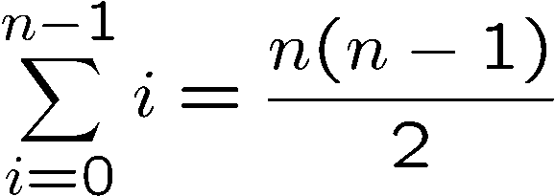
Unstacking Game
What is the best way to play this game?
Suppose there are n boxes.
What is the score if we just take the box one at a time?
n
n-1
1

Slide 43
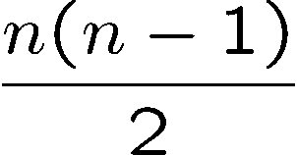
Unstacking Game
What is the best way to play this game?
2n
n
n
Suppose there are n boxes.
What is the score if we cut the stack into half each time?
Say n=8, then the score is 1x4x4 + 2x2x2 + 4x1 = 28
Not better than the first strategy!
first round
second
third
Say n=16, then the score is 8x8 + 2x28 = 120

Slide 44
Unstacking Game
Claim: Every way of unstacking gives the same score.
Claim: Starting with size n stack, final score will be
Proof: by Induction with Claim(n) as hypothesis
Base case n = 0:
score = 0
Claim(0) is okay.

Slide 45
Unstacking Game
Inductive step. assume for n-stack,
and then prove C(n+1):
(n+1)-stack score =
Case n+1 = 1. verify for 1-stack:
score = 0
C(1) is okay.

Slide 46
Unstacking Game
Case n+1 > 1. So split into an a-stack and b-stack,
where a + b = n +1.
(a + b)-stack score = ab + a-stack score + b-stack score
by induction:
a-stack score =
b-stack score =

Slide 47
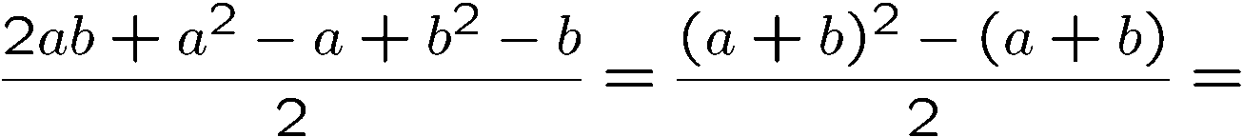
Unstacking Game
(a + b)-stack score = ab + a-stack score + b-stack score
so C(n+1) is okay.
We’re done!

Slide 48
Induction Hypothesis
Wait: we assumed C(a) and C(b) where 1  a, b  n.
But by induction can only assume C(n)
the fix: revise the induction hypothesis to
In words, it says that we
assume the claim is true
for all numbers up to n.
Proof goes through fine using Q(n) instead of C(n).
So it’s OK to assume C(m) for all m  n to prove C(n+1).

Slide 49
Strong Induction
Strong induction
Prove P(0).
Then prove P(n+1) assuming all of
P(0), P(1), …, P(n) (instead of just P(n)).
Conclude n.P(n)
equivalent
Ordinary induction
0 → 1, 1 → 2, 2 → 3, …, n-1 → n.
So by the time we got to n+1, already know all of
P(0), P(1), …, P(n)
The point is: assuming P(0), P(1), up to P(n), it is often easier to prove P(n+1).

Slide 50
Divisibility by a Prime
Theorem. Any integer n > 1 is divisible by a prime number.
Let n be an integer.
If n is a prime number, then we are done.
Otherwise, n = ab, both are smaller than n.
If a or b is a prime number, then we are done.
Otherwise, a = cd, both are smaller than a.
If c or d is a prime number, then we are done.
Otherwise, repeat this argument, since the numbers are
getting smaller and smaller, this will eventually stop and
we have found a prime factor of n.
Remember this slide?
Now we can prove it
by strong induction
very easily. In fact
we can prove a
stronger theorem
very easily.
Idea of induction.

Slide 51
Prime Products
Claim: Every integer > 1 is a product of primes.
Proof: (by strong induction)
Base case is easy.
Suppose the claim is true for all 2 <= i < n.
Consider an integer n.
If n is prime, then we are done.
So n = k·m for integers k, m where n > k,m >1.
Since k,m smaller than n,
By the induction hypothesis, both k and m are product of primes
        k = p₁⋅ p₂⋅ ⋅ ⋅ p₉₄
        m = q₁⋅ q₂⋅ ⋅ ⋅ q₂₁₄

Slide 52
Prime Products
Claim: Every integer > 1 is a product of primes.
…So
n = k⋅ m = p₁⋅ p₂⋅ ⋅ ⋅ p₉₄⋅ q₁⋅ q₂⋅ ⋅ ⋅ q₂₁₄
is a prime product.
∴ This completes the proof of the induction step.

Slide 53
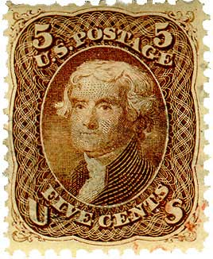

Postage by Strong Induction
Available stamps:
5¢
3¢
What amount can you form?
Theorem: Can form any amount ≥ 8¢
Prove by strong induction on n.
P(n) ::= can form (n +8)¢.

Slide 54
Postage by Strong Induction
Base case (n = 0):
(0 +8)¢:
Inductive Step: assume (m +8)¢ for 0 m  n,
then prove ((n +1) + 8)¢
cases:
n +1= 1, 9¢:
n +1= 2, 10¢:

Slide 55
Postage by Strong Induction
case n +1 ≥ 3: let m =n − 2.
now n ≥ m ≥ 0, so by induction hypothesis have:
+
= (n +1)+8
3
(n −2)+8
We’re done!
In fact, use at most two 5-cent stamps!

Slide 56
Postage by Strong Induction
Given an unlimited supply of 5 cent and 7 cent stamps,
what postages are possible?
Theorem: For all n >= 24,
it is possible to produce n cents of postage from 5¢ and 7¢ stamps.

Slide 57
This Lecture
  Strong induction
  Well Ordering Principle
  Invariant Method

Slide 58
Well Ordering Principle
Every nonempty set ofnonnegative integers
has a least element.
Axiom
This is an axiom equivalent to the principle of mathematical induction.
Note that some similar looking statements are not true:
Every nonempty set of nonnegative rationals
has a least element.
NO!
Every nonempty set of nonnegative integers
has a least element.
NO!

Slide 59
Well Ordering Principle
Thm: is irrational
Proof: suppose
…can always find such m, n without common factors…
why always?
By WOP,  minimum |m| s.t.
so
where |m₀| is minimum.

Slide 60
Well Ordering Principle
but if m₀, n₀ had common factor c > 1, then
and contradicting minimality of |m₀|
The well ordering principle is usually used in “proof by contradiction”.
Assume the statement is not true, so there is a counterexample.
Choose the “smallest” counterexample, and find a even smaller counterexample.
Conclude that a counterexample does not exist.

Slide 61
Well Ordering Principle in Proofs
To prove ``nN. P(n)’’ using WOP:
Define the set of counterexamples
C ::= {n  | ¬P(n)}
2. Assume C is not empty.
3. By WOP, have minimum element m₀  C.
4. Reach a contradiction (somehow) –
usually by finding a member of C that is < m₀ .
5. Conclude no counterexamples exist. QED

Slide 62
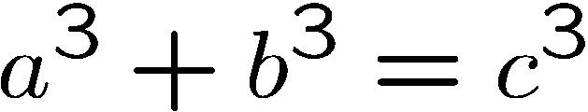
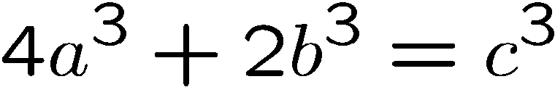
Non-Fermat Theorem
It is difficult to prove there is no positive integer solutions for
Fermat’s theorem
But it is easy to prove there is no positive integer solutions for
Non-Fermat’s theorem
Hint: Prove by contradiction using well ordering principle…

Slide 63
Non-Fermat Theorem
Suppose, by contradiction, there are integer solutions to this equation.
By the well ordering principle, there is a solution with |a| smallest.
In this solution, a,b,c do not have a common factor.
Otherwise, if a=a’k, b=b’k, c=c’k,
then a’,b’,c’ is another solution with |a’| < |a|,
contradicting the choice of a,b,c.
(*) There is a solution in which a,b,c do not have a common factor.

Slide 64
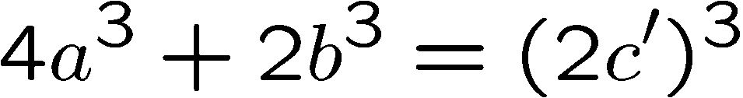
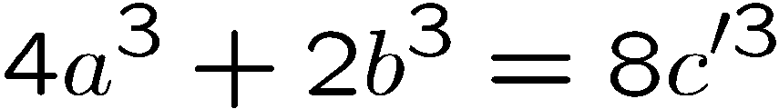
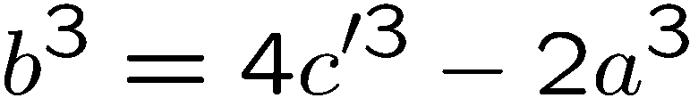
Non-Fermat Theorem
On the other hand, we prove that every solution must have a,b,c even.
This will contradict (*), and complete the proof.
First, since c³ is even, c must be even.
(because odd power is odd).
Let c = 2c’, then

Slide 65
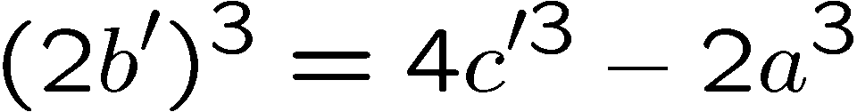
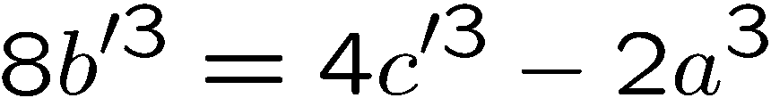
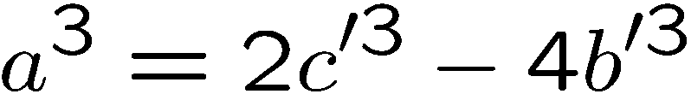
Non-Fermat Theorem
Since b³ is even, b must be even. (because odd power is odd).
Let b = 2b’, then
Since a³ is even, a must be even. (because odd power is odd).
There a,b,c are all even, contradicting (*)

