Slide 1
LECTURE 02 • WEEK 07
Design and Analysis of Algorithms
Algorithms & Programming Review
From C++ basics to thinking like an algorithm designer
International Software Engineering Students
Dr Hussain
Dr Hussain | Zhengzhou University | Software Engineering
01

Slide 2
WEEK 07 • FOUNDATIONS
What is pseudocode?
1
Plain-language instructions for a solution.
2
Independent of C++ or Python syntax.
3
Easy to read, explain and revise.
4
Useful before writing the actual program.
Dr Hussain | Zhengzhou University | Software Engineering
02

Slide 3
Design and Analysis of Algorithms
Significance of Algorithms: Bad Algorithm
Bad Algorithm
1. Start.
2. Initialize sum to 0.
3. Loop from 1 to 10¹².
4. Add current i to sum.
5. Repeat for each i.
6. Return sum.
7. Stop.
Equivalent C++ program
long int calculate_sum() {
long int sum = 0, i;
for (i=1; i<=1000000000000; i++) {
sum += i;
}
return sum;
}
WEEK 07 • ALGORITHM ANALYSIS
Dr Hussain | Zhengzhou University | Software Engineering
03

Slide 4
Design and Analysis of Algorithms
Counting Instructions in the Bad Algorithm
Bad Algorithm
Equivalent C++ program
long int calculate_sum() {
long int sum = 0, i;
for (i=1; i<=1000000000000; i++) {
sum += i;
}
return sum;
}
Instruction-count illustration
2 + 1 + 10¹² × (1+1+1) + 1
Each loop iteration contributes three counted operations.
WEEK 07 • ALGORITHM ANALYSIS
Dr Hussain | Zhengzhou University | Software Engineering
04

Slide 5
Design and Analysis of Algorithms
Total Instructions: Bad Algorithm
long int calculate_sum() {
long int sum = 0, i;
for (i=1; i<=1000000000000; i++) {
sum += i;
}
return sum;
}
Number of instructions
2 + 1 + 1,000,000,000,000 × (1 + 1 + 1) + 1
= 3,000,000,000,004 instructions
WEEK 07 • ALGORITHM ANALYSIS
Dr Hussain | Zhengzhou University | Software Engineering
05

Slide 6
Design and Analysis of Algorithms
Convert Instruction Count to Time
long int calculate_sum() {
long int sum = 0, i;
for (i=1; i<=1000000000000; i++) {
sum += i;
}
return sum;
}
Assume 100,000,000 instructions per second.
Time for y instructions = 1 second
Time for 1 instruction = 1/y seconds
Time for x instructions = x/y seconds
3,000,000,000,004 ÷ 100,000,000
≈ 30,000 seconds ≈ 500 minutes
WEEK 07 • ALGORITHM ANALYSIS
Dr Hussain | Zhengzhou University | Software Engineering
06

Slide 7
Design and Analysis of Algorithms
Bad Algorithm: Total Execution Time
Bad Algorithm
Sum 1 to 10¹² using a loop.
One addition for every integer.
Illustrative result
≈ 30,000 seconds
≈ 500 minutes
≈ 8 hours 20 minutes
long int calculate_sum() {
long int sum = 0, i;
for (i=1; i<=1000000000000; i++) {
sum += i;
}
return sum;
}
WEEK 07 • ALGORITHM ANALYSIS
Dr Hussain | Zhengzhou University | Software Engineering
07

Slide 8
Design and Analysis of Algorithms
Significance of Algorithms: Good Algorithm
Good Algorithm
1. Start.
2. Set n = 10¹².
3. Calculate sum = n(n+1)/2.
4. Output sum.
5. Stop.
Equivalent C++ program
long int calculate_sum() {
long int n = 1000000000000;
long int sum;
sum = (n * (n + 1)) / 2;
return sum;
}
WEEK 07 • ALGORITHM ANALYSIS
Dr Hussain | Zhengzhou University | Software Engineering
08

Slide 9
Design and Analysis of Algorithms
Good Algorithm: Instruction Count
Equivalent C++ program
long int calculate_sum() {
long int n = 1000000000000;
long int sum;
sum = (n * (n + 1)) / 2;
return sum;
}
Number of instructions = 2 + 4 + 1
= 7 instructions
Assume 100,000,000 instructions per second.
Time = 7 ÷ 100,000,000
= 0.00000007 seconds
WEEK 07 • ALGORITHM ANALYSIS
Dr Hussain | Zhengzhou University | Software Engineering
09

Slide 10
Design and Analysis of Algorithms
Good Algorithm: Very Short Execution Time
Good Algorithm
Equivalent C++ program
long int calculate_sum() {
long int n = 1000000000000;
long int sum;
sum = (n * (n + 1)) / 2;
return sum;
}
Illustrative total time
0.00000007 seconds
Compare with about 8 hours for the loop.
WEEK 07 • ALGORITHM ANALYSIS
Dr Hussain | Zhengzhou University | Software Engineering
10

Slide 11
Design and Analysis of Algorithms
Decidable Problems
Finite input
Algorithm (decidable)
Terminates with an answer
Original source associates decidability with polynomial time; this is not required by the definition.
WEEK 07 • ALGORITHM ANALYSIS
Dr Hussain | Zhengzhou University | Software Engineering
11

Slide 12
Design and Analysis of Algorithms
Undecidable Problems
Finite input
Decision problem
No guaranteed decider
Exponential time and undecidability are different concepts.
WEEK 07 • ALGORITHM ANALYSIS
Dr Hussain | Zhengzhou University | Software Engineering
12

Slide 13
Design and Analysis of Algorithms
Polynomial vs. Exponential Time
Exponential time
T(n)
Polynomial time
Input size (n)
WEEK 07 • ALGORITHM ANALYSIS
Dr Hussain | Zhengzhou University | Software Engineering
13

Slide 14
Design and Analysis of Algorithms
Nature of Exponential-Time Problems: n = 100
Input n = 100
Algorithm: 2ⁿ steps
2¹⁰⁰ operations
Increasing n by one doubles the number of operations.
WEEK 07 • ALGORITHM ANALYSIS
Dr Hussain | Zhengzhou University | Software Engineering
14

Slide 15
Design and Analysis of Algorithms
Exponential-Time Example: Work per Year
Assume a computer executes 2²⁰ instructions per second.
Instructions in one year:
2²⁰ × 60 × 60 × 24 × 365
≈ 2⁴⁵ instructions per year
WEEK 07 • ALGORITHM ANALYSIS
Dr Hussain | Zhengzhou University | Software Engineering
15

Slide 16
Design and Analysis of Algorithms
Exponential-Time Example: Years Needed
2⁴⁵ steps / year
2¹⁰⁰ total steps
2⁵⁵ years
Illustrative estimate using the stated instruction rate.
WEEK 07 • ALGORITHM ANALYSIS
Dr Hussain | Zhengzhou University | Software Engineering
16

Slide 17
Design and Analysis of Algorithms
Introduction to Analysis of Algorithms
• Study an algorithm’s performance based on time and memory-space consumption.
• The algorithm taking the least time and memory space is preferred.
Two ways to analyze an algorithm:
1. Priori Analysis
2. Posteriori Analysis
WEEK 07 • ALGORITHM ANALYSIS
Dr Hussain | Zhengzhou University | Software Engineering
17

Slide 18
Design and Analysis of Algorithms
Priori vs. Posteriori Analysis
Priori Analysis
• Estimation of time and memory before executing an algorithm.
• Independent of programming language.
• Independent of hardware.
Posteriori Analysis
• Calculation of time and memory after executing an algorithm.
• Dependent on programming language.
• Dependent on hardware.
WEEK 07 • ALGORITHM ANALYSIS
Dr Hussain | Zhengzhou University | Software Engineering
18

Slide 19
Design and Analysis of Algorithms
Importance of Algorithm Analysis
Compare time
Correct solutions
Choose the approach that best fits the problem and constraints.
Compare memory
WEEK 07 • ALGORITHM ANALYSIS
Dr Hussain | Zhengzhou University | Software Engineering
19

Slide 20
Design and Analysis of Algorithms
Example: Finding the Key
Approach 1: Linear search
1
23
34
46
65
78
90
101
Key = 90 • 7 comparisons
Approach 2: Binary search
Repeatedly halve the sorted range to locate 90.
WEEK 07 • ALGORITHM ANALYSIS
Dr Hussain | Zhengzhou University | Software Engineering
21

Slide 21
Design and Analysis of Algorithms
Finding the Key: 100 Integers
For 100 integers:
Linear Search: 100 comparisons
Binary Search: 7 comparisons
The slide compares worst-case search counts for sorted data.
Linear search: O(n)
Binary search: O(log n)
WEEK 07 • ALGORITHM ANALYSIS
Dr Hussain | Zhengzhou University | Software Engineering
22

Slide 22
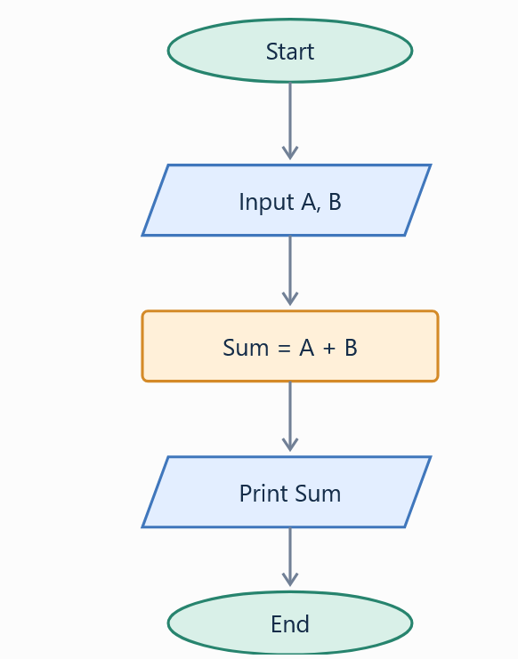
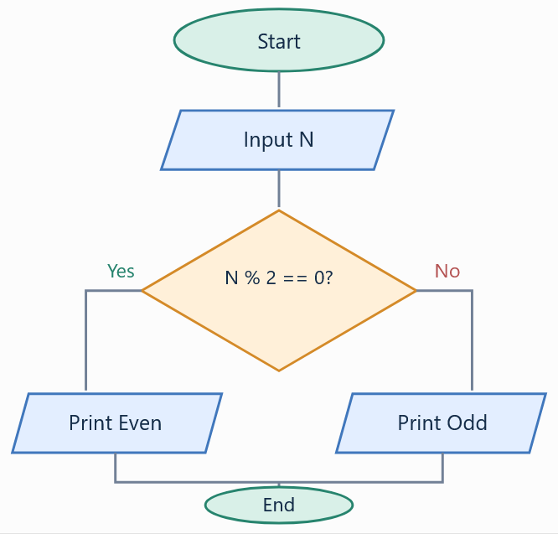
WEEK 07 • FOUNDATIONS
Flowchart symbols
Parallelogram
Oval
Input / Output
Start / End
Rectangle
Diamond
Process
Decision
Dr Hussain | Zhengzhou University | Software Engineering
25

Slide 23
CLASS QUIZ • DISCUSS BEFORE REVEALING
Quick Check
Which flowchart shape represents a decision?
A. Rectangle
B. Diamond
C. Oval
D. Arrow
Dr Hussain | Zhengzhou University | Software Engineering
26

Slide 24
WEEK 07 • FOUNDATIONS
Debugging: common beginner mistakes
1
Wrong array index.
2
Missing loop update.
3
Incorrect comparison operator.
4
Using an uninitialized variable.
Dr Hussain | Zhengzhou University | Software Engineering
27

Slide 25
C++ REVIEW • READ, TRACE, EXPLAIN
Spot the bug
int a[] = {2, 4, 6};
for (int i=0; i<=3; i++) {
cout << a[i];
}
THINK ABOUT
Which index is invalid?
How would you fix the condition?
Dr Hussain | Zhengzhou University | Software Engineering
28

Slide 26
WEEK 07 • FOUNDATIONS
How can we search?
Linear search
Binary search
Check elements one by one.
Repeatedly halve a sorted range.
Dr Hussain | Zhengzhou University | Software Engineering
29

Slide 27
WEEK 07 • FOUNDATIONS
Linear search example
4
9
2
7
5
0
1
2
3
4
Index (starts at 0)
Find 7: inspect 4 → 9 → 2 → 7.
Dr Hussain | Zhengzhou University | Software Engineering
30

Slide 28
CLASS QUIZ • DISCUSS BEFORE REVEALING
Quick Check
In linear search, which item is checked first?
A. Middle item
B. First item
C. Last item
D. Largest item
Dr Hussain | Zhengzhou University | Software Engineering
31

Slide 29
C++ REVIEW • READ, TRACE, EXPLAIN
C++: linear search
int a[]={4,9,2,7,5};
int key=7;
for(int i=0;i<5;i++){
if(a[i]==key)
cout << i;
}
THINK ABOUT
What index is printed?
What if key is absent?
Dr Hussain | Zhengzhou University | Software Engineering
32

Slide 30
WEEK 07 • FOUNDATIONS
Binary search requires sorted data
2
4
6
8
10
12
14
0
1
2
3
4
5
6
Index (starts at 0)
Find 12 by comparing with the middle value and discarding half.
Dr Hussain | Zhengzhou University | Software Engineering
33

Slide 31
WEEK 07 • FOUNDATIONS
Binary search idea
Sorted data
→
Check middle
→
Keep one half
→
Repeat
Try to explain each step in your own words.
Dr Hussain | Zhengzhou University | Software Engineering
34

Slide 32
CLASS QUIZ • DISCUSS BEFORE REVEALING
Quick Check
What must be true before standard binary search?
A. Data is sorted
B. Data is random
C. Data has duplicates
D. Data is reversed
Dr Hussain | Zhengzhou University | Software Engineering
35

Slide 33
WEEK 07 • FOUNDATIONS
Sorting: put data in order
Before
After
9, 2, 7, 4
2, 4, 7, 9
Dr Hussain | Zhengzhou University | Software Engineering
36

Slide 34
WEEK 07 • FOUNDATIONS
Selection sort: find the smallest
9
2
7
4
0
1
2
3
Index (starts at 0)
First pass: select 2 and move it to the first position.
Dr Hussain | Zhengzhou University | Software Engineering
37

Slide 35
WEEK 07 • FOUNDATIONS
Bubble sort: compare neighbors
9
2
7
4
0
1
2
3
Index (starts at 0)
Swap 9 and 2, then compare the next adjacent pair.
Dr Hussain | Zhengzhou University | Software Engineering
38

Slide 36
CLASS QUIZ • DISCUSS BEFORE REVEALING
Quick Check
Which output is ascending order?
A. 9,7,4,2
B. 2,7,4,9
C. 2,4,7,9
D. 4,2,9,7
Dr Hussain | Zhengzhou University | Software Engineering
39

Slide 37
WEEK 07 • FOUNDATIONS
Why analyze algorithms?
Time
Space
How the work grows as input grows.
How much memory is needed.
Dr Hussain | Zhengzhou University | Software Engineering
40

Slide 38
WEEK 07 • FOUNDATIONS
Mini classroom practice
1
Write pseudocode to find the smallest of 3 numbers.
2
Trace a loop that prints even numbers from 2 to 10.
3
Search for 6 in {3, 6, 1, 8}.
4
Explain why a sorted array helps binary search.
Dr Hussain | Zhengzhou University | Software Engineering
50

Slide 39
WEEK 07 • FOUNDATIONS
Take-home assignment (no project)
1
Write pseudocode for finding the maximum in a list.
2
Implement the solution in C++.
3
Test with two different input lists.
4
State how many elements your loop checks.
Dr Hussain | Zhengzhou University | Software Engineering
51

Slide 40
WEEK 07 • FOUNDATIONS
What to remember today
Design
Implement
Analyze
Describe a solution as steps.
Turn steps into code.
Estimate time and memory.
Dr Hussain | Zhengzhou University | Software Engineering
52

Slide 41
WEEK 07 • FOUNDATIONS
Reading and references
Adapted from the reference materials supplied for this lecture:
• Design and Analysis of Algorithms Tutorial
• Data Structures – Algorithms Basics
• Analysis of Algorithms
• Data Structures – Asymptotic Analysis
• Time Complexity and Space Complexities
• Methodology of Analysis
Dr Hussain | Zhengzhou University | Software Engineering
53

