Slide 1


On the Emergence of Thinking in LLMs I:
Searching for the Right Intuition
Team 05
Σταύρος Μανιατογιάννης
Ηλίας Στυλιανός Ηλιάδης
Αναστάσιος Γιωτίτσας Δημήτριος Λιβανάς
Supervisor:
Ιωάννης Καλογιαννίδης

Slide 2



The RLSP Framework: 3 Key Steps
1. Supervised Fine-Tuning
3. RL with PPO as Training Algorithm
SFT with reasoning
demonstration dataset (human or synthetic). Acts as textbook study before problem-solving.
PPO training using binary outcome verifier. Incentivizing self-play over new CoT reasoning traces of previous step.
2. Independent Exploration Reward
Encouraging diverse search behaviors (length penalty or LLM-judge) regardless of solution’s correctness. Motivates model to synthetically create novel CoT data

Slide 3

The Reward Function Dynamics
▹
Decoupled Signals: Separates exploration effort from the objective correctness of the answer.
▹
Outcome Verifier: Provides unambiguous binary signal on final correctness.
▹
Exploration Reward: Based on: (I) Function of Length Response ${,R}_{ex}\left(q,o\right)=−\frac{C}{|o|}$
(II) LLM as a judge
▹
Balance Requirement: Although in the presented paper’s experiments α is set as 0.8, in practice this hyperparameter needs to be tuned and increased over time, preventing reward hacking of the exploration reward signal and ensuring true reasoning and better generalization.

Slide 4

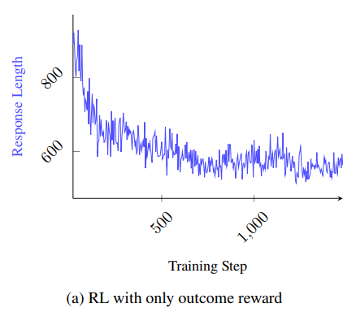
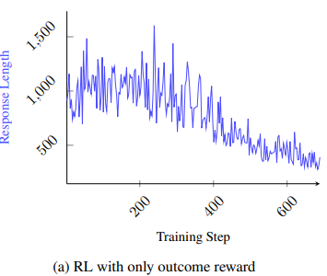
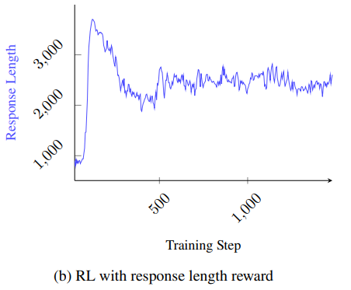
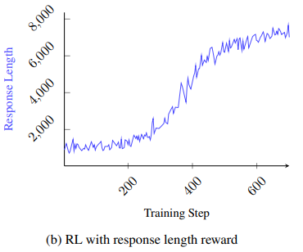
Paper’s Results Recap (I) – Exploration Reward Effect
Some form of explicit reward
to encourage the thinking process
may be more efficient and scalable way
to enable search behavior in LLMs overall
Response length during RL training of
Llama-3.1-8B-Instruct.
Response length during RL training of
Qwen2.5-7B-Instruct model domain.

Slide 5
Paper’s Results Recap (II) - Metrics
Accuracy over Math-500 and AIME2024
MATH-500
Llama-8B (Base): 50.6%
Llama-8B (SFT): 70.2%
Llama-8B (RLSP): 73.4%
MATH-500
Qwen-32B (Base): 81.6%
Qwen-32B (Base + ER-RLSP): 83.2%
AIME 2024
Qwen-32B (Base): 13.3%
Qwen-32B (RLSP): 23.3%
Token Efficiency: RLSP vs Self-Consistency
Model / Benchmark | Self-Consistency Accuracy | SFT + ER-RLSP Accuracy
Llama-8B (MATH-500) | 61.8% (16 samples) | 73.4%
Qwen-32B (AIME 2024) | 20.0% (8 samples) | 23.3%

Slide 6


Results – A General Roadmap of our work
TOKEN EFFICIENCY EXAMINATION
ALTERNATIVE EXPLORATION REWARD FUNCTIONS
MODEL CHOICE
TRAINING PHASE
Qwen2.5-1.5B-Instruct
Llama-3.2-1B-Instruct
Training our models on MATH and AIME dataset
RLSF framework vs Self Consistency utilizing the same computing resources
$$−C/{\sqrt{\left|O\right|}} , {−Ce}^{(−\sqrt{\left|O\right|})}$$
RESOURCE MANAGEMENT
Dynamic
hyperparameter a
EVALUATION PHASE
LoRa
Quantization
GRPO
Kaggle + LightningAI
Evaluating trained models on MATH500 and AIME24 Datasets
$$\text{Linear} \text{increasement} \text{of} \text{the} \text{value} \text{of} \text{a} \text{over} \text{time} \text{discouraging} \text{exploration} \text{at} \text{later} \text{steps}$$
ENVIROMENT SETUP
RECREATION PHASE
EXTENSIONS

Slide 7
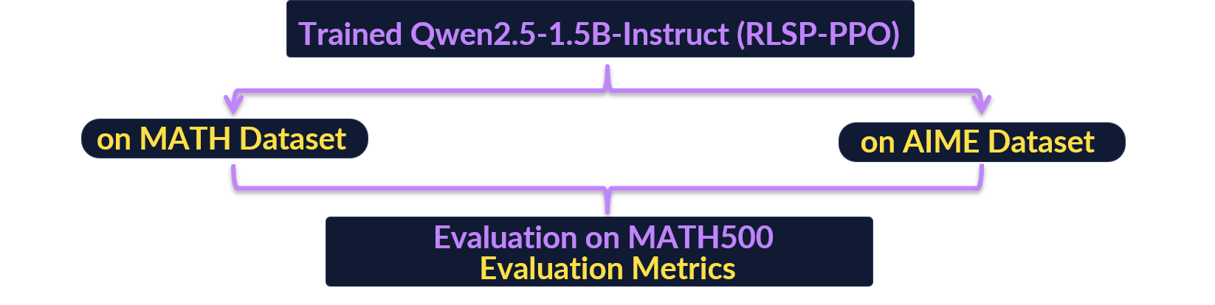
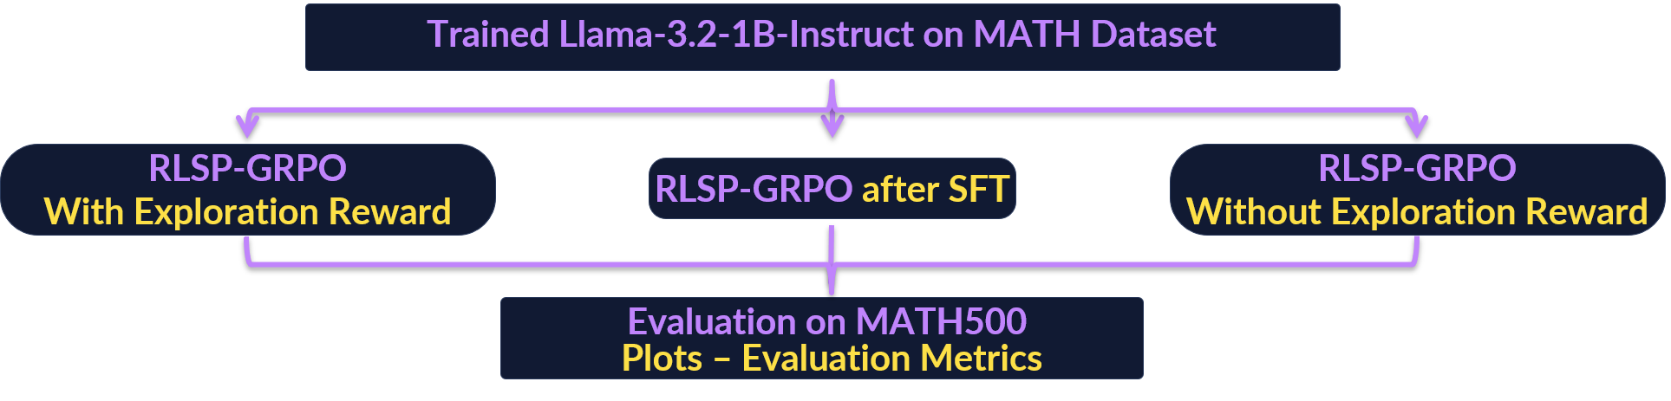
Recreation of Paper’s Results (I)
▹
▹
▹
Token Efficiency Examination for Both Qwen & Llama models

Slide 8
Recreation of Paper’s Results (I) – PPO vs GRPO
Proximal Policy Optimization (PPO)
PPO is an actor–critic algorithm consisting of:
The Current Policy Model
Old Policy Model
The Reference Model
where:
Multiple parallel actors collect T timesteps of data.
This collected data is used to construct the surrogate loss.
The loss is optimized over K epochs.
Further Details:
The policy model is trained jointly with a separate value function, the critic.
The reference model is usually the initial SFT model.
A per-token KL-divergence is incorporated into the reward function to prevent over-optimization and excessive deviation from the reference Policy
Group Relative Policy Optimization (GRPO)
GRPO is a group-relative algorithm consisting of:
The current policy model
old policy model
The reference model,
where:
G outputs are sampled for each question in the batch
Reward is computed for each sampled output
Advantage estimation is group relative
Policy model is updated by maximizing the GRPO objective
Main Differences between the GRPO and the PPO:
GRPO removes the need for the critic
In GRPO the reference model is extracted from the policy model
In GRPO the KL-divergence penalty is added directly in
the optimization objective
GRPO introduced as a more memory-efficient alternative to PPO

Slide 9
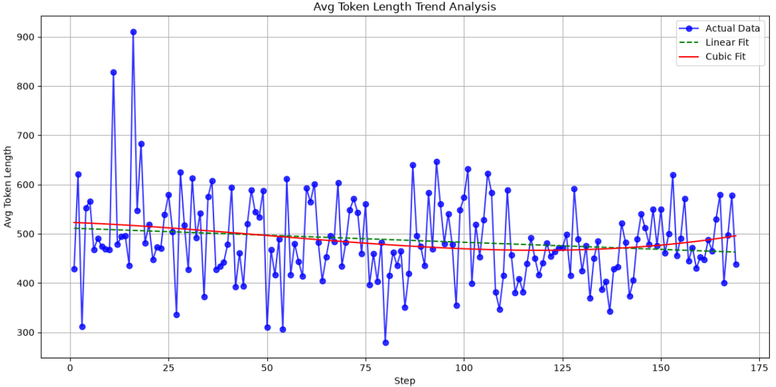
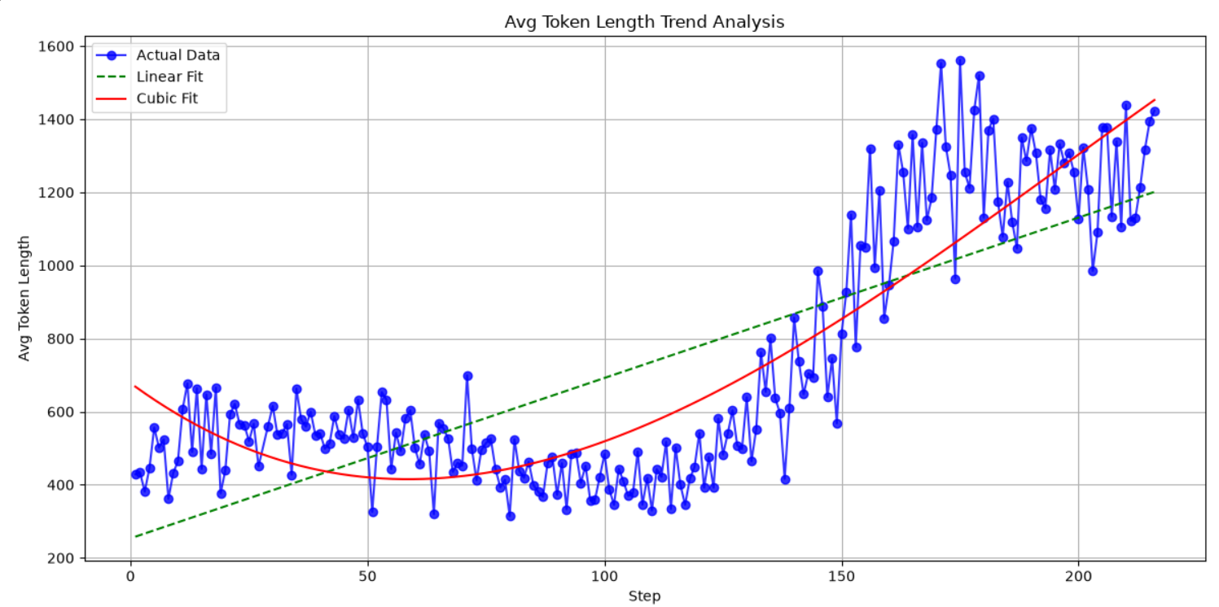
Recreation of Paper’s Results (II)
Response length during RL training of Llama-3.2-1B-Instruct.
Without Exploration Reward (α = 1)
With Exploration Reward (α = 0.8)

Slide 10
Recreation of Paper’s Results (III) - Metrics
meta-llama/Llama-3.2-1B-Instruct on MATH-500 Dataset
Llama-1B (Base): 23.8%
Llama-1B (RLSP on Math Dataset): 25.8%
Llama-1B (SFT): 26.8%
Llama-1B (RLSP+SFT on Math Dataset): 27.8%
Qwen/Qwen2.5-1.5B-Instruct on MATH-500 Dataset
Qwen-1.5B (Base): 40%
Qwen-1.5B (RLSP on Math Dataset): 43.6%
Qwen-1.5B (RLSP on AIME Dataset): 40.4%
Validating the paper, we observe that RLSP training yields improvement on MATH-500 dataset
Metrics on AIME2024 Dataset are not provided because not a single model managed to solve any AIME question. The dataset contains a lot of complex questions that require reasoning and creativity that exceed the abilities of such small models

Slide 11
Recreation of Paper’s Results (IV) –
Token Efficiency Examination
▹
In this experimental procedure, we compare the RLSP framework with self-consistency techniques, such as majority voting applied to the base model, while utilizing the same token budget.
The objective is to investigate whether RLSP leads to better reasoning while using the same computational resources.
By calculating the average number of tokens generated by the RLSP-trained model and dividing it by the corresponding average number of tokens generated by the base model, we determine the average number of samples used for majority voting.
▹
▹
Since the models used in our experiments were not sufficiently large, we observed that the number of tokens generated by the trained model differed from that of the base model by a multiplicative factor smaller than 2. Consequently, investigating whether RLSP can achieve better performance while utilizing, on average, the same number of tokens is not feasible under these experimental conditions.
Comparison of Majority Voting with 3 samples without token limitations and RLSP trained models
 | Qwen2.5-1.5B-Instruct + RLSP N_samplings = 1 | Qwen2.5-1.5B-Instruct N_samplings = 3
Majority voting accuracy | 0.436 | 0.412
 | Llama-3.2-1B-Instruct + (SFT+RLSP) N_samplings = 1 | Llama-3.2-1B-Instruct N_samplings = 3
Majority voting accuracy | 0.258 | 0.238

Slide 12
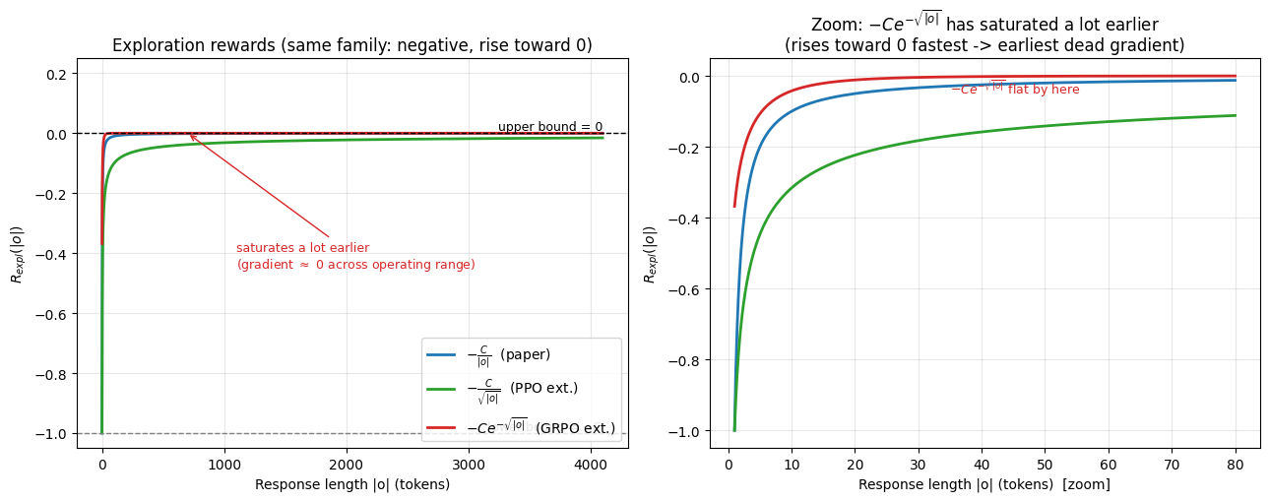
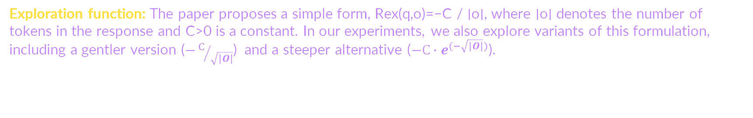
Extensions (I)
Dynamic α: The scope of this experiment is to encourage greater exploration during the early stages of training, while progressively increasing the emphasis placed on the outcome verifier. Considering the reward function used, α should increase over time.
$$α=α_{\text{start}}+t⋅\left(α_{\text{end}}−α_{\text{start}}\right) \text{where} t=\min\left(\frac{\text{current}_training_steps}{\max\left(\text{max}\text{_}\text{training}\text{_}\text{steps},1\right)},1.0\right)$$
Exploration function: The paper proposes a simple form, Rex(q,o)=−C / ∣o∣, where ∣o∣ denotes the number of tokens in the response and C>0 is a constant. In our experiments, we also explore variants of this formulation, including a gentler version ($−C/{\sqrt{\left|O\right|}}$) and a steeper alternative ($−{C∙e}^{(−\sqrt{\left|O\right|})}$).

Slide 13
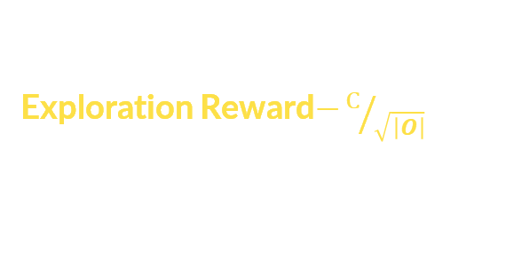

Extensions (II) - Roadmap
Trained Qwen2.5-1.5B-Instruct
Dynamic α
Exploration Reward$−C/{\sqrt{\left|O\right|}}$
Evaluation on MATH500
Evaluation Metrics
Trained Llama-3.2-1B-Instruct
Exploration Reward $−{C∙e}^{(−\sqrt{\left|O\right|})}$
Evaluation on MATH500
Evaluation Metrics

Slide 14

Extensions (III) - Metrics
meta-llama/Llama-3.2-1B-Instruct on MATH-500 Dataset
Llama-1B (RLSP on Math Dataset): 25.8%
Llama-1B (RLSP with ${C∙e}^{(−\sqrt{\left|O\right|})}$ on Math Dataset): 25.6%
Llama-1B (Base): 23.8%
Qwen/Qwen2.5-1.5B-Instruct on MATH-500 Dataset
Qwen-1.5B (RLSP on Math Dataset): 43.6%
Qwen-1.5B (Dynamic RLSP on Math Dataset): 44.4%
Qwen-1.5B (RLSP with $−C/{\sqrt{\left|O\right|}}$on Math Dataset): 44.2%
Qwen-1.5B (Base): 40%

Slide 15
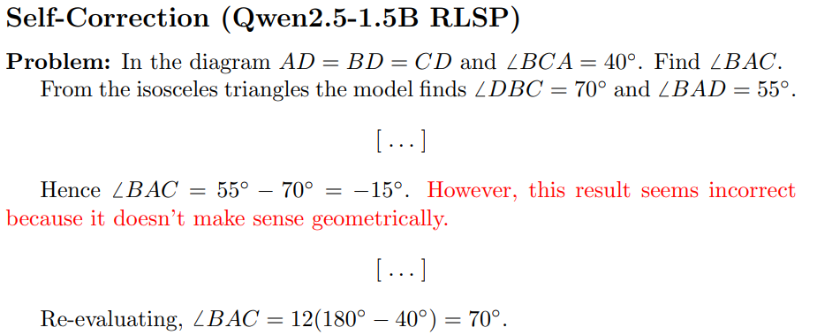
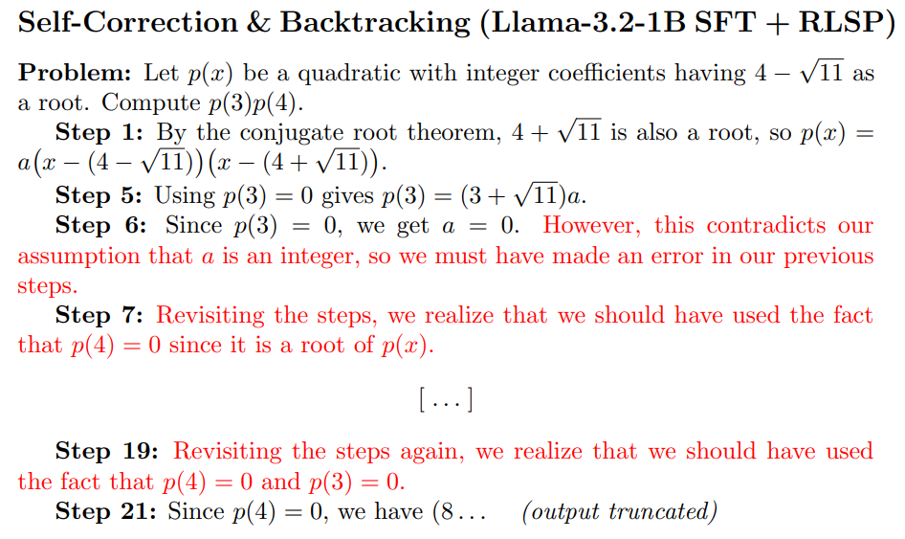
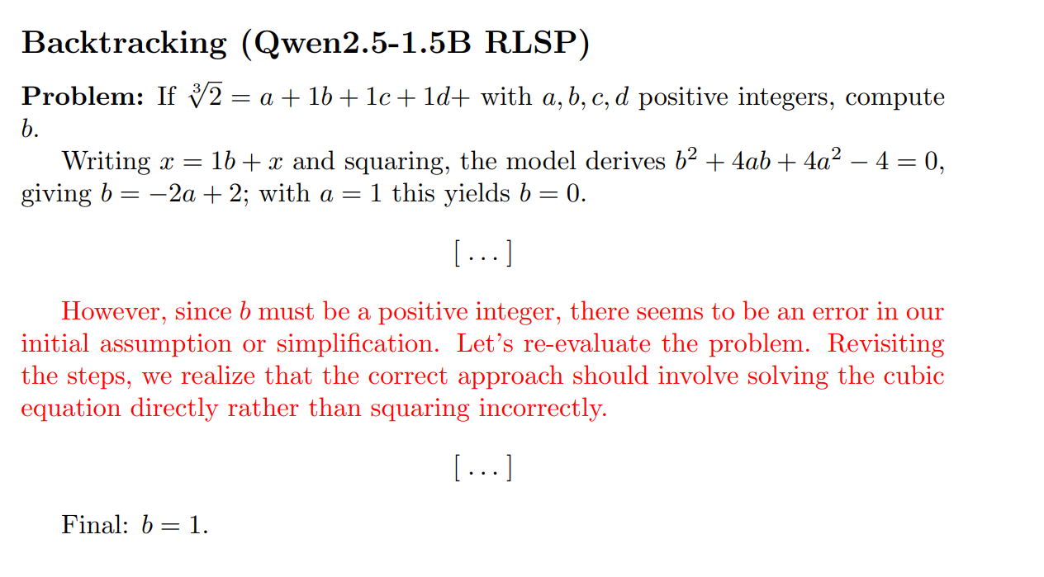
Emergent Behaviors

Slide 16
Evaluation
Technical Evaluation & Project Outcome
Resource Constraints & Methodology: The verification of the paper was conducted on a qualitative level. Due to limited computational resources, we were required to scale down to smaller models and restrict the token generation during the PPO (Proximal Policy Optimization) phase.
Dataset Limitations: Testing was exclusively limited to the MATH500 dataset. The AIME24 dataset consistently yielded zero scores; therefore, conducting an evaluation on it was deemed uninformative and subsequently omitted.
Model Limitations: The scaled-down models exhibited an inherent lack of reasoning capabilities. This limitation directly resulted in performance issues, specifically manifesting as a low Effective Context Reward.
Corroboration of Findings: Despite the hardware constraints, our results successfully corroborate the paper's central claim: the implementation of an Exploration Reward generally leads to improved outcomes. However, due to the small size of the models used, this effect—along with the phenomena of backtracking and self-verification—was less pronounced than it would be in larger models.
Project Management & Team Collaboration
Timeline Adherence: The project schedule was largely adhered to. Minor deviations occurred due to the team members' external obligations and unforeseen technical challenges that arose during the implementation phase.
Communication Strategy: Team communication was smooth and highly organized, facilitated by a dedicated GitHub Repo. We established specialized channels to systematically track project progress and document emerging technical issues.
Workflow & Syncing: The team maintained daily progress updates regarding ongoing experiments and assigned tasks. This was supplemented by synchronous team meetings (group calls) conducted at least twice a week.

Slide 17
FUTURE EXTENSIONS
▹
Alternative Dataset: Explore the RLSP Framework over different domains.
▹
LLM as a Judge
▹
Further Experimentation of Dynamic Hyperparameter α and Exploration Reward functions
▹
Further Research on Extension of RLSP to the Subsequent levels of abstraction: Ability to create abstractions and tools (theorems, new definitions, validation techniques) and solve open-ended problems.

Slide 18
Team Roles & Task Assignment
 | Verification of Paper's Results | GRPO Implementation | Dynamic Tuning of α Hyperparameter | Generalizing the Reward Function
Σταύρος Μανιατογιάννης
Αναστάσιος Γιωτίτσας
Ηλίας Στυλιανός Ηλιάδης
Δημήτριος Λιβανάς
TASKS
MEMBERS

Slide 19
Retrospective
CHALLENGES
POSSIBLY IMPROVEMENTS
A primary bottleneck in our project was the severe limitation of computational resources.
we faced inadequate processing speeds during the model training phase and critically insufficient Video RAM (VRAM),.
Small Size Models
Time Constraints
Implemented comprehensive runtime logging from project inception
Optimizer Memory Handling in order to increase token length capacity during training phase

Slide 20

THANK YOU FOR YOUR ATTENTION
ANY QUESTIONS?

