Slide 1

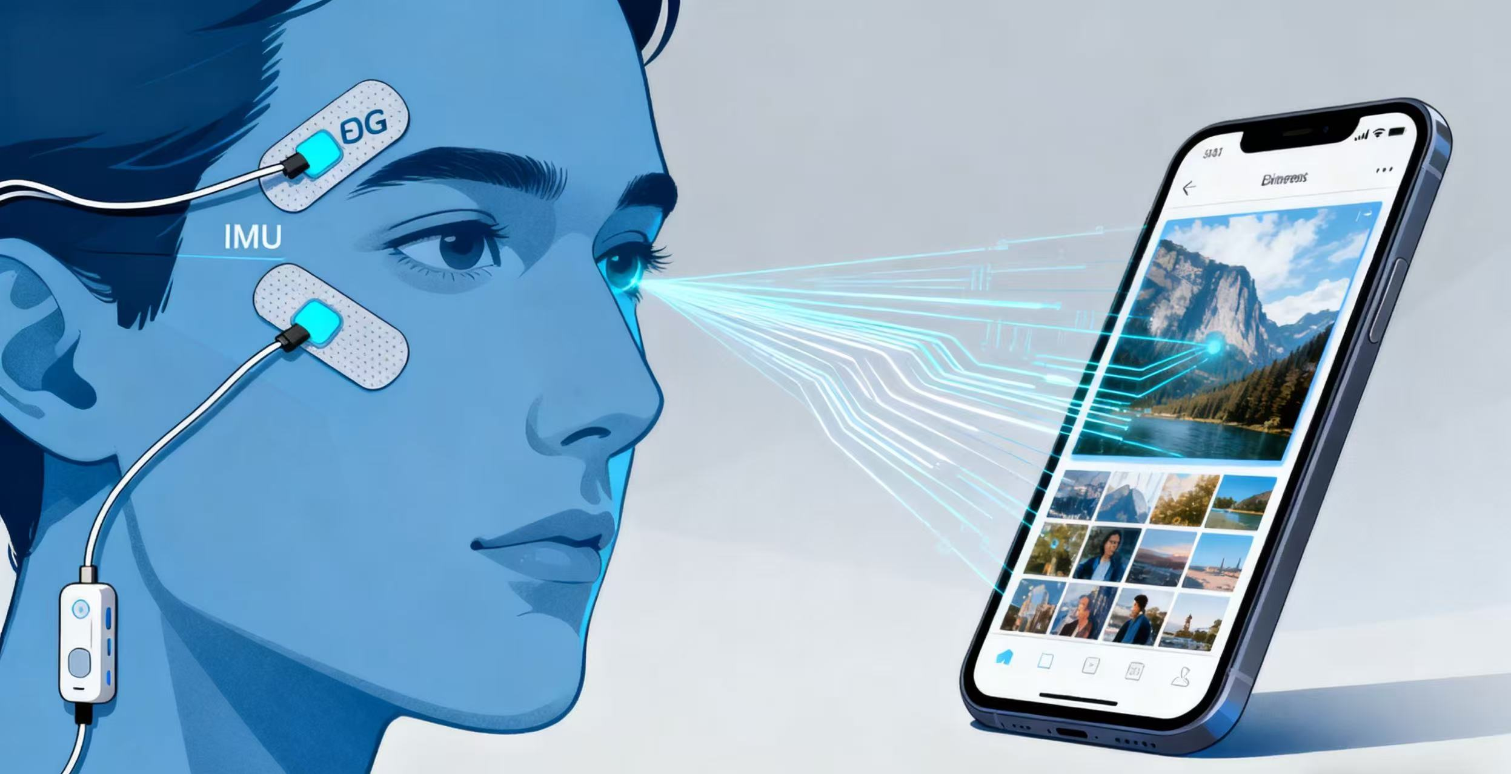
Multi-Modal Sensor Fusion System for Hands-Free Mobile Interaction
Group Name:
  Gitpull
Team Member:
  Chenxu Zhang
  Siyuan Zhang
  Kunpeng xu

Slide 2
The Problem: Why Hands-Free?
The Primary Need: Accessibility
  A significant user base with motor impairments (e.g., ALS, spinal cord injuries) lacks the fine motor control required for standard touchscreen interaction.
  We see a critical need for a more intuitive, low-cost, and non-invasive alternative.
The Growing Problem: Hands-Occupied Scenarios
  Sterile Environments: Surgeons or lab technicians who cannot touch a non-sterile screen.
  Work/Industrial: Mechanics needing information while handling tools.
  On the Move: Drivers or cyclists interacting with navigation.
  Future Tech: The rise of Augmented Reality (AR) glasses, where hands-free input is essential.
Our Idea: An Intuitive & Multi-Modal System
The Concept: A non-invasive, wearable system that fuses data from two key sensor types (IMU + EOG).
The Interaction: This multi-modal approach leverages natural, low-effort gestures (head movements and eye blinks) to perform core mobile functions.
The Goal: To provide a reliable, real-time, and intuitive control solution for users who cannot use their hands.

Slide 3
Project Pipeline: From Gesture to Action
This is how we translate a user's thought (gesture) into a phone's action (click).
SENSE (Hardware: Arduino)
  IMU sensor captures macro head movements (Nod, Shake).
  EOG sensor captures micro eye-muscle signals (Blink, Gaze).
TRANSMIT (Hardware → PC)
  All sensor data is streamed in real-time to a PC via USB.
ANALYZE (Software: PC)
  A Python script receives the data stream.
  An AI Model (ML) classifies the data in real-time, mapping gesture patterns to commands (e.g., "Nod" gesture → "CLICK" command).
FORWARD (PC → Phone)
  The PC sends the simple command string (e.g., "CLICK") over Wi-Fi to a companion app on the phone.
EXECUTE (Software: Phone)
  The phone app receives the command.
  It uses an Accessibility Service to execute the action (e.g., simulate a tap, a swipe, or the "Back" button).

Slide 4
Sensor Selection
IMU (Inertial Measurement Unit)
  For: Head Gestures (Nod, Shake, Tilt).
  Why: Provides 6-axis data (accelerometer + gyroscope). Accurately tracks head orientation and high-speed motion in 3D space.
EOG (Electrooculography)
  For: Eye Gestures (Blink, Gaze Left/Right).
  Why: A non-invasive method to detect eye movement. It measures the small electrical potential changes between the front and back of the eye.
Machine Learning (ML) Integration
1. Data Acquisition (Offline Prep)
  We Plan to use a Python script to record and label sensor data (7 channels: 6-IMU + 1-EOG).
  We will capture hundreds of samples for each gesture: Nod, Shake, Blink, etc.
2. Model Training (Offline Prep)
  Data is segmented into "time windows" (e.g., 1.5 seconds).
  A Time-Series Classification Model (e.g., CNN or LSTM) is trained to classify these windows.
  Result: A model that can map a 1.5-second snapshot of sensor data to a specific gesture.
3. Real-Time Inference (Live Execution)
  The trained model runs in our main PC Python script.
  It continuously "scores" the live data stream from the Arduino.
  When a gesture is detected with high confidence (e.g., “Nod” > 95%), it triggers the command to be sent to the phone and control the phone as well.

Slide 5
Idea2: AuraAlign: Your Personal AI Yoga Instructor
Background: The At-Home Yoga Dilemma
The Problem: The global popularity of at-home yoga (driven by apps and videos) is rising. However, practicing without an instructor leads to a high risk of incorrect form and misalignment.
The Need: Novice and intermediate practitioners lack the real-time, personalized, and accurate feedback necessary to correct their alignment and practice safely.
Our 3-Step Pipeline: From Motion to Correction
1. sensor
Lightweight IMUs are placed on key body points (e.g., spine, hips, knees, shoulders).
These sensors capture 3D biomechanical data (orientation, acceleration) in real-time.
2. ANALYZE
Data is streamed via Low-Energy Bluetooth to a mobile application.
A proprietary AI model analyzes the incoming data, reconstructs a 3D model of the user's pose, and compares it against a database of ideal postures.
3. CORRECT
The system instantly detects critical deviations from safe alignment (e.g., incorrect spinal alignment, joint angles, or weight distribution).
The user receives immediate, gentle, and specific corrective commands via audio (e.g., “Engage your core “)

Slide 6
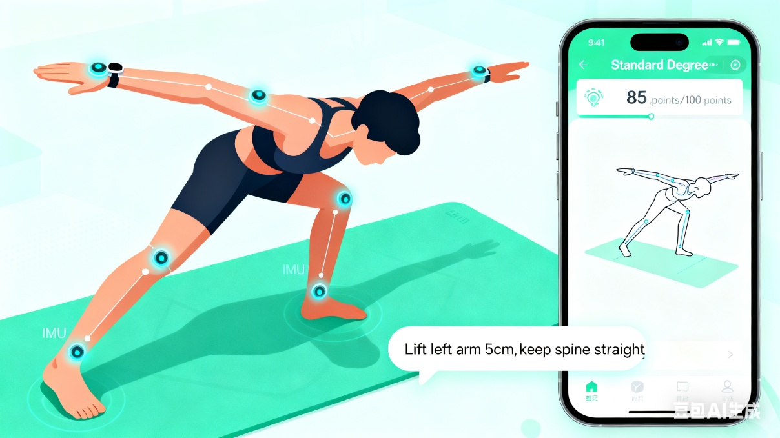
Core Technology
1. Wearable Sensor Array
Hardware: Multi-axis IMUs (Inertial Measurement Units) combining 3-axis accelerometers, 3-axis gyroscopes, and magnetometers for high-fidelity motion tracking.
Design: Sensors are integrated into a comfortable, breathable smart garment (e.g., leggings, top) or as discrete, lightweight pods that can be attached to existing clothing.
2. AI & Biomechanical Engine
Core Model: A deep learning model trained on a vast dataset of yoga postures from certified instructors, accommodating various body types.
Real-Time Analysis: The engine performs rapid sensor fusion to calculate 3D joint angles, spinal curvature, and center of balance.
3. User Interface (Mobile Application)
The Audio Coach: Provides clear and actionable voice feedback. The primary interface during practice.
Visual Feedback: A companion UI on the app shows a real-time 3D avatar of the user, visually highlighting areas that need correction.

