Slide 1
Infinite Int Calculator Presentation
1
2
3
4
5
6
7
8
9
10
11
12
int main(void) { Team team07 = new Team(); team07.add_member("20204946", "이규성"); team07.add_member("20203436", "이병구"); team07.add_member("20203458", "조영호"); team07.set_project("inf_int calculator"); team07.start_presentation(); return (0); }
CAU CSE 23-2
Team #7
Object Oriented Programming Project02

Slide 2
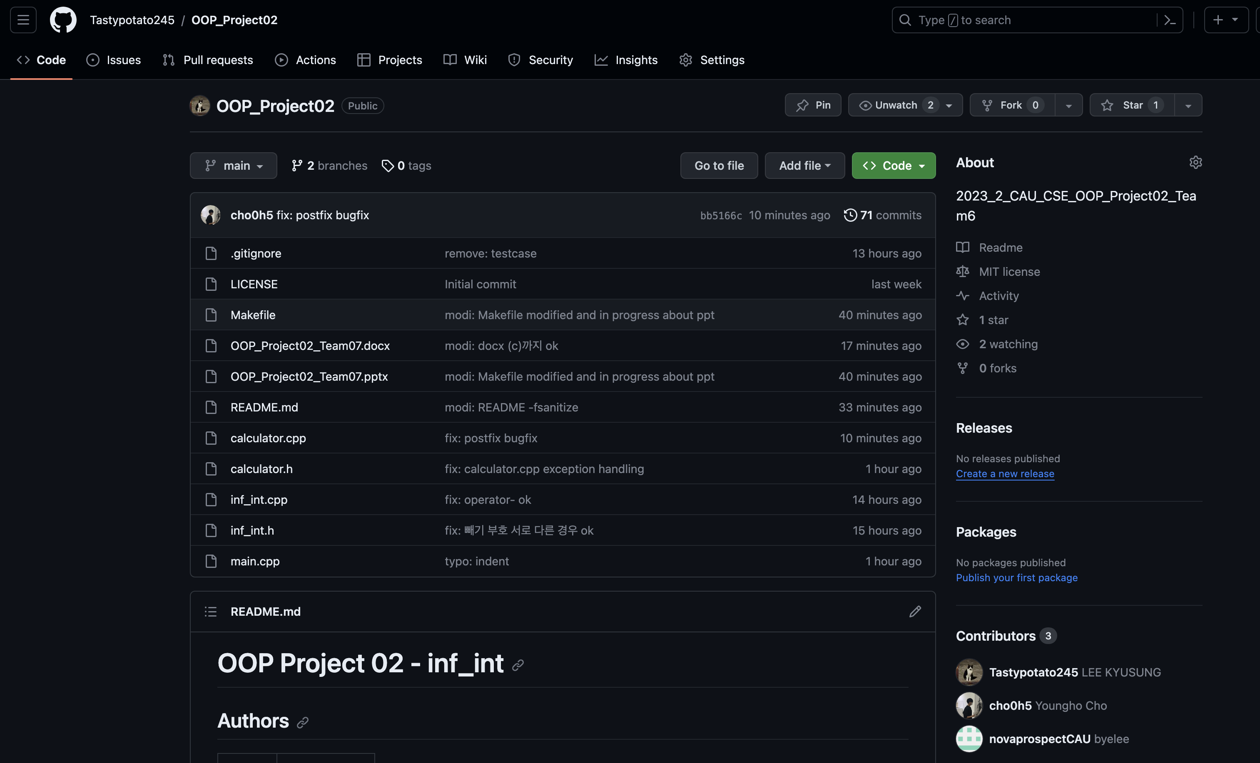
Project Managing
https://github.com/Tastypotato245/OOP_Project02

Slide 3
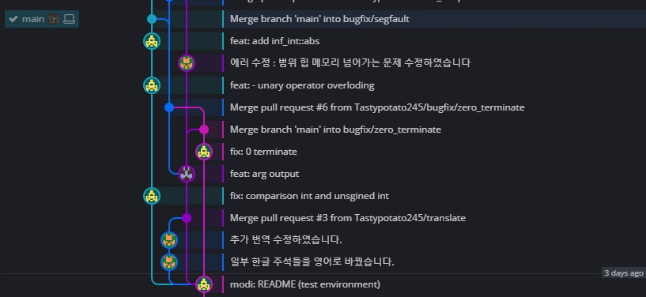
Project Managing

Slide 4
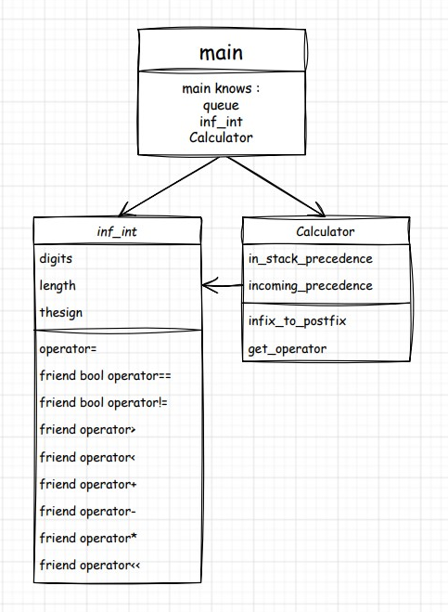
Class UML

Slide 5
Functionalities
==
!=
<
>
+
-
*
=
<<
Comparison Operator
Arithmetic Operator
Assignment Operator
Ostream Operator

Slide 6
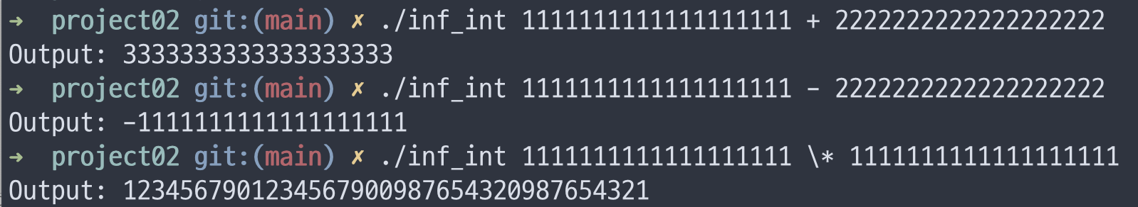
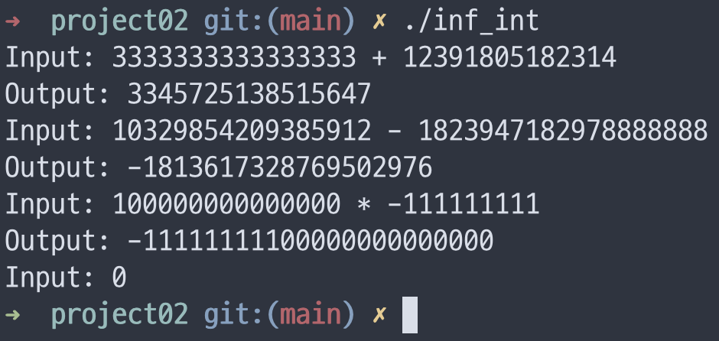
Functionalities
Single Operation

Slide 7
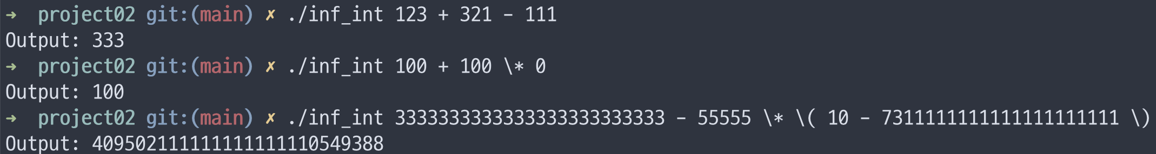
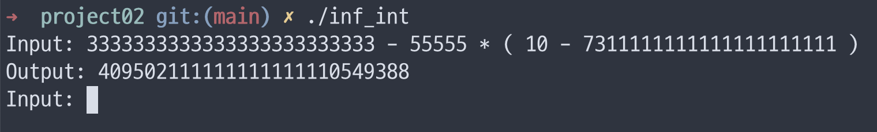
Functionalities
Multiple Operation

Slide 8
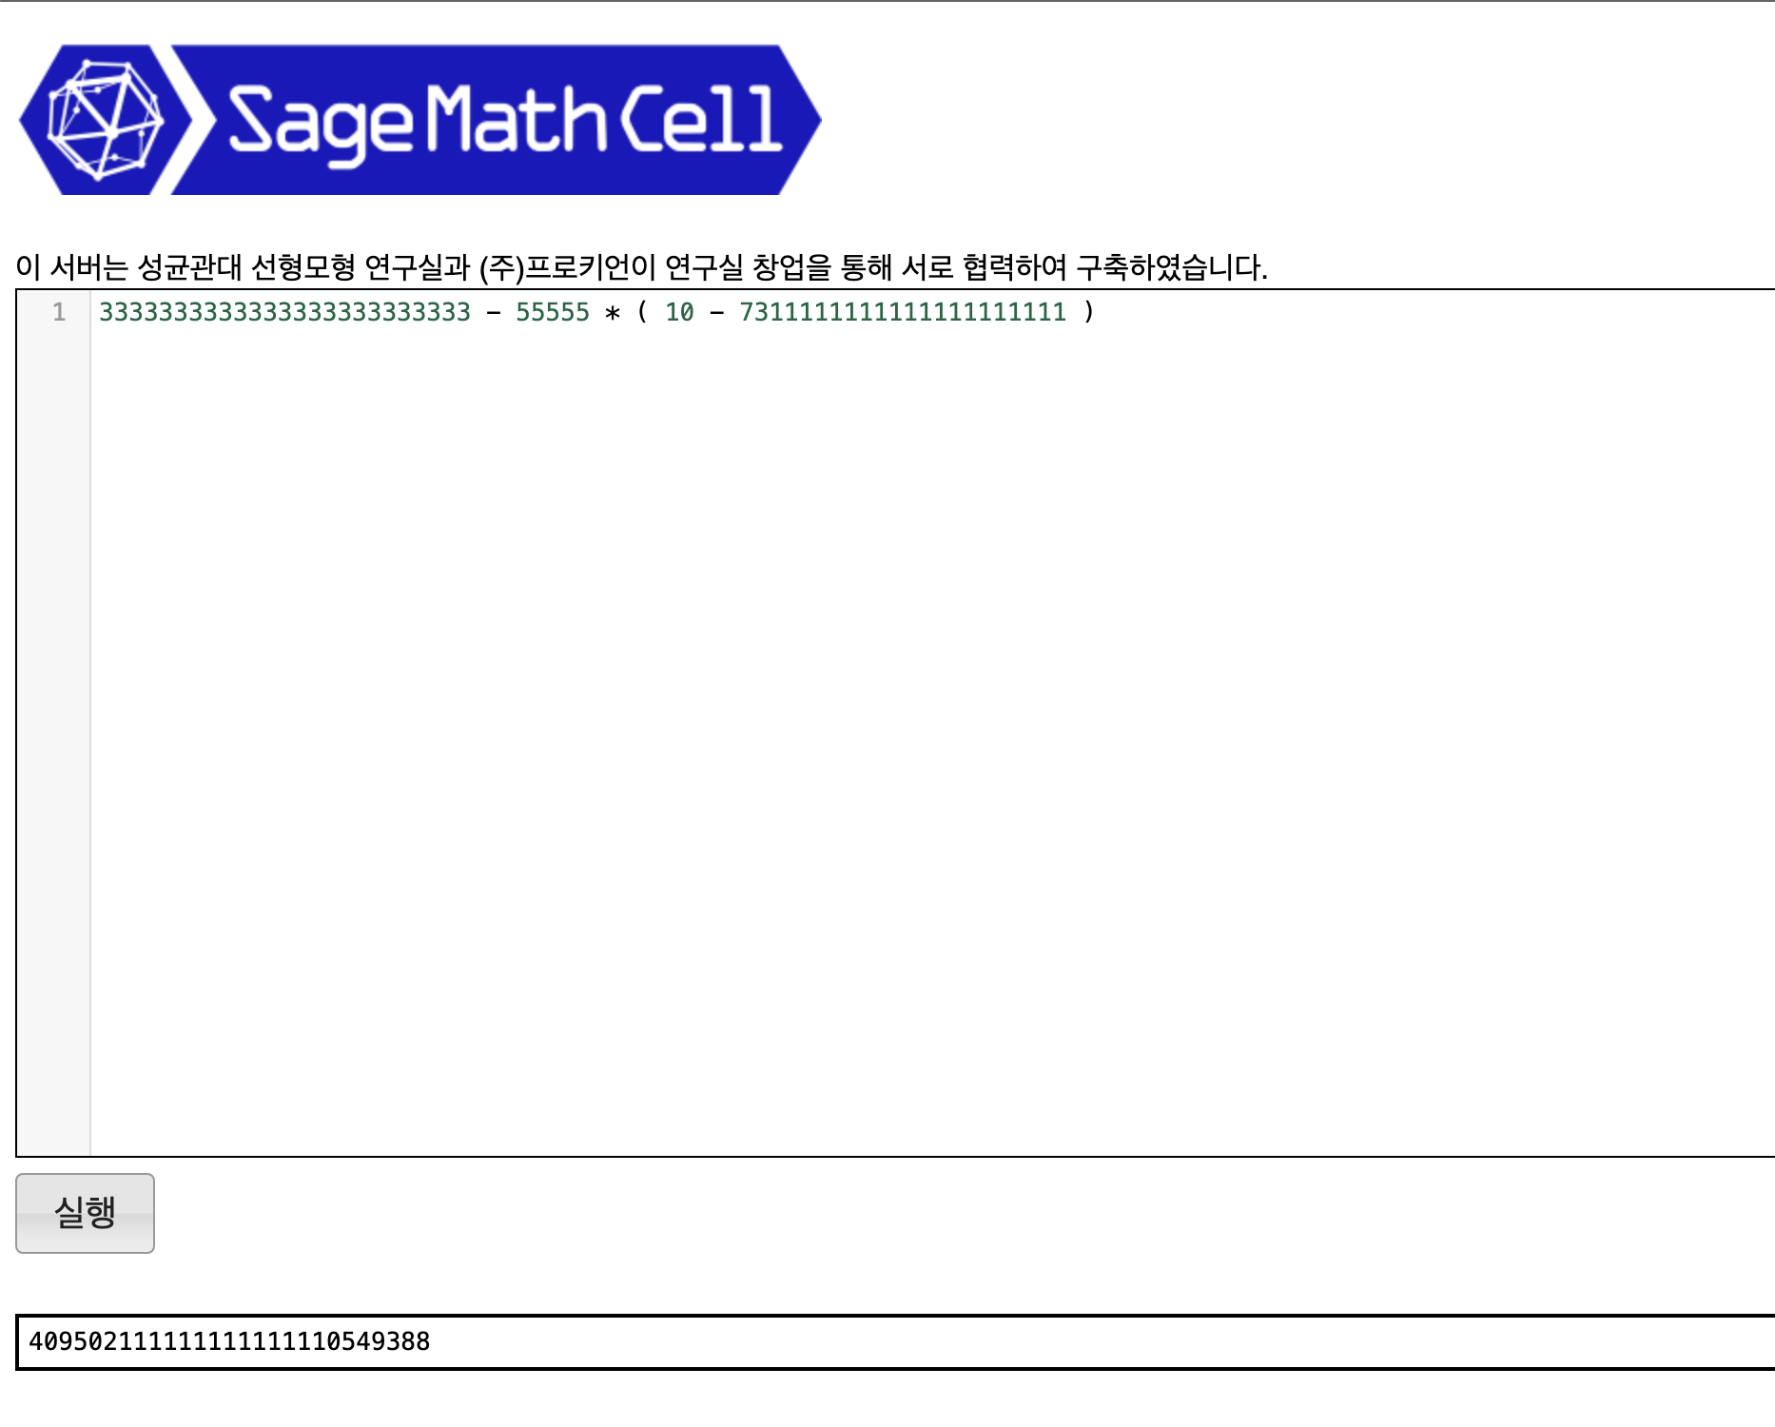
Comparison
http://sage.skku.edu/

Slide 9
Build and Run
# Build
$ make
# Test environment
macOS 14.0 arm64 (clang 15.0.0)
Debian GNU/Linux 11 aarch64 (g++ 10.2.1)
if you want to execute on macOS(using Intel CPU),
delete "-fsanitize=address -g3" of (Makefile - CFLAG option)

Slide 10
Code Review and Demo

Slide 11
Conclusion
1. Operator Overloading
2. Constructor and Destructor
3. Copy Constructor and Assign Operator Overloading
4. Encapsulation

Slide 12
EOF

