Slide 1
PROBLEM STATEMENT Running GenAI on Intel AI Laptops and Simple LLM Inference on CPU and fine-tuning of LLM Models using Intel® OpenVINO™

Slide 2
Unique Idea Brief (Solution) The goal of this project is to create a robust typo detection system that can identify and correct typographical errors in text. The system leverages a pre-trained BERT model fine-tuned for the specific task of typo detection and correction. After fine-tuning, the model is optimized using Intel's OpenVINO toolkit to enable efficient inference on Intel AI hardware, providing both high performance and low latency.

Slide 3
Features Offered Typo Detection: Identifies sentences that contain typographical errors. Typo Correction: Provides corrected versions of sentences with detected typos. Efficient Inference: Utilizes OpenVINO for optimized inference on CPU, ensuring fast processing. Scalability: The solution can be integrated into larger applications such as word processors, chatbots, and automated proofreading tools. User-friendly Interface: Easy-to-use interface for inputting text and receiving typo detection and correction.

Slide 4
Process Flow Data Preparation: Load and preprocess the dataset containing sentences with and without typos. Model Training: Fine-tune a pre-trained BERT model on the prepared dataset. Model Optimization: Convert the fine-tuned model to OpenVINO format for optimized inference. Inference: Load the optimized model and run inference to detect and correct typos in input text.

Slide 5
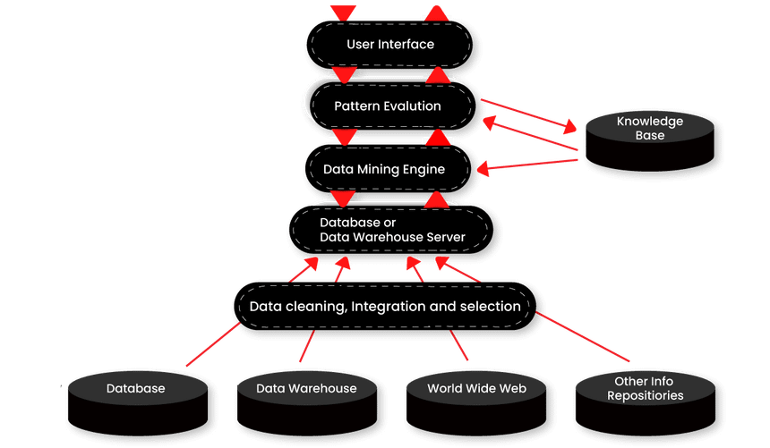
ARCHITECTURE DIAGRAM

Slide 6
Technologies Used BERT (Bidirectional Encoder Representations from Transformers): A pre-trained transformer-based model used for natural language understanding tasks. Transformers Library: Provides the necessary tools and pre-trained models for fine-tuning BERT. PyTorch: An open-source machine learning library used for training and fine-tuning the BERT model. OpenVINO (Open Visual Inference and Neural Network Optimization): A toolkit developed by Intel for optimizing and deploying deep learning models. Datasets Library: Used to load and preprocess the dataset for training and evaluation. Pandas: Data manipulation and analysis library used for handling datasets. Python: The programming language used to implement the solution.

Slide 7
Team Members and Contribution
Team Member 1 (Ritabrata Paul) - Responsible for integrating the model and running it on Intel processor, showcasing the optimization and how OpenVino is more suitable for running high end to end projects, as well as training and testing of the model.
Team Member 2 (Gagan Bansal) – Responsible for training and testing of the model, so that the project can be used as a trained model for integrating with the OpenVino platform running on the interface.

Slide 8
CONCLUSION
In conclusion, the GenAI project demonstrates a significant advancement in typo detection and correction systems by leveraging state-of-the-art technologies. By fine-tuning a pre-trained BERT model and optimizing it with Intel's OpenVINO toolkit, the project ensures efficient and high-performance inference on Intel AI hardware. This integration highlights the capabilities of running complex AI models on consumer-grade laptops, making sophisticated AI solutions accessible and practical for everyday applications.

