Slide 1

PriaccEnterprise.AI: Hackathon Project
Welcome to the documentation for PriaccEnterprise.AI, a smart Slack-like platform designed to revolutionize business workflows. This presentation outlines our project's objectives, team structure, technical architecture, and key deliverables. Get ready to explore how we integrate AI, SAP-style processes, and robust automation to create a seamless enterprise solution.

Slide 2

Project Overview
1
2
3
Objective
Core Features
Key Technologies
Build a smart Slack-like platform with integrated AI, SAP-style workflows, live chat, Power BI, and robust automation.
AI Assistant (Natural Language → Action), SAP-style workflows (HR, PO, Inventory), Live chat, Power BI dashboards, DevOps automation, Testing automation.
React, Spring Boot, LangChain/Python, PostgreSQL, Docker, GitHub Actions, Selenium, JUnit, PyTest.

Slide 3
Team Structure & Roles
Frontend Developer
Build chat UI, trigger forms, connect WebSocket, show updates.
Backend Developer
APIs, WebSocket, connect UI and SAP.
AI Data Scientist
Predict delays, auto-tag tasks, analyze history, intent recognition.
SAP Simulation Developer
Simulate HR, PO, Inventory workflows.
Database Engineer
PostgreSQL schema, logs, views for BI.
Power BI Developer
Dashboards on workflows, AI usage.
QA Tester
Write Selenium, JUnit, PyTest test cases.
DevOps Engineer
Docker, GitHub Actions, CI/CD setup.

Slide 4
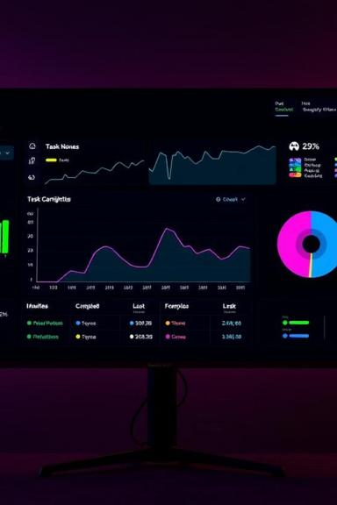
SAP Workflow Modules & Power BI
SAP Workflow Modules to Simulate
Power BI Dashboards
Requests by type and department
HR: Apply Leave, View Profile
Procurement: Create PO, Cancel PO
Workflow completion time
Status trends (Approved, Rejected, Pending)
Inventory: View/Update Stock
Vendor Mgmt: Add Vendor, View List
AI Assistant usage trends

Slide 5
Submission Checklist
1
Code pushed to GitHub
2
Working demo
(UI + AI + SAP + DB + Dashboard)
3
All modules integrated
4
All test cases pass
5
Dockerfile/CI/CD working
6
Final documentation + team report

Slide 6
Key Roles & Deliverables
Frontend Developer
Backend Developer
AI/NLP Developer
Build main UI, chat screen, side navigation, workflow forms, and connect to WebSocket for live messaging.
Develop API system for frontend and AI, trigger SAP-like workflows, and build WebSocket server for live chat.
Build the AI brain to understand user messages, detect commands using LangChain/OpenAI, and trigger workflows.
WebSocket backend
Chat interface
REST APIs
Intent classifier
Workflow trigger UI
Secure API tokens
FastAPI server
Socket connection
6+ natural language commands

Slide 7

Project Folders & Expectations
Folder Structure
Expectations
frontend/: React Chat UI
"Treat this like your first real client project. You're no longer just a student — you're acting like a real software engineer. Build smart, integrate well, and make something you're proud to demo to anyone. Let's go!"
backend/: Java APIs + WebSocket
ai-assistant/: LangChain + Python
sap-simulation/: SAP logic
database/: PostgreSQL schemas
powerbi/: Dashboards
testing/: Selenium, JUnit, PyTest
devops/: Docker, GitHub Actions
docs/: Architecture, notes
README.md: Main setup file

Slide 8
THANK YOU !

