Slide 1

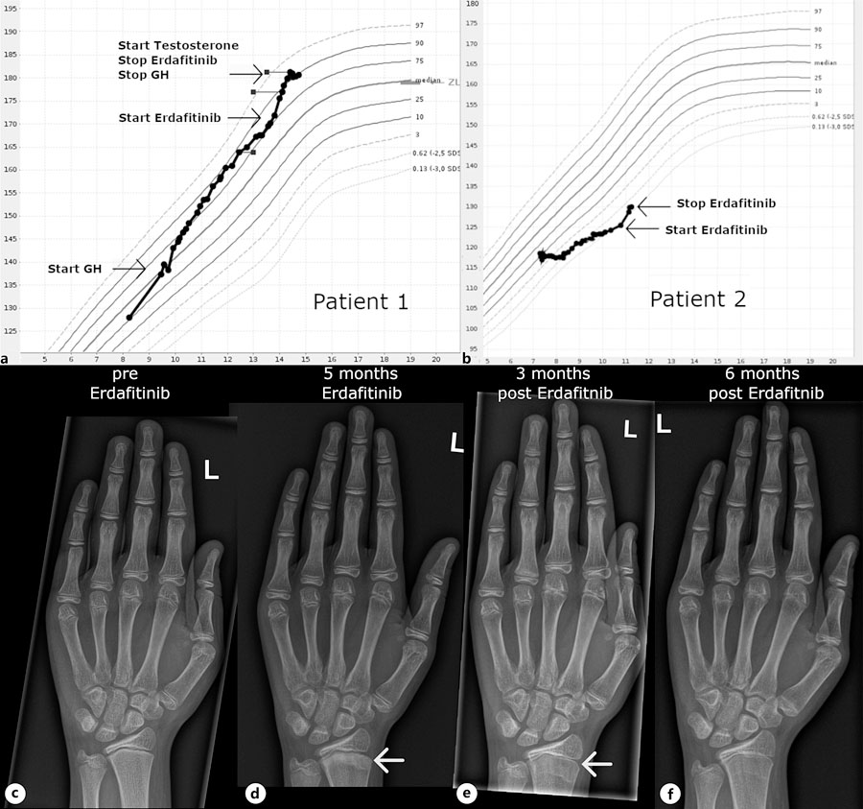
From: Accelerated Linear Growth during Erdafitinib Treatment: An FGFR-Related, but Growth Factor and Sex Steroid-Independent Mechanism?
Horm Res Paediatr. 2024;98(6):753-757. doi:10.1159/000540485
^{Date of Download: 8/10/2026}
Copyright © 2026 Karger Publishers. All rights reserved.
Notes:
Figure Legend: Linear growth was accelerated in patient 1 (a) and patient 2 (b) in association with treatment onset of erdafitinib depicted on Austrian reference data [6]. Development of metaphyseal sclerosis in patient 1 during erdafitinib treatment with subsequent normalization of bone mineralization after treatment halt (c–f).

